Slide 1
Hyper Heterogeneous Cloud-based IMS Software Architecture: A Proof-of-Concept and Empirical Analysis
2020/05/14
陳靖
joesph60261@gmail.com
Lecture Notes of the Institute for Computer Sciences Social Informatics and Telecommunications Engineering, 2016.
Impact factor: Conference paper

Slide 2
Outline
Author
Abstract
Introduction
Related Work
Unity Cloud
Experimentation
Discussion and Conclusion
References

Slide 3
Author
Pascal Potvin,Hanen Garcia Gamardo :
Ericsson Canada inc., Town of Mount-Royal, Canada
Kim-Khoa Nguyen, Mohamed Cheriet :
École de Techologie Supérieure, Montréal, Canada
Notes:
École de technologie supérieure，ÉTS:高等工程技術學院,是位於加拿大魁北克蒙特婁的公共工程學校

Slide 4
Abstract
The IP Multimedia Subsystem (IMS) defined by the 3GPP has been mainly developed and deployed by telephony vendors on vendor-specific hardware.
Recent advances in Network Function Virtualisation (NFV) technology paved the way for virtualized hardware and telephony function elasticity.
Notes:
1.3GPP組織規範的IMS,開發和佈署在電信公司的客製化硬體
2.NFV技術推進虛擬化硬體和靈活化電話功能

Slide 5
Abstract
As such, Telecom vendors have started to embrace the cloud as a deployment platform, usually selecting a privileged virtualization platform.
Operators would like to deploy telecom functionality on their already existing
IT cloud platforms.
Achieving such flexibility would require the telecom
vendors to adopt a software architecture allowing deployment on many cloud platforms or even heterogeneous cloud platforms.
Notes:
電信商開始使用雲端,常常選擇有優先權之分的虛擬化平台作為佈署的平台。
營運商也佈署電信功能在自己擁有的IT雲端平台。
要達成彈性的特性,就需要電信商採用軟體架構,可以佈署在許多雲端平台甚至異構雲端平台。

Slide 6
Abstract
We propose a distributed software architecture enabling the deployment of a single software version on multiple cloud platforms thus allowing for a solution-based deployment. We also present a prototype we developed to study the characteristics of this
architecture.
Notes:
本篇提出分散式軟體架構,可以佈署單一版本的軟體在多個雲端平台,順便可以solution-based的方式來佈署。
本篇也展示作者研究的架構原型

Slide 7
Introduction
1

Slide 8
Introduction
The IMS is a standardized solution that addresses an operator’s need to provide advanced services on top of both mobile and fixed networks. It uses the Session Initiation Protocol (SIP) to establish and manage sessions.
Notes:
IMS作為一個公用的解決方案,讓營運商在行動和固網上提供優良的服務,使用SIP來建立和管理session

Slide 9
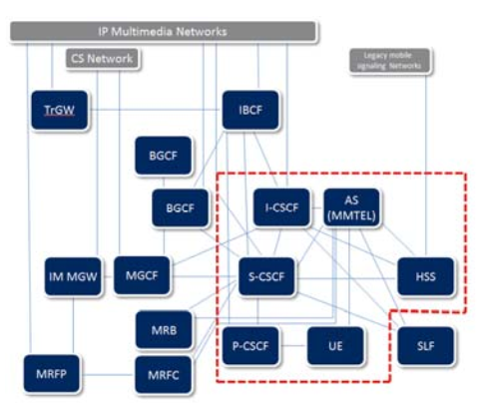
Fig 1 (A)
Notes:
圖1 (A)為IP Multimedia Subsystem (IMS) 整個系統架構,紅色虛線圈起來的是作者們主要探討的元件:
Call Session Control Functions (CSCF)
Home Subscriber Server (HSS)
Multimedia Telephony (MMTEL)
Media Resource Functions(MRF)

Slide 10
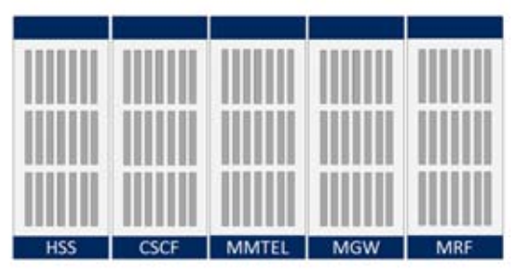
Fig 1 (B)
Notes:
圖1(B)為伺服器櫃中IMS可能的部屬方式

Slide 11
Introduction
Current IMS deployments are typically done on vendor-specific hardware.
For example, Ericsson has a family of hardware platforms for IMS deployment purposes.
In other words, IMS functions are customarily deployed on dedicated physical nodes.
Notes:
現有的IMS部屬在客製化的硬體為主,像是愛立信有一系列的硬體平台供給IMS佈署用,換句話說IMS的功能通常佈署在專用的硬體節點上。

Slide 12
Introduction
The Network Function Virtualisation (NFV) standardization effort [3] has recently sought to introduce virtualization platforms for telephony functions and IMS.
The NFV standard leverages the evolution of the current (predominantly) vendor-based hardware deployment consisting of Physical Network Functions (PNF) to a vendor-agnostic hardware platform running on virtualized hardware with Virtual Network Functions (VNF).
Notes:
1.NFV標準化規格嘗試用虛擬化平台引入電話功能和IMS
2.NFV標準影響了硬體的演進,從vendor-based硬體(由實體網路功能Physical network function : PNF)發展成透過VNF執行的虛擬硬體的非客製化的硬體平台

Slide 13
Introduction
NFV introduces the concept of elasticity for telephony application deployment, allowing a wide range of potential implementations of the elasticity concept from no implementation at all to fully automated
Until very recently, the deployment of a VNF was still executed on a per node basis, thus providing coarse scalability and limited elasticity [4].
Notes:
NFV在電話應用部署中引入了彈性概念(concept of elasticity),使彈性概念(concept of elasticity)的潛在應用範圍廣泛，從完全不實作到完全自動化。
直到最近,VNF的佈署仍以node basis為主,因此限制彈性且粗略的可擴展性

Slide 14
Introduction
The problems associated with such coarse scalability are well covered in [5] and the general problem of scaling the IMS [6] is considered in [4] and [7].
Prior solutions focused on resource over-provisioning to solve scalability issues leading to poor resource utilization derived from scaling on a per-node basis.
Notes:
粗略的可擴展性的相關問題在ref [5]有了很詳細的討論,而在[4]和[7]中討論了IMS的一般擴展問題[6]。
先前的解决方案主要研究以node為單位的scaling,產生資源配置過剩導致較低的資源使用率，如何解决可擴展性的問題

Slide 15
Introduction
A dynamic distribution, or concentration of IMS functionality has been proposed [8], but this still maintains node-based coarse scaling.
This approach helps increase utilization but fails to solve the over-provisioning issue.
A similar approach, so called “Merge-IMS” [9] proposes a pool of IMS VMs containing CSCF and HSS functionality whereby a specific VM instance is assigned to a subscriber at registration.
Notes:
一種動態分布或是將IMS功能集中化在ref [8]被提出,但是還有node-based的粗略擴展性問題,這方法提升使用率但是未解決過度配置的問題。
有個相似的方法叫做”merge-IMS”,提出一堆的IMS VM,裡面包含CSCF和HSS的功能在註冊時把特定的VM instance分配給該用戶。

Slide 16
Introduction
Today, Cloud providers usually build their cloud on homogeneous commoditized hardware to reduce acquisition and operating costs. As Cloud technology is being adopted, Telecom vendors might have to deploy their software on an operator’s cloud which is very different from one operator to another.
Part of the Telecom vendor’s software functionality might be better suited for certain types of hardware. Given this, the ability to deploy the same software in a solution-defined heterogeneous pool of computing resources is desirable.
Notes:
現在,雲端供應商常常以相同規格的商用硬體建置雲端,採取這種方式佈署雲端,電信商難以佈署軟體在不同的營運商。
電信商的一些軟體功能可能比較適合某些特定的硬體。有鑑於此,我們希望佈署相同軟體在solution-defined(解決方案導向)的異構計算資源群

Slide 17
Introduction
Section 2:Related Work
Section 3:Unity Cloud
Section 4:Experimentation
Section 5:Discussion and Conclusion
Notes:
第二部分介紹關於本篇相關的先前研究
第三部分描述 “Hyper Heterogeneous Cloud”架構(叫做Unity Cloud)的三個主要層次:1.Unity架構和Unity 框架 2.Unity框架下重新設計IMS應用 3.硬體上的實作與實驗
第四部份描述實驗
第五部分討論研究成果和結論

Slide 18
Related Work
So far, the definition of “Heterogeneous Cloud” is still unclear. Some authors associate it to the Cloud software stack currently being built by multiple vendors [10]
e.g. a management tool from one vendor driving a hypervisor from another.
Others associate it to the use of hardware clusters that contain heterogeneous equipment [11],[12]
e.g. general purpose computing platforms sitting next to specialized accelerators or mixed-characteristic general computing platforms where some equipment has faster processing, better I/O capacity or provides different memory/storage capacities.
Notes:
到目前為止,異構雲端的定義仍然不夠明確。一些作者以多個vendor建立cloud software stack與異構雲端的概念產生關聯。
像是一個廠商的管理工具來驅動另一個廠商的hypervisor。
其他相關研究[11][12]用不同的配備來組成硬體cluster。
像是一般用途的計算平台使用特殊的加速器,或是混合功能的通用計算平台其中一些配備有較快的處理能力,較佳的I/O性能,或者提供不同memory /storage的容量

Slide 19
Related Work
Nevertheless, much work has been done on the Heterogeneous Cloud.
In [11] the authors propose a solution to schedule tasks to best fit hardware computing resources.
in [12] the authors propose a cloud built of a mix
of Central Processing Unit (CPU) and Graphical Processing Unit (GPU) based computing resources through virtualization.
Another CPU/GPU study [13] looks at how proper allocation and scheduling on such heterogeneous cloud can benefit Hadoop [14] workload.
Notes:
然而已經有很多在異構雲端上實作的研究了
[11]的作者提出一個解決方案,安排任務到最適合的硬體計算資源上
[12]的作者提出雲端建置在含有CPU和GPU的虛擬化混合平台
另一個CPU/GPU的研究[13],討論如何適當的分配和排程在異構雲端,可以優化Hadoop的工作負載

Slide 20
Related Work
Unfortunately, to the best of our knowledge, no architecture has yet been proposed for the telecom sector in order to provide portability between multiple cloud environments or to enable solution-oriented heterogeneous cloud deployments.
At the same time, no approach has been proposed to distribute and instantiate core IMS functionality in an on-demand, per subscriber and per service basis.
Notes:
很可惜的,根據我們所知,沒有一個架構已經被提出為電信商提供多种雲端之間的可移植性，也没有提出針對解决方案的異構雲端佈署方式。
同時還沒有提出根據需求、用户和服务來分配和實作 core IMS功能的方法。

Slide 21
Related Work
This paper is therefore dedicated to address the following questions:
1.Can we define a cloud-based software architecture that can be easily deployed on heterogeneous hardware clusters(containers, virtual machines, bare metal servers clusters, specialized accelerator clusters…)?
Notes:
這篇論文在以下描述的問題提供一些貢獻:
1.我們是否可以定義一個cloud-based軟體架構,可輕易的佈署在異構硬體群(container, VM ,bare metal伺服器群,特殊加速器群)

Slide 22
Related Work
2.Can we implement an IMS over such an architecture in order to provide on-demand per subscriber and per service functionality
3.What would be the characteristics of such an architecture and how does it compare to a node-based deployment?
Notes:
2.我們是否可以實作IMS在所上一個問題所提的架構,可以按每個用戶 每個服務功能來提供需求?
3.這個架構的特性是什麼? 相比node-based佈署方式的差異?

Slide 23
Unity Cloud
3

Slide 24
Unity Cloud
The “Hyper Heterogeneous Cloud” architecture named Unity that we propose in this paper can be deployed on a set of different hardware infrastructures, using a mix of management tools and a mix of deployment technologies.
In other words, part of the deployment may be on Virtual Machines (VMs), on containers and on bare metal to take advantages of the various platforms and their availability.
Notes:
在本篇中提出的叫作Unity的 “Hyper Heterogeneous Cloud ”架構，可以在一组不同的基礎硬體設施上部署，使用混合的管理工具和混合的部署技術。
換句話說,佈署方式可以一部分用VM,container和bare metal,可以利用每種不同平台的優勢

Slide 25
Unity Cloud
Our goal is to build a system and software architecture which allows a single software base to be deployed on heterogeneous hardware and cloud platforms.
Specific requirements are met through deployment configuration rather than a design for a specific platform set.
Notes:
作者的目標是建立一個系統和軟體架構,讓單一的軟體可以在不同的硬體和雲端平台上部署。
透過佈署配置来滿足特殊的需求，而不是設計來符合特定平台。

Slide 26
Unity Cloud
To study the characteristics of a Hyper Heterogeneous Cloud Deployment Software Architecture, we built a simplified IMS system on a Microservices-based architecture [15].
This gives us the flexibility to distribute the IMS functions on a combination of platforms, through a Descriptor file which defines the available pools of platform resources and the deployment model of the Microservices.
Notes:
为了研究Hyper Heterogeneous雲端佈署軟體架構的特性，作者基於Microservices-based架構上建立一個簡化的IMS系統[15]。
这使得我们可以透過一個Descriptor文件来定義平台資源的available pools和Microservice的佈署模型，讓们可以靈活地把IMS功能分布在不同平台的组合上。

Slide 27
Unity Cloud
The Meta Manager and Orchestrator we built can deploy the functionality on heterogeneous platforms.
This approach allows defining Hybrid deployments since the defined platforms could as well be provided by a Public Cloud.
The list of Microservices developed for the Unity Cloud and the IMS functionality implemented is detailed later in this paper.
We first focus on the software architecture and infrastructure enabling a Hyper Heterogeneous Cloud deployment.
Notes:
作者建立的Meta Manager和Orchestrator可以佈署功能在異構平台上
这种方法允许定义混合部署，因为定义的平台也可以由公有雲提供。
本篇后面会详细介绍为Unity Cloud开发的microservices列表和實現的IMS功能。
我们首先關注的是實現Hyper Heterogeneous Cloud佈署的軟體架構和基礎設施。

Slide 28
Unity Cloud
In this architecture the Cloud platform is responsible for allocating computing,network and storage resources to provide the required telecom functionality on a per-user or per-service basis.
In order to cater to the heterogeneity of the platforms (PaaS,IaaS, BareMetal, etc.) we introduce an abstraction layer which represents an instance of a computing resource on a platform.
We define a Pouch (Fig. 2 and Fig. 3) as a computing resource combined with a lightweight platform framework.
Notes:
在这個架構中，雲端平台负责分配计算、网络和存储资源，以提供使用者或服務所需的电信功能。
為了相容不同平台（PaaS、IaaS、BareMetal等,直接統稱Xaas），作者介紹了一個抽象層，它表示平台上的计算资源的一个实例。
我们将Pouch定义为计算资源與輕量化平台框架一起結合的计算资源（图2和图3）。

Slide 29
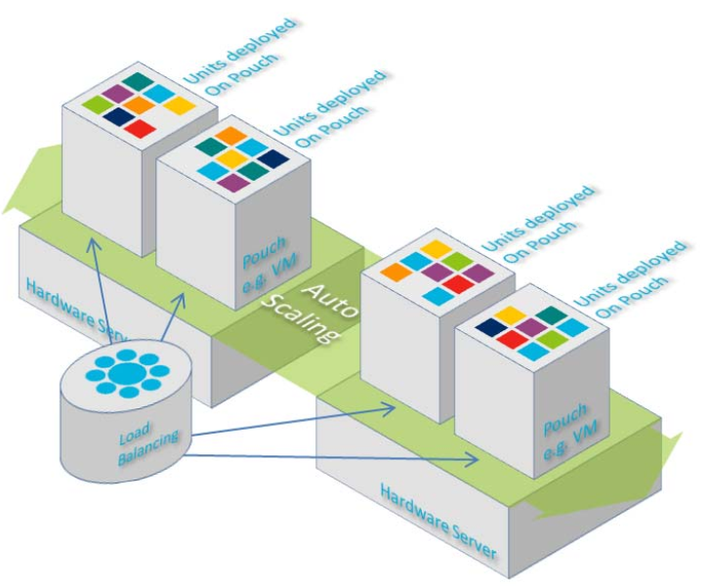
Fig 2
Notes:
Fig. 2. Distributed deployment of Units on Pouch scaling as needed.
圖2 : 分散式佈署的基本單位,Pouch根據scaling的需求

Slide 30
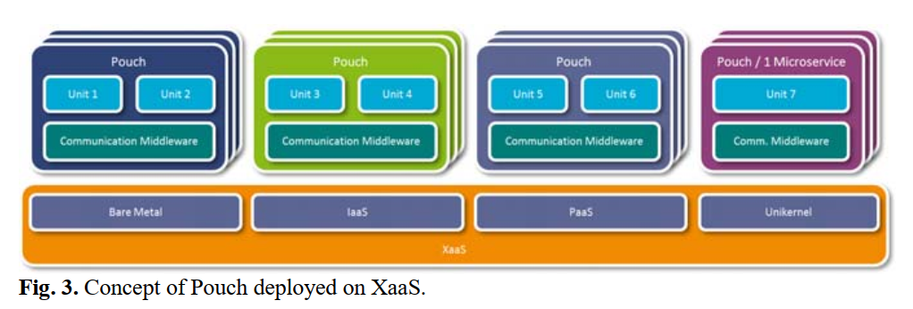
Fig 3
Notes:
圖3:Pouch佈署在不同服務的概念圖

Slide 31
Unity Cloud
The framework supports functions which are offered as a library to the application code rather than an over the network as a service.
The Pouch can be seen as a set of libraries and daemons running on a computing resource to support the Microservices and facilitate access to other services.
In practice a Pouch can be a Bare Metal server,a Virtual Machine on IaaS, a Container/job on PaaS, a Microservice on a Unikernel,etc.
Notes:
该框架支援把功能當作library提供给應用程式程式碼，而不是通过網路作为服务提供。
Pouch可以看成是一套运行在计算资源上的library和程序，以支援microservices，方便使用其他services。
Pouch可以運行在Bare Metal server,Iaas上的VM,Paas上的Container/job,Unikernel上的Microservice

Slide 32
Unity Cloud
The number of Microservices and instances held by a Pouch can vary from one to thousands depending on the characteristics of the host where the Pouch is deployed.
One can scale out any number of Pouches on a platform;
a Unit which can be assimilated to an actor in the Actor Model and instantiated within a Pouch is able to transparently communicate with other Units within other Pouches through the Communication Middleware.
Notes:
一个Pouch所擁有的microservices和instances数量可以从一個到數千個不等，这取决于部署Pouch的主机的特性。
在一个平台上，可以扩展出任意数量的Pouches。
一個Unit可視為一個演員,並在一个Pouch内實例化，它能够通过Communication Middleware和其他Pouch内的其他单元进行直接的通信。

Slide 33
The Unity Cloud Architecture
3.1

Slide 34
3.1 The Unity Cloud Architecture
The Unity architecture (Fig. 4) defines a set of functionality or services allowing a Microservices-based application to be deployed on Hyper Heterogeneous Cloud platforms.
The Microservices performs a specific task and covers a single scaling domain.
For example a Microservice may handle a limited number of related telephony services or the HSS interrogating functionality of an application.
The Microservices are deployed as “Units” as follows.
Notes:
Unity架构（图4）定义了一组功能或服务，允许Microservices-based的應用程式在Hyper Heterogeneous雲端平台上部署。
Microservices执行特定的任务，並只在单一的scaling domain內運行。
例如，Microservices可以处理有限数量的相关電信服務或應用程式的HSS查询功能。
Microservice以 “Unit “的方式來部署，以下說明。

Slide 35
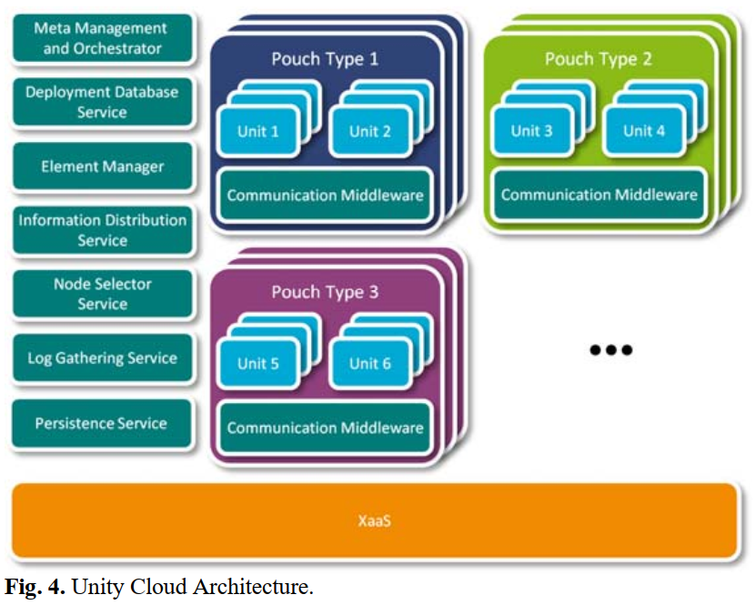
Fig 4

Slide 36
3.1 The Unity Cloud Architecture
Meta Management and Orchestrator (MMO) is responsible for reading the Descriptor file and deploying the appropriate Pouches on the available platform pools.It also monitors usage information from the CMWs via the IDS and instantiates new Pouches to provide elasticity.
Element Manager (EM) is responsible for configuring the Microservices (called Units) running on the Pouches.
Notes:
MMO:
负责读取Descriptor檔案，並在可用平台池上部署適合的Pouches。
MMO还通过IDS监控来自CMW的使用訊息，并实例化新的Pouches以提供弹性。
EM:
元件管理负责配置运行在Pouches上的Microservices（也稱作Units）。

Slide 37
3.1 The Unity Cloud Architecture
Communication Middleware (CMW) forms the basis of the Unity Cloud Architecture;
each Pouch is required to run a single instance of a CMW.
It manages most basic functionality that is required for the Unity Cloud operation such as Inter-Unit communication, Unit spawning, Pouch monitoring and Unit/Service address resolving.
Notes:
CMW:
构成了Unity Cloud架构的基础。
每个Pouch都需要執行一个CMW的single instance。
它管理Unity Cloud運作所需的大多数基本功能，如unit之間的通訊、unit生成、Pouch监控和unit/service位址解析等。

Slide 38
3.1 The Unity Cloud Architecture
Node Selector Service (NSS) implements the logic of spreading the Subscribers’ service instances on the available Pouches.
It ensures that most of the service requests for a Subscriber are made to the same Pouch in order to maximize local memory cache hit.
Notes:
NSS實現将使用者的service instances分布到可用的Pouches上。
它保證了使用者的大部分服务请求都是向同一个Pouch发出的，使local memory cache hit最大化

Slide 39
3.1 The Unity Cloud Architecture
Information Distribution Service (IDS) allows information exchange based on a publish/subscribe system.
Some of the information disseminated through it includes:
resource utilization, service/unit resolving updates, system status updates, log levels and log entries, global configuration, etc.
Notes:
IDS 允许在publish/subscribe系统的基础上进行資訊交流。
通过该系统发布的一些信息包括：
資源使用率、service/unit解析更新、系统状态更新、記錄檔级别和記錄檔目錄、全域設置等。

Slide 40
3.1 The Unity Cloud Architecture
Deployment Database Service (DDS) maintains copies of VM images and service and Microservice binaries that are necessary to deploy software on the Pouches of the system.
Notes:
DDS :维护在系统的 Pouches 上部署软件所需的 VM 映像和服务及 Microservice binary檔案的副本。

Slide 41
3.1 The Unity Cloud Architecture
Log Gathering Service (LGS) sorts and consolidates the logging information received from the Pouches, Services and Microservices.
Notes:
LGS :從Pouches、services、microservices收到的記錄檔訊息进行分类和整合。

Slide 42
The IMS Telephony Application
3.2

Slide 43
3.2 The IMS Telephony Application
To study the advantages of a Hyper Heterogeneous Cloud-based approach (fully distributed and elastic deployment on heterogeneous platforms) versus a Node-based approach (functions constrained to dedicated hardware or virtual machine (VM)) in terms of telecommunication functionality, we built a simplified IMS on the Unity Cloud Microservices-based architecture with the goal of deploying it in a heterogeneous cloud infrastructure.
Notes:
为了研究Hyper Heterogeneous Cloud-based方法（在heterogeneous平台上完全分散式和弹性部署）与Node-based的方法（功能受制于專用硬體或虚拟机（VM））的比較，在电信功能方面的优势，我们在Unity Cloud microservice-based的架构上构建了一个简化的IMS，目标是在heterogeneous cloud infrastructure中部署。

Slide 44
3.2 The IMS Telephony Application
This allowed us to select the distribution of the functions on the physical or virtual platform
i.e. IMS functions can be fully distributed on a pool of compute resources (Cloud-based) or on a specific compute resource (Node-based) given a single software base, thus enabling a fair comparison.
Notes:
这使我们能够选择分配在 在物理或虚拟平台上的功能，也就是說IMS功能可以完全分布在一个计算资源pool 上（clould-based），也可以分布在一个特定的计算资源上（Node-based），给定一个单一的软件基底，因此可以公平的比较。

Slide 45
3.2 The IMS Telephony Application
The simplified IMS functions are split amongst a number of communicating Microservices joined in a complete service chain (or call chain).
Fig. 5 illustrates how the Microservices are linked in a complete service chain to provide a phone call between two subscribers.
Notes:
简化后的IMS功能被分割成多個通信用的microservices，連接成一個完整的service chain(或是call chain)
图5说明了microservices是如何在一个完整的service chain中，将microservices连接起来，在兩個使用者之间提供電話通信

Slide 46
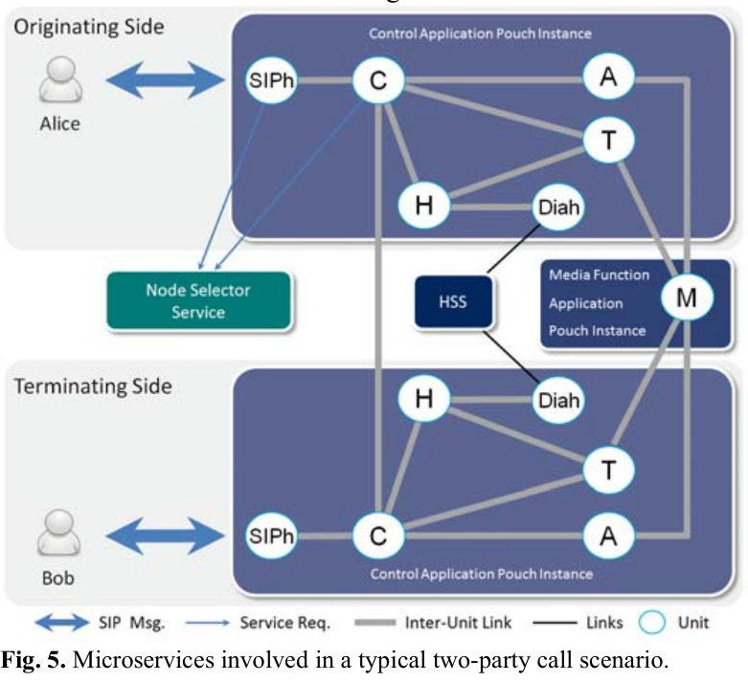
Fig 5
Notes:
圖5:一個典型的雙方通話場景所觸發的microservices

Slide 47
Microservices介紹
Notes:
以下提出为Unity Cloud IMS电话应用开发的microservices（也称为Units），并说明了它们提供了哪些IMS功能。

Slide 48
Microservices
SIP Handler (SIPh) implements the SIP processing functions of the P-CSCF and the I-CSCF.
It is the first Unit involved in a service setup scenario. It uses the Node Selector Service to figure out where the Call Session Unit should be instantiated and forwards it the received SIP messages.
Notes:
SIPh 處理P-CSCF和I-CSCF的部分SIP功能。
它是service设置场景中涉及的第一个unit。它使用Node Selector Service来找出呼叫会话单元的实例化位置，并将收到的SIP消息转发给它。
紅字:主要用途
橘字:對象
綠字:部分詳細流程

Slide 49
Microservices
Call Session (C) performs the functionality of an S-CSCF. It handles the request coming from the UA, fetches the Subscriber profile based on service triggers and builds the appropriate service chain to provide the requested service.
The C Unit is instantiated on request to handle the Subscriber service and is terminated when the service has completed e.g. during a call, it remains active until the SIP Bye message has been acknowledged.
The C Unit makes use of the Node Selector Service in order to figure out where the terminating Call Session Unit should be instantiated.
Notes:
Call Session執行SCSCF的功能。它处理来自UA的请求，根据服务触发器获取用户配置文件，并建立适当的服务链来提供所需的服务。
Call Session在request时被实例化，以处理使用者service，并在service完成时結束，例如，在呼叫期间，它保持活动状态，直到SIP Bye message传来为止。已被确认。
Call Session利用Node Selector Service 來找出哪裡應該終止call session unit實例化。

Slide 50
Microservices
HSS Front-End (H) is used to fetch a Subscriber profile. It is responsible for querying the HSS database in order to get this information.
Diameter Handler (Diah) is used by the H Unit as an interface that implements the diameter protocol towards the HSS in order to fetch a Subscriber profile.
Notes:
HSS前端用來擷取使用者相關資料,負責查詢HSS database獲得使用者資訊
Diameter Handler當作HSS前端的介面用來實作diameter協定給HSS,為了取得使用者資訊

Slide 51
Microservices
Anchor Point Controller (A) covers the MRFC functionality controlling the Media Processor Unit as needed for the requested service and informs the interested Units of the availability of the functionality in the service chain.
The A Unit’s main function is to negotiate the media codec so that the UA can properly exchange media with the Media Processor Unit.
Notes:
Anchor Point Controller(A)涵盖了Media processor unit的MRFC(Media resource function controller)功能，根据所需服务的需要，并通知感兴趣的unit在服务链中提供该功能。
Anchor Point Controller的主要功能是協調媒体编解码器，使UA能够与Media Processor Unit正确地交换媒体。

Slide 52
Microservices
Media Processor (M) is a dialog-based Microservice that handles the media plane of the call through RTP as an IMS MRFP would do. It provides point-to-point connectivity for basic 2-way calls and provides voice mixing in conference calls.
Notes:
Media Processor (M) 是個dialog-based的microservice,它通过RTP处理呼叫的媒体平面，就像IMS MRFP那样，通过RTP处理呼叫的媒体平面。它为基本的双向通话提供点对点连接，并在会议通话中提供语音混合。

Slide 53
Microservices
Telephony Server (T) provides telephony related features to the Subscriber.
As an IMS MMTEL it can listen to DTMF activities to trigger supplementary services like ad-hoc conferences by adding another call leg to the current call.
It is created by the C Unit on both the originating and terminating sides based on the Subscriber profile fetched via the H Unit;
it connects to the M Unit to receive the media plane telephony events and to control the connectivity of the media plane.
Notes:
Telephony Server (T)为用户提供电话相关的功能。
作为一个IMS MMTEL(多媒體電話)，它可以监听DTMF(Dual-Tone multi-Frequency)活动，通过在当前通话的基础上增加另一个呼叫流程来触发补充服务，如临时会议(ad-hoc conferences)。
它是由Call sessio根据通过HSS前端获取的用户配置文件在始发端和终结端创建的。
它连接到media processor，接收media plane telephony events，并控制媒体平面的连接。

Slide 54
THE hardware platform
3.3

Slide 55
The Hardware Platform
We deployed our Microservices IMS Telephony application on two distinct platforms.
The first deployment platform (Fig. 6.A) is based on a cluster made of eight Raspberry Pi’s [16] (RPi).
The benefits of this platform are twofold. Firstly, it is a cost effective way to have a 24/7 cloud we can experiment on and secondly, RPi being a simple single core computer, limits the number of variables required to consider while studying the system.
Notes:
作者佈署microservices IMS 電信應用在兩個不同的平台上
第一個平台是由八個樹莓派所組成的cluster(如圖6A)
這個平台有兩個好處,
第一,低成本的情況下可以每天24小時一周7小時運行實驗
第二,樹梅派是簡單的單核心電腦,限制了研究系统时需要考虑的变量数量。

Slide 56
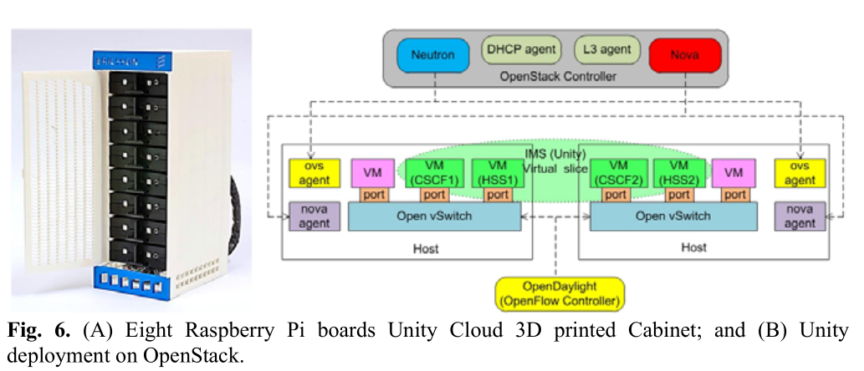
Fig6
Notes:
圖6A 八個樹梅派在一個3D列印的櫃子
圖6B 在openstack上佈署unity的架構圖

Slide 57
The Hardware Platform
The Unity Cloud RPi platform is built of:
8 Model B RPi stacked together in a custom made 3D printed cabinet where each RPi is set in a removable sliding tray.
8 custom-made RPi Daughter Boards enabling the display of information via 2 RGB LEDs and allowing input via a button.
1 Gigabit Ethernet switch providing the backbone network for the system.
1 Wi-Fi router providing access to UEs (hosting the UA) and providing the NAS functionality on a USB Storage Device.
1 Power Supply for the Cabinet.
Notes:
Unity cloud 樹梅派平台由以下元件組成
1. 8個B型樹梅派裝在客製的3D列印機櫃,每個樹梅派可以從滑軌來裝卸
2. 8個客製化的樹梅派子版,透過兩個RGB LED燈顯示訊息,可以用按鈕輸入資訊
3. 1個億兆網路卡,為系統提供骨幹網路
4. Wi-Fi路由器，提供接入UE 和USB儲存裝置上的NAS功能。
5. 1个机柜电源。

Slide 58
The Hardware Platform
The second deployment (Fig. 6.B) is on top of OpenStack deployed on an Ericsson Blade System (EBS) [17] consisting of 8 VMs (2 virtual cores and 2GB of RAM)deployed on 4 physical blades. An automatic orchestration mechanism is triggered to balance load of the blades though VM migrations.
Notes:
第二种部署（图6.B）是在OpenStack之上，部署在Ericsson Blade System（EBS）[17]上，由8个虚拟机（2个虚拟核心和2GB内存）组成，部署在4个physical blades上。一个自动协调机制被触发，通过虚拟机的迁移来平衡刀片的负载。

Slide 59
Experimentation
4

Slide 60
Experimentation
The first experiment is carried out to demonstrate the compatibility and compliance between different cloud-based deployment platforms (RPi cluster and EBS VMs) regarding IMS telephony Microservice functions developed for the Unity Cloud.
Our measurement consists of a collection of in-process logs which are collected in a file on the Unity Cloud. The open-source tool SIPp [18] has been used to generate SIP traffic.
Notes:
第一个实验是为了展示不同的云端部署平台（RPi cluster 和 EBS VMs）之间在IMS电话microservices功能方面的兼容性和是否符合規格，为Unity Cloud开发的IMS电话微服务功能。
測量方式由一些程式執行中的記錄，这些記錄被收集在Unity Cloud上的文件中。开源工具SIPp[18]用來產生SIP trafiic。

Slide 61
Experimentation
We measure the delay from the reception of the SIP INVITE by the Unity Cloud until it is sent to the terminating UA (Fig. 7). This way we keep the measurement to the portion that is directly dependent on Unity Cloud processing and independent from UA delays. We also take measurements about the average CPU load on all Computing Units (CUs) against the number of concurrent calls being served by the system (Fig. 8).
Notes:
我们测量从Unity Cloud接收SIP INVITE到发送到终端UA的延迟（图7）。
这样，我们将测量的部分直接依赖于Unity Cloud的处理，而不依赖于UA的延迟。
我们还测量了所有compute units（CU）的平均cpu使用率与系统所服务的正在通話的數量的比較（图8）。

Slide 62
Experimentation
For all measurements we settled on:
Call Rate: 30 2-way calls establishment minute
Call Duration: 3:20 minutes
Subscribers: 200 registered users
Background Registration: 20 re-registration / minute
Notes:
- Call rate:每分鐘建立30個2-way call
Call Duration:200秒
- 使用者數量:200個已註冊使用者
- 背景的註冊量：每分鐘20個re-registration

Slide 63
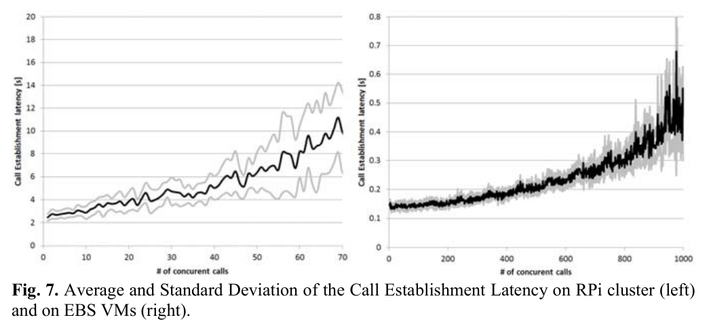
Fig 7
Notes:
圖7 延遲

Slide 64
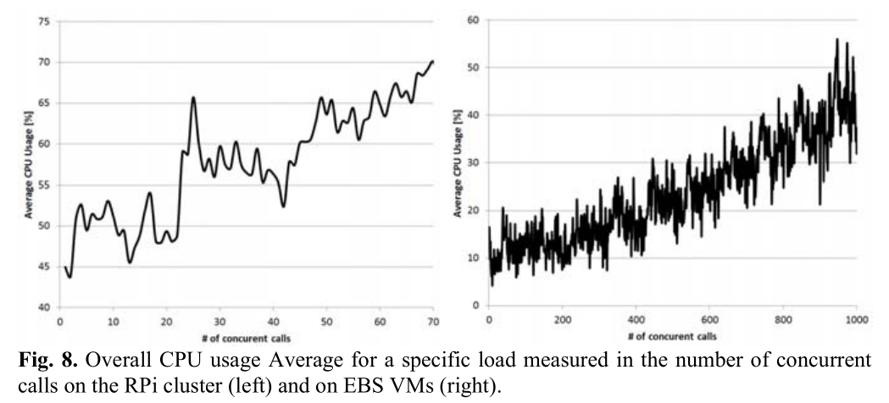
Fig 8
Notes:
圖8 CPU平均使用率

Slide 65
Experimentation
As shown in Fig. 7, calls could be successfully established in both experimental platforms and the QoS characteristics show similar behavior. QoS characteristics are obviously better on the more powerful EBS but the QoS trend is similar to the RPi cluster.
In Fig. 8, we notice similarities in the resource usage profile where average CPU usage increases relatively linearly with the number of concurrent calls.
Notes:
如图7所示，在两个实验平台上都能成功建立call，且有非常相似的QoS特性。在功能較强的EBS上，QoS特性明顯的表現較佳，但QoS趋势与Rpi cluster相似。
在图8中，我们注意到資源使用率也有相似之处，平均CPU使用量随着concurrent calls的增加而呈現相對的线性增加。

Slide 66
Experimentation
In a Node-based architecture the provisioning of the nodes needs to be perfectly engineered. However, since we had only a limited number of CUs available and didn’t have proper methods to manually engineer the provisioning, we evaluated a number of configurations. These configurations and their functionality distribution are shown for the 8 available CUs in Table 1.
Notes:
在一个Node-based的架构中，节点的配置需要完美的調整。然而，因為我们可用的computer units数量有限，没有合适的方法去調整，所以我们评估了一些配置。这些配置及其功能(functions)分配可看table 1 中有8个可用CU。

Slide 67
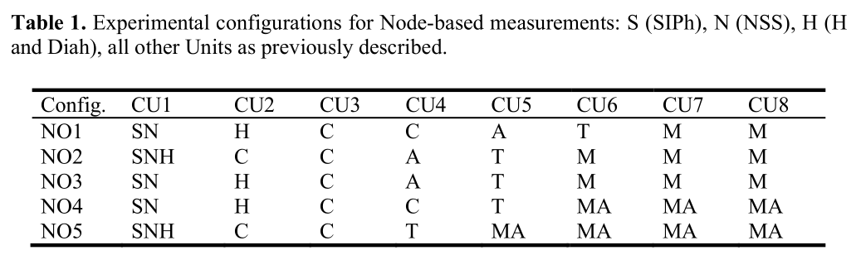
Table 1

Slide 68
Experimentation
As shown in Fig. 9 the distributed Cloud-based approach gives similar average control plane QoS characteristics compared to Node-based approach while avoiding the worst case scenario exposed by poorly engineered resource allocation.
This is depicted in the Node-based deployment configuration NO3, where the C Unit processing is starved as it is deployed on a single CU.
It is worth noting that the Cloud-based approach exhibits the best data plane QoS characteristics compared to all Node-based deployment configurations.
Notes:
如图9所示，distributed Cloud-based方法与Node-based的方法相比，distributed Cloud-based方法给出了类似于平均control plane的QoS特性，同时避免了资源分配不理想所發生的最坏情况。
这在Node-based部署配置NO3中可以看到，由于call session的处理只有一個CU來處理，所以call session的处理是缺乏效能。
值得注意的Cloud-based的方法，与Node-based的佈署配置比較其他所有的数据平面QoS特性，表现出最佳的数据平面QoS特性。。

Slide 69
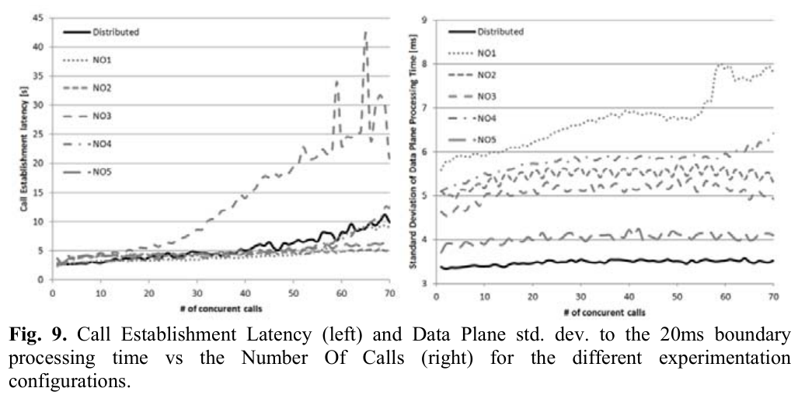
Fig 9
Notes:
左圖 不同配置的call建立延遲與concurrent call的性能表現
右圖 不同配置的concurrent call與data plane處理時間的標準差的性能表現

Slide 70
Discussion and Conclusion
5

Slide 71
Discussion
Our deployment of a Microservices-based IMS telephony solution on different cloud platforms (RPi cluster and OpenStack/EBS platform) shows that this architecture enables one-time development of the business logic across multiple deployments on various platforms through modification of deployment configuration only.
It demonstrates the possibility of defining an architecture supporting Cloud features, especially automatic scaling out of the business logic for the telecom sector.
Notes:
我们部署的Microservices-based的IMS電信解决方案在不同的雲端平台（RPi cluster和OpenStack/EBS platform）展示這個架構可以实现跨多个business logic的即時佈署。只需要修改部署配置就可以在不同平台上佈署。
本篇展示了定义一个支援雲端特性的架构的可能性。特别是自動地替電信sector scale out出business logic。

Slide 72
Discussion
Fig. 7 and Fig. 8 show that the QoS of the application and platform (e.g., in terms of Call Establishment Delay and CPU consumption) are comparable in both RPi and EBS deployments.
A larger number of calls can be handled on the EBS deployment but the trend of QoS characteristics stays the same.
This suggests that we achieved our goal of defining a cloud-based software architecture that can be easily deployed on heterogeneous hardware clusters using a single application code base.
Notes:
从图7和图8可以看出，在RPi和EBS部署中，应用和平台的QoS特性（如呼叫建立时延和CPU消耗等方面）是相似的。
在EBS部署中，可以处理更多的呼叫，但QoS特性的趋势保持不变。
这表明我们实现了我们的目标，即定义了一种基于云的软件架构，可以使用单一的应用代码库在异构硬件集群上轻松部署。

Slide 73
Discussion
In Fig. 9 we observe that accurately allocating resources is required for each node in a Node-based system, and this must be done statically due to the static configuration of the Node-based system.
For example, dramatic performance degradation is experienced on NO3 where the lack of resources allocated to the C Unit degrades the control plane latency in a very noticeable fashion.
Aside from control plane Unit resource allocation, media plane resource allocation must also be considered.
Notes:
在图9中我们观察到，在Node-based的系统中，需要对每个节点进行精确的资源分配，由于Node-based系统是静态配置，所以必须静态地进行资源分配。
例如，NO3上的性能急剧下降，分配给C单元的资源不足，使控制平面的延迟明显下降。
除了控制平面单元资源分配外，还必须考虑媒体平面的资源分配。

Slide 74
Discussion
In contrast, the distributed Cloud-based approach allocates the same amount of resources to both media and control plane and also to each unit since distribution is based on CPU usage.
As such, we observe better media plane performance and average control plane performance.
Using our approach, the Microservices can be distributed and combined without location restrictions on VMs in order to efficiently use the available resources.
This is an advantage compared to a Node-based deployment where functionality is bound to specific resources.
Notes:
相比之下，基于分布式云计算的方法则是将相同数量的资源分配给媒体和控制平面，同时也分配给每个单元，因为分配是基于CPU的使用情况。
因此，我们观察到媒体平面性能平均比控制平面性能較好
使用我们的方法，Microservices可以在没有位置限制的情况下对虚拟机进行分配和组合，以有效地利用可用资源。
与Node-based部署相比，这是一个优势，因为在Node-based部署中，某些功能被绑定到特定的资源上。

Slide 75
Conclusion
In conclusion, a distributed Cloud-based approach can provide automatic platform resource allocation which cannot be easily achieved by a Node-based architecture.
Failure to properly engineer node resource allocation in a node-based architecture can lead to major impacts on performance.
Node-based deployment also reduces the reliability of the overall system since if a node is deployed on only one CU and it fails, then the whole system fails and the service will remain unavailable until that function is restored.
Notes:
总之，distributed Cloud-based方式可以提供平台资源的自动分配，这是a Node-based架构无法轻易達成的。
在node-based架构中，如果不能对节点资源分配进行正确的調整配置，会对性能产生重大影响。
Node-based部署也会降低整个系统的可靠性，因为如果一个节点只部署在一个CU上，而它发生了故障，那么整个系统就会出现故障，在恢复该功能之前，服务将一直无法使用。

Slide 76
Conclusion
In the distributed cloud-based model, such a failure will terminate the services hosted on a single CU but the system will remain available to provide new service instances spread across other available CUs.
The hyper-heterogeneity aspect of the proposed architecture enables us to deploy an application that is designed once across different cloud platforms, thus easing the job of telco vendors to deploy network functions on various operator-owned clouds.
Notes:
在distributed cloud-based模型中，这种故障将终止托管在单个compute unit上的服务，但系统仍可提供分布在其他可用compute unit上的新服务instances。
所提出的架构的hyper-heterogeneity方面，使我们能够在不同的云平台上部署一次设计的应用，从而减轻了电信厂商在不同的运营商云上部署网络功能的工作。

Slide 77
Conclusion
The hyper-heterogeneity aspect also allows tailoring of the deployment to take advantage of the benefits of specific platforms for a given application.
For example, an accelerator-based cloud might be beneficial for media resource processing functions while a general-purpose cloud might be more appropriate for control information.
Notes:
hyper-heterogeneity方面还允许对客製化的佈署，以利用特定平台对特定应用的优势。
例如，accelerator-based的雲端可能有利于媒体资源处理功能，而通用云可能更适合控制信息。

Slide 78
Conclusion
In the future it would be interesting to evaluate heterogeneous deployments where a system would be deployed on integrated clusters of different technologies e.g. bare metal server pool used for data plane processing and a VM-based cloud used for control plane processing.
Notes:
在未来，对heterogeneous部署进行评估将是很有意义的，在这种情况下，系统将部署在不同技术的整合cluster上，例如，bare metal server pool用來處理data plane,和VM-based的雲端用來處理control plane，會是個值得考慮的方式

Slide 79
Acknowledgements
This work is sponsored by Ericsson Canada Inc. where we would like to thank the team researchers developing the PoC: Marc-Olivier Arsenault, Gordon Bailey, Mario Bonja, Léo Collard, Alexis Grondin, Philippe Habib, Olivier Lemelin, Mahdy Nabaee, Maxime Nadeau, Fakher Oueslati and Joseph Siouffi.

Slide 80
References
1. 3GPP, “IP Multimedia Subsystem (IMS).” TS 23.228, v. 10.8.0, December 2013.
2. Ahlforn, Goran, and Erik Ornulf. "Ericsson's family of carrier-class technologies."ERICSSON REV(ENGL ED) 78.4 (2001): 190-195.
3. ETSI, “Network Function Virtualisation (NFV); Virtual Network Functions Architecture.”GS NFV-SWA 001, v 1.1.1, December 2014.
4. Agrawal, Prathima, et al. “IP multimedia subsystems in 3GPP and 3GPP2: overview and scalability issues.” Communications Magazine, IEEE 46.1 (2008): 138-145.
5. Glitho, Roch. “Cloudifying the 3GPP IP Multimedia Subsystem: Why and How?.” New Technologies, Mobility and Security (NTMS), 2014 6th International Conference on. IEEE,2014.

Slide 81
References
6. Hammer, Manfred, and Wouter Franx. “Redundancy and Scalability in IMS.”Telecommunications Network Strategy and Planning Symposium, 2006. NETWORKS 2006. 12th International. IEEE, 2006.
7. Bellavista, Paolo, Antonio Corradi, and Luca Foschini. “Enhancing Intradomain Scalability of IMS-Based Services.” Parallel and Distributed Systems, IEEE Transactions on 24.12 (2013): 2386-2395.
8. Dutta, Ashutosh, et al. “Self organizing IP multimedia subsystem.” Internet Multimedia Services Architecture and Applications (IMSAA), 2009 IEEE International Conference on.IEEE, 2009.
9. Carella, Giuseppe, et al. “Cloudified IP Multimedia Subsystem (IMS) for Network Function Virtualization (NFV)-based architectures.” Computers and Communication (ISCC), 2014IEEE Symposium on. IEEE, 2014.

Slide 82
References
10. D. Wellington, Homogeneous vs. heterogeneous clouds: pros, cons, and unsolicited opinions, http://www.bmc.com/blogs/what-price-homogeneity, 2012.
11. Xu, Baomin, Ning Wang, and Chunyan Li. "A cloud computing infrastructure on heterogeneous computing resources." Journal of Computers 6.8 (2011): 1789-1796.
12. Crago, Steve, et al. "Heterogeneous cloud computing." Cluster Computing (CLUSTER), 2011 IEEE International Conference on. IEEE, 2011.
13. Lee, Gunho, Byung-Gon Chun, and Randy H. Katz. "Heterogeneity-aware resource allocation and scheduling in the cloud." Proceedings of HotCloud (2011): 1-5.

Slide 83
References
14. Hadoop, http://hadoop.apache.org.
15. Newman, Sam. Building Microservices. " O'Reilly Media, Inc.", 2015.
16. Raspberry Pi, https://www.raspberrypi.org
17. Ericsson BSP 8000, http://www.ericsson.com/ourportfolio/products/bsp-8000?nav=productcategory008%7Cfgb_101_0538.
18. SIPp, http://sipp.sourceforge.net

