Slide 1
Use of a virtualization in the transition of a telecommunication networks toward 5G
2020/04/26
陳靖
joesph60261@gmail.com
International Journal of DIGITAL TECHNOLOGY & ECONOMY · Nov 2017
Impact factor:0.95(2019)

Slide 2
Author
Name:Valerij Grasic
任職公司:Iskratel
地點:Kranj, Slovenia
Email:valerij.grasic@gmx.com

Slide 3
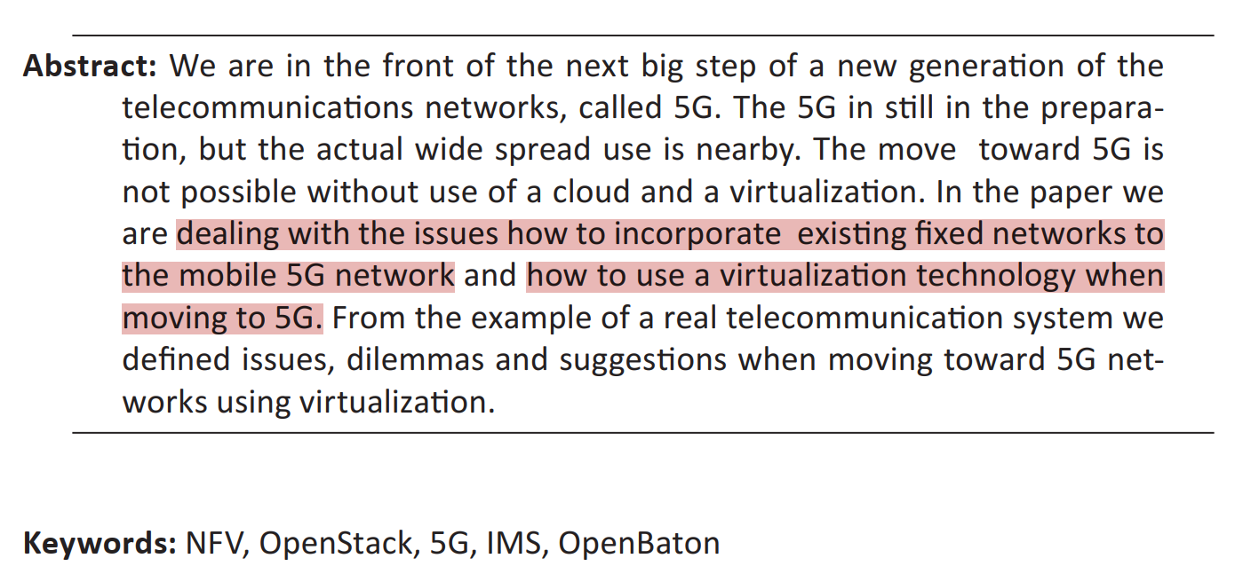
Abstract
Notes:
現有設備轉移到5G很難無法不使用雲端和虛擬化技術

Slide 4
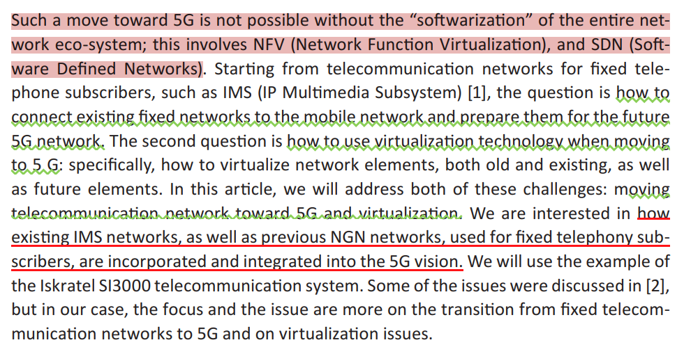
Introduction

Slide 5
Introduction
Such a move toward 5G is not possible without the “softwarization” of the entire network eco-system; this involves NFV (Network Function Virtualization), and SDN (Software Defined Networks).

Slide 6
Introduction
Starting from telecommunication networks for fixed telephone subscribers, such as IMS (IP Multimedia Subsystem) [1], the question is how to connect existing fixed networks to the mobile network and prepare them for the future5G network. The second question is how to use virtualization technology when moving to 5 G.
specifically, how to virtualize network elements, both old and existing, as well as future elements. In this article, we will address both of these challenges: moving telecommunication network toward 5G and virtualization.

Slide 7
PROBLEM DEFINITION
The concept of multiple co-existing networks
Birth of nfv
Benefits of the virtualization
Development of telecommunication networks
Use of virtualization
Notes:
問題敘述 : 問題的前情概要
也有文獻回顧的意義

Slide 8
THE CONCEPT OF MULTIPLE CO-EXISTING NETWORKS
The idea of virtualization is not new: it is a concept based on the idea of multiple co-existing networks [3]. It has appeared in the networking literature several times in different capacities. Authors discuss three such incarnations that are closely related to the concept of network virtualization.
A virtual private network, also known as a VPN, is
a specialized virtual network that connects multiple distributed sites through tunnels over shared or public networks.
Notes:
Incarnations : 典型的

Slide 9
THE CONCEPT OF MULTIPLE CO-EXISTING NETWORKS
An overlay network is yet another form of network virtualization which is typically implemented in the application layer, although various implementations at lower layers of the network stack do exist. It has been extensively used as a weak but effective tool to deploy new features and fixes within the Internet.
Active and programmable networks, in contrast, are a concept that enables the customization of network elements based on service providers’ requirements.

Slide 10
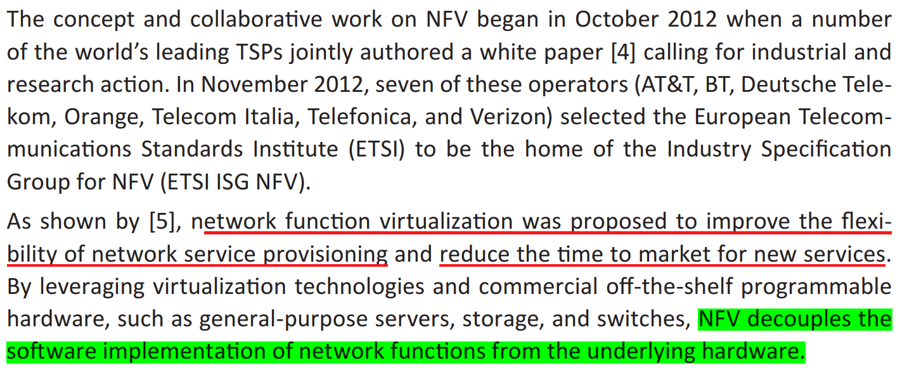
BIRTH OF NFV
Notes:
NFV的源起
紅線處:NFV被創造出時想要解決的問題
leverage:利用
綠底:NFV的功能隻一

Slide 11
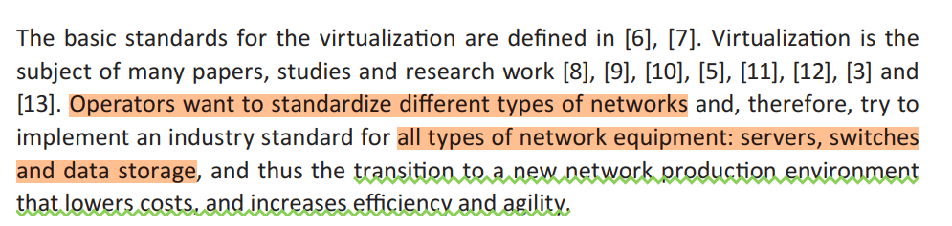
BENEFITS OF THE VIRTUALIZATION

Slide 12
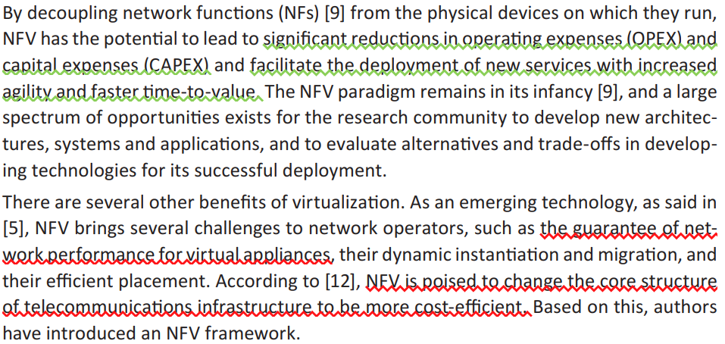
BENEFITS OF THE VIRTUALIZATION
Notes:
紅線處:使用NFV技術要面對的挑戰

Slide 13
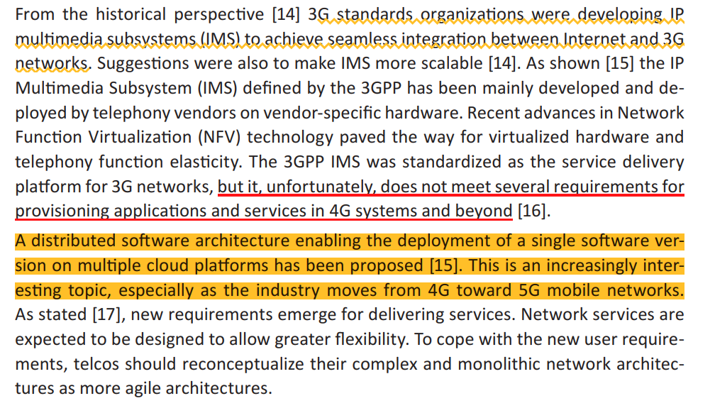
Development of telecommunication networks
Notes:
黃底曲折線:3G標準組織發展IMS為了無縫整合網際網路和3G網路
紅底:3G網路無法符合4G系統的需求
黃底:分散式軟體架構能讓單一軟體解決方案在多個雲端平台佈署,許多從4G轉移到5G網路的研究會參考到

Slide 14
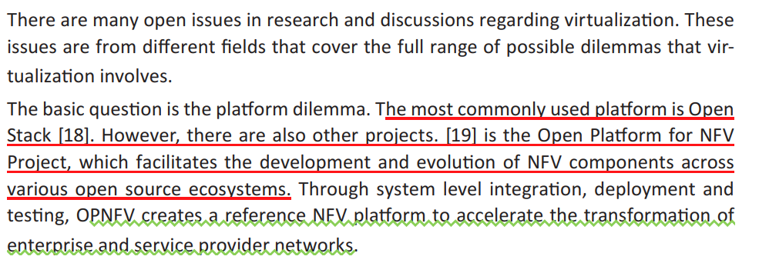
USE ＯF VIRTHUALIZATION
Notes:
本張投影片的大意:過去研究怎麼使用虛擬化技術
Open Platform for NFV (OPNFV) is a project and community that facilitates a common NFVI, continuous integration (CI) with upstream projects, stand-alone testing toolsets, and a compliance and verification program for industry-wide testing and integration to accelerate the transformation of enterprise and service provider networks. Participation is open to anyone, whether you are an employee of a member company or just passionate about network transformation.

Slide 15
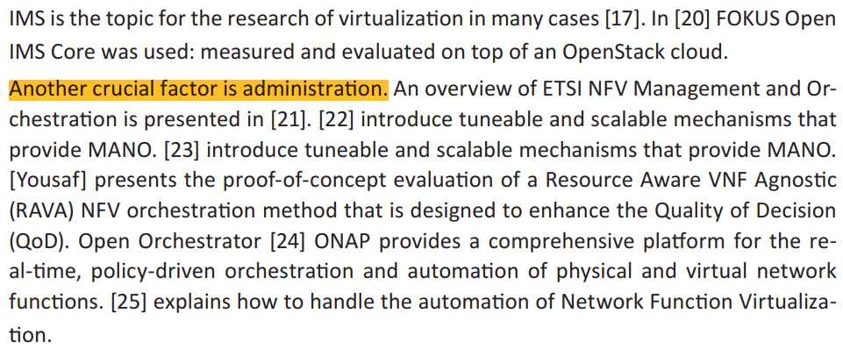
USE ＯF VIRTHUALIZATION
Notes:
使用虛擬化技術需要注意管理的問題
Tuneable:可調整的

Slide 16
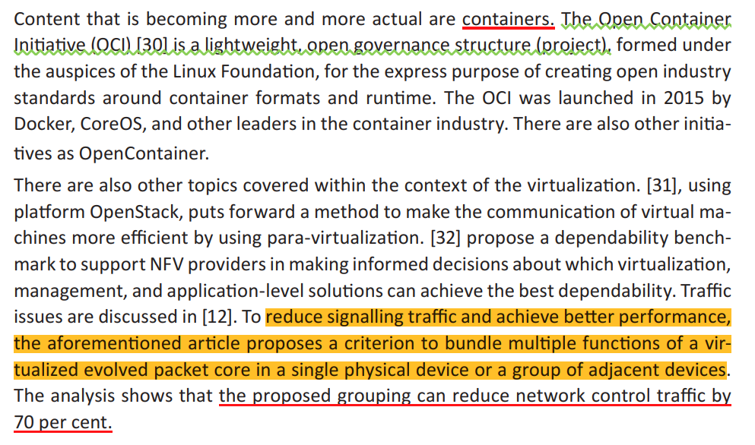
USE ＯF VIRTHUALIZATION
Notes:
Container技術簡介 : Open Container Initiative. opencontainers.org
auspice:主持 主辦

Slide 17
TOWARD 5G
5G
IMS BASED NETWORKS
VIRTHUALIZATION
Notes:
關於5G

Slide 18
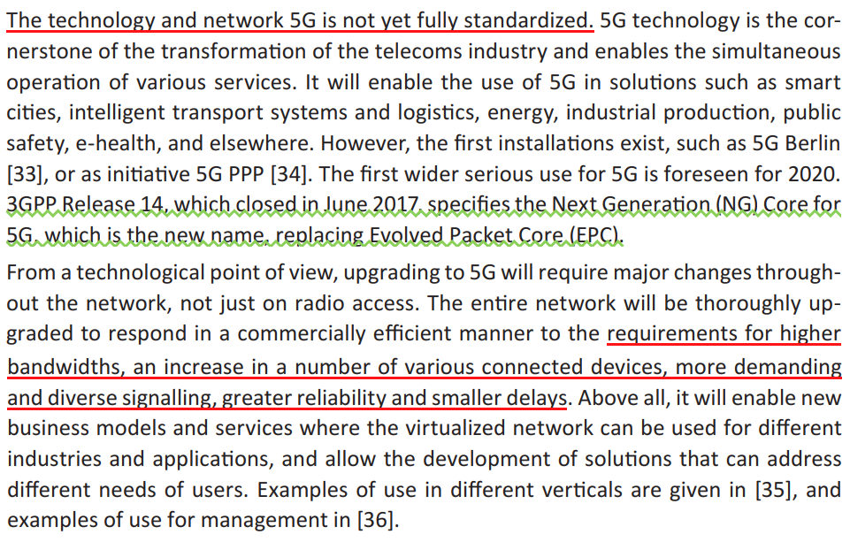
5G

Slide 19
IMS based networks
The telecommunication networks for fixed phone subscribers are based on IMS.
The basic idea of IMS is the convergence of voice, data, and multimedia applications
within a common network.
For IMS, the main protocol is SIP, but Diameter is also very important.
Multi-layer architecture is achieved by dividing logic into service, control, and access planes as defined by 3GPP/TISPAN standards for IMS. (Fig 1)
Due to historical reasons, such a system also includes the previous NGN networks, as well as previous SS7 based networks
Notes:
Diameter : Diameter is used to authenticate, authorize and provide accurate billing information for those sessions.

Slide 20
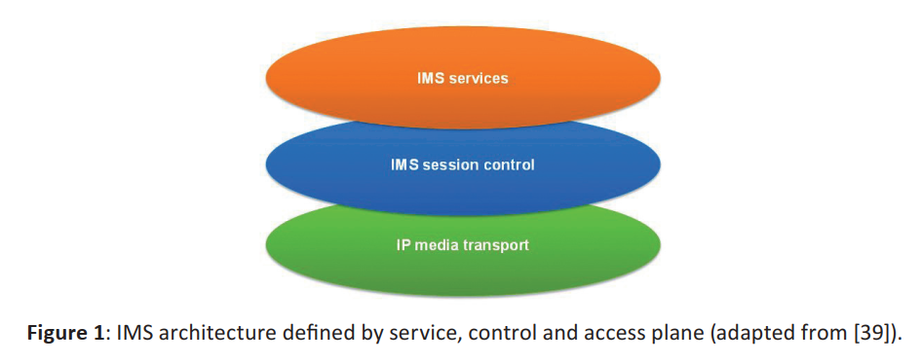
IMS based networks

Slide 21
Virtualization
According to ETSI, the NFV Architecture is composed of three key elements: Network Function Virtualization Infrastructure (NFVI), VNFs and NFV MANO:
The NFVI is the combination of both hardware and software resources which make up the environment in which VNFs are deployed. NFVI supports the execution of the VNFs. It represents standardized infrastructure abstraction layer to different virtualization technologies (e.g. KVM, VMware, Xen, Hyper-V, Docker).

Slide 22
Virtualization
Virtualized Network Function (VNF) is the software implementation of a network function that is capable of running over the NFVI.
NFV Management and Orchestration, which covers the orchestration and
lifecycle management of VNFs and resource reservation using NFVI interfaces.

Slide 23
Virtualization
Virtualization eliminates the dependency between a network function (NF) and its hardware, as seen in typical physical network appliances by creating
a standardised execution environment and management interfaces for the Virtualised
Network Functions (VNFs).
This results in the sharing of the physical hardware by multiple VNFs in the form of virtual machines (VM).

Slide 24
Virtualization
In the mobile network, i.e. Evolved Packet Core (EPC) and IP Multimedia System (IMS) NFs, potential candidates for virtualization can be a Mobility Management Entity (MME), a Serving and Packet Data Networks Gateway (S/P-GW), Call Session Control Functions (CSCFs), as well as Base Stations using different wireless standards.
The EPC and IMS NFs can be consolidated on the same hardware resource pool.
Virtualization of EPC as defined by ETSI [6] is shown in Figure 2.

Slide 25
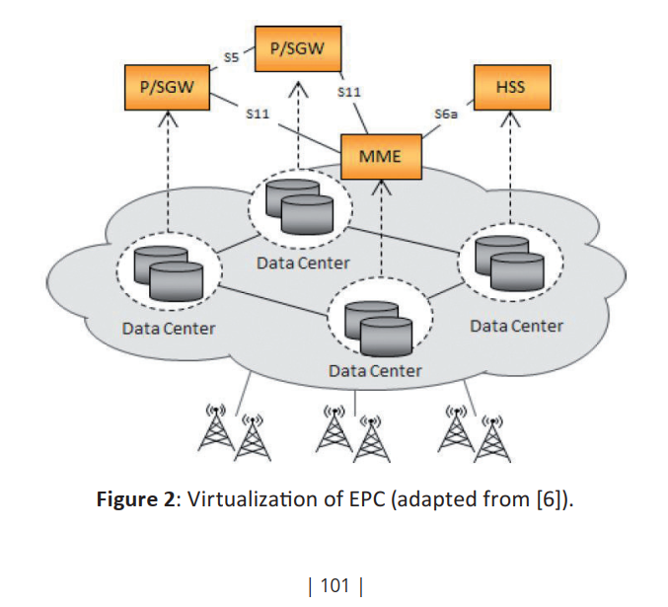
Fig 2
Notes:
ETSI文件定義EPC虛擬化的示意圖
ETSI GS NFV 001 P29

Slide 26
Suggestions for virtualization
Architecture
Cloud services platform(CSP)
IMS
Next generation core(EPC)
Cloud operating system
MANO(OpenBaton)
Storage platform(CEPH)
Monitoring
Notes:
虛擬化技術的相關建議

Slide 27
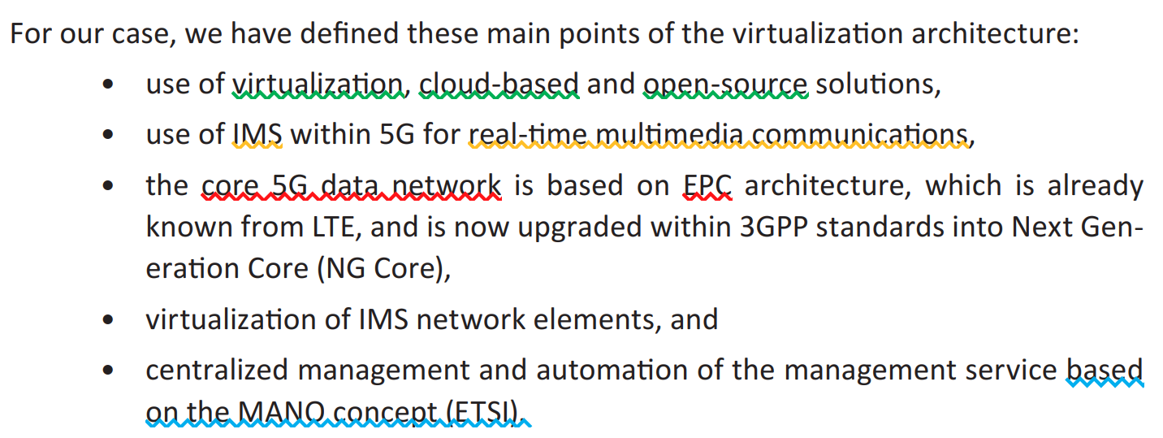
Architecture

Slide 28
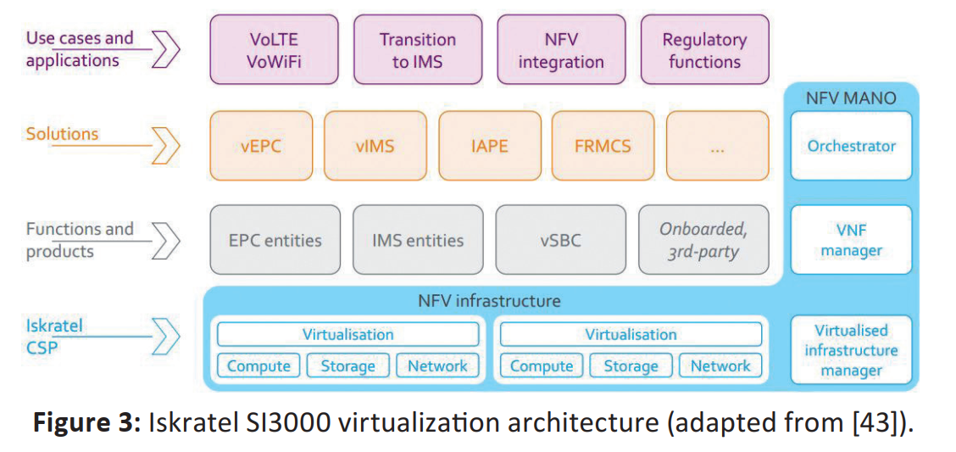
Fig 3
Notes:
不懂得abbreviation要去查,老師會問

Slide 29
Cloud services platform(CSP)
Cloud Services Platform (CSP) is Iskratel cloud-services platform that guarantees high availability and geo-redundancy of cloud services for different industry verticals on an open, ETSI NFV-compliant architecture. It enables grouping of services from different industry verticals into unique solutions.
The solution uses mature, OPNFV (Open Platform for NFV), approved opensource technology, enriched with Iskratel’s own extensions that provide high availability and low-latency operation.

Slide 30
Cloud services platform(CSP)
CSP is a flexible platform for hosting virtualized network functions (VNFs), virtualized legacy applications, and containers.
The platform is comprised of four building blocks:
NFVO (orchestrator for service lifecycle and service chaining), VNFM (VNF manager for
VNF lifecycle), VIM (Virtualized infrastructure manager), and NFVI (NFV infrastructure).

Slide 31
Cloud services platform(CSP)
The major open source components used in CSP are OpenStack, OpenBaton,and Ceph.
NFVO implemented in Iskratel’s CSP is based on OpenBaton with Iskratel extensions.
VNFM implemented in Iskratel’s CSP is based on OpenBaton’s VNFM with Iskratel extensions for carrier grade availability of VNFs.
For storage infrastructure, CephFS is used.

Slide 32
CSP NFVI
The NFVI (Network Function Virtualization Infrastructure) is a key component of ETSI NFV architecture.
It represents a set of computing, storage, and network resources which are used to build NFV solutions.
NFVI has implemented APIs for using resources which are provided by hardware or by a virtualization hypervisor.
It works with VNFs and Virtual Infrastructure Manager
(VIM) in collaboration with NFVO.
NFVI architecture in Iskratel’s CSP is based on OpenStack.

Slide 33
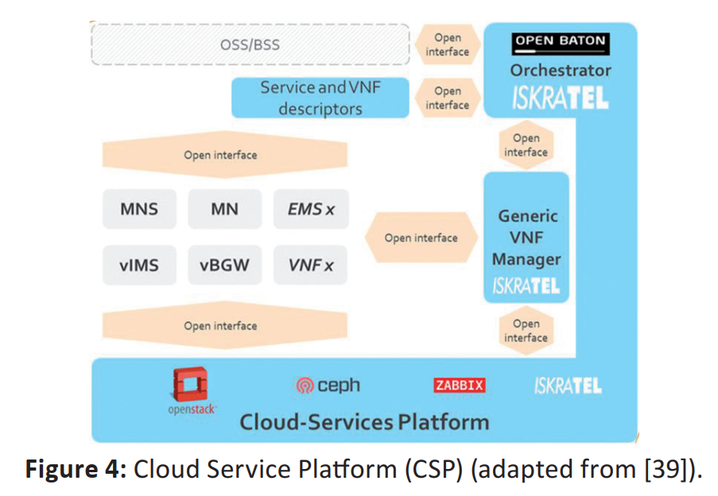
Fig 4
Notes:
不懂得abbreviation要去查,老師會問
BSS:Business support system 業務支撐系統
OSS:Operation support system 運營支撐系統

Slide 34
Cloud services platform(CSP)
The major CSP services are
the onboarding of VNFs, Management and Orchestration (MANO)
Network Connectivity of VNFs,
availability and reliability of NFVI,
support for High-Availability of VNFs,
diagnostics of NFVI and VNF cloud resources,
quality metrics of NFVI and VM resources for Orchestration and SLA supervision.

Slide 35
IMS
The Iskratel SI3000 vIMS solution includes the virtualization of all major IMS entities
according to the ETSI NFV Architecture.
These entities are vIMS TAS (Telephony Application Server), vIMS Core (including S-CSCF, I-CSCF, P-CSCF), vIMS Edge (including BGCF,MGCF, AGCF, RGCF, and MRFC), HSS, DNS/ENUM Server, and SBC.
All required functionalities for all virtualized vIMS network functions are ensured according to the standard ETSI NFV architecture, and they can be presented as Virtual Network Functions.
Notes:
不懂得abbreviation要去查,老師會問

Slide 36
IMS
In addition company based products, other 3rd party products are used.
The main 3rd party products are Open Stack (open source NFV IaaS platform), OpenBaton(open source implementation of NFV ETSI MANO orchestrator), Zabbix (open source NFV monitoring solution) and CepH (open source NFV storage platform) .

Slide 37
Next generation core(EPC)
EPC is deployed on Cloud Service Platform (CSP).
In the employment of EPC as VNF in the Cloud, some challenges have appeared.
The first key issue is performance.
There is a performance cost of virtualization that can be problematic for UP functions,like SGW and PGW. The solution relies on Intel’s Data Plane Development Kit (DPDK)
that increases and optimizes packet processing per second.

Slide 38
Next generation core(EPC)
Latency is another issue with the virtualization that affects MME, which requires tight time limitations to respond to procedures towards the access network and device.

Slide 39
Cloud operating system (Openstack)
OpenStack is a cloud operating system that controls large pools of computing, storage, and networking resources within a given data centre. All these pools are managed through a dashboard that gives administrators control while enabling their users to provision resources through a web interface.
OpenStack enables multiple datacentre management from a single screen, complete with common
security, identity services, APIs, and user interfaces.
The open, modular and interoperable framework of the OpenStack project offers telecoms and enterprises the ability to design the NFV system of their choosing, without unnecessary components.

Slide 40
MANO(OpenBaton)
Management and Orchestration (MANO) service covers the orchestration and lifecycle management of resources that support the infrastructure virtualization and the lifecycle management of VNFs.
it has three main functional blocks: NFV orchestrators, VNF managers and virtualized infrastructure managers (VIMs).
Open Baton is an ETSI NFV MANO compliant framework, which can be used for the management and orchestration of NFV environments.
In SI3000 CSP it is integrated with OpenStack’s VIM and is primarily used as VNFM and NFVO.

Slide 41
MANO(OpenBaton)
The main components of CSP MANO
VNFMs (Virtual Network
Function Element Managers)
EMs (Element Managers) FMS (Fault Monitoring System)
PQMS (Performance and Quality Monitoring System)

Slide 42
MANO(OpenBaton)
The advantage in the case of CSP is that the same NFVI infrastructure for NFV ready systems and legacy systems (LNFV) is implemented. NFV demands are too complex for legacy systems, and the possibility of orchestrating legacy systems depends on legacy system implementation itself.

Slide 43
Storage platform(CEPH)
Ceph is an open source storage platform implemented on a single distributed computer cluster, providing interfaces for an object, block and file-level storage.
Ceph primarily aims for completely distributed operation without a single point of failure scalable to the exabyte level.
Ceph replicates data and makes it fault tolerant using
commodity hardware and requiring no specific hardware support.

Slide 44
Storage platform(CEPH)
As a result of its design, the system is self-healing and a self-managing, aiming to minimize administration
time and other costs.
In SI3000 CSP it is used for all three types of storage and is also intended for DBaaS solutions.

Slide 45
Monitoring
To supervise the cloud operation and the SLA of services hosted in the cloud, CSP according to ETSI NFV recommendations supports the monitoring and collection of different quality metrics.
Monitoring availability and performances of infrastructure are done by Zabbix.
It automatically discovers network servers and devices.
Zabbix is configured with many templates and provides several methods for collecting performance and availability information from monitored infrastructure.

Slide 46
DISCUSSION
Current status
Main issues for the furture

Slide 47
Current status
The solution based on the SI3000 product line is in step with other current solutions used for the transition of the networks toward 5G.
The main technologies needed in such a transition are virtualization with NFV, OpenStack, and MANO.
Virtualization and NFV are poised to change the core structure of telecommunications infrastructure to be more cost-efficient .

Slide 48
Current status
OpenStack has become the de facto standard for cloud-based solutions.
The role of NFV MANO functionality is to control the entire life cycle of such services, from instantiation and configuration to monitoring,
migrating, scaling and, terminating them.

Slide 49
Main issues for the future
These main issues are the use of containers, placement, automation, and
communication improvements and scalability issues.

Slide 50
The use of containers
[32] presents a benchmarking case study on two alternatives, production-grade virtualization solutions, namely VMware ESXi/vSphere (hypervisor-based) and Linux/Docker (container-based), on which they deploy an NFV-oriented IMS system.
Their experiments suggest that the container-based configuration can be less dependable than the
hypervisor-based one.

Slide 51
The use of containers
A proposal for using microservices is also given in [17].
As proposed by the Open Container Initiative [30], it is expected that the use of containers will
have an ever-increasing impact, which raises questions regarding which applications
will not be suitable for using microservices.

Slide 52
Placement, Automation & communication improvements
Placement improvement makes it possible to better utilize the equipment, which is very
interesting in the case of large-scale environments [29].
Automation improvement with
the automation of Network Function Virtualization is proposed in [25].
With communication improvements, as suggested in [31], communication efficiency improves.

Slide 53
Scalability
For the future, scaling is a vital issue.
[27] proposes, in addition to the default deployment methods provided in OpenStack, an additional policy of scaling, which needs to be improved. Improving the utilization of cloud platform for deploying service function chaining is suggested.
A similar proposal was also proposed in [26]. Suggestions for IMS scalability improvement using virtualization are also proposed in [15], [26] and [14].

Slide 54
Conclusion
In this article, we have examined the issues, dilemmas, and suggestions when moving
toward 5G networks. We showed how virtually all the elements of the existing IMS network can be virtualized and as such prepared for any cloud-based hardware. This is valid
for elements of the IMS core and for the edge of such a network. Such a system can be
integrated into the 5G telecommunication system.

Slide 55
Conclusion
We have shown that virtualization is a significant issue, with many challenges.
Some of the main solutions are clearly visible, such as the use of OpenStack and OpenBaton.
There are, however, also many minor dilemmas. Such dilemmas are issues of scalability and the dynamic management of orchestration.
For a wider use of 5G there is still some time, and by that time all these matters should be clarified, elaborated, and resolved.

Slide 56
參考文獻
Open Platform for NFV (OPNFV): Open Platform for NFV Project. www.opnfv.org
Open Orchestrator. https://www.onap.org/
OpenBaton. www.openbaton.org
CepH. www.ceph.com
Zabbix. www.zabbix.com
Diameter https://ribboncommunications.com/company/get-help/glossary/diameter-protocol
Open Container Initiative:opencontainers.org

