Slide 1
PP5GS—An Efficient Procedure-Based and Stateless Architecture for Next-Generation Core Networks
Endri Goshi , Raffael Stahl, Hasanin Harkous,
MuHe, Rastin Pries, Wolfgang Kellerer
IEEE TRANSACTIONS ON NETWORK AND SERVICE MANAGEMENT, VOL. 20, NO. 3, SEPTEMBER 2023
IF = 5.3

Slide 2
Outline
Abstract
Background
  5G Core & SBA
  State Management in 5GC
  Free5GC
  Cloud-Native Orchestration
System Design and Implementation
  Stateless Free5GC
  Per-Procedure Network Functions
  (Procedure-based Functional Decomposition for 5G Core Network Functions)
Performance Evaluation
  Testbed and Measurement Setup
  Performance Compare
  Performance Evaluation for Edge Offloading Scenarios
Conclusions

Slide 3
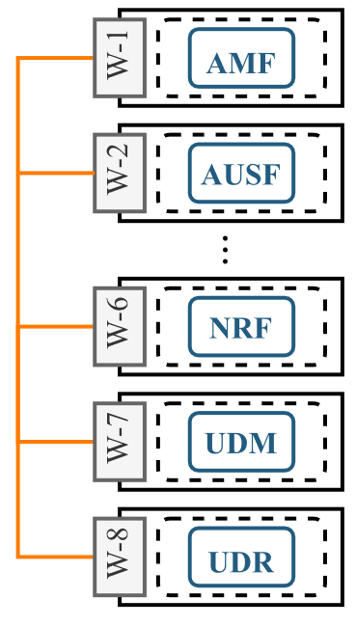
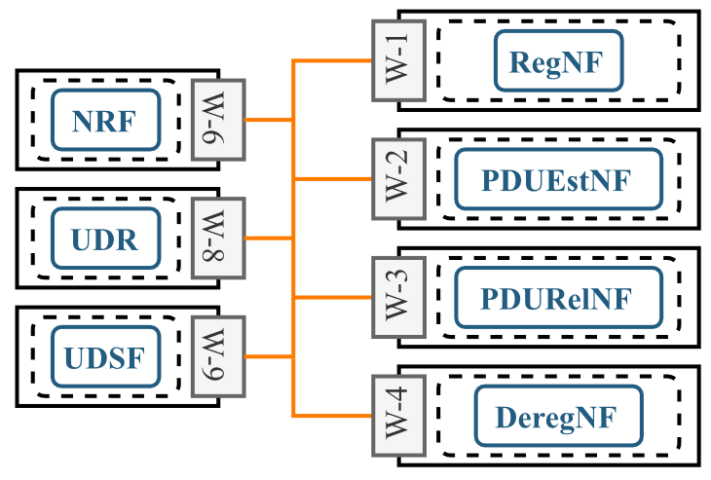
Abstract
The high degree of functional decomposition in SBA has implications in terms of increased inter-NF signaling traffic during the execution of control plane procedures, as well as an increased complexity in orchestrating a system with tight inter-NF dependencies.
In this work, we introduce PP5GS as a stateless 5G Core architecture that implements a procedure-based functional decomposition of the 5G Core NFs.
We develop Per-Procedure NFs for four different control plane procedures and perform extensive evaluations in a private cloud environment orchestrated with Kubernetes.
The results show that PP5GS requires up to 34% and 55% less computing resources compared to the baseline stateful and stateless systems, respectively, while generating at least 40% less signaling traffic. Moreover, complex control plane procedures can complete up to 50% faster. Lastly, the results show that PP5GS is a more feasible architecture in leveraging edge-offloading of 5G Core NFs.
Notes:
因為SBA的設計方式會導致NF之間溝通的訊號流量。並且在編排上也會因為NF之間的依賴關係，導致系統的複雜性增加。這些都是SBA的缺點。
所以在這篇論文中，作者將會介紹PP5GS，一個stateless的5G 核心網路架構。並且作者以四個最主要的control plane procedure設計新的NF，最後使用K8s進行廣泛的評估。
結果顯示，與baseline stateful或修改後stateless的5GC相比，PP5GS可以分別節省34%與55%的計算資源，同時訊號流量減少40%。並且control plane的完成速度可以加快50%。最後，相較於傳統設計，PP5GS設計也對於edge-offloading更加可行。

Slide 4
Outline
Abstract
Background
  5G Core & SBA
  State Management in 5GC
  Free5GC
  Cloud-Native Orchestration
System Design and Implementation
  Stateless Free5GC
  Per-Procedure Network Functions
  (Procedure-based Functional Decomposition for 5G Core Network Functions)
Performance Evaluation
  Testbed and Measurement Setup
  Performance Compare
  Performance Evaluation for Edge Offloading Scenarios
Conclusions

Slide 5
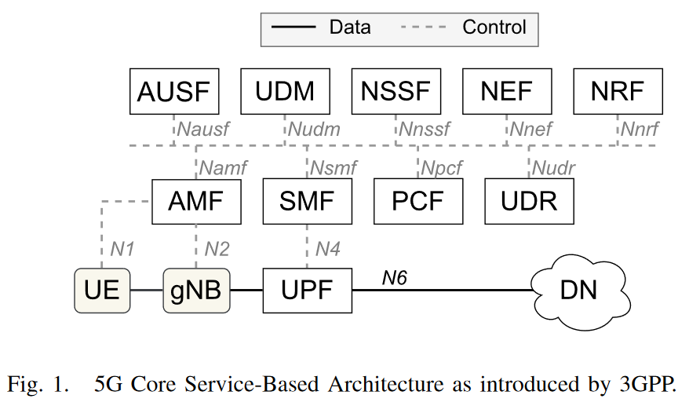
Background -
A. 5GC & SBA
Starting with 3G, the mobile networks are separated in two main parts, namely:
  Access Network (AN)
  Core Network (CN)
In EPC, the number of NFs was small and point-to-point interfaces were implemented for the communication between them.
The major changes in designing and operating 5GC are empowered by the introduction of the cloud-native paradigm in this domain.
These architectural principles led to the introduction of the 5G Service-Based Architecture (SBA), shown in Fig. 1.
Notes:
首先介紹5GC與SBA的設計
從3G開始，網路拆成兩個主要的部份。一個是AN，一個是CN。我之前研究的ORAN就是屬於AN的領域，而這篇論文以及作者實驗是在做的就是CN的領域。
以往在4G EPC 中，NF之間是透過point-to-point的介面互相溝通。到了5G，核心網路引進了cloud-native的設計模式。
這種架構原則使5G引入了SBA的設計，也就是Service-Based Architecture (SBA), 如圖一。

Slide 6
Background -
A. 5GC & SBA
To address inter-NF communication mechanisms, Service-Based Interfaces (SBIs) are introduced for the inter-NF communication.
Similar to the microservice architecture, SBI is a concept borrowed from the IT applications domain. The main idea behind it is that each 5GC NFs exposes its services through REST interfaces that are defined in standardized OpenAPI descriptions.
During start-up, the NFs register their services to the NRF, where other NFs can discover and consume them by sending HTTP/2 requests.
Notes:
為了解決SBA下各個NF之間溝通的需求，因此有了SBI的設計。
類似於微服務架構，SBI是從IT應用領域借來的概念。它背後最主要的概念是，每個 5GC NF 都通過 OpenAPI 標準所描述定義的 REST 介面公開其服務。
在啟動期間，NF 會將自己的服務 註冊 到 NRF，而其他 NF 可以通過發送 HTTP/2 請求給NRF來發現和使用它們。

Slide 7
Background -
B. State Management in 5GC
A stateful application maintains locally the necessary context for its correct operation. In case the application crashes or is terminated, the information is lost and hence, affects directly the offered services.
Therefore, the absence of guaranteed liveliness for a given instance makes the deployment of stateful applications unfeasible.
A stateless application is designed by separating the processing logic from the state database (DB).
When the application needs context information, it queries the DB and upon finishing the processing, it updates the information in the DB.
Stateless services can be scaled-out when the input load increases, as processing is not bound to any specific instance.
Aiming to support stateless deployments of 5GC, 3GPP introduced the Unstructured Data Storage Function (UDSF) to be used as a state DB.
Notes:
第二個背景介紹一下5gc中的state概念
一個stateful的application會在本地維護其所需的context。如果這個應用崩潰或終止，他所保存的context將丟失，從而影響到他所提供的服務。
因為無法保證安全，所以部屬stateful app 在一些場景下是不可行的。
而一個stateless app會將狀態context儲存到遠端的DB中，
當應用程式需要context 資訊時，它會查詢資料庫，並在完成處理後更新資料庫中的資訊。
如果input 負載增加時，可以隨意橫向擴展Stateless 服務，因為處理或是說資料不綁定到任何特定instance 。
回到5GC，為了支援5GC的Stateless 部署，3GPP引入了Unstructured Data Storage Function (UDSF)作為狀態資料庫。這篇論文中作者也有實作出一個UDSF，在後面會做介紹

Slide 8
Background -
C. Free5GC
The Free5GC system offers:
  Control plane NFs including AMF, SMF, AUSF, NRF, NSSF, Policy Control Function (PCF), Unified Data Management (UDM) and Unified Data Repository (UDR);
  A softwarized User Plane Function (UPF).
Alongside the NFs mentioned above, a MongoDB instance is deployed. It serves as a backend database for NRF and UDR to store NF-related and UE-related information such as policy data, authentication keys, authentications status, etc.
However, its purpose is not to enable any form of stateless deployment for the control plane NFs. The UE context and the NFs’ self-context is still maintained locally.
Notes:
第三個背景: 快速介紹Free5gc
Free5GC提供了…
除了上述 NF 之外，在安裝過程中還會部署 MongoDB instance 。 它作為NRF和UDR的後端資料庫，儲存NF相關和UE相關的訊息，例如policy data, authentication keys, authentications status等等。
然而，其目的並不是為control plane NF 啟用 Stateless 部署。 Uecontext 和 NF 的 context 仍然在各自的 local中維護。

Slide 9
Background -
D. Cloud-Native Orchestration
The monolithic architecture poses some major drawbacks, such as:
  Applications may become too large and complex thus affecting the start-up time.
  Difficulties in scaling because different modules may have conflicting resource requirements.
  Difficulties in adopting new technologies as changes in languages or frameworks will affect the entire application.
Therefore, at the core of cloud-native deployments, resides the concept of microservices.
However, microservice applications can quickly become too complex to orchestrate and manage as more instances are deployed to handle the incoming load or provide additional features.
Therefore, containerized workloads and services are generally managed through container orchestration tools.
Notes:
第四個介紹cloud native的 orchestration
傳統的單體架構存在一些主要缺點，例如：
應用 procedure 可能會變得太大和複雜，從而影響啟動時間。
擴展困難，因為不同的模組可能具有衝突的資源需求。
由於語言或框架的變化，採用新技術的困難將影響整個應用 procedure 。
因此cloud native的核心其實是微服務的概念。
但是，隨著部署越來越多的微服務應用來處理傳入流量或提供其他功能，這些微服務應用 procedure 可能很快就會變得過於複雜，難以編排和管理。
因此，容器化的workloads和service通常通過container orchestration tools進行管理，現在常見的就是K8s

Slide 10
Outline
Abstract
Background
  5G Core & SBA
  State Management in 5GC
  Free5GC
  Cloud-Native Orchestration
System Design and Implementation
  Stateless Free5GC
  Per-Procedure Network Functions
  (Procedure-based Functional Decomposition for 5G Core Network Functions)
Performance Evaluation
  Testbed and Measurement Setup
  Performance Compare
  Performance Evaluation for Edge Offloading Scenarios
Conclusions
Notes:
接下來介紹作者實作出PP5GS的設計與過程
需要兩個步驟，第一個步驟是將stateful 的 free5gc改成 stateless 的 Free5GC
接著才是將NF拆解，接著合併成PPNF

Slide 11
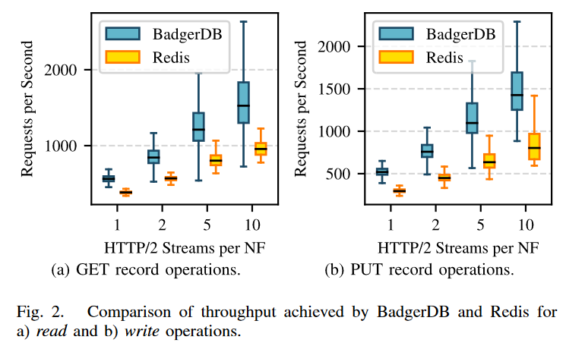
System Design and Implementation -
Stateless Free5GC
3GPP Release 15 includes a specification for the Unstructured Data Storage Function (UDSF) which exposes a data repository service that accepts arbitrary formed binary payloads.
For ease of implementation, we choose to serialize the application state in the JSON text format.
Being unstructured, UDSF’s implementation is backed by a key-value database.
Fig. 2 shows a benchmark where we compared the two implementations over a wide range of payloads sampled from the different client NFs.
Therefore, we deploy a single UDSF instance with BadgerDB as backend database.
Notes:
第一個步驟是將stateful 的 free5gc改成 stateless 的 Free5GC
在3GPP 官方 release 15 的spec中有定義一個叫Unstructured Data Storage Function (UDSF) 的規格，這個NF是一個data repository ，接受任何形式的binary資料。(有格式的叫做Unified Data Repository (UDR))
為了便於實現，作者選擇以 JSON 文字格式序列化紀錄 procedure 狀態。
由於是非結構化的，所以UDSF 的實現是由key-value資料庫所實作。
圖 2是一個benchmark測試，作者比較Redis與badgerDB兩種資料庫的性能。結果顯示逐步增加的輸入流量下，badgerDB可以擁有較高的讀寫操作。
因此，作者選擇部署一個BadgerDB 作為後端資料庫 作為 UDSF instance 。

Slide 12
System Design and Implementation -
Stateless Free5GC
In addition, some of the 5GC NFs need to be modified to enable statelessness.
NRF and UDR reuse the already existing MongoDB connection to store subscriptions and do not require modifications.
NSSF does not store any UE-specific application state.
For the AMF, many small NGAP messages are exchanged in quick succession per procedure, and therefore, procedural statelessness is a reasonable choice.
AUSF, PCF, SMF, and UDM, we implement transactional statelessness from the perspective of the HTTP API.
In SMF, the transactional statelessness also covers any communication with the UPF as part of the request.
Notes:
有了UDSF之後，一些 5GC NF 需要修改以啟用stateless。
在 Free5GC 中，NRF 和 UDR 因為使用現有的 MongoDB 來儲存訂閱資料，因此這兩個NF不需要做修改。
NSSF 本身就不儲存UE-specific application state。
對於AMF，因為它參與的每個procedure都會快速連續交換許多小的NGAP msg，因此，procedural statelessness是一個合理的選擇。
AUSF、PCF、SMF 和 UDM，作者從 HTTP API 的角度實現transactional stateless 。
此外在SMF中，transactional stateless還包括與UPF的任何communication。

Slide 13
System Design and Implementation -
Per-Procedure Network Functions
Procedure-based Functional Decomposition for 5G Core Network Functions
Endri Goshi, Raffael Stahl, Mu He, Rastin Pries, Wolfgang Kellerer
April 2022
Conference: 3. KuVS Fachgespräch "Network Softwarization"
Notes:
將5gc改成stateless後，下一步就是拆解5gc

Slide 14
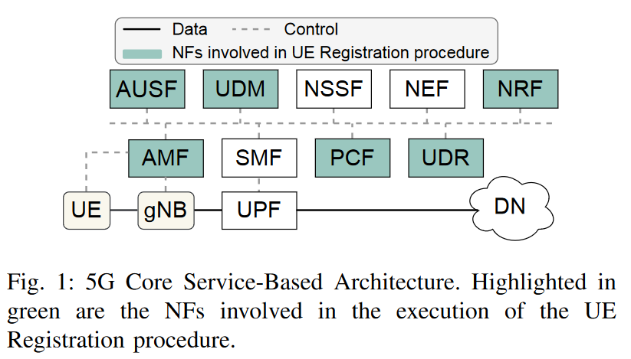
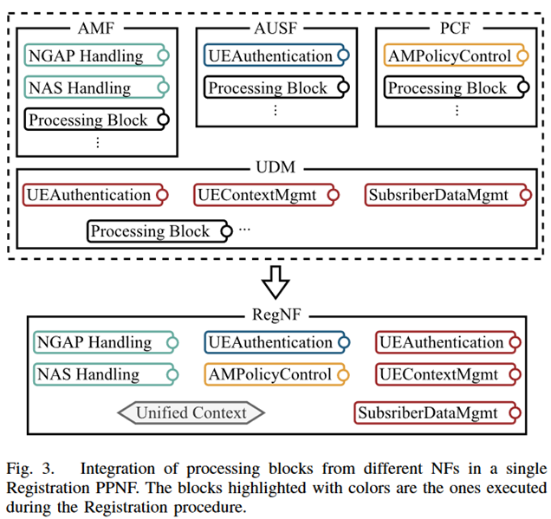
System Design and Implementation -
Per-Procedure Network Functions
Overall, the adoption of SBA leads to the following issues:
  High volume of CP traffic
  More complex orchestration
First, we identify the NFs that take part in the execution of different CP procedures, e.g., UE Registration as highlighted in Fig. 1.
Next, we identify the function blocks within these NFs that are triggered during the execution of the given procedure.
To identify the blocks in AUSF and PCF that are called during the registration procedure, we look at the generated HTTP requests and their destination SBIs.
These blocks are then implemented in a single NF (e.g., RegistrationNF) that will solely serve a given procedure.
In RegistrationNF, AMF is the entry point of traffic coming from the RAN to the core. Therefore, we use it as a base NF and extend it with some functional blocks of AUSF and PCF.
Notes:
整體而言，採用 SBA 導致以下問題：
1. 大量 CP 流量
2. 更複雜的協調
所以作者設計了Per-Procedure Network Functions來解決這些問題
首先，作者識別參與不同 CP procedure執行的 NF（例如，如圖1所示的 UE Registration ）。
接下來，作者識別這些 NF 內的功能 block ，在給定procedure的執行期間被觸發。
為了識別在Registration procedure期間調用的 AUSF 和 PCF 中的 block ，作者查看生成的 HTTP 請求及其目的地 SBI。
然後，這些 block 被實現在單個 NF 中（例如，RegistrationNF），它將僅服務於特定procedure。
在 RegistrationNF 中，AMF 是來自 RAN 到核心的流量的入口點。因此，作者將其當作基本 NF，並通過添加一些 AUSF 和 PCF 的功能 block 來擴展它。

Slide 15
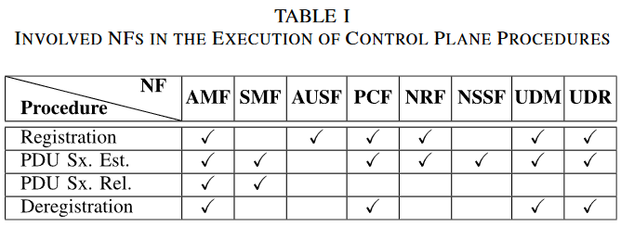
System Design and Implementation -
Per-Procedure Network Functions
In Table I, the involved NFs in each of the considered control plane procedures are shown.
The Registration and PDU Session Establishment procedures trigger complex Service Function Chains (SFCs) where 6 and 7 NFs are involved, respectively.
On the other hand, the PDU Session Release and Deregistration procedures rely less on inter-NF communication and the logic is concentrated in fewer NFs.
Due to their functions as service-discovery mechanisms or database abstraction layers, we do not integrate NRF, UDR and UDSF in the new PPNFs.
We develop PP5GS using Free5GC v3.0.6.
Notes:
在表格 I 中，顯示了四個 control plane procedure 中所涉及的 NF。
Registration 和 PDU Session 建立 的procedure觸發了較複雜的服務功能鏈（SFCs），分別涉及 6 和 7 個 NF。
而PDU Session Release 和 Deregistration procedure則較少依賴 NF 之間的通信，並且邏輯集中在較少的 NF 中。
由於它們作為服務發現機制或數據庫抽象層的功能，作者不會將NRF、UDR 和 UDSF納入重構。
接著，作者使用 Free5GC v3.0.6 開發 PP5GS。

Slide 16

System Design and Implementation -
Per-Procedure Network Functions
For example, the sourcecode of the NF serving Registration procedure (RegNF) only contains logic that in an SBA system is distributed among AMF, AUSF, PCF and UDM.
Next, each processing block that is executed during the given procedure needs to be identified.
To achieve this, we track the requests that are initiated inside 5GC and leverage the SBIs that the involved NFs expose through their HTTP/REST server.
By inspecting the inter-NF traffic that is generated in 5GC, it is possible to extract the URI information of the destination endpoints for each request, leading us to their callback functions.
Notes:
繼續以（RegNF）為例， Registration procedure的 source code 包含在 AMF、AUSF、PCF 和 UDM 之中。接下來，需要識別在給定procedure期間執行的每個處理 block 。
為了實現這一目標，作者trace在 5GC 內部發起的請求，並利用相應的 NF 通過其 HTTP/REST 服務器公開的 SBIs。
通過檢查在 5GC 中生成的 NF 之間的流量，可以提取每個請求的目標endpoint的 URI 信息，從而引導作者找到它們的 callback function 。

Slide 17
System Design and Implementation -
Per-Procedure Network Functions
In the integration phase, AMF is considered as the base NF and its functionalities are extended with the other processing blocks. To better understand the architecture of PPNFs, we refer the reader to Fig. 3 where RegNF is shown.
Each of the highlighted processing blocks do not represent a single callback function, but rather a logical group of functions.
RegNF retains the AMF’s NG Application Protocol (NGAP) and Non-Access Stratum (NAS) communication handling logic necessary to process the packets coming from UE and gNB, and in addition the following endpoints are integrated:
  /nausf-auth is migrated from AUSF,
  /npcf-am-policy-control is migrated from PCF, and
  some functions from the /nudm-ueau, /nudm-uecm and /nudm-sdm are migrated from UDM.
Notes:
整理出每個block後，在整合階段，AMF 被視為基礎 NF，它會透過併入其他的功能block來進行擴展。 為了更能理解 PPNF 的架構，可以參考圖 3，其中顯示了 RegNF。
每個突出顯示的處理區 block 並不代表單一個函數，而是一組邏輯函數。
RegNF 保留了處理來自 UE 和 gNB 的資料包所需的 AMF NG Application Protocol (NGAP)和Non-Access Stratum (NAS) communication handling logic ，此外還整合了以下端點：
/nausf-auth 是從 AUSF 遷移而來的，
/npcf-am-policy-control 是從 PCF 遷移的，並且
/nudm-ueau、/nudm-uecm 和 /nudm-sdm 中的一些功能是從 UDM 遷移的。

Slide 18
System Design and Implementation -
Per-Procedure Network Functions
Once a PPNF finishes serving a procedure, it serializes the UE context and state and sends it to UDSF which maintains the latest versions. The local context is deleted to avoid wasting memory resources unnecessarily. When a following procedure is initiated, the responsible PPNF queries the information from UDSF before proceeding to serve the request.
Using the methodology described above, in this work we have successfully developed RegNF, PDUEstNF, PDURelNF and DeregNF
Notes:
一旦 PPNF 完成procedure，它就會序列化 UE context 和狀態，並將其傳送到維護最新版本的 UDSF。 並且刪除本地context，避免不必要地浪費記憶體資源。 如果接下來還有要執行的procedure 時，負責的 PPNF 在繼續服務請求之前從 UDSF 查詢資訊。
使用上述方法，在這項工作中，作者開發了 RegNF、PDUestNF、PDUrelNF 和 DeregNF

Slide 19
Outline
Abstract
Background
  5G Core & SBA
  State Management in 5GC
  Free5GC
  Cloud-Native Orchestration
System Design and Implementation
  Stateless Free5GC
  Per-Procedure Network Functions
  (Procedure-based Functional Decomposition for 5G Core Network Functions)
Performance Evaluation
  Testbed and Measurement Setup
  Performance Compare
  Performance Evaluation for Edge Offloading Scenarios
Conclusions
Notes:
接下來是效能評估的部分，總共分成三個小節
第一節介紹測試環境與確認UE Emulator 可以達到實驗所需的性能
第二節開始比較CPU使用率、procedure完成時間，以及NF之間 cp 流量的比較
第三節會評估將NF放置到edge端的性能表現

Slide 20
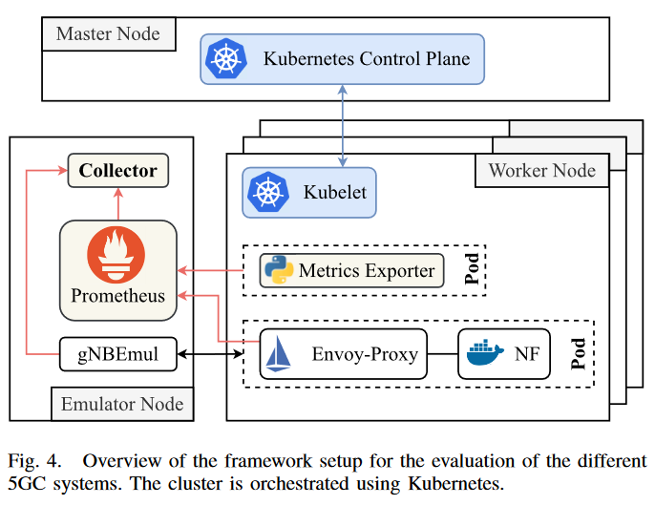
Performance Evaluation -
Measurement Setup and Emulator Performance
As shown in Fig. 4, we set up a testbed composed of 11 bare-metal nodes (machines) and use Kubernetes as the orchestration tool.
In this testbed we distinguish between three types of nodes:
  Master Node
  5GC Worker
  Emulator Node
Notes:
如圖4所示，作者建立了一個由11個node（機器）組成的testbed ，並使用Kubernetes作為編排工具。
在此testbed 中有三種類型的節點：
Master Node
5GC Worker
Emulator Node

Slide 21
Performance Evaluation -
Measurement Setup and Emulator Performance
Master Node
  It is responsible only for running the K8s control plane and orchestrating the deployment of 5GC systems. No additional workload is scheduled on this node.
5GC Worker Node
Emulator Node
Notes:
Master node: 它只負責運行K8s cp， 並協調5GC系統的部署。 該節點上沒有安排額外的工作負載。

Slide 22
Performance Evaluation -
Measurement Setup and Emulator Performance
Master Node
5GC Worker Node
  The considered deployments consist of at most 9 control plane NFs, thus we deploy 9 worker nodes in the cluster.
  In addition to the 5GC NFs, an Envoy-Proxy instance is deployed as a sidecar container as part of Istio service-mesh. It facilitates traffic routing and management and allows for some metrics collection as well.
Emulator Node
Notes:
5GC Worker Node: 考慮到後續實驗最多需部屬 9 個cp NF，因此作者在cluster 中部署 9 個工作節點。
除了 5GC NF 之外，Envoy-Proxy instance 還部署為邊車容器，作為 Istio service-mesh 的一部分。 它有助於流量路由和管理，並允許收集一些指標

Slide 23
Performance Evaluation -
Measurement Setup and Emulator Performance
Master Node
5GC Worker Node
Emulator Node
  This node is used to host the gNB & UE Emulator (gNBEmu) application.
  We develop this application for the purpose of generating scalable control plane traffic, and evaluate the performance of the 5G systems.
  Additionally, it hosts Prometheus and Collector instances which are necessary for the measurements setup.
Notes:
Emulator Node: 此節點用於託管 gNB 和 UE Emulator (gNBEmu) 應用 procedure 。
作者開發gNBEmu的目的是產生可調整的cp 流量，並評估 5G 系統的效能。
此外，它也運行測量設定所需的 Prometheus 和 Collector instance 。

Slide 24
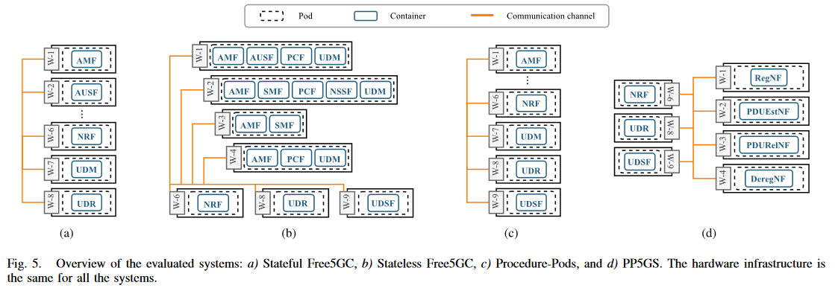
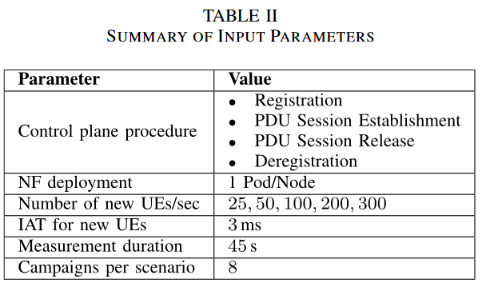
Performance Evaluation -
Measurement Setup and Emulator Performance
For the purpose of evaluating the improvements that PP5GS brings, we consider the following Systems Under Test (SUTs).
In Table II, we summarize the input parameters used during the evaluation.
c)
b)
Notes:
為了評估 PP5GS 帶來的改進，在接下來的實驗中，就會以以下這四個的Systems Under Test (SUT) 作為實驗對象。
表二則是作者總結了評估期間使用的input參數。

Slide 25
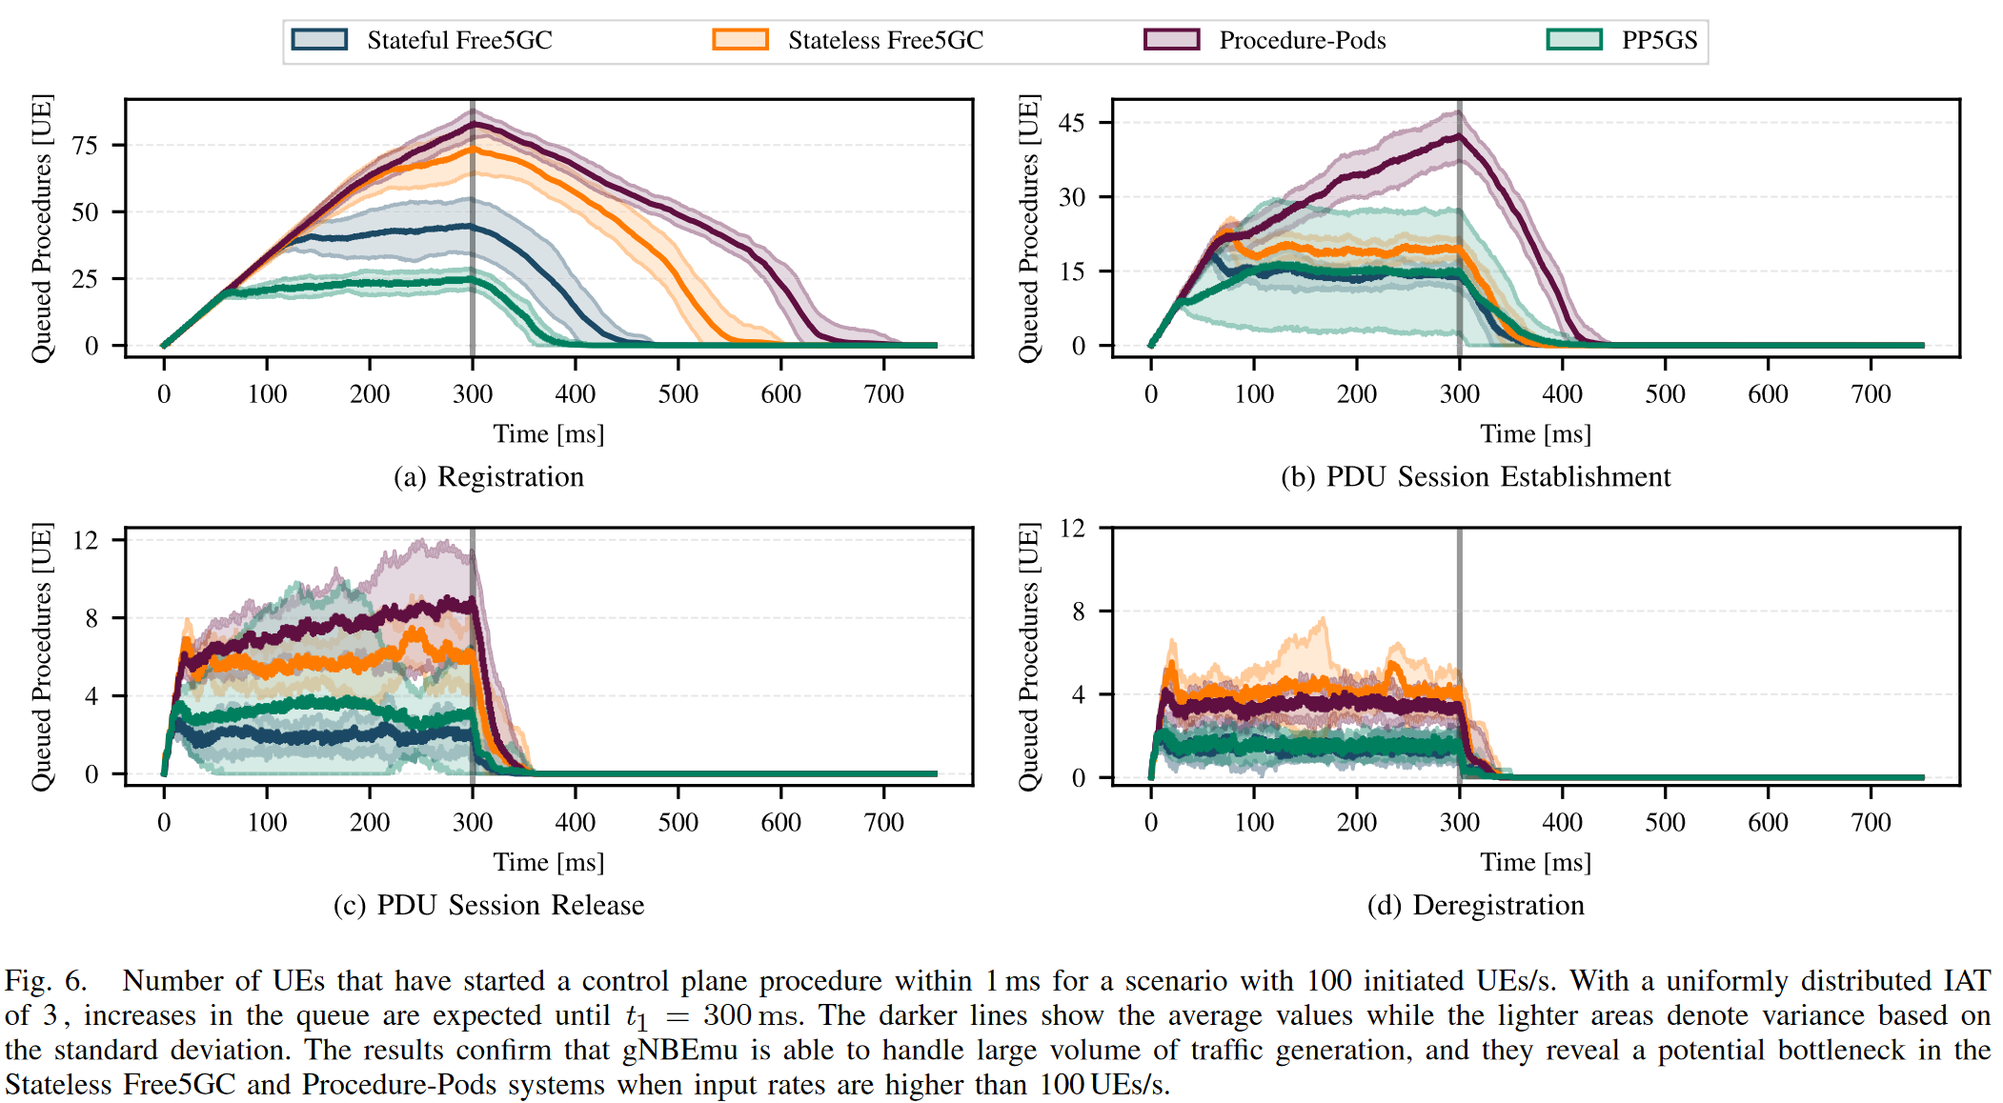
Performance Evaluation -
Measurement Setup and Emulator Performance
We first assess the performance of gNBEmu to confirm that it can indeed generate traffic according to its configuration file description.
In Fig. 6 we show the average number of queued procedures (UEs) in the system within the 1 s interval for all the considered control plane procedures.
we observe that the Registration procedure (shown in Fig. 6a) exhibits the highest number of queued UEs for all the systems. This is expected as it is the most complex procedure in terms of inter-NF communication, hence taking more time to finish each execution.
Nonetheless, the gNBEmu correctly initiates new procedures in accordance with the traffic model and starting from t1 = 300 ms the number of queued UEs drops (i.e., there are no new procedures initialized after this point).
Notes:
作者首先評估 gNBEmu 的效能，以確認它確實可以根據其設定檔描述產生流量。
在圖 6 中，作者顯示了所有考慮的cp procedure ，以 1 秒為間隔，排隊procedure (UE) 的平均數量。
作者觀察到，Registration procedure （如圖 6a 所示）是所有系統中排隊 UE 數量最多的。 這是預料之中的事，因為它是 NF 間通訊中最複雜的procedure ，因此需要更多時間來完成執行。
不管怎樣，都可以確認gNBEmu 有根據參數設定正確啟動，並且從 t1 = 300 ms 開始，排隊的 UE 數量下降（即，此後沒有初始化新procedure ）。

Slide 26
Performance Evaluation -
Measurement Setup and Emulator Performance
Overall, PP5GS exhibits the lowest number of queued UEs in the system for three out of four procedures.
Only in the PDU Session Release shown in Fig. 6c, we observe that Stateful Free5GC outperforms PP5GS.
On the other hand, Stateless Free5GC and Procedure-Pods exhibit poorer performance, especially in the case of the Registration procedure.
Notes:
再進一步分析這些結果，
整體而言，對於四分之三的procedure ，PP5GS 展現了系統中排隊 UE 數量最少的情況。
僅在圖 6c 所示的 PDU Session Release 中，作者觀察到Stateful Free5GC 優於 PP5GS。
另一方面，Stateless Free5GC 和 procedure-Pods 表現出較差的性能，特別是在Registration procedure 的情況下。

Slide 27
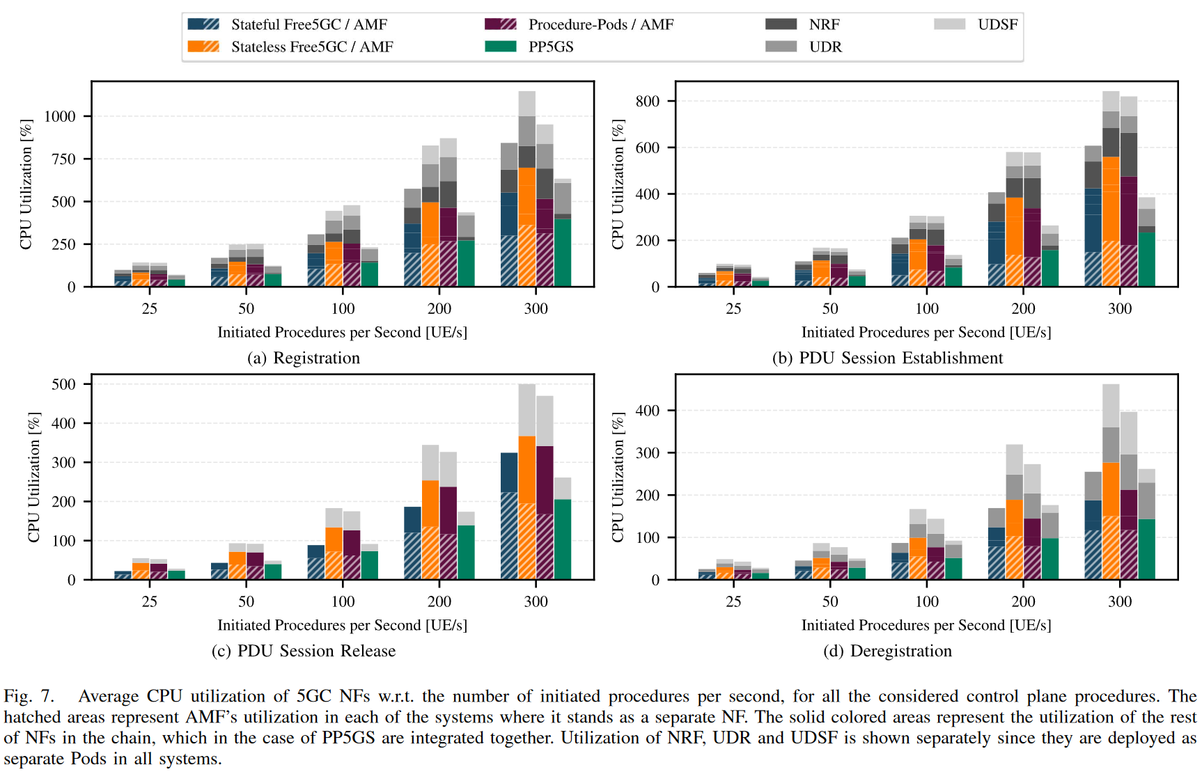
Performance Evaluation -
Performance Compare
CPU Utilization:
For the Registration procedure, on average it requires 26% and 42% less resources compared to Stateful Free5GC and Stateless Free5GC respectively.
The efficiency increases further during PDU Session Establishment Procedure, with an improvement of 34% compared to Stateful Free5GC and 55% compared to Stateless Free5GC.
For the less complex procedures, PP5GS compared to Stateless Free5GC, ∼45% less resources are required for both procedures.
Notes:
接下來就開始實驗比較，第一個比較CPU的使用率：
就Registration procedure來說 ，與Stateful Free5GC 和Stateless Free5GC 相比，PP5GS平均所需的資源分別減少 26% 和 42%。
PDUSession 建立 procedure 中的效率進一步提高，與Stateful Free5GC相比提高了34%，與Stateless Free5GC相比提高了55%。
對於不太複雜的流程，PP5GS 與Stateless Free5GC 相比，所需的資源減少了約 45%。

Slide 28
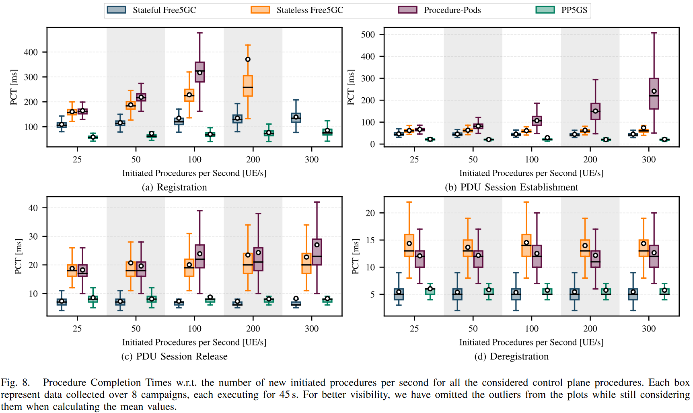
Performance Evaluation -
Performance Compare
Procedure Completion Times:
The PCT comparisons for the four systems with respect to the number of new initiated procedures per second are shown in Fig. 8.
The faster 5GC manages to complete control plane procedure, the sooner can UEs start transmitting in the data plane.
On average, PP5GS completes Registration 42% faster and PDU Session Establishment 50% faster than the baseline.
Compared to the baseline, PDU Session Release (see Fig. 8c) and Deregistration (see Fig. 8d) take on average ∼12% and ∼8% longer. However, in terms of absolute values the difference is negligible being ∼1ms.
Notes:
第二個比較procedure 的完成時間：
圖 8 顯示了四個系統每秒新啟動 procedure 數量的 PCT 比較。
會做這個比較很重要的一點是：如果5GC 完成cp procedure 的速度越快，UE 就能越早開始在資料平面中進行傳輸。
平均而言，PP5GS 完成Registration 的速度比基準快 42%，PDU Session 建立 的速度比基準快 50%。
如果是PDU Session Release （見圖 8c）和 Deregistration （見圖 8d），會比baseline多花費約 12% 和約 8% 的時間。實際上絕對值大概只有1ms而已，幾乎可以忽略不計。

Slide 29
Performance Evaluation -
Performance Compare
Procedure Completion Times:
On the other hand, Stateless Free5GC and Procedure-Pods exhibit very low performance compared to the other systems.
In the scenario with 300 UEs/s performing the Registration procedure, average PCTs reach 521ms and 11.48s for the Stateless Free5GC and Procedure-Pods, respectively.
Therefore, we have excluded them from the plots as their performance is not comparable to the other high-performing systems.
Notes:
另一方面，Stateless Free5GC 和 procedure-Pod 的效能非常低。
在300個UE/s執行Registration procedure 的場景下，Stateless Free5GC和Procedure-Pods的平均PCT分別達到521ms和11.48s。
因此，作者將它們排除在圖中，因為它們的性能無法與其他高效能系統進行比較。

Slide 30
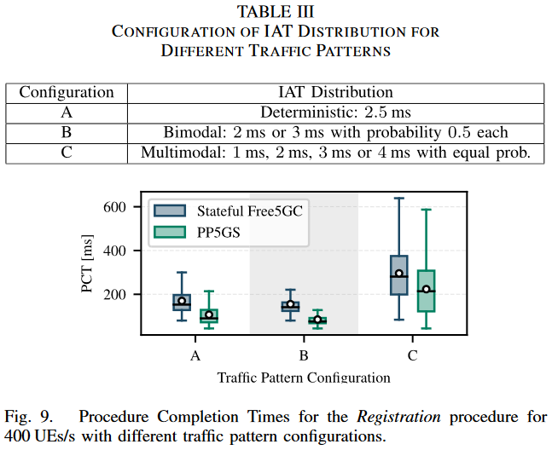
Performance Evaluation -
Performance Compare
PCT for other traffic patterns:
We define three different configurations of IAT distribution resulting in different control plane traffic patterns. These configurations are presented in Table III, and for each configuration we consider a scale of 400 UEs/s.
The obtained results show that for the same number of UEs/s, the traffic patterns yield different results w.r.t. the PCTs. Nonetheless, PP5GS still outperforms the baseline for all the considered configurations.
Notes:
接續剛剛的實驗，作者又做了其他流量參數的實驗:
作者定義了三種不同的 IAT 分配配置，從而產生不同的cp 流量模式。 這些配置如表 III 所示，對於每種配置，作者使用 400 UE/s 的數量。
得到的結果顯示，對於相同數量的 UE/s，流量模式會產生不同的結果(也就是 PCT)。 儘管如此，PP5GS 仍然優於所有考慮的配置的基準。

Slide 31
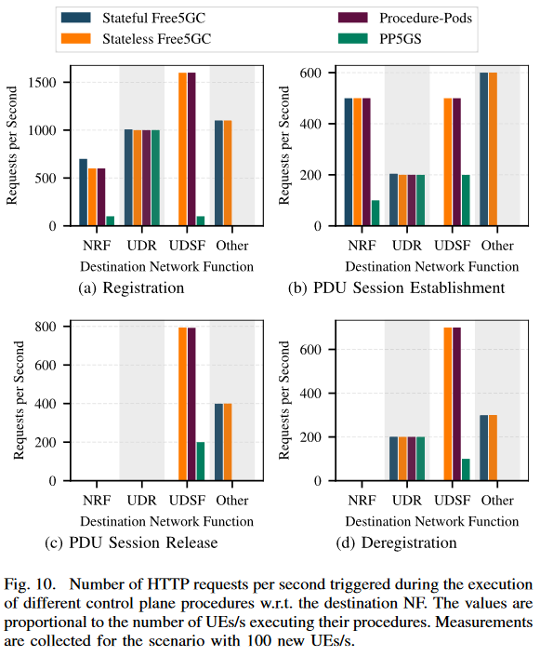
Performance Evaluation -
Performance Compare
Control Plane Communication Overhead:
The number of requests per second with respect to the destination NF for each of the control plane procedures are shown in Fig. 10.
In PP5GS, the deployment of the self-contained PPNFs inherently reduces the exchanged traffic because:
  There is no inter-NF communication between the integrated NFs.
  Less requests need to be send to NRF for discovering the other NFs in the chain.
  Less communication with UDSF since the entire system is procedural-stateless.
When comparing Stateless Free5GC and Procedure-Pods, the only difference is regarding traffic destined to Other NFs. Having a multi-container deployment in the case of ProcedurePods means that the inter-NF traffic does not leave the Pod namespace, hence no traffic destined for Other.
Notes:
cp 通訊的開銷：
圖10是以目標 NF 為對象做統計，每秒的request數量統計圖
在 PP5GS 中，NF之間減少了交換流量，因為：
整合後的 NF 之間不存在 NF 間通訊。
在尋找其他NF時，會發送較少的request給NRF
由於整個系統是procedure Stateless 的，因此與 UDSF 的通訊較少。
在比較Stateless Free5GC 和 procedure-Pod 時，唯一的差別在於發送到Other NF 的流量。 對於 procedure Pods 來說，採用多容器部署意味著 NF 間流量不會離開 Pod 命名空間，因此沒有發送到「其他」的流量。

Slide 32
Performance Evaluation -
Performance Compare
For the Registration procedure, PP5GS achieves a 57% reduction compared to Stateful Free5GC and 72% compared to Stateless Free5GC.
During PDU Session Establishment, PP5GS generates 61% and 72% less requests compared to Stateful Free5GC and Stateless Free5GC, respectively.
During the PDU Session Release and Deregistration procedures, PP5GS achieves a reduction of 83% and 75%, respectively, compared to Stateless Free5GC, while in comparison to Stateful Free5GC the reduction is 50% and 40%.
For all the procedures, PP5GS proves to be considerably more efficient in comparison to the other systems.
Notes:
對於Registration 流程，PP5GS 與 Stateful Free5GC 相比減少了 57%，與 Stateless Free5GC 相比減少了 72%。
對於 PDU Session 建立，與Stateful Free5GC 和Stateless Free5GC 相比，PP5GS 產生的請求分別減少了 61% 和 72%。
在 PDU Session Release 和 Deregistration procedure 中，PP5GS 與 Stateless Free5GC 相比分別減少了 83% 和 75%，而與 Stateful Free5GC 相比減少了 50% 和 40%。
對於所有procedure ，PP5GS 被證明比其他系統更有效率。

Slide 33
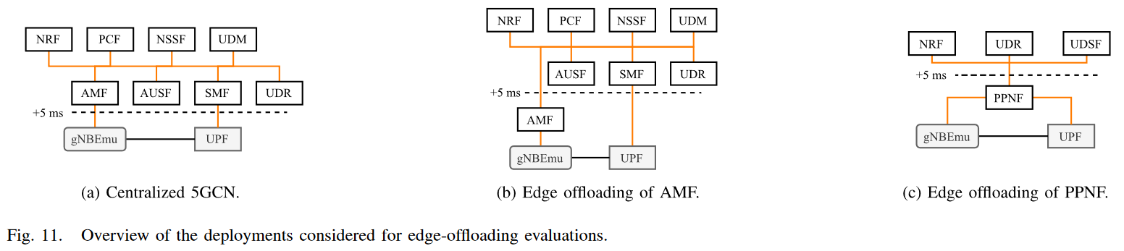
Performance Evaluation -
Performance Evaluation for Edge Offloading Scenarios
Lastly, we evaluate the performance of PP5GS in scenarios where edge offloading of 5GC NFs is performed.
Centralized 5GCN:
  where only gNBEmu and UPF run at the edge, while all control plane NFs are deployed in the central cloud as shown in Fig. 11a.
Edge AMF
  where only AMF is offloaded to the edge in an attempt to increase the performance as shown in Fig. 11b.
Edge PPNF
  where depending on the procedure the relevant PPNF is offloaded while NRF, UDR and UDSF reside in the Core as shown in Fig. 11c.
Notes:
最後，作者評估了 PP5GS 在執行 5GC NF 邊緣部屬到edge的場景中的效能。
Centralized 5GCN:
其中只有 gNBEmu 和 UPF 在邊緣運行，而所有cp NF 都部署在 central cloud 中，如圖 11a 所示。
Edge AMF
其中僅 AMF 被部屬到edge以嘗試提高效能，如圖 11b 所示。
Edge PPNF
其中，根據procedure ，相關 PPNF 被部屬到edge，而 NRF、UDR 和 UDSF 駐留在核心中，如圖 11c 所示。

Slide 34
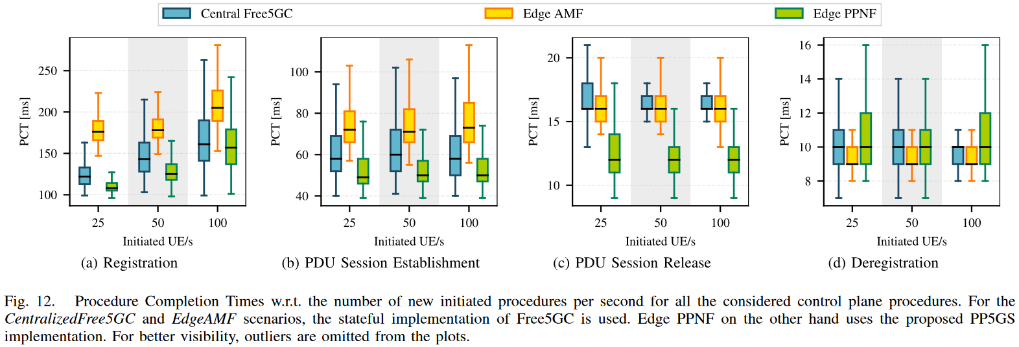
Performance Evaluation -
Performance Evaluation for Edge Offloading Scenarios
The boxplots of the PCT with respect to the number of new initiated procedures are shown in Fig. 12.
It can be seen that the performance of 5GC during the execution of complex procedures drops when we offload AMF to the edge.
The reason is that the number of messages exchanged between the AMF and the other NFs is higher than the amount of traffic exchanged between gNBEmu or UPF and the control plane NFs. Since every pair of messages exchanged encounters at least 5 ms of transmission delay, the PCTs increase considerably.
This is however not the case for less-complex procedures.
Notes:
PCT 的結果圖如圖 12 所示。
可以看出，當作者將 AMF 部屬到edge時，5GC 在執行複雜procedure 時的效能會下降。
原因是 AMF 和其他 NF 之間交換的訊息數量高於 gNBEmu 或 UPF 和cp NF 之間交換的流量。 由於每對交換的訊息都會遇到至少 5 ms 的傳輸延遲，因此 PCT 顯著增加。
然而，對於不太複雜的procedure 來說，至種情況就不明顯。

Slide 35
Performance Evaluation -
Performance Evaluation for Edge Offloading Scenarios
Offloading a PPNF indeed mitigates the issue seen with offloading 5G SBA NFs.
The median values of the obtained measurements for the Registration, PDU Session Establishment and PDU Session Release procedures are always lower than Edge-AMF.
The only exception is observed during Deregistration where Edge PPNF exhibits similar performance to the other deployments. The reason is due to the number of messages exchanged between NFs deployed in the Edge and Core parts of the network being equal in all the considered deployments.
Notes:
部屬到edge 的 PPNF 確實可以緩解剛剛提到AMF部屬到edge時出現的問題。
Registration 、PDU Session 建立 和 PDU Session Release procedure 獲得的測量值的中位數始終低於 Edge-AMF。
唯一的例外是在 Deregistration 期間觀察到，其中 Edge PPNF 表現出與其他部署類似的效能。 原因是在所有考慮的部署中，部署在網路邊緣和核心部分的 NF 之間交換的訊息數量是相等的。

Slide 36
Outline
Abstract
Background
  5G Core & SBA
  State Management in 5GC
  Free5GC
  Cloud-Native Orchestration
System Design and Implementation
  Stateless Free5GC
  Per-Procedure Network Functions
  (Procedure-based Functional Decomposition for 5G Core Network Functions)
Performance Evaluation
  Testbed and Measurement Setup
  Performance Compare
  Performance Evaluation for Edge Offloading Scenarios
Conclusions
Notes:
最後是結論

Slide 37
Conclusions
First, the CPU utilization evaluation shows that the integration of processing logic in a single NF reduces the overall needed resources, hence increasing the energy efficiency. Moreover, it enables deploying the 5GC NFs in the edge, which has limited resources compared to the central cloud.
Furthermore, we demonstrate that offloading single NFs to the edge in the case of an SBA deployment is in fact counter-productive for some control plane procedures. The high number of interactions with the NFs residing in the central cloud increases the completion time, a problem which PP5GS by design mitigates with the processing logic integrated in a single NF.
Our evaluation shows that PP5GS is indeed faster in processing incoming requests, especially for more complex procedures such as Registration and PDU Session Establishment where improvements up to 50% are achieved. This insight is particularly important because the faster these procedures are completed, the faster the UEs can start sending their data.
Notes:
首先，CPU 使用率評估表明，將處理邏輯整合在單一 NF 中能夠減少所需的整體資源，從而提高了能源效率。 此外，它還支援在與 central 的雲端相比，資源有限的邊緣edge端部署 5GC NF。
此外，作者還證明，在 SBA 部署的情況下將單一 NF 部屬到edge端實際上會對某些cp procedure 產生反作用。 edge端的NF與保留在 central cloud 端的 NF 進行大量互動會增加處裡時間，PP5GS 在設計上透過整合在單一 NF 中的處理邏輯來緩解這個問題。
作者的評估表示，PP5GS 在處理傳入請求方面確實更快，特別是對於Registration 和 PDU Session 建立 等更複雜的流程，實現了高達 50% 的改進。 這個觀點尤其重要，因為這些procedure 完成得越快，UE 就能夠越早開始發送資料。

Slide 38
Conclusions
From the perspective of operators, PP5GS is considerably easier to deploy because they do not need to consider the interNF dependencies and their impact on performance.
However, a limitation of PP5GS is that it requires a procedure-aware traffic router able to distinguish and forward the incoming traffic to the correct PPNFs. This entity would then be deployed between gNBs and PPNFs, abstracting the architecture of 5GC.
Multi-vendor deployments are still viable in a system where each PPNF is developed from a different vendor, as long as the state information is stored remotely in a standardized format.
In the future, we plan to evaluate the data plane performance and assess how adopting PP5GS in the control plane impacts the user experience. Furthermore, we deem it important to investigate the behavior of PP5GS in dynamic autoscaling deployments and in the face of failures to then propose adequate recovery mechanisms.
Notes:
從營運商的角度來看，PP5GS 的部署要容易得多，因為他們不需要考慮 interNF 依賴性及其對效能的影響。
然而，PP5GS 的限制在於它需要一個 procedure-aware 的 traffic router，能夠區分傳入流量並將其轉送到正確的 PPNF。 然後，該實體將部署在 gNB 和 PPNF 之間，抽象化 5GC 的架構。
只要 state information 以標準化格式儲存在遠端，每個 PPNF 均能由不同供應商開發，多供應商部署仍然可行。
未來，作者計劃評估data plane的效能，並評估在 cp 中採用 PP5GS 對使用者體驗的影響。 此外，作者認為研究 PP5GS 在動態自動擴展部署中的行為以及面對故障時提出適當的恢復機制非常重要。

Slide 39
Thank you

