Slide 1
Efficient Certificateless Conditional
Privacy-Preserving Authentication for VANETs
Xiaotong Zhou, Min Luo , Pandi Vijayakumar , Senior Member, IEEE, Cong Peng ,
and Debiao He , Member, IEEE

Slide 2
Outline
Introduction
Preliminary knowledge
Proposed Certificateless CPPA Scheme
Security Analysis
Performance evaluation
Conclusion

Slide 3
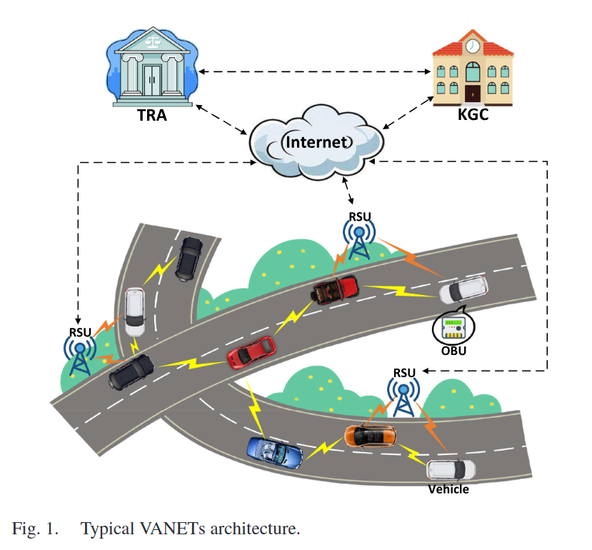
Introduction
VANET：self-configuring ad-hoc networks typically including vehicle-to-vehicle (V2V) and vehicle-to-infrastructure (V2I) communications.
TRA：Tracing Authority
KGC：Key Generation Center
RSU：Road-Side Union
OBU：On-board unit
Notes:
TRA是可信任的，有足夠的運算和儲存能力。該實體負責為車輛設定匿名身分並追蹤其真實身分（如果需要）。
KGC 也負責車輛登記和部分私鑰產生的信任和記帳。此外，KGC擁有足夠的記憶體和運算能力。
車輛可以向其他車輛或 RSU 無線廣播交通狀態資料。其配備的防篡改OBU可以儲存私鑰和系統參數。車輛儲存空間、運算能力有限，但防篡改能力強
RSU 是路邊的短程通訊基礎設施。該設備一般透過 DSRC 協議與車輛通信，並驗證接收到的交通相關消息

Slide 4
Introduction
CPPA：To mitigate the contradiction between anonymity and traceability, the conditional privacy-preserving authentication (CPPA) [1] has been proposed in VANETs.
Issues：most of them involve certificate management issues (e.g., involving a troublesome certificate revocation list)、secret keys of vehicles will be leaked once the KGC is compromised.
[1] R. Lu, X. Lin, H. Zhu, P.-H. Ho, and X. Shen, “Ecpp: Efficient conditional privacy preservation protocol for secure vehicular communications,” in Proc. IEEE INFOCOM 27th Conf. Comput. Commun., 2008, pp. 1229–1237.
Notes:
VANET最重要的兩個資安問題是anonymity和traceability
訊息認證[7]是常見的方法之一解決了上面的問題，但是比較容易造成隱私問題駕駛員資訊的風險（例如位置、車牌號碼、以及出行路線)
當車輛和路側單元之間交換交通狀態時，識別資訊會在廣播頻道中公開。攻擊者可以輕鬆收集資訊並獲取目標車輛的歷史路線。這可能會嚴重威脅用戶的隱私並帶來嚴重影響，例如被用於犯罪活動。因此，匿名服務是 VANET 的重要組成部分。
然而，絕對匿名可能會導致虛假和錯誤的訊息在 VANET 中傳播。例如，惡意駕駛者可能會廣播GPS位置、天氣狀況、道路狀況等虛假交通法規，幹擾正常通訊甚至實施犯罪。因此，受信任的第三方應該能夠追蹤惡意行為的原始身分。
為了緩解匿名性和可追溯性之間的矛盾，在車載自組網中提出了條件隱私保護認證（CPPA）[1]。
其中大多數涉及證書管理問題（例如，涉及麻煩的證書吊銷清單）、一旦KGC洩露，車輛的密鑰將洩露。

Slide 5
Introduction
CLCPPA：To solve the above issues, certificateless CPPA (CLCPPA) has been introduced in VANETs [2]–[4].
Issues：most of existing schemes involve high communication costs or complex computation overheads.
[2] M. Azees, P. Vijayakumar, and L. J. Deborah, “EAAP: Efficient anonymous authentication with conditional privacy-preserving scheme for vehicular ad hoc networks,” IEEE Trans. Intell. Transp. Syst., vol. 18, no. 9, pp. 2467–2476, Sep. 2017.
[3] H. Du and Q. Wen, “Efficient and provably-secure certificateless short signature scheme from bilinear pairings,” Comput. Stand. Interfaces, vol. 31, no. 2, pp. 390–394, 2009.
[4] C. Fan, R. Hsu, and P. Ho, “Truly non-repudiation certificateless short signature scheme from bilinear pairings,” J. Inf. Sci. Eng., vol. 27, no. 3, pp. 969–982, 2011.
Notes:
在這些方案中，車輛有兩種類型的私鑰（即partial私鑰和full私鑰），分別由可信任機構（即 KGC）和自身產生。因此，與 KGC 勾結的攻擊者無法獲得車輛的完整鑰匙。

Slide 6
Introduction
Main contributions：
Authors instantiate a digital signature forgery attack on Ali et al.’s scheme[5] and analyze possible flaws in their provable security proofs.
Authors design a new provably secure CLCPPA scheme for VANETs without any complex bilinear pairing and MapToPoint operations.
Authors give the performance evaluation of their proposal and the comparison to that of other CLCPPA schemes.
[5] I. Ali, Y. Chen, N. Ullah, R. Kumar, and W. He, “An efficient and provably secure ecc-based conditional privacy-preserving authentication for vehicle-to-vehicle communication in VANETs,” IEEE Trans. Veh. Technol., vol. 70, no. 2, pp. 1278–1291, Feb. 2021.
Notes:
在這些方案中，車輛有兩種類型的私鑰（即partial私鑰和full私鑰），分別由可信任機構（即 KGC）和自身產生。因此，與 KGC 勾結的攻擊者無法獲得車輛的完整鑰匙。
作者對 Ali 等人的方案 [5] 實例化了數位簽章偽造攻擊，並分析了其可證明的安全證明中可能存在的缺陷。
作者為 VANET 設計了一種新的可證明安全的 CLCPPA 方案，無需任何複雜的雙線性配對和 MapToPoint 操作。
作者對他們的提案進行了性能評估，並與其他 CLCPPA 方案進行了比較。

Slide 7
Outline
Introduction
Preliminary knowledge
Proposed Certificateless CPPA Scheme
Security Analysis
Performance evaluation
Conclusion

Slide 8
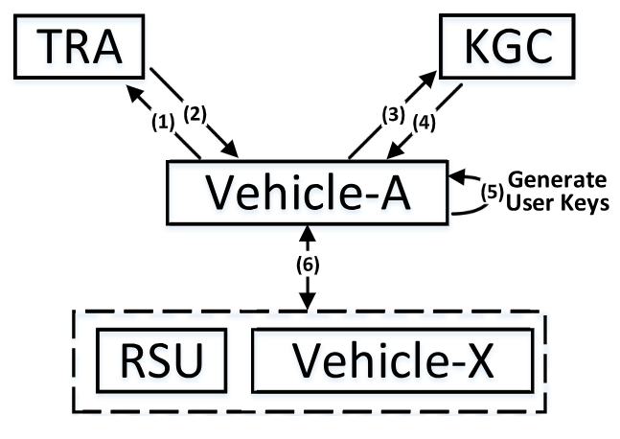
The authentication steps for VANETs.
1) The vehicle (e.g., Vehicle-A) applies to the TRA for registration.
2) The TRA generates anonymous identities and sends them to the vehicle. Then, the vehicle preloads them to the OBU.
3) The vehicle sends registration request to the KGC and obtains its partial private key.
Notes:
車輛（例如車輛A）向TRA申請註冊。
TRA 產生匿名身分並將其發送到車輛。然後，車輛將它們預先載入到 OBU。
車輛向KGC發送註冊請求並獲取其patial 私鑰。

Slide 9
The authentication steps for VANETs.
4) The KGC produces and sends back the partial private key to the vehicle secretly.
5) The vehicle generates its full private key and corresponding public key for authentication.
6) The vehicle generates the signature and sends message/signature pair to surrounding vehicles or RSUs. The receivers (vehicles or RSUs) check the message.
Notes:
4. KGC 產生partial私鑰並將其秘密發送回車輛。
5. 車輛產生full私鑰和相應的公鑰以進行身份驗證。
6. 車輛產生簽章並將訊息/簽章對發送到周圍的車輛或 RSU。接收者（車輛或 RSU）檢查訊息。

Slide 10
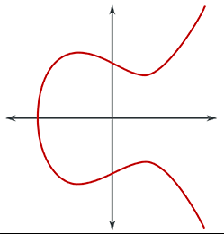
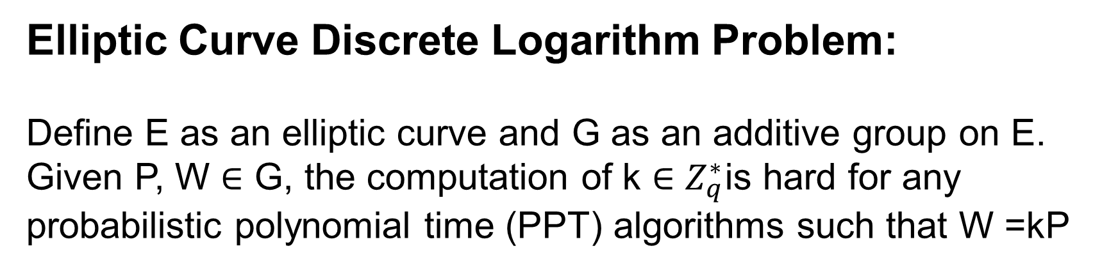
ECDLP
Elliptic Curve Discrete Logarithm Problem:
Define E as an elliptic curve and G as an additive group on E. Given P, W ∈ G, the computation of k ∈ $Z_{q}^{∗}$is hard for any probabilistic polynomial time (PPT) algorithms such that W =kP

Slide 11
Security Model of CLCPPA
According to security requirements of the CLCPPA for VANETs, we present two types of adversaries:
Type-I (A₁) and Type-II (A₂)
A₁ can replace a vehicle’s public key, but can’t get KGC’s master private key.
A₂ can’t replace a vehicle’s public key, but can get KGC’s master private key.
A₁ interacts with C in Game I, A₂ interacts with C in Game II.
Notes:
根據CLCPPA的安全模型 這邊提出兩種對手

Slide 12
Security Model of CLCPPA
Definition :
(EUF-CMA of CLCPPA) A CLCPPA scheme is with existential unforgeability under adaptive chosen message attacks, if no PPT adversary (A₁ or A₂) can win the following games (Game I and Game II respectively) with non-negligible probabilities.
Notes:
存在性不可偽造性under CMA就是對手可以透過不斷的是調整input給某個演算法，最終都可以得到自己要的資訊
如果沒有對手可以在多項式機率時間內以不可忽略的機率贏得遊戲

Slide 13
Security Model of CLCPPA
A (i.e., A₁ or A₂) can make following oracle queries in different games：
H_{i}, RevealPartialSecretKey, RevealSecretKey, RevealPublicKey, ReplacePublicKey, Sign.
Notes:
對手A會透過以下的queries來取得他需要的資料
例如RevealPartialSecretKey可以得到psk
RevealSecretKey可以得到full sk依此類推
Sign可以得到signature

Slide 14
Security Model of CLCPPA
In Game I & II
-Query : A makes queries on the oracles with any messages adaptively.
-Forge : A forges a signature and message.
Notes:
Query:A1可以自適應性的query oracle models, 以得到需要訊息，
Forge:A1最終可以製造出偽造的簽章以及訊息

Slide 15
Security Requirements
Following requirements are essential in the CLCPPA scheme
- Message authentication
- Anonymity
- Non-repudiation
- Conditional traceability
- Un-linkability
- Resistant against attacks
Notes:
Message authentication : receiver可以驗證訊息的有效性，來源是否為合法的user
Anonymity : 車輛可被匿名化，惡意攻擊者無法分析訊息來源
Non-repudiation : 認證過的資料不可被”否認”
Conditional traceability : 信任第三方可以追蹤惡意攻擊者的
Un-linkability : 只有信任第三方可以將多個訊息連接至同個車輛或RSU
Resistant against attacks : 要可以承受在VANET裡存在的惡意攻擊

Slide 16
Outline
Introduction
Preliminary knowledge
Proposed Certificateless CPPA Scheme
Security Analysis
Performance evaluation
Conclusion

Slide 17
Proposed Certificateless CPPA Scheme
Our proposal is composed by seven algorithms
- Setup
- Anonymization
- Extract PSK(private secret key)
- Extract USK(user secret key)
- Sign
- Verification
- Batch Verification

Slide 18
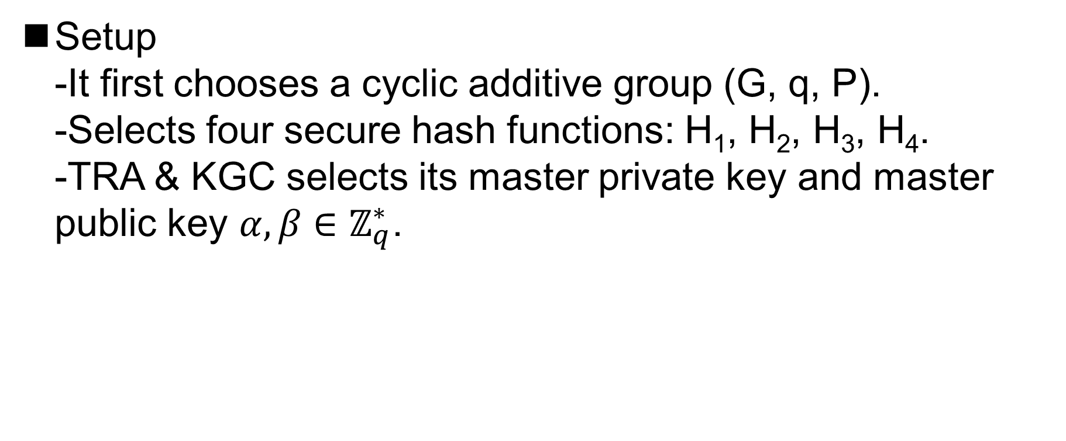
Proposed Certificateless CPPA Scheme
Setup
-It first chooses a cyclic additive group (G, q, P).
-Selects four secure hash functions: H₁, H₂, H₃, H₄.
-TRA & KGC selects its master private key and master public key $α,β∈ℤ_{q}^{∗}$.
Notes:
是一個循環加法群，q為一個質數，P是橢圓曲線上的點的generator
有四個hash function 主要是用來做加密用
Z*q是1~q-1 與q互質的整數

Slide 19
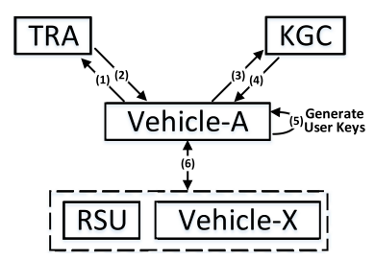
Proposed Certificateless CPPA Scheme
Anonymization
-Invoked by TRA to initialize anonymous identities of vehicles( AID ).
-Vehicle send its RID(Real ID) to TRA to produce AID.
-TRA stores AID and transmits it to the KGC and the vehicle.
Notes:
由TRA呼叫去初始化匿名
其中會經過兩次的hash function運算加密
TRA會保存AID(裡面包含AID1,i，AID2,i，Ti)，也會將AID傳給KGC以及vehicle，以便之後KGC來做驗證。

Slide 20
Proposed Certificateless CPPA Scheme
Extract PSK
-Carried out by KGC to compute the partial private key of vehicles.
-Vehicle sends AID to the KGC.
-KGC send partial private key to vehicle secretly.

Slide 21
Proposed Certificateless CPPA Scheme
Extract USK
- Carried out by Vehicles to produce its key pair.
- With its own AID, it can produce its private key and secret key.

Slide 22
Proposed Certificateless CPPA Scheme
Sign
-Invoked by any vehicle or RSU to compute message/signature pairs.
-After the sign was produced, they broadcasts messages to surrounding vehicles or RSUs.

Slide 23
Proposed Certificateless CPPA Scheme
Verification
-This algorithm is invoked by a verifier to verify a received message/signature pair.
- If it is valid, the verifier can accept the message and perform further actions (e.g., re-routing) if needed.

Slide 24
Proposed Certificateless CPPA Scheme
Batch Verification
-This algorithm provides a batch verification of multiple message/signature pairs to improve the efficiency.

Slide 25
Outline
Introduction
Preliminary knowledge
Proposed Certificateless CPPA Scheme
Security Analysis
Performance evaluation
Conclusion

Slide 26
Security Analysis
We employ two types of games to prove its security, which are played between a challenger C and two different adversaries A₁ and A₂.
Notes:
在安全性分析，我們用兩種games來驗證他的安全性，分別由challenger C以及adversaries A1&2
他們透過互相互動來取得資料
A1可以更換車輛的public key但無法取得KGC的master private key
A2無法更換車輛的public key但可以取得KGC的master private key

Slide 27
Security Analysis
Theorem :
If the ECDLP assumption holds, our proposal can be proved existentially unforgeable under Type-I & Type-II adversary A₁ & A₂ in the random oracle model.
Notes:
如果ECDLP的假設依然成立，那我們的方法就可以被證明在存在性不可偽造性下，
A1及A2都不可以透過random oracle model來贏得勝利
剛剛說的C就是一個random oracle model(預言機)，就像一個黑盒子，A給input，C會給出他想要的output，這之中我們不考慮C的計算複雜度。
存在性不可偽造性

Slide 28
Security Analysis
Adversaries A₁ and A₂ query the oracle model with system parameters and finally get a forged signature.
However, the ECDLP is actually difficult to solve for PPT adversaries.
Therefore, we can conclude that our proposal is secure against the Type-I & Type-II adversaries.
Notes:
RevealPartialSecretKey:
-A給參數，會先跟系統參數比對，如果有就可以拿到psk，如果比對不通過就繼續query直到可以通過比對，最終得出psk.
最後挑戰者A可以透過C在PPT時間內得出需要的signature
然而，ECDLP的計算難度是公認非常難解決的問題
所以就算A可以在PPT時間內得出C，也必須要先解出ECDLP
所以我們可以說，本論文提出CLCPPA方法是安全的。

Slide 29
Outline
Introduction
Preliminary knowledge
Proposed Certificateless CPPA Scheme
Security Analysis
Performance evaluation
  Computation Cost
  Communication Overhead
  Power Consumption
Conclusion

Slide 30
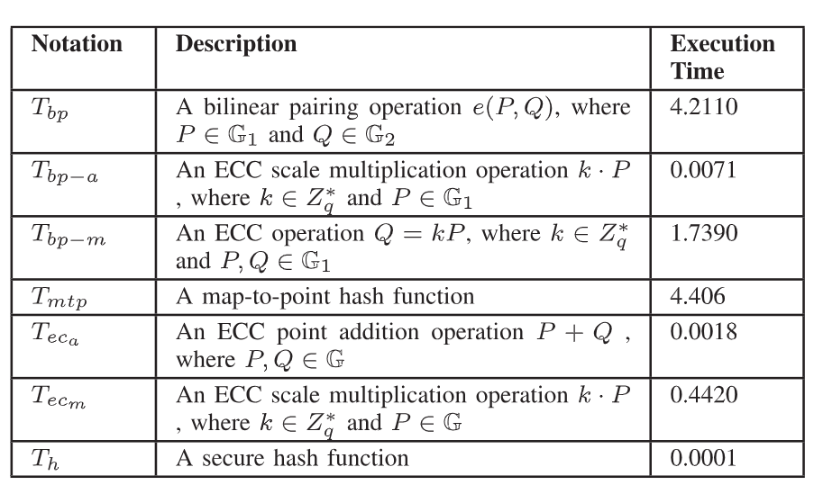
Performance evaluation
Computation Cost
The evaluation method for VANETs designed by He et al. [6].
[6] D. He, S. Zeadally, B. Xu, and X. Huang, “An efficient identity-based conditional privacy-preserving authentication scheme for vehicular ad hoc networks,” IEEE Trans. Inf. Forensics Secur., vol. 10, no. 12, pp. 2681–2691, Dec. 2015.

Slide 31
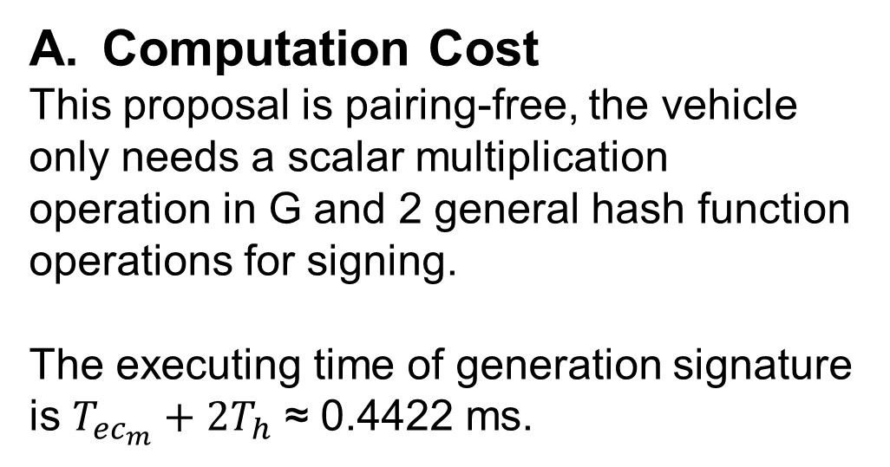
Performance evaluation
Computation Cost
This proposal is pairing-free, the vehicle only needs a scalar multiplication operation in G and 2 general hash function operations for signing.
The executing time of generation signature is $T_{{ec}_{m}}+2T_{h}$ ≈ 0.4422 ms.
Notes:
該提案是免配對的，車輛只需要 G 中的純量乘法運算和 2 個通用雜湊函數運算來進行簽名。
產生簽章的執行時間為𝑇_(〖𝑒𝑐〗_𝑚)+2𝑇_ℎ ≈ 0.4422 ms。

Slide 32
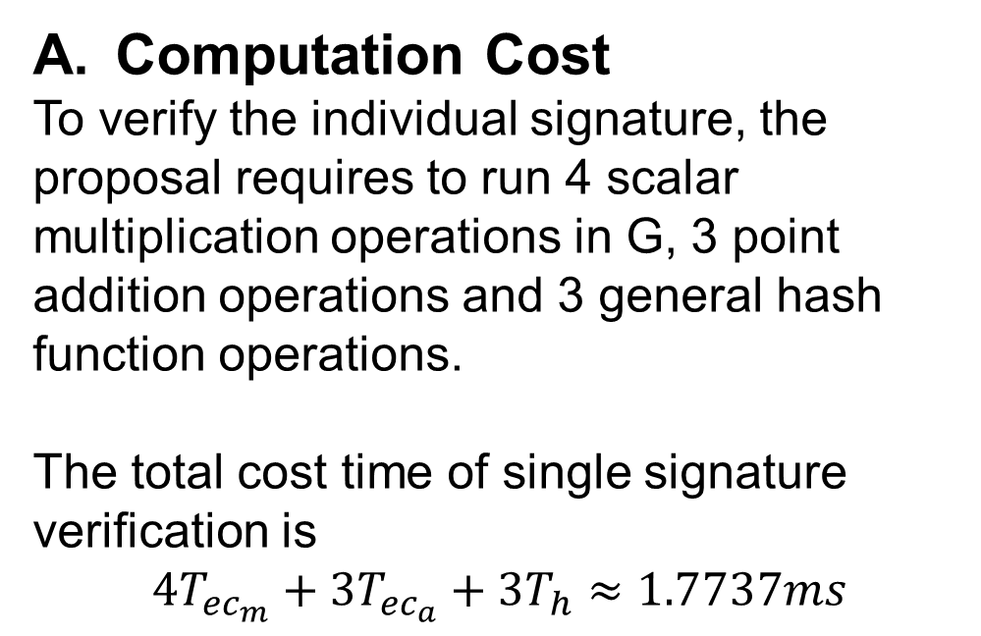
Performance evaluation
Computation Cost
To verify the individual signature, the proposal requires to run 4 scalar multiplication operations in G, 3 point addition operations and 3 general hash function operations.
The total cost time of single signature verification is
$$4T_{{ec}_{m}}+3T_{{ec}_{a}}+3T_{h}≈1.7737ms$$
Notes:
為了驗證個人簽名，該提案需要在 G 中運行 4 次純量乘法運算、3 次點加法運算和 3 次通用雜湊函數運算。

Slide 33
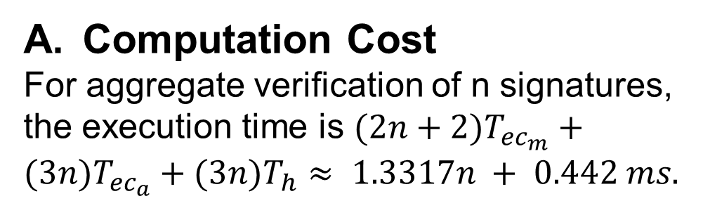
Performance evaluation
Computation Cost
For aggregate verification of n signatures, the execution time is $(2n+2)T_{{ec}_{m}}+(3n)T_{{ec}_{a}}+(3n)T_{h}≈ 1.3317n + 0.442 ms.$

Slide 34
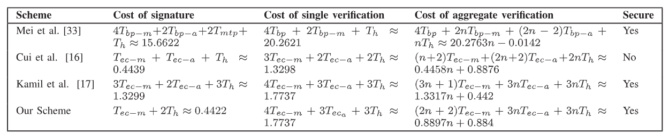
Performance evaluation
Computation Cost

Slide 35
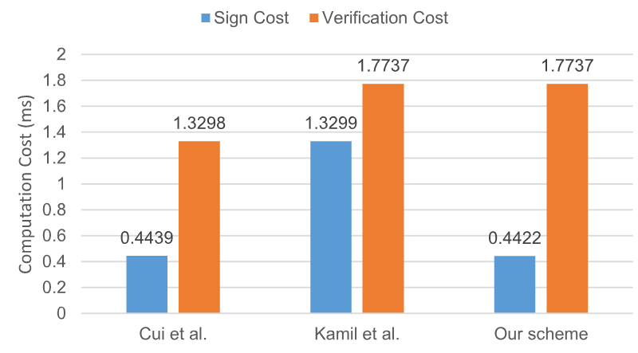
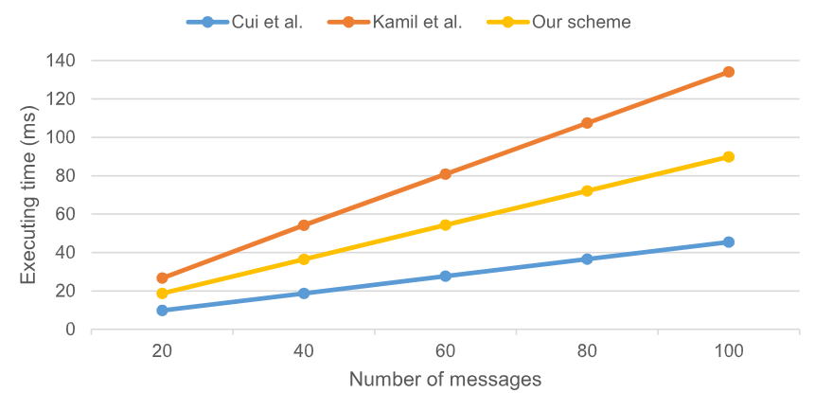
Performance evaluation
Computation Cost

Slide 36
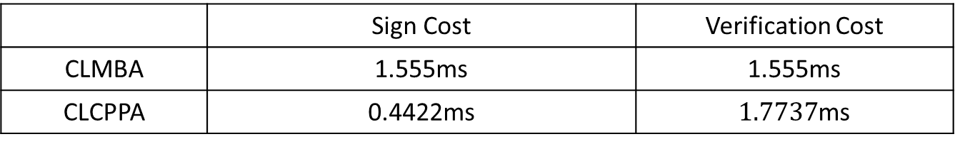
Performance evaluation
Computation Cost (comparing with CLMBA)
 | Sign Cost | Verification Cost
CLMBA | 1.555ms | 1.555ms
CLCPPA | 0.4422ms | $1.7737$ms

Slide 37
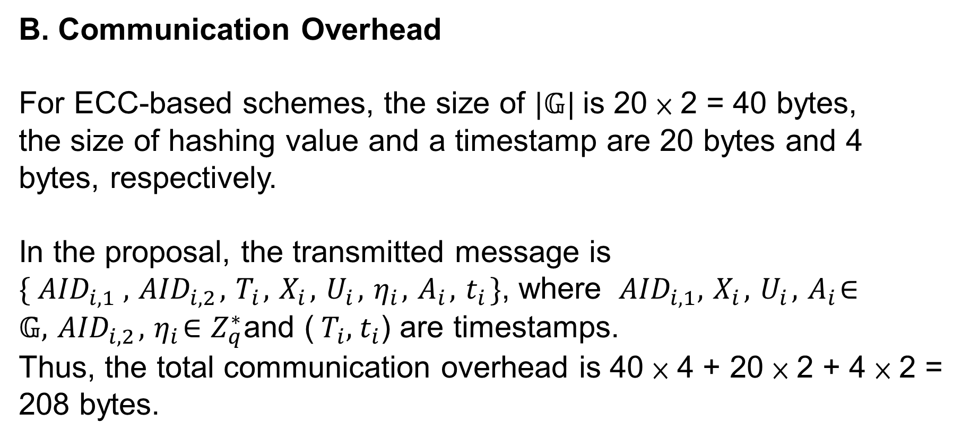
Performance evaluation
B. Communication Overhead
For ECC-based schemes, the size of $|𝔾|$is 20 × 2 = 40 bytes,
the size of hashing value and a timestamp are 20 bytes and 4 bytes, respectively.
In the proposal, the transmitted message is $\{{ AID}_{i,1} ,{ AID}_{i,2},{ T}_{i},{ X}_{i},{ U}_{i},{ η}_{i},{ A}_{i},{ t}_{i}\}$, where ${ AID}_{i,1},{ X}_{i},{ U}_{i},{ A}_{i}∈𝔾,{ AID}_{i,2},{ η}_{i}∈Z_{q}^{∗}$and (${ T}_{i},{ t}_{i}$) are timestamps.
Thus, the total communication overhead is 40 × 4 + 20 × 2 + 4 × 2 = 208 bytes.

Slide 38
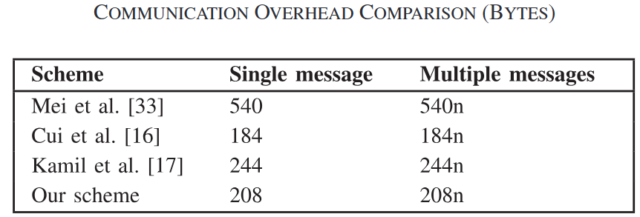
Performance evaluation
B. Communication Overhead

Slide 39
Performance evaluation
B. Communication Overhead(comparing with CLMBA)
 | Single message | Multiple message
CLMBA | 80 bytes | 160n bytes
CLCPPA | 208 bytes | 208n bytes

Slide 40
Performance evaluation
C. Power Consumption
On the basis of evaluation method designed by Thumbur et al. [7], authors analyze the power utilization of their scheme.
The power consumption can be computes as E = tP , where
E is the consumed energy, t is a total time cost and P is the
maximum power of CPU (10.88 W).
[7] T. Gowri, G. S. Rao, P. V. Reddy, N. B. Gayathri, D. V. R. K. Reddy, and M. Padmavathamma, “Efficient and secure certificateless aggregate signature-based authentication sheme for vehicular ad hoc Networks,” IEEE Internet Things J., vol. 8, no. 3, pp. 1908–1920, Feb. 2021.

Slide 41
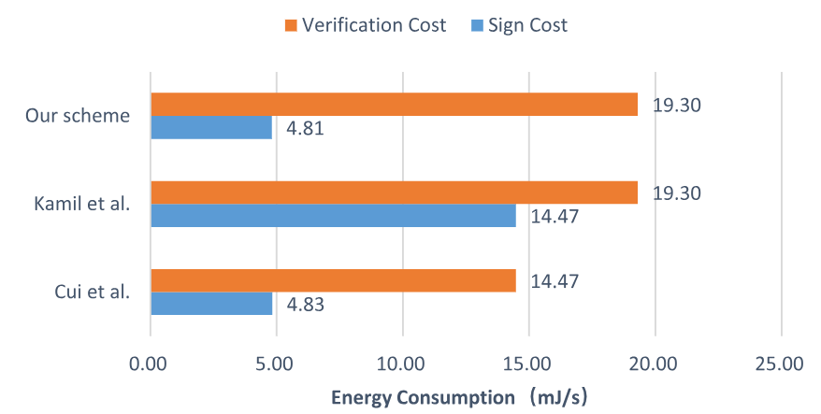
Performance evaluation
C. Power Consumption
our scheme requires lower energy than [8]. While the cost of signature verification of our scheme is higher than that of [9], their scheme is vulnerable to withstand attacks.
[8] I. A. Kamil and S. O. Ogundoyin , “An improved certificateless aggregate signature scheme without bilinear pairings for vehicular ad hoc networks,” J. Inf. Secur. Appl., vol. 44, pp. 184–200, 2019.
[9] J. Cui, J. Zhang, H. Zhong, R. Shi, and Y. Xu, “An efficient certificateless aggregate signature without pairings for vehicular ad hoc networks,” Inf. Sci., vol. 451-452, pp. 1–15, 2018.

Slide 42
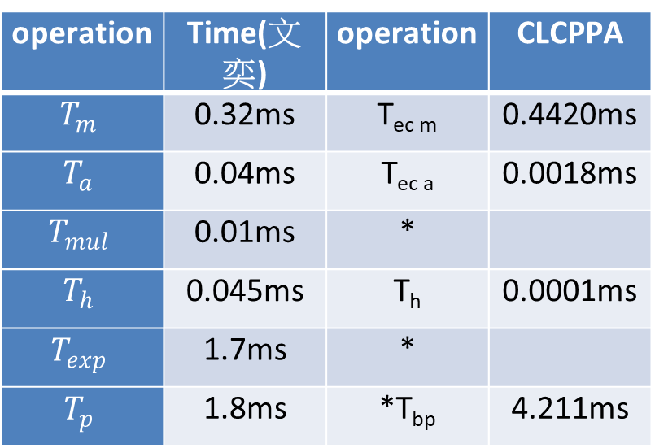
Performance evaluation
operation | Time(文奕) | operation | CLCPPA
$$T_{m}$$ | 0.32ms | T_{ec m} | 0.4420ms
$$T_{a}$$ | 0.04ms | T_{ec a} | 0.0018ms
$$T_{mul}$$ | 0.01ms | *
$$T_{h}$$ | 0.045ms | T_{h} | 0.0001ms
$$T_{exp}$$ | 1.7ms | *
$$T_{p}$$ | 1.8ms | *T_{bp} | 4.211ms

Slide 43
Outline
Introduction
Preliminary knowledge
Proposed Certificateless CPPA Scheme
Security Analysis
Performance evaluation
Conclusion

Slide 44
Conclusion
analyze the vulnerability of Ali et al’s proposal and demonstrate a signature forgery attack on their scheme.
design an improved CLCPPA scheme for VANETs and the security analysis presents that our proposal is with existential unforgeability against two types of adversaries in random oracle model and satisfies the necessary security requirements.
the evaluation result further supports the feasibility of their scheme.

