Slide 1
The Cost of Stateless Network Functions in 5G & Towards A Low-Cost Stateless 5G Core
Presenter: 彭奎量 2023/03/31

Slide 2
Introduction of two papers
The Cost of Stateless Network Functions in 5G
Towards A Low-Cost Stateless 5G Core
Notes:
第一篇會介紹 stateless NF 的 cost 以及降低 cost 的方法
第二篇會基於第一篇論文，再設計出一個降低更多cost的solution

Slide 3
1. The Cost of Stateless Network Functions in 5G
Conference: ANCS
ANCS: Architecture for Networking and Communications Systems - ACM
December 2021
Author:
Umakant Kulkarni: Purdue University
Amit Sheoran: AT&T Labs - Research, USA
Sonia Fahmy: Purdue University

Slide 4
2. Towards A Low-Cost Stateless 5G Core
Conference: 2022 LANMAN
LANMAN: IEEE International Symposium on Local and Metropolitan Area Networks
July 2022
Author:
Umakant Kulkarni: Purdue University
Amit Sheoran: AT&T Labs - Research, USA
Sonia Fahmy: Purdue University

Slide 5
Outline
The Cost of Stateless Network Functions in 5G
Introduction
Stateless 5GS Functions
Reducing the Cost of Transactional Statelessness
Evaluation
Towards A Low-Cost Stateless 5G Core
Introduction
Reducing Stateless NF Latency
Evaluation
Conclusion & Future Work

Slide 6
Abstract
The Cost of Stateless Network Functions in 5G

Slide 7
The Cost of Stateless Network Functions in 5G ABSTRACT
The adoption of a cloud-native architecture in 5G networks has facilitated rapid deployment and update of cellular services.
An important part of this architecture is the implementation of 5G network functions statelessly.
However, statelessness and its associated serialization and de-serialization of data and database interaction significantly increase latency.
We compare the cost of different state management paradigms and propose a number of optimizations to reduce this cost.
Notes:
在5G網路中採用雲原生的架構促進了蜂窩服務的快速部署和更新。
這種架構的一個重要部分是以statelessly方式實作出5G NF，但是，stateless 及其相關的 data 序列化和反序列化，以及資料庫互動會明顯的增加延遲。
我們比較了不同狀態管理範例的成本，並提出了一些優化方式來降低這些成本。

Slide 8
Introduction
The Cost of Stateless Network Functions in 5G

Slide 9
The Cost of Stateless Network Functions in 5G INTRODUCTION
The 5G System (5GS) architecture (section 4 of TS 23.501) recommends employing stateless network functions (NFs) or microservices, interacting via service-based interfaces.
Unstructured Data Store Function (UDSF) : A network function in 5GS can operate statelessly by storing the current state of the end user device (referred to as user equipment, or UE) in a remote database
However, this statelessness comes at a performance cost.
In this paper, we investigate two types of stateless functions, procedurally stateless and transactionally stateless, and propose a number of optimizations to mitigate the performance cost of transactional statelessness.
Notes:
在TS 23.501 第四節中建議5G 系統 （5GS） 架構使用stateless network functions (NFs)或microservices，通過service-based的interfaces進行互動。
Unstructured Data Store Function （UDSF）是5GS中一個可以儲存其他NF最終UE狀態的遠端資料庫。然而，這種達成 stateless 狀態的方法會帶來性能上的損失。
在接下來的章節中，作者會探討兩種stateless模式：Procedurally與transaction stateless。並提出數種優化來降低 stateless 的 cost 成本。
(4.1 Support "stateless" NFs, where the "compute" resource is decoupled from the "storage" resource. / The 5G System architecture shall leverage service-based interactions between Control Plane (CP) Network Functions where identified. )

Slide 10
STATELESS 5GS FUNCTIONS
The Cost of Stateless Network Functions in 5G
Notes:
介紹stateless 5gs functions

Slide 11
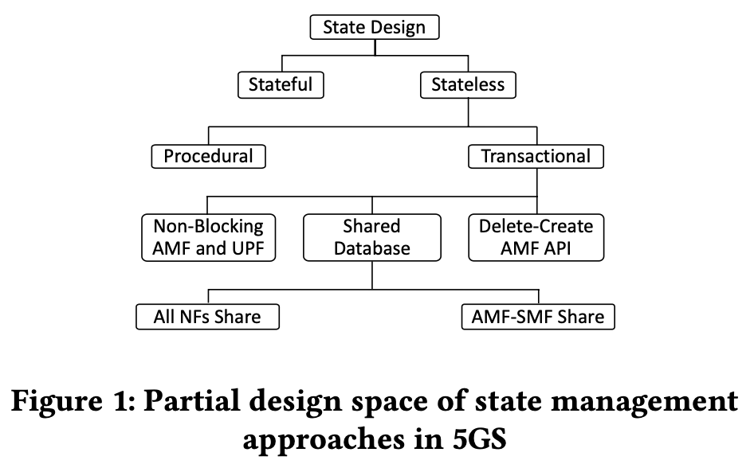
The Cost of Stateless Network Functions in 5G STATELESS 5GS FUNCTIONS
Procedures are executed as a sequence of transactions.
A transaction is a message interaction between two functions that involves exactly one request and its corresponding response.
SFC: Service Function Chain
Notes:
首先介紹什麼是 Procedures 與 transactions
一個 Procedures 是由很多個 transactions 所串聯組合成的
而 transactions 指的就是倆個 NF 之間，每一組request 與 response就叫一個transaction
作者將這些 串連的 Service function chain 簡稱為 SFC

Slide 12
The Cost of Stateless Network Functions in 5G STATELESS 5GS FUNCTIONS
Procedural and Transactional Statelessness compare :
Procedural statelessness refers to storing the UE state in the database at the end of a procedure. During the operation of a procedure, the function stores the state in the local cache or memory. Once the entire procedure is completed, the function updates the state in the database.
Transactional statelessness is more fine-grained: the function stores the UE state after completing each individual transaction.
Notes:
將 Procedural 與 transaction 做比較：
Procedural會在每一次procedural結束後，才將 UE state 儲存至 database。
而 Transaction 則更為細膩，會在每一次個別的transaction結束後，就將 UE state 儲存至 database。

Slide 13
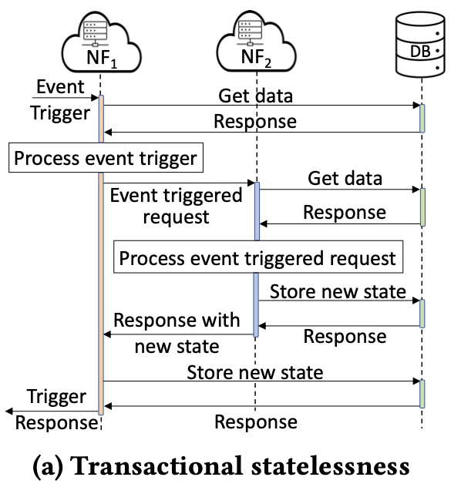
The Cost of Stateless Network Functions in 5G STATELESS 5GS FUNCTIONS
Notes:
藍色框框是 procedural
紅色框框是 transacion

Slide 14
The Cost of Stateless Network Functions in 5G STATELESS 5GS FUNCTIONS
Two important drawbacks of Procedural Statelessness :
First, all transactions in a given procedure must be processed by the same instance.
Thus, operators need to implement an additional intermediate node to function as a load balancer.
Second, procedural statelessness is less resilient to node failures or function restarts since a function may lose the state of the UE.
Network functions that precede it in the service chain need to retransmit the messages to recover.
We focus on better understanding and reducing the cost of transactional stateless in the remainder of this paper.
Notes:
Procedural Statelessness 有兩個重要的缺點：
所有給定procedure的transaction都需要由同一個實體處理。
因此可能會需要額外中介的點，去扮演load balancer的角色。
Procedural一但有節點錯誤，或是NF重新啟動，就有可能會lose掉UE的state
如此一來就會需要前一個NF重傳message來恢復。
在這篇論文的接下來部分，作者主要會以transactional stateless 作為重點介紹與設計

Slide 15
The Cost of Stateless Network Functions in 5G STATELESS 5GS FUNCTIONS
Cost of Transactional Statelessness :
When an NF receives an event trigger, it requests the latest data required to process the event from the database.
When the last NF (say 𝑁𝐹𝑛 ) in the SFC processed the request, it stores the newly processed data in the database and sends back the response to 𝑁𝐹𝑛−1.
The number of messages exchanged with the database is 2 × 𝑛 for the read operations plus 2 × 𝑛 for the write operations, for a total of 4 × 𝑛 messages for a service function chain of 𝑛 functions.
Notes:
計算 Transactional Statelessness 的 Cost :
當一個NF收到一個event trigger，他會跟database請求最新的資料
SFC中每個NF都會這樣做，
當最後一個NF完成處理後，會將結果寫入到DB
再一層一層的回傳回去，然後每一層也會將相同的結果寫入到DB
這樣一來每個NF就會產生總共 4xn 的 messages，兩個 read，兩個 write

Slide 16
The Cost of Stateless Network Functions in 5G STATELESS 5GS FUNCTIONS
Notes:
兩個read兩個write

Slide 17
REDUCING THE COST OF TRANSACTIONAL STATELESSNESS
The Cost of Stateless Network Functions in 5G
Notes:
介紹如何降低transaction的cost

Slide 18
The Cost of Stateless Network Functions in 5G REDUCING THE COST OF TRANSACTIONAL STATELESSNESS
Notes:
從transactional下來，作者提出三種優化方式，其中shared Databasse 又分成全部NF跟AMF-SMF
而shared database 也是這篇論文的主要貢獻

Slide 19
The Cost of Stateless Network Functions in 5G REDUCING THE COST OF TRANSACTIONAL STATELESSNESS
Shared database :
In our example in Section 2.3, NF1 and NF2 independently write the state to the database.
If NFs can share the state in the database, it is sufficient for a single NF to write the data to the database.
In other words, if NF writes the data on behalf of both itself and NF, then the write operation by NF is no longer required.
Notes:
第一個介紹shared database，就如同我們前面舉的圖例，NF1與NF2會將相同的state分別寫入db
若這些NF 可以互相共享state，那只需要有一個代表將資料寫入到db即可，換句話說，如果有NF代表自己與其他的NF，將資料寫入DB，那麼自己以外的其他NF就不再需要寫入動作了。
就像紅色框框圈起來的，在這個設計中就是屬於多餘的傳送

Slide 20
The Cost of Stateless Network Functions in 5G REDUCING THE COST OF TRANSACTIONAL STATELESSNESS
We note that there is always a function in 4G or 5G that maintains the latest and correct UE state.
This role is played by the packet gateway in the 4G architecture, and the Session Management Function (SMF) in 5G, as the SMF is the connecting link between the 5G control and user planes.
As described in section 6.2 of TS 23.501, the SMF receives access network data from the AMF and configures the UPF.
Hence, the state maintained by the AMF or UPF is a subset of the state maintained by the SMF.
We take advantage of this fact, and propose transactional statelessness, sharing the state in the database to reduce write operations.
Notes:
作者發現在4G與5G中永遠有一個function會維持UE最後且正確的狀態。
在4G中是packet gateway，5G中則是SMF，因為SMF連接著5G control plane與user planes。
根據TS23.501第6.2節中的描述，SMF會接收來自AMF 的access network data後配置UPF。
因此，AMF與UPF所維護的state，其實是SMF所維護的state的子集。
作者利用這個事實的優勢，提出一種transactional statelessness，透過共享資料庫中的state來減少寫入操作。
我對這句話的理解是因為UPF在下層，接收的是來自SMF的資料，而處理完成後上層AMF最終得到的結果也是SMF所傳遞的，從此可以看出SMF是其中穩定掌握最新的資料的角色。

Slide 21
The Cost of Stateless Network Functions in 5G REDUCING THE COST OF TRANSACTIONAL STATELESSNESS
Consider the example of the “Create SM Context” transaction, executed as a part of several 5G procedures.
This transaction is between the AMF and SMF, where the AMF sends a request to the SMF when it receives a trigger from the gNB (i.e., the cell tower).
The SMF processes the request received from the AMF and sends the response back.
The processing involves other interactions (e.g., with AUSF, UDM, and PCF) by both the AMF and SMF, but we will omit these for the purposes of this discussion.

Slide 22
The Cost of Stateless Network Functions in 5G REDUCING THE COST OF TRANSACTIONAL STATELESSNESS
Figure 2b depicts the “Create SM Context” transaction.
Upon receiving the request from the AMF, the SMF processes it and writes the new UE state to the database. The response to the AMF contains the same data that the SMF has just stored in the database. When the AMF receives the response from the SMF, it writes the same data to the database and sends data back to the gNB.
In other words, with transactional statelessness, both functions store the same data at the end of their respective transactions.
Notes:
圖2b繪製的是Create SM Context 的 transaction。
一但接收到來自AMF的request，SMF進行處理後就會將新的UE state寫入DB，並將相同state response給AMF。當AMF接收到response後，他又會將相同資料寫入到DB一次，

Slide 23
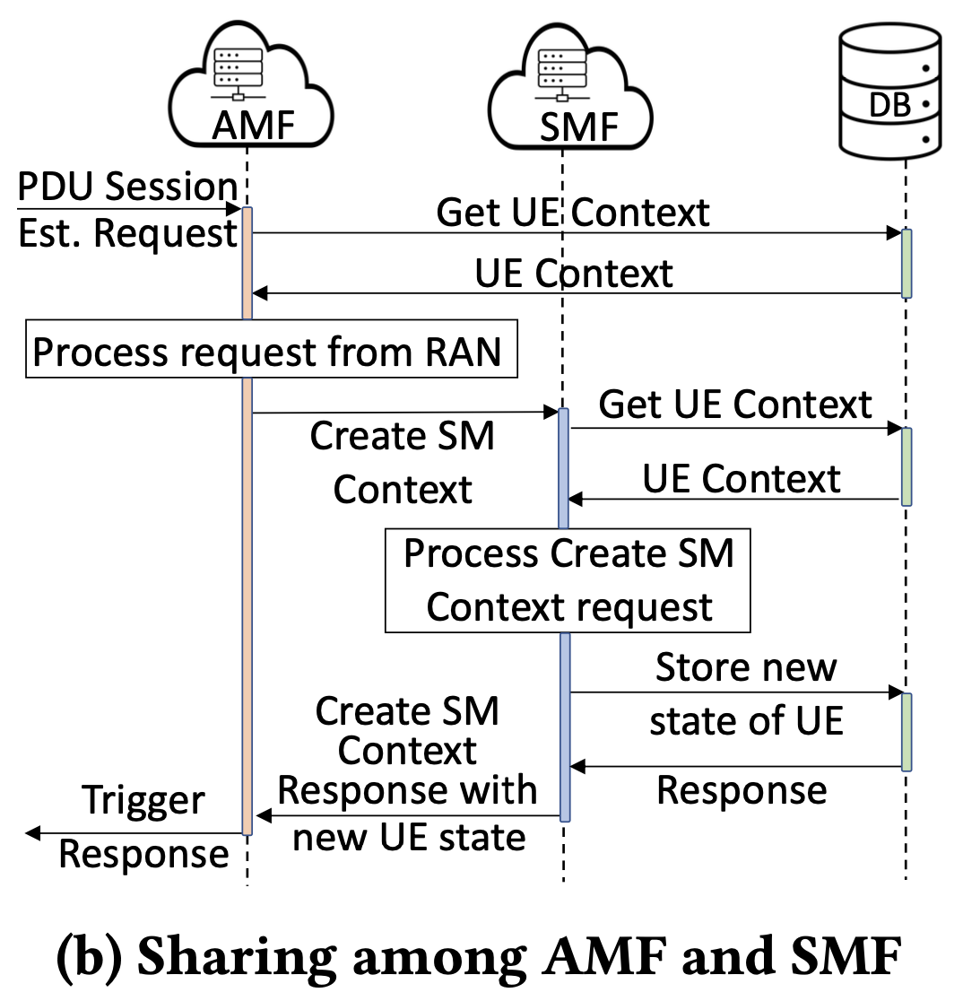
The Cost of Stateless Network Functions in 5G REDUCING THE COST OF TRANSACTIONAL STATELESSNESS
We propose that a single function store data on behalf of both functions in this case.
Specifically, the SMF writes the data to the database and the AMF can later access that same data.
Hence, when a new request arrives as a part of a new transaction, the AMF will fetch the data from this shared database, which was written by the SMF in the earlier transaction.
This reduces the number of databases written by one for each such transaction.
Notes:
在這種情況下，作者提出使用單個function代表兩個functions存儲data。
具體來說，在SMF寫入資料後，AMF可以從DB存取到相同的資料。
因此，當一個新的transaction中的一部分request到達時，AMF可從share database 中取得稍早由SMF寫入在DB中的資料。
這可以減少由各個transaction所產生的寫入數量。

Slide 24
The Cost of Stateless Network Functions in 5G REDUCING THE COST OF TRANSACTIONAL STATELESSNESS
Non-blocking AMF and UPF :
An alternative optimization can be performed through parallelism.
As defined in TS 29.518 and TS 29.502, 5G NFs share data or UE state by sending JSON payloads using a REST API over the service-based interfaces for processing calls or events.
Additional latency is introduced by serialization and de-serialization of binary and JSON data, and converting it to a database-compatible format, e.g., BSON (Binary JSON Serialization) if the database is implemented using MongoDB.
Notes:
第二個介紹Non-blocking AMF and UPF 。
一種利用平行化來進行的替代優化方法。
根據TS 29.518與TS29.502中的描述，NFs之間是透過JSON以及REST API，透過service-based介面來處理請求或事件。
額外的延遲就在 binary與 JSON 之間序列化與去序列化，以及轉換到database-compatible格式之間產生。
例如使用MongoDB的話，就會是BSON格式。

Slide 25
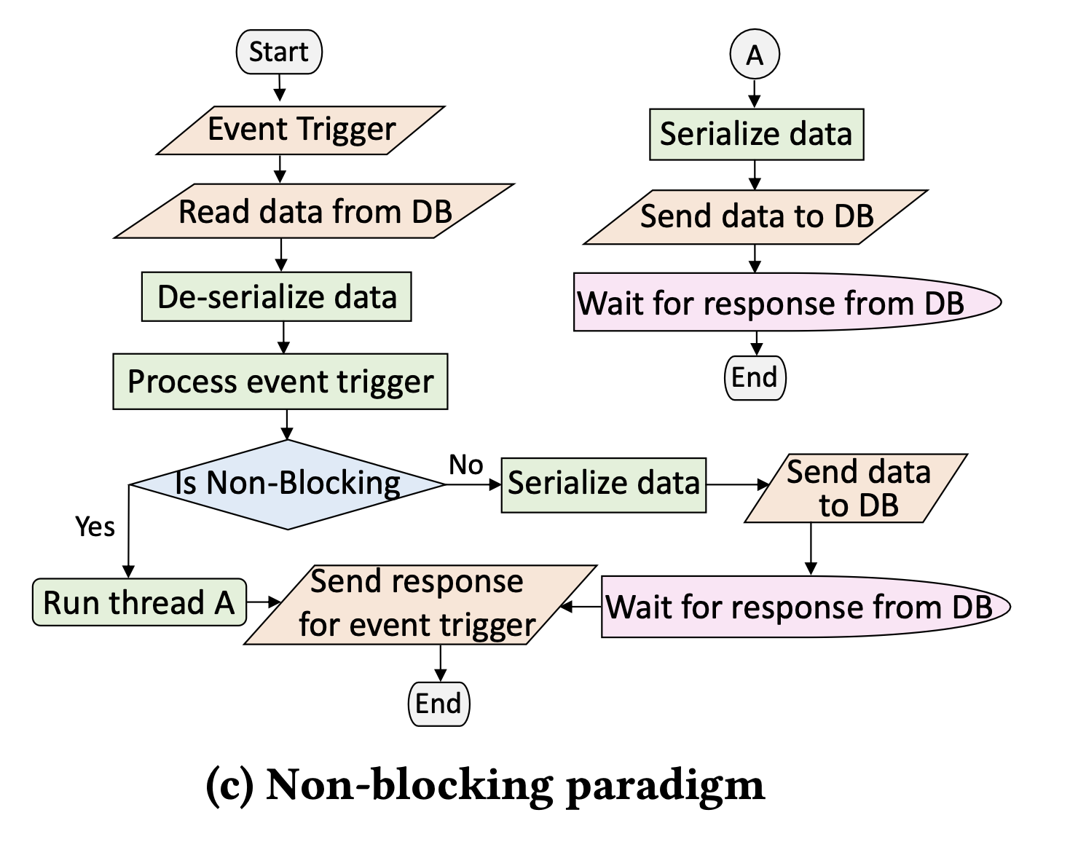
The Cost of Stateless Network Functions in 5G REDUCING THE COST OF TRANSACTIONAL STATELESSNESS
To reduce this processing latency incurred by data structure translations, we propose a paradigm where the AMF and the UPF make non-blocking calls to the database while writing data, whereas the SMF continues to make blocking calls to the database (Figure 2c).
This ensures that the SMF still maintains the correct UE state at the transactional level and that all three functions are fully stateless without violating cloud-native principles.
Notes:
為了減少這種資料格式處理的延遲，作者提出一個範例。
當AMF與UPF在寫入data時對資料庫進行 non-block 呼叫，而SMF繼續使用 blocking 呼叫，詳細流程在2c圖中。
如果是AMF與UPF，會開一個新的執行序A，執行序A會序列化資料，並傳送到DB。如果是SMF，不會開新的執行序，將資料序列化後就傳送到DB。
這可以確保SMF仍然維護著正確的UE state，並且所有function都仍是fully stateless，沒有違反cloud-native 原則。

Slide 26
The Cost of Stateless Network Functions in 5G REDUCING THE COST OF TRANSACTIONAL STATELESSNESS
Delete-create AMF API :
NoSQL databases like MongoDB use WiredTiger storage engine which reads and writes data through in-memory B+ tree data structures.
When an update adds new fields, the B+ tree executes a search, insert, swap, or move operations of key-value pairs across its leaf nodes.
This makes the total time complexity 𝐶 × 𝑂 (𝑙𝑜𝑔 𝑛) where 𝑛 is the number of keys and 𝐶 is the number of new fields.
Notes:
最後一個是Delete-create API
像是NoSQL且使用WiredTiger儲存引擎的MongoDB，他讀寫資料都是使用 in-memory B+ tree 的資料結構。
當一個資料要更新時，這個B+ tree透過key-value搜尋，插入，交換，或是移動他的樹葉節點。
這會導致總體的時間複雜度為 𝐶 × 𝑂 (𝑙𝑜𝑔 𝑛) ，其中n為keys的數量，C是新欄位的數量。

Slide 27
The Cost of Stateless Network Functions in 5G REDUCING THE COST OF TRANSACTIONAL STATELESSNESS
The larger the document and the number of new fields, the longer it takes to modify it.
To address this performance issue, we will explore using two separate APIs (delete and then create) to perform the update operation with time complexity 1 + 𝑂 (𝑙𝑜𝑔 𝑛).
Notes:
當新欄位越大，資料庫就會花越久去編輯。
為了解決這個performance的問題，作者利用del+create來執行update，並且時間複雜度可以降低到1 + 𝑂 (𝑙𝑜𝑔 𝑛).

Slide 28
EVALUATION
The Cost of Stateless Network Functions in 5G
Notes:
接下來是評估章節

Slide 29
The Cost of Stateless Network Functions in 5G EVALUATION
v5.4.0-77-generic kernel with Ubuntu 20.04 and Kubernetes v1.22.4
A network with 15 nodes, 11 of which constitute a Kubernetes cluster with one master and ten worker nodes.
open5gs v2.3.6 which is written in C
MongoDB v5.0.3
UERANSIM which is written in C++
Notes:
這邊是實驗環境的介紹

Slide 30
The Cost of Stateless Network Functions in 5G EVALUATION
UE-initiated PDU session establishment request procedure, defined in section 4.3.2.2 of TS23.502.
We trigger this procedure through “UE registration,” which involves communication between almost all functions within the 5G system (UE, RAN, AMF, SMF, UPF, PCF, UDR, UDM, NRF, NSSF, and AUSF).
We compare seven alternatives: (1) Stateful NFs, (2) Fully transactionally-stateless NFs, (3) Procedurally-stateless NFs, (4) All NFs share the database, (5) Only AMF and SMF share the database, (6) Non-blocking AMF and UPF APIs, and (7) Delete-Create AMF API.
We vary the number of simultaneous requests made between 600 and 1000, in steps of 100.
We choose the AMF for this time computation because it is the first NF in the service function chain responsible for processing the procedure.
Notes:
TS23.502 4.3.2.2節中定義了UE-initiated PDU session establishment request 的 procedure
作者透過UE registration觸發這個procedure，並且這個communication 幾乎包含了所有的ＮＦ
作者會比較7種選擇
會同時發送600到1000的request，以100為一個單位增加
作者選擇使用AMF作為時間計算，因為AMF是這些SFC中第一個執行的NF

Slide 31
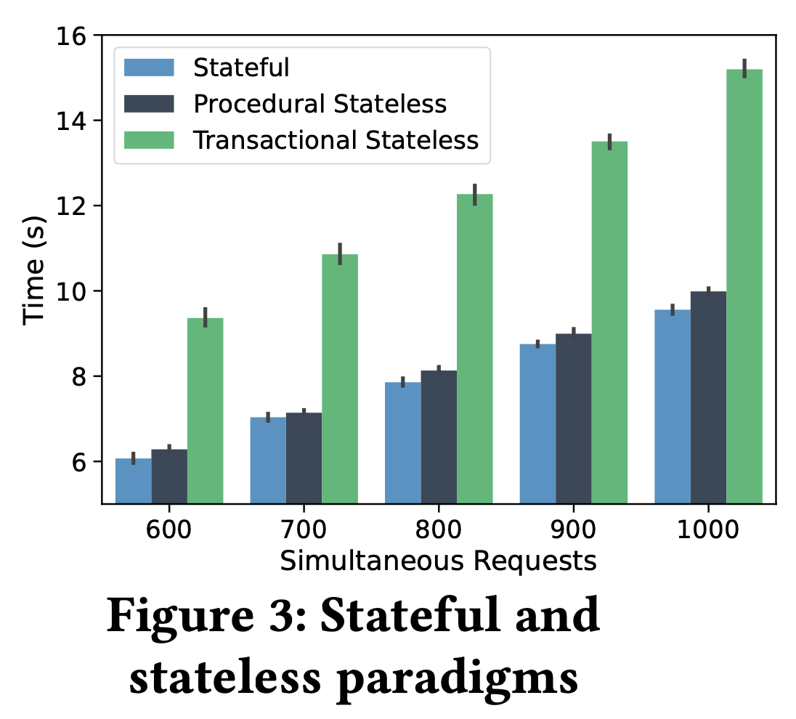
The Cost of Stateless Network Functions in 5G EVALUATION
Since there is a single read and a single write from/to the database per NF, no significant time difference between the stateful and procedurally-stateless implementations is observed.
If we compare the stateful and transactionally-stateless implementations, the mean time difference is around 56% which goes up to 71%.
This is because there are additional read-and-write interactions with the database by the three NFs (the AMF, SMF and UPF).
Notes:
實驗結果如圖，因為同樣是single read and single write，因此stateful與procedurally-stateless沒有太大差異。
如果比較stateful與transactionally-stateless，平均時間差距到56%最高到71%
這是因為transactionally-stateless額外的DB寫入所造成的延遲。

Slide 32
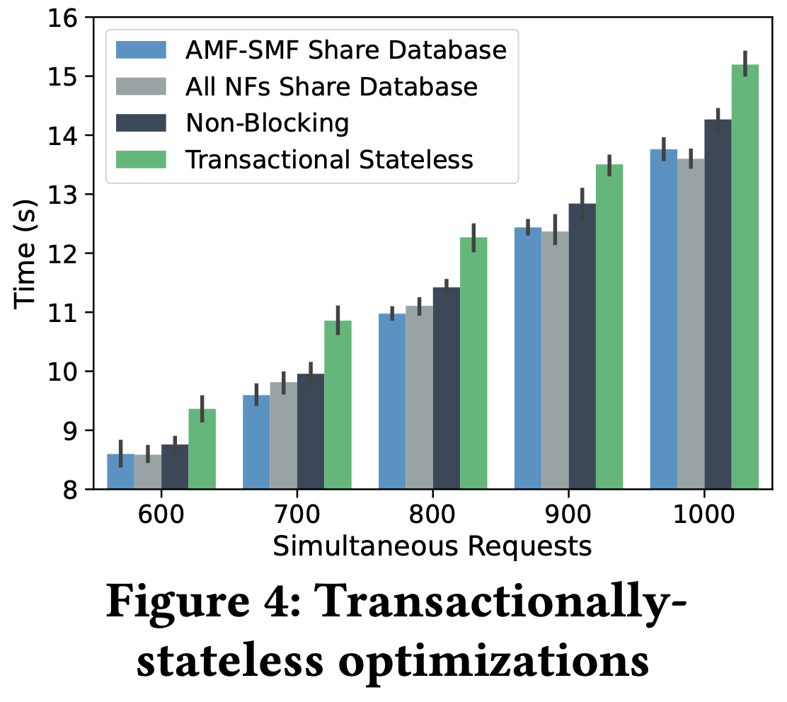
The Cost of Stateless Network Functions in 5G EVALUATION
From Figure 4, we see that both types of sharing yield gains by reducing the number of written transactions to the database.
The improvements over traditional transactional statelessness are 10% on average and can go up to 21% (for 100 to 1000 requests).
Notes:
從圖四中可以看到兩種share Database的方式都可以降低寫入DB的次數。
相較於traditional transactional statelessness ，有平均１０％的進步，最高可以到２１％

Slide 33
The Cost of Stateless Network Functions in 5G EVALUATION
We now experiment with an approach where the AMF and UPF make non-blocking calls to the database.
We create a thread pool during NF initialization, and use a thread from this pool (stack) to serialize and upload the data to the database. Once the upload is complete, the thread is pushed back onto the stack.
This approach saves time over creating and destroying a thread during each transaction.
Notes:
現在再觀察non-blocking的效果，
作者在NF初始化時，也建立的一個thread pool，並且使用pool中的一個thread來序列化資料並將其上傳到資料庫。
當上傳完成後，這個thread就會回到stack中。
這個方法可以節省每個transaction產生及刪除一個thread的時間。

Slide 34
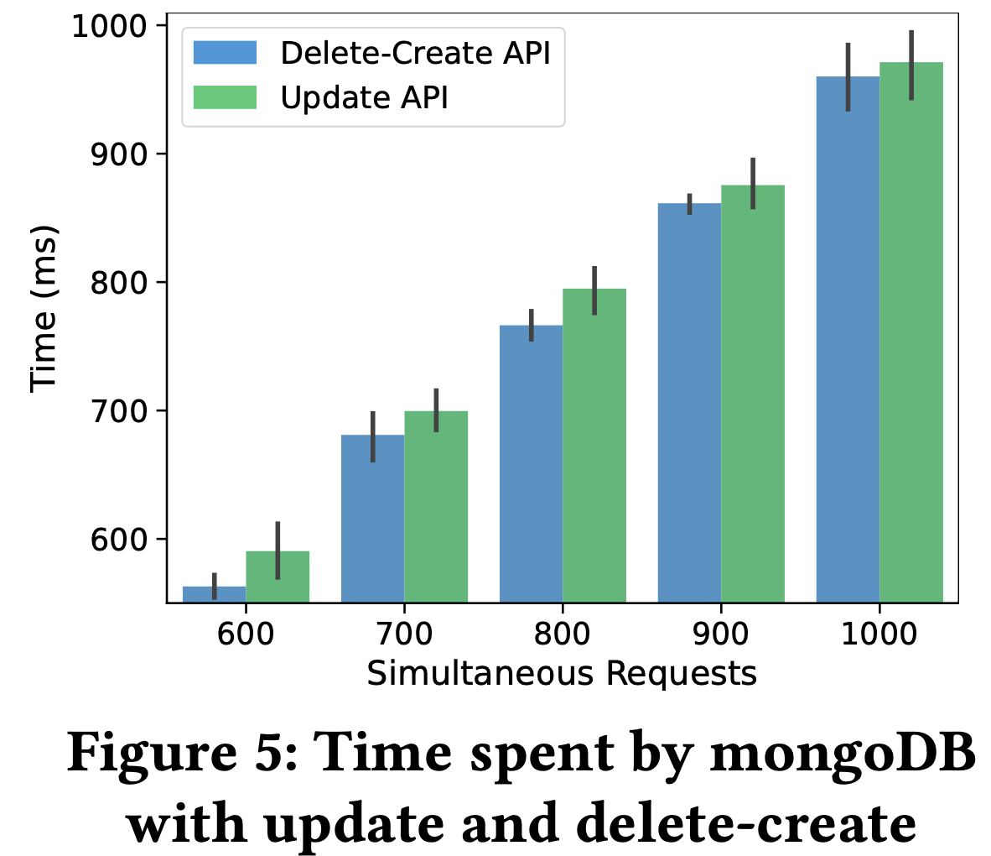
The Cost of Stateless Network Functions in 5G EVALUATION
We explore another optimization by exercising in two ways: (1) using the update API defined in the mongoDB driver, and (2) using a sequence of delete and create APIs.
Although the number of interactions with the database increases with the delete-create API, the total (read + write) time that MongoDB spends on these operations is on average 3.5% lower than the update API (Figure 5).
Notes:
最後是替換DB api的實驗結果，
可以看到雖然將update api拆成del+create會造成指令數量的變多，但比起使用update api，平均還是有3.5%的時間的減少。

Slide 35
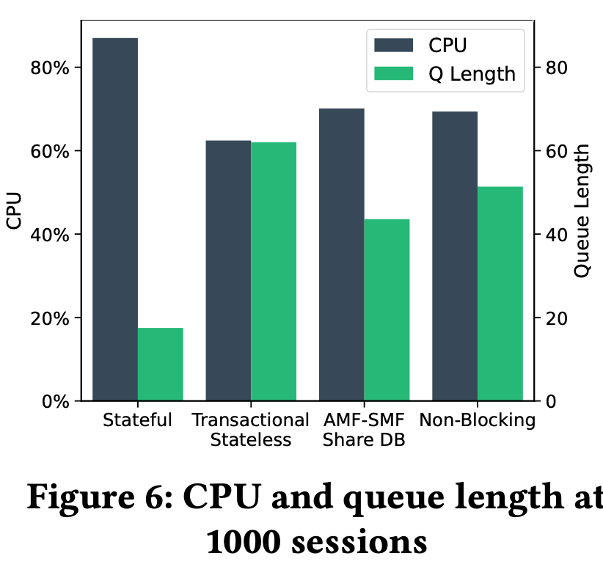
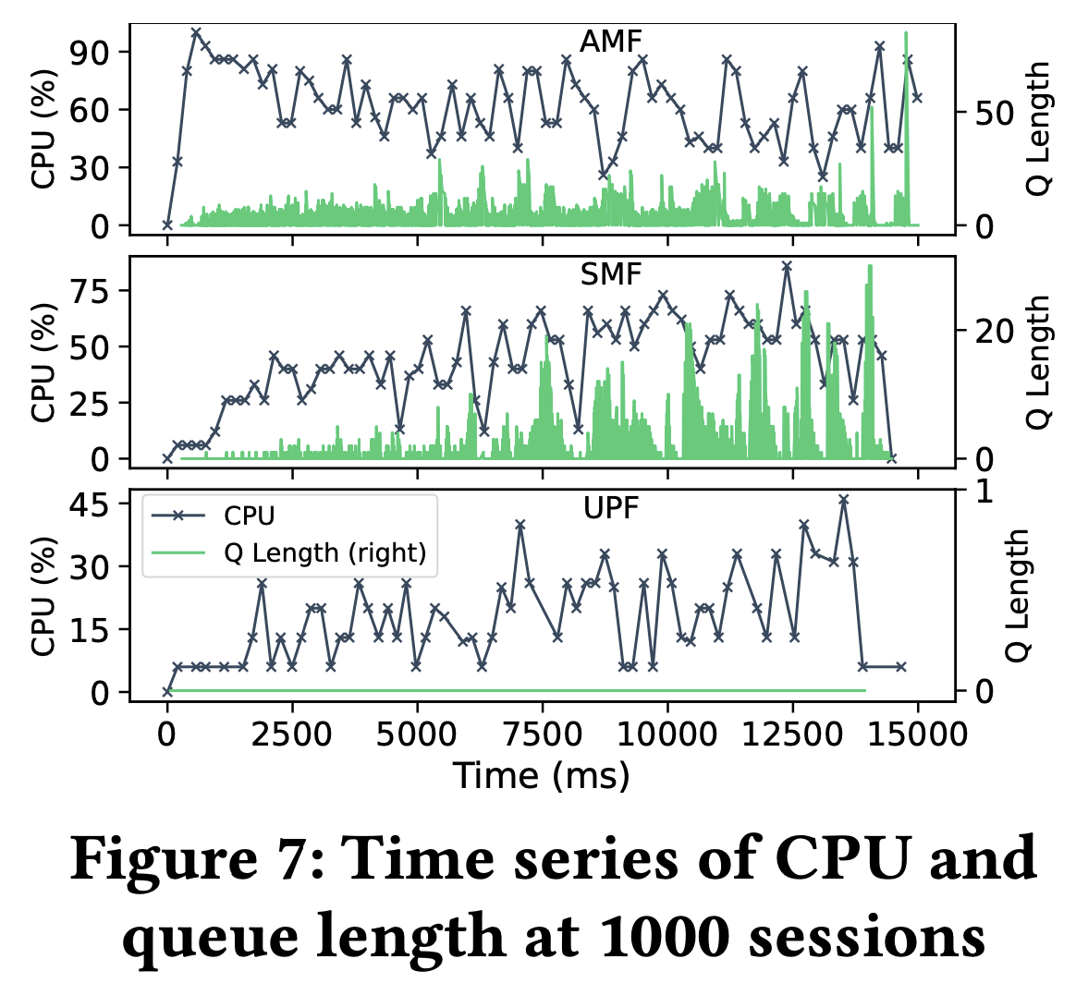
The Cost of Stateless Network Functions in 5G EVALUATION
Since additional computing is involved in the case of transactional statelessness, we expect to see a higher average CPU usage by NFs in this case. We find that the opposite is true.
This trend starts at the first NF in the service chain (AMF) and propagates to the following NFs (SMF, UPF) in the chain. As SMF and UPF process calls and serialize / de-serialize the data, AMF waits for responses from them. Thus, a stateless AMF spends a longer time waiting, making its average CPU usage per unit time lower than with the stateful paradigm.
Notes:
在實驗過程中作者也有額外發現，原先作者預期因為stateless額外的計算，會導致較高的CPU使用率，結果事實相反。
經過觀察圖表後，可以看到當AMF傳播到下層的NFs後，會因為SMF/UPF的序列化時間而開始進入等待。
如此一來就造成每個單位時間，平均處理器使用量反而比stateful的方法還低。

Slide 36
introduction
Towards A Low-Cost Stateless 5G Core
Notes:
接下來介紹2022年7月發表在IEEE的這篇論文

Slide 37
Towards A Low-Cost Stateless 5G Core INTRODUCTION
Considering the time-critical applications of 5G, the telecommunications standards have set the upper limit on the control plane (core) latency to be 10 ms [1].
At the same time, the 3GPP standards recommend stateless 5G network functions (NFs).
In this poster, we propose a new optimization on top of database sharing, where we reduce the number of read operations to a single read operation.
We achieve this by sending the data to the next NF in a service function chain (SFC) over the standard end-user state creation/modification request.
Reduces the cost of transactional statelessness by more than 33%, which is 22% more than the previously proposed state-sharing optimization.
Notes:
跟前一篇論文類似，作者在這邊說考慮到5G的低延遲要求，以及10ms延遲的標準，
再加上3GPP建議stateless 5G NFs
在這篇論文中，會提出一個新的優化方式，將對資料庫的讀取數量減少到只有一個讀取動作
作者透過將資料傳送到下一個NF來完成這件事，根據實驗結果這個方式相較於傳統stateless可以減少高達33%，比前一篇提出的方法高出22%

Slide 38
REDUCING STATELESS NF LATENCY
Towards A Low-Cost Stateless 5G Core

Slide 39
Towards A Low-Cost Stateless 5G Core REDUCING STATELESS NF LATENCY
The total cost of transactional statelessness is 4 × n messages, where n is the number of NFs in an SFC.
The goal of this work is to reduce the 2 × n read cost to just two messages, by taking advantage of the sequential execution of requests and responses in an SFC.
We take advantage of the serial execution of transactions so that only the first NF (NF1) needs to read the user’s state from the database.
NF1 can then embed this data in the underlying 5G control-plane request. The receiving side NF (NF2) extracts the data from the request and uses it to process the remaining part of the request.
The process of embedding the data into the requests continues until the last NF in the SFC.
Notes:
如同上篇論文所提，一個transactional statelessness 會有 4 × n messages
目標是將原本2xn的讀取數量，降低到總共僅剩兩條訊息。
作者利用transactions中一系列執行的優勢，讓僅有第一個NF1從資料庫拿取所需的user state。
接著NF1將資料嵌入在control-plane的request中，NF2收到request後就可以提取這些資料。
這個動作會重複直到SFC中最後一個ＮＦ

Slide 40
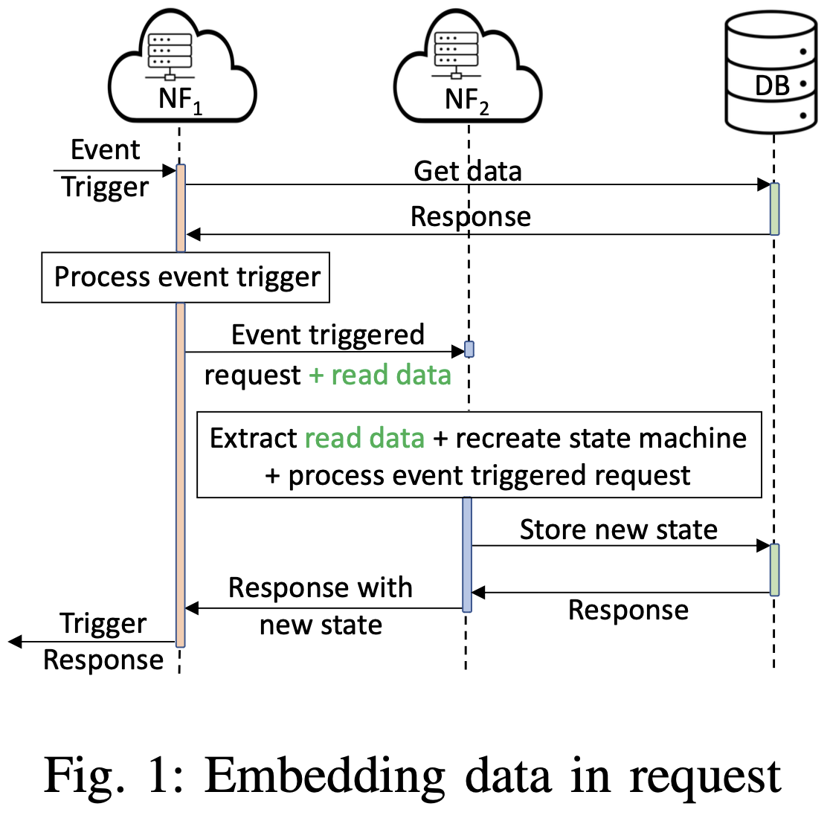
Towards A Low-Cost Stateless 5G Core REDUCING STATELESS NF LATENCY
Notes:
就像圖片中的這樣，NF1拿取資料後就會將data與request合併在一起傳給下一個NF。

Slide 41
evaluation
Towards A Low-Cost Stateless 5G Core
Notes:
接下來是評估章節

Slide 42
Towards A Low-Cost Stateless 5G Core EVALUATION
5.4.0-77-generic kernel with Ubuntu 20.04 and Kubernetes v1.23
A network with 15 nodes, 11 of which constitute a Kubernetes cluster with one master and ten worker nodes.
open5gs v2.3.4 which is written in C
MongoDB v5.0.3
UERANSIM v3.2.5 which is written in C++
Notes:
跟前篇論文的環境都一樣，僅有部分的小版本改變

Slide 43
Towards A Low-Cost Stateless 5G Core EVALUATION
We trigger this procedure through “UE registration,” which involves communication between almost all functions within the 5G system (UE, RAN, AMF, SMF, UPF, PCF, UDR, UDM, NRF, NSSF, and AUSF).
Compare three alternatives: (1) Fully transactionally-stateless NFs as the baseline, (2) Our previously proposed optimization where NFs share the database, (3) The proposed optimization of embedding read data.
We vary the number of simultaneous requests made between 600 and 1000, in steps of 100.
Notes:
一樣使用UE registration來trigger procedure。
這邊會比較三種選擇，1.Fully transactionally-stateless 作為基準，2. 前一篇提出的優化方式、3. 這篇提出的優化方式。
會同時發送600到1000的request，以100為一個單位增加

Slide 44
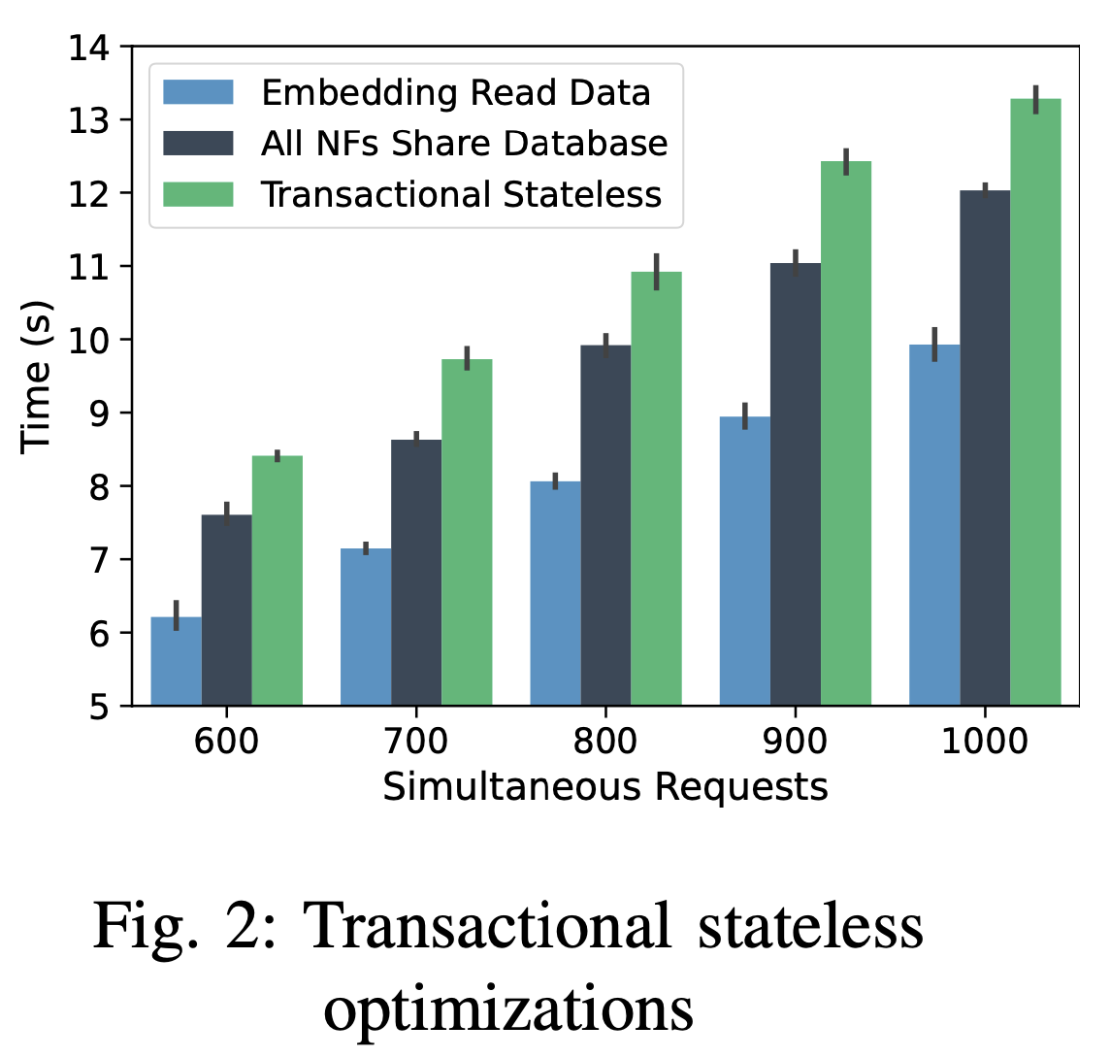
Towards A Low-Cost Stateless 5G Core EVALUATION
In the embedding optimization, each NF sends additional data, and the serialization/de-serialization of this data incurs additional processing costs. However, is still the lowest.
The average reduction in time for the embedding optimization is 33% over the standard transactionally stateless baseline and 22% over the state-sharing optimization.
Notes:
在embedding優化方式中，每個NF都會傳送額外的data，以及額外的序列/去序列化時間，然而雖然有這些額外成本，embedding優化仍然是所費時間最低的方式。
平均下來，使用embedding優化，可以比傳統的transaction stateless 減少３３％的處理時間，相較於前一篇論文提出的方法，可以減少２２%的處理時間

Slide 45
Conclusion & FUTURE WORK
The Cost of Stateless Network Functions in 5G
Towards A Low-Cost Stateless 5G Core

Slide 46
CONCLUSION & FUTURE WORK
We have introduced a number of state management optimizations for 5G networks and compared their cost to a stateful implementation.
Procedural statelessness has a low-performance overhead but has robustness concerns. Transactional statelessness is robust, at the cost of higher performance overhead.
Applying these optimizations to the entire call flow would increase the performance gains.
As future work, we plan to break down 5G control-plane signaling cost with multiple microservices for each NF, in order to better understand the overhead of inter-microservice communication and state management as the number of microservices in an SFC increases.
Notes:
作者提出了數種state管理優化以及與stateful相互比較。
Procudural有低性能開銷的優勢，但有可靠性的憂慮，
而Transactional statelessness雖然穩定性較高，但代價是更高的性能開銷。
如果使用這些優化方式到整個call flow，可以增加伺服器性能。
在未來，作者希望可以透過多個NF的微服務，拆解5G control-plane，以便更好地了解隨著微服務數量的增加，微服務間溝通和state管理的開銷。

