Slide 1
B-TSCA: Blockchain Assisted Trustworthiness
Scalable Computation for V2I Authentication in VANETs
CHEN WANG , JIAN SHEN , JIN-FENG LAI , AND JIANWEI LIU
(2021) IEEE Transactions on Emerging Topics in Computing
IF: 6.595
Notes:
B-TSCA：用於 VANET 中 V2I 身份驗證的區塊鏈輔助可信度可擴展計算
作者皆來自中國

Slide 2
ABSTRACT
Much research focused on secure communication in VANETs, especially V2V or V2I communications. However, they often require complex re-authentication when vehicles enter a new infrastructure coverage, which greatly reduces the efficiency of the entire network. In this article, blockchain is utilized to enhance the scalability of the trustworthiness scalable computation.
The proposed blockchain assisted trustworthiness scalable computation based V2I authentication (B-TSCA) scheme achieves rapid re-authentication of vehicles through secure ownership transfer between infrastructures. Blockchain technology ensures the decentralization and non-tamper ability of the scalable computation result. The security analysis indicates that B-TSCA scheme is a CDH-secure scheme. The time cost of the novel handover authentication phase is half of that of the initial one as is presented in the simulation.
Notes:
VANET 是智能駕駛的主要環境，提供道路信息、V2V 或V2I 之間的即時通信。 VANET 的信息交互安全對於交通的正常運行至關重要。 近年來的許多研究都集中在 VANET 中的安全通信，尤其是安全的 V2V 或 V2I 通信。 然而，當前的安全方案在車輛進入新的基礎設施覆蓋範圍時往往需要進行複雜的身份重新認證，降低了整個網絡的效率。
區塊鏈的出現為克服上述 VANET 中的挑戰創造了機會。
在本文中，區塊鏈被用來增強可信任可擴展計算的可擴展性。 所提出的基於區塊鏈輔助可信可擴展計算的 V2I 身份驗證（B-TSCA）方案通過基礎設施之間的安全所有權轉移實現了車輛的快速重新認證。區塊鏈技術輔助保證了可擴展計算結果的去中心化和不可篡改。 安全性分析表明B-TSCA方案是一種CDH安全方案。 新的切換認證階段的時間成本是模擬中顯示的初始階段的一半。

Slide 3
INTRODUCTION
VANETs are the most considered network model for an intelligent transportation system. The decentralization, heterogeneity and nontrustworthiness of VANETs pose the challenges in secure message-transmission and transaction-execution [1], [2]. Integrating blockchains with VANETs can provide solutions to some existing challenges.
The establishment of VANETs can greatly promote breakthroughs in applications such as driverless and intelligent road rescue. The complex VANETs require the data transmission schemes to be extremely scalable.
Hence, scalable computation is an important part of advancing VANETs technology. Furthermore, the increasing data scale of IoT and new trends in data applications have spurred the growing demand for scalable computation in new networks [6], [7].
Notes:
下一代網絡的發展推動了智能交通的研究。 VANET 是智能交通系統考慮最多的網絡模型。 VANET 的去中心化、異構性和不可信任性對安全消息傳輸和交易執行 [1]、[2] 提出了挑戰。將區塊鏈與 VANET 集成可以為一些現有挑戰提供解決方案。
VANETs的建立可以促進無人駕駛、智能道路救援等應用的突破。複雜的 VANET 要求數據傳輸方案具有極高的可擴展性。
因此，可擴展計算是推進 VANET 技術的重要組成部分。此外，物聯網（IoT）數據規模的不斷擴大和數據應用的新趨勢刺激了新網絡對可擴展計算的需求不斷增長[6]，[7]。

Slide 4
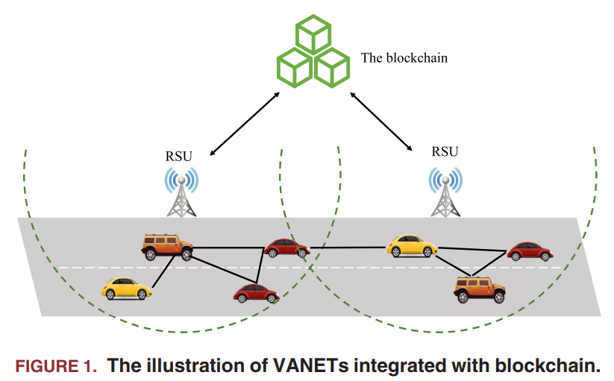
In traffic networks, vehicles collect and upload their own attribute data or surrounding road condition information monitored by on-board units (OBUs) [8], [9]. Meanwhile, roadside infrastructure and remote servers can collect and analyze uploaded information.
The appearance of blockchain provides a solution for VANETs to solve the problems of trustworthiness scalable computation [12], [13].
Notes:
在交通網絡中，車輛收集並上傳自身的屬性數據或由車載單元（OBU）監控的周圍路況信息[8]，[9]。 同時，路邊基礎設施和遠程服務器可以收集和分析上傳的信息。根據分析結果，交通控制中心製定了最優的交通流量管理策略和應急響應方法[10]，[11]。
區塊鏈的出現為 VANETs 解決可信可擴展計算問題提供解決方案 [12]，[13]。
一個具體的集成了區塊鏈的VANET一般由三個主體組成：
車輛單元
主要指各類車輛，其上部署傳感器節點等OBU，採集車輛屬性參數和車輛周邊路況信息[14]。
路邊基礎設施
通常是指用作通信中繼節點的路邊單元 (RSU)。
由基礎設施維護的區塊鏈。
用於記錄網絡中車輛的屬性和可信度。

Slide 5
Trustworthiness is an important reference for the reliability of the network. Trustworthiness scalable computation can help system evaluate the trustworthiness of a changing vehicle. Simultaneously, the secure release of the traffic control information from the remote server can also be guaranteed. Without a trusted third party, blockchains enable the trustworthiness be computed and be validated in a mutually distrusted system with a decentralized consensus.
Secure V2I communication can provide a channel for uploading vehicle attribute parameters and their surrounding road condition information. On account of the authentication of vehicles to be contacted with, the trustworthiness of a vehicle needs to be evaluated from time to time. The trustworthiness comes primarily from the evaluation of all aspects of the vehicle attributes collected by OBUs. What’s more, the scalable computing ability is especially critical for trustworthiness computation.
Notes:
Trustworthiness 是衡量網絡可靠性的重要參考。可信度可擴展計算可以幫助系統評估不斷變化的車輛的可信度。同時也可以保證遠程服務器的流量控制信息的安全發布。在沒有受信任的第三方干預的情況下，區塊鏈可以在具有去中心化共識的相互不信任的系統中計算和驗證可信度。VANET [15]、[16] 中涉及各種類型的通信關係。
安全的V2I通信可以提供上傳車輛屬性參數及其周邊路況信息的通道。 由於接觸車輛的身份驗證，需要根據上傳的屬性不時評估車輛的可信度。車輛的可信度在 VANET 中至關重要。可信度主要來自對OBU收集的車輛屬性的各個方面的評估。更重要的是，可擴展的計算能力對於可信度計算尤為重要。

Slide 6
A. MOTIVATION
Every terminal in VANETs may suffer from all kinds of malicious attacks. Most schemes nowadays designed for V2I communication require the vehicles to re-authenticate with every RSU when they join different RSUs. However, they also cause large communication overhead and redundant operation, which leads to a lot of unnecessary overhead and reduces the efficiency of the vehicle network.
Thus, it is necessary to reduce the redundancy caused by repeated authentication, so as to reduce the computing burden of vehicles and the network time delay. Additionally, it is challenging to assure the trustworthiness in decentralized nontrusted VANETs and restrict the misbehaving vehicles [17]. Moreover, there is a lack of scalability in the computation of vehicle trustworthiness, which leads to the inability to adapt to the changing needs of vehicle networks.
Notes:
VANETs中的每個終端都可能遭受各種惡意攻擊。現在大多數為 V2I 通信設計的方案都要求車輛在加入不同 RSU 的範圍時對每個 RSU 重新進行身份驗證。然而，這些認證方式雖然每次都能對車輛的身份進行認證，但也帶來了通信開銷大、冗餘操作等問題導致不必要的開銷，降低車輛網絡的效率。
因此，需要減少重複認證帶來的冗餘，以減輕車輛的計算負擔和網絡時延。此外，確保去中心化的不受信任的 VANET 的可信度並限制惡意的車輛 [17] 具有挑戰性。此外，車輛可信度的計算缺乏可擴展性，導致無法適應車輛網絡不斷變化的需求。

Slide 7
Our Contributions
The novel scheme is named as a blockchain assisted trustworthiness scalable computation based V2I authentication (B-TSCA) scheme. The contributions can be described as follows:
  Blockchain Based Tamper-Resistant and Traceable Vehicle Attribute Record is Designed.
  Tamper-resistance and traceability of the vehicle attributes are two essential properties of vehicle
  authentication in VANETs. Blockchain record the vehicle attributes and trustworthiness.
  A Novel Scalable Computation System is Presented for Trustworthiness Evaluation. Trustworthiness computation ensures the reliability of the authenticated vehicle. In VANETs, the scalability of trustworthiness computation is very important, because the performance, number and relationship of vehicles in the network change at any time.
Notes:
在本文中，針對上述問題提出了一種可能的解決方案。 該新方案被命名為基於區塊鏈輔助可信可擴展計算的 V2I 身份驗證（B-TSCA）方案。 本文的貢獻可以描述如下：
設計了基於區塊鏈的防篡改可追溯車輛屬性記錄。
車輛屬性的防篡改和可追溯性是 VANET 中車輛身份驗證的兩個基本屬性。 在本文中，使用區塊鏈來記錄車輛屬性和可信度。區塊鏈具有防篡改和可追溯性。車輛屬性的變化被視為比特幣交易中的數據變化。不可篡改保證了車輛的屬性不能被任意篡改，從而保證了可信度計算的可靠性。溯源性保證車輛的可信度隨時可查詢，通過歷史數據分析，為可信度計算提供更可靠的參考。
提出了一種用於可信度評估的新型可擴展計算系統。
可信度計算可確保經過身份驗證的車輛的可靠性。在VANETs中，可信度計算的可擴展性非常重要，因為網絡中車輛的性能、數量和關係隨時都在變化。需要實時記錄這些變化，以便分析車輛的可靠性。在本文中，我們提出了一個區塊鏈輔助的可信度可擴展計算系統。RSU 作為系統中的礦工，通過共識機制實現可信度的驗證。該系統利用默克爾哈希樹（MHT）實現車輛屬性的實時記錄。記錄可以針對新車、不同車型等網絡中的新變化進行擴展，大大增加了系統的實用性。

Slide 8
  A Time-Efficient V2I-Handover Authentication Scheme is Proposed.
  For the new vehicles entering the network, initial authentication phase combines the blockchain-assisted trustworthiness scalable computation, and utilizes the queried trustworthiness value to check the reliability of the vehicle with low client computing overhead.
  Handover phase is designed for the following authentication of a vehicle when it is already a legal member of the network by the initial authentication. Some handover message and a token are utilized to simplify this handover authentication phase and save time on calculations in subsequent vehicle authentication processes.
Notes:
提出了一種時間高效的 V2I 切換認證方案。
對於新入網的車輛，本文給出了詳細的初始認證階段。該階段首先結合區塊鏈輔助的可信度可擴展計算，利用查詢到的可信度值來檢驗車輛的可靠性。初始階段能夠以較低的客戶端計算開銷對新車輛進行身份驗證。通過這種認證，路邊基礎設施能夠充分確認車輛的合法性。
更重要的是，當車輛通過初始認證已經是網絡的合法成員時，設計了一個額外的切換階段用於車輛的後續認證。利用一些切換消息和令牌來簡化這個切換認證階段並且節省後續車輛認證過程中的計算時間。交接階段的設計使得車輛所有權在不同RSU之間的轉移變得方便和安全，這使得網絡更具可擴展性。

Slide 9
B. RELATED WORK
VANET authentication has generated considerable recent research interest. In addition, blockchains are also widely utilized in the integration of new technologies in VANETs.
Solutions for the privacy protection of vehicles.
  Huang et al. [18] presented a pseudonymous authentication scheme for conditional privacy in VANETs. The scheme can provide vehicle anonymity and revocation. However, achieve motor vehicles division which might lead to an additional computing overhead.
  Horng et al. [19] also proposed a secure and privacy enhancing communication schemes for vehicle-to-vehicle communications which can resist impersonation attack. Roadside infrastructure RSUs were utilized to collect messages from vehicles in their scheme, while V2I communications were not considered.
  Zhong et al. [20] presented a privacy-preserving authentication scheme with full aggregation in VANETs using certificateless aggregate signature to achieve secure vehicle-to-infrastructure (V2I) communications.
Notes:
VANET 身份驗證最近引起了相當大的研究興趣。 區塊鏈還被廣泛用於VANETs中新技術的集成。
車輛隱私保護的解決方案。 黃等 [18] 提出了一種用於 VANET 中條件隱私的假名身份驗證方案。 該方案可以提供車輛匿名和撤銷。 但是，使用越野單元來實現機動車輛劃分，這可能會導致額外的計算開銷。
霍恩等人。 [19] 還提出了一種安全和隱私增強的車對車通信方案，可以抵抗假冒攻擊。
在他們的計劃中，路邊基礎設施 RSU 被用來收集來自車輛的信息，而沒有考慮 V2I 通信。
鐘等 [20] 提出了一種在 VANET 中完全聚合的隱私保護認證方案，使用無證書聚合簽名來實現安全的車輛到基礎設施（V2I）通信。

Slide 10
Achieved authentication with signature.
  Biswas et al. [21] verified messages of each vehicle according to data link layer priorities and the application relevance of individual safety messages. A cross-layer privacy-preserving authentication scheme was proposed for OBUs and RSUs. However, the scheme was proven to be insecure against secret key recovery attacks [22].
  After that, Cui et al. [23] proposed a self-healing key distribution method with a certificateless signature in VANETs.
Batch authentication
  Shao et al. [24] proposed a group authentication scheme for both V2V and V2I authentication in VANETs, which is actually a signature scheme providing no message encryption.
  Jiang et al. [25] achieved batch authentication by calculating the hash message authentication code. Cuckoo filter and the binary search methods were utilized in [26] and was claimed to achieve high success rate in the batch verification phase.
Notes:
一些研究人員通過簽名實現了身份驗證。
比斯瓦斯等。 [21] 根據數據傳輸層優先級和各個安全消息的應用相關性驗證每輛車的消息。 針對OBU和RSU提出了跨層隱私保護認證方案。 然而，該方案被證明無法抵禦密鑰恢復攻擊 [22]。 之後，崔等人。 [23] 提出了一種在 VANET 中使用無證書籤名的自愈密鑰分發方法。
批量認證也是 VANET 中組驗證的一個重要研究課題。 邵等。 [24] 提出了一種針對 VANET 中 V2V 和 V2I 身份驗證的組身份驗證方案，這實際上是一種不提供消息加密的簽名方案。 薑等。 [25]通過計算哈希消息認證碼實現批量認證。 布穀鳥過濾器和二進制搜索方法在[26]中被使用，並聲稱在批量驗證階段實現了高成功率。

Slide 11
Road condition monitoring is one of the main purposes of the development of VANETs.
  Wang et al. [27] presented a source authentication scheme for road condition monitoring associated by cloud computing technology. Multi-keys were utilized in authentication scheme proposed in [28] to achieve location based services in VANETs.
The application of blockchain for trustworthiness computation in VANETs.
  Yang et al. [29] developed a trust-management platform in VANETs on top of blockchains. The trustworthiness of messages can be validated via proof of work (PoW) and proof of stake (PoS) consensus executed by RSUs. Lu et al. [30] presented a blockchain-based trust management scheme for VANETs. The scheme is utilized to break the link ability between the real ID and the public key.
However, the excising research has not paid much attention to the authentication when the vehicle travels from one RSU coverage to the next. Simultaneously, the attribute parameters of vehicles are not fully utilized to compute the trustworthiness of a vehicle, so as to improve the reliability and scalability of VANETs.
Notes:
路況監測是VANET發展的主要目的之一。 王等 [27] 提出了一種基於雲計算技術的路況監測源認證方案。 在 [28] 中提出的身份驗證方案中使用了多密鑰，以在 VANET 中實現基於位置的服務。
研究人員還提出了一些在 VANET 中應用區塊鏈進行可信度計算的方案。 例如，楊等人。 [29] 在區塊鏈之上的 VANET 中開發了一個信任管理平台。 消息的可信度可以通過 RSU 執行的工作量證明 (PoW) 和權益證明 (PoS) 共識來驗證。
盧等人。 [30] 提出了一種基於區塊鏈的 VANET 信任管理方案。 該方案用於打破真實ID和公鑰之間的關聯性。
然而，現有的研究並沒有過多關注車輛從一個 RSU 覆蓋範圍行駛到下一個 RSU 覆蓋範圍時的身份驗證。 同時，沒有充分利用車輛的屬性參數來計算車輛的可信度，從而提高VANETs的可靠性和可擴展性。

Slide 12
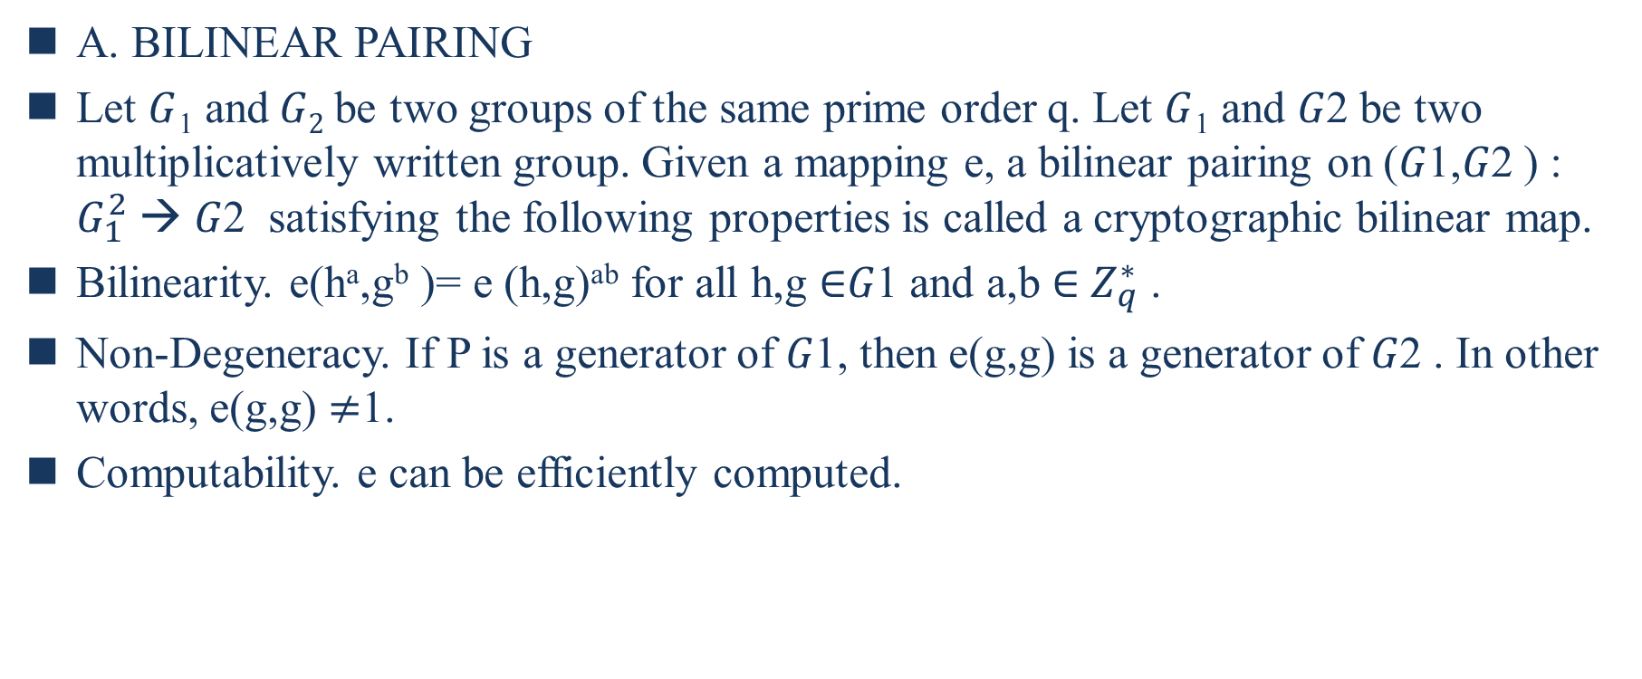
II. PRELIMINARIES
A. BILINEAR PAIRING
Let $G$₁ and$G2$be two groups of the same prime order q. Let $G$₁ and 𝐺2 be two multiplicatively written group. Given a mapping e, a bilinear pairing on (𝐺1,𝐺2 ) : $G_{1}^{2} →$ 𝐺2 satisfying the following properties is called a cryptographic bilinear map.
Bilinearity. e(hª,g^{b} )= e (h,g)^{ab} for all h,g $∈$𝐺1 and a,b $∈$ $Z_{q}^{∗}$ .
Non-Degeneracy. If P is a generator of 𝐺1, then e(g,g) is a generator of 𝐺2 . In other words, e(g,g) $≠$1.
Computability. e can be efficiently computed.
Notes:
在本節中，列出了一些必要的準備工作，例如雙線性配對和計算 Diffie-Hellman 假設
令 G1和 G2為階數皆為 q 的兩組質數階乘法循環群。令 G11 和 G22 為兩個乘法群。
兩個G1上面的點連線後會映射到G2上面的為一點
給定映射 e，在 (G1,G2) : G21 →→ G2 滿足以下性質的稱為密碼雙線性映射。
雙線性 : 對於所有h,g ∈∈G1以及a,b∈∈ Z∗q , e (ha , gb) = e (h,g)ab 。整數有線與
非退化性 : 如果 P 是 ＄G1＄ 的生成元，則 e(g,g)是 G2 的生成器。 換句話說，e(g,g) ≠≠ 1。非退化性保证了只要我们选择椭圆曲线上的非单位成员G，就能得到目标群中的非单位元
可計算性 : 可以有效地計算 e。

Slide 13
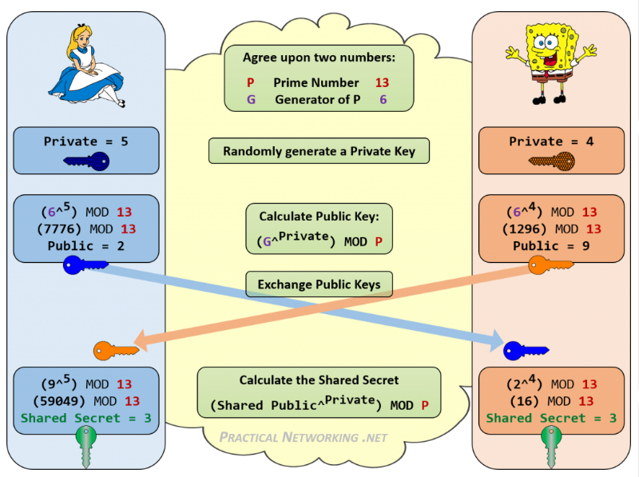
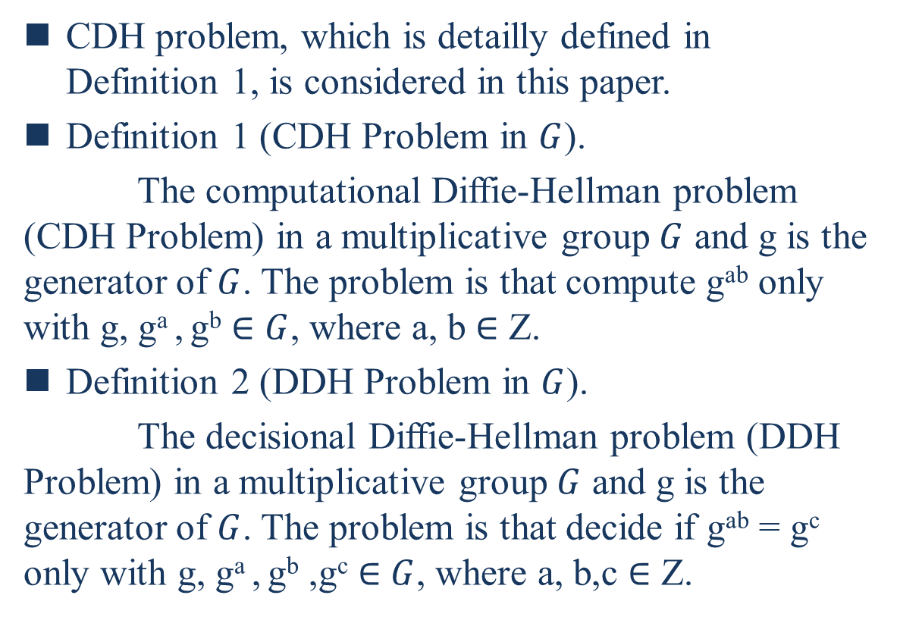
B. COMPUTATIONAL DIFFIE-HELLMAN (CDH) ASSUMPTION
CDH problem, which is detailly defined in Definition 1, is considered in this paper.
Definition 1 (CDH Problem in $G$).
The computational Diffie-Hellman problem (CDH Problem) in a multiplicative group $G$ and g is the generator of $G$. The problem is that compute g^{ab} only with g, gª , g^{b} $∈$ $G$, where a, b $∈$ Z.
Definition 2 (DDH Problem in $G$).
The decisional Diffie-Hellman problem (DDH Problem) in a multiplicative group $G$ and g is the generator of $G$. The problem is that decide if g^{ab} = g^{c} only with g, gª , g^{b} ,g^{c} $∈$ $G$, where a, b,c $∈$ Z.
Notes:
本文考慮了Def1 中詳細定義的 CDH 問題。
留言
Def1（G 中的 CDH 問題）。 乘法群 G 中的計算 Diffie-Hellman 問題（CDH 問題）, g 是 G 的生成器。問題是只用 g , ga, gb∈∈ G計算 gab； 其中a, b ∈∈ Z。
Def2（G 中的 DDH 問題）。 乘法群 G 中的決策 Diffie-Hellman 問題（DDH 問題）,g 是 G 的生成器。 問題是決定 whether gab = gc , 當g, ga gb, gc ∈∈ G ；其中a, b, c ∈∈ Z。
顯然 DDH 比 CDH 弱，因為如果我們能夠解決 CDH，我們就可以確定地知道 DDH 問題的答案。儘管如此，DDH 問題被認為在某些群上是困難的，例如某些橢圓曲線，但在其他群上則不是，如下圖所示。

Slide 14
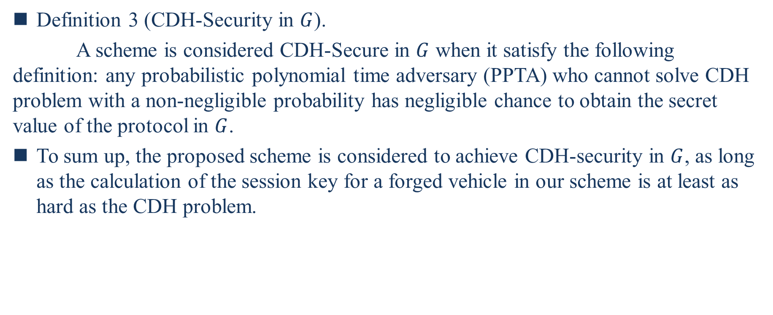
Definition 3 (CDH-Security in $G$).
A scheme is considered CDH-Secure in $G$ when it satisfy the following definition: any probabilistic polynomial time adversary (PPTA) who cannot solve CDH problem with a non-negligible probability has negligible chance to obtain the secret value of the protocol in $G$.
To sum up, the proposed scheme is considered to achieve CDH-security in $G$, as long as the calculation of the session key for a forged vehicle in our scheme is at least as hard as the CDH problem.
Notes:
Def3（G 中的 CDH-安全）。 當一個方案滿足以下定義時，它在 G 中被認為是 CDH 安全的：任何不能以不可忽略的概率解決 CDH 問題的概率多項式時間對手（PPTA）獲得 G 中協議的秘密值的機會可以忽略不計。
留言
綜上所述，只要在我們的方案中計算偽造車輛的會話密鑰至少與 CDH 問題一樣困難，就認為所提出的方案在 G 中實現了 CDH 安全性。

Slide 15
III. SYSTEM MODEL AND SECURITY MODEL
A vehicle will pass through the coverage of different RSUs and needs to continuously authenticate with these RSUs. An RSU needs to identity authentication of all vehicles entering its signal coverage range and the information interaction with legal vehicles.
The system model is composed of two main parts:
The trustworthiness scalable computation part
  vehicles : the uploader of attributes collected by the OBUs on the vehicle
  RSUs : evaluating the vehicles and recording the results into the blockchain.
The network authentication part
  vehicles : apply to join the jurisdiction of an RSU,
  RSU : judging whether the vehicle is qualified to enter the network within its coverage. Certified vehicles will be utilized for aggregation and delivery of traffic condition, and will receive real-time information feedback from RSUs.
Notes:
車輛在路上行駛時，會經過不同RSU的覆蓋範圍。它需要不斷地與這些 RSU 進行身份驗證才能進入網絡並參與消息交互。
RSU需要負責所有進入其信號覆蓋範圍的車輛的身份認證，以及與合法車輛的信息交互。
該系統由兩個主要部分組成：可信可伸縮計算部分和網絡認證部分。車輛和 RSU 在這兩個部分中扮演著不同的角色。
在可信度可擴展計算部分
車輛被視為車輛上OBU收集的屬性的上傳者，
RSU負責評估車輛並將結果記錄到區塊鏈中。
在網路認證部分
車輛需要申請加入一個RSU的管轄，
RSU負責判斷車輛在其覆蓋範圍內是否有資格進入網路。通過認證的車輛將用於聚合和傳遞交通狀況，並將接收來自 RSU 的實時信息反饋。

Slide 16
The components of this system are listed as follows:
Key Generation System: KGC is a trusted component for key generation and distribution.
The Blockchain: Record the attributes and trustworthiness of vehicles.
Roadside units (RSUs) :Responsible for collecting vehicle attribute information and conducting trustworthiness scalable computation on vehicles, and maintaining the trustworthiness blockchain. It’s also responsible for authenticating the identity of a vehicle.
Vehicles: Equipped with lots of sensor nodes, called on-board units (OBUs). OBUs collect real attribute information of the vehicle and send to the nearby RSUs. When vehicles enters the coverage of an RSU, it needs to do initial authentication or handover authentication with the RSU, by using some original parameters distributed by KGC to itself and authentication parameters or tokens sent from the RSU.
Notes:
該系統的組成部分如下：
密鑰生成系統：密鑰生成系統 (KGC) 是密鑰生成和分發的可信組件。
區塊鏈：用於記錄車輛的屬性和可信度。對於車輛認證是非常重要的參考。
路邊單元：負責收集車輛屬性信息並對車輛進行可信可擴展計算，並維護可信區塊鏈。此外，RSU 還負責驗證車輛的身份。如果車輛尚未在網絡中進行身份驗證，則 RSU 需要對其進行初始身份驗證。車輛從上一RSU駛出後進入本RSU區域，RSU應藉助上一RSU信息對其進行切換認證。
車輛：裝有大量傳感器節點，稱為車載單元（OBU）。OBU收集車輛的真實屬性信息，並將信息發送給附近的RSU。當車輛進入RSU覆蓋範圍時，需要利用KGC分配給自身的一些原始參數和RSU發送的認證參數或token，與RSU進行初始認證或切換認證。

Slide 17
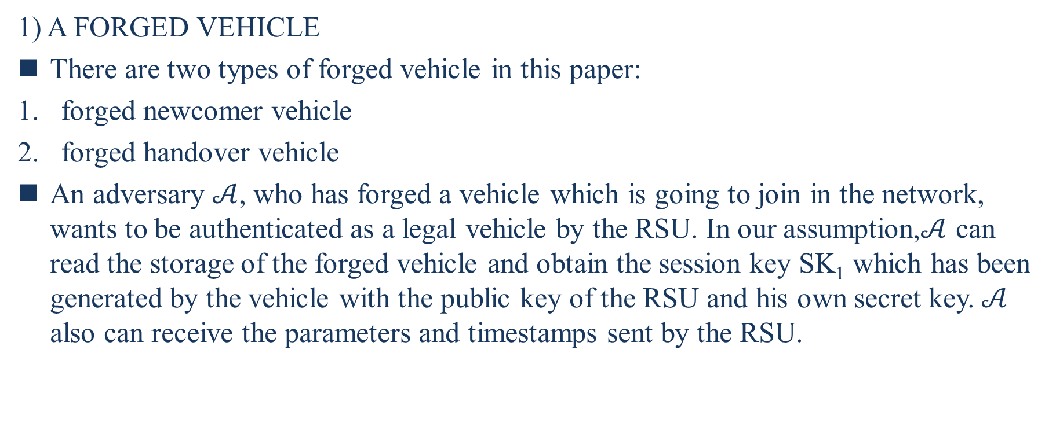
B. SECURITY MODEL
1) A FORGED VEHICLE
There are two types of forged vehicle in this paper:
forged newcomer vehicle
forged handover vehicle
An adversary $𝒜$, who has forged a vehicle which is going to join in the network, wants to be authenticated as a legal vehicle by the RSU. In our assumption,$𝒜$ can read the storage of the forged vehicle and obtain the session key SK₁ which has been generated by the vehicle with the public key of the RSU and his own secret key.$𝒜$ also can receive the parameters and timestamps sent by the RSU.
Notes:
The security model of this paper is presented in this section. Note that, the RSU is considered as a trusted terminal in our scheme.
RSU 在我們的方案中被視為可信終端。
鍛造車輛
本文中的鍛造車輛分為兩種：一種是鍛造newcomer，一種是鍛造handover車。
敵手 A 偽造了要加入網絡的車輛，希望通過 RSU 驗證為合法車輛。 在我們的假設中，A 可以讀取偽造車輛的存儲並獲得由車輛使用 RSU 的公鑰和他自己的密鑰生成的會話密鑰 SK1。A 也可以接收 RSU 發送的參數和時間戳。
敵手 A 偽造了一輛即將加入下一個 RSU 區域的車輛，希望通過下一個 RSU 的身份驗證。 在我們的假設中，A 有能力使用前 RSu 發送的參數獲取車輛生成的前會話密鑰。 A 也可以接收前一個 RSU 發送的參數和時間戳以及下一個 RSU 發送的token。

Slide 18
2) MAN-IN-THE-MIDDLE ATTACK
Man-in-the-Middle (MITM) attack refers to the attack that the attacker intercepts and attempted to tamper with the message. We assume that an MITM attacker have the ability to block the message and implement all necessary calculations.
3) REPLY ATTACK
Replay attack means that the attacker collects authentication messages sent before from the vehicle and to the RSU, trying to pass the authentication by RSU. An old authentication message might be abused by malicious users to achieve their goals.
Notes:
MAN-IN-THE-MIDDLE ATTACK
中間人（MITM）攻擊是指攻擊者攔截並試圖篡改消息的攻擊。這種攻擊會導致原始信息被更改。我們假設 MITM 攻擊者有能力阻止消息並執行所有必要的計算。
REPLY ATTACK
重放攻擊是指攻擊者收集之前從車輛發送到 RSU 的認證消息，試圖通過 RSU 的認證。 在這種攻擊中使用經過身份驗證的消息。 惡意用戶可能會濫用舊的身份驗證消息來實現他們的目標。

Slide 19
IV. BLOCKCHAIN ASSISTED TRUSTWORTHINESS SCALABLE COMPUTATION
In this section, Blockchain assisted trustworthiness scalable computation, which will be utilized in the proposed authentication scheme for region access control and vehicle authentication [31]. In this system, RSU is regarded as the hub of trustworthiness scalable computation, mining the attribute data of vehicles to realize the real-time scalable computation of vehicle trustworthiness.
With consensus mechanism, the reliability of vehicles is guaranteed to be unified in the whole network in real time. Each RSU can find trustworthiness value of any vehicle in blockchain to determine whether the vehicle meets the requirements of information access in the region. The trustworthiness is also utilized to assist the realization of identity authentication. With the aid of the blockchain, the vehicle trustworthiness computation will be more scalable.
Notes:
在本文的區塊鏈輔助的可信度可擴展計算，該計算將用於所提出的區域訪問控制和車輛認證的認證方案 [31]。基於區塊鏈不可篡改、可追溯等特點，設計了區塊鏈輔助可信可擴展計算系統。在該系統中，RSU作為可信度可擴展計算的中樞，挖掘車輛的屬性數據，實現車輛可信度的實時可擴展計算。
通過共識機制，保證車輛的可靠性在全網實時統一。 每個 RSU 可以在區塊鏈中找到任何車輛的可信度值，以確定車輛是否滿足該區域的信息訪問要求。 還利用可信度輔助實現身份認證。借助區塊鏈，車輛可信度計算將更具可擴展性。

Slide 20
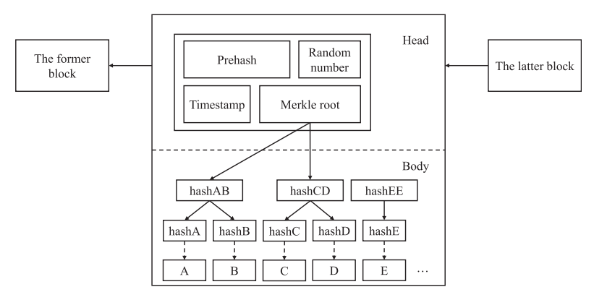
A. THE CONCEPT OF BLOCKCHAIN
A decentralized distributed accounting system. P2P interaction is utilized to avoid the centralized structure. Blockchain applies cryptography technology, timestamp and consensus algorithm to ensure the consistency in each node database, so that records can be instantly verified, transparent and traceable, undeniable and difficult to tamper.
Hash functions are mainly utilized for data integrity preserving, data encryption, consensus calculation for workload proof, block linkage, etc.
Merkle hash tree (MHT), a binary tree, is widely used in blockchain. The hash values of information are stored in the nodes. Each transaction record is calculated as a hash value and be stored as a leaf node in MHT. Then, two leaf nodes are hashed in pairs and stored in the block until the last hash value is taken as the Merkle root.
Notes:
區塊鍊是一種去中心化的分佈式記賬系統。優勢在於可以以非常低的成本處理網絡中的個人誠信記錄等問題。 利用點對點（P2P）交互來避免傳統的中心化結構。 區塊鏈應用密碼學技術、時間戳和共識算法保證各節點數據庫中信息的一致性，使記錄即時可驗證、透明可追溯、不可否認、難以篡改。
hash function主要用於數據完整性保持、數據加密、工作量證明的共識計算、區塊鏈接等。
Merkle hash tree（MHT），在區塊鏈中被廣泛使用。
binary tree通常應用於區塊鏈。信息的hash值存儲在節點中。每條交易記錄都被計算為hash值，並作為葉節點存儲在 MHT 中。 然後，將兩個葉子節點成對hash並存儲在塊中，直到最後一個hash值作為默克爾root。 如圖2所示，節點hashAB的值是兩個葉子節點hashA和hashB的hash值。 當hashE這樣的葉子節點只有一個時，系統會認為是兩個相同的葉子節點，使用上述方法計算hashEE。

Slide 21
B. DETAILS OF BLOCKCHAIN ASSISTED TRUSTWORTHINESS SCALABLE COMPUTATION
Consider a typical VANET, vehicles and RSUs communicating with each other. Every moment, each vehicle node belongs to a unique RSU, and each RSU is responsible for the scalable computation of the trustworthiness value of multiple vehicle nodes. A single RSU is responsible for mining the attribute information of vehicles within its jurisdiction, evaluating it, and entering the evaluated vehicle trustworthiness value into the blockchain ledger.
The trustworthiness scalable computation method for vehicles is first mentioned in [32]. Two definitions are defined well: trustworthiness attribute information (TAI) and trustworthiness level (TL).
Notes:
考慮一個典型的 VANET，車輛和路邊基礎設施 RSU 相互通信。 每時每刻，每個車輛節點都屬於一個唯一的 RSU，每個 RSU 負責可擴展地計算多個車輛節點的可信度值。 單個RSU負責挖掘其轄區內車輛的屬性信息，並對其進行評估，並將評估後的車輛可信值錄入區塊鏈賬本。在[32]中首次提到了車輛的可信度可擴展計算方法。兩個定義：可信賴屬性信息（TAI）和可信賴級別（TL）。

Slide 22
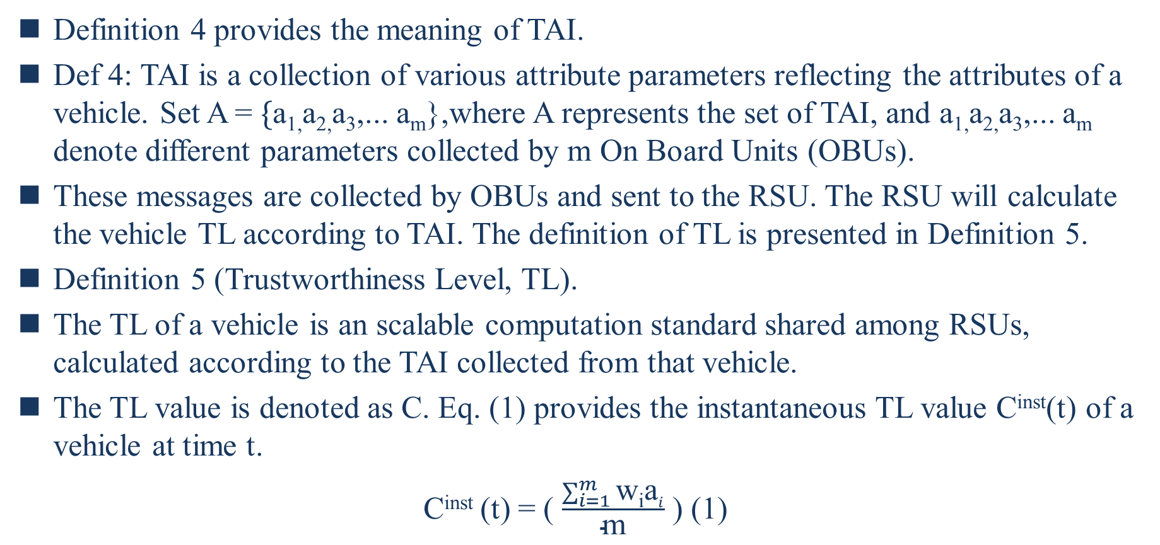
Definition 4 provides the meaning of TAI.
Def 4: TAI is a collection of various attribute parameters reflecting the attributes of a vehicle. Set A = $\{$a_{1,}a_{2,}a₃,... a_{m}},where A represents the set of TAI, and a_{1,}a_{2,}a₃,... a_{m} denote different parameters collected by m On Board Units (OBUs).
These messages are collected by OBUs and sent to the RSU. The RSU will calculate the vehicle TL according to TAI. The definition of TL is presented in Definition 5.
Definition 5 (Trustworthiness Level, TL).
The TL of a vehicle is an scalable computation standard shared among RSUs, calculated according to the TAI collected from that vehicle.
The TL value is denoted as C. Eq. (1) provides the instantaneous TL value C^{inst}(t) of a vehicle at time t.
C^{inst} (t) = ( $\frac{\sum_{i=1}^{m}{\text{w}\text{i}\text{a}i}}{\text{m}}$ ) (1)
Notes:
Def4（可信屬性信息，TAI）。
TAI是反映車輛屬性的各種屬性參數的集合。 設置集合A = {a1, a2, a3, …, am}，其中A代表TAI的集合，a1, a2, a3, …, am表示由 m 個車載單元 (OBU) 收集的不同參數。
這些消息由 OBU 收集並發送到 RSU。 TAI 增加了可信度計算數據源的可擴展性。
RSU 將根據 TAI 計算車輛可信度（TL）。
Def5（可信度，TL）。車輛的 TL 是 RSU 共享的可擴展計算標準，根據從該車輛收集的 TAI 計算得出。TL 值表示為 C. Eq(1) 提供車輛在時間 t 的瞬時 TL 值 Cinst (t)。
留言
其中 wi 是第 i個 TAI 的權重，應謹慎選擇，以便每個參數變化都能反映在 TL 值中。此外，Cinst (t) 是 A 中包含的 m 個屬性的加權平均值。

Slide 23
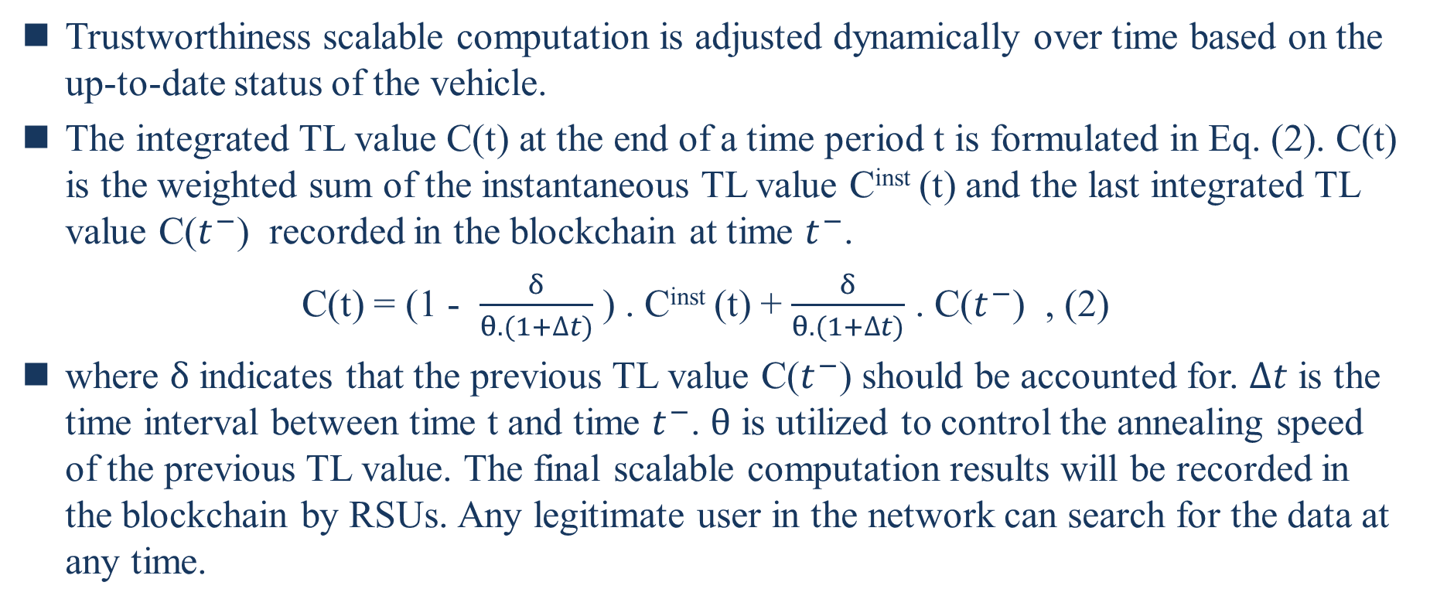
Trustworthiness scalable computation is adjusted dynamically over time based on the up-to-date status of the vehicle.
The integrated TL value C(t) at the end of a time period t is formulated in Eq. (2). C(t) is the weighted sum of the instantaneous TL value C^{inst} (t) and the last integrated TL value C($t^{−}$) recorded in the blockchain at time $t^{−}$.
C(t) = (1 - $\frac{δ}{θ.(1+∆t)}$ ) . C^{inst} (t) + $\frac{δ}{θ.(1+∆t)}$ . C($t^{−}$) , (2)
where $δ$ indicates that the previous TL value C($t^{−}$) should be accounted for. $∆t$ is the time interval between time t and time $t^{−}$. $θ$ is utilized to control the annealing speed of the previous TL value. The final scalable computation results will be recorded in the blockchain by RSUs. Any legitimate user in the network can search for the data at any time.
Notes:
可信度可擴展計算會根據車輛的最新狀態隨時間動態調整。在時間段 t 結束時的綜合 TL 值 C (t) 在列在Eq.(2). C (t) 是瞬時 TL 值 Cinst (t) 與 t− 時刻記錄在區塊鏈中的最後一個積分 TL 值 C (t−)的加權和。
留言
其中 d 表示應考慮先前的 TL 值 C (t−)。 Δt 是時間 t 和時間 t− 之間的時間間隔。θ用於控制前一個TL值的退火速度。 最終可擴展的計算結果將由 RSU 記錄在區塊鏈中。網絡中的任何合法用戶都可以隨時搜索數據。

Slide 24
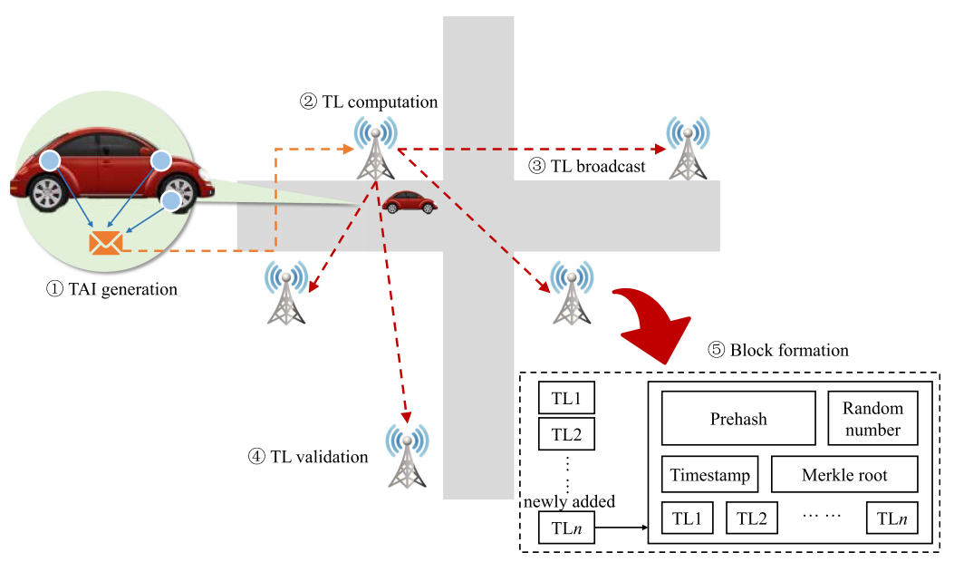
Here gives an instance of the proposed blockchain assisted trustworthiness scalable computation as is shown in Figure 3.
Notes:
這裡給出了所提出的區塊鏈輔助可信度可擴展計算的一個實例，如圖 3 所示。
該方案中的 RSU 幫助區塊鏈更新和記錄車輛的可信度。 新增的 TLn 表示時間戳 n 處的可信度。RSU幫助系統計算此時車輛的可信度，並將其添加到區塊鏈中。然後，區塊鏈根據歷史可信度和新增可信度計算區塊信息。最後，這些值被記錄在區塊鏈中，用於查詢網絡中的所有 RSU。
整個計算主要分為以下五個步驟：
TAI 生成：車輛上的 OBU 生成 TAI（在定義 4 中定義）。這些屬性的變化通過比特幣錢包反映到路邊設備上。
TL計算：當TAI被傳送到最近的RSU時，RSU就知道了車輛的身份，節點的編號，以及車輛屬性的具體變化。 RSU 然後根據 TAI（在定義 5 中定義）計算車輛的 TL 值。
TL 廣播：不僅 TL，而且 TAI 都廣播到網絡中的其他 RSU。
TL Validation：所有 RSU 都承諾在收到廣播後解決這個難題。 一旦礦工成功解決了難題，經過驗證的 TL 就會被附加到鏈的末端，從而在區塊鏈中形成一個新塊。
區塊形成：最後，當經過驗證的 TL 附加到區塊鏈時，每個節點都會保存更新區塊鏈的副本。

Slide 25
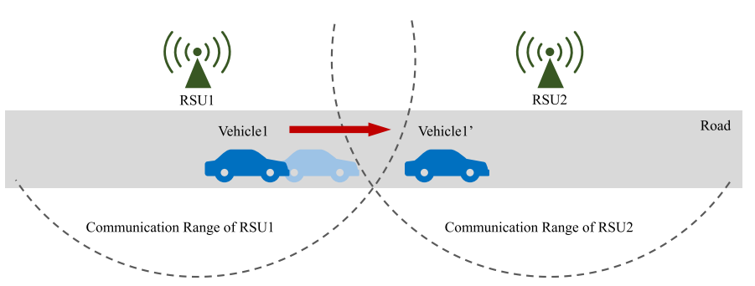
V. OUR PROPOSED SCHEME
A. OVERVIEW OF OUR SCHEME In view of the problem of secure handover of vehicles between two adjacent RSUs, we propose a trustworthiness-based time efficient V2I authentication scheme. Figure 4 depicts the application scenario of the proposed scheme.
Notes:
In this section, the proposed time-efficient V2I authentication scheme is detailedly described. Table 1 lists the frequently used notations in our scheme.
在本節中，詳細描述了所提出的具有時間效率的 V2I 身份驗證方案。 表 1 列出了我們方案中常用的符號。
鑑於車輛在兩個相鄰 RSU 之間的安全切換問題，我們提出了一種基於可信度的時間高效的 V2I 身份驗證方案。圖 4 描述了所提出方案的應用場景。
該方案的大致流程如下。
基於車輛當前的可信度，RSU和車輛完成認證並生成初始會話密鑰。
當車輛所屬的RSU通信範圍發生變化時，前一個RSU向下一個RSU和車輛發送切換證書(OC)，後一個RSU向車輛發送token。
在車輛和後者RSU同時計算出相應的會話密鑰後，車輛恢復與路邊基礎設施的通信。這裡需要注意的是，當車輛進入下一個RSU的覆蓋範圍時。RSU只需要檢查車輛的可信度是否發生變化。

Slide 26
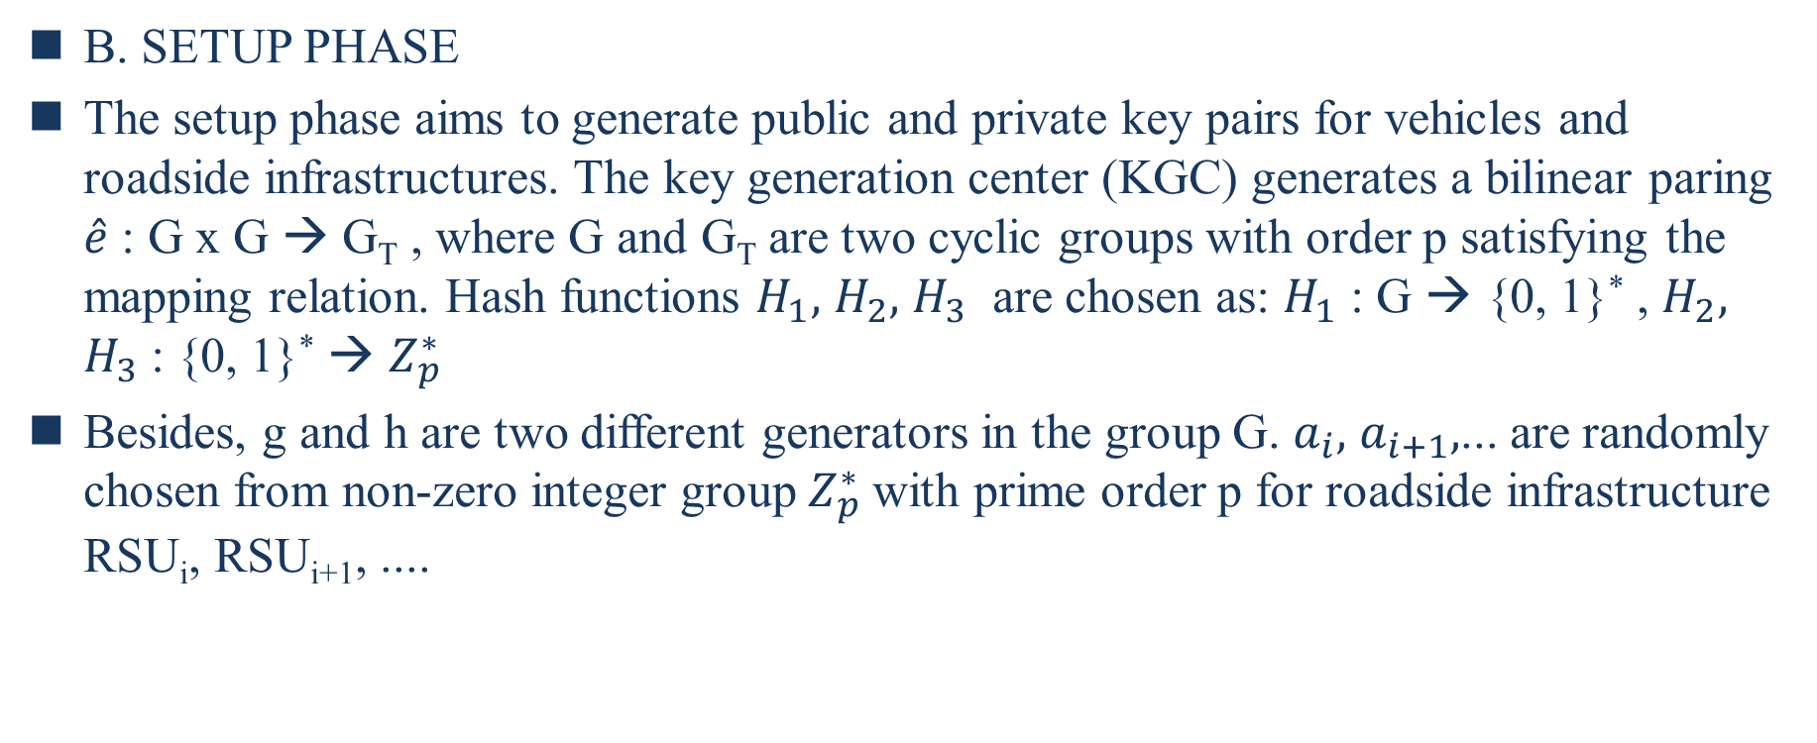
B. SETUP PHASE
The setup phase aims to generate public and private key pairs for vehicles and roadside infrastructures. The key generation center (KGC) generates a bilinear paring $\hat{e}$ : G x G → G_{T} , where G and G_{T} are two cyclic groups with order p satisfying the mapping relation. Hash functions $H_{1},$ $H_{2},$ $H_{3}$ are chosen as: $H_{1}$ : G → {0, 1}* , $H_{2},$ $H_{3}$: {0, 1}* → $Z_{p}^{∗}$
Besides, g and h are two different generators in the group G. $a_{i},$ $a_{i+1},$... are randomly chosen from non-zero integer group $Z_{p}^{∗}$with prime order p for roadside infrastructure RSU_{i}, RSU_{i+1}, ....
Notes:
setup階段旨在為車輛和路邊基礎設施生成公鑰和私鑰對。密鑰生成中心 (KGC) 生成一個雙線性配對 ^e: G * G → GT ，其中G和GT是兩個循環群，p階滿足映射關係。Hash function H1, H2, H3,被選為H1 : G → {0,1}∗, H2, H3 : {0,1}∗ → Z∗p 。此外，g和h是G群中的兩個不同的生成器。ai, ai+1+1,…是從非零整數群Z∗p隨機選出，伴隨質數階q給路邊基礎設施RSUi,$RSU_{i+1},…
G映射到一串遊二禁制組成的位元
一串二禁制的位元會映射到整數有限欲

Slide 27
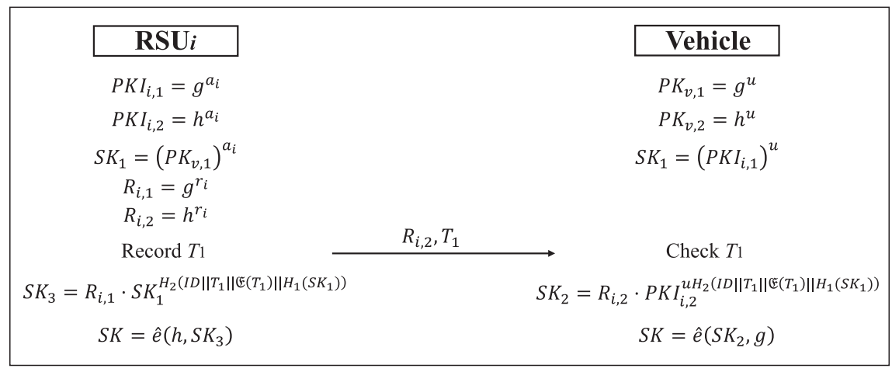
V2I-INITIAL AUTHENTICATION PHASE
PreKeyGen
RSUSKGen
VehiSKGen
Notes:
第二階段被命名為 V2I initial 身份驗證階段。利用可信度可伸縮計算系統生成的TL值。該階段旨在幫助RSU在RSU信號覆蓋下車輛入網時對車輛身份進行身份驗證，並為RSU和本車生成會話密鑰。該階段由三個階段組成：
PreKeyGen
RSU 和車輛分別使用彼此的公鑰生成 Diffie-Hellman 密鑰。
RSUi計算SK1然後車輛計算SK1 = , a
i和u是RSUi和車輛的私鑰。
接著RSUi選擇ri∈ Z∗ip Ri,1= gri被計算後被RSUi保密著。 Ri,2 = hri接著被計算並發送給車輛，連同發送消息前記錄的時間戳 T1。
VehiSKGen
在該演算法中，車輛檢查來自 RSUi的時間戳 Ti。
然後，車輛計算 SK2：
其中 Ri,2為 RSUi 發送的消息，ID 表示車輛的唯一標識號，C (T1) 表示車輛在 C(T1) 時刻的可信度。
最後，車輛計算會話密鑰 SK：
RSUSKGen
RSUi計算 SK3：
其中 Ri,1為自己計算出的密文，ID 為車輛唯一標識號，C (T1) 為車輛在 C(T1) 時刻的可信度。
TL 值由可信可伸縮計算系統生成。如果該車輛的即時可信度記錄為0，則RSU將該車輛視為可撤銷車輛，拒絕提供服務。由於區塊鏈的防竄改性，被吊銷的車輛無法偽裝成普通車輛與RSU交換數據。最後，RSUi 計算會話密鑰 SK：

Slide 28
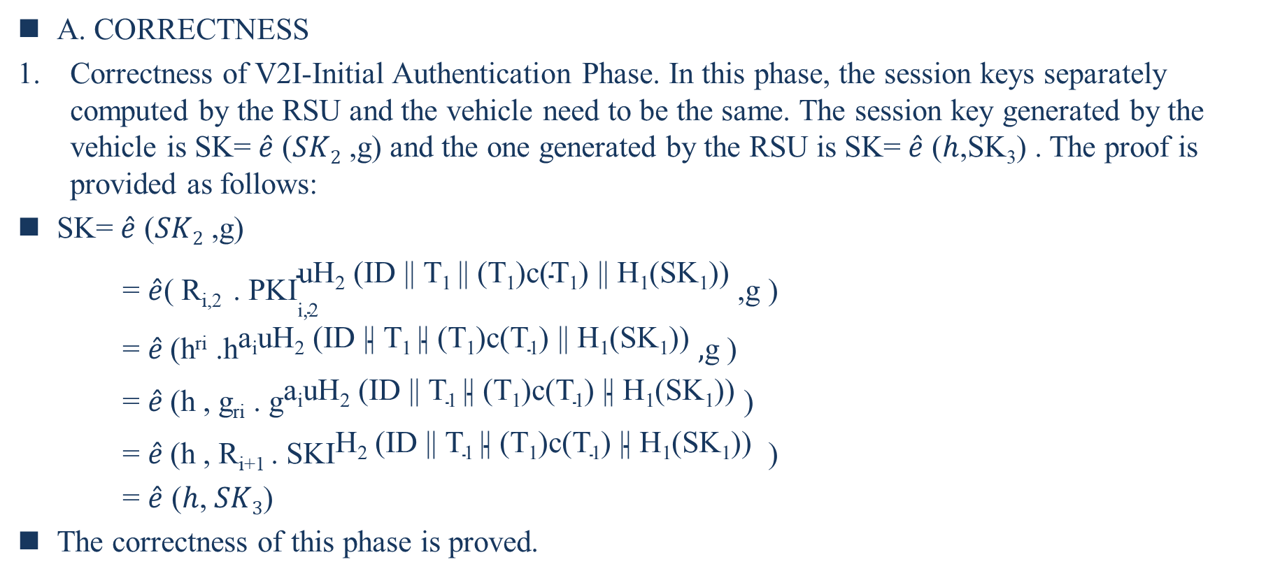
VI. SECURITY ANALYSIS
A. CORRECTNESS
Correctness of V2I-Initial Authentication Phase. In this phase, the session keys separately computed by the RSU and the vehicle need to be the same. The session key generated by the vehicle is SK= $\hat{e}$ ($SK2$ ,g) and the one generated by the RSU is SK= $\hat{e}$ ($h$,SK₃) . The proof is provided as follows:
SK= $\hat{e}$ ($SK2$ ,g)
= $\hat{e}$( R_{i,2} . ${\text{PKI}}_{\text{i}\text{,2}}^{\text{uH}\text{2} \text{(}\text{ID}\text{ || }\text{T}\text{1} \text{||} \text{(}\text{T}\text{1}\text{)}\text{c}\text{(}\text{T}\text{1}\text{)} \text{|| }\text{H}\text{1}\text{(}\text{SK}\text{1}\text{))}}$,g )
= $\hat{e}$(h^{ri} .${\text{h}}^{\text{a}\text{i}\text{uH}\text{2}\text{ (}\text{ID}\text{ || }\text{T}\text{1 }\text{|| (}\text{T}\text{1}\text{)}\text{c}\text{(}\text{T}\text{1}\text{) || }\text{H}\text{1}\text{(}\text{SK}\text{1}\text{))}}$ $,$g )
= $\hat{e}$(h , g_{ri} . ${\text{g}}^{\text{a}\text{i}\text{uH}\text{2}\text{ (}\text{ID}\text{ || }\text{T}\text{1 }\text{|| (}\text{T}\text{1}\text{)}\text{c}\text{(}\text{T}\text{1}\text{) || }\text{H}\text{1}\text{(}\text{SK}\text{1}\text{))}}$ )
= $\hat{e}$(h , R_{i+1} . ${\text{SKI}}^{\text{H}\text{2}\text{ (}\text{ID}\text{ || }\text{T}\text{1 }\text{|| (}\text{T}\text{1}\text{)}\text{c}\text{(}\text{T}\text{1}\text{) || }\text{H}\text{1}\text{(}\text{SK}\text{1}\text{))}}$ )
= $\hat{e}$ ($h$, $SK3$)
The correctness of this phase is proved.
Notes:
本節分析了新方案的正確性和其他安全性能。
這裡，本小節證明了 V2I 初始認證階段的安全性。 圖 5 詳細說明了這個階段。
A. CORRECTNESS
V2I-Initial Authentication Phase的正確性。
在這個階段，RSU 和車輛分別計算的會話密鑰需要相同。車輛生成的會話密鑰為SK=e^( SK2,g)，RSU生成的是SK =e^(h ,SK3)。 證明如下：
證明了該階段的正確性。

Slide 29
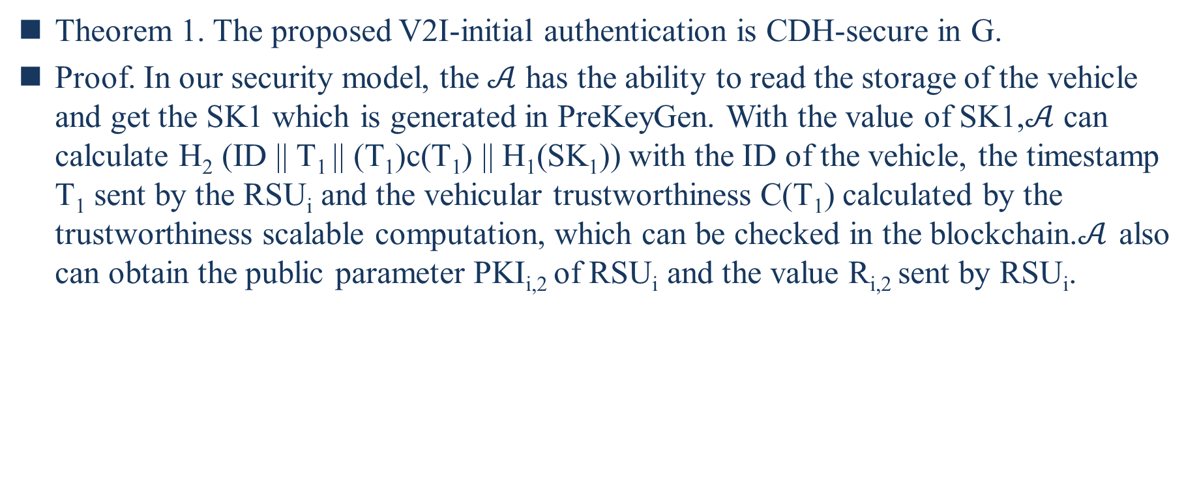
Theorem 1. The proposed V2I-initial authentication is CDH-secure in G.
Proof. In our security model, the $𝒜$ has the ability to read the storage of the vehicle and get the SK1 which is generated in PreKeyGen. With the value of SK1,$𝒜$ can calculate $\text{H}\text{2}\text{ (}\text{ID}\text{ || }\text{T}\text{1 }\text{|| (}\text{T}\text{1}\text{)}\text{c}\text{(}\text{T}\text{1}\text{) || }\text{H}\text{1}\text{(}\text{SK}\text{1}\text{))}$with the ID of the vehicle, the timestamp T₁ sent by the RSU_{i} and the vehicular trustworthiness C(T₁) calculated by the trustworthiness scalable computation, which can be checked in the blockchain.$𝒜$ also can obtain the public parameter PKI_{i,2} of RSU_{i} and the value R_{i,2} sent by RSU_{i}.
Notes:
Theorem1. The proposed V2I-initial authentication is CDH-secure in G.
Proof: 在我們的安全模型中，A 有能力讀取車輛的存儲並獲得在 PreKeyGen 中生成的 SK1。根據SK1的值，A可以伴隨車輛ID計算，RSUi發送的時間戳 T1和可信度可擴展計算計算的車輛可信度 C(T1)，可以在區塊鏈中檢查。
A也可以獲得RSUi的公共參數PKIi,2和RSUi發送的值Ri,2。

Slide 30
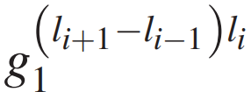
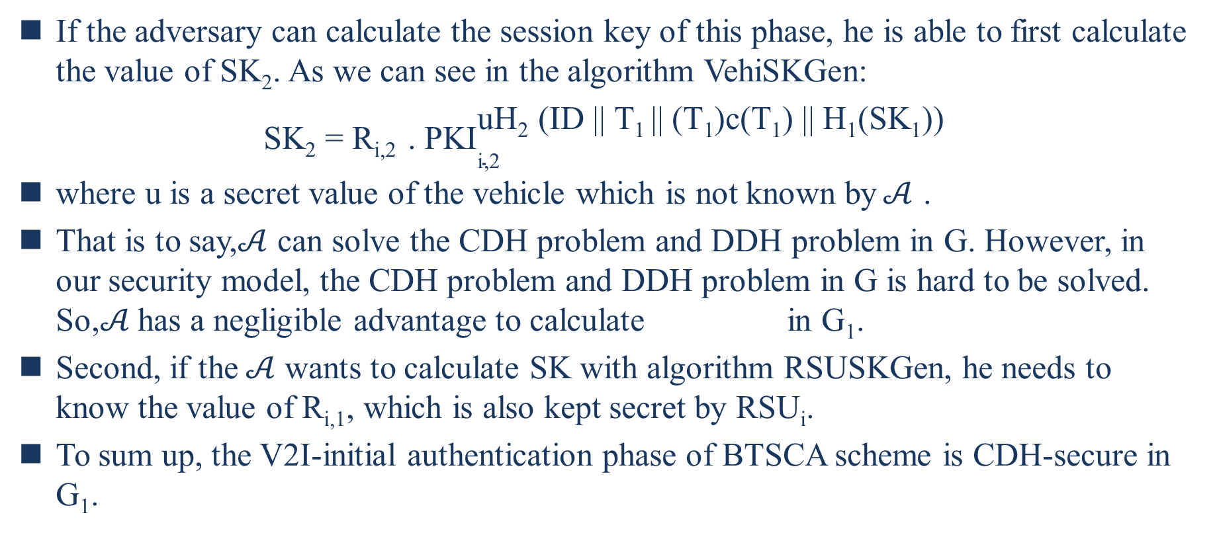
If the adversary can calculate the session key of this phase, he is able to first calculate the value of SK₂. As we can see in the algorithm VehiSKGen:
SK₂ = R_{i,2} . ${\text{PKI}}_{\text{i}\text{,2}}^{\text{uH}\text{2} \text{(}\text{ID}\text{ || }\text{T}\text{1} \text{||} \text{(}\text{T}\text{1}\text{)}\text{c}\text{(}\text{T}\text{1}\text{)} \text{|| }\text{H}\text{1}\text{(}\text{SK}\text{1}\text{))}}$
where u is a secret value of the vehicle which is not known by$𝒜$ .
That is to say,$𝒜$ can solve the CDH problem and DDH problem in G. However, in our security model, the CDH problem and DDH problem in G is hard to be solved. So,$𝒜$ has a negligible advantage to calculate in G₁.
Second, if the$𝒜$ wants to calculate SK with algorithm RSUSKGen, he needs to know the value of R_{i,1}, which is also kept secret by RSU_{i}.
To sum up, the V2I-initial authentication phase of BTSCA scheme is CDH-secure in G₁.
Notes:
那樣：
其中 u是 A 不知道的車輛秘密值。也就是說，A可以解決G中的CDH問題和DDH問題。但是，在我們的安全模型中，G中的CDH問題和DDH問題是很難解決的。因此，A 計算的優勢可以忽略不計。其次，如果 A 想用算法 RSUSKGen 計算 SK，他需要知道 Ri,11 的值，這也被 RSUi保密。綜上所述，B-TSCA 方案的 V2I 初始認證階段在 G1 中是 CDH 安全的。

Slide 31
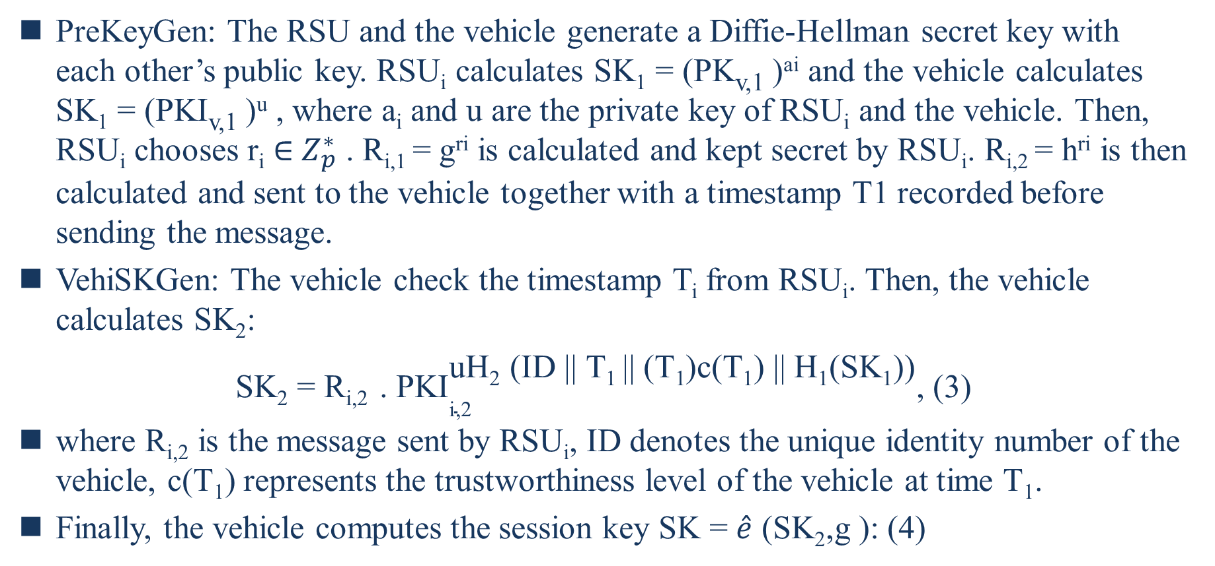
PreKeyGen: The RSU and the vehicle generate a Diffie-Hellman secret key with each other’s public key. RSU_{i} calculates SK₁ = (PK_{v,1} )^{ai} and the vehicle calculates SK₁ = (PKI_{v,1} )^{u} , where a_{i} and u are the private key of RSU_{i} and the vehicle. Then, RSU_{i} chooses r_{i} $∈$ $Z_{p}^{∗}$ . R_{i,1} = g^{ri} is calculated and kept secret by RSU_{i}. R_{i,2} = h^{ri} is then calculated and sent to the vehicle together with a timestamp T1 recorded before sending the message.
VehiSKGen: The vehicle check the timestamp T_{i} from RSU_{i}. Then, the vehicle calculates SK₂:
SK₂ = R_{i,2} . ${\text{PKI}}_{\text{i}\text{,2}}^{\text{uH}\text{2} \text{(}\text{ID}\text{ || }\text{T}\text{1} \text{||} \text{(}\text{T}\text{1}\text{)}\text{c}\text{(}\text{T}\text{1}\text{)} \text{|| }\text{H}\text{1}\text{(}\text{SK}\text{1}\text{))}}$, (3)
where R_{i,2} is the message sent by RSU_{i}, ID denotes the unique identity number of the vehicle, $\text{c}\text{(}\text{T}\text{1}\text{) }$represents the trustworthiness level of the vehicle at time T₁.
Finally, the vehicle computes the session key SK = $\hat{e}$ (SK₂,g ): (4)
Notes:
PreKeyGen���������
RSU 和車輛分別使用彼此的公鑰生成 Diffie-Hellman 密鑰。
RSUi����計算SK1��1 = 然後車輛計算SK1��1 = , ai��和u�是RSUi����和車輛的私鑰。
接著RSUi����選擇ri�� ∈∈ Z∗i��∗. Ri,1��,1 = gri���被計算後被RSUi����保密著。 Ri,2��,2 = hriℎ�� r接著被計算並發送給車輛，連同發送消息前記錄的時間戳 T1�1。
VehiSKGen��ℎ������
在該演算法中，車輛檢查來自 RSUi���� 的時間戳 Ti��。
然後，車輛計算 SK2��2：
其中 Ri,2��,2 為 RSUi���� 發送的消息，ID 表示車輛的唯一標識號，C�(T1�1) 表示車輛在 C�(T1�1) 時刻的可信度。
最後，車輛計算會話密鑰 SK：

Slide 32
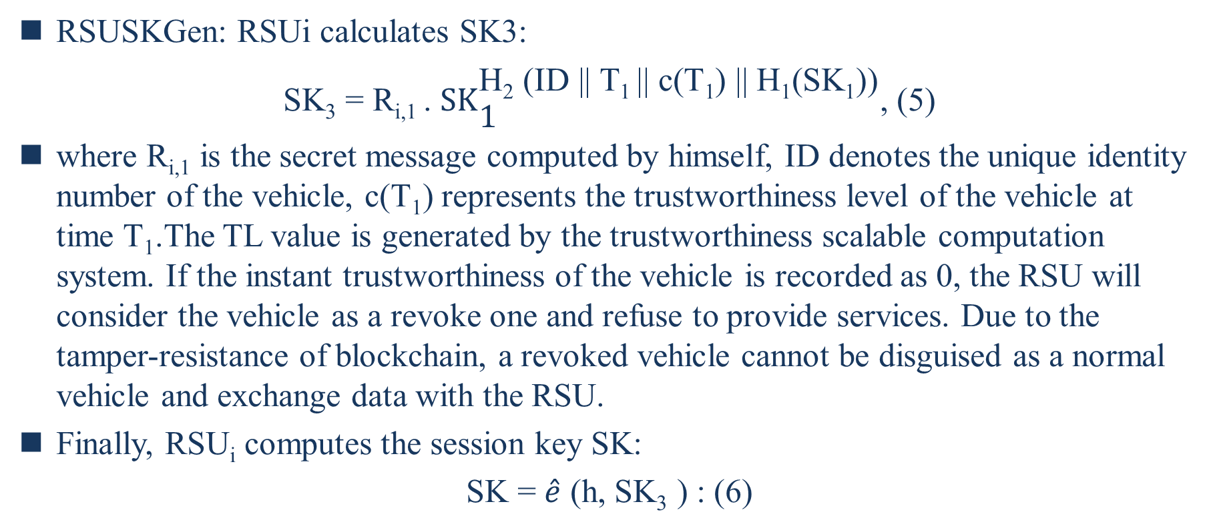
RSUSKGen: RSUi calculates SK3:
SK₃ = R_{i,1} . ${\text{SK}}_{\text{1}}^{\text{H}\text{2} \text{(}\text{ID}\text{ || }\text{T}\text{1} \text{||} \text{c}\text{(}\text{T}\text{1}\text{)} \text{|| }\text{H}\text{1}\text{(}\text{SK}\text{1}\text{))}}$, (5)
where R_{i,1} is the secret message computed by himself, ID denotes the unique identity number of the vehicle, $\text{c}\text{(}\text{T}\text{1}\text{) }$represents the trustworthiness level of the vehicle at time T₁.The TL value is generated by the trustworthiness scalable computation system. If the instant trustworthiness of the vehicle is recorded as 0, the RSU will consider the vehicle as a revoke one and refuse to provide services. Due to the tamper-resistance of blockchain, a revoked vehicle cannot be disguised as a normal vehicle and exchange data with the RSU.
Finally, RSU_{i} computes the session key SK:
SK = $\hat{e}$ (h, SK₃ ) : (6)

Slide 33
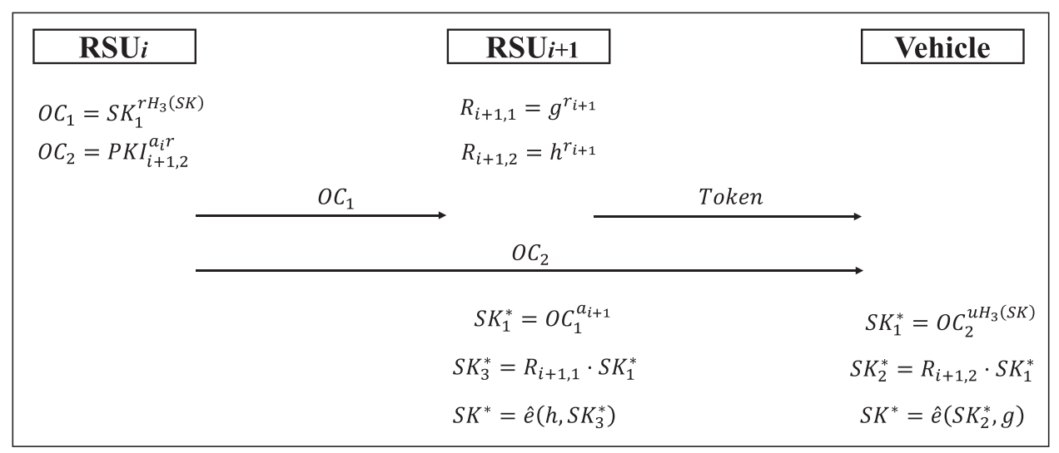
D. V2I-HANDOVER AUTHENTICATION PHASE
OCGen
TokenGen
VehiSKGen2
RSUSKGen2
Notes:
第三階段被命名為 V2I 切換認證階段。當車輛離開前一個RSU的信號覆蓋範圍，進入下一個RSU的信號覆蓋範圍時，系統執行該階段，將車輛與基礎設施之間的通信移交給下一個RSU。RSU 首先向區塊鏈查詢車輛的可信度。 如果從接受上一次RSU認證開始到當前車輛的可信度沒有發生變化，則本次RSU無需再次進行可信度認證。 然後，將執行以下步驟。
OCGen: 該演算法由 RSUi執行，以生成 RSUi+1 和車輛的切換證書 (OC)。 RSUi選擇一個隨機數 r ∈∈ Z∗p 。
OC1計算如下：
其中 SK1在演算法 PreKeyGen 中計算，SK 是在演算法 RSUSKGen 中生成的會話密鑰。OC1 被發送到下一個基礎設施 RSUi+1。
然後，OC2 計算如下：
其中 PKIi+1,2是在設置階段生成的 RSUi+1的公鑰部分。 OC2 被發送到車輛。
TokenGen：當從 RSUi收到 OC1 時，從 Z∗p 中選擇一個隨機值 ri+1。Ri+1,1 = gri+1被計算後被RSUi+1保密著。。 Ri+1,2 = hri+1被視為token並發送給車輛。
VehiSKGen2：當車輛從 RSUi+1收到token 並從 RSUi 收到 OC2 時，他計算 SK∗1 和 SK∗2，如下所示：
Ri+1,2是token。最後，車輛的SK∗計算如下：
SUSKGen2：RSUi+1 還計算 SK∗1 和 SK∗3，如下所示：
最後，RSUi+1的 SK*計算如下：

Slide 34
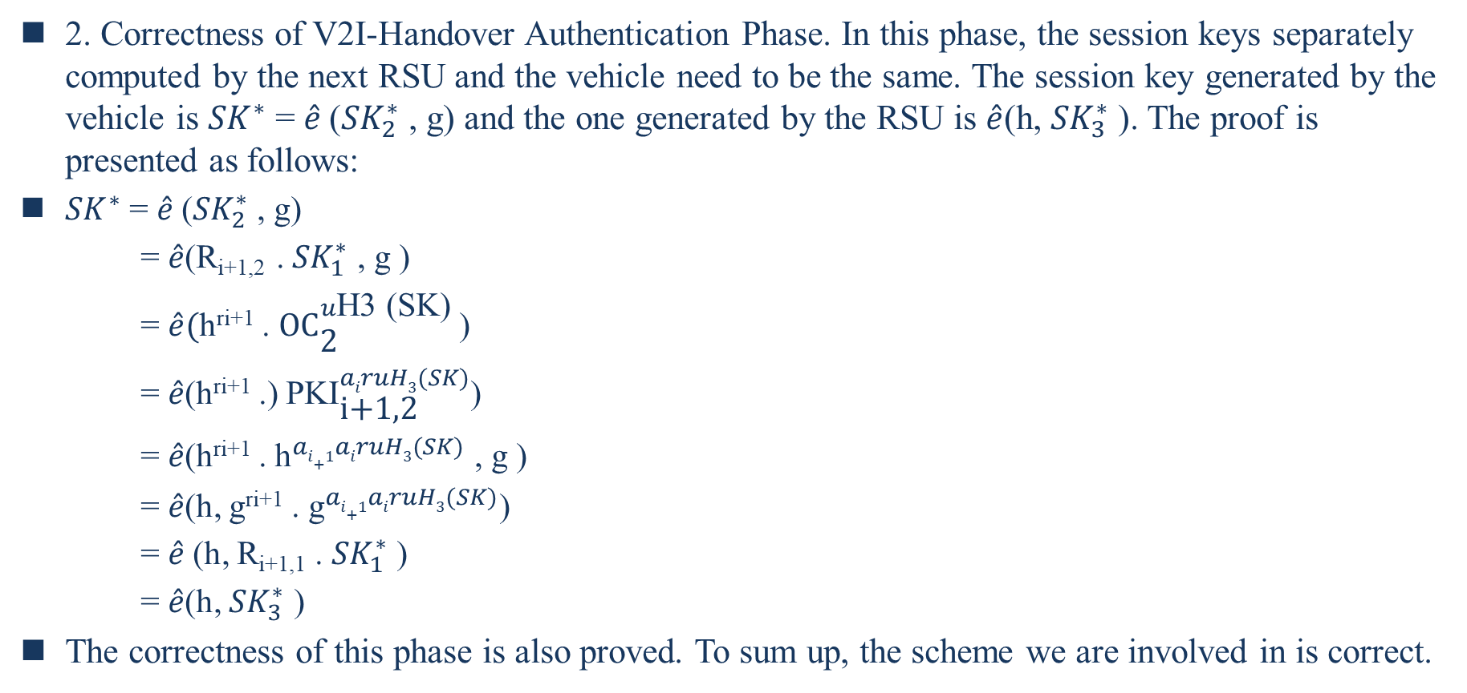
2. Correctness of V2I-Handover Authentication Phase. In this phase, the session keys separately computed by the next RSU and the vehicle need to be the same. The session key generated by the vehicle is ${SK}^{∗}$ = $\hat{e}$(${SK}_{2}^{∗}$ , g) and the one generated by the RSU is $\hat{e}$(h, ${SK}_{3}^{∗}$ ). The proof is presented as follows:
${SK}^{∗}$ = $\hat{e}$(${SK}_{2}^{∗}$ , g)
= $\hat{e}$(R_{i+1,2} . ${SK}_{1}^{∗}$ , g )
= $\hat{e}($h^{ri+1} . ${\text{OC}}_{\text{2}}^{u\text{H}\text{3 (}\text{SK}\text{)}}$)
= $\hat{e}$(h^{ri+1} .) ${\text{PKI}}_{\text{i}\text{+1,2}}^{airuH3(SK)}$)
= $\hat{e}$(h^{ri+1} . ${\text{h}}^{ai+1airuH3(SK)}$ , g )
= $\hat{e}$(h, g^{ri+1} . ${\text{g}}^{ai+1airuH3(SK)}$)
= $\hat{e}$(h, R_{i+1,1} . ${SK}_{1}^{∗}$ )
= $\hat{e}$(h, ${SK}_{3}^{∗}$ )
The correctness of this phase is also proved. To sum up, the scheme we are involved in is correct.
Notes:
Correctness of V2I-Handover Authentication Phase.
本小節證明了V2I-切換認證階段的安全性。
在這個階段，下一個 RSU 和車輛分別計算的會話密鑰需要相同。 車輛生成的會話密鑰為 SK= ^e( SK∗2,g)，RSU生成的是SK = e^(h ,SK∗3)。 證明如下：
也證明了該階段的正確性。 綜上所述，我們參與的方案是正確的。

Slide 35
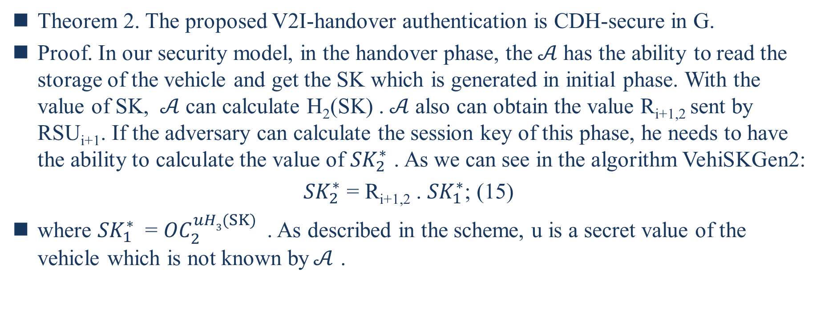
Theorem 2. The proposed V2I-handover authentication is CDH-secure in G.
Proof. In our security model, in the handover phase, the$𝒜$ has the ability to read the storage of the vehicle and get the SK which is generated in initial phase. With the value of SK, $𝒜$ can calculate H₂(SK) .$𝒜$ also can obtain the value R_{i+1,2} sent by RSU_{i+1}. If the adversary can calculate the session key of this phase, he needs to have the ability to calculate the value of ${SK}_{2}^{∗}$ . As we can see in the algorithm VehiSKGen2:
${SK}_{2}^{∗}$ = R_{i+1,2} . ${SK}_{1}^{∗}$; (15)
where ${SK}_{1}^{∗}$ = ${OC}_{2}^{uH3(SK)}$ . As described in the scheme, u is a secret value of the vehicle which is not known by$𝒜$ .
Notes:
Theorem 2. The proposed V2I-handover authentication is CDH-secure in G.
Proof.在我們的安全模型中，在handover階段，A 有能力讀取車輛的存儲並獲得在初始階段生成的 SK。 根據SK的值，A 可以計算出H2 (SK) 。A也可以獲得RSUi+1發送的值Ri+1,2。
如果敵手能夠計算出這個階段的會話密鑰，他就需要有能力計算出SK∗2的值。正如我們在演算法 VehiSKGen2 中看到的那樣： ，其中 SK∗1 = OCuH3(SK)2。如方案中所述，u是 A 不知道的車輛的秘密值。

Slide 36
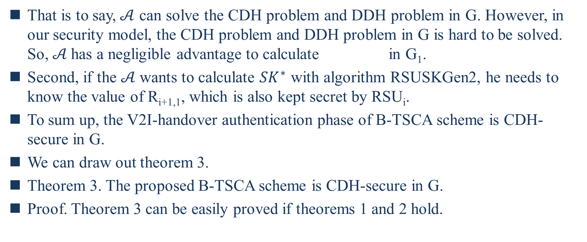
That is to say,$𝒜$ can solve the CDH problem and DDH problem in G. However, in our security model, the CDH problem and DDH problem in G is hard to be solved. So,$𝒜$ has a negligible advantage to calculate in G₁.
Second, if the $𝒜$ wants to calculate ${SK}^{∗}$ with algorithm RSUSKGen2, he needs to know the value of R_{i+1,1}, which is also kept secret by RSU_{i}.
To sum up, the V2I-handover authentication phase of B-TSCA scheme is CDH-secure in G.
We can draw out theorem 3.
Theorem 3. The proposed B-TSCA scheme is CDH-secure in G.
Proof. Theorem 3 can be easily proved if theorems 1 and 2 hold.
Notes:
也就是說，A可以解決G中的CDH問題和DDH問題。但是，在我們的安全模型中，G中的CDH問題和DDH問題是很難解決的。因此，A 計算的優勢可以忽略不計。
其次，如果 A 想用算法 RSUSKGen2 計算 SK∗∗，他需要知道 Ri+1,1 的值，這也由 RSUi保密。
綜上所述，B-TSCA 方案的 V2I 切換認證階段在 G 中是 CDH 安全的。
我們可以引出定理3。
Theorem 3. The proposed B-TSCA scheme is CDH-secure in G.
Proof. 如果定理 1 和 2 成立，則定理 3 很容易證明。

Slide 37
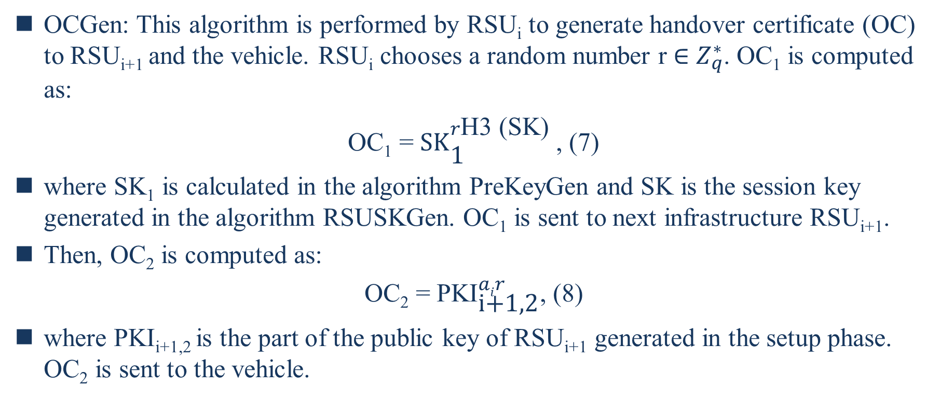
OCGen: This algorithm is performed by RSU_{i} to generate handover certificate (OC) to RSU_{i+1} and the vehicle. RSU_{i} chooses a random number r $∈$ $Z_{q}^{∗}$. OC₁ is computed as:
OC₁ = ${\text{SK}}_{\text{1}}^{r\text{H}\text{3}\text{ (}\text{SK}\text{)}}$, (7)
where SK₁ is calculated in the algorithm PreKeyGen and SK is the session key generated in the algorithm RSUSKGen. OC₁ is sent to next infrastructure RSU_{i+1}.
Then, OC₂ is computed as:
OC₂ = ${\text{PKI}}_{\text{i}\text{+1,2}}^{air}$, (8)
where PKI_{i+1,2} is the part of the public key of RSU_{i+1} generated in the setup phase. OC₂ is sent to the vehicle.
Notes:
OCGen: 該演算法由 RSUi���� 執行，以生成 RSUi+1����+1 和車輛的切換證書 (OC)。 RSUi���� 選擇一個隨機數 r ∈∈ Z∗p��∗ 。
OC1��1 計算如下：
其中 SK1��1 在演算法 PreKeyGen 中計算，SK 是在演算法 RSUSKGen 中生成的會話密鑰。OC1 被發送到下一個基礎設施 RSUi+1����+1。
然後，OC2 計算如下：
其中 PKIi+1,2����+1,2 是在設置階段生成的 RSUi+1����+1 的公鑰部分。 OC2 被發送到車輛。

Slide 38
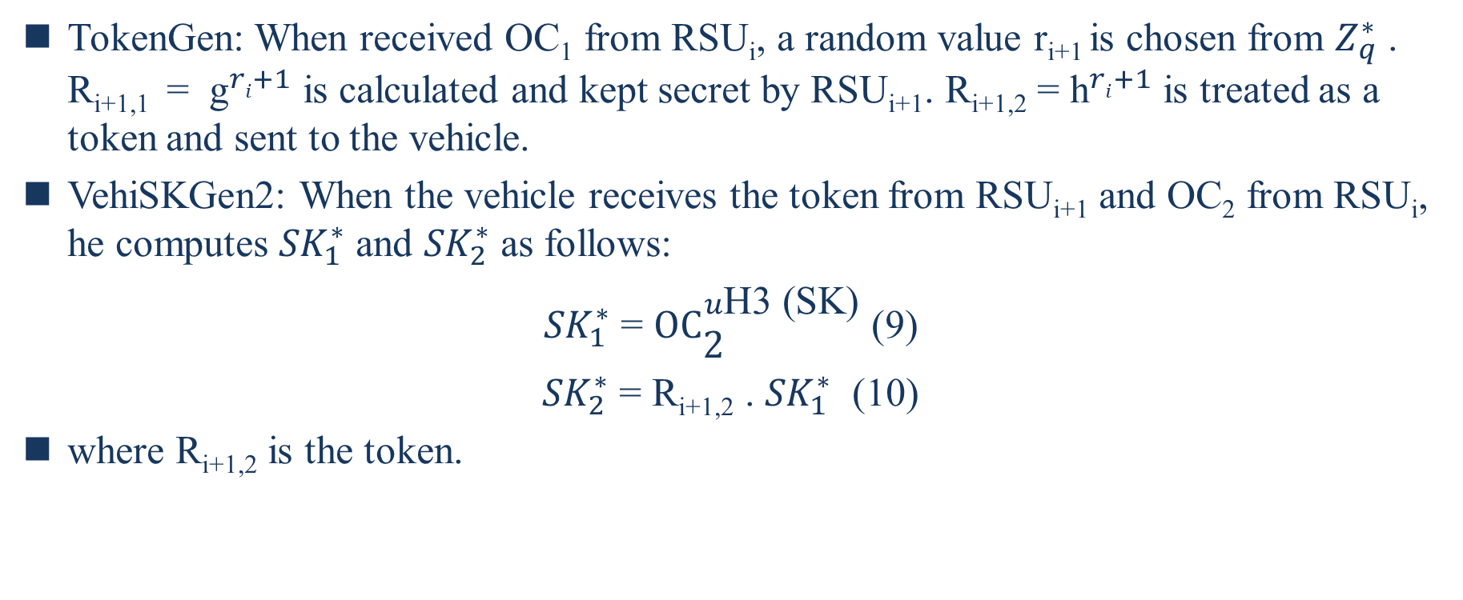
TokenGen: When received OC₁ from RSU_{i}, a random value r_{i+1} is chosen from $Z_{q}^{∗}$ . R_{i+1,1} = ${\text{g}}^{ri+1}$ is calculated and kept secret by RSU_{i+1}. R_{i+1,2} = ${\text{h}}^{ri+1}$ is treated as a token and sent to the vehicle.
VehiSKGen2: When the vehicle receives the token from RSU_{i+1} and OC₂ from RSU_{i}, he computes ${SK}_{1}^{∗}$ and ${SK}_{2}^{∗}$ as follows:
${SK}_{1}^{∗}$ = ${\text{OC}}_{\text{2}}^{u\text{H}\text{3}\text{ (}\text{SK}\text{)}}$ (9)
${SK}_{2}^{∗}$ = R_{i+1,2} . ${SK}_{1}^{∗}$ (10)
where R_{i+1,2} is the token.

Slide 39
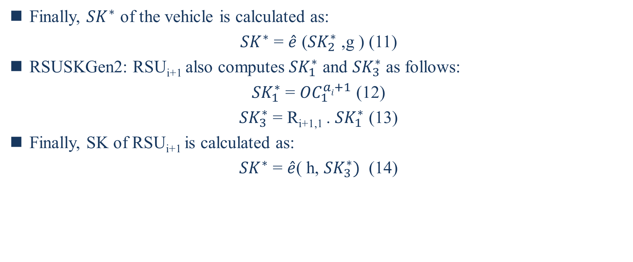
Finally, ${SK}^{∗}$ of the vehicle is calculated as:
${SK}^{∗}$ = $\hat{e}$ (${SK}_{2}^{∗}$ ,g ) (11)
RSUSKGen2: RSU_{i+1} also computes ${SK}_{1}^{∗}$ and ${SK}_{3}^{∗}$ as follows:
${SK}_{1}^{∗}$ = ${OC}_{1}^{ai+1}$ (12)
${SK}_{3}^{∗}$ = R_{i+1,1} . ${SK}_{1}^{∗}$ (13)
Finally, SK of RSU_{i+1} is calculated as:
${SK}^{∗}$ = $\hat{e}$( h, ${SK}_{3}^{∗})$ (14)

Slide 40
D. SECURITY AGAINST MITM ATTACK AND REPLY ATTACK
An MITM attacker may block the message sent by the RSU_{i} or RSU_{i+1}. He may change the message and send a new one to the vehicle. If a tampered R_{i,2} and T₁ is sent to the vehicle, the vehicle will generated a session key according to the tampered message. However, the session key generated with the tampered parameter will not be authenticated by RSU.
A reply attacker may block a message encrypted with SK by the vehicle. If the attacker delays sending the encrypted data to the RSU, the encrypted timestamp will be invalid and the data could not be authenticated. In addition, if the attacker sends the data authenticated by the previous RSU to the next RSU, the data will also fail to pass the authentication. Because this data is not encrypted by the session key generated by the vehicle and the next RSU.
Notes:
MITM 攻擊者可能會阻止 RSUi或 RSUi+1發送的消息。他可以更改消息並向車輛發送新消息。如果將篡改的Ri,2和T1發送給車輛，車輛將根據篡改的消息生成會話密鑰。但是，使用篡改參數生成的會話密鑰將不會被 RSU 驗證。
回復攻擊者可能會阻止車輛用 SK 加密的消息。如果攻擊者延遲將加密數據發送給 RSU，則加密時間戳將失效，數據將無法通過身份驗證。另外，如果攻擊者將前一個RSU認證過的數據發送給下一個RSU，該數據也將無法通過認證。因為這個數據沒有被車輛和下一個 RSU 生成的會話密鑰加密。

Slide 41
VII. PERFORMANCE ANALYSIS
The proposed scheme is simulated on GNU Multiple Precision Arithmetic (GMP) library and Pairing-Based Cryptography (PBC) library1 to show its efficiency. C language is utilized on a Linux system with Ubuntu 16.04 TLS, a 2.60 GHz Intel(R) Xeon(R) CPU E5-2650 v2, and 8 GB of RAM.
We first simulate the time cost of different algorithms running on different system components. As is shown in Figure 7, eight algorithms, PreKeyGen of RSU, PreKeyGen of vehicle, VehiSKGen, RSUSKGen, OCGen, TokenGen, VehiSKGen2, and RSUSKGen2, are simulated and compared.
Notes:
所提出的方案在 GNU 多精度算術 (GMP) 庫和基於配對的密碼學 (PBC) 庫上進行了仿真，以顯示其效率。C 語言在具有 Ubuntu 16.04 TLS、2.60 GHz Intel® Xeon® CPU E5-2650 v2 和 8 GB RAM 的 Linux 系統上使用。
我們首先模擬在不同系統組件上運行不同算法的時間成本。對RSU的PreKeyGen、車輛的PreKeyGen、VehiSKGen、RSUSKGen、OCGen、TokenGen、VehiSKGen2、RSUSKGen2這8種算法進行了仿真比較。

Slide 42
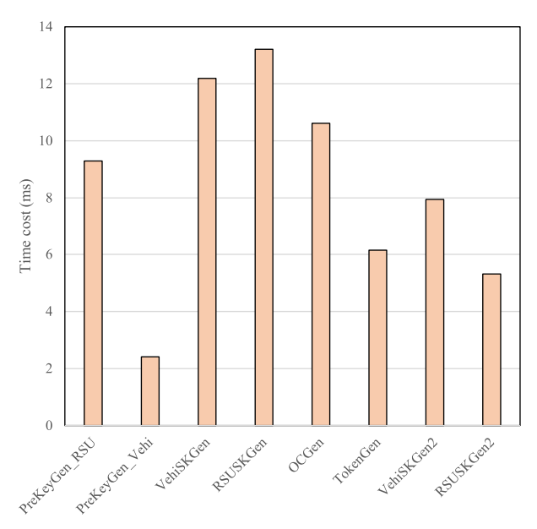
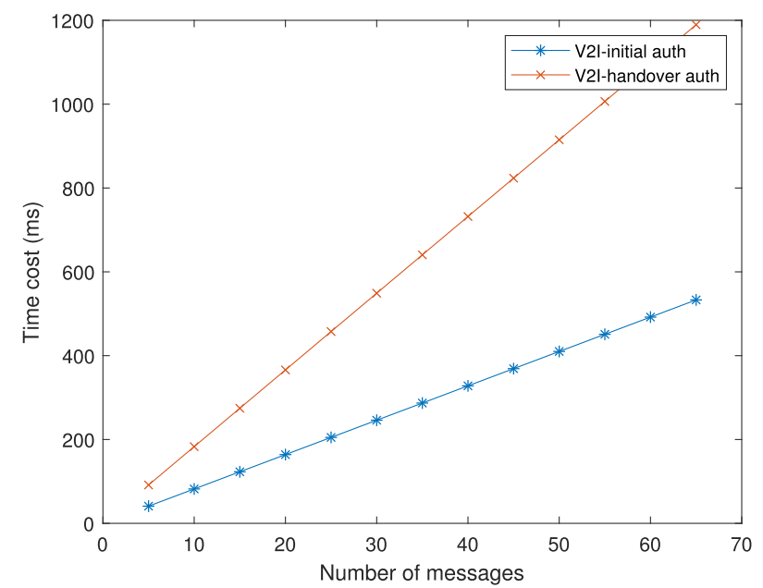
RSU_{i}
RSU_{i+1}
Vehicle
V2I-initial
Handover
Notes:
前四個是V2I-initial認證階段的算法，其他是切換階段的算法。 RSUi運行RSU的PreKeyGen、RSUSKGen、OCGen。 RSUi+1運行 TokenGen 和 RSUSKGen2。該車輛運行 PreKeyGen、VehiSKGen 和 VehiSKGen2 的一部分。 不難看出，車輛在交接階段的成本明顯低於初始階段。 此外，車輛運行的操作比 RSU 運行的操作耗時更少。
在我們的模擬中，分別模擬了 V2I 初始認證階段和 V2I 切換認證階段的時間成本。
與初始認證階段所需的時間相比，設計的遞交認證階段的時間成本減少了一半。 這是因為，在新方案的切換階段，車輛只需根據原RSU生成的原會話密鑰進行少量操作即可。 部分計算操作轉移到前一個RSU和當前RSU之間的切換。

Slide 43
VIII. CONCLUSION
In this paper, a novel V2I authentication scheme for VANETs named B-TSCA scheme is presented with a blockchain assisted trustworthiness scalable computation system. The new B-TSCA scheme is composed of a V2I-initial authentication phase and a V2I-handover authentication phase. When vehicles are authenticated by RSUs, the trustworthiness of vehicle recorded in blockchain is utilized as a part of the authentication parameters.
This scheme aims at reducing the computational cost of continuous identity authentication when vehicle passes through multiple RSUs. The handover strategy is designed to reduce the redundant cost in the subsequent authentication process, which enhances the scalability of VANETs. The security analysis shows that B-TSCA is a CDH-secure scheme. The time cost of the handover authentication phase turns out to be reduced by half compared to the initial authentication in our simulation.
Notes:
在本文中，提出了一種名為 B-TSCA 方案的 VANET 的新型 V2I 身份驗證方案，該方案具有區塊鏈輔助的可信度可擴展計算系統。將區塊鏈技術融入可信計算，確保車輛可信不可篡改和可追溯。 新的B-TSCA方案由V2I初始認證階段和V2I切換認證階段組成。 當車輛通過路邊基礎設施進行身份驗證時，記錄在區塊鏈中的車輛的可信度被用作身份驗證參數的一部分。
留言
該方案旨在降低車輛通過多個 RSU 時連續身份認證的計算成本。 切換策略旨在減少後續認證過程中的冗餘成本，從而增強VANETs的可擴展性。 安全性分析表明B-TSCA是一種CDH安全方案。 與我們模擬中的初始認證相比，切換認證階段的時間成本減少了一半。

