Slide 1
(2022) Dynamic UPF placement and chaining reconfiguration in 5G network
Irian Leyva-Pupo, Cristina Cervelló-Pastor, Christos Anagnostopoulos, Dimitrios P. Pezaros
2022 Computer Networks (IF=4.4)

Slide 2
Outline
Introduction
Optimal UPCR (ILP model & heuristic)
Dynamic UPCR (Reconfiguration mechanism)
Performance Evaluation

Slide 3
Introduction
Research topic :
5G UPF (Chain) Placement
UPF-P Reconfiguration
Notes:
Placement :
在 4G 時代是集中部屬，5G 則是引入 edge computing，要分散式部屬到距離使用者更近的位置，常見的就是放在 BS 附近，而非 DC，以滿足 5G URLLC 情境對低延遲通訊的需求
Edge 好處 : 降低延遲 ; 壞處 : 服務範圍小
Reconfig :
user mobility + edge deployment => session relocation
方法一 : UPF 位置固定不變 ; 方法二 : UPF 位置動態變化 (Reconfig.)
需放圖
方法一有會有固定(穩定範圍)
方法二可以保持更少的 UPF，對使用者沒什麼影響 (反正延遲夠低就行)，Reconfig. 更多是對營運商好
Reconfig (readjust) may produce service interruption => find optimal time to Min. reconfig. Event as possible
綜上 :
目標 : 在滿足 5G 使用者需求(主要是低延遲)的情況下，盡量減少營運商的營運部屬成本

Slide 4
5G UPF Placement
4G central deployment of PGW → 5G edge deployment of UPF
Advantage :
Lower end-to-end latency
Less network congestion (higher scalability)
Disadvantage :
Smaller serving area per UPF (more frequent session relocation / reassignment)
Higher OPEX & CAPEX

Slide 5
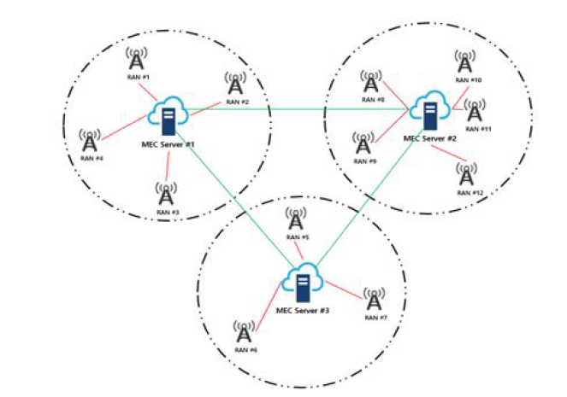
UPF-P Reconfiguration
Static UPF placement :
UPF

Slide 6
UPF-P Reconfiguration
After some time :
UPF

Slide 7
UPF-P Reconfiguration
Dynamic UPF placement (Reconfiguration) :
UPF

Slide 8
Ch.1 - Introduction
Research topic :
5G UPF (Chain) Placement
UPF-P Reconfiguration
Main goal :
Cost reduction while ensuring 5G service requirements are fulfilled

Slide 9
Ch.1 - Introduction
Main Contribution :
Formulated as ILP model, considered Service Function Chain (SFC) order and UPF-specific requirements
Design a heuristic algorithm
Applying Optimal Stopping Theory (OST) to find optimal scheduling reconfiguration

Slide 10
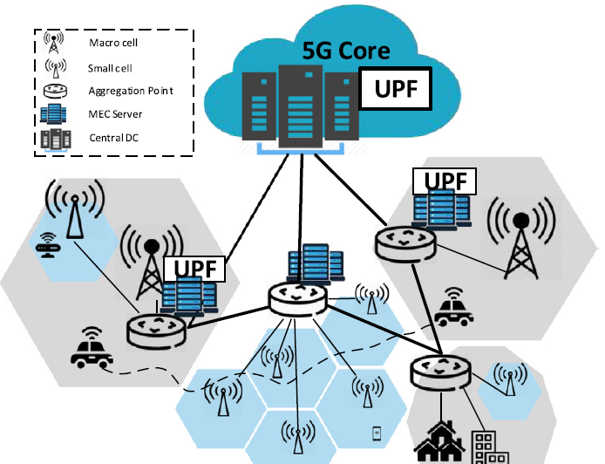
Ch.3 – Optimal UPCR
UPCR : UPF Placement and Chaining Reconfiguration
Notes:
實際 system model 和這個示意圖是有差距的
沒分 macro / micro，總之就是 gNB (RAN) (BS)
沒有 aggregation point，只有 candidate location，所以比如右下的 agg. point 就會被省略掉
System model 是以 session 為單位考慮部屬，而不是 gNB-UPF 的配對
System model 考量的是 UPF chain (3 種)
System model 不只要部屬「點」，也要佈「線」
第三點之後是在後續才會說明

Slide 11
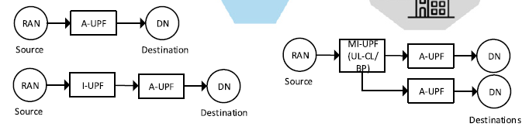
Ch.3 – Optimal UPCR
UPF chain considered in this paper :
1.
2.
3.
Notes:
UPF chain 有 3 種，並且(正好) UPF 也分 3 種 : A-UPF、I-UPF、BP

Slide 12
Ch.3 – Optimal UPCR
UPF
Notes:
在剛才的舉例，可以以 BS 為單位考慮 UPF 部屬位置 (BS-UPF)

Slide 13
Ch.3 – Optimal UPCR
UPCR : UPF Placement and Chaining Reconfiguration
UPF
I-UPF
BP
UPF
Notes:
承上，但如果是這裡的 UPF chain，就要以更細的 session 為單位考慮 UPF 部屬，因為即便出自同一個 BS 的 sessions 也可能需要走不同的路徑
System model 和這個示意圖是有差距的 :
System model 是以 session 為單位考慮部屬，而不是 gNB-UPF 的配對
System model 考量的是 UPF chain (3 種)
System model 不只要部屬「點」，也要佈「線」

Slide 14
補充 : Integer Linear Programming (ILP) Model
Example of Linear Programming (LP) – Furniture Problem
Chair = 5 woods + 10 hours, Price = $ 45
Table = 20 woods + 15 hours, Price = $ 80
We have 400 woods and 450 hours
Question : How to maximize revenue ?

Slide 15
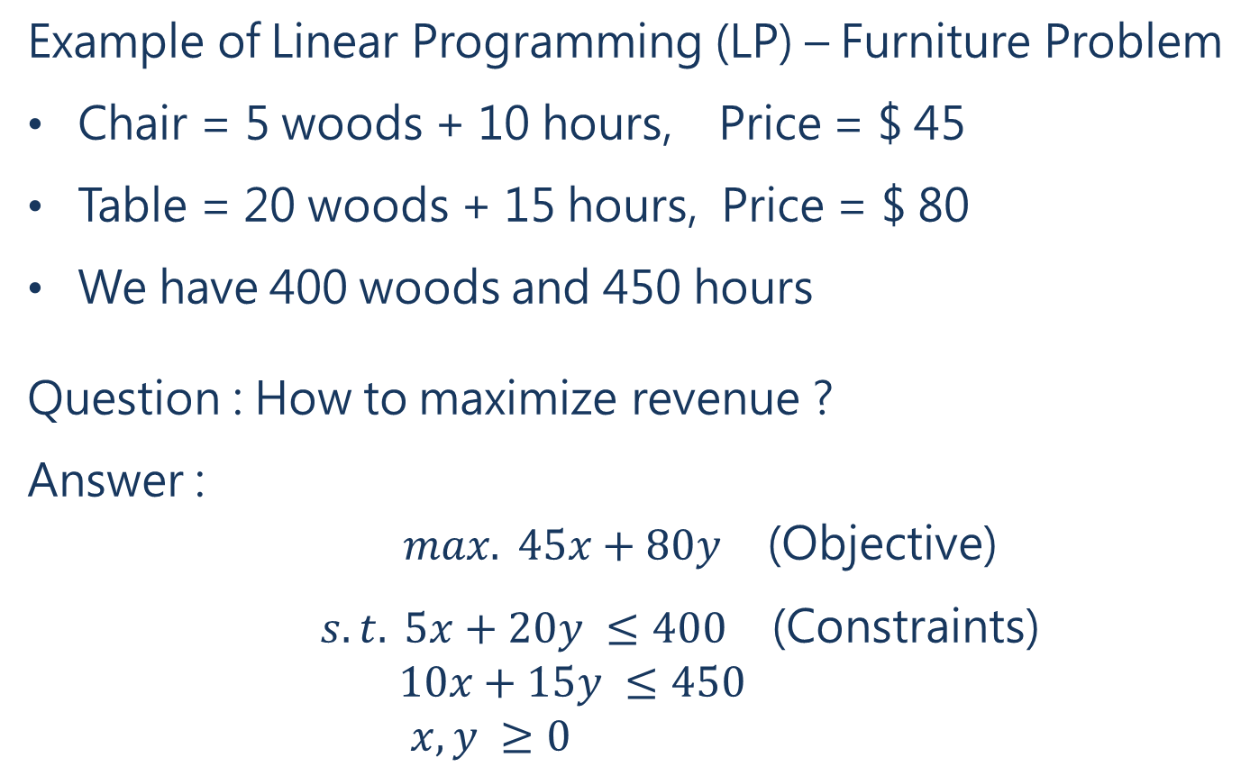
補充 : Integer Linear Programming (ILP) Model
Example of Linear Programming (LP) – Furniture Problem
Chair = 5 woods + 10 hours, Price = $ 45
Table = 20 woods + 15 hours, Price = $ 80
We have 400 woods and 450 hours
Question : How to maximize revenue ?
Answer :
$max. 45x+80y$ (Objective)
$s.t. 5x+20y ≤400$ (Constraints)
$10x+15y ≤450$
$x, y ≥0$

Slide 16
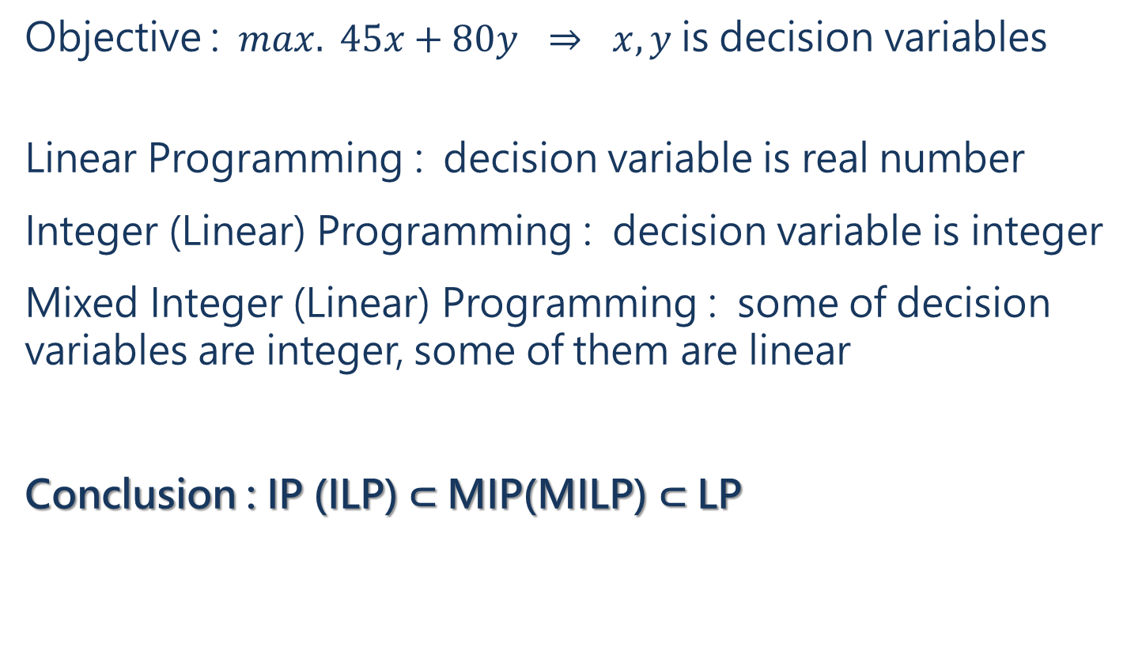
補充 : Integer Linear Programming (ILP) Model
Objective : $max. 45x+80y$ ⇒ $x, y$ is decision variables
Linear Programming : decision variable is real number
Integer (Linear) Programming : decision variable is integer
Mixed Integer (Linear) Programming : some of decision variables are integer, some of them are linear
Conclusion : IP (ILP) ⊂ MIP(MILP) ⊂ LP

Slide 17
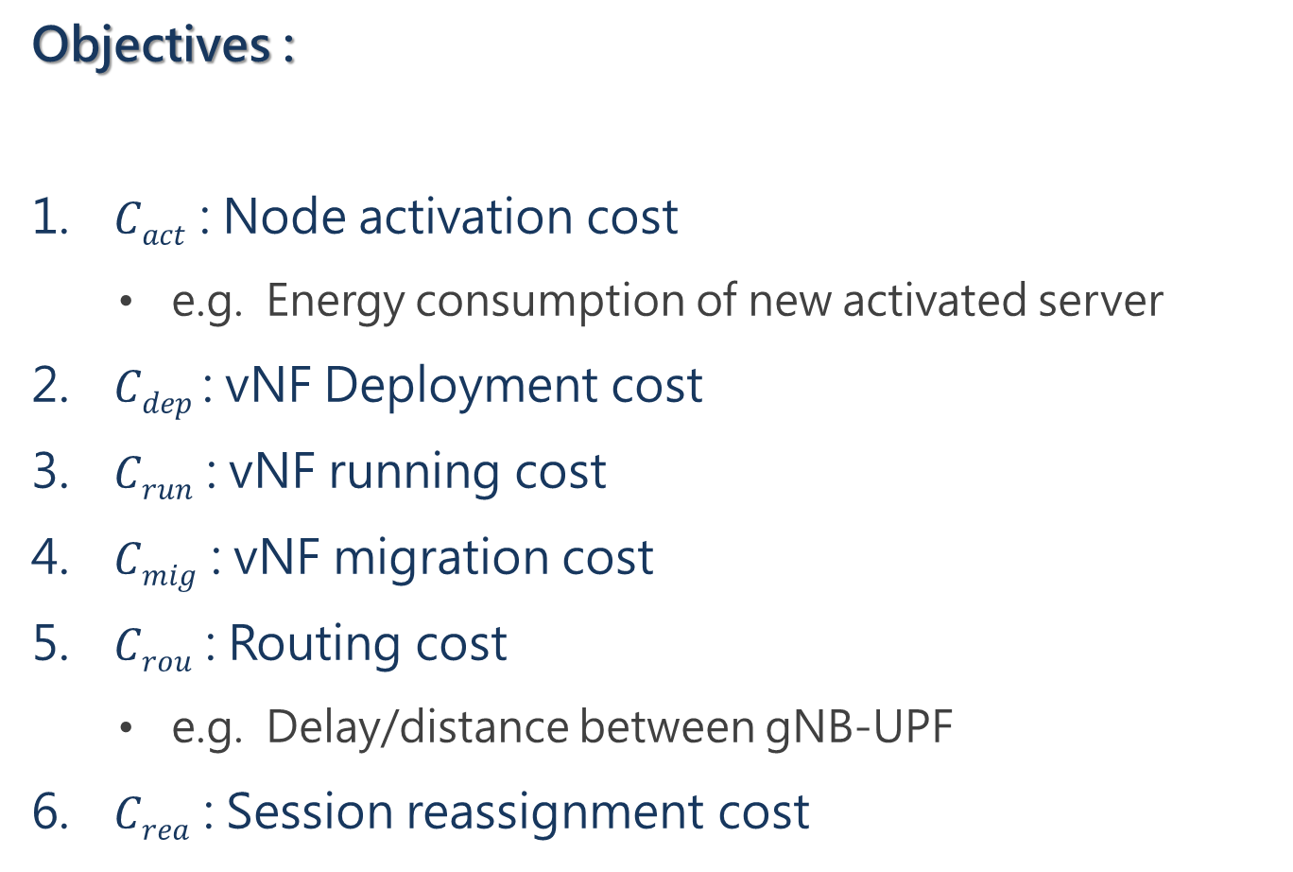
Ch.3 – Optimal UPCR
Objectives :
$Cact$ : Node activation cost
  e.g. Energy consumption of new activated server
$Cdep$ : vNF Deployment cost
$Crun$ : vNF running cost
$Cmig$ : vNF migration cost
$Crou$ : Routing cost
  e.g. Delay/distance between gNB-UPF
$Crea$ : Session reassignment cost

Slide 18


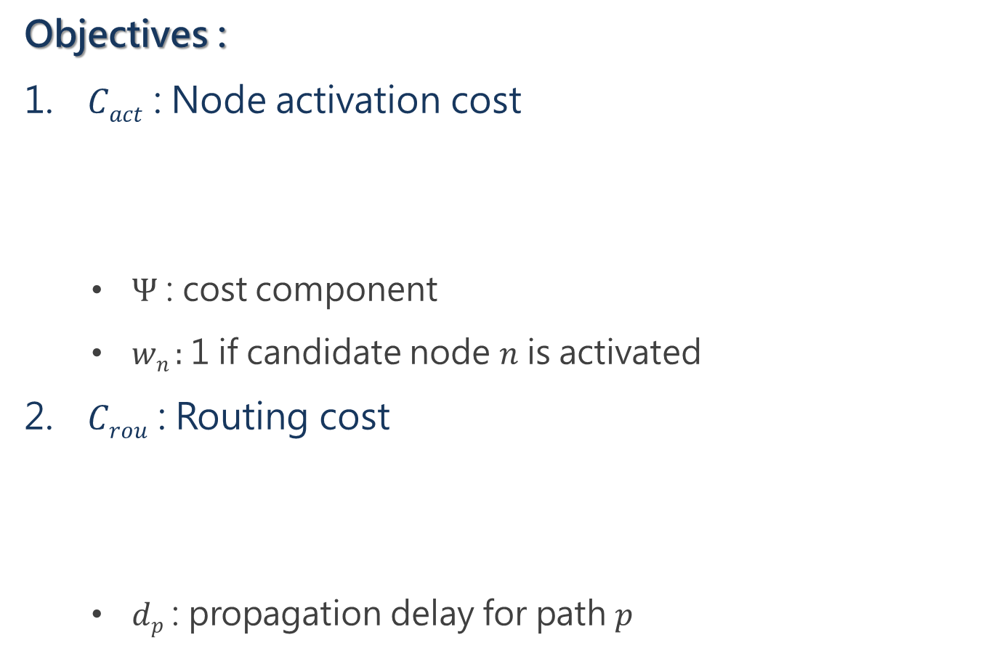
Ch.3 – Optimal UPCR
Objectives :
$Cact$ : Node activation cost
  $Ψ$ : cost component
  $wn$ : 1 if candidate node $n$ is activated
$Crou$ : Routing cost
  $dp$ : propagation delay for path $p$

Slide 19
Ch.3 – Optimal UPCR
Constraints :
Infrastructure resource constraints
vNF placement constraints
vNF assignment constraints
Path mapping constraints
UPF constraints (location constraints)
Reconfiguration constraints

Slide 20
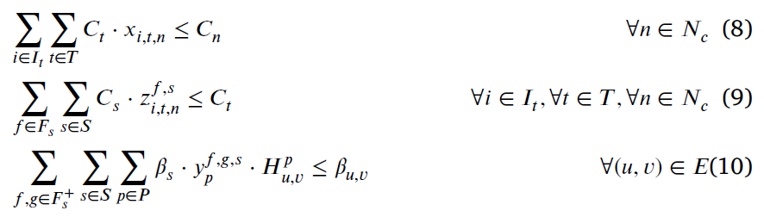
Ch.3 – Optimal UPCR
Constraints :
Infrastructure resource constraints
  (8) : 確保 server 有足夠計算資源服務其上 vNFs
  (9) : 確保 vNF 有足夠計算資源服務其上 sessions
  (10) : 確保所選的 physical path 有足夠通訊頻寬服務其上 sessions

Slide 21
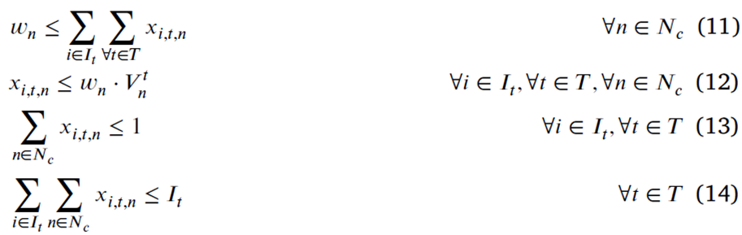
Ch.3 – Optimal UPCR
Constraints :
vNF placement constraints
  (11) : 確保沒有運行 vNF 的 server 是關閉的
  (12) : 確保 vNF 開在有支援此 vNF 的 server 上
  (13) : 確保 vNF 只被部屬於一個 server 上
  (14) : 限制每種類 vNF 的部屬數量不超過規定上限

Slide 22
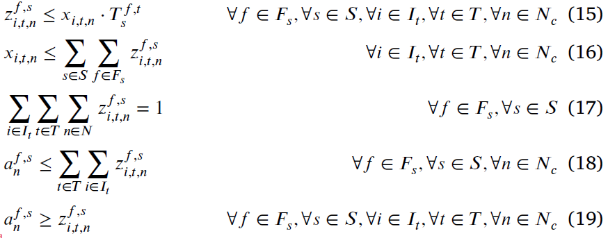
Ch.3 – Optimal UPCR
Constraints :
vNF assignment constraints
  (15) : 如果 vNF 已部屬且類型正確，我們才能把 session 分配給該 vNF 服務
  (16) : 確保運行中的 vNF 都有在為 sessions 服務
  (17) : 確保 session 的每個環節都只有一個 vNF 提供服務
  (18)(19) : 確保如果 SFCR 被分配到某個節點，那是因為該節點上已開啟相應的 vNF

Slide 23
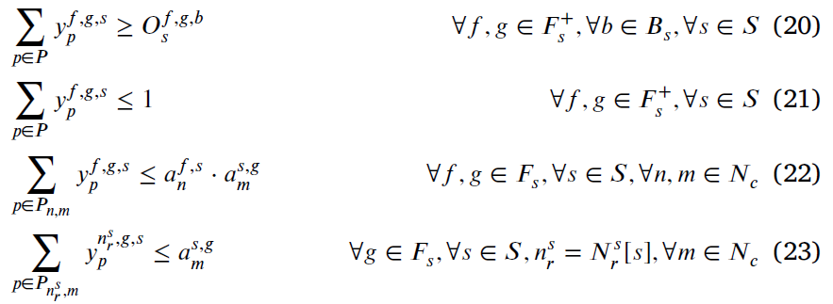
Ch.3 – Optimal UPCR
Constraints :
Path mapping constraints
  (20) : 如果有一條 logical link f → g，則 f, g 的部屬位置之間必須存在一條 physical path
  (21) : 確保 vNF f → g 之間至多只有一條 physical path，以避免迴圈形成
  (22) : 如果於 server n, m 間有一條 physical path，代表 n,m 上一定有運行 vNF f, g

Slide 24
Ch.3 – Optimal UPCR
Constraints :
Path mapping constraints
  (20) : 如果有一條 logical link f → g，則 f, g 的部屬位置之間必須存在一條 physical path
  (21) : 確保 vNF f → g 之間至多只有一條 physical path，以避免迴圈形成
  (22) : 如果於 server n, m 間有一條 physical path，代表 n,m 上一定有運行 vNF f, g

Slide 25
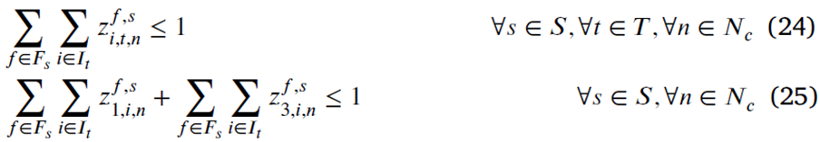
Ch.3 – Optimal UPCR
Constraints :
UPF constraints (location constraints)
  (24) : 確保服務一 session 的同類型 (type) vNFs 部屬於不同 servers，e.g. 兩個 A-UPF 不在同一位置
  (25) 確保服務一 session 的 I-UPF 和 A-UPF，雖然不同類型，但也部屬於不同 servers

Slide 26
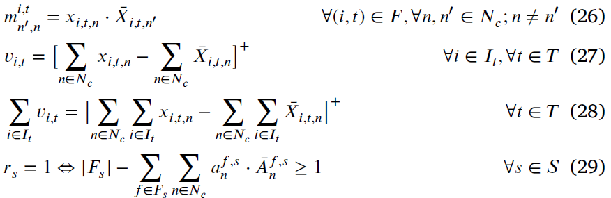
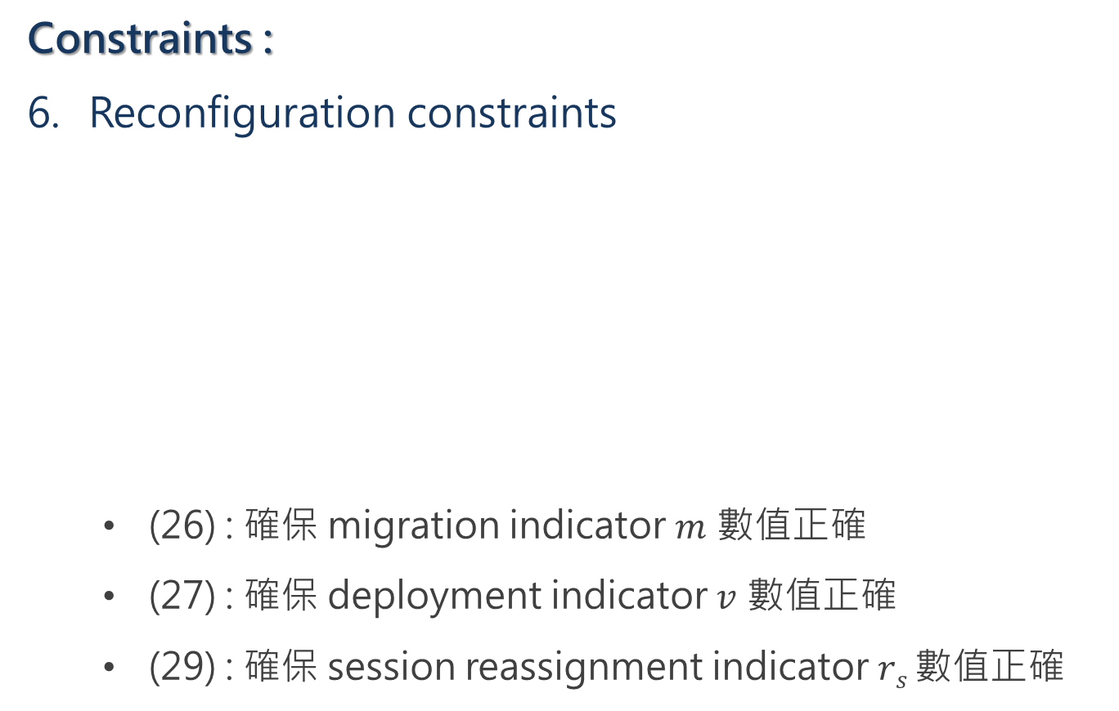
Ch.3 – Optimal UPCR
Constraints :
Reconfiguration constraints
  (26) : 確保 migration indicator $m$ 數值正確
  (27) : 確保 deployment indicator $v$ 數值正確
  (29) : 確保 session reassignment indicator $rs$ 數值正確

Slide 27
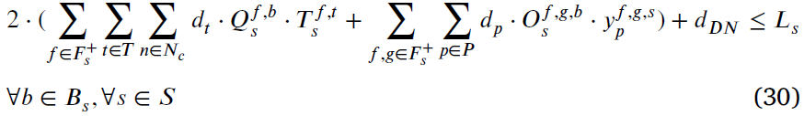
Ch.3 – Optimal UPCR
Constraints :
QoS constraints :
  (30) : 確保沒有 latency violations

Slide 28
Ch.4 - Dynamic UPCR
Because of user mobility, system need to reconfigure (readjust) UPF placement to better serve users
Reconfiguration bring extra cost ⇒ Min. reconfig. event
Decide reconfigure or not based on Optimal Stopping Theory (OST)

Slide 29


Example of OST – Hiring Problem
$n$ candidates apply for 1 job
Decide to hiring him or not on the spot
Objective : find the best candidate
Hired

Slide 30

Example of OST – Hiring Problem
Hire the first candidate ⇒ 1/n chance to be the best
If median score is known, hire the first who surpass median ⇒ 1/2 chance to be the best
Problem is we don’t know median

Slide 31
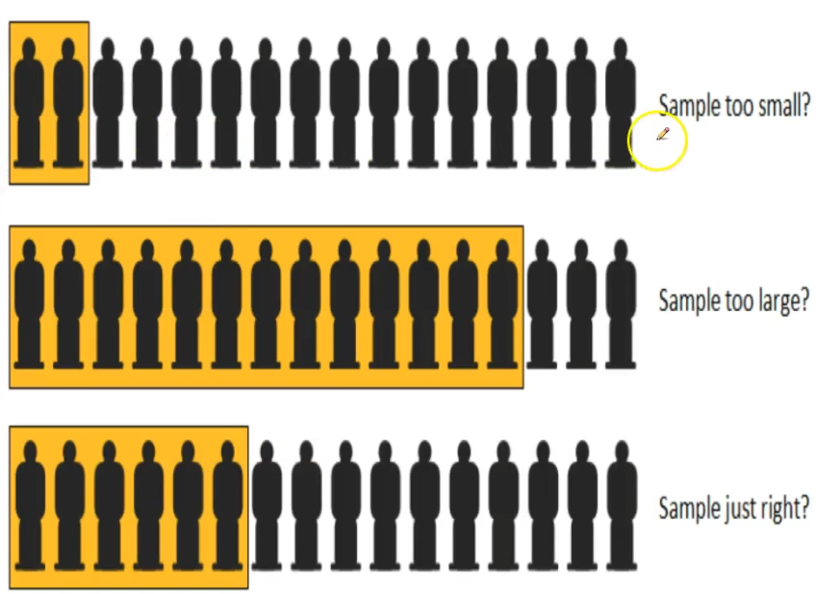
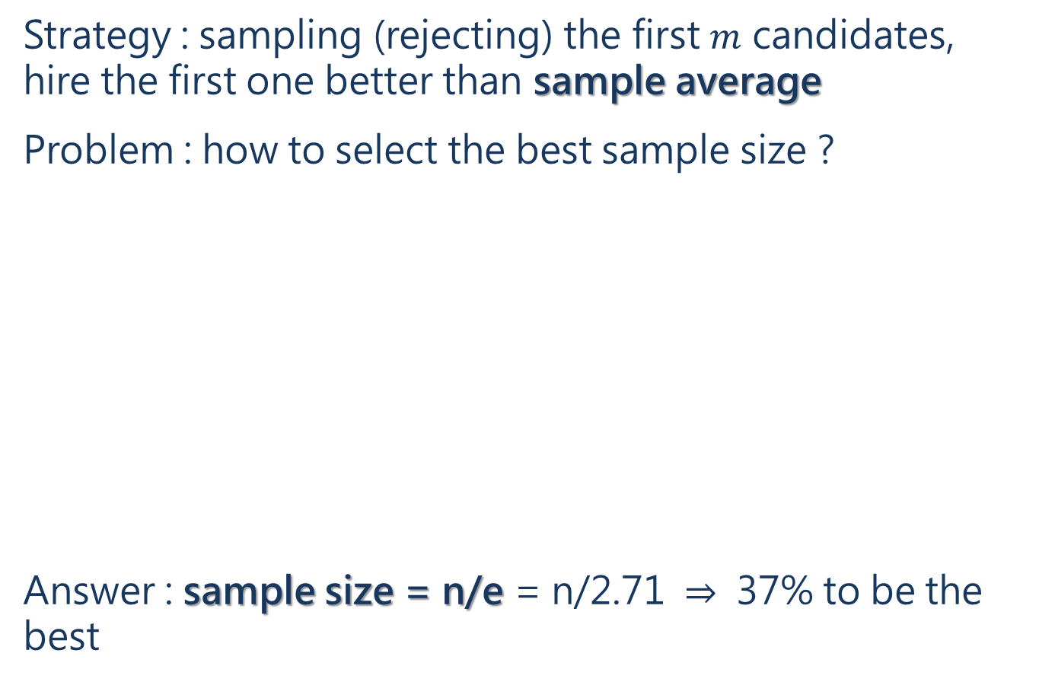
Example of OST – Hiring Problem
Strategy : sampling (rejecting) the first $m$ candidates, hire the first one better than sample average
Problem : how to select the best sample size ?
Answer : sample size = n/e = n/2.71 ⇒ 37% to be the best
Notes:
簡單來說 OST 針對的是一個 markov decision problem (random process problem)，每個 state 你都有固定兩個選擇 : continue or stop
而 OST 的策略就是 : 觀察(起手 continue) -> 做出更聰明的決定

Slide 32
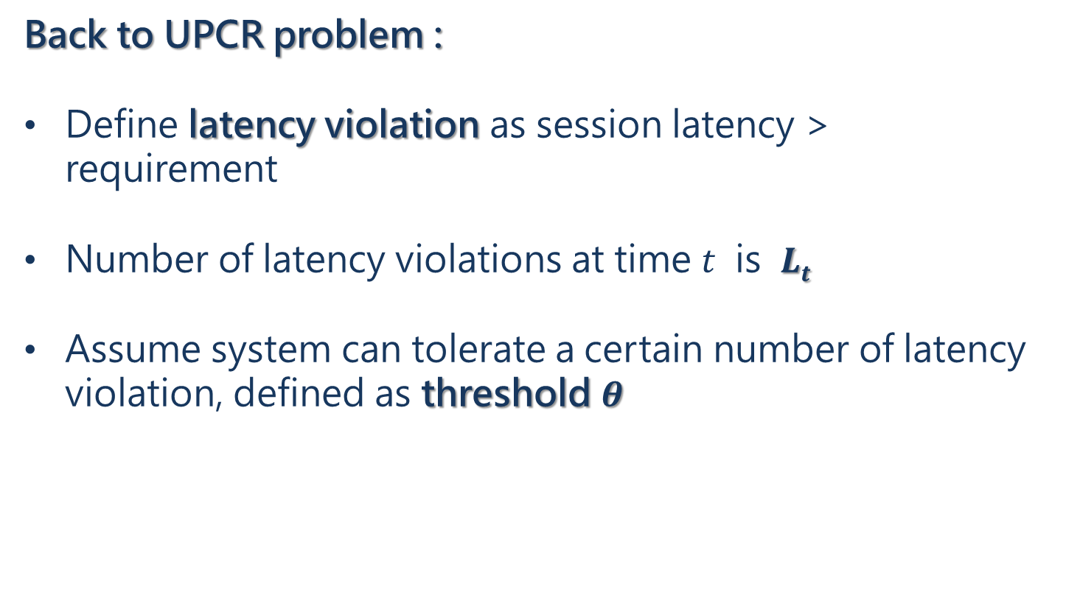
Ch.4 - Dynamic UPCR
Back to UPCR problem :
Define latency violation as session latency > requirement
Number of latency violations at time $t$ is $Lt$
Assume system can tolerate a certain number of latency violation, defined as threshold $θ$
Notes:
一開始部屬是 0但隨著用戶移動，會開始產生 Lt

Slide 33
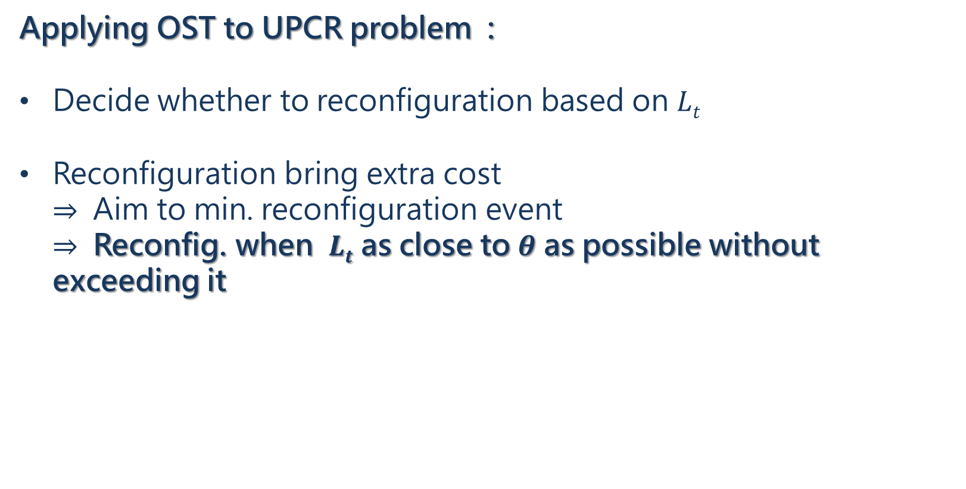
Ch.4 - Dynamic UPCR
Applying OST to UPCR problem :
Decide whether to reconfiguration based on $Lt$
Reconfiguration bring extra cost ⇒ Aim to min. reconfiguration event ⇒ Reconfig. when $Lt$ as close to $θ$ as possible without exceeding it
Notes:
一開始部屬是 0但隨著用戶移動，會開始產生 Lt

Slide 34

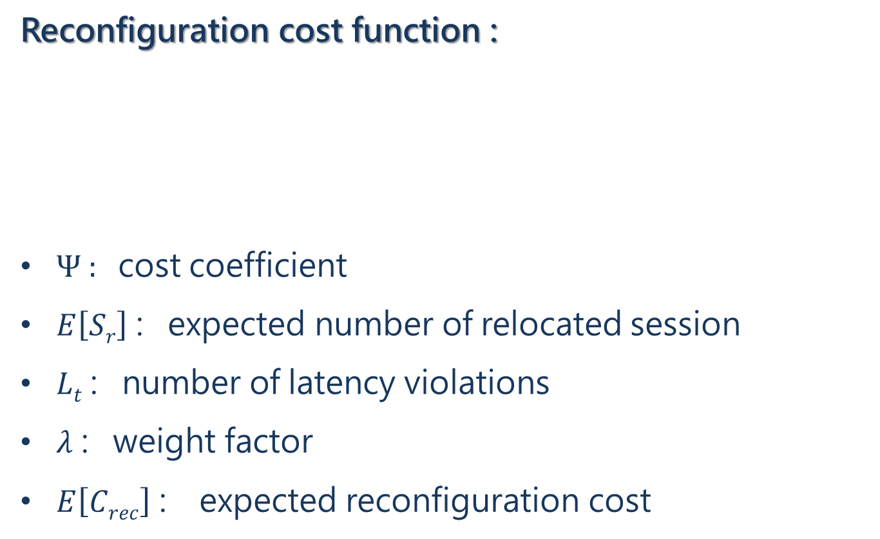
Ch.4 - Dynamic UPCR
Reconfiguration cost function :
$Ψ$ : cost coefficient
$E\left[Sr\right]$ : expected number of relocated session
$Lt$ : number of latency violations
$λ$ : weight factor
$E\left[Crec\right]$ : expected reconfiguration cost
Notes:
Session relocation 發生於當服務 session 的任一 UPF 發生位移

Slide 35
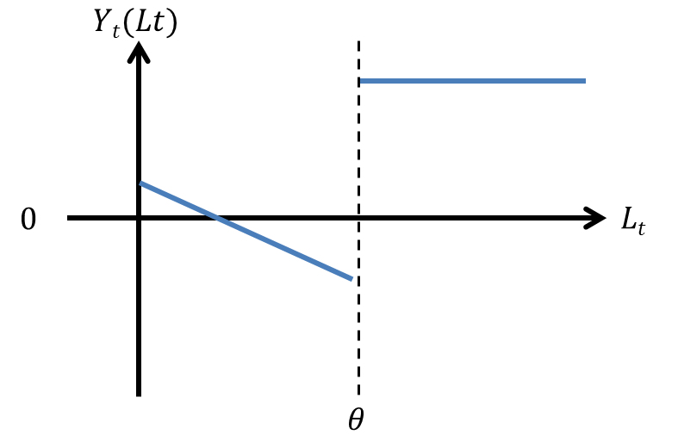
Ch.4 - Dynamic UPCR
Reconfiguration cost function :
Notes:
為何我認為會是如此 ?

Slide 36
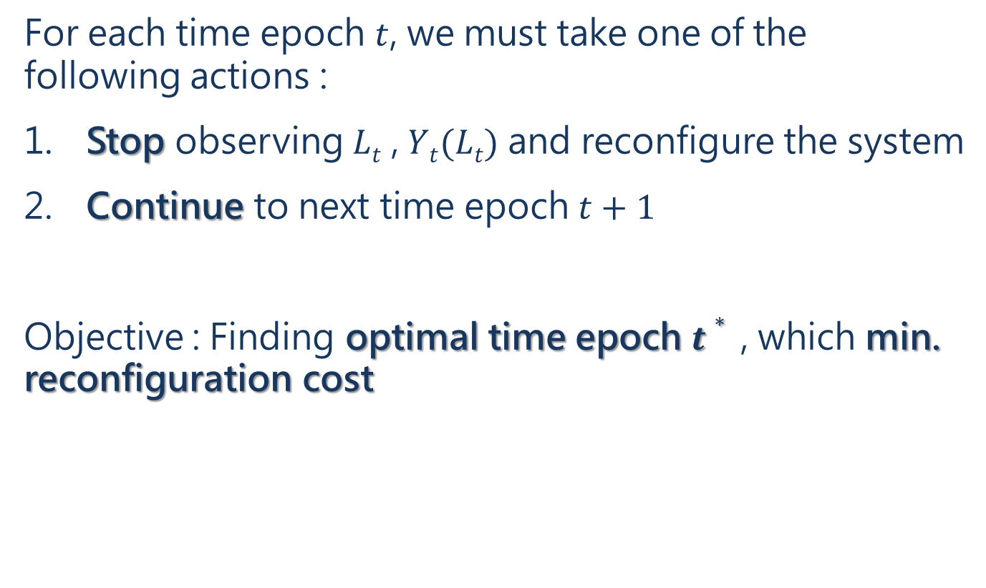
Ch.4 - Dynamic UPCR
For each time epoch $t$, we must take one of the following actions :
Stop observing $Lt$ , $Yt(Lt)$ and reconfigure the system
Continue to next time epoch $t+1$
Objective : Finding optimal time epoch $t∗$ , which min. reconfiguration cost
Notes:
OST : choosing a time to take action based on sequential observed random variable X0~Xt to minimize an expected cost

Slide 37

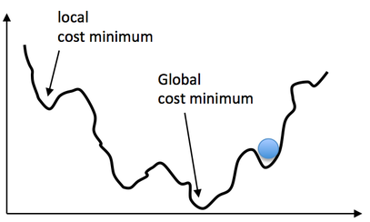
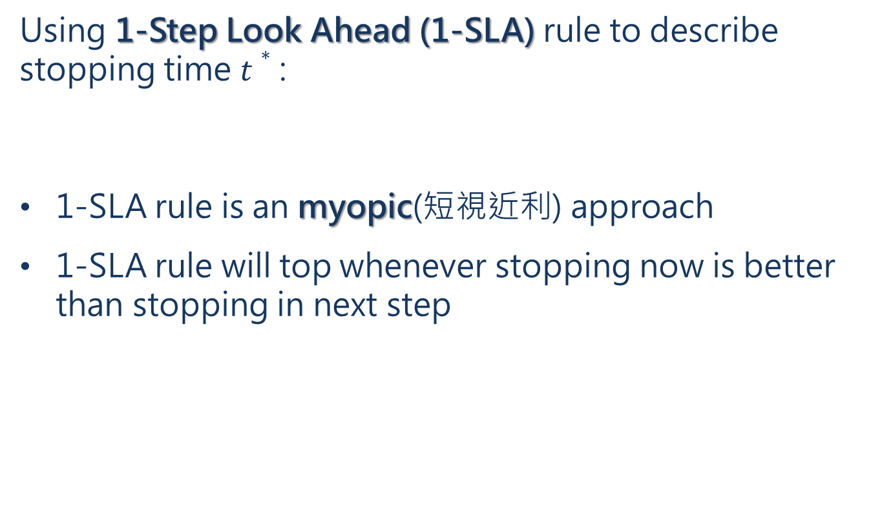
Ch.4 - Dynamic UPCR
Using 1-Step Look Ahead (1-SLA) rule to describe stopping time $t∗$ :
1-SLA rule is an myopic(短視近利) approach
1-SLA rule will top whenever stopping now is better than stopping in next step

Slide 38
Ch.4 - Dynamic UPCR
Theorem 1 :
In monotone stopping rule problems, the 1-SLA rule is optimal
Proof :
skipped in paper

Slide 39
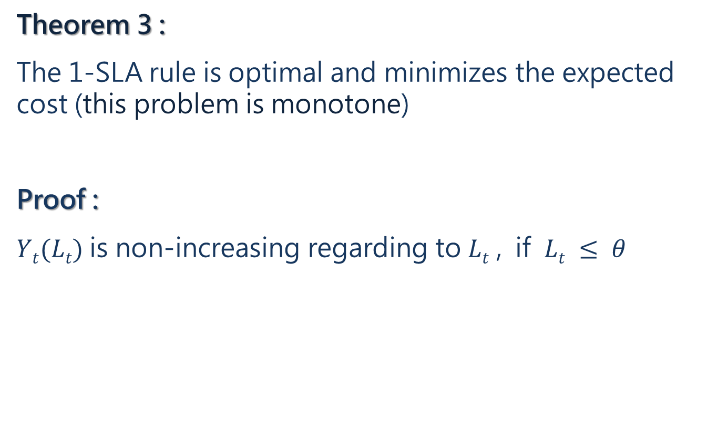
Ch.4 - Dynamic UPCR
Theorem 3 :
The 1-SLA rule is optimal and minimizes the expected cost (this problem is monotone)
Proof :
$Yt(Lt)$ is non-increasing regarding to $Lt$ , if $Lt ≤ θ$
Notes:
所以 1-SLA 什麼時候會 call for stop? 其實就是預測 Lt+1 >θ 的時候， 所以重點就是如何預測 Lt+1

Slide 40
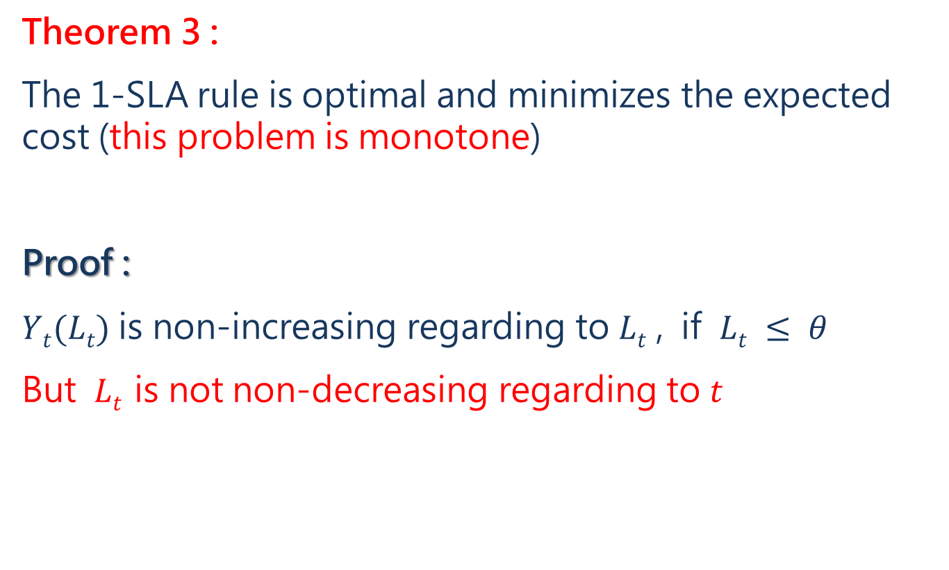
Ch.4 - Dynamic UPCR
Theorem 3 :
The 1-SLA rule is optimal and minimizes the expected cost (this problem is monotone)
Proof :
$Yt(Lt)$ is non-increasing regarding to $Lt$ , if $Lt ≤ θ$
But $Lt$ is not non-decreasing regarding to $t$
Notes:
所以 1-SLA 什麼時候會 call for stop? 其實就是預測 Lt+1 >θ 的時候， 所以重點就是如何預測 Lt+1

Slide 41
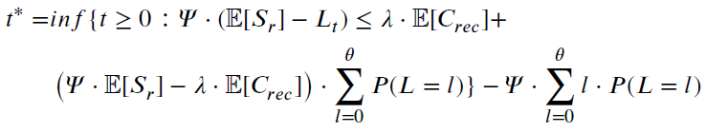

Ch.4 - Dynamic UPCR
Theorem 2 :
Given $θ$ and $L1 \sim Lt$ , then $t∗$ can be translated as :
⇒

Slide 42
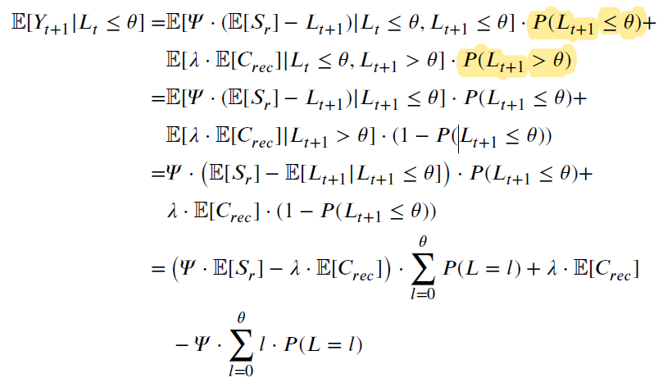
Ch.4 - Dynamic UPCR
Theorem 2 proof :
Notes:
沒有解釋如何預測 Lt+1，雖然我猜射應該是由 L0~t 去預測，但具體怎麼算出機率就不知道了

Slide 43
Ch.3 – Optimal UPCR
Heuristic algorithm - Dynamic priority and cautious UPCR
The algorithm has 4 phases :
Select sessions to be remapped
Find possible candidate locations
Map sessions
Improve solutions by random relaxation
Notes:
ILP model : 太慢 => heuristic

Slide 44
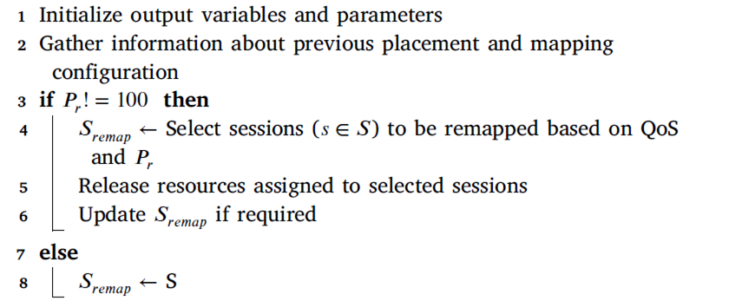
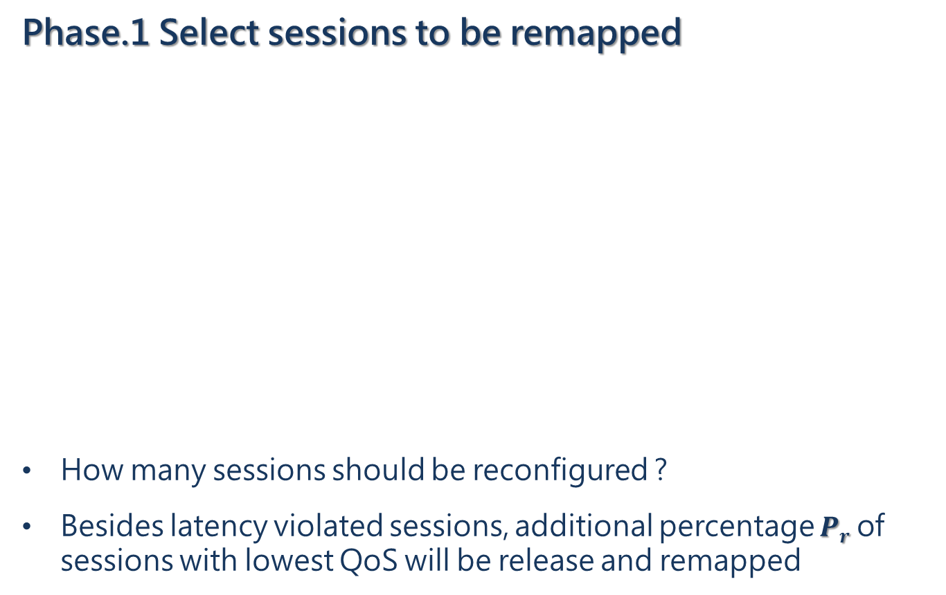
Ch.3 – Optimal UPCR
Phase.1 Select sessions to be remapped
How many sessions should be reconfigured ?
Besides latency violated sessions, additional percentage $Pr$ of sessions with lowest QoS will be release and remapped

Slide 45
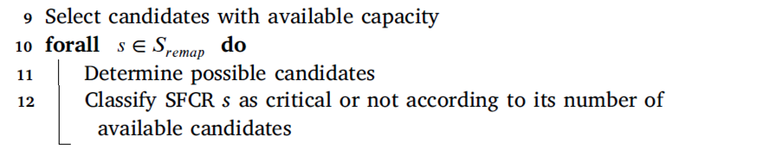

Ch.3 – Optimal UPCR
Phase.2 Find possible candidate locations
Line 9 : Find available candidate servers
Line 11 : Find possible candidate servers
Line 12 : Classify critical session, if servers $≤$ vNFs

Slide 46
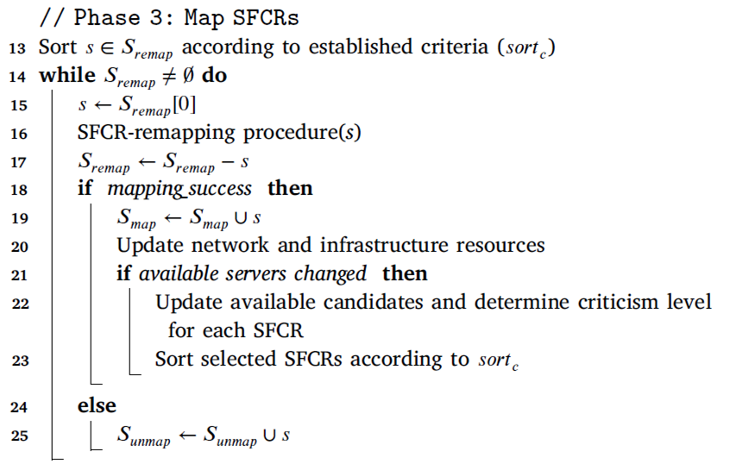
Ch.3 – Optimal UPCR
Phase.3 Map sessions
Line 13 : Sort sessions by various criteria, mapping the most demanding or the most critical sessions first.
Line 16 : sessions remapping function

Slide 47
Ch.3 – Optimal UPCR
Phase.3 Map sessions
Line 21 : if server run out of resources, update candidate servers list and re-sort sessions priority

Slide 48
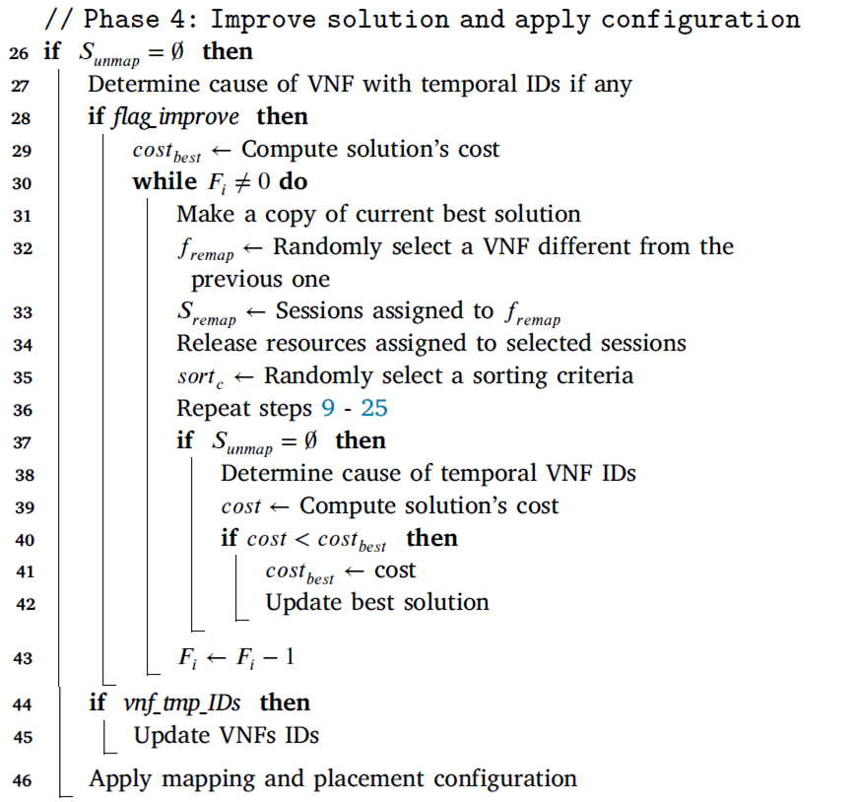
Ch.3 – Optimal UPCR
Phase.4 Improve solution by random relax

Slide 49
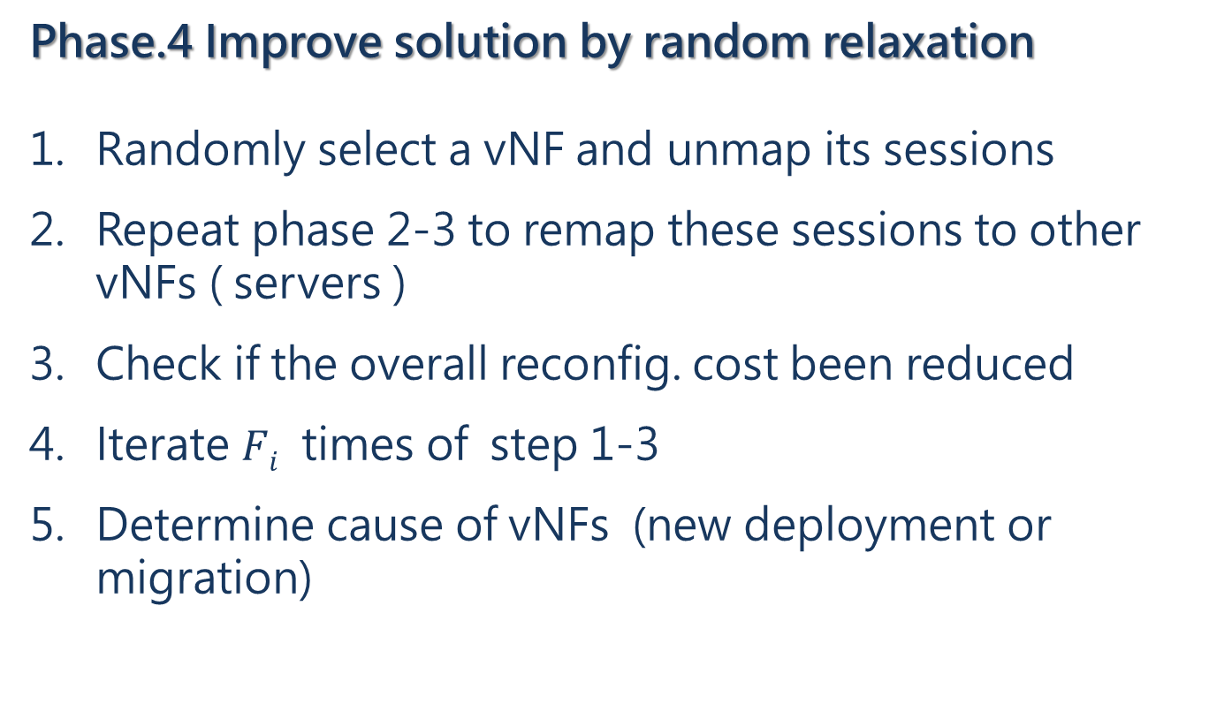
Ch.3 – Optimal UPCR
Phase.4 Improve solution by random relaxation
Randomly select a vNF and unmap its sessions
Repeat phase 2-3 to remap these sessions to other vNFs ( servers )
Check if the overall reconfig. cost been reduced
Iterate $Fi$ times of step 1-3
Determine cause of vNFs (new deployment or migration)

Slide 50
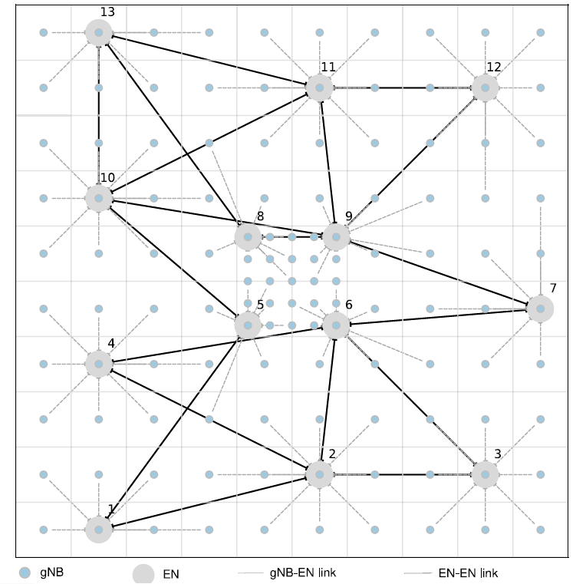
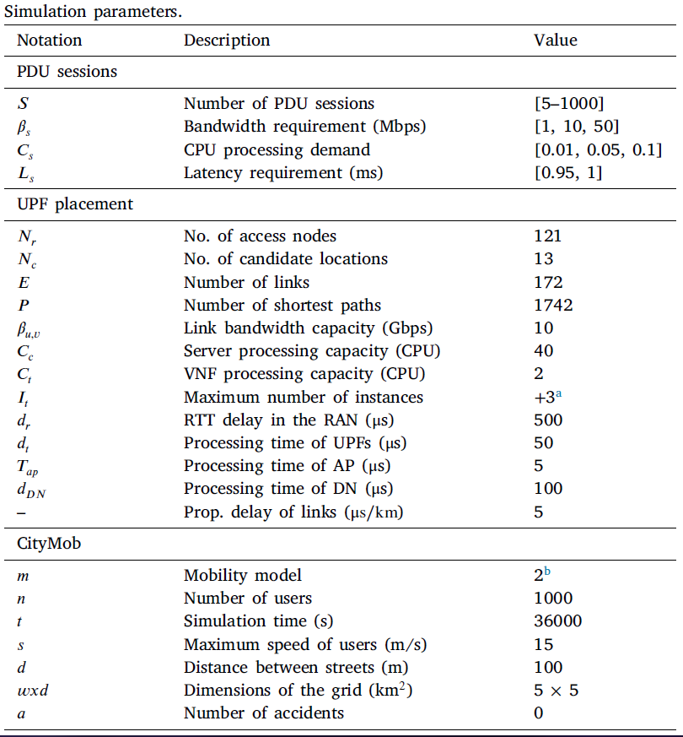
Ch.5 – Performance Evaluation

Slide 51
Ch.5 – Performance Evaluation
Heuristic alogorithm :
Partial unmapping
Improvement stage
Performance
Reconfiguration mechanism :
Number of reconfiguration events
Number of latency violations

Slide 52
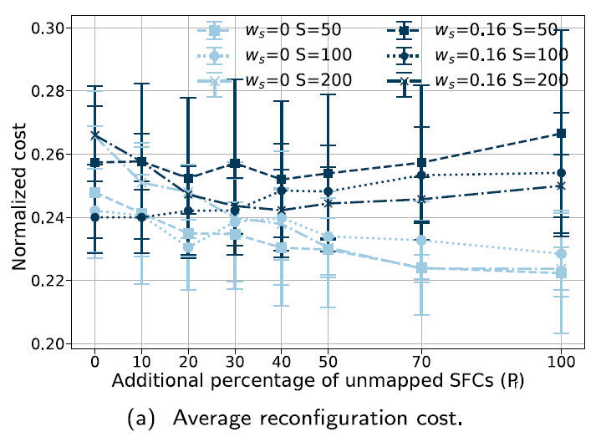
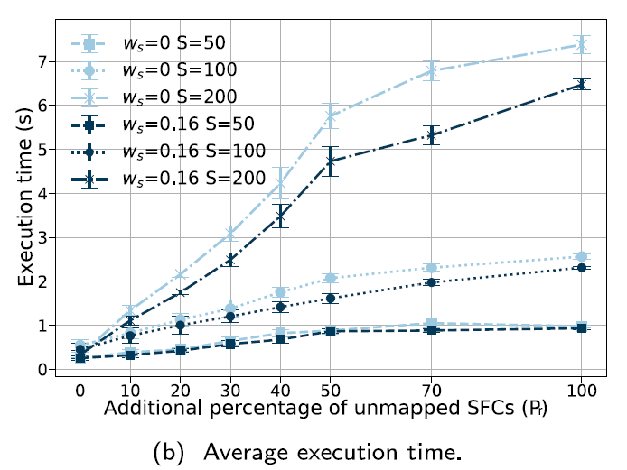
1. Partial Unmapping
When reconfig. triggered, how many session should we remap ?
Light blue : without reconfig. cost Dark blue : with reconfig. cost
Notes:
在不考慮 reconfig. Cost 情況下，session remap 愈多愈能找到更好部屬 (左淺藍)，但如果考慮到 reconfig. Cost ，則不是 session remap 愈多愈好

Slide 53
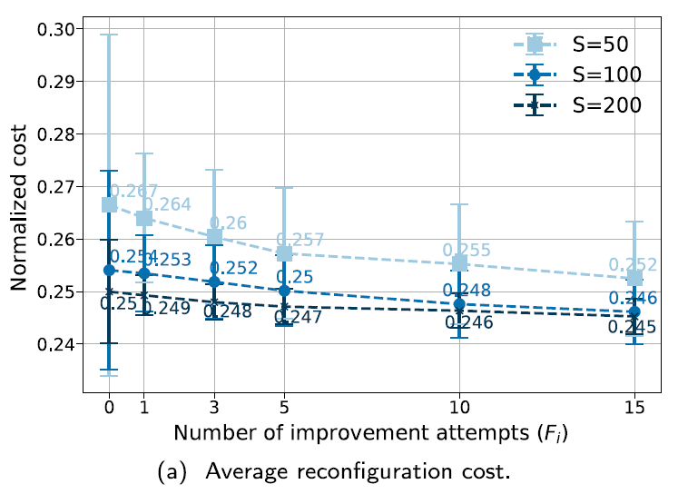
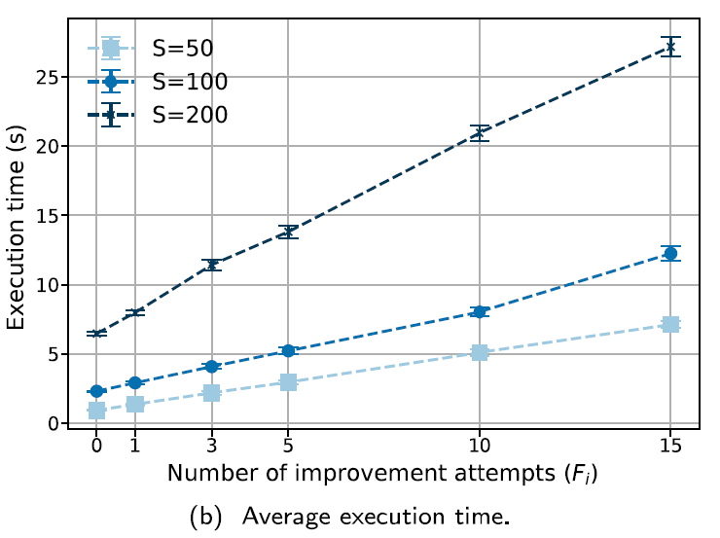
2. Improvement stage

Slide 54
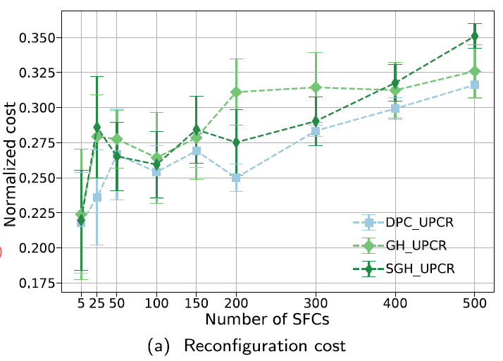
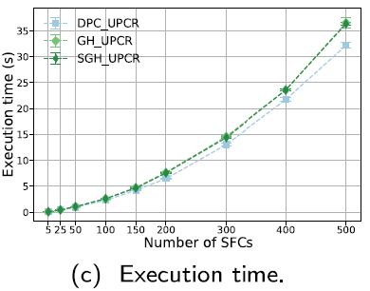
3. Heuristic Algorithm Performance
Compare with (sorted) greedy approach
When placing vNF, do not consider the next vNF that form the SFC

Slide 55
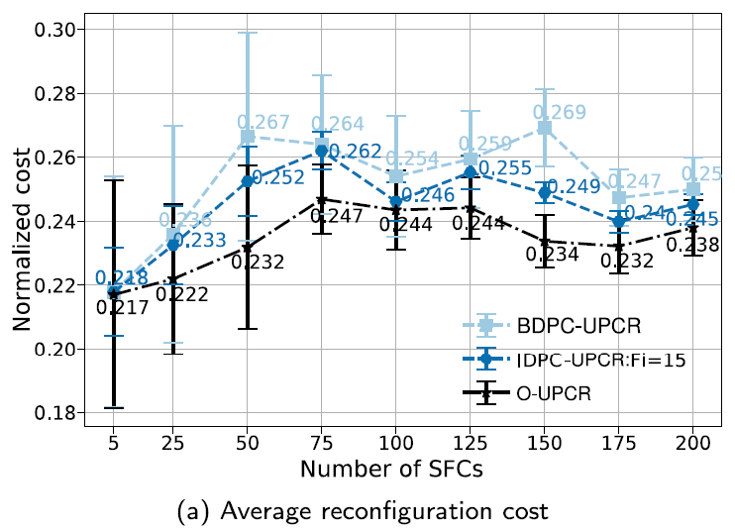
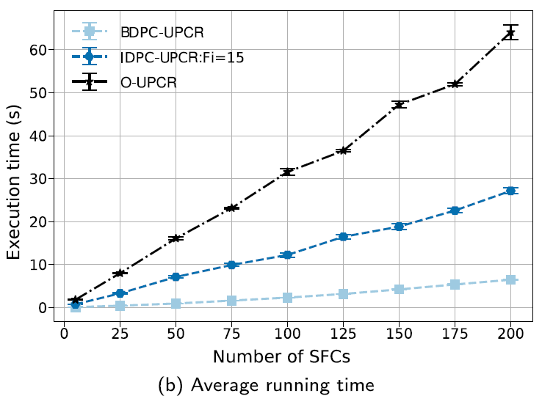
3. Heuristic Algorithm Performance
Compare with ILP model

Slide 56

Reconfiguration Mechanism
Compare Optimal Scheduling Reconfiguration (OSR) with :
Periodic Scheduling Reconfiguration (PSR)
Skeptical Scheduling Reconfiguration (SSR)
  Authors’ previous work
  Main difference is reconfiguration cost function
  Previous :
  Current :
  Current work

Slide 57
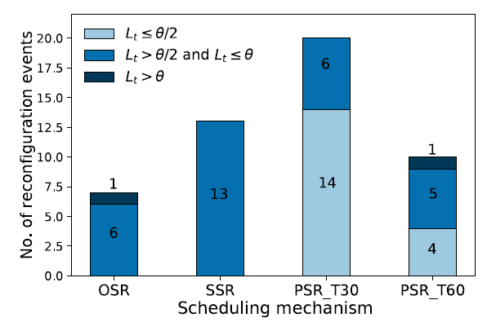
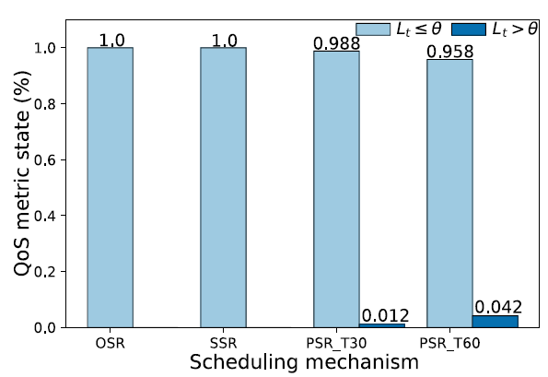
1. Reconfiguration event

Slide 58
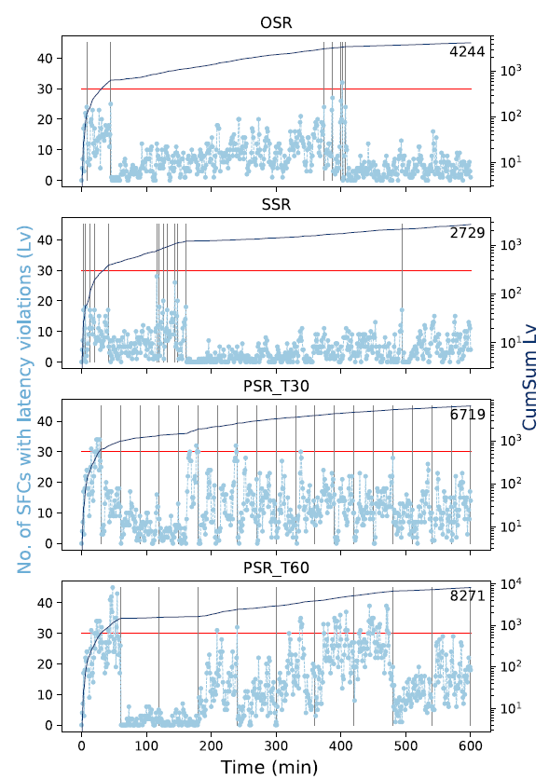
2. Number of latency violation

Slide 59
Q & A

