Slide 1
學習心得報告
彭奎量

Slide 2
papers
Edge Computing in 5G: A Review
  IEEE Access, 30 August 2019, IF=3.476
Mobile Edge Computing Potential in Making Cities Smarter
  IEEE Communications Magazine, 13 March 2017, IF=9.03
Notes:
明威

Slide 3
KEY REQUIREMENTS OF EDGE COMPUTING IN 5G
Four key requirements exist for the successful deployment and operation of edge computing in 5G.
Real-time interaction
Local processing
High data rate
High availability
Notes:
5G edge computing 有四個關鍵的需求

Slide 4
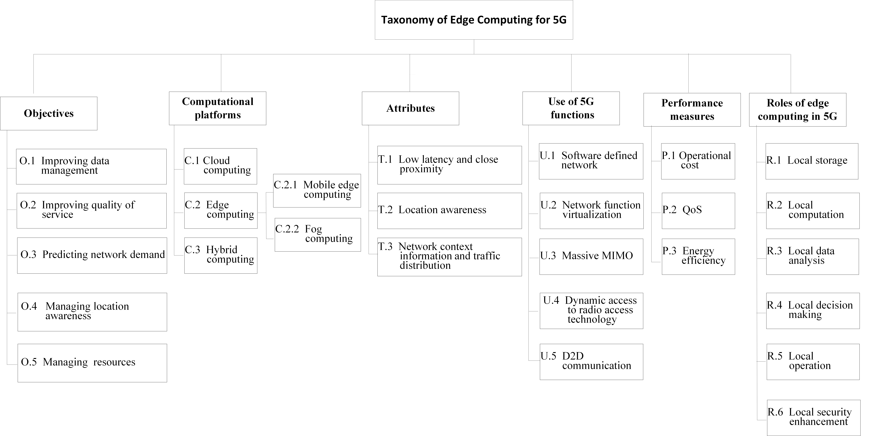
Taxonomy of edge computing in 5G
Notes:
Edge computing 分類

Slide 5
Five main objectives of edge computing in 5G
O.1 Improving data management
  Handle a large amount of data, which are generated by UEs.
  For instance, a smart factory is expected to generate up to 1 petabyte(=1000TB) of data daily.
  Since accessing the cloud will be high latency, edge servers need to be improving data management.
O.2 Improving QoS
  Service providers must have a holistic view of subscribers and customers
  The information can be personalized for attracting potential customers and enhancing their QoE.
Notes:
五個EC的主要目標
增強資料管理，因為 UE 產生很多資料
提升QoS，吸引潛在用戶並提升QoE

Slide 6
Five main objectives of edge computing in 5G
O.3 Predicting network demand
  Estimate the required network resources and provide optimal resource allocation.
  An accurate prediction helps to decide whether a network demand should be handled locally at the edge or at the cloud.
O.4 Managing location-awareness
  Track the location of UEs to support location-based services
  For instance, hospitals and medical advice during emergency response.
O.5 Improving resource management
  The limited network resources are available in the edge server as compared to the cloud.
Notes:
預測網路需求，提供最佳化資源分配，正確預測可以減少網路負擔
管理UE地點資訊，提供緊急快速的回應

Slide 7
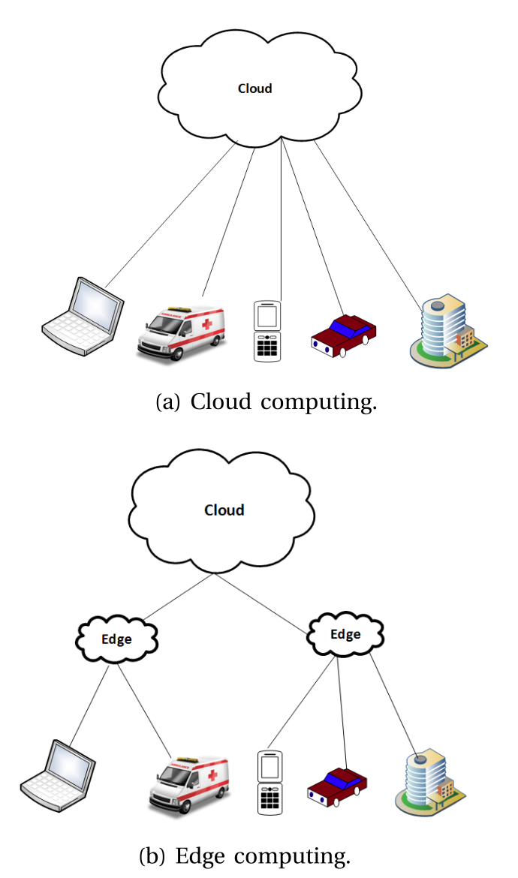
Computational plaforms of edge computing in 5G
C.1 Cloud computing
  Stores a massive amount of data and information.
  Not suitable to provide real-time services.
C.2 Edge computing
  Gathers, processes, and stores a massive amount of local data from UEs.
  Proximity to UEs.
Notes:
EC的計算平台
CC 儲存大量資料與資訊，但不適合即時服務
EC 接收處理大量UE資料，接近UE

Slide 8
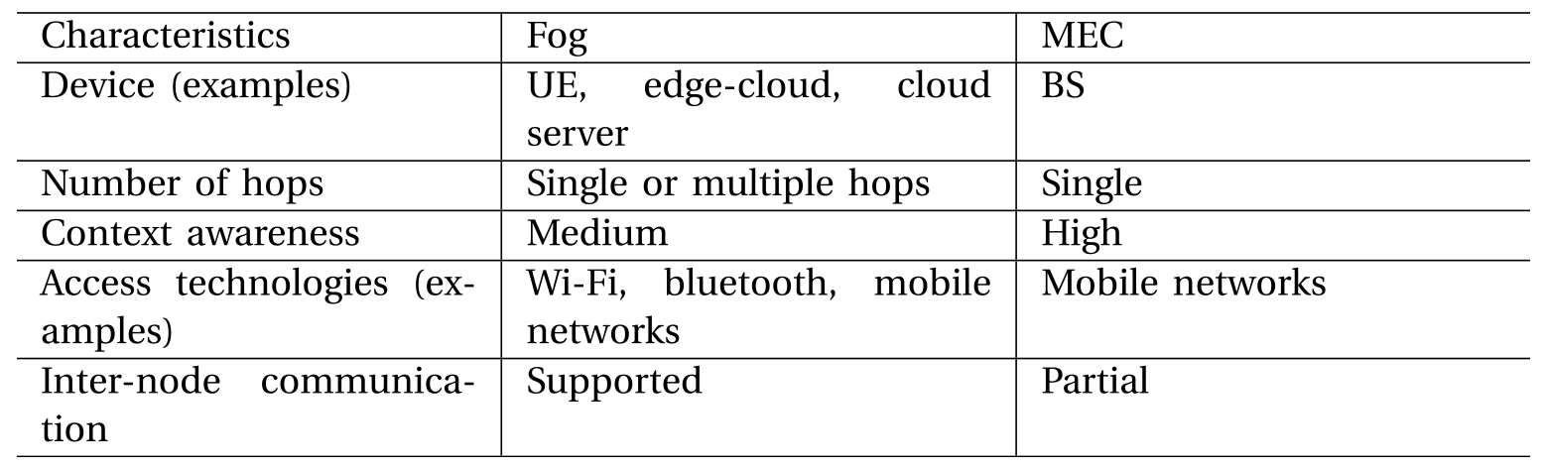
Computational plaforms of edge computing in 5G
C.2.1 MEC
C.2.2 Fog computing
Notes:
EC 再分兩種 Fog不只MCN，藍芽wifi都可以

Slide 9
Computational plaforms of edge computing in 5G
C.3 Hybrid computing
  Combines cloud computing and edge computing so that they can cooperate.
  In general, real-time tasks are executed in the edge layer, and tasks requiring high computation are executed in the cloud layer.
Notes:
最後第三種是混合/合作
即時服務在edge執行，複雜的計算服務在Cloud

Slide 10
Attributes of edge computing in 5G
T.1 Low latency and proximity.
  Enables edge computing to reduce the response delay.
T.2 Location awareness
  Allows location-based and personalized service provisioning to UEs
  edge servers can gather data without sending it to the cloud.
T.3 Network context awareness
  Enables edge servers to acquire network context information
  Helps edge servers to handle a massive amount of traffic to improve network performance.
Notes:
EC的3個重要參數
低延遲
位置感知能力-了解UE位置，提供資訊而不用經過cloud
Context感知能力-提升網路效能

Slide 11
Use of edge computing in 5G
U.1 Software-defined network (SDN)
  Separates a network into control and data planes to provide flexible and agile networks
U.2 Network function virtualization (NFV)
  Network functions (also known as virtual functions) in virtual machines on servers.
U.3 Massive MIMO
  Deploys multiple antenna elements to increase an antenna array.
  Without the need to increase the transmission power, leading to increased network capacity and energy efficiency.
Notes:
5個EC的使用
SDN
NFV
MIMO – 放置多天線

Slide 12
Use of edge computing in 5G
U.4 Dynamic access to radio access technologies
  Provide access to conventional access technologies, such as Wi-Fi, and new radio access technology (RAT) in 5G, such as NR.
U.5 D2D communication
  Enables direct communication between UEs without passing through BSs.
Notes:
連接的協定，例如wifi或RAT，NR
UE之間溝通不經過BSs

Slide 13
Roles of edge computing in 5G
R.1 Local storage
  Edge servers’ storage is much lower than that in the cloud.
  The edge server provides different types of storage strategies to support different kinds of data.
R.2 Local computation
  Edge server handles small tasks and provides real-time responses locally, which helps to reduce the cost and delay incurred to send the required data to the cloud.
Notes:
EC中的六個角色
本地儲存-edge serve提供不同種類的儲存策略來支持不同種類的資訊
本地運算-小任務直接在ES執行，減少delay與流量

Slide 14
Roles of edge computing in 5G
R.3 Local data analysis
  Reduces the latency required to send data to, as well as to wait for responses from, the cloud.
R.4 Local decision making
  Making decisions locally reduces involvement from more components and data or information exchange.
Notes:
本地資料分析
本地決策
這些都可以減少資料需經過cloud所產生的時間，減少response延遲

Slide 15
Roles of edge computing in 5G
R.5 Local operation
  Edge computing enables remote control and monitoring.
R.6 Local security enhancement
  The edge servers provide security management, malware detection, software patch distribution, and trustworthy communications, to detect, validate, and countermeasure attacks.
  Due to the proximity of edge computing, malicious entities can be quickly detected and isolated
Notes:
本地操作 – EC可遠端控制與監視
本地安全性增強 – 因edge serve更加接近UE，所以在惡意軟體偵測、軟體更新分發，信任憑證溝通都更加快速有效率，當出現問題ES可以快速偵測並隔離UE。

Slide 16
Performance measures of edge computing in 5G
P.1 Lower operational cost
  Reduces offloading overhead (or reduces network resource consumption), such as bandwidth.
P.2 Higher QoS
  Reduces the number of tasks and data offloaded to the cloud, and it increases network performance.
P.3 Energy efficiency
  Reduces energy consumption by providing local functions. This reduces the amount of energy incurred to offload tasks and data to the cloud.
Notes:
EC 的性能測量項目
減少營運成本
更好的QoS
更好的資源使用效率

Slide 17
Mobile Edge Computing Potential in
Making Cities Smarter
The authors propose an approach to enhance users’ experience of video streaming in the context of smart cities.
The proposed approach relies on the concept of MEC as a key factor in enhancing QoS.
It sustains QoS by ensuring that applications/services follow the mobility of users, realizing the “Follow-me-Edge” concept.
Notes:
作者群提出了一個提升使用者視訊串流使用體驗的方法。
這個方法基於MEC的概念，透過更換 edge server 的方法維持QoS，實現 “Follow-me-Edge” 概念.

Slide 18
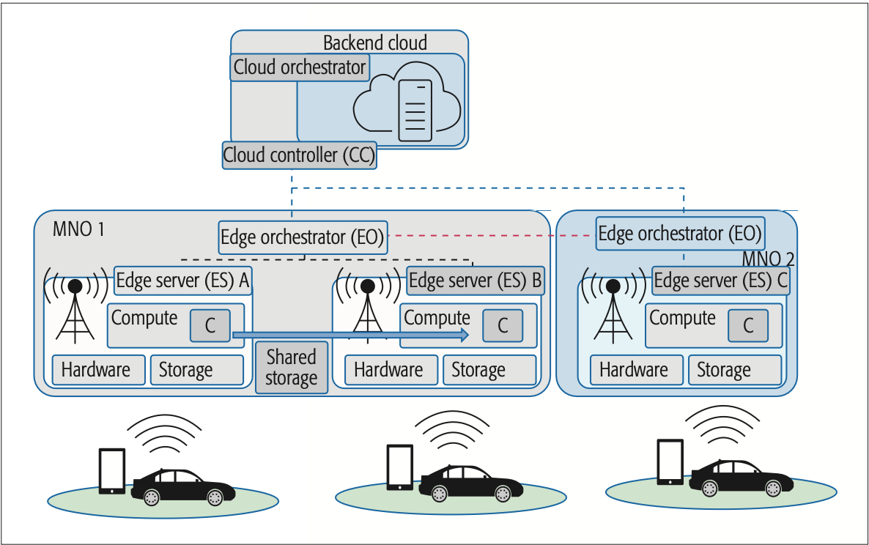
FME Architecture
Notes:
1. ES 屬於 MNO的一部分，由EO來控制。每個MNO有自己的EO，管理自己的ES群
ES有自己的計算與儲存單元，ESES之間有Shared storage待會轉移服務時會使用到
假設一個use case:
Allen連接上ES A觀賞HD影片，他最初會被遠處的cloud服務，但因為網率壅塞而被限制影片解析度。
為了解決這問題，在ES中儲存影片資料，Allen就可以被ES服務，增加使用體驗。

Slide 19
FME Architecture (Before Migration)
EO needs to keep updated information about its resources and user locations.
Compare it with the latency between the same user and the target edge.
Once deemed appropriate, the EO may trigger live migration of the container.
To perform seamless live migration, the service has to ensure that no data is lost.
Notes:
EO 會一直更新紀錄UE資訊位置
比較同個UE，與自己或與目標EO連線的延遲
一旦狀態合適，就會開始搬移包含服務的container
為了保證無縫搬移，服務必須確保沒有資料遺失

Slide 20
FME Architecture (Migration)
Transferring the entire memory content of the running instance (i.e., container) from the source ES to the target ES.
The source ES keeps track of which memory blocks are modified while the transfer is in progress.
Once this initial transfer is complete, the changes that have occurred in the meantime are transferred again.
This continues until the newly built instance becomes identical to the old one. This ensures that after the migration process is complete, the video starts from the exact point rather than overlapping.
Notes:
將正在執行的實體（即容器）的整個記憶體內容從源ES傳輸到目標ES。
Source ES 紀錄在傳輸過程中修改了哪些記憶體塊。 一旦初始傳輸完成，在此期間發生的會再傳輸。
這一直持續到新建的實體與舊實體完全相同。 這確保了遷移過程完成後，影片從確切點開始，而不是重疊。

Slide 21
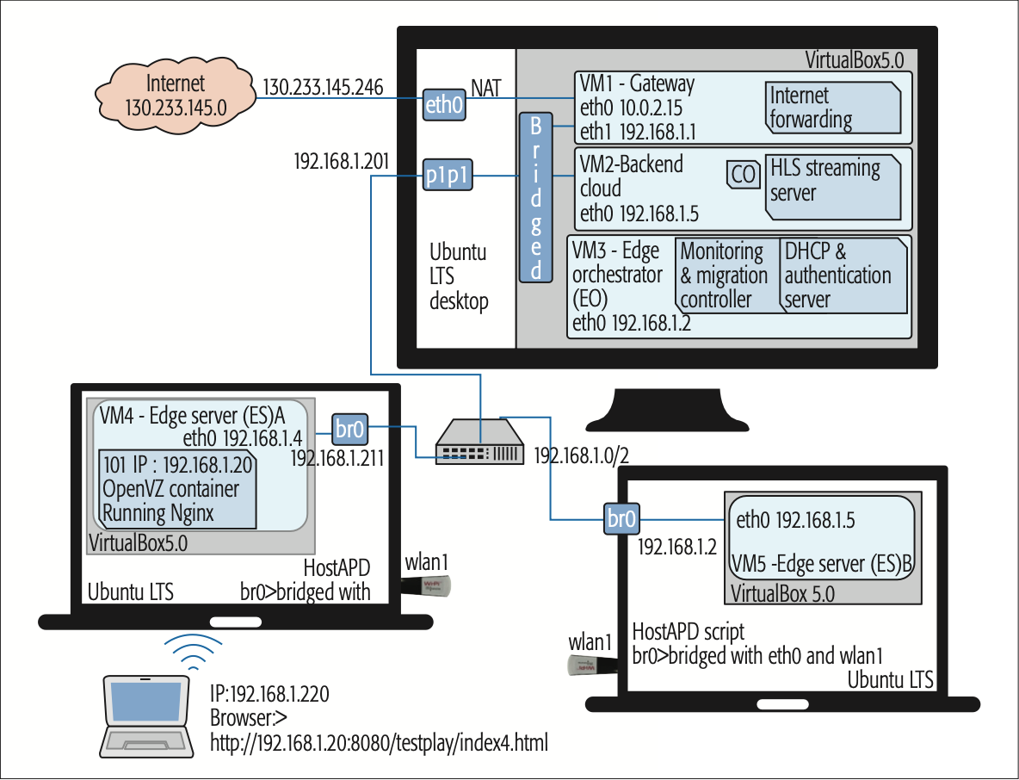
Testbed environment
Notes:
全部都是ubuntu 14.04.3 LTS
VM1 為gateway to access the Internet
VM2 模擬backend，運行著 Http live streaming (HLS) server
VM3 運行著proxmox並且扮演著Edge cluster controller，同時也是DHCP server
VM4 與 VM5 扮演BSs角色，VMs之間透過switch連線，並且VM4與VM5使用相同虛擬環境模擬在同個EO之中。
VM4 中創建了一個linux container，執行Nginx進行反向代理回HLS server
當實驗開始後，使用者使用筆電連接上筆電，取得與ES相同submet的IP address。
接著打開瀏覽器，瀏覽網址。
第一次瀏覽時，container繪像cloud VM 請求影片資料，並且同時快取在container中，當下一次存取同個檔案時，container就會直接response，不論cloud有沒有在線。
因此實現了edge server 減輕core network流量。
接下來模擬mobility，使用者開始移動筆電，當影片仍舊在播放的情況下，自動連線至第二台筆電，當一連線完成時，EO就會產生出log檔。
接著比對client info (i.e., MACID)，確認是同個使用者移動後，原container會開始準備migration。
Migration有兩步驟以避免data loss，第一步先傳送container資訊到新container啟動一個新服務，接著第二步將這短暫時間內改變的memory block傳送給新container。
一但傳送完成，服務會運行在新container中，並release掉舊container

Slide 22
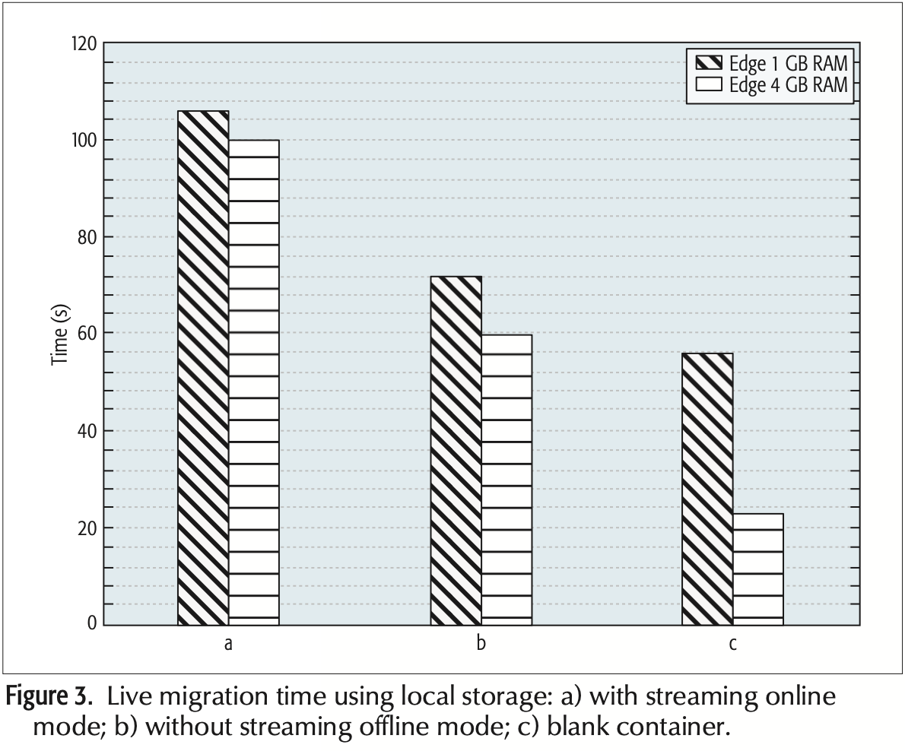
Performance Evaluation
Notes:
• With streaming online mode — streaming in use and the client watching the video
• Without streaming offline mode — streaming in use and the client is not watching the video with no changes in the memory blocks
• Blank container with two different types of ES

Slide 23
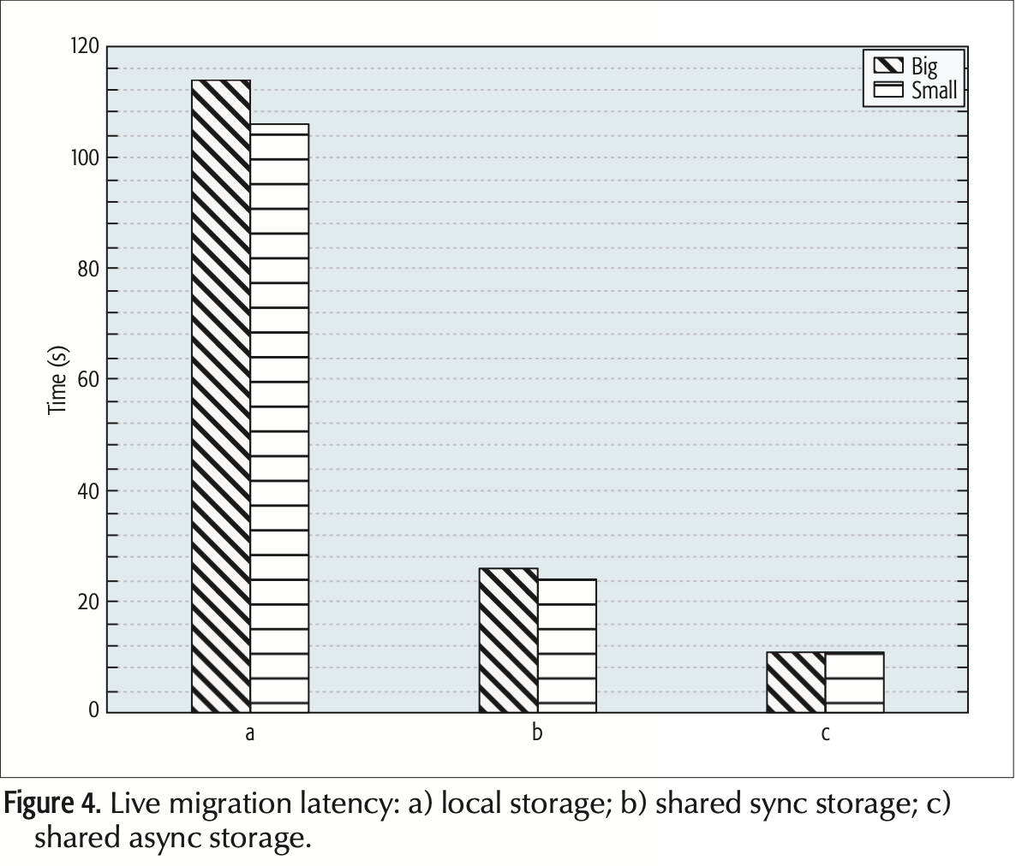
Performance Evaluation
Notes:
這個比較顯示出兩個不同大小的container轉移所花的時間。
結果顯示出container大小只會影響些許搬移時間。
此外，作者群發現使用sync strorage比起local storage可以大幅的減少時間，而async雖然可以再進一步減少延遲，但在時間中造成影片播放有1~2s故障。
最後，透過整個實驗，作者得出container搬移會受到存儲種類與資料大小 很大的影響

Slide 24
Conclusion and future research directions
It becomes apparent that the complexity of the system arises as a trade-off between short migration latency at the cost of possible data loss.
A mechanism to select the right combination of techniques to be used for efficiently migrating service is of vital importance.
Notes:
明顯可以觀察到系統的複雜度與搬移時間有高度相關，並且過度追求低延遲也可能有data loss的代價
如何選擇用正確的技術組合出最佳遷移服務功能至關重要，未來有研究的空間。

