Slide 1
Latency and availability driven VNF placement in a MEC-NFV environment
Louiza Yala , Pantelis A. Frangoudis, and Adlen Ksentini
IRISA/University of Rennes 1, France
EURECOM, Sophia Antipolis, France

Slide 2
Abstract
Multi-access Edge Computing (MEC) is gaining momentum as it is considered as one of the enablers of 5G ultra-Reliable Low-Latency Communications (uRLLC) services.
MEC deploys computation resources close to the end user, enabling to reduce drastically the end-to-end latency.
ETSI has recently leveraged the MEC architecture to run all MEC entities, including MEC applications, as Virtual Network Functions (VNF) in a Network Functions Virtualization (NFV) environment.
Notes:
多接取邊緣運算技術 (MEC) 正在蓬勃發展，因為它被認為是 5G 超高可靠及低延遲 (uRLLC) 服務的技術之一。
MEC 將計算資源部署在靠近最終用戶的位置，為了要大幅減少端到端延遲。
ETSI (歐洲電信標準協會)最近利用 MEC 架構將所有 MEC 實體（包括 MEC 應用程式）
作為網路功能虛擬化 (NFV) 環境中的虛擬網路功能 (VNF) 運行。

Slide 3
Abstract
This evolution allows taking advantage of the mature architecture and the enabling tools of NFV, including the potential to apply a variety of service-tailored function placement algorithms.
However, the latter need to be carefully designed in case of MEC applications such as uRLLC, where service access latency is critical.
In this paper, we propose a novel placement scheme applicable to a MEC in NFV environment.
Notes:
這種演變利用成熟的架構和 NFV 的有力工具，包括應用各種服務定制導向的放置演算法。
但是，對於像是uRLLC的MEC 應用，它需要仔細設計，因為它主要著重於存取服務的延遲。
在本文中，(他)提出了一種適用於 NFV 環境中的 MEC 的新型放置方法。

Slide 4
Abstract
In particular, we propose a formulation of the problem of VNF placement tailored to uRLLC as an optimization problem of two conflicting objectives, namely minimizing access latency and maximizing service availability.
To deal with the complexity of the problem, we propose a Genetic Algorithm to solve it, which we compare with a CPLEX implementation of our model.
Our numerical results show that our heuristic algorithm runs efficiently and produces solutions that approximate well the optimal, reducing latency and providing a highly-available service.
Notes:
(他)提出了一種針對 uRLLC 定制的 VNF 放置問題的公式，作為兩個相互衝突的目標優化問題，
即最小化存取延遲和最大化服務可用性。
為了解決問題的複雜性，(他)提出了一種基因演算法來解決它，
將其與(他)模型的 CPLEX 實現進行了比較。
(他)的結果表明，(他)的啟發式演算法有較高效率且有近似最優的解，
來減少延遲並提供高可用的服務。

Slide 5
I. INTRODUCTION
Ultra-Reliable Low-Latency Communications (uRLLC) services, such as connected car, industry 4.0 and critical IoT, are expected to be deployed using the upcoming 5G systems.
uRLLC services require very low latency access between the remote server and the clients, while running in a highly reliable environment to guarantee service continuity.
Notes:
超高可靠及低延遲 (uRLLC) 服務，例如聯網汽車、工業 4.0 和關鍵物聯網，
預計使用即將推出的 5G 系統。
uRLLC 需要非常低的存取延遲，在遠端伺服器和客戶端之間，同時運行在高可靠的環境中，
以保證服務的連續性。

Slide 6
I. INTRODUCTION
While 5G introduces novel mechanisms to ensure low latency, via MAC layer scheduling and network slicing [1], it requires running the servers belonging to uRLLC at the cloud edge to maintain a low end-to-end latency.
Indeed, Edge Computing allows the deployment of applications close to end users to reduce access latency, as compared to the central cloud access.
Two technologies emerged to enable the edge cloud, FoG and Mobile (or Multi-access) Edge Computing (MEC).
Notes:
在ref[1]中提到，雖然 5G 引入了新的機制來確保低延遲，但透過 MAC層排程和網路切片 ，
它需要在屬於 uRLLC服務器的雲邊緣運行，以保持較低的端到端延遲。
而與中央雲存取相比，邊緣計算允許靠近最終用戶部署在應用程式，以減少存取延遲。
出現了兩種支援邊緣雲的技術，即 FoG(霧運算) 和行動（或多接取）邊緣計算 (MEC)。

Slide 7
I. INTRODUCTION
The former is expected to run at the edge router, while the latter, supported by the European Telecommunications Standards Institute (ETSI) as well as network operators, is expected to run close to 4G/5G base stations (i.e., eNodeBs).
Several ETSI documents have been issued [2], [3] to define a reference architecture and functional blocks to enable running MEC applications at the edge.
Notes:
FoG預計在邊緣路由器上運行，而MEC在 ETSI 和網路運營商的支持下，
預計運行在 4G/5G 基地台附近（即 eNodeB）。
多個 ETSI 文獻已經發布了在ref[2]、[3]中，定義參考架構和功能塊，為了支援在邊緣運行的MEC 應用程式。

Slide 8
I. INTRODUCTION
define interfaces to interconnect MEC applications with the mobile network data plane to interact with the user data.
specify interfaces to run MEC applications within a virtualization platform.
provide MEC services to leverage the mobile operator, by exposing low-level Radio Access Network (RAN) information to third-party application developers, allowing the development of context-aware services.
Notes:
這些文獻中提到3個要點
將 MEC 應用程式與行動網路數據介面互連，以與用戶數據相互影響
指定在虛擬化平台，運行 MEC 應用程式的介面
提供 MEC 服務利用行動運營商, 透過向第三方應用程式開發人員，公開低階的RAN資訊(無線電存取網路) ，
允許開發上下文感知的服務。

Slide 9
I. INTRODUCTION
MEC is more mature and ready to be deployed compared to FoG, where the first release of the architecture has been recently issued, and mainly targets IoT services.
Moreover, ETSI has recently started working on updating the MEC reference architecture to run MEC entities in a Network Functions Virtualization (NFV) environment [4], to take advantage of the latters mature deployment environment in terms of implementation and enabling tools, such as the Open Source Mano (OSM) and OpenBaton orchestration suites.
Notes:
與 FoG 相比，MEC 更加成熟且易於部署，而他最近發布了第一個版本的架構，主要針對物聯網服務。
此外，ETSI 最近開始致力於更新 MEC 參考架構，為了在NFV環境中運行 MEC 實體 [4]，
在實施和有力的工具方面，他利用了成熟的部署環境，例如Open Source Mano (OSM)和 OpenBaton 協調套件。
O gi stration

Slide 10
I. INTRODUCTION
The NFV orchestration process, known as the NFV Orchestrator (NFVO), is in charge of the automation of Network Service (NS) deployment over the virtualized infrastructure, which mainly consists in the instantiation, placement, and life-cycle management of VNFs composing a NS.
By integrating MEC in NFV, ETSI considers MEC applications as classical VNFs, hence using the same orchestration and management process at a centralized NFVO.
Notes:
NFV 協調過程，稱為 NFV Orchestrator (NFVO)，負責在虛擬化基礎設施上實現網路服務 (NS) 部署的自動化，
主要包括 實例化、放置和VNF 的生命週期管理，組成一個NS。
O gi strator
透過在 NFV 中集成 MEC，ETSI 將 MEC 應用程式視為典型的 VNF，
因此在集中式 NFVO 中使用相同的協調和管理流程。

Slide 11
I. INTRODUCTION
It is important to mention that MEC applications need to be hosted at the edge aiming at guaranteeing low latency access to the service.
However, most of the used placement algorithms in NFV [5] aim to reduce deployment costs, increase the users Quality of Service (QoS), ensure service availability, etc., ignoring MEC applications constraints in terms of low latency.
This may MEC application instances to be run at central clouds, as the NFVO and its related placement algorithms do not differentiate between MEC applications and other VNFs.
Notes:
MEC 應用程式需要託管在邊緣，以保證對服務的低延遲存取。
然而，在NFV [5] 中大多數使用的放置演算法的目標是降低部署成本、提高用戶服務品質 (QoS)、確保服務可用性等，
而忽略了 MEC 應用程式在低延遲方面的限制。
這可能會使 MEC 應用程式在中央雲中運行，
因為 NFVO 及其相關放置演算法不區分 MEC 應用程式和其他 VNF。

Slide 12
I. INTRODUCTION
In this paper, we fill this gap by proposing a placement algorithm tailored to uRLLC services in the context of MEC in NFV.
First, the proposed scheme classifies all cloud resources (central and edge cloud) according to their access latency to the user data plane, which avoids the need for additional information to differentiate between edge and central cloud resources, thus being in compliance with the MEC in NFV concept.
Then, the placement algorithm is formulated as an optimization problem, where the objectives are to minimize latency and to maximize service availability (reliability).
Notes:
在本文中，(他)透過提出一種在 NFV 的 MEC 環境為 uRLLC 服務定制的放置算法來填補這個缺陷。
首先，他提出一個方案根據對用戶數據平面的存取延遲對所有雲資源（中央和邊緣雲）進行分類，
避免了需要額外資訊來區分邊緣和中央雲資源，從而符合 NFV中的MEC概念。
然後，放置演算法被視為一個優化問題，而他的目標是最小化延遲和最大化服務可用性（可靠性）。

Slide 13
I. INTRODUCTION
In Section II, we present related work on VNF placement in different environments.
In Section III, we propose a formulation of the VNF placement problem for uRLLC.
In Section IV, we provide solutions to this problem by proposing a suitable Genetic Algorithm, but also by using the CPLEX solver as a benchmark.
In Section V, results are shown.
In Section VI, conclude.
Notes:
在第二節中，(他)介紹了在不同環境中放置 VNF 的相關工作。
在第三節中，提出了 uRLLC 的 VNF 放置問題的公式。
在第四節中，透過提出合適的遺傳算法以及使用 CPLEX作為基準來提供此問題的解決方案。
在第五節中，顯示結果。
在第六節中，總結。

Slide 14
II. RELATED WORK
The VNF placement problem in federated clouds has recently received significant attention.
These clouds involve distributed data centers (DCs) connected into a common resource pool to deliver different cloud services.
The VNF placement problem is similar to the Virtual Machine (VM) placement problem, as VNFs are composed of virtual instances (VMs or containers) that execute network functions.
Notes:
聯合雲中的 VNF 放置問題最近受到了極大的關注。
這些雲涉及連接到公共資源的分散式數據中心 (DC)，以提供不同的雲服務。
VNF 放置問題類似於虛擬機 (VM) 放置問題，因為 VNF 由執行網路功能的虛擬實例（VM 或容器）組成。

Slide 15
II. RELATED WORK
A suitable VNF placement is mostly motivated by maximizing resource utilization or overall performance, while minimizing cost in terms of energy consumption, network traffic or penalties associated with SLA violations under various constraints [6], [7].
Although these metrics are well suited for NFV, putting MEC in the picture may require other metrics to be considered, such as latency.
Indeed, one of the advantages of placing VNFs at the edge is the proximity to end-users, which leads to a low-latency service deployment as reported in [8].
Notes:
ref [6]、[7]中提到，合適的 VNF 放置主要是透過最大限度地提高資源利用率或整體性能，
同時最大限度地減少能源消耗、網路流量或在各種限制下違反 SLA相關的違約金 。
(服務級別協定:是服務提供商與客戶之間定義的承諾)
儘管這些指標非常適合 NFV，但將 MEC 放入雲中可能需要考慮其他指標，例如延遲。
在ref 8中提到，將 VNF 置於邊緣的優勢之一是靠近最終用戶，從而實現低延遲服務部署。

Slide 16
II. RELATED WORK
Specifically the authors analyze the MEC reference architecture and deployment scenarios, which offer multitenancy support for application developers, content providers, and third parties.
They highlight the important changes towards the vision of 5G where MEC is known as one of the key emerging technologies, thanks to its significant contribution to low latency assurance.
Notes:
作者俱體分析了 MEC 參考架構和部署場景，
為應用程式開發人員、內容提供者和第三方提供多租戶支援。
他們強調了 5G 願景的重要變化，
其中 MEC 因為他對低延遲保證，有重大貢獻而被稱為關鍵的新興技術之一。

Slide 17
II. RELATED WORK
Therefore, placement algorithms should be updated to integrate latency as a criterion, in addition to other metrics.
Only few works have addressed the problem of VNF placement in a mixed environment that includes edge and central clouds [9], [10].
Generally, VNFs are placed either in physical machines within central cloud infrastructures only [11], or in MEC servers [12], [13].
Notes:
因此，除了其他指標外，放置算法應該要更新，將延遲作為標準。
在ref[9]、[10]中提到，只有少數文獻解決了包括在邊緣和中央雲的混合環境中放置 VNF 的問題。
在ref [11]中提到，VNF 只放置在中央雲基礎架構內的實體機器中 ，
在ref [12]、[13]中提到，放置在 MEC 服務器中 。

Slide 18
II. RELATED WORK
Other works [14], [15] investigate the placement in the context of a hybrid federated cloud, using a combination of different cloud infrastructures, without however involving the edge.
In this context, the authors in [10] also propose a VNF placement solution that captures the trade-off between cost efficiency and Quality of Experience (QoE) in a multi-cloud environment.
Notes:
其他文獻 像是ref[14]、[15] 研究了混合聯合雲環境中的放置，
使用不同雲基礎設施的組合，但不涉及邊緣。
在這種情況下，ref[10] 中的作者還提出了一種 VNF 放置解決方案，
可以在多雲環境中實現成本效率和體驗質量 (QoE) 之間權衡。

Slide 19
II. RELATED WORK
Similarly to our work, some recent approaches [9], [16] outstrip the common cost and resource optimization by introducing more specific VNF placement and provisioning optimization strategies over edge and central cloud infrastructures.
Jemaa et al [9] take into account QoS requirements such as minimum bandwidth and maximum end-to-end latency.
In particular, their objective is to minimize the maximum utilization of the edge cloud by deploying more VNFs in the traditional cloud.
Notes:
與(他)的文獻類似，最近的一些方法 ref[9]、[16]
透過在邊緣和中央雲基礎設施上引入更具體的 VNF 放置和配置優化策略，
超過了一般的成本和資源優化。
Jemaa 等人 在ref[9]中 考慮了 QoS 要求，例如最小化頻寬和最大化端到端的延遲。
他們的目標是透過在傳統雲中部署更多 VNF ，來減少邊緣雲的使用率。

Slide 20
II. RELATED WORK
In our prior work [5], we studied the problem of jointly allocating compute resources to virtual instances and their placement on a traditional cloud infrastructure for the provision of CDN-as-a-Service.
Our focus was on simultaneously addressing the conflicting requirements for improving service availability and reducing management cost.
In particular, as in our prior work, we provide a multi-objective optimization problem formulation and apply the service availability model we introduced in [5].
Notes:
在(他)之前的工作 [5] 中，(他)研究了將計算資源聯合分配給虛擬實例及其在傳統雲基礎架構上的放置問題，
以提供 CDN 即服務。
(內容傳遞網路（CND） 是指一組分佈在不同地理位置的伺服器，協同工作以提供網際網路內容的快速交付。)
(他)的重點是同時解決提高服務可用性和降低管理成本的相互衝突的需求。
特別是，在(他)之前的工作中，(他)提供了一個多目標優化問題公式，
並應用了(他)在 [5] 中引入的服務可用性模型。

Slide 21
II. RELATED WORK
However, from a system model perspective, this paper has the following distinct differences:
physical machines are not considered identical regarding their reliability and the cost of deploying VMs on top of them, thus differentiating between edge and central cloud hosts.
latency minimization is one of the objectives.
the CPU resource requirements per VNF instance to deploy are part of the problem input.
Notes:
然而，從系統模型的角度來看，本文有以下明顯差異：
1.實體機器在可靠性和在其上部署虛擬機的成本方面並不相同，因此區分邊緣和中心雲主機，
2.延遲最小化是目標之一
3.要部署在每個 VNF 實例的 CPU 資源需求是問題輸入的一部分。

Slide 22
III. PROBLEM FORMULATION
We assume that an operator manages a set of data centers (DCs), which can either be installed at the network edge, and therefore close to end-users, or in the traditional central cloud.
The uRLLC service is composed by a number of VNFs, which are in turn composed of a set of VMs (a VNF could be composed of one or more VMs to guarantee scalability).
Notes:
(他)假設運營商管理一組數據中心 (DCs)，這些數據中心可以安裝在網路邊緣，
因此靠近最終用戶，也可以安裝在傳統的中央雲中。
uRLLC 服務由多個 VNF 組成，
這些 VNF 又由一組 VM 組成（一個 VNF 可以由一個或多個 VM 組成，以保證可擴展性）。

Slide 23
III. PROBLEM FORMULATION
The operator aims to derive a suitable placement of those virtual instances (VMs) in DCs, where each DC has a set of physical machines (PMs) where VMs can be launched according to the demand.
The objective is to find an appropriate placement of the n VM composing a service instance on a subset of the m available PMs.
Notes:
運營商的目標是從 DC 中，導出這些虛擬實例 (VM) 的合適位置，
其中每個 DC 都有一組實體機 (PM)，可以根據需要再啟動 其中的VM。
而目標是在 m 個可用 PM 的子集上找到構成服務實例的 n 個 VM 的適當位置。

Slide 24
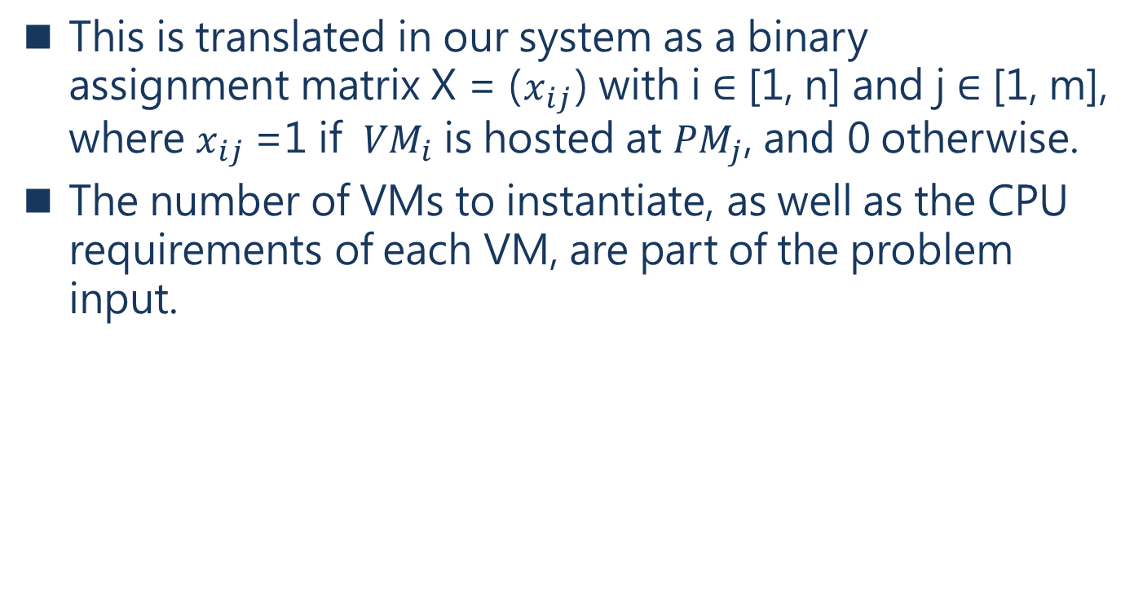
III. PROBLEM FORMULATION
This is translated in our system as a binary assignment matrix X = ($x_{ij}$) with i ∈ [1, n] and j ∈ [1, m], where $x_{ij}$ =1 if ${VM}_{i}$ is hosted at ${PM}_{j}$, and 0 otherwise.
The number of VMs to instantiate, as well as the CPU requirements of each VM, are part of the problem input.
Notes:
這在(他)的系統中被轉換為二進制分配矩陣 X = (xij)，其中 i ∈ [1, n]， j ∈ [1, m]，
如果 V Mi 託管在 PMj，則 xij 等於 1，否則等於 0。
要實例化的 VM 數量以及每個 VM 的 CPU 需求是問題輸入的一部分。

Slide 25
III. PROBLEM FORMULATION
The calculation of the optimal assignment should minimize the average access latency of the service deployment, consider the CPU capacities of the underlying physical hosts, not exceed a budget, and respect a service availability constraint.
We recall that we target a uRLLC service, which requires both low latency access and reliability.
Notes:
最優分配的計算應該最小化服務部署的平均存取延遲，考慮底層實體主機的CPU資源，
不超過預算，並遵守服務可用性限制。
(他)的目標是 uRLLC 服務，它需要同時滿足低延遲存取和可靠性。

Slide 26
III. PROBLEM FORMULATION
A. Latency model
We consider two types of hosts (PMs): ones which are located at centralized clouds/NFV infrastructures, and ones at MEC DCs.
Hosts are grouped by DC and all hosts belonging to the same DC are assumed to share the same access latency value.
Note that by characterizing DCs/hosts by latency, we do not need to explicitly differentiate between MEC and central cloud PMs; for a delay-minimizing algorithm, only the latency property is relevant.
Notes:
Latency model
(他)考慮兩種類型的主機 (PM)：
一個是位於集中式雲/NFV 基礎設施中的主機，一個是位於 MEC Data centers 的主機。
主機按照 DC 分組，並且假定屬於同一 DC 的所有主機，共享相同的存取延遲值。
透過延遲代表 DC/主機，(他)不需要明確區分 MEC 和中央雲 PMs；
對於延遲最小化演算法，只有延遲屬性是相關的。

Slide 27
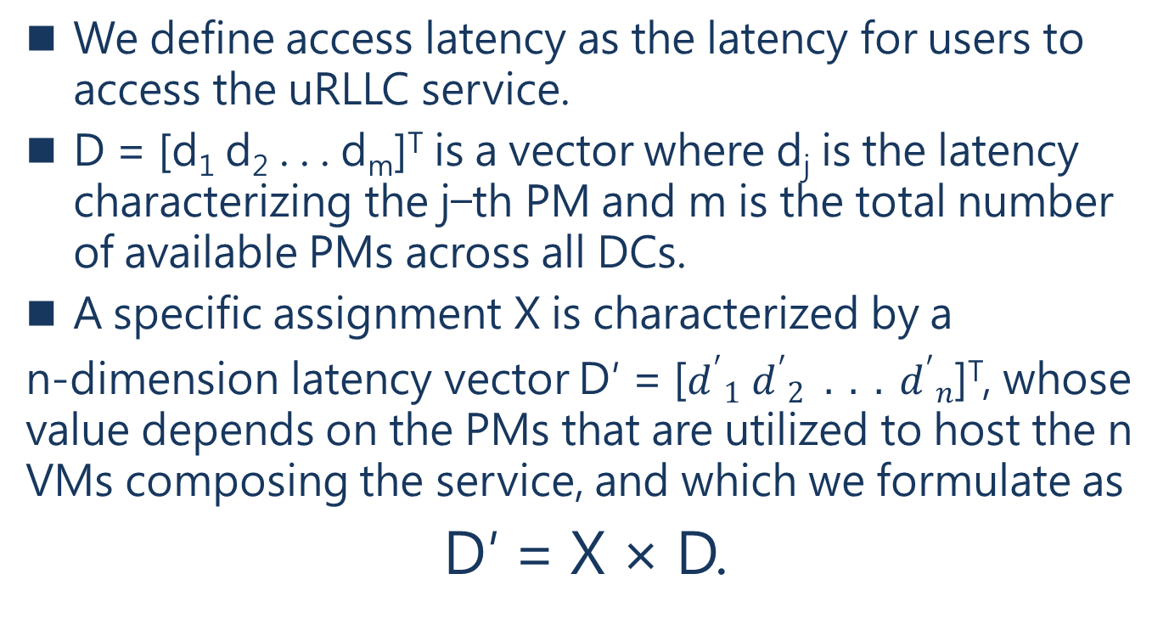
III. PROBLEM FORMULATION
We define access latency as the latency for users to access the uRLLC service.
D = [d₁ d₂ . . . d_{m}]^{T} is a vector where d_{j} is the latency characterizing the j−th PM and m is the total number of available PMs across all DCs.
A specific assignment X is characterized by a
n-dimension latency vector D′ = [${d^{′}}_{1}{{ d}^{′}}_{2}{ . . . d^{′}}_{n}$]^{T}, whose value depends on the PMs that are utilized to host the n VMs composing the service, and which we formulate as
D′ = X × D.
Notes:
(他)將存取延遲定義為用戶存取 uRLLC 服務的延遲。
D = [d1 d2 . . . dm]^{T} 是一個向量，其中 dj 是指第 j 個 PM 的延遲，
m 是所有 DCs 中可用 PMs 的總數。
一個特定的賦值(assignment) X 的指是一個 n 維的延遲向量 D′= [${d^{′}}_{1}{{ d}^{′}}_{2}{ . . . d^{′}}_{n}$]^{T}，
其值取決於，用於託管服務的 n 個 VMs 的 PMs，公式為

Slide 28

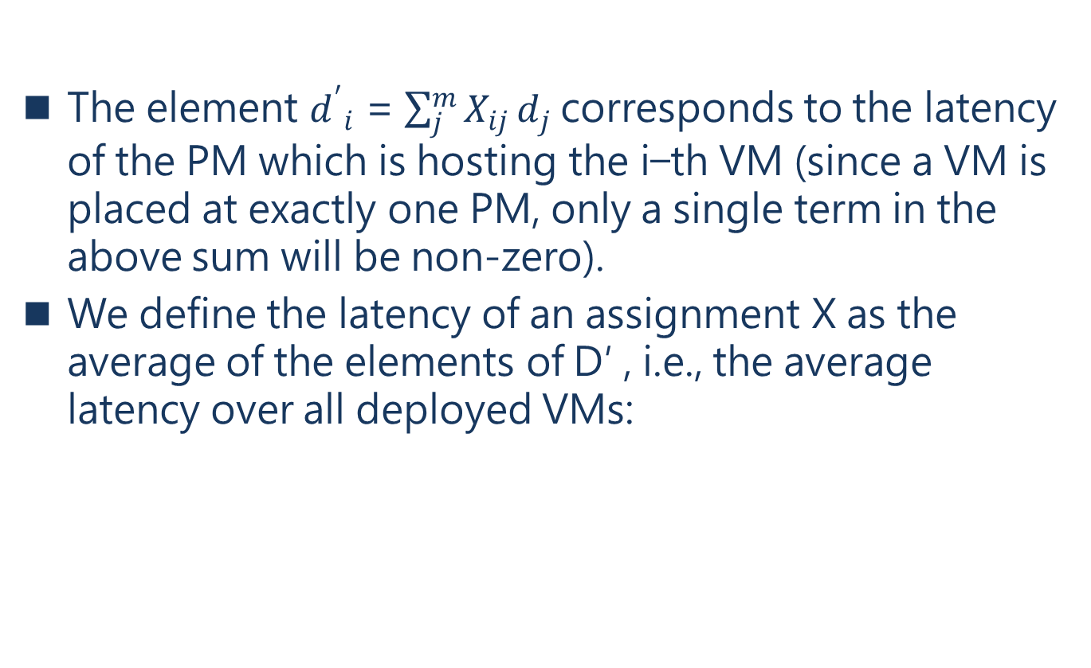
III. PROBLEM FORMULATION
The element ${d^{′}}_{i}$ = $\sum_{j}^{m}{X_{ij}}d_{j}$corresponds to the latency of the PM which is hosting the i−th VM (since a VM is placed at exactly one PM, only a single term in the above sum will be non-zero).
We define the latency of an assignment X as the average of the elements of D′ , i.e., the average latency over all deployed VMs:
Notes:
${d^{′}}_{i}$ = $\sum_{j}^{m}{X_{ij}}d_{j}$，對應於託管第 i 個 VM 的 PM 的延遲（因為 VM 恰好放置在一個 PM，因此上述的總和中只有一個項為非零）。
(他)將賦值(assigment) X 的延遲定義為 D' 元件的平均值，所有已部署 VMs 的平均延遲公式：

Slide 29
III. PROBLEM FORMULATION
B. Availability model
In our model, availability is the ability of the system to offer at least a minimal functional and accessible service.
In particular, a service instance is considered available if at least one of its constituent VMs remains accessible, which implies that the PM hosting it is accessible as well.
Notes:
B. Availability model
在(他)的模型中，可用性是系統至少提供一個最小函數和可存取服務的能力。
如果要一個服務實例被認為是可用的，那麼至少一個組成 VM 仍然可以存取，
這意味著託管它的 PM 也是可存取的。

Slide 30
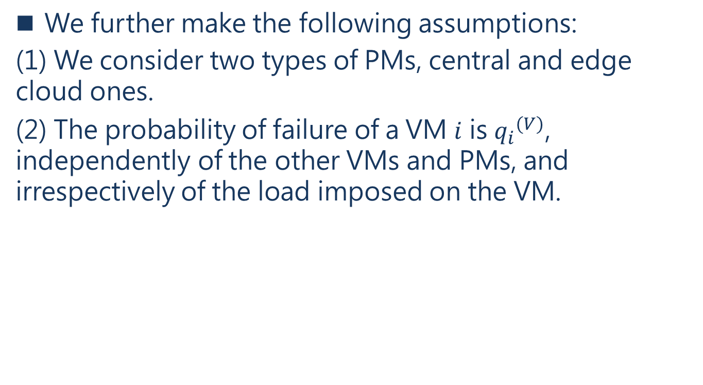
III. PROBLEM FORMULATION
We further make the following assumptions:
(1) We consider two types of PMs, central and edge cloud ones.
(2) The probability of failure of a VM $i$ is ${q_{i}}^{(V)}$, independently of the other VMs and PMs, and irrespectively of the load imposed on the VM.
Notes:
(他)進一步做出以下假設：
(他)考慮兩種類型的PMs，中央雲和邊緣雲。
2. VM i 的故障率為${q_{i}}^{(V)}$，與其他 VMs 和 PMs 無關，並且與施加在 VM 上的負載無關。

Slide 31
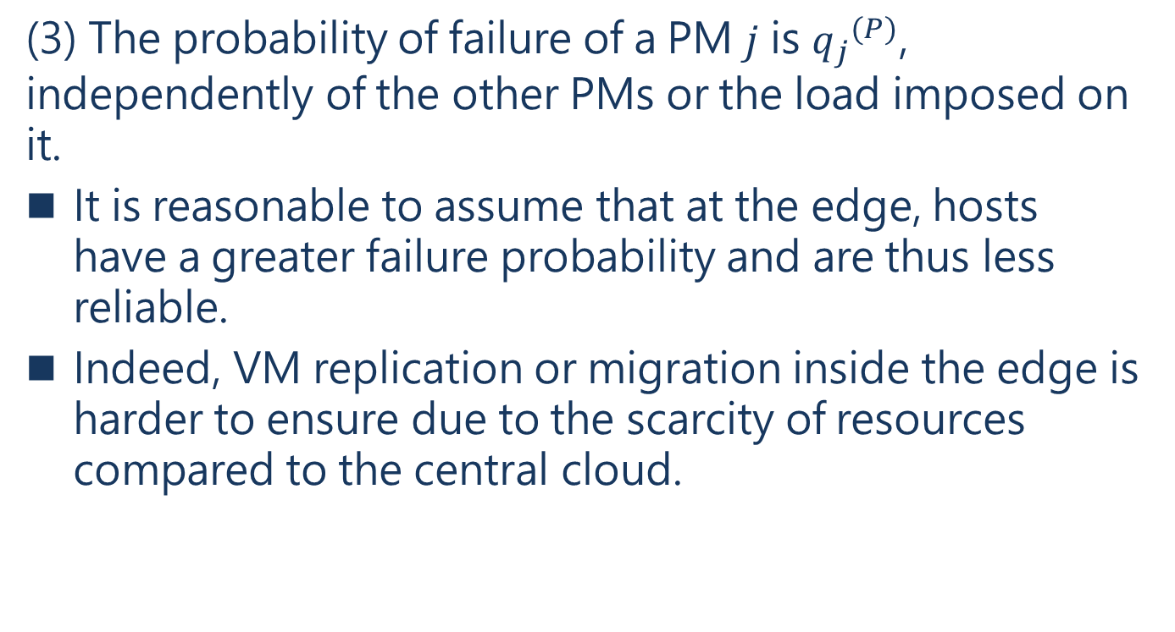
III. PROBLEM FORMULATION
(3) The probability of failure of a PM $j$ is ${q_{j}}^{(P)}$, independently of the other PMs or the load imposed on it.
It is reasonable to assume that at the edge, hosts have a greater failure probability and are thus less reliable.
Indeed, VM replication or migration inside the edge is harder to ensure due to the scarcity of resources compared to the central cloud.
Notes:
3. PM j 的故障率為${q_{j}}^{(P)}$，與其他 PMs 或施加在PM上的負載無關。
可以合理地假設，在邊緣雲，主機有更大的故障率，因此可靠性較低。
事實上，與中央雲相比，由於缺乏資源，邊緣雲內的虛擬機複製或遷移更難確保。

Slide 32
III. PROBLEM FORMULATION
(4) If a PM fails, all VMs deployed on it fail because of that.
(5) A VM may become inaccessible either because it fails or because the PM that hosts it fails.
(6) The system operator knows the value of the PM and VM failure probabilities, as a result of measurement studies, prior experience, or other historical information.
Notes:
4.如果PM 出現故障，部署在PM上的所有VM 都會因此而故障。
5. VM可能無法存取，因為它發生故障或託管它的 PM 發生故障。
6.作為測量研究、先前經驗或其他歷史資訊的結果，系統操作員知道 PM 和 VM 故障率的值。

Slide 33
III. PROBLEM FORMULATION
Since VM failures can be correlated due to their dependence on the underlying PMs, we define a correlated group of VMs as the set of VMs that are executed on the same PM.
A correlated group is available under the following conditions:
(1) The PM is up.
(2) At least one of the VMs deployed on the PM does not fail.
Notes:
由於 VM 故障受底層 PMs的影響，因此它們是相互關聯的，(他)將一組相關的 VM 定義為，在同一 PM 上執行的一組 VM。
關聯組在以下條件下可用：
PM 起用了。
2. 至少一個VM部署在PM 上不會出現故障。

Slide 34

III. PROBLEM FORMULATION
We define the probability that a correlated group deployed on PM j is available as follows:
At least one correlated group should be available in order to have a service/application deployment available.
Notes:
(他)定義部署在 PM j 上的相關組可用的機率如下：符號(有下極限的乘積)
PM 起用了。
2. 至少一個VM部署在PM 上不會出現故障。
PM j 的故障率為${q_{j}}^{(P)}$
VM i 的故障率為${q_{i}}^{(V)}$
(1-PM j 的故障率)*(1-VM有部屬在PM上的VM i 故障率)
至少應該有一個相關組可用，以便提供可用的服務或是應用程式部署。

Slide 35
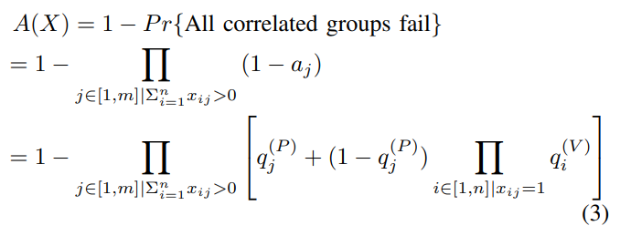
III. PROBLEM FORMULATION
Since correlated groups fail independently, the probability that a service deployment is available is given by
Note that, by construction, any feasible solution includes at least one PM with at least one VM assigned to it; therefore, both product terms in (3) are over non-empty sets.
Notes:
由於相關組出現故障，服務部署可用的機率如下公式給出
透過建構，任何可行的解決方案包括至少一個 PM 分配了至少一個 VM；
因此，（3）中的兩個乘積項都在非空集合上。

Slide 36
III. PROBLEM FORMULATION
C. Cost model
In our prior work [5], we considered that the deployment of a VM comes with a fixed management overhead.
In this work, however, not all VMs come with the same cost.
In particular, we treat cost as a function of the associated VM workload.
Notes:
C. Cost model
在(他)之前的文獻 [5] 中，(他)認為部署 VM 會帶來固定的管理開銷。
然而，在此篇論文中，並非所有 VM 都具有相同的成本。
特別是，(他)將成本視為相關 VM 工作負載的函數（就分配給 VM 的 vCPUs 數量而言，
並假設更強大的 VM 處理更多應用程式工作負載）。

Slide 37
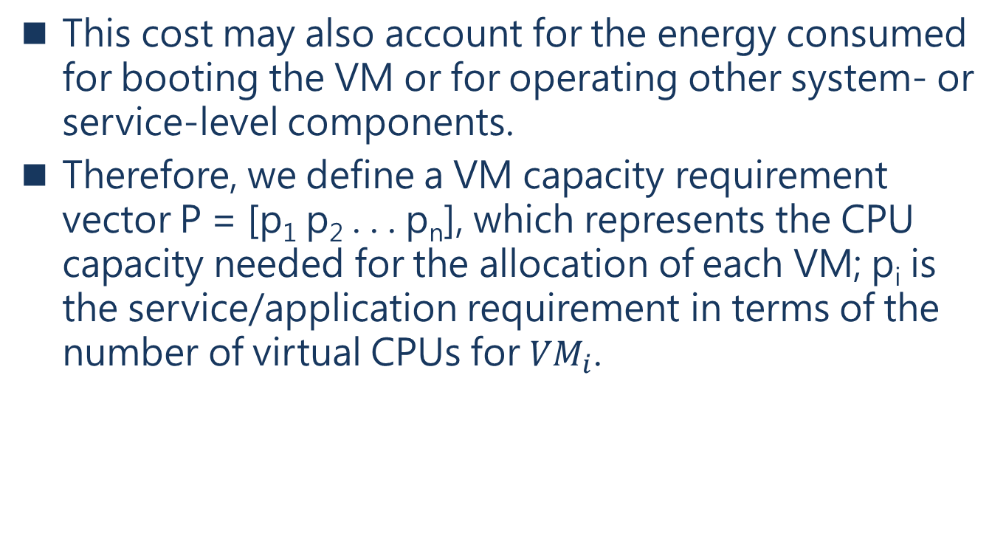
III. PROBLEM FORMULATION
This cost may also account for the energy consumed for booting the VM or for operating other system- or service-level components.
Therefore, we define a VM capacity requirement vector P = [p₁ p₂ . . . p_{n}], which represents the CPU capacity needed for the allocation of each VM; p_{i} is the service/application requirement in terms of the number of virtual CPUs for ${VM}_{i}$.
Notes:
此成本還考量啟動 VM 或操作其他系統或服務級別組件所消耗的能量。
因此，(他)定義了一個 VM 資源需求向量 P = [p1 p2 . . pn]，代表分配每個VM所需的CPU資源；
就V Mi 的虛擬 CPU 數量而言，pi是服務/應用程序需求。

Slide 38
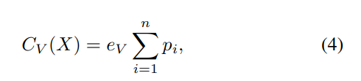
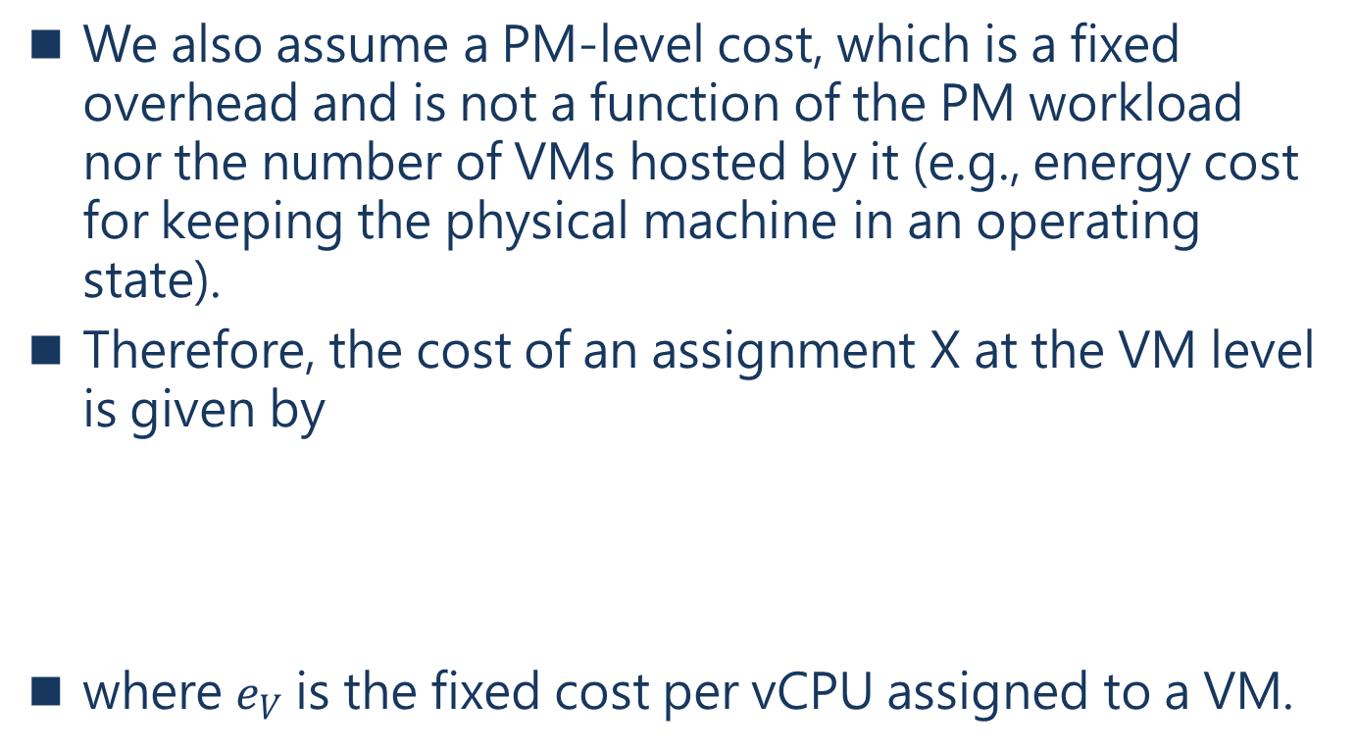
III. PROBLEM FORMULATION
We also assume a PM-level cost, which is a fixed overhead and is not a function of the PM workload nor the number of VMs hosted by it (e.g., energy cost for keeping the physical machine in an operating state).
Therefore, the cost of an assignment X at the VM level is given by
where $e_{V}$ is the fixed cost per vCPU assigned to a VM.
Notes:
(他)還假設 PM 級別的成本，這是一個固定的開銷，不是 PM 工作負載的函數，
也不是它託管的 VM 數量的函數（像是，能源成本保持在PM處於運行狀態）。
因此，VM 級別的賦值 X 的成本由下式給出
分配每個VM所需的CPU資源*分配給 VM 的每個 vCPU 的固定成本
其中 eV 是分配給 VM 的每個 vCPU 的固定成本.

Slide 39
III. PROBLEM FORMULATION
The cost at the PM level is determined by the number and the type of the PMs involved.
Note that we consider it more costly to operate on edge hosts.
This is due to the value and scarcity of edge resources.
We assume that when involving a PM in an assignment, this comes with a fixed PM-level cost.
We encode these fixed costs in vector K = [k₁ k₂ . . . k_{m}], each element of which corresponds to the cost associated with a specific PM.
Notes:
PM 級別的成本取決於所涉及 PM 的數量和類型。
(他)認為在邊緣主機上操作的成本更高。
這是由於邊緣資源的價值和缺乏。
(他)假設在分配PM 時，會帶來固定的 PM 級別成本。
(他)將這些固定成本編碼成一個向量 K = [k1 k2 . . km]，其中每個元件對應於與特定 PM 相關的成本。

Slide 40


III. PROBLEM FORMULATION
The PM-level cost of an assignment is defined as the sum of the fixed costs of all the PMs that are used, i.e., the PMs that host at least one of the service’s VMs:
The overall cost of a placement is then given by
Notes:
分配的 PM 級別成本定義為所有使用的 PMs 的固定成本的總和，就是託管至少一個服務 VMs 的 PMs：
每個元件對應於與特定 PM 相關的成本
1代表有部屬在PM的VM
這個放置的總成本的公式如下
剛剛的有個式子做加總得到這個公式

Slide 41
III. PROBLEM FORMULATION
D. Objective
The objective of the system is to derive an optimal assignment that minimizes latency while maximizing availability.
Each criterion drives VM placement towards a different type of solutions.
Focusing on a low latency service deployment will lead the system to place the service components at edge servers, which provide shorter response times but are more expensive.
Notes:
D. Objective
該系統的目標是得出一個最佳分配，在最大限度地提高可用性的同時最小化延遲。
每個標準都將 VM 放置推向不同類型的解決方案。
低延遲服務部署將導致系統將服務組件放置在邊緣服務器上，這樣可以提供更短的回覆時間，但更昂貴。

Slide 42
III. PROBLEM FORMULATION
On the contrary, traditional central DC_{s} offer higher availability but with longer delays.
Since it is not possible to optimize for both criteria at the same time, we apply a scalarization approach to transform the problem to a single objective one.
The relative importance of the two criteria in deriving an optimal placement is dictated by a specific policy, which is encoded in a pair of weights, w_{l} for latency and w_{a} for availability, such that w_{l} +w_{a} = 1.
Notes:
相反，傳統的中央 DC 提供更高的可用性，但延遲更長。
由於不可能同時針對兩個標準進行優化，因此(他)應用標量化方法將問題轉換為單一目標問題。
兩個標準，在推導最佳位置時，由特定策略決定，編碼為一對權重，
wl 表示延遲，wa 表示可用性，這樣 wl +wa = 1。

Slide 43
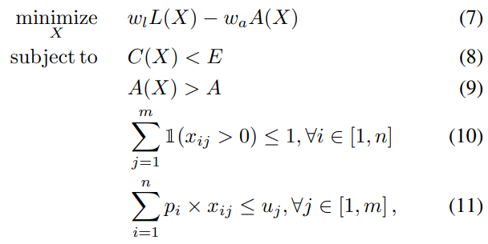
III. PROBLEM FORMULATION
Given a specific policy that depends on the particular uRLLC service, the system operator derives the optimal solution to the following problem:
with U = {u₁ u₂ . . . u_{m}} representing the available CPU capacity for each of the m PMs.
Notes:
給定一個依據在特定的 uRLLC 服務上的特定策略，系統運營商推導出以下問題的最佳解決方案：
在這個公式中，
Constraint (8) 中(他)考慮了預算，它將服務部署的成本限制在不違反與客戶的初始預算E以下。 *
Constraint (9) 確保服務具有最低可用性。
Constraint (10) 確保每個 VM 分配給單個主機，因為 VM 不能拆分，
Constraint (11) 保證不超過每個主機的資源。
U = {u1 u2 。 . . um} 表示 1至m PMs中可用的 CPU 資源。

Slide 44
IV. A GENETIC ALGORITHM FOR VM PLACEMENT
Many VM or network function placement problems are known to be NP-hard [17] and various heuristics are being proposed for this reason.
Therefore, we present in this section a Genetic Algorithm (GA) meta-heuristic tailored to our model, that we selected to tackle our VM placement problem.
A GA solves an optimization problem applying iteratively two main operations: crossover and mutation.
Notes:
許多 VM 或網路功能放置問題是 NP-hard [17]，因此提出了各種啟發式的方法。
因此，(他)介紹了為(他)的模型定制的基因演算法 (GA) 元啟發式演算法，用他來解決VM 放置問題。
GA 迭代應用兩個主要操作來解決優化問題：交叉、交配(crossover)和變異(mutation)。

Slide 45
IV. A GENETIC ALGORITHM FOR VM PLACEMENT
It encodes each potential solution as a chromosome (a sequence of characters) of properties called genes and characterizes each solution with a fitness value, which is an expression of the solution’s quality.
The GA starts with an initial pool of candidate solutions and iteratively tunes them to produce new generations of better quality by using crossover to generate new chromosomes from selected parents and mutation to randomly adjust a chromosome.
Notes:
它將每個潛在解決方案編碼為稱為基因的染色體（字符序列），並用適當的值代表每個解決方案。
基因演算法從候選解的初始值開始，透過使用交叉(crossover)，從選定的父母中生成新的染色體，
並使用變異(mutation)隨機調整染色體，迭代調整它們以產生質量更好的新一代。

Slide 46
IV. A GENETIC ALGORITHM FOR VM PLACEMENT
Our genetic algorithm is inspired by the work of Xu and Fortes [18], who proposed a Grouping Genetic Algorithm (GGA) to solve the problem of VM placement on physical resources, aiming to optimize, as in our case, a multi-objective function.
Their objectives are minimizing resource wastage, power consumption and maximum thermal dissipation.
These three objectives are conflicting because placing VMs on a small number of PMs increases thermal dissipation in the used PMs, while the two other objectives decrease.
Notes:
(他)的基因演算法受到 Xu 和 Fortes [18] 文獻的啟發，他們提出了一種分組基因演算法 (GGA) 來解決 VM 在實體資源上的放置問題，
Xu 和 Fortes目的是在優化，而就像此篇論論文是為了多目標函數。
Xu 和 Fortes的目標是最小化減少資源浪費、功耗和最大限度地散熱。
這三個目標是矛盾的，因為將 VMs 放置在少量 PMs 上，會增加所用 PMs 的散熱，而另外兩個目標會降低。

Slide 47
IV. A GENETIC ALGORITHM FOR VM PLACEMENT
In the same spirit, our GGA integrates our availability and latency objectives.
Unlike Xu and Fortes, though, who use a fuzzy logic system as a fitness function to jointly consider the three objectives, our fitness function is dictated by the weights (policy) and is a direct application of our objective function equation (7).
Notes:
(他)的 GGA 集成了(他)的可用性和延遲目標。
但是，與Xu 和 Fortes 不同，Xu 和 Fortes使用模糊邏輯系統作為適應度函數來共同考慮三個目標，
(他)的適應度函數由權重（策略）決定，並且(他)目標函數直接使用方程 (7)。minimize X wlL(X) − waA(X)

Slide 48
IV. A GENETIC ALGORITHM FOR VM PLACEMENT
Our GGA takes as input the number of VMs and creates an initial solution by generating S random assignments of VMs to PMs.
For each solution in S, each group of VMs on a PM is a gene.
Once the initial solution pool is generated, the GGA runs for G generations.
Notes:
(他)的 GGA 將 VMs 的數量作為輸入，並透過生成 S，隨機分配給 PMs 的 VMs 來創建初始解決方案。
對於 S 中的每個解決方案，PMs 上的每組 VM 都是一個基因。
一旦生成初始解池，GGA 將運行 G 代。

Slide 49
IV. A GENETIC ALGORITHM FOR VM PLACEMENT
Xu and Fortes [18] introduced a ranking-crossover operator, which is an improved version of the classical crossover.
The latter choses genes blindly from selected parents.
On the other hand, ranking-crossover selects the genes which have a higher rank according to the average value of specific efficiency functions defined per objective, hence expected to produce higher quality offspring.
Notes:
Xu 和 Fortes [18] 引入了排序交叉(ranking-crossover)運算子，它是典型交叉的改進版本。
後者(crossover)從選定的父母那裡盲目地選擇基因。
另一方面，排序交叉(ranking-crossover)根據每個目標定義的特定效率函數的平均值，
選擇具有更高等級的基因，從而產生更高質量的後代。

Slide 50
IV. A GENETIC ALGORITHM FOR VM PLACEMENT
In our case, for each ranking-crossover operation, our GGA calculates the efficiency value for each involved gene from two random chromosomes.
Contrary to their work, we chose as an efficiency function the distance between a gene’s derived values for latency and availability given by (1) and (3) respectively, and ideal ones.
These ideal values are probably unattainable at the same time by a single gene and correspond to a utopian case.
Notes:
在(他)的例子中，根據每個排序交叉(ranking-crossover)操作，(他)的 GGA 計算來自兩個隨機染色體的效率值。
與Xu 和 Fortes的文獻相反，(他)選擇了（1）和（3）分別給出的基因衍生值的延遲和可用性之間的距離作為效率函數。
(1)延遲model (3)可用性的相關組
這些理想值可能是單個基因無法同時達到的，對應於一個烏托邦式的案例。

Slide 51

IV. A GENETIC ALGORITHM FOR VM PLACEMENT
For example, we have set the ideal values to u_{l} ≈ 0 (latency) and u_{a} = 100% (availability).
Our efficiency function is defined as the Euclidean distance between the utopian point (u_{l} , u_{a}) and the point representing the gene’s latency and availability values (l, a), formulated as:
Notes:
例如，(他)將理想值設置為 ul ≈ 0（沒有延遲）和 ua = 100%（可用性）。
(他)的效率函數被定義為烏托邦點(理想點) (ul, ua) 和代表基因延遲和可用性值的點 (l, a) 之間的歐幾里德距離，
公式如下：

Slide 52
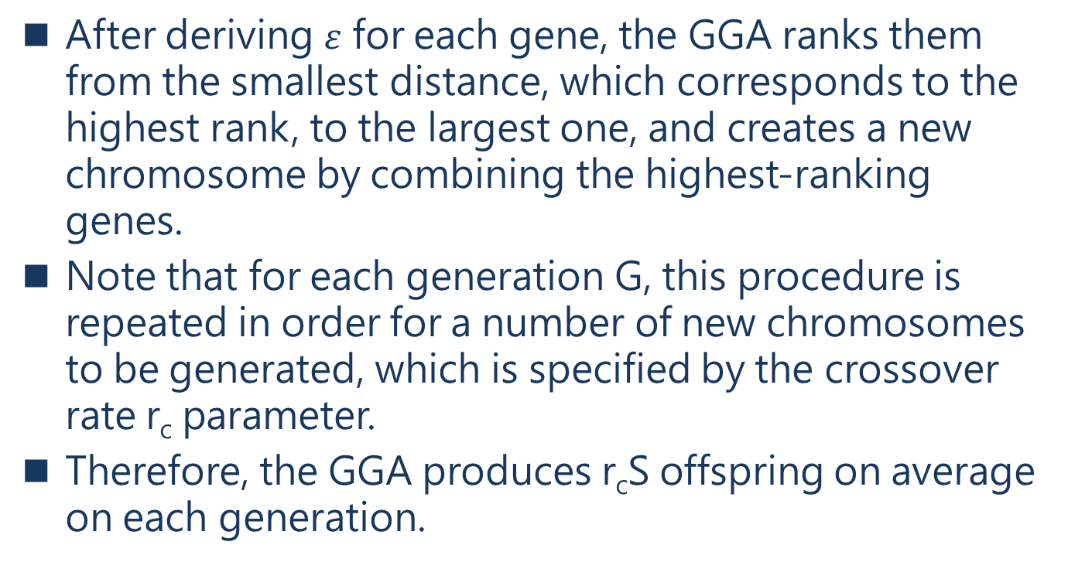
IV. A GENETIC ALGORITHM FOR VM PLACEMENT
After deriving $ε$ for each gene, the GGA ranks them from the smallest distance, which corresponds to the highest rank, to the largest one, and creates a new chromosome by combining the highest-ranking genes.
Note that for each generation G, this procedure is repeated in order for a number of new chromosomes to be generated, which is specified by the crossover rate r_{c} parameter.
Therefore, the GGA produces r_{c}S offspring on average on each generation.
Notes:
在為每個基因導出$ε$後，GGA 將它們從最小距離（對應於最高等級）到最大距離進行排序，
並透過組合最高等級的基因來創建新的染色體。
對於每一代 G，重複此過程以生成許多新染色體，這由交叉率 rc 參數指定。
因此，GGA 每代平均產生 rcS 後代。

Slide 53
IV. A GENETIC ALGORITHM FOR VM PLACEMENT
The solution pool population at the end of a generation is constructed by evaluating the fitness function for each chromosome and keeping the top-S of them.
After G generations, our algorithm terminates by returning solution with the highest fitness function value.
During the whole process our GGA eliminates solutions that violate any of the constraints.
Notes:
透過評估每個染色體的適應度函數並保留它們的top-S來建構一代末的解池種群。
在 G 代之後，(他)的演算法透過回傳最高適應度函數值的解來終止。
在整個過程中，(他)的 GGA 消除了違反任何constraints的解決方案。

Slide 54
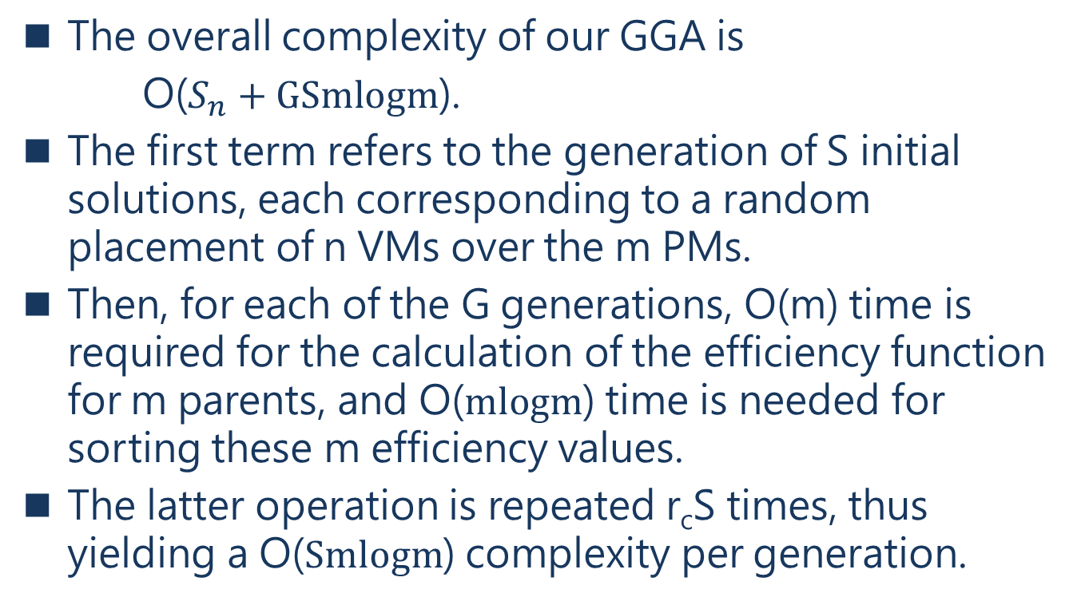
IV. A GENETIC ALGORITHM FOR VM PLACEMENT
The overall complexity of our GGA is
O($S_{n}+GSmlogm$).
The first term refers to the generation of S initial solutions, each corresponding to a random placement of n VMs over the m PMs.
Then, for each of the G generations, O(m) time is required for the calculation of the efficiency function for m parents, and O($mlogm$) time is needed for sorting these m efficiency values.
The latter operation is repeated r_{c}S times, thus yielding a O($Smlogm$) complexity per generation.
Notes:
(他)的 GGA 的整體複雜度是 O(Sn+GSmlogm)。
第一項是指生成 S 個初始解，每個解對應於 n 個 VMs 在 m 個 PMs 上的隨機放置。
那麼，對於每一G代，計算m個父代的效率函數需要O(m)時間，
排序這m個效率值需要O(mlogm)時間。
後一個操作重複 rcS 次，因此每代產生 O(Smlogm) 複雜度。

Slide 55
V. NUMERICAL RESULTS
For our experiments, we consider different configurations, where we use different types of hosts, central cloud and MEC ones.
We show the positive impact of using edge hosts in deployment delays and how we capture the trade-off between latency and availability.
We also compare our scheme with a CPLEX implementation in terms of the quality of the solution and execution time.
Notes:
對於(他)的實驗，考慮了不同的配置，(他)使用不同類型的主機，中央雲和 MEC 主機。
(他)展示了在部署延遲中使用邊緣主機的正向影響，以及(他)如何在延遲和可用性之間進行權衡。
(他)還在解決方案的質量和執行時間方面，將(他)的方案與 CPLEX 實現進行了比較。

Slide 56
V. NUMERICAL RESULTS
We assume a uRLLC service composed of 90 VMs that need to be deployed over a federated cloud (including edge DCs).
We consider a system with 150 PMs, 100 PMs within the traditional cloud each with a capacity between 5 and 15 vCPUs, and 50 MEC servers with a capacity between 1 and 6 vCPUs each.
Host capacities are selected uniformly at random.
Notes:
(他)假設一個 uRLLC 服務由 90 個VMs組成，這些VMs需要部署在聯合雲（包括邊緣 DCs）上。
(他)考慮一個具有 150 個 PMs 的系統，
傳統雲中的 100 個 PMs，每個 PM 的資源在 5 到 15 個 vCPUs 之間，
以及 50 個 MEC 服務器，每個服務器的資源在 1 到 6 個 vCPUs 之間。
主機資源統一隨機選擇。

Slide 57
V. NUMERICAL RESULTS
We fix the budget to E = 320 and assume that all PMs of a specific type incur the same fixed cost.
For each edge server, the PM-level cost is k_{e} = 2, while for each central cloud host it is k_{c} = 1.
The cost of one vCPU assigned to a VM is e_{v} = 1.
All the VMs have the same failure probability q_{v} = 0.001.
Notes:
(他)將預算固定為 E = 320，並假設特定類型的所有 PMs 產生相同的固定成本。
對於每個邊緣服務器，PM 級成本是 k_{e} = 2，而對於每個中央雲主機，它是 k_{c} = 1。
分配給 VM 的一個 vCPU 的成本是 e_{v} = 1。
所有 VMs 具有相同的故障率 q_{V} = 0.001。

Slide 58
V. NUMERICAL RESULTS
The PM failure probabilities are set to q_{p1} = 0.004 for MEC servers and q_{p2} = 0.002 for central cloud servers, since we assume that the reliabilities are different for the two types of hosts.
We select uniformly at random the delays, which we set to between 1 and 5 ms for the 50 edge servers, and between 4 and 10 ms for the 100 central cloud servers.
Notes:
MEC 服務器的 PM 故障率設置為 q_{P1} = 0.004，
中央雲服務器的 PM 故障率設置為 q_{P2} = 0.002，
因為(他)假設兩種主機的可靠性不同。
(他)統一隨機選擇延遲，(他)將 50 台邊緣服務器的延遲設置為 1 到 5 毫秒，
而將 100 台中央雲服務器設置為 4 到 10 毫秒。

Slide 59
V. NUMERICAL RESULTS
We run both algorithms (CPLEX and GGA) for:
(i) the same number of vCPUs assigned to each VMs
(ii) the same number of VMs
(iii) the same PM delays
Notes:
(他)針對以下情況運行兩種演算法（CPLEX 和 GGA）：
(i) 分配給每個 VMs 的相同數量的 vCPUs，
(ii) 相同數量的 VMs，
(iii) 相同的 PMs 延遲 。

Slide 60
V. NUMERICAL RESULTS
Regarding the GGA we configure the solution pool size to S = 80 and the number of generations to G = 30.
We chose those values experimentally, since we found them representative to a good compromise between execution time and quality of the solutions.
Notes:
關於 GGA，(他)將解決方案池大小配置為 S = 80，將代數配置為 G = 30。
(他)透過實驗選擇了這些值，因為(他)發現它們代表了執行時間和解決方案質量之間有良好的折衷。

Slide 61
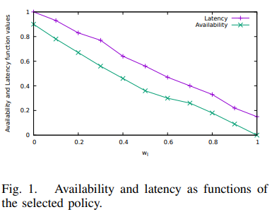
V. NUMERICAL RESULTS
Notes:
圖 1 概述了(他)算法針對不同策略的可用性和延遲函數值。
這些值透過將每個目標的最低和最高值分別映射到 0 和 1 來規範。
結果表明策略越是面向延遲（wl > 0.6），演算法對可用性的犧牲就越多。

Slide 62
V. NUMERICAL RESULTS
In particular, since our GGA is guided by the applied policy, the objective function value of equation (7) decreases because the chosen servers for the deployment have small delays (small values of d_{j}); more edge servers are used to deploy the service components than central ones.
Notes:
特別是，由於(他)的 GGA 受應用策略的影響，等式（7）的目標函數值會降低，minimize X wlL(X) − waA(X)
因為用於部署，所選的服務器具有較小的延遲（dj 值較小）；
用於部署服務組件的邊緣服務器比中央服務器多。

Slide 63
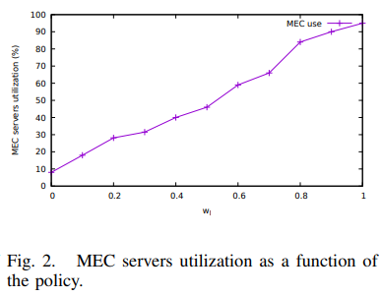
V. NUMERICAL RESULTS
Notes:
這在圖 2 中更清楚的表示， MEC 服務器作為應用策略的函數的使用率。
可以看出，當 wl 增加時，邊緣內的主機會被使用，
因為邊緣上的延遲更小，(他)的演算法遵守提供最小延遲的主機的使用率。

Slide 64
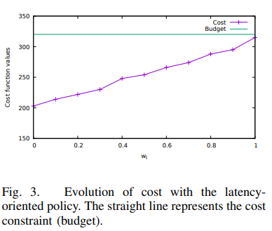
V. NUMERICAL RESULTS
Notes:
圖 3 顯示了放置期間成本的演變，其中 y 軸表示給定策略的函數的成本值。
綠色直線代表設置的最大預算，為 E = 320 。
可以看出，成本隨著 wl 顯著增加。
(他)認為 GGA 使用更多 MEC 主機來放置虛擬機的事實，證明了一點，這些主機更昂貴。

Slide 65
V. NUMERICAL RESULTS
In our second experiment, we run our GGA by fixing the policy to (w_{a}, w_{l}) = (0.5, 0.5), using the same number of PMs and their capacities, and for the same number of vCPUs (200).
We vary the number of VMs in an interval of n ∈ [0 − 60] for 100 iterations and present results with 95% confidence intervals.
Notes:
在(他)的第二個實驗中，(他)透過將 (wa, wl)設為= (0.5, 0.5)
來運行(他)的 GGA，使用相同數量的 PMs 及其資源，
以及相同數量 vCPUs (200)。
(他)在 n ∈ [0 − 60] 的區間內改變 VMs 的數量，進行 100 次迭代，並以 95% 的信賴區間呈現結果。

Slide 66
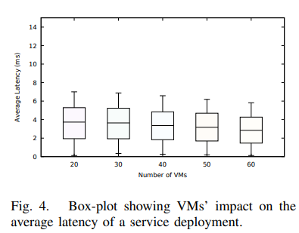
V. NUMERICAL RESULTS
Notes:
圖 4 中顯示為箱線圖，說明了根據 VMs 數量的平均延遲的演變。
當 n 增加時，平均延遲減少。
事實上，添加更多的 VMs會導致它們放置在更小的 DCs 中，在(他)的例子中對應於邊緣 PMs；
如果VMs越多，那麼分配給每個虛擬機的 vCPUs 就越少，因為(他)所有的測試中 vCPUs 的數量都保持不變。

Slide 67
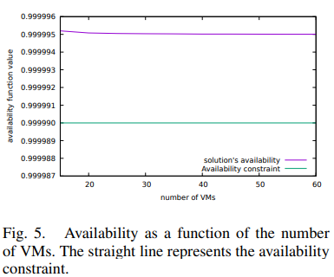
V. NUMERICAL RESULTS
Notes:
在圖 5 中，對於(他)的 GGA 獲得的解決方案，(他)強調了可用性作為 VMs 數量的函數的演變。
直線代表可用性constraint，設置為 uRLLC 服務可靠性需求的第 5 類 (99,999%)。

Slide 68
V. NUMERICAL RESULTS
From the resulting plot we can see that the availability slightly decreases with the number of VMs, which is compatible with the growing use of MEC servers previously pointed out.
Considering the small capacities within the edge servers, the VMs with the small number of vCPUs assigned to them are placed on those servers.
However, even if the values of availability decrease, the availability constraint is not violated.
Notes:
從結果圖中，(他)可以看到可用性隨著 VMs 數量的增加而略有下降，
這與之前指出的 MEC 服務器使用量的增加相兼容。
考慮到邊緣服務器的容量較小，分配給它們較少的 vCPUs 數量的VMs放置在這些服務器上。
然而，即使可用性值降低，也不會違反可用性constraint。

Slide 69
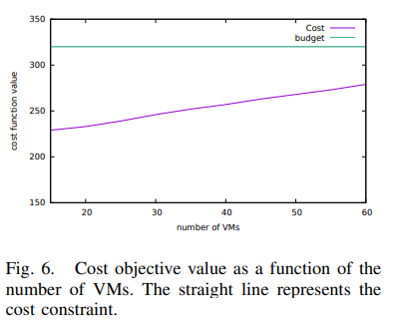
V. NUMERICAL RESULTS
Notes:
關於成本，圖 6 說明了它作為相同情況下 VM 數量的函數的演變。
(他)清楚地看到成本隨著 VMs 數量的增加而增加，這更應證 (他)從前兩個圖得出的結果。
成本受到使用來自邊緣的 PMs 的影響，這些 PMs 更昂貴。
綠線是他設的預算320

Slide 70
V. NUMERICAL RESULTS
In our third experiment, we implement our model in the CPLEX environment and use its optimizer to derive exact optimal solutions.
We compare and evaluate the CPLEX results with our GGA.
Notes:
在(他)的第三個實驗中，(他)在 CPLEX 環境中實現(他)的模型並使用其優化器來推導出精確的最優解。
(他)將 CPLEX 結果與(他)的 GGA 進行比較和評估。

Slide 71
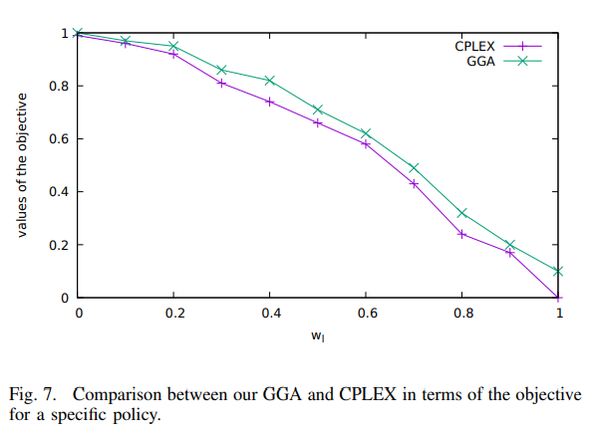
V. NUMERICAL RESULTS
Notes:
圖 7 顯示了(他)的 GGA和 CPLEX的相同配置下，獲得的目標函數值作為應用策略的函數的比較。
由於(他)正在解決最小化問題，特定權重組合的較低值意味著更好的性能。
(他)的元啟發式演算法近似 CPLEX 提供的最優解。

Slide 72
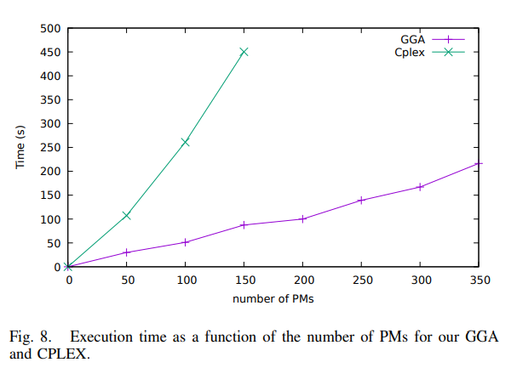
V. NUMERICAL RESULTS
Notes:
圖 8 顯示了 CPLEX 和 GGA 在增加可用服務器數量時的執行時間結果。
可以看出，隨著 PM 數量的增加，(他)的 GGA 可以很好地擴展。
即使多於200 多個，它也會在幾分鐘內生成接近最佳的解決方案。
另一方面，CPLEX 的執行時間急劇增加，並且它會在超過大約 150 個 PM 的解決方案停止。

Slide 73
V. NUMERICAL RESULTS
Our experiments were performed on an Intel i7 machine with 8 CPU cores and 8 GB of RAM, running Ubuntu 14.04.
Note that we carried out those experiments by fixing the policy to w_{l} = w_{a} = 0.5.
Notes:
(他)的實驗是在具有 8 個 CPU cores和 8 GB RAM，在 Ubuntu 14.04 的 Intel i7 上執行的。
(他)透過將策略固定為 wl = wa = 0.5 來進行這些實驗

Slide 74
VI. CONCLUSION
In this paper, we presented our study on the problem of placing VNF instances on a mixed environment which considers two different types of hosts, namely PMs from the edge and the central cloud.
We proposed a multi-objective optimization formulation of the problem that captures the tradeoff between service access latency and availability, which correspond to the criteria of uRLLC services.
Notes:
在本文中，(他)介紹了在混合環境中放置 VNF 實例問題的研究，
該環境考慮了兩種不同類型的主機，來自邊緣和中央雲的 PM。
(他)提出了該問題的多目標優化公式，
該公式擷取了存取服務延遲和可用性之間的權衡，這與 uRLLC 服務的標準相對應。

Slide 75
VI. CONCLUSION
To solve this placement problem, we provided an appropriate adaptation of the Genetic Algorithm meta-heuristic.
Our experimental results show that our solutions are close to the optimal, while simultaneously it takes considerably less time to derive them than an exact algorithm provided by CPLEX.
We have also shown how our method can reduce delays and still provide a highly-available service.
Notes:
為了解決這個放置問題，(他)提供了對元啟發式的基因演算法做適當改編。
(他)的實驗結果表明，(他)的解決方案接近最優，同時與 CPLEX 提供的精確算法相比，
推導出它們所需的時間要少得多。
(他)還展示了(他)的方法如何減少延遲並仍然提供高度可用的服務。

Slide 76
VI. CONCLUSION
Our approach tackles important aspects regarding uRLLC services, but more needs to be done, and this is the subject of our ongoing work.
First, we will consider different types of components, such as caches, which may influence the type of resources needed and thus the number of vCPUs as well as the number of VMs.
Notes:
(他)的方法解決了有關 uRLLC 服務的重要方面，但還有更多工作要做，
這是(他)正在進行的文獻的主題。
首先，(他)將考慮不同類型的組件，例如緩存，它們可能會影響所需資源的類型，
從而影響 vCPUs 的數量以及 VMs 的數量。

Slide 77
VI. CONCLUSION
Second our mechanism will take into account failure recovery in case of PM breakdowns, especially at the edge and for critical services, such as the connected car.
Finally, we are exploring uses of our model with respect to the establishment of SLAs with the customer, in order to create a clear common understanding about different services.
Notes:
其次，(他)的機制將在 PM 故障的情況下考慮故障恢復，
特別是在邊緣和關鍵服務，例如聯網汽車。
最後，(他)正在探索在與客戶建立 SLAs 方面使用(他)的模型，
以便對不同的服務創造一個清晰的理解。

Slide 78
REFERENCES
[1] A. Ksentini, P. A. Frangoudis, P. C. Amogh, and N. Nikaein, “Providing low latency guarantees for slicing-ready 5G systems via two-level MAC scheduling,” IEEE Network, 2018, in press.
[2] Mobile Edge Computing (MEC); Framework and Reference Architecture, ETSI Group Specification MEC 003, 2016.
[3] Mobile Edge Computing (MEC); Mobile Edge Management; Part 2: Application lifecycle, rules and requirements management, ETSI Group Specification MEC 010, 2017.
[4] Mobile Edge Computing (MEC); Deployment of Mobile Edge Computing in an NVF environment, ETSI Group Report MEC 017, 2018.
[5] L. Yala, P. Frangoudis, G. Lucarelli, and A. Ksentini, “Balancing between cost and availability for cdnaas resource placement,” in Proc. IEEE GLOBECOM, 2017.
[6] J. Dong, X. Jin, H. Wang, Y. Li, P. Zhang, and S. Cheng, “Energy-saving virtual machine placement in cloud data centers,” in Proc. IEEE/ACM CCGrid, 2013.
[7] N. Quang-Hung, N. T. Son, and N. Thoai, “Energy-saving virtual machine scheduling in cloud computing with fixed interval constraints,” in Transactions on Large-Scale Data-and Knowledge-Centered Systems XXXI. Springer, 2017, pp. 124–145.

Slide 79
REFERENCES
[8] T. Taleb, K. Samdanis, B. Mada, H. Flinck, S. Dutta, and D. Sabella, “On multi-access edge computing: A survey of the emerging 5G network edge cloud architecture and orchestration,” IEEE Communications Surveys & Tutorials, vol. 19, no. 3, pp. 1657–1681, 2017.
[9] F. B. Jemaa, G. Pujolle, and M. Pariente, “QoS-aware VNF placement optimization in edge-central carrier cloud architecture,” in Proc. IEEE GLOBECOM, 2016.
[10] I. Benkacem, T. Taleb, M. Bagaa, and H. Flinck, “Optimal VNFs placement in CDN slicing over multi-cloud environment,” IEEE Journal on Selected Areas in Communications, vol. 36, no. 3, pp. 616–627, 2018.
[11] F. Bari, S. R. Chowdhury, R. Ahmed, R. Boutaba, and O. C. M. B. Duarte, “Orchestrating virtualized network functions,” IEEE Transactions on Network and Service Management, vol. 13, no. 4, pp. 725–739, 2016.
[12] S. Wang, R. Urgaonkar, M. Zafer, T. He, K. Chan, and K. K. Leung, “Dynamic service migration in mobile edge-clouds,” in Proc. IFIP Networking, 2015.
[13] K. Katsalis, T. G. Papaioannou, N. Nikaein, and L. Tassiulas, “SLAdriven VM scheduling in Mobile Edge Computing,” in Proc. 9 th IEEE International Conference on Cloud Computing (CLOUD), 2016, pp. 750–757.

Slide 80
REFERENCES
[14] Z. Wen, J. Cała, P. Watson, and A. Romanovsky, “Cost effective, reliable and secure workflow deployment over federated clouds,” IEEE Transactions on Services Computing, vol. 10, no. 6, pp. 929–941, 2017.
[15] R. Van den Bossche, K. Vanmechelen, and J. Broeckhove, “Cost-optimal scheduling in hybrid IaaS clouds for deadline constrained workloads,” in Proc. IEEE 3 rd International Conference on Cloud Computing (CLOUD), 2010, pp. 228–235.
[16] A. Alleg, T. Ahmed, M. Mosbah, R. Riggio, and R. Boutaba, “Delayaware VNF placement and chaining based on a flexible resource allocation approach,” in Proc. 13th International Conference on Network and Service Management (CNSM), 2017.
[17] Z. A. Mann, “Allocation of virtual machines in cloud data centers–a survey of problem models and optimization algorithms,” ACM Comput. Surv., vol. 48, no. 1, p. 11, 2015.
[18] J. Xu and J. A. B. Fortes, “Multi-objective virtual machine placement in virtualized data center environments,” in Proc. 2010 IEEE/ACM Int’l Conference on Green Computing and Communications (GreenCom), & Int’l Conference on Cyber, Physical and Social Computing (CPSCom), 2010, pp. 179–188.

Slide 81
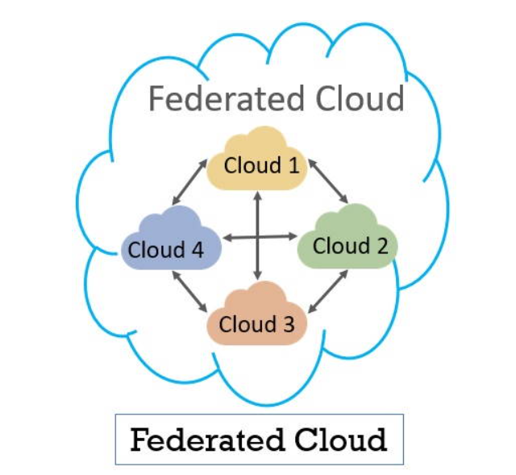
federated clouds
是部署和管理多個外部和內部雲的計算服務，以匹配業務需求。
它是一個將私有雲、社區雲和公共雲集成到可擴展的計算平台中的跨國雲系統。
聯合雲是通過使用通用標準連接不同的雲環境。

