Slide 1
NFV and SFC: A Case Study of Optimization for Virtual Mobility Management
Hao Jin, Yi Jin, Haiya Lu, Chenglin Zhao, and Mugen Peng

Slide 2
Abstract
To support the typical application scenarios defined in the fifth generation wireless network
virtual Mobility Management Entity (vMME) is a promising solution, which runs on universal servers and network functions virtualization instead of conventional hardware-dedicated mobility management entity.
Notes:
為了支持5G典型應用的場景
可以運行在universal servers and network functions virtualization(NFV)上的VMME是一個可行的解決方案

Slide 3
Abstract
Among different vMME mapping solutions, the decomposing of MME into multiple components is a prospective approach to implementing distributed and virtualized mobility management.
Notes:
在不同的vMME映射解决方案中，透過將MME分解為多個元件是一種分散式和虛擬化的移動性管理可行性的方法。

Slide 4
Abstract
In this paper, the optimization of mobility management is addressed by using NFV and service function chain.
A general signaling processing flow of vMME based on service function chain is analyzed.
Notes:
在本篇論文的目標，通過使用NFV和SFC來解決移動性管理的優化問題。
透過分析在SFC上的vMME的所有signaling processing (flow)流 藉此得到成本

Slide 5
Abstract
The performance of vMME is formulated considering the total signaling communication overhead cost, the total signaling communication overhead cost on backhauls as well as the migration overhead cost of state data under different function component placement of vMME.
Notes:
以vMME的所有信號傳輸/回傳通信費用成本以及vMME(不同功能组件放置下)的狀態數據(state data )傳遞費用成本這三種成本來計算出vMME的效能表現結果

Slide 6
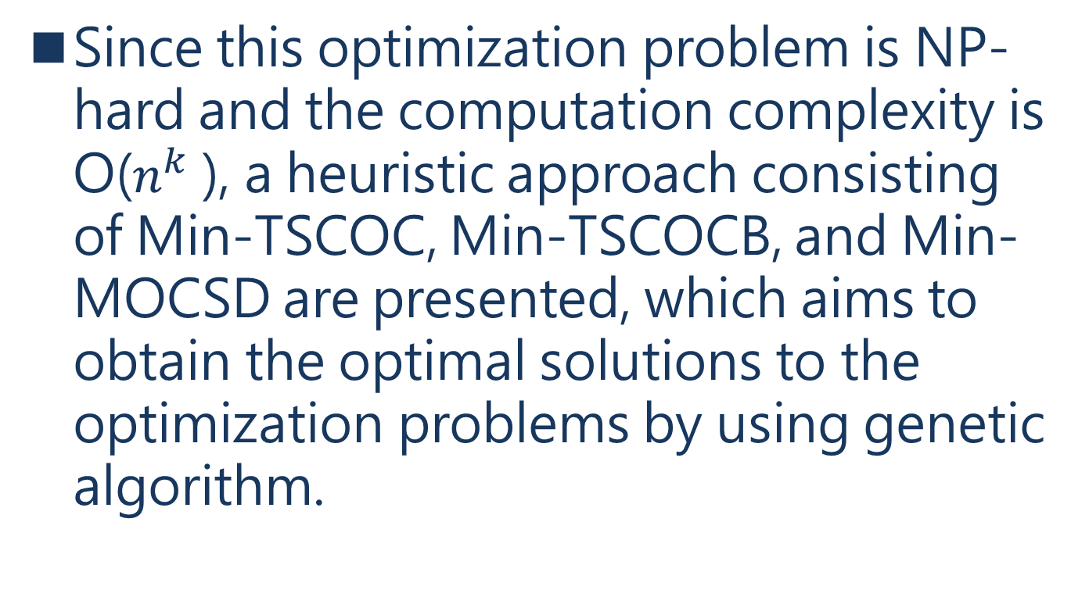
Abstract
Since this optimization problem is NP-hard and the computation complexity is O($n^{k}$ ), a heuristic approach consisting of Min-TSCOC, Min-TSCOCB, and Min-MOCSD are presented, which aims to obtain the optimal solutions to the optimization problems by using genetic algorithm.
Notes:
這個優化問題是複雜度為O(nk)的NP-hard
藉由Min-TSCOC、Min-TSCOCB和Min-MOCSD三個組成的啟發式方法(該方法旨在通過使用遺傳算法獲得優化問題的最優解)去求得優化問題的最優解

Slide 7
I. INTRODUCTION
the 5G research on typical service scenarios including Enhanced Mobile Broadband (eMBB), massive Machine Type of Communication (mMTC), Ultra Reliable and Low Latency Communication (URLLC) as well as vehicular network [1]–[3].
[1] E. Dahlman et al., “5G wireless access: Requirements and realization,” IEEE Commun. Mag., vol. 52, no. 12, pp. 42–47, Dec. 2014.
[2] H.-J. Einsiedler, A. Gavras, P. Sellstedt, R. Aguiar, R. Trivisonno, and D. Lavaux, “System design for 5G converged networks,” in Proc.IEEE Eur. Conf. Netw. Commun. (EuCNC), Paris, France, Jun. 2015,pp. 391–396.
[3] B. M. Masini, A. Bazzi, and E. Natalizio, “Radio access for future 5G vehicular networks,” in Proc. IEEE 86th Veh. Technol. Conf. (VTC-Fall), Toronto, ON, Canada, Sep. 2017, pp. 1–7.
Notes:
隨著5G快速的發展越來越多人對於5G特性 eMBB、mMTC、URLLC以及車輛網路進行研究

Slide 8
I. INTRODUCTION
The typical networking architecture of 5G radio access network and various service requirements brings a great challenge to the existing mobility management based on EPC.
Notes:
5G網路架構跟各式各樣的服務需求帶給現有的EPC的移動性管理巨大的挑戰
EPC 4G網路裏的架構 主要原件為MME、S-GW、P-GW

Slide 9
I. INTRODUCTION
The existing mobility management solution of cellular mobile network provides mobility management functions through functional modules including source base station, target base station, Mobility Management Entity (MME), Serving Gateway (S-GW), Packet Gateway (P-GW), HSS, and PCRF.
Notes:
現有的蜂巢式 mobile network mobility management 是透過(source base station、target base station、MME、S-GW、P-GW、HSS、RCRF)實體的設備的functional 模組達到mobility management 的功能

Slide 10
I. INTRODUCTION
The core functional modules of mobility management are deployed in the core network in a centralized manner including MME, S-GW, P-GW, HSS and PCRF.
Notes:
透過將functional 模組集中部屬在核心網路，可以解決(下一頁!!)

Slide 11
I. INTRODUCTION
Therefore, the existing solution for mobility management brings about not only limitation of single point of failure, but also scalability and elasticity to meet various service requirements and radio access network architecture [4], [5].
[4] Distributed Mobility Management Deployment Scenario and Architecture,
document draft-liu-dmm-deployment-scenario-02, IETF, 2015.
[5] X. An, F. Pianese, I. Widjaja, and U. G. Acer, “DMME: Virtualizing
LTE mobility management,” in Proc. IEEE 36th Conf. Local Comput.
Netw., Bonn, Germany, Oct. 2011, pp. 528–536.
Notes:
可以解決現有的移動性管理單點故障的限制問題，還帶來了可擴展性和彈性，並滿足各種服務需求。從[4], [5]得證。

Slide 12
I. INTRODUCTION
The heterogeneity, dense deployment, and flattening characteristics of 5G mobile radio access networks directly affects the performance of control plane for mobility management.
Notes:
5G移動無線接入網的異構、密集部署和扁平化(減少管理層級)三個特性會直接影響到移動管理控制平面的性能。

Slide 13
I. INTRODUCTION
To address the limitations of existing mobility management, two methodologies are provided：
distributed mobility management [4], [5]
virtualized mobility management [6].
[6] T. Taleb et al., “EASE: EPC as a service to ease mobile core network
deployment over cloud,” IEEE Netw. Mag., vol. 29, no. 2, pp. 78–88,
Mar. 2015.
Notes:
現有的兩個方法分散式以及虛擬化可以解決現有移動性管理的局限性

Slide 14
I. INTRODUCTION
Distributed mobility management pushes the management of cellular mobility management toward the edge of the network to meet the various demands of services as well as the performance requirements of mobility management.
Notes:
分佈式移動管理指的是將現有移動管理的管理推向網絡邊緣(邊緣計算的概念)

Slide 15
I. INTRODUCTION
A distributed system called DMME is presented to implement mobility management for LTE (Long Term Evolution), which confirms that distributed architectures are efficient to reliably support high-throughput, latency-sensitive control plane functions by prototype implementation and simulations [5].
[5] X. An, F. Pianese, I. Widjaja, and U. G. Acer, “DMME: Virtualizing
LTE mobility management,” in Proc. IEEE 36th Conf. Local Comput.
Netw., Bonn, Germany, Oct. 2011, pp. 528–536.
Notes:
藉由DMME證實了分佈式架構能有 有效地且可靠high-throughput、延遲敏感的控制平面功能

Slide 16
I. INTRODUCTION
In order to reduce the deployment cost of MME, virtual Mobility Management Entity (vMME) was proposed as an alternative solution based on Network Functions Virtualization (NFV) instead of conventional hardware-dedicated MME entity [6].
[6] T. Taleb et al., “EASE: EPC as a service to ease mobile core network
deployment over cloud,” IEEE Netw. Mag., vol. 29, no. 2, pp. 78–88,
Mar. 2015.
Notes:
透過使用vMME取代MME實體設備可以有效降低部屬的成本

Slide 17
I. INTRODUCTION
NFV-based mobility management provides more flexible, scalable and resilient mobility management service with on-demand orchestration of mobility management, which enables distributed and semi-distributed solutions for mobility management.
Notes:
NFV的移動性管理提供了更加靈活、可擴展和有彈性的移動性管理服務
讓管理方法有了分佈式和半分佈式方案

Slide 18
I. INTRODUCTION
By using NFV, each conventional network function (NF) is now running on a virtual machine (VM) as a 1:1 mapping model or is decomposed into smaller components called Virtual Network Function Components (VNFC) running on multiple VMs as a 1:N mapping model. [7]–[9]
[7] B. Han, V. Gopalakrishnan, L. Ji, and S. Lee, “Network function virtualization:Challenges and opportunities for innovations,” IEEE Commun.Mag., vol. 53, no. 2, pp. 90–97, Feb. 2015.
[8] R. Mijumbi, J. Serrat, J.-L. Gorricho, N. Bouten, F. De Turck, and R. Boutaba, “Network function virtualization: State-of-the-art and research challenges,” IEEE Commun. Surveys Tuts., vol. 18, no. 1,
pp. 236–262, 1st Quart., 2016.
[9] Network Functions Virtualisation (NFV); Management and Orchestration;Report on Policy Management in MANO; Release 3, document ETSI GR NFV-IFA 023 V3.1.1, 2017.
Notes:
NFV定義為將傳統的network function1:1 mapping到一個虛擬機上或分解成多個元件
其中1通常代表分解的網絡功能，N是功能分解後的VNFC數量。

Slide 19
I. INTRODUCTION
Programmable network connectivity provided by Software Defined Networking (SDN) brings about the combination of SDN and NFV to provide dynamic, flexible deployment and on-demand scaling of VNFs, which contributes a lot to the development of the mobile packet core towards 5G system [6], [10].
[6] T. Taleb et al., “EASE: EPC as a service to ease mobile core network deployment over cloud,” IEEE Netw. Mag., vol. 29, no. 2, pp. 78–88,Mar. 2015.
[10] V.-G. Nguyen, A. Brunstrom, K.-J. Grinnemo, and J. Taheri, “SDN/NFVbased mobile packet core network architectures: A survey,” IEEE Commun. Surveys Tuts., vol. 19, no. 3, pp. 1567–1602, 3rd Quart., 2017.
Notes:
SDN高相容性可以讓SDN與NFV結合增加NFV優點，這點對於5G發展有很大的貢獻

Slide 20
I. INTRODUCTION
One typical case for NFV/SDN is virtualized Evolved Packet Core (vEPC), and the other is the NG core architecture standardized by 3GPP [11]–[14].
[11] I. Afolabi, T. Taleb, K. Samdanis, A. Ksentini, and H. Flinck, “Network slicing and softwarization: A survey on principles, enabling technologies, and solutions,” IEEE Commun. Surveys Tuts., vol. 20, no. 3, pp. 2429–2453, 3rd Quart., 2018, doi: 10.1109/COMST.2018.2815638.
[12] K. Mahmood, T. Mahmoodi, R. Trivisonno, A. Gavras, D. Trossen, and M. Liebsch, “On the integration of verticals through 5G control plane,” in Proc. IEEE Eur. Conf. Netw. Commun. (EuCNC), Oulu, Finland,
Jun. 2017, pp. 1–5.
[13] Technical Specification Group Services and System Aspects; System Architecture for the 5G System; Stage 2 (Release 15), 3GPP TS Standard 23.501, 2018.
[14] Technical Specification Group Services and System Aspects; Procedures for the 5G System; Stage 2 (Release 15), 3GPP TS Standard 23.502, 2018.
Notes:
NFV/SDN結合的一個典型案例是虛擬化的進化分組核心（vEPC），另一個是3GPP[11]-[14]標準化的NG核心架構。
不過NG核心架構還不成熟大多數關於vMME的研究問題都是基於vEPC的架構，很少有研究集中於NG核心架構。

Slide 21
I. INTRODUCTION
vEPC can be categorized into four ways:
a) Fully NFV-based EPC architecture
b) SDN/NFV-based EPC architecture with virtualized data/user plane
c) SDN/NFV-based EPC architecture with non-virtualized data/user plane
d) Fully SDN-based Mobile Packet Core (MPC) architecture
[10] V.-G. Nguyen, A. Brunstrom, K.-J. Grinnemo, and J. Taheri, “SDN/NFVbased mobile packet core network architectures: A survey,” IEEE
Commun. Surveys Tuts., vol. 19, no. 3, pp. 1567–1602, 3rd Quart., 2017.
Notes:
目前有的vEPC可以分為四種方式:
完全使用NFV的EPC架構
同時使用SDN跟NFV外加虛擬化的data plane、user plane 的EPC架構
只同時使用SDN跟NFV的EPC架構
完全使用SDN的MPC架構

Slide 22
I. INTRODUCTION
In the above architectures, MME is still one of the function modules coupled in the NFV/SDN architecture instead of vMME.
Notes:
上述四種仍然是用MME去couple並非vMME

Slide 23
I. INTRODUCTION
In [6], EPC as a service is proposed, and four methods are described to deploy EPC in cloud environments which include 1:1 mapping, 1:N mapping, N:1 mapping and N:2 mapping depending on different VNF mapping approaches.
vMME is also categorized into 1:1, 1:N, N:1 as well as N:2 mapping.
[6] T. Taleb et al., “EASE: EPC as a service to ease mobile core network deployment over cloud,” IEEE Netw. Mag., vol. 29, no. 2, pp. 78–88, Mar. 2015.
Notes:
在[6]中，提出了EPC作為一種服務，並描述了在cloud中部署EPC的四種方法，分別為1：1映射、1：N映射、N：1映射和N：2映射，取決於不同的VNF映射方法。
vMME也被分為1:1、1:N、N:1以及N:2映射

Slide 24
I. INTRODUCTION
In [16], the cost of VNF/VNFC deployment strategies is analyzed for a virtualized mobile network infrastructure providing Evolved Packet Core as a Service (EPCaaS) considering functional and administrativ constraints.
The cost is measured in terms of the utilization of data center infrastructure resources such as computation and networking.
Notes:
在[16]中，考慮到功能和管理方面的限制，對提供Evolved Packet Core as a Service（EPCaaS）的虛擬化移動網絡基礎設施分析了VNF/VNFC部署策略的成本。
成本是以數據中心基礎設施資源的使用率來衡量的

Slide 25
I. INTRODUCTION
In [17], different VNF placement algorithms for carrier cloud are introduced aiming at minimizing path, as well as minimizing S-GW relocation frequency.
The algorithms are presented to deal with the optimal placement of VNFs on the user plane.
[17] T. Taleb, M. Bagaa, and A. Ksentini, “User mobility-aware virtual
network function placement for virtual 5G network infrastructure,”
in Proc. IEEE Int. Conf. Commun. (ICC), London, U.K., Jun. 2015,
pp. 3879–3884.
Notes:
在[17]中，引入了不同的carrier cloud的VNF放置算法，旨在最小化UE和底層VNI的PDN-GW VNF之間的路徑，以及最小化S-GW的搬遷頻率。
並提出了處理VNFs在用戶平面上的最佳放置的算法。

Slide 26
I. INTRODUCTION
In [18], a practical realization of cellular core called KLEIN is presented as a minimally disruptive design by using vEPC and SDN for service chaining in data centers, with a global resource management scheme to map traffic to different data center locations.
[18] Z. A. Qazi, P. K. Penumarthi, V. Sekar, V. Gopalakrishnan, K. Joshi, and S. R. Das, “KLEIN: A minimally disruptive design for an elastic cellular core,” in Proc. Symp. SDN Res. (SOSR), Santa Clara, CA, USA,Mar. 2016, pp. 1–12.
Notes:
在[18]中，提出了一個名為KLEIN的蜂窩核心的實際實現，通過使用vEPC和SDN來實現數據中心的SFC，並通過全局資源管理方案將流量映射到不同的數據中心位置，從而實現最小的破壞性設計。

Slide 27
I. INTRODUCTION
In [19], a decentralized core network architecture optimized for the identified control events is proposed for Machine Type Communication which brings massive control signaling.
The proposed control plane functions can be executed separately.
[19] A. Roozbeh, “Distributed cloud and de-centralized control plane:
A proposal for scalable control plane for 5G,” in Proc. IEEE/ACM. 8th
Int. Conf. Utility Cloud Comput. (UCC), Limassol, Cyprus, Dec. 2015,
pp. 348–353.
Notes:
在[19]中，為機器類型通信提出了一個分散的核心網絡架構，該架構為確定的控制事件進行了優化，使得可以有大規模的控制信號。

Slide 28
I. INTRODUCTION
In [20], an implemental architecture of a vEPC is proposed to accommodate M2M services.
Every vEPC is optimized by eliminating EPC components or replacing standardized interface protocols with internal application interworking.
[20] H. Baba, M. Matsumoto, and K. Noritake, “Lightweight virtualized
evolved packet core architecture for future mobile communication,” in
Proc. IEEE Wireless Commun. Netw. Conf. (WCNC), New Orleans, LA,
USA, Mar. 2015, pp. 1811–1816.
Notes:
在[20]中，提出了一個vEPC的實現架構以適應M2M服務。
每個vEPC都通過實體轉成虛擬進行優化。

Slide 29
I. INTRODUCTION
In [21] and [22], 1:N mapping of vMME is investigated, and vMME is decoupled into three functional entities, namely the Front-End (FE), the Worker (W) and the state DataBase (DB).
[21] P. Andres-Maldonado, P. Ameigeiras, J. Prados-Garzon,
J. J. Ramos-Munoz, and J. M. Lopez-Soler, “MME support for
M2M communications using network function virtualization,” in Proc.
IEEE 12th Adv. Int. Conf. Telecommun. (AICT), Valencia, Spain,
May 2016, pp. 106–111.
[22] J. Prados-Garzon, P. Ameigeiras, J. J. Ramos-Munoz,
P. Andres-Maldonado, and J. M. Lopez-Soler, “Analytical modeling
for virtualized network functions,” in Proc. IEEE Int. Conf. Commun.
Workshops (ICC Workshops), Paris, France, May 2017, pp. 979–985.
Notes:
根據21 22篇vMME被拆分為FE,worker,DB三個功能實體

Slide 30
I. INTRODUCTION
From the view point of Service Function Chain(SFC) and VNF embedding, a chained VNFs is defined as a chain-ordered set of service functions (SFs) that handles the traffic of the delivery (data plane), control, and monitoring (control plane) of a specific service/application [23].
[23] A. M. Medhat, T. Taleb, A. Elmangoush, G. A. Carella, S. Covaci, and T. Magedanz, “Service function chaining in next generation networks: State of the art and research challenges,” IEEE Commun. Mag., vol. 55,no. 2, pp. 216–223, Feb. 2017.
Notes:
從服務功能鏈 (SFC) 和 VNF 嵌入的角度來看，鏈接的 VNF 被定義為一組有順序的服務功能 (SF)，用於處理（數據平面）、（控制 平面）的特定服務/應用程序

Slide 31
I. INTRODUCTION
Some typical network services such as IMS, load balancing and vCDN are modelled and analyzed from the perspective of SFC in current literatures.
Notes:
大部分的文獻網絡服務都是從SFC去討論的

Slide 32
I. INTRODUCTION
In [26], optimal placement of VNFs for network load balancing are formulated aiming at minimizing the distance from a smaller cluster of servers to the data center in a common cloud and network service approach, and three optimization methods are compared for the allocation and replication of VNFs.
[26] F. Carpio, S. Dhahri, and A. Jukan, “VNF placement with replication
for Load balancing in NFV networks,” in Proc. IEEE Int. Conf.
Commun. (ICC), Paris, France, May 2017, pp. 1–6.
Notes:
在[26]中，提出了三種優化方法用於網絡負載平衡的VNFs的優化放置，目的最小化從較小的服務器集群到數據中心的距離，

Slide 33
I. INTRODUCTION
The focus of this paper is the optimization of vMME by using NFV and SFC for different service scenarios.
The main contribution of this paper is as follows:
Notes:
本文的重点是通过使用NFV和SFC对不同服务场景的vMME进行优化
本文主要貢獻如下

Slide 34
I. INTRODUCTION
(1)A MANO-based vMME framework is proposed by using the 1:3 mapping, and a general signaling processing flow of vMME based on SFC is analyzed.
Notes:
利用1:3的映射提出了MANO的vMME框架，並分析了SFC的vMME的一般信令處理流程。

Slide 35
I. INTRODUCTION
(2)An optimization method of vMME is proposed, and the performances of vMME is formulated as optimization problems to minimize the total signaling communication overhead cost, the total signaling communication overhead cost on backhauls and the migration overhead cost of state data for different placement of VNF components of vMME.
Notes:
在1:3映射的虛擬化移動性管理框架的基礎上，提出了vMME的優化方法，並將vMME的性能formulated為優化問題，以最小化vMME不同位置的VNF組件的相關成本

Slide 36
I. INTRODUCTION
(3)In order to solve the NP-hard optimization problems, a heuristic approach is proposed including algorithms called Min-TSCOC, Min-TSCOCB and Min-MOCSD, and the performances of vMME are evaluated with different function placement solutions.
Notes:
為了解決NP-hard優化問題，提出了一種啟發式方法為了解決NP-hard優化問題，提出了一種啟發式方法

Slide 37
II. SYSTEM MODEL
In this section, a MANO-based virtualized mobility management framework is proposed by using 1:3 mapping.
Notes:
在本節中，通過使用1:3映射，提出了一個基於MANO的虛擬化移動性管理框架。

Slide 38
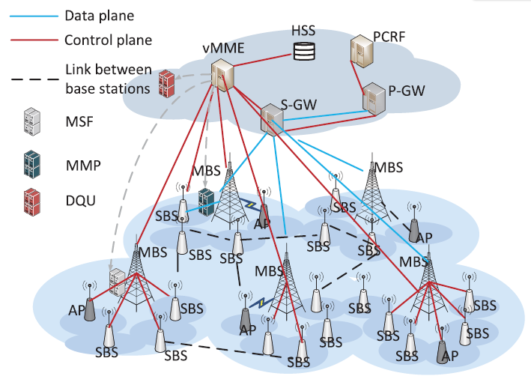
II. SYSTEM MODEL
A. Scenario of vMME
Notes:
考慮到異構無線接入網絡有幾個MBS（Macro Base Station）和SBS（Small Base Station）的情況，SBS提供熱點覆蓋，MBS提供廣域覆蓋。
由於VNFC是組合在一起的，並且位於不同的MBS和SBS來支持vMME，因此移動性管理的控制平面上的通信過程構成了SFC，VNFC之間的一些通信互動需要MBS或SBS的單hop或多hop中繼。

Slide 39
II. SYSTEM MODEL
A. Scenario of vMME
Since VNFCs are combined and located at different MBSs and SBSs to support vMME, the communication process on the control plane for mobility management composes service function chains.
Notes:
由於VNFC是組合在一起的，並且位於不同的MBS和SBS來支持vMME，因此移動性管理的控制平面上的通信過程構成了SFC，VNFC之間的一些通信互動需要MBS或SBS的單hop或多hop中繼。

Slide 40
II. SYSTEM MODEL
B. The Framework of vMME Based on MANO
As a typical use case, mobility management(MM) can be virtualized as a service in the MANO based architecture [10], and vMME can be managed and optimized through MANO architecture.
Notes:
移動性管理可以在基於MANO的架構中被虛擬化為一種服務[10]，並且vMME可以通過MANO架構進行管理和優化。

Slide 41
II. SYSTEM MODEL
B. The Framework of vMME Based on MANO
In the MANO architecture for vMME, NFVO is responsible for the orchestration of mobility management services
Notes:
在vMME的MANO架構中，NFVO負責移動性管理服務的協調，

Slide 42
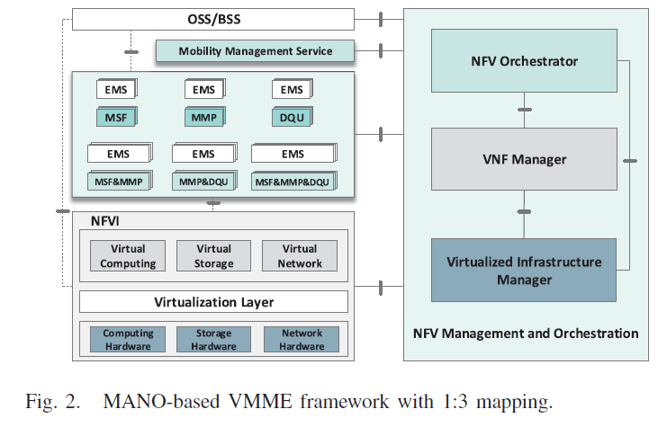
II. SYSTEM MODEL
B. The Framework of vMME Based on MANO
Notes:
MANO的1:3映射的vMME框架

Slide 43
II. SYSTEM MODEL
B. The Framework of vMME Based on MANO
The Virtualized Infrastructure Manager (VIM) provide optimal mapping of virtual resources used by mobility management function modules to the physical resources including computation,storage and communication resources.
Notes:
虛擬化基礎設施管理器（VIM）提供移動性管理功能模塊使用的虛擬資源與物理資源的最佳映射，包括計算、存儲和通信資源。

Slide 44
II. SYSTEM MODEL
B. The Framework of vMME Based on MANO
Mobility management has been decomposed according to the control and data planes [4].
Generally, from the view point of function, the functions of mobility management contain handover management, data management and location management.
[4] Distributed Mobility Management Deployment Scenario and Architecture,document draft-liu-dmm-deployment-scenario-02, IETF, 2015.
Notes:
移動性管理已經根據控制和數據平面進行了分解[4]。
一般來說，從功能的角度來看，移動性管理的功能可以分為handover management,data management, location management.三種功能

Slide 45
II. SYSTEM MODEL
B. The Framework of vMME Based on MANO
Based on the main functions of mobility management, the first step for decomposition of mobility management is to split the functions into control plane and data plane.
Notes:
根據移动性管理的主要功能，移动性管理分解的第一步是将功能分成控制平面和数据平面。

Slide 46
II. SYSTEM MODEL
B. The Framework of vMME Based on MANO
Taking the mobility management of LTE as an example, the most relevant control plane functions related with mobility includes,
(1)Authenticating the UE as it accesses the system;
(2) Managing UE state while the users are idle
Notes:
以LTE的移動性管理為例，與移動性有關的最相關的控制平面功能包括。做法類似像陳靖情境相關的放在一起
在UE訪問系統時對其進行認證
在用戶閒置時管理UE的狀態

Slide 47
II. SYSTEM MODEL
B. The Framework of vMME Based on MANO
(3)Supervising handovers between different base stations;
(4)Establishing bearers as required by services for connectivity in a mobile context;
(5) Generating billing information
(6) Implementing lawful interception policies, and overseeing a large number of features defined in 3GPP specifications
Notes:
監督不同基站之間的handover
按照服務的要求建立連線，以便在移動環境下進行連接
生成計費信息
實施合法的攔截政策，並監督3GPP規範中定義的大量功能

Slide 48
II. SYSTEM MODEL
B. The Framework of vMME Based on MANO
The mobility management events frequently processed on control plane message procedures includes Attach, Idle, Wakeup and Handover [22], [30], and all of them require the interaction of MME with almost all of the entities.
[23] A. M. Medhat, T. Taleb, A. Elmangoush, G. A. Carella, S. Covaci, and
T. Magedanz, “Service function chaining in next generation networks:
State of the art and research challenges,” IEEE Commun. Mag., vol. 55,
no. 2, pp. 216–223, Feb. 2017.
[30] H. Lindholm, L. Osmani, H. Flinck, S. Tarkoma, and A. Rao, “State
space analysis to refactor the mobile core,” in Proc. ACM 5th Workshop
Things Cellular, Oper., Appl. Challenges, London, U.K., Aug. 2015,
pp. 31–36.
Notes:
有四個事件包括附加、空閒、喚醒和切換[22],[30]，所有這些都需要MME與幾乎所有的實體互動

Slide 49
II. SYSTEM MODEL
B. The Framework of vMME Based on MANO
Concerning the above mentioned mobility events of MME, some functions requires interactions with database such as (1) and (2), and some of them can be implemented locally in RAN without database query such as (3), (4) for mMTC.
Notes:
有些功能需要與數據庫互動，如(1)和(2)
有些功能可以在RAN中本地實現，無需查詢數據庫，如(3)和(4)的mMTC。

Slide 50
II. SYSTEM MODEL
B. The Framework of vMME Based on MANO
Since the interactions involving database query leads to delay, which derivate the performance of MME, while distributed database brings about synchronization problem of state data of MME, the database query related interaction procedure and the related function placement becomes a tradeoff for the further decouple and design of vMME.
Notes:
由於涉及到數據庫查詢的交互會導致延遲，從而影響MME的性能，而分佈式數據庫又會帶來MME狀態數據的同步問題，所以數據庫查詢相關的交互程序和相關的功能放置成為vMME進一步拆分和設計的一個考量因素。

Slide 51
II. SYSTEM MODEL
B. The Framework of vMME Based on MANO
Another problem is the hierarchical deployment of cellular radio access network, which aggravates the burden of vMME by the frequent interactions of mobility events on hotspot areas as well as the signaling load on the backhauls if some function components of vMME is located in the core network.
Notes:
另一個問題是蜂窩無線接入網的分層部署，如果vMME的某些功能組件位於核心網絡中，那麼熱點區域的移動性事件互動頻率多會造成vMME的負擔

Slide 52
II. SYSTEM MODEL
B. The Framework of vMME Based on MANO
the second step is decoupling MME into three components including a component which is located nearby RAN nodes, a component responsible for signaling processing and a component for database query.
Notes:
第二步是將MME解耦為三個組件，包括一個位於RAN節點附近的組件、一個負責信令處理的組件和一個負責數據庫查詢的組件。

Slide 53
II. SYSTEM MODEL
B. The Framework of vMME Based on MANO
If the number of VNFCs is more than three, on the one hand, the methodology of decoupling MME becomes more complicated, on the other hand, the optimal replacement of decomposed components leads to not only more composition patterns, but also complexity of the synchronization of state data and frequent migration among VNFCs as well.
Notes:
如果VNFC的數量超過3個，一方面，解耦MME的方法變得更加複雜，另一方，狀態數據同步的複雜性和VNFC之間的頻繁遷移。

Slide 54
II. SYSTEM MODEL
B. The Framework of vMME Based on MANO
we adopt the 1:3 mapping solution for vMME, and divide the vMME into three virtual components including Mobility Signaling Forwarding (MSF), Mobility Management Processor (MMP) and Data Query Update (DQU).
Notes:
我們對vMME採用1：3的映射方案，將vMME分為三個虛擬組件(MSF、MMP、DQU)，

Slide 55
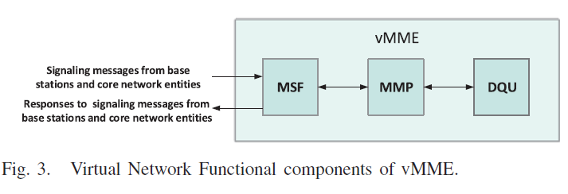
II. SYSTEM MODEL
B. The Framework of vMME Based on MANO
Notes:
MSF:負責處理轉發或回傳的signaling messages，它實際上充當了vMME和其他網絡實體之間的通信接口，用戶的一些移動context information被存儲在MSF中
MMP:它負責實現移動性管理功能邏輯，用戶的移動性context information也存儲在MMP中。
DQU:它負責查詢和更新移動用戶的相關狀態信息，同時也為移動用戶存儲一些移動context information。

Slide 56
II. SYSTEM MODEL
B. The Framework of vMME Based on MANO
For simplicity of analysis on signaling procedures, the external interfaces of vMME is MSF with BSs and core network (including service gateways such as P-GW and S-GW, HSS), while the internal interfaces are the interfaces of MSF with MMP, and MMP with DQU.
Notes:
為了簡化對信令程序的分析，vMME的外部接口是MSF與BS和核心網（包括業務網關，如P-GW和S-GW，HSS）的接口，而內部接口是MSF與MMP，以及MMP與DQU的接口。

Slide 57
II. SYSTEM MODEL
B. The Framework of vMME Based on MANO
When MMP receives the signaling messages from other network entities forwarded from the MSFs, MMP proceeds the signaling messages according to its functional logic.
Notes:
當MMP收到其他網絡實體從MSF轉發的信令信息時，MMP根據其功能邏輯進行信令信息的處理

Slide 58
II. SYSTEM MODEL
B. The Framework of vMME Based on MANO
If the data cannot be obtained in the MMP cache during the process, which are required for mobility management signaling process, then the MMP sends a query request to the DQU, and the required data is obtained for signaling process from the DQU’s reply for the query request.
Notes:
如果在這個過程中，MMP緩存中不能獲得移動性管理信令過程所需的數據，MMP會去向DQU查詢

Slide 59
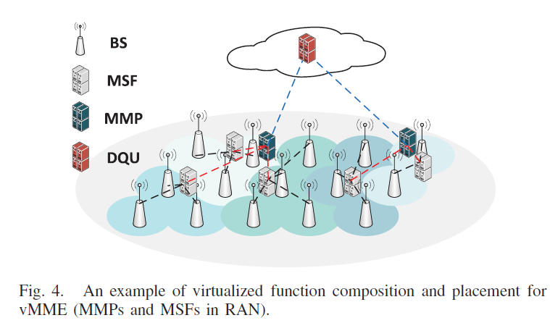
II. SYSTEM MODEL
B. The Framework of vMME Based on MANO
Notes:
一個部署方案的例子，DQU被部署在核心網絡中，MSF、MMP和DQU通過無線或有線鏈接進行連接。

Slide 60
II. SYSTEM MODEL
C. Service Function Chain Based Signaling Process
From the respect of optimal deployment of VNFs, the main objective is to achieve fast, scalable and dynamic composition and allocation of VNFs to execute a network service (NS).
Notes:
從VNFs的優化目標VNFs的快速、可擴展和動態組成和分配，以執行網絡服務（NS）。

Slide 61
II. SYSTEM MODEL
C. Service Function Chain Based Signaling Process
However, since a NS requires a set of VNFs, two problems are needed to be solved in order to achieve the efficiency of service coordination and management, namely optimal composition of VNFs for a determined NS, and efficiently allocation and scheduling the VNFs of a NS onto a substrate network [23].
[23] A. M. Medhat, T. Taleb, A. Elmangoush, G. A. Carella, S. Covaci, and
T. Magedanz, “Service function chaining in next generation networks:
State of the art and research challenges,” IEEE Commun. Mag., vol. 55,
no. 2, pp. 216–223, Feb. 2017.
Notes:
由於NS需要一組VNFs，VNFs的組成和VNF配置的位置這兩問題，為了實現服務協調和管理的效率所需解決的

Slide 62
II. SYSTEM MODEL
C. Service Function Chain Based Signaling Process
vMME can be viewed as a network service.
the VNF components of vMME can be connected and chained together to execute the function of mobility management.
Notes:
vMME 可以看作是一種網絡服務。
vMME的VNF組件可以被連接和串聯起來，以執行移動性管理的功能。

Slide 63
II. SYSTEM MODEL
C. Service Function Chain Based Signaling Process
the optimization of vMME is not only related to VNF component optimal placement, but also constrained with the service function chains based on the signaling processes.
Notes:
vMME的優化不僅與VNF組件的優化放置有關還受限於SFC

Slide 64
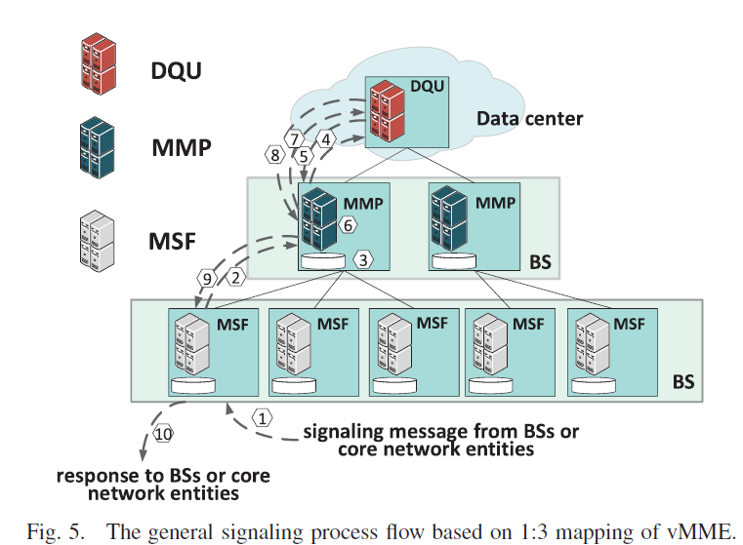
II. SYSTEM MODEL
C. Service Function Chain Based Signaling Process
Notes:
說明了DQU、MMP和MSF在vMME中的分層控制框架。
五個MSF被放置在五個不同的BS上，每個MSF至少管理一個BS，並處理附屬於MSF管理的BS的UE的所有信令請求。
兩個MMP被放置在兩個不同的BS上。
每個MMP至少管理一個MSF，並處理來自MMP管理的MSF的所有信令信息。

Slide 65
II. SYSTEM MODEL
C. Service Function Chain Based Signaling Process
According to the above framework of vMME, the general signaling process flow based on 1:3 mapping of MSF, MMP and DQU is presented as follows:
(1)The MSF receives the signaling message coming from BSs, S-GW, P-GW and HSS as the communication interface between vMME and network entities related mobility management including BSs, S-GW, P-GW and HSS;
Notes:
根據上述vMME的框架，MSF、MMP和DQU的1：3映射的一般信令流程如下。
MSF作為vMME對外的通訊接口

Slide 66
II. SYSTEM MODEL
C. Service Function Chain Based Signaling Process
(2)The MSF checks the network entity information of the signaling message and forwards it to the corresponding MMP;
(3)The MMP receives the signaling message, and processes it according to its function logic. During the process, the MMP checks whether the data required for processing the signaling message is stored in its cache;
Notes:
MSF轉發給對應的MMP
MMP收到後會對其功能邏輯進行處理

Slide 67
II. SYSTEM MODEL
C. Service Function Chain Based Signaling Process
(4)If the data required for processing the signaling message cannot be found in its cache, then the MMP sends a data query request to the DQU to retrieve the required data from the database.During the database retrieval period, the MMP processes other signaling messages;
Notes:
所需資料不足的話，MMP會去向DQU進行查詢的動作

Slide 68
II. SYSTEM MODEL
C. Service Function Chain Based Signaling Process
(5) The DQU processes the data query request, and send back the query result to the MMP;
(6) When the MMP obtains the required data to process the signaling process, the signaling message is processed;
Notes:
DQU再將MMP要的資料回傳給MMP
MMP收後就會繼續處理

Slide 69
II. SYSTEM MODEL
C. Service Function Chain Based Signaling Process
(7)After the MMP completes the processing of the signaling message, and if some mobility context information in the DQU is needed to be updated, the MMP sends a data update request to the DQU;
(8) the DQU completes the data updating according to the data update request, and then sends a data update completion response to the MMP;
Notes:
如果MMP發現DQU有資料需要被更新的話，MMP會對DQU發送更新請求
接著DQU就會進行更新，完成後會再回傳告知MMP

Slide 70
II. SYSTEM MODEL
C. Service Function Chain Based Signaling Process
(9)As the MMP completes the processing of signaling message, it generates one or more response messages according to the function logic and sends them to the MSF;
(10) After receiving the response messages, the MSF forwards them to the corresponding network entities according to their network entity information in the signaling messages.
Notes:
MMP完成處理後會再把訊息傳給該MSF
MSF再轉發給對應的網路實體

Slide 71
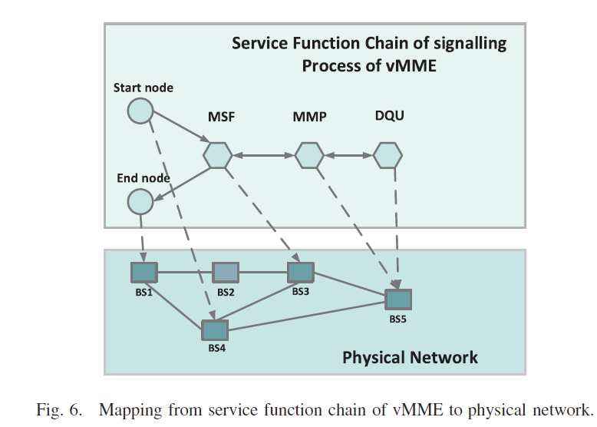
II. SYSTEM MODEL
C. Service Function Chain Based Signaling Process
Notes:
VMME對應到實體網路的流程。考慮服務場景和要求，在最佳物理節點上有效部署vMME的每個VNF組件確實很複雜。

Slide 72
III. PROBLEM FORMULATION
In this Section, based on the framework proposed in Section II, an optimization method of vMME is proposed, and the performances of vMME is formulated as optimization problems to minimize the total signaling communication overhead cost, the total signaling communication overhead cost on backhauls and the migration overhead cost of state data for different placement of VNF components of vMME
Notes:
根據上述提出一個vMME的優化方法，並最小化vMME相關成本

Slide 73
III. PROBLEM FORMULATION
The optimization of vMME can be considered from two ways, one is the function optimization, which takes into account the virtual function component partition and the optimal virtual function component composition under specified virtual function component partition result
Notes:
vMME的優化可以從兩個方面考慮，一是功能優化，即考慮虛擬功能組件的partition和指定虛擬功能組件partition結果下的最佳虛擬功能組件組成

Slide 74
III. PROBLEM FORMULATION
the other is the performance optimization, which aims at the optimization of performance metrics oriented from MME, mobile users as well as operators on the basis of virtual function component partition and placement.
Notes:
二是性能優化，即在虛擬功能組件partition和放置的位置進行優化

Slide 75
III. PROBLEM FORMULATION
Since communication resources are constrained, minimizing the total signaling communication overhead cost is a key performance metric to optimize the VNF component placement as well as minimize the delay of mobility management.
Notes:
在有限資源下，最小化總信令通信overhead成本是一個關鍵的性能指標，以優化VNF組件的放置，以及最小化移動性管理的延遲。

Slide 76
III. PROBLEM FORMULATION
Meanwhile, state data migration is also a burden to communication resources due to the mobility of UEs and distributed placement of MSFs and MMPs.
Notes:
同時，由於UE的移動性以及MSF和MMP的分佈式放置影響著狀態數據遷移

Slide 77
III. PROBLEM FORMULATION
Therefore, minimizing the total signaling communication overhead cost and the migration overhead cost of state data are chosen as the optimization objectives in the problem formulation.
Notes:
選擇最小化總信令通信overhead成本和狀態數據的遷移開銷成本作為優化目標。

Slide 78
III. PROBLEM FORMULATION
From the viewpoint of function optimization, in vMME, virtual function component composition and optimization placement plays an important role in the optimization of vMME, and it also contributes to both the total signaling communication overhead cost and the migration overhead cost of state data.
Notes:
從功能優化的角度來看，在vMME中，虛擬功能組件的組成和優化放置對vMME的優化起著重要的作用，它也對總信令通信開銷成本和狀態數據的遷移overhead成本都有影響。

Slide 79
III. PROBLEM FORMULATION
The optimization of vMME is modeled in the scenario of Fig.1, where there are several MBSs, SBSs and UEs.
The virtual function components of vMME include MSF, MMP and DQU, which can be deployed on MBSs, SBSs and in the core network.
Notes:
vMME的優化是以圖1的場景為模型
vMME的虛擬功能組件包括MSF、MMP和DQU，它們可以部署在MBS、SBS和核心網中。

Slide 80
III. PROBLEM FORMULATION
Therefore, the virtual function components deployed in the different locations cooperate to provide the function of mobility management.
Notes:
部署在不同地點的虛擬功能組件合作提供管理的功能。

Slide 81
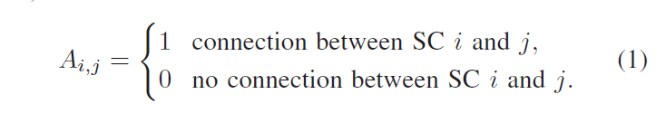
III. PROBLEM FORMULATION
Notes:
鄰接矩陣A用來表示SC之間的連接

Slide 82

III. PROBLEM FORMULATION
Notes:
與vMME有直接信令交互的實體
由於SGW、PGW和HSS都位於核心網絡中，為簡單起見，讓CN表示S-GW、P-GW和HSS

Slide 83

III. PROBLEM FORMULATION
Notes:
代表會發生的四個事件的集合

Slide 84
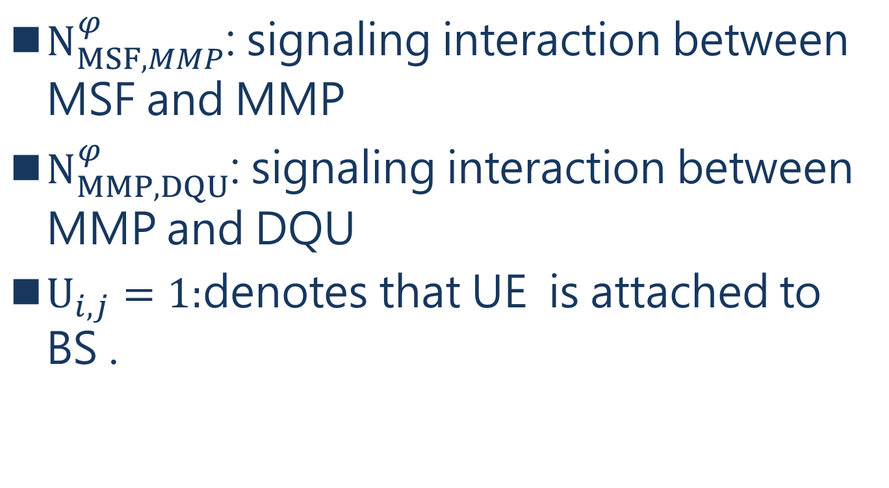
III. PROBLEM FORMULATION
$N_{MSF,MMP}^{φ}$: signaling interaction between MSF and MMP
$N_{MMP,DQU}^{φ}$: signaling interaction between MMP and DQU
$U_{i,j}=1:$denotes that UE is attached to BS .
Notes:
代表發生在MSF和MMP之間交互處理時發生事件
代表發生在DQU和MMP之間交互處理時發生事件
代表UE attache到BS

Slide 85
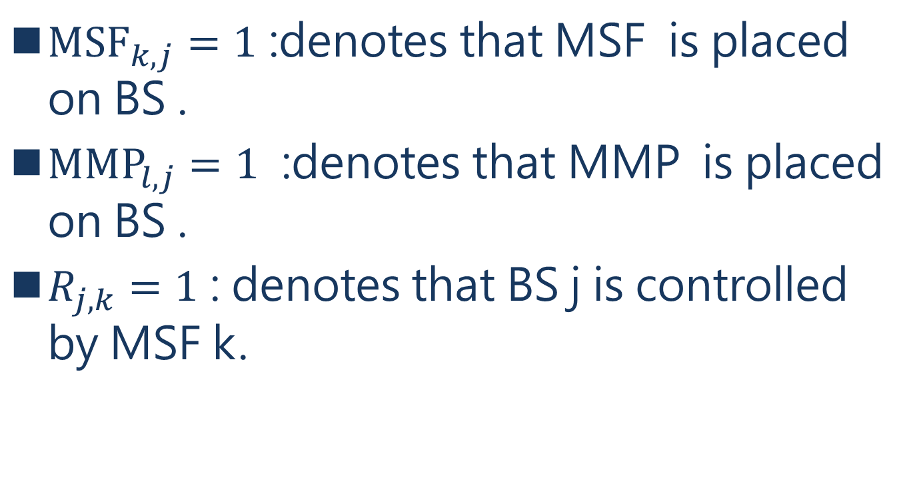
III. PROBLEM FORMULATION
${MSF}_{k,j}=1$ :denotes that MSF is placed on BS .
${MMP}_{l,j}=1$ :denotes that MMP is placed on BS .
$R_{j, k}=1$ : denotes that BS j is controlled by MSF k.
Notes:
代表第k個MSF被放在第j個BS
代表第l個MMP被放在第j個BS

Slide 86
III. PROBLEM FORMULATION
Two cases are divided for signaling interaction between entities, namely signaling interaction between vMME and external entities and signaling interaction within vMME internal entities, respectively.
Notes:
實體之間的信令交互分為兩種情況，即vMME與外部與內部之間信號交互

Slide 87
III. PROBLEM FORMULATION
Signaling interaction between vMME and external entities include interaction between BS and MSF, interaction between CN and MSF, as well as interaction between CN and DQU.
Notes:
vMME和外部實體之間的信令交互指的就是與前面提到的CN交互

Slide 88
III. PROBLEM FORMULATION
Signaling interaction within vMME internal entities includes interaction between MSF and MMP and interaction between MMP and DQU.
Notes:
vMME內部實體的信號互動包括MSF和MMP之間的互動以及MMP和DQU之間的互動

Slide 89
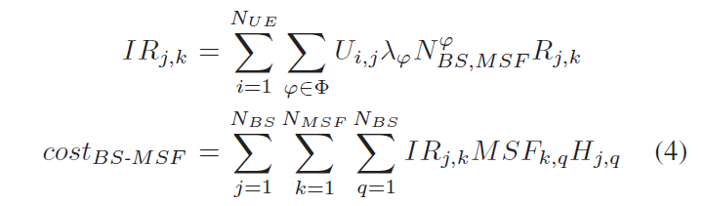
III. PROBLEM FORMULATION
Notes:
表示所有BS和所有MSF之間的信令交互率的權重
costBS-MSF為BS和MSF之間的信令通信overhead成本
平均hop數

Slide 90
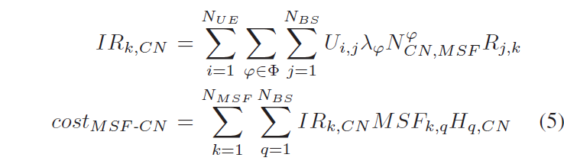
III. PROBLEM FORMULATION
Notes:
跟上面一樣試算MSF與CN之間的成本
平均hop數

Slide 91
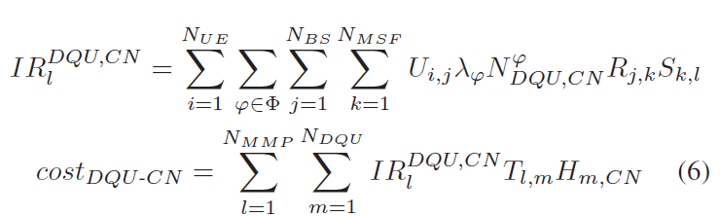
III. PROBLEM FORMULATION
Notes:
跟上面一樣試算DQU與CN之間的成本
平均hop數

Slide 92
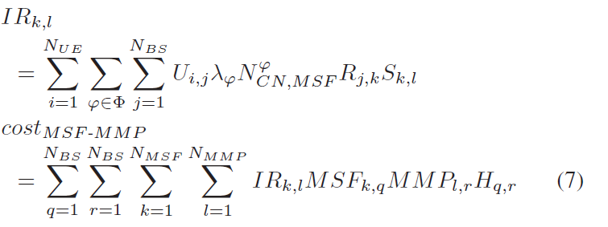
III. PROBLEM FORMULATION
Notes:
跟上面一樣試算MSF與MMP之間的成本
平均hop數

Slide 93
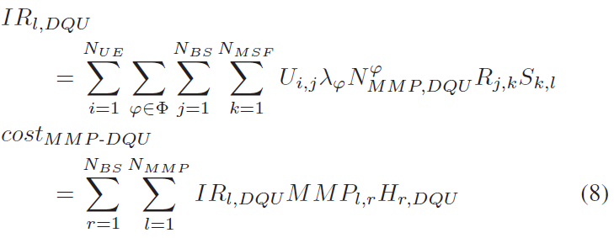
III. PROBLEM FORMULATION
Notes:
跟上面一樣試算MMP與DQU之間的成本
平均hop數

Slide 94

III. PROBLEM FORMULATION
Notes:
所有成本就是vMME外部與內部成本之和

Slide 95
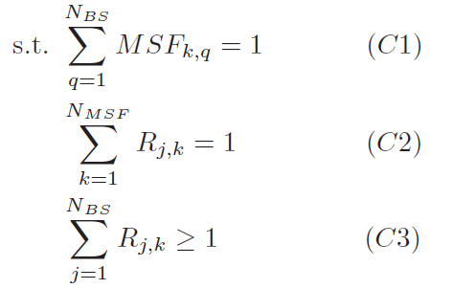
III. PROBLEM FORMULATION
Notes:
為了使總的信令通信overhead成本最小化所以有C1~C8限制式
C1到C3是MSF的限制式，其中C1是每個MSF只能放在一個BS上的約束。
C2表示每個BS只能由一個MSF控制，而C3表示每個MSF控制的BS數量不少於一個。

Slide 96
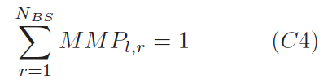
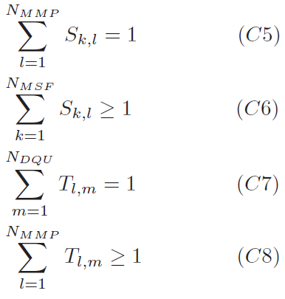
III. PROBLEM FORMULATION
Notes:
C4到C8是與MMP有關的約束，其中C4表示每個MMP只能放在一個BS上，C5表示每個MSF只能由一個MMP控制，C6表示每個MMP控制的MSF數量不少於1，C7表示每個MMP只能由一個DQU控制，C8表示每個DQU控制的MMP數量不少於1。

Slide 97
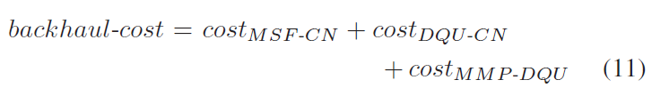
III. PROBLEM FORMULATION
Notes:
把所有UE在回程中的總信令通信overhead稱為回程成本

Slide 98
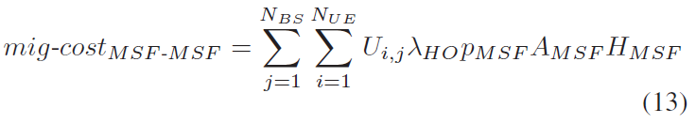
III. PROBLEM FORMULATION
Notes:
MSF之間的遷移overhead成本
pMSF是指當切換MSF發生的機率
AMSF為MSF之間搬遷數據的遷移量.
HMSF是當前部署策略下MSF之間的平均跳數。

Slide 99
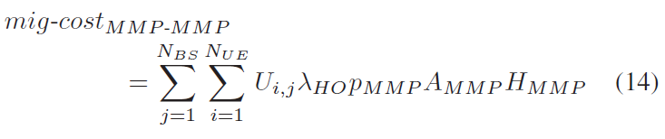
III. PROBLEM FORMULATION
Notes:
mig-costMMP-MMP為狀態數據在MMP和MMP之間的遷移overhead費用

Slide 100

III. PROBLEM FORMULATION
Notes:
所有UE的狀態數據的遷移overhead成本表示為MIG-COS

Slide 101
III. PROBLEM FORMULATION
The optimization problems in (10) are general integer linear programming problems, which is a NP hard problem [31].
It is difficult to find an optimized solution in an efficient way when the network size becomes large.
[31] C. Baolin, Theory and Algorithms for Optimization, 2nd ed. Beijing,
China: Tsinghua Univ. Press, 2005.
Notes:
優化問題是一般的整數線性規劃問題，這是一個NPhard問題[31]。
當網絡規模變得很大時，很難以有效的方式找到一個優化的解決方案。

Slide 102
III. PROBLEM FORMULATION
In order to get the optimized solutions of (10), a heuristic approach is proposed including Min-TSCOC(Minimization on Total Signaling Communication Overhead Cost), Min -TSCOCB(Minimization on Total Signaling Communication Overhead Cost on Backhauls) and Min-MOCSD(Minimization on Migration Overhead Cost of State Data), respectively.
Notes:
為了得到(的優化解，提出了一種啟發式方法也就後面這三種演算法

Slide 103
IV. PERFORMANCE EVALUATION
In this section, the performance of vMME is evaluated under the virtual function component partition including MSF, MMP and DQU.
Notes:
對vMME性能進行評估包括MSF、MMP和DQU在內的虛擬功能組件

Slide 104
IV. PERFORMANCE EVALUATION
six feasible cases of vMME function composition placement are presented
(1)MSFMMPDQU: MSF, MMP and DQU are placed separately, where MSF and MMP are placed in RAN and DQU is placed in the core network.
(2)MMP&DQUCN: MSF is placed in RAN, and MMP and DQU are merged and placed in the core network.
Notes:
提出了六個可行的vMME功能構成放置案例，具體說明如下。
MSF、MMP和DQU是分開放置的，其中MSF和MMP放置在RAN，DQU放置在核心網。
MSF放在RAN中，MMP和DQU合併並放在核心網中。

Slide 105
IV. PERFORMANCE EVALUATION
(3)MMP&DQUAN: MSF is placed in RAN, MMP and DQU are merged and placed in RAN, but MSF is placed separately from MMP&DQU.
(4)MSF&MMPAN: MSF and MMP are merged and placed in RAN, and DQU is placed independently in the core network.
Notes:
MSF被放在於RAN，MMP和DQU被合併並放在RAN，但MSF與MMP&DQU分開放置。
MSF和MMP合併後放在RAN中，而DQU則獨立放在核心網中。

Slide 106
IV. PERFORMANCE EVALUATION
(5)MSF&MMP&DQUCN: MSF, MMP and DQU are merged and placed in the core network.
(6) MSF&MMP&DQUAN: MSF, MMP and DQU are merged and placed in RAN.
Notes:
MSF、MMP和DQU被合併並放在核心網絡中。
MSF、MMP和DQU被合併並置於RAN。

Slide 107
IV. PERFORMANCE EVALUATION
Since the optimal solution of vMME depends on the service scenarios, and the mobility feature of UEs is different under different service scenarios, one of the feasible ways to describe the mobility of UEs is the difference of four mobility management events measured from realistic networks.
Notes:
由於vMME的最優方案取決於服務場景，而不同的服務場景下UE的移動性特徵是不同的，所以描述UE的移動性的可行方法之一就是現實網絡中測得的四個移動性管理事件的差異。

Slide 108
IV. PERFORMANCE EVALUATION
We select four typical application scenarios including vehicular network, shared bicycle, IoT(smart home) and IoT(smart meter) as the application cases, and give different parameter settings according to their typical mobility features extracted and calculated from [22].
[22] J. Prados-Garzon, P. Ameigeiras, J. J. Ramos-Munoz,
P. Andres-Maldonado, and J. M. Lopez-Soler, “Analytical modeling
for virtualized network functions,” in Proc. IEEE Int. Conf. Commun.
Workshops (ICC Workshops), Paris, France, May 2017, pp. 979–985.
Notes:
我們選擇了四個典型的應用場景作為應用案例，並根據從[22]中選取和計算出的其典型的移動性特徵給予不同的參數設置。

Slide 109
IV. PERFORMANCE EVALUATION
The performance metrics in the simulation are defined as follows:
(1)Total signaling communication overhead cost per UE is the average of the sum of signaling communication overhead cost between vMME and external entities and signaling communication overhead cost within vMME internal entities for every UE;
Notes:
模擬性能數值定義如下
每個UE的總信令通信overhead成本式vMME外部加內部之和的平均值

Slide 110
IV. PERFORMANCE EVALUATION
(2)Total signaling communication overhead cost on backhauls per UE is the average of the signaling communication overhead cost on backhauls for every UE;
Notes:
每個UE的回傳總信令通信overhead成本是每個UE的回傳信令通信overhead成本的平均值。

Slide 111
IV. PERFORMANCE EVALUATION
(3)Migration overhead cost of state data per UE is the average of the sum of migration overhead cost of state data between MSFs and migration overhead cost of state data between MMPs for every UE.
Notes:
每個UE的狀態數據搬移overhead成本是每個UE的MSF之間的狀態數據搬移overhead成本和MMP之間的狀態數據搬移overhead成本之和的平均值。

Slide 112
IV. PERFORMANCE EVALUATION
The optimization approach of vMME is evaluated including algorithms of Min-TSCOC, Min-TSCOCB and Min-MOCSD.
The optimization of vMME is evaluated by MATLAB with Monte Carlo method.
Notes:
評估了vMME的優化方法，包括Min-TSCOC、Min-TSCOCB和Min-MOCSD算法。
vMME的優化是由MATLAB用蒙地卡羅方法評估的

Slide 113
IV. PERFORMANCE EVALUATION
Based on the network generated, the placement of MSF located at MBS and SBS are got according to the distribution of UEs and the constrained hops from UE to the MSF (The constrained hops is 2 in the simulation).
The placement of MMP is determined by choosing the nodes within one hop with the MSFs.
Notes:
根據生成的網絡，根據UE的分佈和UE到MSF的受限跳數（模擬中受限跳數為2），得到位於MBS和SBS的MSF的位置。
MMP的放置是選擇與MSF在一跳之內的節點來選擇的。

Slide 114
IV. PERFORMANCE EVALUATION
With the initialized number of the instances of MSF, MMP and DQU, the optimal placement and number of MSF, MMP and DQU are optimized with different object functions
Notes:
在MSF、MMP和DQU實例的初始化數量下，通過不同的目標函數優化MSF、MMP和DQU的最佳佈局和數量

Slide 115
IV. PERFORMANCE EVALUATION
including minimizing the total signaling communication overhead cost, the total signaling communication overhead cost on backhauls as well as the migration overhead cost of state data among MSF, MMP and DQU under different cases of vMME function composition placement and application scenarios, respectively.
Notes:
包括在vMME功能組成佈局和應用場景的不同情況下，分別最小化總信令通信overhead成本、回傳總信令通信overhead成本以及MSF、MMP和DQU之間狀態數據的遷移overhead成本。

Slide 116
IV. PERFORMANCE EVALUATION
A. Simulation Parameters
In order to evaluate the performance of vMME in a scalable network, and at the same time considering the computational complexity of the algorithms, the number of nodes (including SBS and MBS) is 50 in the simulation.
Notes:
為了評估vMME在可擴展網絡中的性能，同時考慮到算法的計算複雜性，模擬中的節點數（包括SBS和MBS）為50。

Slide 117
IV. PERFORMANCE EVALUATION
A. Simulation Parameters
The number of UEs in each base station follows a uniform distribution of 5 to 20 [33].
In order to differentiate the weight of link type (link type of RAN and that of core network), the parameter of each hop to the core network is 5, and each hop in RAN is 1.
[33] N. Golrezaei, K. Shanmugam, A. G. Dimakis, A. F. Molisch, and
G. Caire, “FemtoCaching: Wireless video content delivery through
distributed caching helpers,” in Proc. IEEE INFOCOM, Orlando, FL,
USA, Mar. 2012, pp. 1107–1115.
Notes:
每個基站的UE數量遵循5到20的均勻分佈
為了區分鏈路類型（RAN的鏈路類型和核心網的鏈路類型）的權重，到核心網的每一跳參數為5，RAN的每一跳參數為1。

Slide 118
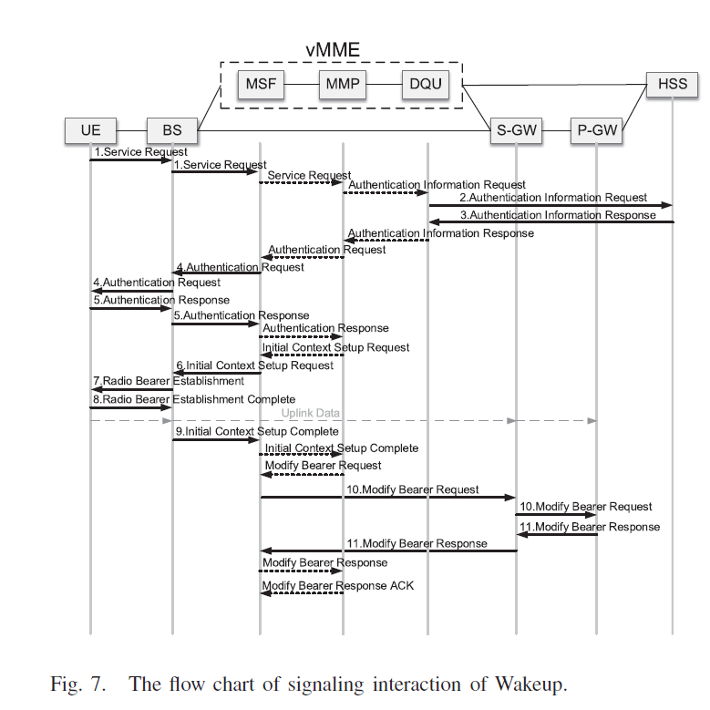
IV. PERFORMANCE EVALUATION
A. Simulation Parameters
[28] Technical Specification Group Radio Access Network; Evolved Universal Terrestrial Radio Access (E-UTRA) and Evolved Universal Terrestrial Radio Access Network (E-UTRAN); Overall Description; Stage 2 (Release 15), 3GPP TS Standard 36.300, 2018.
[29] Technical Specification Group Services and System Aspects; General Packet Radio Service (GPRS) Enhancements for Evolved Universal Terrestrial Radio Access Network (E-UTRAN) Access (Release 15), 3GPP TS Standard 23.401, 2018.
Notes:
以喚醒事件為用例，圖7顯示了根據[28]和[29]的喚醒信號交互的流程圖。

Slide 119
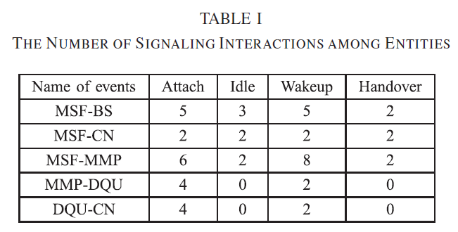
IV. PERFORMANCE EVALUATION
A. Simulation Parameters
Notes:
表I中給出了MSF、MMP和DQU實體之間信號互動數量的最佳結果之一。

Slide 120
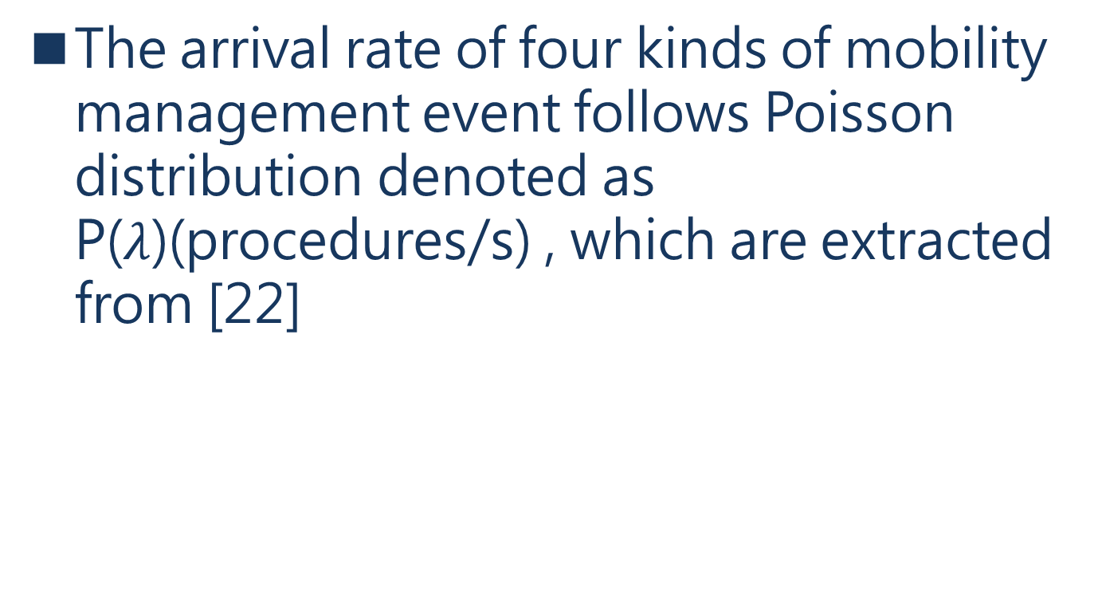
IV. PERFORMANCE EVALUATION
A. Simulation Parameters
The arrival rate of four kinds of mobility management event follows Poisson distribution denoted as P($λ$)(procedures/s) , which are extracted from [22]
[22] J. Prados-Garzon, P. Ameigeiras, J. J. Ramos-Munoz,
P. Andres-Maldonado, and J. M. Lopez-Soler, “Analytical modeling
for virtualized network functions,” in Proc. IEEE Int. Conf. Commun.
Workshops (ICC Workshops), Paris, France, May 2017, pp. 979–985.
Notes:
四個事件發生的機率為一個卜瓦松分布，此篇作者從22篇參考她的數據

Slide 121
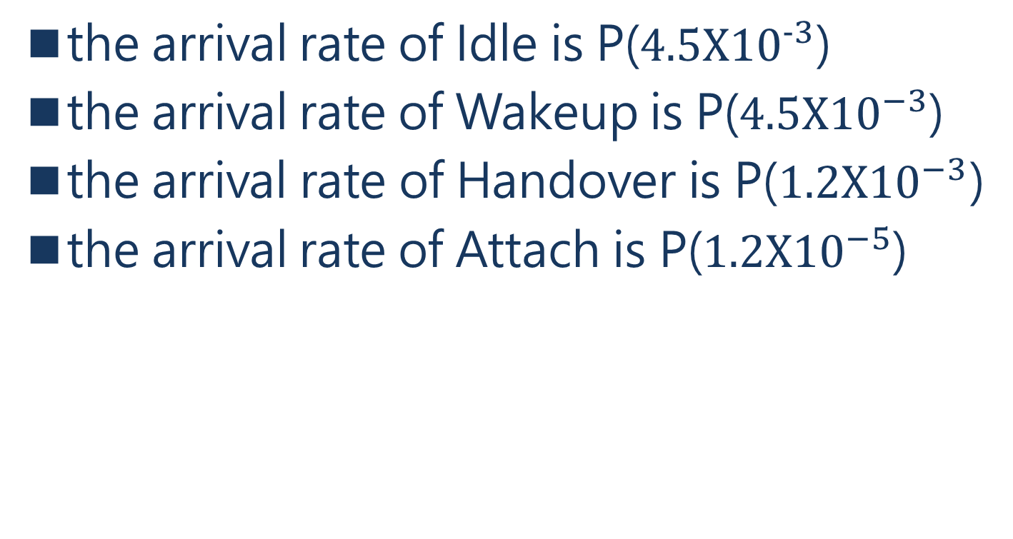
IV. PERFORMANCE EVALUATION
A. Simulation Parameters
the arrival rate of Idle is P($4.5X{10}^{−3}$)
the arrival rate of Wakeup is P($4.5X{10}^{−3}$)
the arrival rate of Handover is P($1.2X{10}^{−3}$)
the arrival rate of Attach is P($1.2X{10}^{−5}$)
Notes:
四個事件的卜瓦松分布

Slide 122
IV. PERFORMANCE EVALUATION
A. Simulation Parameters
The parameters are calculated assuming that the average intervals of the four events of Vehicular network are 30 min for Attach, 1 min for Idle, 1 min for Wakeup and 0.6 min for Handover
Notes:
這些參數的計算是假設車輛網絡的四個事件的平均間隔是30分鐘的Attach，1分鐘的Idle，1分鐘的Wakeup和0.6分鐘的Handover。

Slide 123
IV. PERFORMANCE EVALUATION
A. Simulation Parameters
the intervals of the four events of Shared bicycle are 10 min for Attach, 10 min for Idle, 10 min for Wakeup and 3.6 min for Handover;
the intervals of the four events of IoT (Smart home) are 5 min for Attach, 1 min for Idle, 1 min for Wakeup and no Handover events
Notes:
共享單車的四個事件的時間間隔分別是10分鐘的Attach、10分鐘的Idle、10分鐘的Wakeup和3.6分鐘的Handover。
物聯網（智能家居）的四個事件的時間間隔是：5分鐘的Attach，1分鐘的Idle，1分鐘的Wakeup，沒有Handover事件。

Slide 124
IV. PERFORMANCE EVALUATION
A. Simulation Parameters
and the intervals of the four events of IoT (Smart meter) are 14 days for Attach, 14 days for Idle, 14 days for Wakeup and no Handover events.
The diameter of the small cell is 600 m, the speed of the Shared bicycle is 10 km/h and the speed of the Vehicular network is 60 km/h.
Notes:
而物聯網（智能電錶）的四個事件的時間間隔為：14天的附加事件、14天的空閒事件、14天的喚醒事件和沒有移交事件。
小區的直徑為600米，共享單車的速度為10公里/小時，車聯網的速度為60公里/小時。

Slide 125
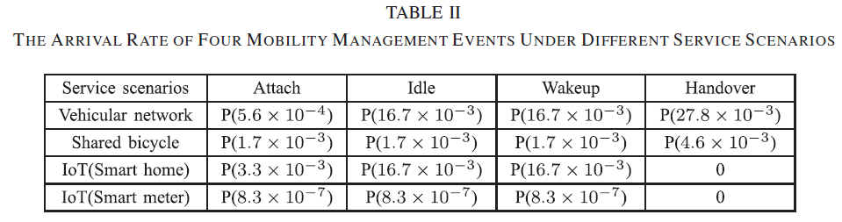
IV. PERFORMANCE EVALUATION
A. Simulation Parameters
Notes:
在這些應用場景中，移動性管理事件的到達率被計算出來並列在表二中

Slide 126
IV. PERFORMANCE EVALUATION
A. Simulation Parameters
According to [5], the state data migration of the UE is usually only a few KB.
[5] X. An, F. Pianese, I. Widjaja, and U. G. Acer, “DMME: Virtualizing
LTE mobility management,” in Proc. IEEE 36th Conf. Local Comput.
Netw., Bonn, Germany, Oct. 2011, pp. 528–536.
Notes:
根據[5]，UE的狀態數據搬移通常只有幾KB

Slide 127
IV. PERFORMANCE EVALUATION
A. Simulation Parameters
Considering the diversity of future services as well as the overhead cost due to virtualization of functional components [34], the state data migration of the UE would be more than a few KB,
[34] P. Yu, X. Ma, J. Cao, and J. Lu, “Application mobility in pervasive
computing: A survey,” Pervasive Mobile Comput., vol. 9, no. 1,
pp. 2–17, Jul. 2013.
Notes:
考慮到服務未來的多樣性以及功能部件虛擬化帶來overhead成本，UE的狀態數據搬移將超過幾KB，

Slide 128
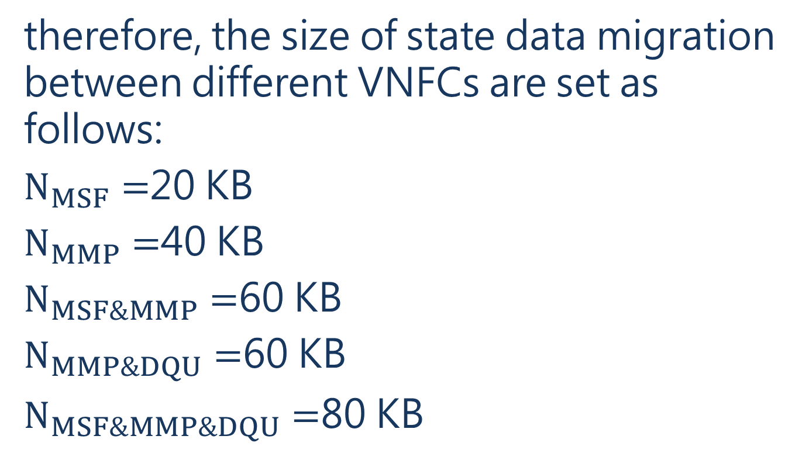
IV. PERFORMANCE EVALUATION
A. Simulation Parameters
therefore, the size of state data migration between different VNFCs are set as follows:
$N_{MSF}=$20 KB
$N_{MMP}=$40 KB
$N_{MSF\&MMP}=$60 KB
$N_{MMP\&DQU}=$60 KB
$N_{MSF\&MMP\&DQU}=$80 KB
Notes:
因此，不同VNFC之間的狀態數據搬移的大小設定如下。

Slide 129
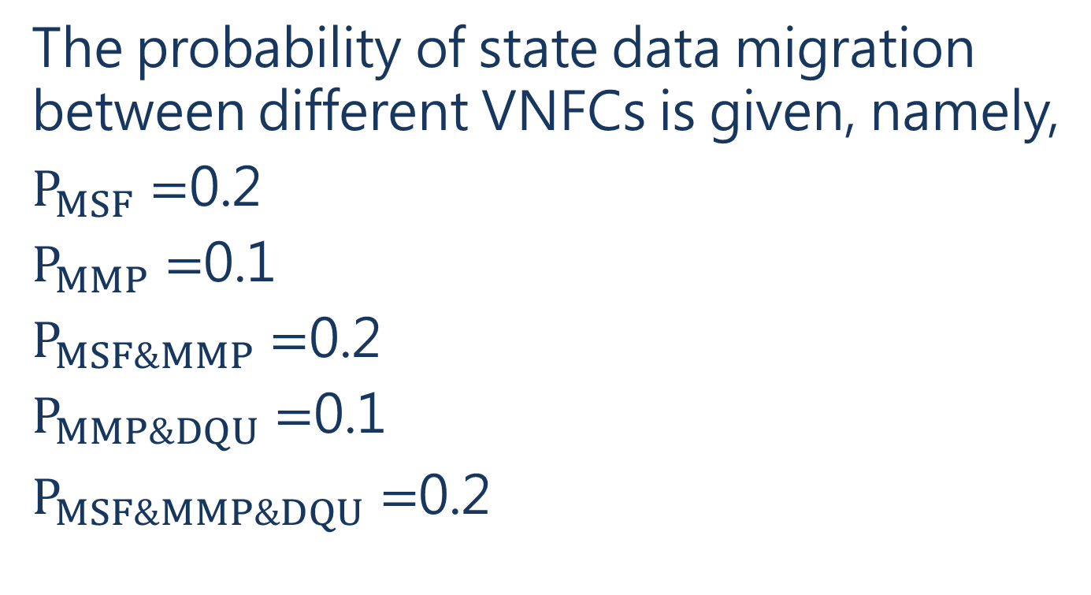
IV. PERFORMANCE EVALUATION
A. Simulation Parameters
The probability of state data migration between different VNFCs is given, namely,
$P_{MSF}=$0.2
$P_{MMP}=$0.1
$P_{MSF\&MMP}=$0.2
$P_{MMP\&DQU}=$0.1
$P_{MSF\&MMP\&DQU}=$0.2
Notes:
不同VNFC之間的狀態數據搬移的機率是給定的

Slide 130
IV. PERFORMANCE EVALUATION
B. Performance Evaluation
1)Network Generated Based on Complex Network and Placement of Instances:
The network topology of radio access network is generated based on complex network so as to evaluate the performances of vMME, in which the connection relation of BSs follows BA model.
Notes:
UE和無線接入網的聯網對MSF、MMP和DQU的位置和實例數量的影響在1）中提出。
以評估vMME的性能，其中BSs的連接關係依照剛剛前面提到的BA模型去建立的。

Slide 131
IV. PERFORMANCE EVALUATION
B. Performance Evaluation
In the simulation , the number of nodes in the network is 50, and the average degree value is 2.
With the generated radio access network, the number of VNFCs of vMME including MSF and MMP are initiated as 16 and 6, respectively.
Notes:
在模擬中，網絡中的節點數為50個，average degree為2。(根據22 32)
MSF啟動16個MMP啟動6個 VNFC數量=MSF數量+MMP數量

Slide 132
IV. PERFORMANCE EVALUATION
B. Performance Evaluation
With the initiated number of the instances of VMME components, the optimization process is executed, and the number of instances of MSF and MMP are 12 and 5 after optimization algorithm of Min-TSCOC.
Notes:
經過Min-TSCOC的優化算法，MSF和MMP的數量化簡為12和5。

Slide 133
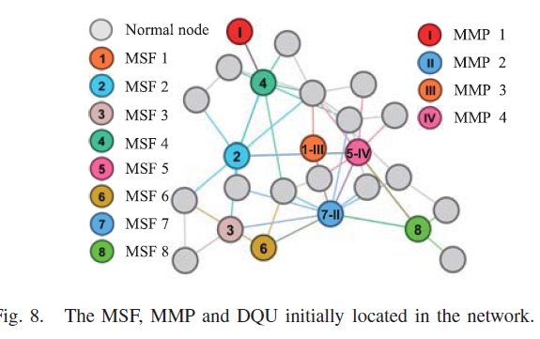
IV. PERFORMANCE EVALUATION
B. Performance Evaluation
Notes:
當節點數為25時，MSF和MMP的啟動放置的模擬結果

Slide 134
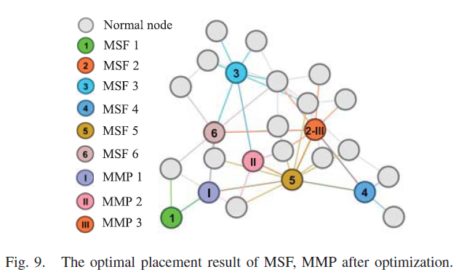
IV. PERFORMANCE EVALUATION
B. Performance Evaluation
Notes:
優化後的MSF、MMP和DQU的最佳放置結果。

Slide 135
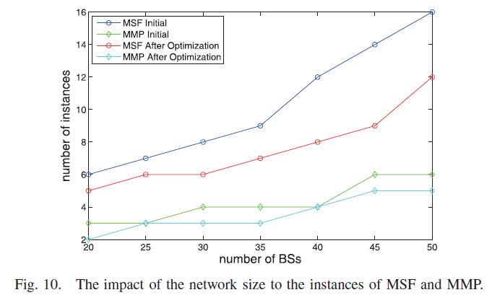
IV. PERFORMANCE EVALUATION
B. Performance Evaluation
Notes:
當平均度數為2時，網絡規模（節點數）對MSF和MMP實例的影響

Slide 136
IV. PERFORMANCE EVALUATION
B. Performance Evaluation
2) Impact of the Arrival Rate of Four Events to Total-Cost: Fig.11, Fig.12, Fig.13 and Fig.14 show the impact of the arrival rate of four mobility management events on the total signaling communication overhead cost when the arrival rate of one event changes while the arrival rate of other events takes the default value.
Notes:
顯示了四個移動性管理事件的到達率對總信令通信開銷成本的影響，當一個事件的到達率發生變化而其他事件的到達率保持定值時。

Slide 137
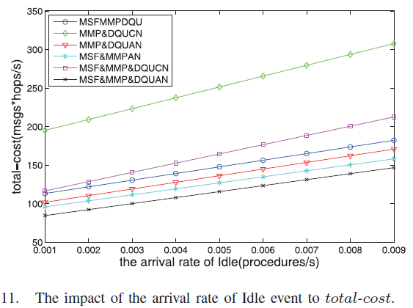
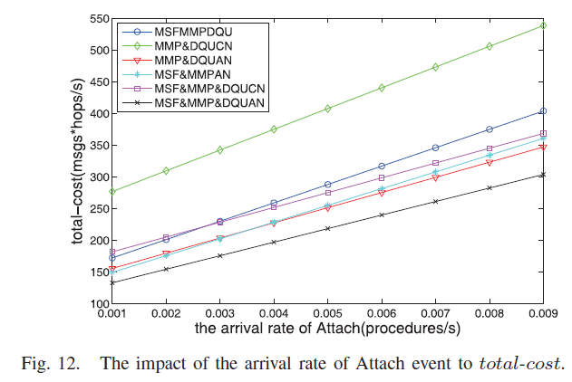
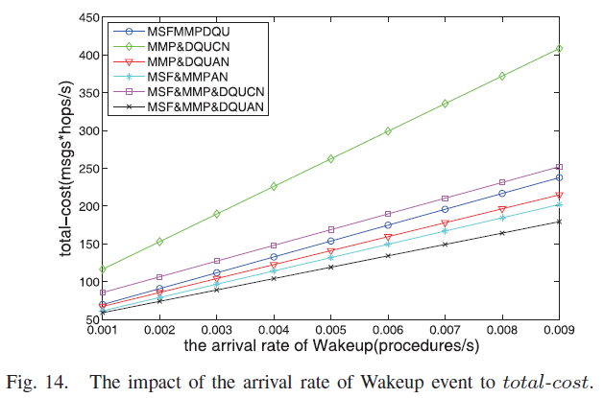
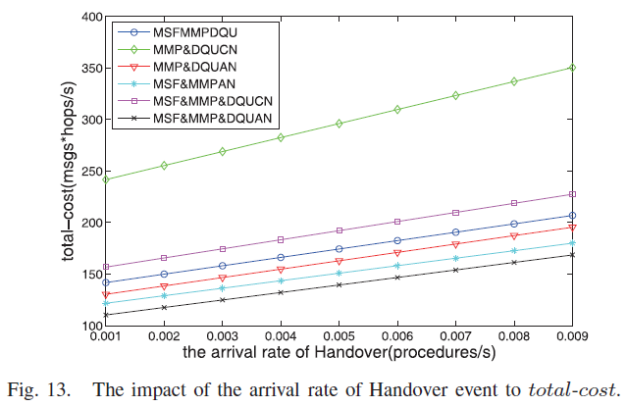
IV. PERFORMANCE EVALUATION
B. Performance Evaluation
Notes:
在每個圖中，總的信令通信開銷成本隨著事件到達率的增加而增加。

Slide 138
IV. PERFORMANCE EVALUATION
B. Performance Evaluation
The total signaling communication overhead cost is the sum of the signaling communication overhead cost of the radio access network and the signaling communication overhead cost of the core network.
Notes:
總的信令通信overhead成本是RAN的信令通信overhead成本和核心網的信令通信overhead成本之和。

Slide 139
IV. PERFORMANCE EVALUATION
B. Performance Evaluation
The total-cost of MMP&DQUCN is much larger than that of other cases since there is both more frequent signaling interaction between MSF and MMP and more hops between RAN and the core network.
Notes:
MMP&DQUCN的總成本比其他情況大得多，因為MSF和MMP之間的信令交互更頻繁，RAN和核心網之間的跳數更多。

Slide 140
IV. PERFORMANCE EVALUATION
B. Performance Evaluation
The total-cost of MSF&MMP&DQUAN is the minimal among all the cases since MSF, MMP and DQU are merged and placed in RAN and there is no signaling communication overhead cost among the three vMME function component entities.
Notes:
MSF&MMP&DQUAN的總成本是所有情況中最低的，因為MSF、MMP和DQU被合併並置於RAN中，並且在三個vMME功能組件實體之間沒有信令通信overhead成本。

Slide 141
IV. PERFORMANCE EVALUATION
B. Performance Evaluation
The difference of the total-cost of the remaining four cases is not obvious, but the total-cost of MSF&MMP&DQUCN (the existing mobility management solution) is larger, indicating that the 1:3 mapping method can reduce the total-cost.
Notes:
其餘四種情況的總成本差異不明顯，但MSF&MMP&DQUCN（現有移動性管理方案）的總成本較大，說明1:3的映射方法可以降低總成本。

Slide 142
IV. PERFORMANCE EVALUATION
B. Performance Evaluation
MSF&MMP&DQUAN seems to have the least total-cost, however, more state data migration between VNFC instances is needed, which is a tradeoff between the total-cost and the cost for state data migration among VNFCs.
Notes:
MSF&MMP&DQUAN似乎總成本最低，然而，需要在VNFC實例之間進行更多的狀態數據搬移，這是總成本和VNFC之間的狀態數據搬移成本之間的要考慮的問題。

Slide 143
IV. PERFORMANCE EVALUATION
B. Performance Evaluation
Impact of the Arrival Rate of Four Events to Backhaul-Cost:
The impact of the arrival rate of four mobility management events to the total signaling communication overhead cost on backhauls are given in Fig.15, Fig.16, Fig.17 and Fig.18.
Notes:
四個事件的到達率對回傳成本的影響。

Slide 144
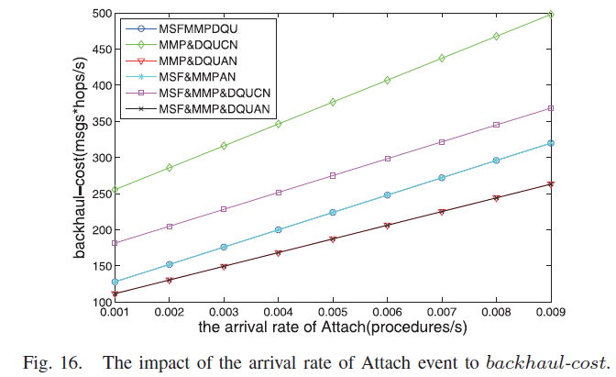
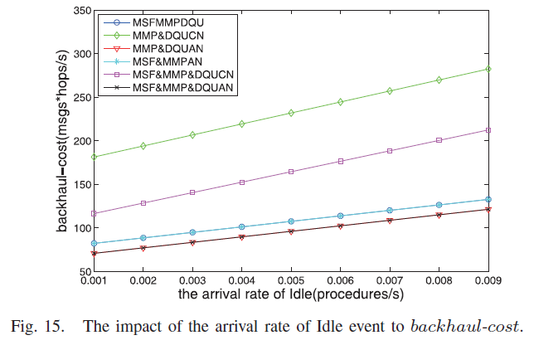
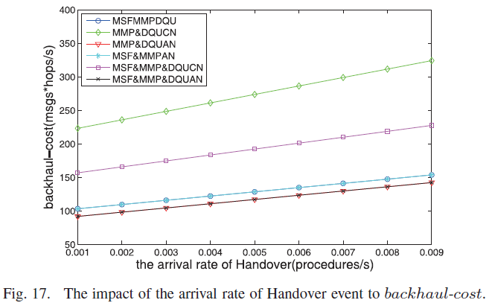
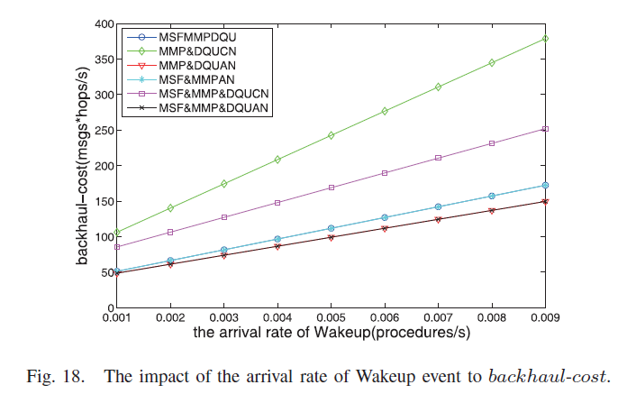
IV. PERFORMANCE EVALUATION
B. Performance Evaluation
Notes:
每個圖中，回程的總信令通信overhead成本隨著事件到達率的增加而增加。
由於MSF、MMP和DQU部署在RAN中，MSF和MMP之間的信令交互只在RAN中產生信令通信overhead成本，而對回傳的流量負載幾乎沒有影響。
所以MSFMMPDQU的曲線(深藍色)和MSF&MMPAN的曲線(淺藍色)在四個圖中是重合的。
MMP&DQUAN的曲線(紅色)和MSF&MMP&DQUAN的曲線(黑色)也是重合的，因為MSF和MMP之間的信號互動對回傳運輸沒有影響。
MMP&DQUCN(綠色)的回傳成本比其他情況大得多，因為MSF和MMP之間的信令交互更頻繁，而且RAN和核心網之間的hop更多。
MSF&MMP&DQUAN(黑色)的回傳費用和MMP&DQUAN的回傳程費用都比較小，因為DQU和核心網之間的信令交互較少。

Slide 145
IV. PERFORMANCE EVALUATION
B. Performance Evaluation
Compared with existing mobility management schemes(namely MSF&MMP&DQUCN), the pattern of MSFMMPDQU, MSF&MMPAN, MMP&DQUAN and MSF&MMP&DQUAN can significantly reduce the backhaul-cost.
Notes:
跟MSF&MMP&DQUCN相比，其他幾種的模式可以大大降低 回傳成本。

Slide 146
IV. PERFORMANCE EVALUATION
B. Performance Evaluation
The backhaul-cost of MSF&MMP&DQUAN reduces to almost half of the backhaul-cost compared with MSF&MMP&DQUCN with the increase of four mobility events.
Notes:
與MSF&MMP&DQUCN相比，MSF&MMP&DQUAN的回傳成本隨著四個移動事件的增加而減少到幾乎是回傳成本的一半。

Slide 147
IV. PERFORMANCE EVALUATION
B. Performance Evaluation
Impact of vMME Function Composition to Total-Cost and Backhaul-Cost:
The impact of vMME function composition to total-cost per UE in different application scenarios is evaluated in Fig.19.
Notes:
vMME功能組成對總成本和回傳成本的影響。
圖19評估了不同應用場景下vMME功能組成對每個UE總成本的影響。

Slide 148
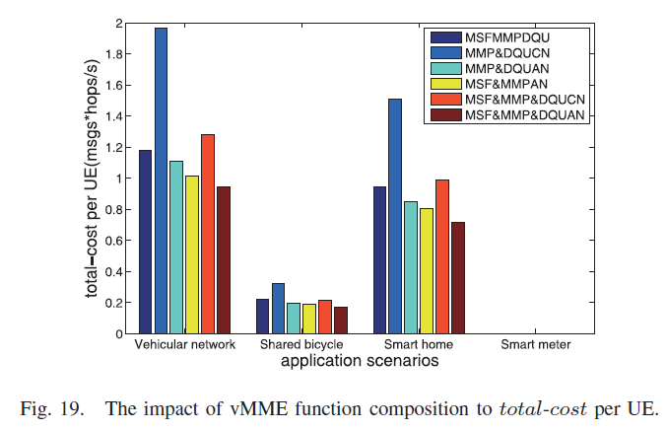
IV. PERFORMANCE EVALUATION
B. Performance Evaluation
Notes:
車輛應用場景的總成本最大，而物聯網（智能電錶）的總成本最小，因為車輛應用場景的四個移動性管理事件的比其他幾個多了很多移動性的事件
其中MMP&DQUCN的總成本是最大的，MSF&MMP&DQUAN的總成本是最小的。
從總信令通信overhead成本的角度來看，MSF&MMP&DQUAN在不同的應用場景中比其他情況比較好的表現。

Slide 149
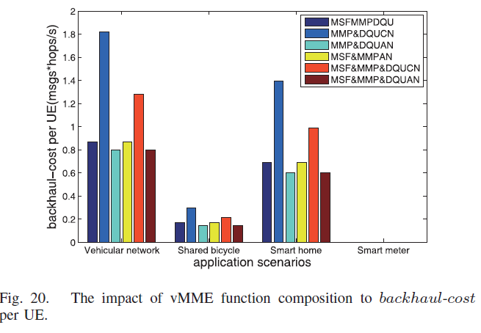
IV. PERFORMANCE EVALUATION
B. Performance Evaluation
Notes:
圖20給出了四種應用場景下vMME功能組成對回傳成本影響的模擬結果。
由於車輛應用場景前面到達率遠遠大於物聯網（智能電錶），因此車輛應用場景的回傳成本也是最大的。
物聯網（智能電錶smart meter）的回程成本是最小的
MMP&DQUCN的回傳成本是最大的，MSF&MMP&DQUAN的回傳成本是最小的。
從回傳的總信令通信overhead的角度來看，MSF&MMP&DQUAN在不同的應用場景下都比其他情況要好

Slide 150
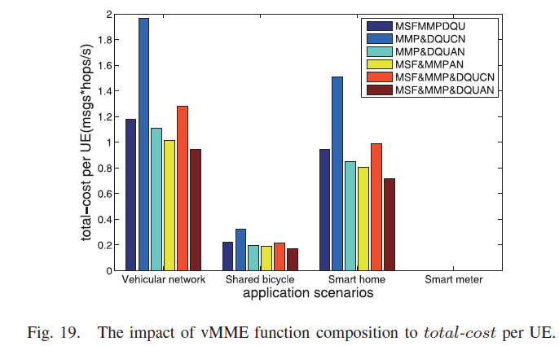
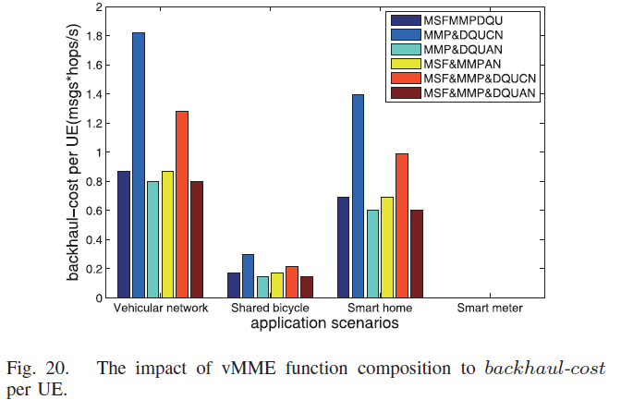
IV. PERFORMANCE EVALUATION
B. Performance Evaluation
Notes:
智能家居的總成本和回傳成本比那些限制性移動應用場景（如共享單車）要高，由於其頻繁的移動管理事件，vMME程序優化會考慮到這一點。

Slide 151
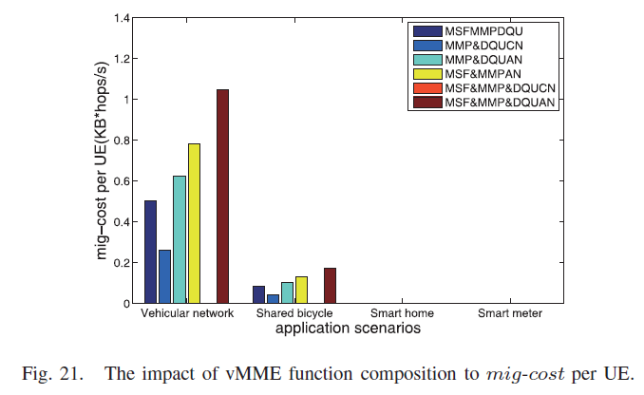
IV. PERFORMANCE EVALUATION
B. Performance Evaluation
Impact of vMME Function Composition to Mig-Cost:
Notes:
vMME功能組成對Mig-Cost的影響
22說明了vMME功能組成對Mig-cost的影響
在智能家居和智能電錶的場景中，大多數移動設備幾乎沒有移動性的交接事件，因此它們不會產生狀態數據的搬移overhead。
模擬結果來看，MSF&MMP&DQUAN的搬移成本最大，因為在MSF&MMP&DQUAN的情況下，UE的切換機率很大，需要搬移的狀態數據量也很大。
MSF&MMP&DQUCN的搬移成本是最小的，因為MSF&MMP&DQU被放在核心網中，UE不需要在MSF&MMP&DQU中切換
MMP&DQUCN的組成是一個可行的方案，因為與MMP&DQUAN和MSF&MMPAN的組成相比，其搬移成本較低。

Slide 152
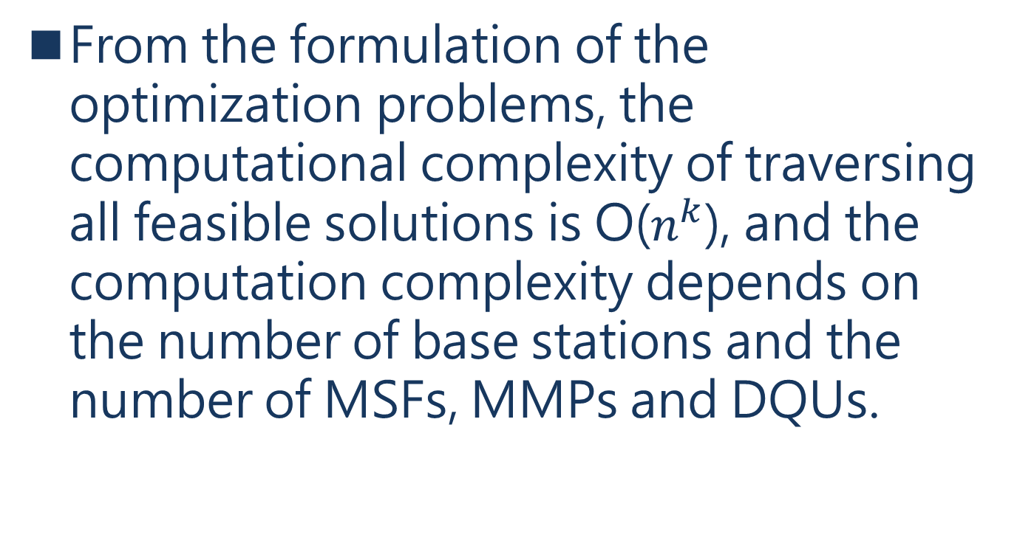
IV. PERFORMANCE EVALUATION
C. Complexity of the Optimization Approach
From the formulation of the optimization problems, the computational complexity of traversing all feasible solutions is O($n^{k}$), and the computation complexity depends on the number of base stations and the number of MSFs, MMPs and DQUs.
Notes:
從problem formulation來看，試過所有可行方案的計算複雜度為O(nk)計算複雜度取決於BS的數量以及MSF、MMP和DQU的數量。

Slide 153
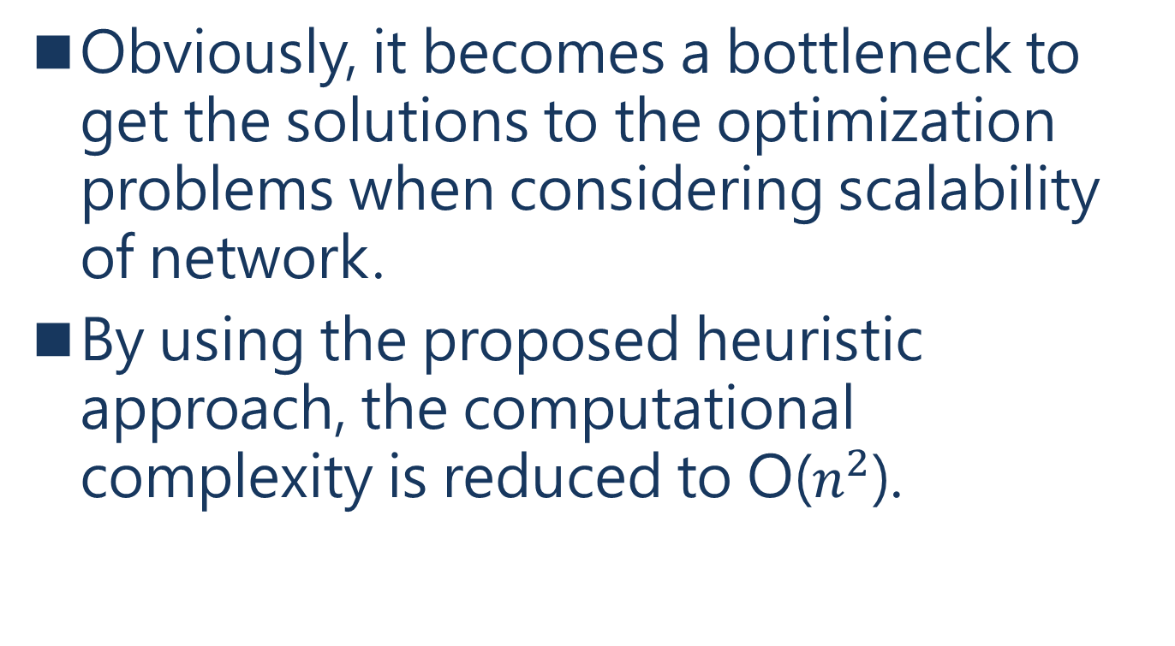
IV. PERFORMANCE EVALUATION
C. Complexity of the Optimization Approach
Obviously, it becomes a bottleneck to get the solutions to the optimization problems when considering scalability of network.
By using the proposed heuristic approach, the computational complexity is reduced to O($n^{2}$).
Notes:
顯然，當考慮到網絡的可擴展性時，它成為優化問題的瓶頸。
使用前面建議的啟發式方法，計算複雜度可以降低到O(n2)。

Slide 154
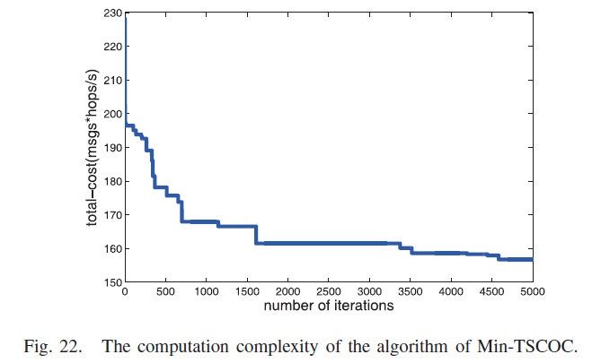
IV. PERFORMANCE EVALUATION
C. Complexity of the Optimization Approach
Notes:
以Min-TSCOC算法為例，顯示了迭代次數對總信令通信overhead成本的影響，其中四個事件的到達率為定值(基站數量設置為50，UE和MSF之間的約束跳數設置為2)。
當迭代次數達到5000次時，它表明啟發式算法已經收斂。

Slide 155
V. CONCLUSION
In this paper, the optimization of MME is investigated by using network function virtualization and service function chain for 1:3 function mapping of vMME.
A general signaling processing flow of vMME based on service function chain is analyzed.
Notes:
本文通過使用網絡功能虛擬化和服務功能鏈來研究MME的優化，實現vMME的1：3功能映射。
分析了一個基於服務功能鏈的vMME的一般信令處理流程。

Slide 156
V. CONCLUSION
The performance of vMME is formulated as optimization problems to minimize the total signaling communication overhead cost, the total signaling communication overhead cost on backhauls and the migration overhead cost of state data for different function component placement of vMME.
Notes:
vMME的性能被formulated為優化問題，以最小化相關overhead 成本

Slide 157
V. CONCLUSION
To solve the NP-hard problem, a heuristic approach is proposed including algorithms of Min-TSCOC, Min-TSCOCB and Min-MOCSD.
The approach is evaluated by simulation under various composition of vMME and service scenarios.
Notes:
為了解決NP-hard問題，我們提出了一種啟發式方法，包括Min-TSCOC、Min-TSCOCB和Min-MOCSD的算法。
該方法通過在不同的vMME組成和服務場景下進行模擬評估。

Slide 158
V. CONCLUSION
The simulation results reveals that MSF&MMP&DQUAN is an alternative solution for reducing total-cost and backhaul-cost.
From the aspect of migration cost, the composition of MMP&DQUCN is an alternative solution because of its low migration cost compared with the composition of MMP&DQUAN and MSF&MMPAN.
Notes:
模擬結果顯示MSF&MMP&DQUAN是一種降低總成本和回傳成本的替代方案。
從搬移成本方面來看，MMP&DQUCN的組成是一個可供選擇的解決方案，因為與MMP&DQUAN和MSF&MMPAN的組成相比，其搬移成本較低。

Slide 159
V. CONCLUSION
The proposed optimization approach is concentrated on the vEPC based architecture, while the NG architecture separates the current EPC functions into more fine-granular modular network functions which can be composed to build a control plane service tailored to a network slice [11], [12]
[11] I. Afolabi, T. Taleb, K. Samdanis, A. Ksentini, and H. Flinck, “Networkslicing and softwarization: A survey on principles, enabling technologies,and solutions,” IEEE Commun. Surveys Tuts., vol. 20, no. 3,
pp. 2429–2453, 3rd Quart., 2018, doi: 10.1109/COMST.2018.2815638.
[12] K. Mahmood, T. Mahmoodi, R. Trivisonno, A. Gavras, D. Trossen, and M. Liebsch, “On the integration of verticals through 5G control plane,” in Proc. IEEE Eur. Conf. Netw. Commun. (EuCNC), Oulu, Finland,
Jun. 2017, pp. 1–5.
Notes:
建議的優化方法集中放在vEPC的架構上，而NG架構將目前的EPC功能分離成更細的模塊化網絡功能，這些功能可以被組成，以建立一個為網絡切片的control plane

Slide 160
REFERENCES
REFERENCES

Slide 161
Enhanced Mobile Broadband
Enhanced Mobile Broadband (eMBB) provides higher rate and access capabilities to support quality of experience of mobile users.
Notes:
提供用戶高速的行動網路

Slide 162
massive Machine Type of Communication
The scenario for massive Machine Type of Communication (mMTC) demands for optimized signaling control with high connection density, efficient access and management of large-scale, low-cost and low-power IoT devices.
Notes:
mMTC的方案要求優化信令控制，進此提供低功率以及數量眾多的IOT能多設備傳輸連線，

Slide 163
Ultra Reliable and Low Latency Communication
The scenario for Ultra Reliable and Low Latency Communication (URLLC) leverages low latency and reliable information interaction capabilities to support realtime, sophisticated and secure collaboration among connected entities.
Notes:
Ultra Reliable and Low Latency Communication提供低延遲和可靠的信息交互能力

Slide 164
Evolved Packet Core network
Notes:
Policy and charging rules function(PCR)策略和計費規則功能是實時確定在多媒體網絡策略規則指定的軟件節點。

Slide 165
Front-End (FE)
The FE is the communication interface with other network entities and it is also responsible for balancing the load between Ws.
Notes:
FE負責提供與其他實體網路通訊接口並且處理worker間的平衡

Slide 166
Worker (W)
W is only responsible for implementing vMME’s functional logic and it does not store UE’s session state information.
Notes:
Worker負責vMME的functional logic並不會儲存任何資料

Slide 167
state DataBase (DB).
The DB stores session state information of users.
Notes:
DB存儲用戶的session狀態信息

Slide 168
data management
Location management maintains the reachability of mobile users independent of the UE location or connected network.
It has associated an identification database, containing bindings with UEs’ identification and its current address.
Notes:
可以讓用戶有獨立性不受UE所在的位置和連接上的網路影響
它有一個相關的識別數據庫，包含與UE的識別和其當前地址的綁定。

Slide 169
Data management
Data management is responsible for encapsulation of data packets through address translation, it does not provide any signaling and it only receives signaling from handover management.
Notes:
數據管理負責通過地址轉換對數據包進行封裝，只接收來自handover management的指令。

Slide 170
handover management
Handover management maintains sessions active when a UE roams between networks, so it provides handover detection and negotiation, being responsible for the signaling that communicates with data management and location management after a handover.
Notes:
當UE進行漫遊時，負責handover後的data management and location management 之間的通訊訊號

Slide 171
handover management
Another function of handover management is to maintain the mobility context and routes [27].
[27] T. Condeixa and S. Sargento, “Studying the integration of distributed and dynamic schemes in the mobility management,” Comput. Netw., vol. 60, no. 2, pp. 46–59, Feb. 2014.
Notes:
數據管理負責通過地址轉換對數據包進行封裝，只接收來自移交管理的信令。

Slide 172
Location management
Location management maintains the reachability of mobile users independent of the UE location or connected network.
Notes:
位置管理可以保持移動用戶的可及性，不受UE位置或連接網絡的影響。

Slide 173
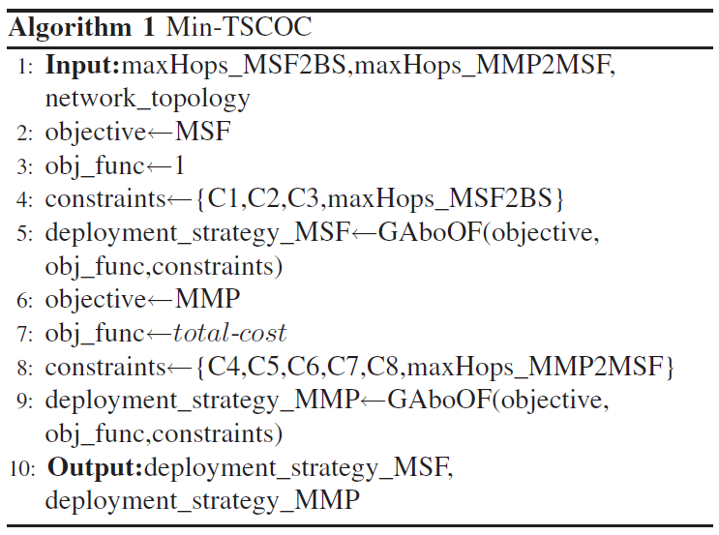
Min-TSCOC
Notes:
得到最小總成本的MSF與MMP的部屬方式

Slide 174

Min-TSCOCB
Notes:
得到最小回傳成本的MSF與MMP的部屬方式

Slide 175

Min-MOCSD
Notes:
得到最小資料搬移成本的MSF與MMP的部屬方式

