Slide 1
Cost Efﬁcient Scheduling for Delay-sensitive Tasks in Edge Computing System
Yongchao Zhang∗, Xin Chen∗, Ying Chen∗, Zhuo Li∗, Jiwei Huang† ∗ School of Computer Science, Beijing Information Science & Technology University Beijing, China Email: zhangyongchao@mail.bistu.edu.cn, {chenxin, chenying, lizhuo}@bistu.edu.cn † Beijing University of Posts and Telecommunications Beijing, China Email: huangjw@bupt.edu.cn
Notes:
前四個北京信息科技大學
一個中國石油大學
在邊緣計算系統 針對延遲敏感的任務做成本效益的排程

Slide 2
Outline
Purpose: minimize the system cost while satisfying the delay requirements of all the tasks.
NP Hard Problem: Three-dimensional vector packing
Heuristic algorithm: TTSCO

Slide 3
Abstract
Edge computing
Several servers are placed on the network edge near the IoT devices to process the ofﬂoaded tasks.
Edge computing issue: Reduce the system cost while completing the ofﬂoaded tasks.
task scheduling problem : model as an optimization problem.
We propose a task scheduling algorithm, called Two-stage Task Scheduling Cost Optimization (TTSCO) and conduct the analysis for the TTSCO algorithm.
Notes:
邊緣計算 可以 降載 對延遲敏感的計算任務 從有限的計算資源及能量的物聯網裝置 到邊緣雲
多個伺服器 都被放置在靠近物聯網的裝置 來處理降載的任務
一個在邊緣計算系統的關鍵事情是如何同時完成降載的任務及減少系統所花的成本
在此篇paper，他們研究任務排程問題來減少邊緣計算系統的成本
我們將任務排程問題模擬為一個最佳化問題
目標是最小化系統成本同時滿足所有任務的延遲需求
接下來，我們會證明提出的最佳化問題是一個NP-HARD的問題
為了有效率的解決這個最佳化問題， 我們提出了一個任務排成的演算法， 叫做兩階段任務排程最佳化成本 TTSCO

Slide 4
Abstract
Performance evaluation shows that our algorithm can effectively reduce the cost of edge computing system while satisfying the delay requirements of all the tasks.
Performance evaluation shows that our algorithm can effectively reduce the cost of edge computing system while satisfying the delay requirements of all the tasks.
Notes:
我們證實我們演算法跟其他最佳解比起來較有效率
這顯示我們的演算法可以有效率的減少邊緣計算系統的成本 同時滿足所有任務的延遲需求

Slide 5
INTRODUCTION
With the development of IoT technology, the number of delay-sensitive applications (e.g., health monitoring [1], location-based augmented reality games) are increasing rapidly [2].
As the computing resources and energy of IoT devices are limited, many processing-heavy tasks should be ofﬂoaded to remote servers to be processed.
Cloud computing with powerful computing capacity is considered as a potential way for processing the ofﬂoaded tasks.
Notes:
伴隨著IOT技術的發展 對於延遲很敏感的應用程式數量 例如健康監測、以地點為基礎的擴增實境遊戲 都急速的增加
在IOT 設備的雲端資源及能量都有限的情況下， 很多附載比較重的處理任務 應該降載到遠端伺服器處理
有著足夠計算容量的雲計算被視為 一個處理降載任務的 潛在方式

Slide 6
INTRODUCTION
However, due to the long distance between the conventional cloud and IoT devices, sending a large number of tasks to conventional cloud for processing will cause long response time and serious network congestion: edge computing
Edge computing provides an additional layer of computing infrastructure which consists of some servers at the network edge (i.e., base stations).
Notes:
然而因為傳統雲跟IOT設備的遠距離 傳送大量的任務到傳統雲做處理 會導致回應時間太長以及嚴重的網路壅塞
為了處理這個問題 邊緣計算最近被提出作為一個有前途的計算模型
邊緣計算提供一個額外的計算基礎設施 這層包含了一些在網路端的伺服器(例如基地台)

Slide 7
INTRODUCTION
For the computing tasks ofﬂoaded from IoT devices, edge computing provides the computing services and returns the results to the devices.
The transmission delay of ofﬂoaded task and the trafﬁc load of core network will reduce.
In the edge computing, task scheduling problem has become a hot topic for studying [9]-[18].
Notes:
對於降載IOT的計算任務 邊緣計算提供計算服務 然後回傳結果到設備
用這種方式， 降載任務及核心網路的交通負載 的傳輸延遲會大量的減少
因為這些好處 邊緣計算被更多的研究者注意到
在邊緣計算 任務排程問題變成一個熱門的研究

Slide 8
INTRODUCTION
To reduce the energy consumption caused by the computing of tasks, IoT devices would ofﬂoad computing tasks to the edge servers.
However, the task ofﬂoading consumes extra energy to transfer tasks to the edge servers, and the completion time of ofﬂoaded task would also increase.
In this case, some works studied how the devices make the task ofﬂoading decision [9]-[12].
Notes:
為了減少計算任務時的電力消耗 IOT裝置會降載計算任務到邊緣伺服器
然而 降載任務會消耗額外的電力來傳輸任務到邊緣伺服器 降載任務的完成時間也會增加
在這個案例， 有些研究設備如何決定任務降載

Slide 9
INTRODUCTION
When the computing task is scheduled to different edge servers, the cost of transmission and computation are also different.
Therefore, some works aimed to reduce the system cost generated by the transmission or computation of tasks [13]-[18].
However, these works rarely considered the cost generated by the edge servers.
Notes:
當計算任務被分配到不同邊緣伺服器 傳輸以及計算的成本也會不同
因此，ref13-18致力於減少因為傳輸或計算任務的系統成本
然而，他們很少考慮邊緣伺服器產生的成本

Slide 10
INTRODUCTION
The problem of reducing the system cost caused by the servers during the off-peak times (e.g., at night) is largely unexplored [5].
We develop a task scheduling model for the delay-sensitive input tasks.
Finally, simulation results are provided to verify the accuracy and performance improvement of our algorithm.
Notes:
ref5提到問題是 減少因為伺服器在離峰時的系統成本 是大量的未探索
我們針對延遲敏感的任務 開發一個任務排程的模型
最後，模擬的結果會提供來驗證我們演算法的所提升的準確度及表現

Slide 11
RELATED WORK
Previous work about the edge computing included fog computing [6], cloudlet [7], [8], femtoclouds [9], and mobile edge computing [10].
Bonomi et al. [6] introduced the concept and characteristics of fog computing which enabled a style of applications and services.
Notes:
最近邊緣計算受到很多重視 霧計算:(在網絡邊緣擴展雲計算功能的過程。霧結合了靠近物聯網層的計算、存儲和網絡資源，以促進數據處理)
之前的研究有包含 霧計算、輕量級的雲伺服器，被稱為（cloudlet）「小雲片」，它在邊緣網絡中， 一個或是一群資源豐富的電腦 可以提供附近的一棟設備使用
Femtocloud 從移動設備集群中提供動態、自配置和多設備移動雲。 美國卡內基大學提出Femtoclouds系統。Femtoclouds是一個動態的、自配置的「多設備移動雲系統」，通過協調多個行動裝置來擴展 cloudlet 的計算資源。Femtoclouds利用客戶附近空閒的行動裝置，為本地移動終端提供計算服務，因此減少了傳統的將計算遷移到雲數據中心過程中產生的網絡時延。 移動邊緣計算提出在蜂窩網絡的基站中協同定位計算和存儲資源。
Reference 6 介紹霧計算的概念跟特點

Slide 12
RELATED WORK
Verbelen et al. [8] presented a cloudlet architecture with three layers, and executed the AR use case based on their architecture.
A femtocloud system consisting of several co-located mobile devices was proposed to provide cloud services at the edge [9].
Michael et al. [10] presented an architectural topology of mobile edge computing and classiﬁed serval applications deployed at the mobile edge.
Notes:
Reference 8 提出一個三層的cloudlet架構，並且基於他們的架構上執行AR的use case
Reference 9一個femtocloud系統包含多共置的行動裝置， 被提出來在邊緣提供雲服務
Reference 10 提出一個行動邊緣計算的架構拓樸 以及把部屬再行動邊緣的數個應用程式分類

Slide 13
RELATED WORK
There were extensive research studies about the task scheduling problem in edge computing system.
Kim et al. [11] studied the cost-delay tradeoff for dual-side in mobile computing system, and proposed control algorithm to minimize the cost in the competition and cooperation scenario.
Mao et al. [12] proposed a dynamic computation ofﬂoading policy to minimize the execution cost of a green Mobile Edge Computing (MEC) system with energy harvesting devices.
Notes:
對邊緣計算的任務排程問題有很多研究
在refernce11 研究了 雙邊行動計算系統的成本跟延遲的權衡 提出了控制演算法來在競爭及合作的場景裡 最小化成本
在refernce12 提出一個動態計算卸載的策略 來最小化具有能量收集的綠色移動邊緣計算系統 的執行成本

Slide 14
RELATED WORK
Lyu et al. [13] proposed an asymptotically optimal ofﬂoading approach to maximize the network utility and guarantee the quality of service of wireless applications.
An online joint radio and computational resource management algorithm were proposed to minimize the long-term average power consumption for the multi-user MEC system [14].
Notes:
在13裡 提出一種漸進最優的卸載方法 來最大化網路效用 以及保證無線應用程式 的服務質量
在14 裡提出了 在線聯合無線電 及資源管理演算法 來最小化多用戶移動邊緣計算系統 的長期平均功力消耗

Slide 15
RELATED WORK
These works considered the distribution of workload between the user and edge cloud, but the task scheduling within the edge cloud was not studied.
Jia et al. [15] studied multiple cloudlets placement problem in a large scale Wireless Metropolitan Area Network (WMAN),which was to minimize the average access delay between mobile and cloudlets.
Notes:
這些工作考慮了 用戶及邊緣雲的工作負載分配 但邊緣雲的任務排程並沒有被研究
在15 研究了大規模無線區域網路的 多個小雲放置問題 ，這個問題想要最小化在行動及小雲片之間的平均存取延遲

Slide 16
RELATED WORK
Zeng et al. [16] proposed an task scheduling and resource management strategy to minimize the task completion time in fog computing system.
Gu et al. [17] proposed a two-phase linear programming-based algorithm to tackle the cost efﬁciency problem in fog computing medical cyber-physical systems (FC-MCPS).
In order to handle the peak workloads from mobile users and efﬁciently utilize cloud resources, Tong et al. [18] proposed a tree hierarchy of geo-distributed servers in the edge cloud.
Notes:
在16 提出一個 任務排程及 資源管理的策略來 最小化在霧計算系統的任務完成時間
在17 提出一個兩階段基於線姓規劃的演算法 來處理霧計算 的醫療監控(醫療信息物理融合系統) 的 成本效率問題
為了處理 來自移動用戶 的尖峰工作附載 以及有效的利用雲資源 第18篇 提出一個 在邊緣雲的地理分布伺服器的樹狀階層

Slide 17
RELATED WORK
And they also proposed an efﬁcient heuristic algorithm to schedule the workloads.
Urgaonkar et al. [19] modeled the optimize operational costs as a Markov Decision Problem (MDP), and presented an approach to minimize the operational costs in this model.
To satisfy the quality of service requirements of the tasks, Song et al. [20] presented an periodical task distribution to maximize the number of tasks which can be processed in the edge cloud.
Notes:
他們還提出一種有效的啟發是演算法來 安排工作附載
第19 將最優化營運成本 模擬為 馬可夫決策問題 並且提出一個方法來 在這個模擬最小化營運成本
為了滿足任務的服務質量需求，第20 提出一個週期性的任務分布 來最大化可以在邊緣雲被處裡的任務數量

Slide 18
RELATED WORK
In this works, the task scheduling and resource management problem within the edge cloud were well studied.
However, they did not consider the task scheduling problem for reducing system cost generated by the edge servers.
Notes:
在這些研究，邊緣雲內的任務排程及資源管理問題都被完善的研究
然而他們並沒有考慮到 減少 邊緣伺服器所產生的系統成本 的任務排程問題

Slide 19
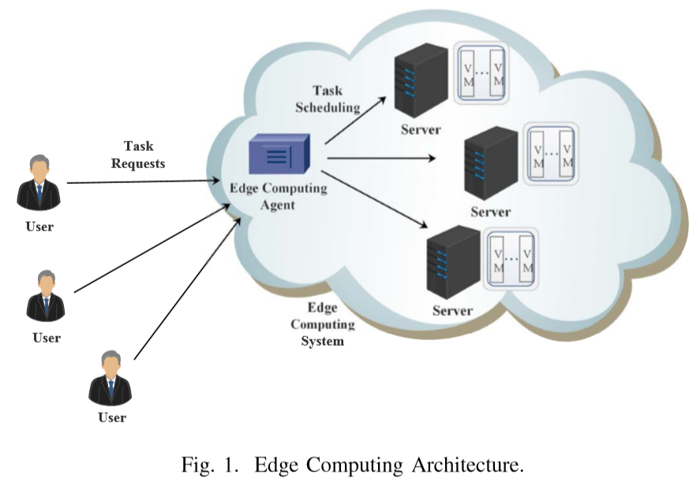
SYSTEM MODEL
Notes:
在這節，我們首先介紹邊緣計算的系統 接著基於系統的模型 我們制定成本最優化的問題
結構
一個邊緣計算系統是由 一個邊緣計算代理及數個 異質邊緣伺服器所組成 如圖一所示
ECA 擁有所有可用資源的全覽 並且與各個被部屬的伺服器溝通
各個伺服器運行多個虛擬機 他們處理users的卸載任務
藉由卸載計算任務到邊緣計算系統 更好的體驗品質例如 強大的運算能力 低延遲等)可以被達成
對於各個 從user降載的計算任務 ECA會根據他的資源需求 來選擇一個可用的伺服器來處理
在本篇paper我們考慮 ECA 會週期性的執行 任務排程策略 然後在目前的任務都完成後 排程策略會執行

Slide 20
SYSTEM MODEL
Let I be the interval time between two consecutive task scheduling process. As the completion time of each group will be different from each other, we dynamically adjust the value of I, which is given as follows,
I = t_{md} (1)
Here, t_{md} is the maximum of expect completion time of all the tasks.
Notes:
I 是兩個連續任務排程過程 的間隔時間
每組任務的完成時間不同 我們動態的調整 I 的值
T md 是所有任務 期許的完成時間的最大值

Slide 21
SYSTEM MODEL
B. Problem Formulation
To formulate the task scheduling problem in the edge computing system, we ﬁrst model the input tasks ofﬂoaded from the users and the available edge servers.
Then, we derive the resource constraints of task scheduling problem, and propose a uniﬁed optimization framework.
Notes:
為了制訂 在邊緣計算系統的任務排程問題
我們先對user卸載的input任務 以及可用的邊緣伺服器 建模型
接著 我們得到任務排程問題的資源約束 然後提出一個統一的優化框架

Slide 22
SYSTEM MODEL
Task Model and Server Model:
In the edge computing system, we consider a group of delay-sensitive tasks T = {t₁,t₂,···,t_{n}} to be processed at the time of executing the tasks scheduling strategy, where n is the total number of input tasks.
Each task t_{i} ∈ T is indicated by t_{i} = {d_{i},w_{i},δ_{i},s_{i}}.
Notes:
任務模型 跟伺服器模型
在邊緣計算系統 我們考慮在執行任務排成策略 時要處理的 一組對延遲很敏感的任務
N是input任務的總數量
各個t I 表示為 di wi sigma I si
Di表示 ti 的傳輸資料大小 包含了要被伺服器計算的input data以及 要給user的output data
w I 表示ti 的計算工作附載
Sigma I 表示ti 的deadline需求
Si 表示ti的儲存要求

Slide 23
SYSTEM MODEL
We consider there are m heterogeneous edge servers E = {e₁,e₂,···,e_{m}} in the edge computing system.
Each server e_{j} ∈ E is denoted by ej = {B_{j},V_{j},R_{j},S_{j}}.
And the bandwidth occupied by each VM can be dynamically adjusted when the task scheduling happens.
Besides, we denote b_{ij} as the bandwidth requirement when t_{i} is scheduled to e_{j} for processing, and C_{j} as the cost of server e_{j} when it is in the ON state.
For the brevity, the major notations and deﬁnitions used in this paper are listed in Table I.
Notes:
我們考慮有m 個異質的邊緣伺服器
每個伺服器 表示成 B j V j R j S j
Bj 表示在執行任務排程策略時 伺服器 ej跟ECA之間可用的溝通頻寬
一組虛擬機被部屬在各個伺服器 而且每個虛擬機只能同時 處理一個計算任務
Vj 是被部署在伺服器ej 的虛擬機數量 Rj 表示在伺服器ej 每個虛擬機的計算速率 Sj 表示 伺服器ej的可用儲存資源
每個任務排程發生時 每個虛擬機占用的頻寬是可以被動態調整的 我們用 Bij 表示當ti 被排給 ej 處理時 所需的頻寬需求 Cj 表示伺服器ej 在ON狀態時的成本
這篇paper主要的符號跟定義如 table 1所示

Slide 24
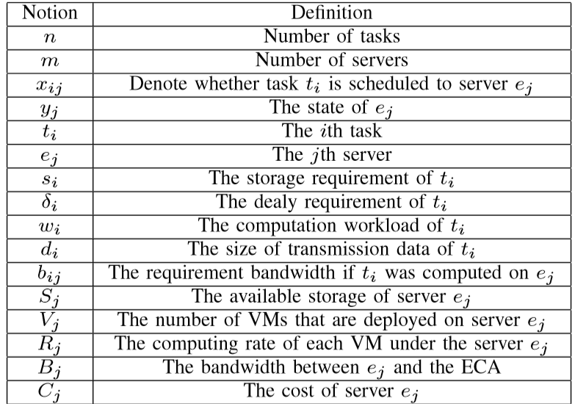
SYSTEM MODEL

Slide 25
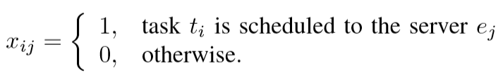
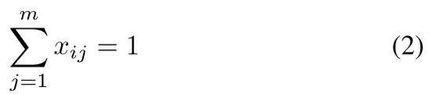
SYSTEM MODEL
We deﬁne binary variable x_{ij} to denote whether task t_{i} is scheduled to server e_{j}, i.e.,
Since the edge computing system has sufﬁcient service capacity to process all the task requests, each task t_{i} will be scheduled to one server for processing. And a task can only be processed by one server. This leads to
Notes:
我們定義了一個二元變數 xij 來表示ti是否被配給ei
因為邊緣計算系統有足夠的服務能力來處理所有任務需求
每個任務ti可以配給一個伺服器處理
而且一個任務也只能被一個伺服器處理

Slide 26
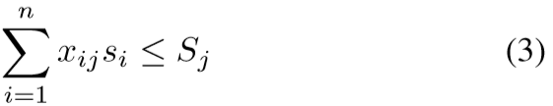
SYSTEM MODEL
As the resources in each server are limited, these following task scheduling constraints must be satisﬁed. In each server, there must be sufﬁcient storage space to store the processed tasks, otherwise it will result in the loss of task data.
Therefore, the total storage requirement of each task scheduled to server e_{j} can not exceed the storage resource of server e_{j}. That is,
Notes:
因為每個伺服器上的資源是有限的
以下的任務排程約束必須被滿足
在每個伺服器 必須要有足夠的儲存空間來儲存 被處理的任務 否則就會導致 被處理任務的數據 遺失
因此 每個任務配給伺服器ej 所需的儲存需求 不能超過ej的儲存資源

Slide 27
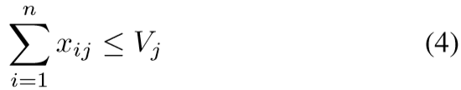
SYSTEM MODEL
In addition, since the number of VMs deployed per server is limited, the total number of tasks scheduled to server e_{j} can not exceed the number of VMs on server e_{j.}
2) Performance:
In this paper, since the ofﬂoaded task has its delay requirement, the constraint is that each task must be completed within its deadline.
Notes:
因為在伺服器上部署的虛擬機數量是有限的
被配給伺服器ej 的任務總數
不能超過在伺服器上的虛擬機總數
表現
在本篇，因為被卸載的任務都有自己的延遲需求
每個任務的限制 必須在他的deadline裡完成

Slide 28
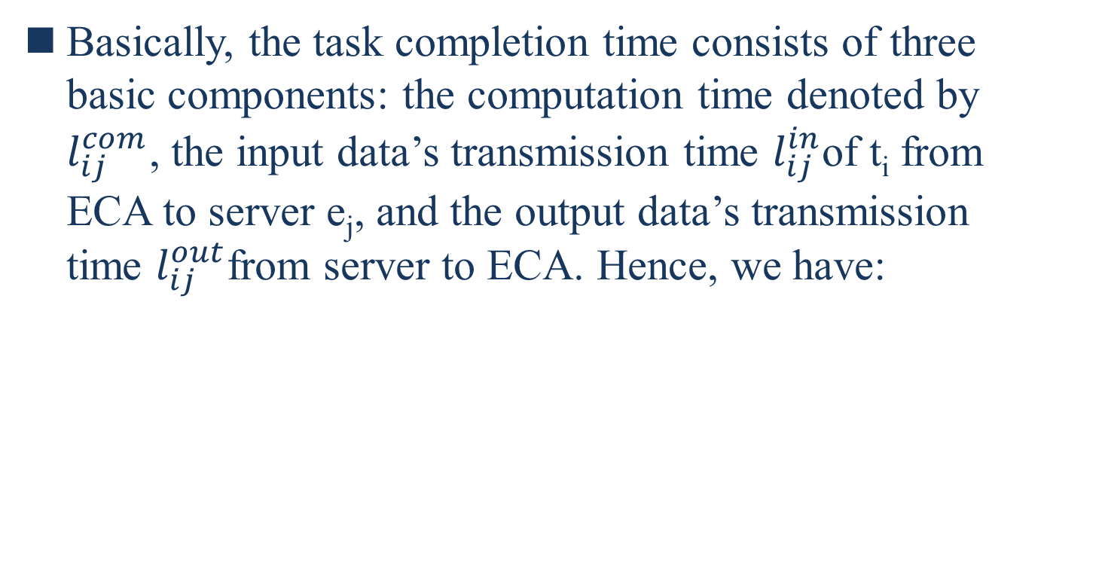
SYSTEM MODEL
Basically, the task completion time consists of three basic components: the computation time denoted by $l_{ij}^{com}$, the input data’s transmission time $l_{ij}^{in}$of t_{i} from ECA to server e_{j}, and the output data’s transmission time $l_{ij}^{out}$from server to ECA. Hence, we have:
Notes:
基本上 任務的完成時間有三個部分
計算時間
Ti 的Input data從ECA到伺服器ej傳輸時間
Output data從伺服器到ECA的傳輸時間
要小於等於sigma I
ti 的延遲需求

Slide 29
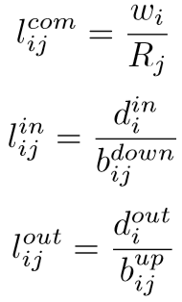


SYSTEM MODEL
For each task t_{i} scheduled to server e_{j}, the three components of time can be calculated as follows [22],
where $d_{i}^{in}$denote the size of task t_{i}’s input data
$d_{i}^{out}$denote the size of task t_{i}’s output data
$b_{ij}^{up}$and $b_{ij}^{down}$denote the uplink and downlink bandwidth of t_{i} between the ECA and the server, respectively.
Notes:
每個ti配給伺服器ej 有三個部份的時間可以被計算
計算時間 : ti上的計算工作負載/ 每個虛擬機的計算速率
Ti 的Input data從ECA到伺服器ej傳輸時間 : Ti input data的大小/ECA跟伺服器間TI的下行頻寬
Output data從伺服器到ECA的傳輸時間 : :Ti output data的大小/ECA跟伺服器間TI的上行頻寬

Slide 30



SYSTEM MODEL
In this paper, we assume that $b_{ij}^{up} \text{is} \text{equal} \text{to} b_{ij}^{down}$, i.e.,
Thus, (5) now becomes
Notes:
我們假設 ECA跟伺服器間TI的下行頻寬 跟上行頻寬相等
因此第五式變為

Slide 31
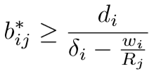

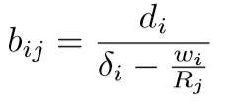

SYSTEM MODEL
If task t_{i} is scheduled to server e_{j}, the required bandwidth can be obtained by solving (10). The bandwidth requirement inequality is as follows,
To reduce the cost of edge computing system, we consider that all tasks are completed correctly at their respective deadlines δ_{i}. Then, the required bandwidth of task t_{i} between the ECA and e_{j} can be obtained as follows,
Notes:
如果TI配給伺服器EJ 藉由第10式 可以求出頻寬需求
頻寬需求的不等式如下
為了減少邊緣計算系統的資源
我們考慮所有任務都被正確的在她的DEADLINE SIGMA I內完成
接著 TI在ECA 和ej間所需的頻寬如下

Slide 32
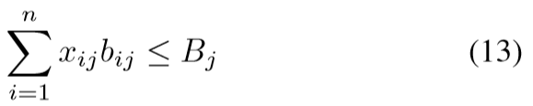
SYSTEM MODEL
For each edge server e_{j}, the sum of required bandwidth of the task scheduled to server e_{j} must be no greater than the bandwidth of server e_{j}. That is,
Notes:
對於各個邊緣伺服器 ej 被分配給ej的任務所需頻寬的總和不能大於ej的頻寬

Slide 33
SYSTEM MODEL
3) Cost:
In the edge computing system, since ECA communicates with each edge server and manages it, each server can be switched ON or OFF by the ECA.
For the server which is in ON state, the edge computing system will pay a certain cost to maintain the normal running of this server [23]. For example, the resource in ECA will be consumed to manage the running server, and the running server will consume a lot of energy.
Notes:
成本
在邊緣計算系統，因為ECA跟各個邊緣伺服器溝通且管理他們
每個伺服器可以被ECA打開或關掉
對於在ON狀態的伺服器，邊緣計算系統會付出一定的成本來維持 這個伺服器的正常運行
例如 ECA的資源會被消耗去管理運行中的伺服器 然後運行中的伺服器會消耗大量能量

Slide 34

SYSTEM MODEL
Let C_{j} denote the cost which the edge computing system pays when the server e_{j} is in ON state. In this paper, we deﬁne the cost of edge computing system as the sum cost of those servers which are in ON state.
Then we identify the binary variable about the state of e_{j}. Let y_{j} represent the state of server e_{j}. That is,
Notes:
當伺服器ej在ON狀態時 邊緣計算系統需要付出的成本以cj 表示
在這篇paper 我們定義邊緣計算系統的成本是那些在ON 狀態伺服器的總成本
Yj表示ej的狀態

Slide 35
SYSTEM MODEL
4) Optimization Problem:
In the edge computing system, ECA schedules each ofﬂoaded task to the edge server. When the server is assigned tasks, it will be in ON state, otherwise be in OFF state [24].
The optimization objective of our task scheduling strategy is to minimize the cost of the edge computing system.
Notes:
最佳化問題
在邊緣計算系統中 ECA分配各個卸載任務 到邊緣伺服器
當伺服器被分配任務時 他會處於ON 狀態 否則為OFF
我們任務排程策略 的最佳化目標是 最小化 邊緣計算系統的成本

Slide 36
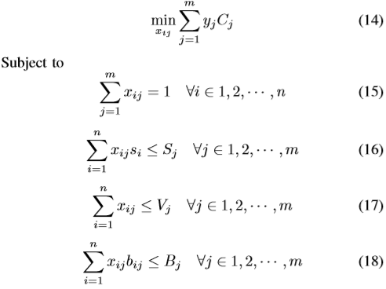
SYSTEM MODEL
Summarize all issues discussed above, the cost minimization optimization problem of edge computing system can be formulated as follows,
Notes:
邊緣計算系統 裡 成本最小化的最佳問題可以公式化為以下

Slide 37
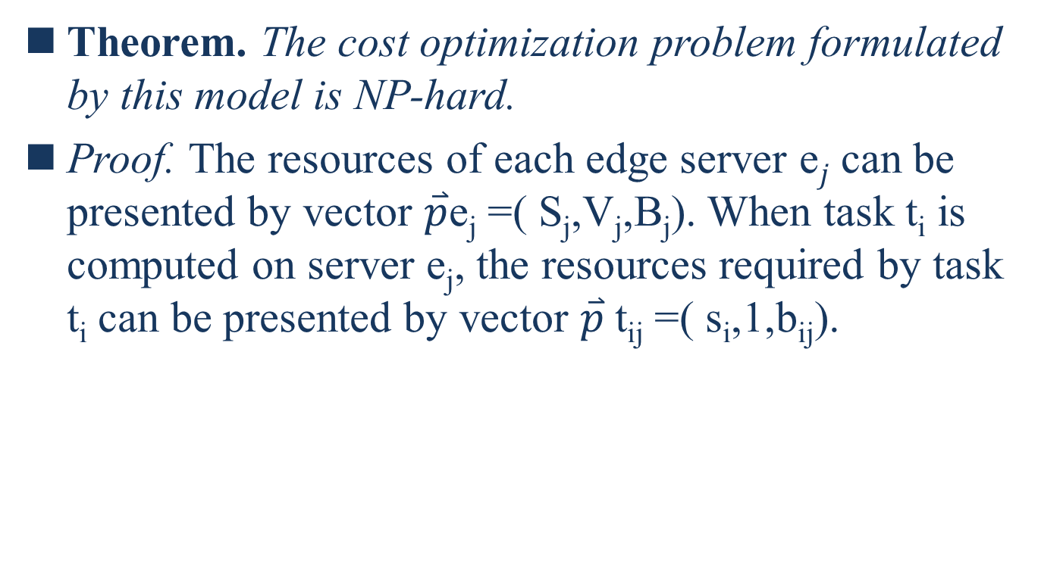
SYSTEM MODEL
Theorem. The cost optimization problem formulated by this model is NP-hard.
Proof. The resources of each edge server e$j$ can be presented by vector $\overset{⃑}{p}$e_{j} =( S_{j},V_{j},B_{j}). When task t_{i} is computed on server e_{j}, the resources required by task t_{i} can be presented by vector $\overset{⃑}{p}$t_{ij} =( s_{i},1,b_{ij}).
Notes:
該模型制定的 成本最優化問題 是NP HARD問題
每個伺服器ej的資源可以表示成Pej 當任務i在伺服器上ej計算時，任務所需的資源可以表示為
Sj ej 的可用儲存空間
V 上部署的虛擬機數量
B 跟ECA之間的頻寬
S ti 的儲存需求
B 如果ti 在ej上計算所需的頻寬需求

Slide 38
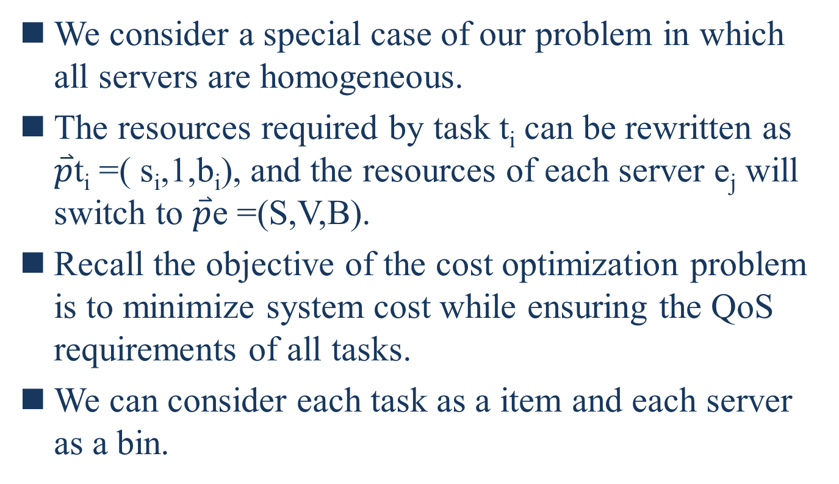
SYSTEM MODEL
We consider a special case of our problem in which all servers are homogeneous.
The resources required by task t_{i} can be rewritten as $\overset{⃑}{p}$t_{i} =( s_{i},1,b_{i}), and the resources of each server e_{j} will switch to $\overset{⃑}{p}$e =(S,V,B).
Recall the objective of the cost optimization problem is to minimize system cost while ensuring the QoS requirements of all tasks.
We can consider each task as a item and each server as a bin.
Notes:
我們考慮一個特殊的case就是 所有伺服器都是同質
Pti ej
成本最優化的問題是要最小化系統成本 同時 滿足各個任務的QOS
我們可以將 每個任務視為一個物品 每個伺服器是一個容器

Slide 39
SYSTEM MODEL
Then, the goal is to use the minimum number of bins to pack all items into bins. Obviously, this special problem is equivalent to the three-dimensional vector packing problem, which is NP-hard [25].
Prove that our cost optimization problem is NP-hard by using reduction to absurdity.
Assuming the optimization problem is not NP-hard, then the special case of the problem must not be NP-hard. However, it is contrary to the conclusion we have derived. Hence our cost optimization problem is NP-hard.
Notes:
我們的目標是用最少的容器來‘裝所有的任務
這個問題跟 三維的裝箱問題 相等 是一個NP HARD 問題
假設最佳化的問題不是NP HARD 那這個特殊的情況也不是NP HARD
然而這跟我們的出的結論相反 因此我們的成本最優化問題是NP HARD

Slide 40
ALGORITHM DESIGN
In this section, we propose an efﬁcient TTSCO algorithm to solve our cost optimization problem. Then, we conduct the analysis for the TTSCO algorithm.
Since the cost optimization problem proposed in this paper is NP-hard, it is impossible to obtain the optimal solution in polynomial time [26].
Notes:
在本節 我們提出一個有效的TTSCO演算法 來解決我們的成本最佳問題
接著我們對TTSCO 演算法進行分析
因為本篇的成本最佳化問題是NP HARD 所以不可能在多項式時間內 找到最佳解

Slide 41
ALGORITHM DESIGN
Based on the heuristic algorithm (BF), we design TTSCO algorithm to solve the optimization problem.
The TTSCO algorithm consists of two stages. In the stage 1, we obtain a preliminary task scheduling strategy using the improved BF algorithm.
And in the stage 2, we optimize the previous task scheduling scheme and get the ﬁnial strategy.
Notes:
基於啟發式演算法 我們設計TTSCO演算法來解決最佳化問題
TTSCO演算法包含兩階段
第一階段是我們利用改進的啟發是演算法來 獲得 初步的任務排成策略
第二階段 我們優化先前的任務排成方案 然後得到最終策略

Slide 42
ALGORITHM DESIGN
Stage 1.
Since the edge servers are heterogeneous in the cost optimization problem, the TTSCO algorithm should consider how to select edge servers to process the ofﬂoaded tasks.
Recall the goal of our task scheduling strategy is to minimize the cost of edge computing system, TTSCO algorithm selects the server with the smallest unit cost u_{j}, which is expressed as (19).
Notes:
第一階段
由於邊緣伺服器在成本優化問題裡是異質的 TTSCO演算法應該考慮如何選擇邊緣伺服器來處理卸載的任務
TTSCO 選擇單位成本uj最小的伺服器

Slide 43
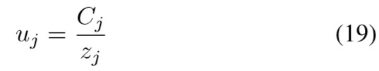

ALGORITHM DESIGN
Without loss of generality, the unit cost of different edge servers are also unequal.
Where z_{j} denote the size of server e_{j},
Notes:
不失一般性，不同邊緣伺服器的單位成本 也不同
Zj表示ej的大小

Slide 44
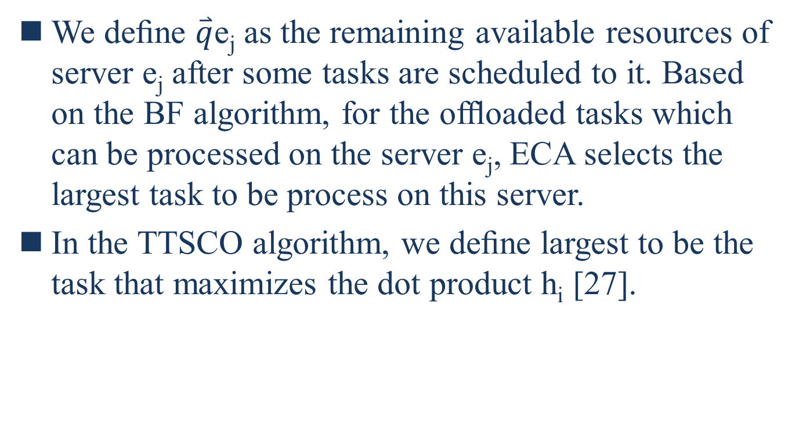
ALGORITHM DESIGN
We deﬁne $\overset{⃑}{q}$e_{j} as the remaining available resources of server e_{j} after some tasks are scheduled to it. Based on the BF algorithm, for the ofﬂoaded tasks which can be processed on the server e_{j}, ECA selects the largest task to be process on this server.
In the TTSCO algorithm, we deﬁne largest to be the task that maximizes the dot product h_{i} [27].
Notes:
Qej 定義伺服器ej在被分配一些任務後剩餘的可用資源
機瑜啟發是演算法 對於可以在伺服器ej上處理的卸載任務 ECA會選擇最大的任務來讓這個伺服器處理
在TTSCO演算法 我們定義最大 是 hi內積的最大值

Slide 45
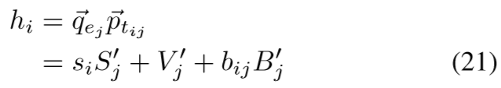
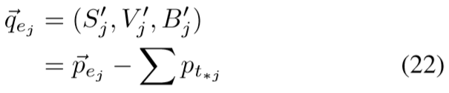
ALGORITHM DESIGN
Formally, the dot product h_{i} can be expressed as,
Where
Within p_{t∗j} denote the resource requirements of all tasks scheduled to server e_{j}.
Notes:
Hi的內積 是 最大化剩餘容量向量和物品的需求向量
(微軟提出)
P t*j表示所有分配到伺服器ej的任務 所需的資源

Slide 46
ALGORITHM DESIGN
Stage 2.
After the stage 1, we get the preliminary task scheduling strategy. But it is worth noting that, in some special cases, the system cost of preliminary scheduling strategy can be reduced further.
For a simple example, consider there are two tasks A1, A2 to be computed, and two edge servers B1, B2. The resource requirement vector of tasks A1, A2 are (10,10,10) and (20,20,20), respectively.
Notes:
第二階段
在第一階段後，我們得到初步的任務排成策略
值得注意的是 在一些特殊情況裡 可以進一步減少初步任務排成策略的系統成本
舉一個簡單的例子 考慮有兩個任務A1 A2 要被計算
兩個伺服器B1 B2
A1 A2的資源需求向量為 10 10 10 及 20 20 20

Slide 47
ALGORITHM DESIGN
And the available resource vector of servers B1 and B2 are (15,15,15) and (50,50,50), respectively.
According to the ﬁrst scheduling stage, task A1 will be scheduled to server B1, then task A2 will be scheduled to server B2. In this case, the total cost is the sum of two servers’ cost.
However, if all tasks are scheduled to server B2 for processing, the total cost is only the cost of server B2. By this scheduling strategy, the total cost is obviously reduced.
Notes:
伺服器B1 B2 的可用資源向量是 15 15 15 及 50 50 50
根據第一個排程階段 A1會被分配給B1 A2 會被分配給B2
在這個case 總成本會是兩個伺服器的成本總和
然而如果兩個任務都被分配給B2 總成本就只會是B2的成本
藉由這種排程策略 總成本被明顯的減少

Slide 48
ALGORITHM DESIGN
According to the above example, for the server which is selected in the end, only a small amount resources are used.
Therefore, after the ﬁrst scheduling stage, we need to further optimize the scheduling strategy to reduce unnecessary cost. In the general case, the last selected server will have a large amount of available resources.
In the TTSCO algorithm, we propose an optimization strategy to maximize resources utilization of the last selected server.
Notes:
根據上面的例子 對於最後選擇的伺服器，只有少量的資源被使用
因此在第一階段後，我們需要進一步優化排程策略來減少不必要的成本
一般情況下 最後被選擇的伺服器會有大量的可用資源
在TTSCO演算法 我們提出一個最優策略來 最大化最後被選擇伺服器的資源利用率

Slide 49
ALGORITHM DESIGN
The main idea of optimization strategy is to re-put the tasks in the smallest cost servers into the last selected server after the ﬁrst stage.
In this way, the TTSCO algorithm can increase the utilization of the server with highest cost, and reduce unnecessary cost which are caused by the servers with smaller cost.
Summarize all above discussions, we propose the TTSCO algorithm to solve our optimization problem, as shown in Algorithm 1.
Notes:
最優化策略的主要思想 就是在第一階段後 將成本最小的伺服器 重新放入最後被選的伺服器
如此一來 TTSCO 演算法可以增加有最高程本伺服器的利用率 減少 小成本伺服器造成的 不必要成本
總結以上我們提出TTSCO 演算法來解決我們的最優問題

Slide 50
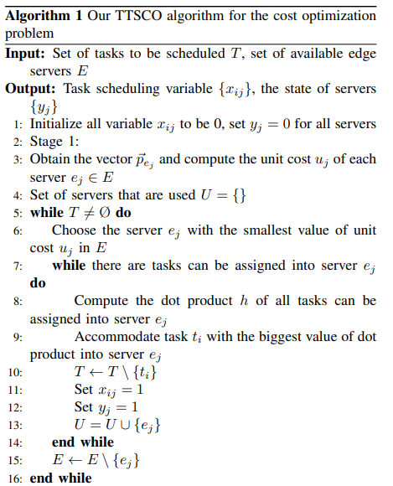
Notes:
演算法的input是要被分配到伺服器的任務集合 以及可用的邊緣伺服器集合 在第一行 我們先初始化在最優問題 的決策二元變數 xij 和yj 在第一階段 當單位成本相等時 我們將邊緣伺服器進行排序 單位成本uj 及 cj都按照 非遞減 排序 從5-16行 我們根據任務的資源需求以及伺服器的可用資源來選擇要處理沒被分配的任務給伺服器 在第6行 我們在可用的伺服器集合E裡 選擇有最小單位程本的伺服器ej 如果選中的伺服器的可用資源 可以滿足還沒被分配的任務集合T中 某些任務的資源需求
就選擇最大的任務來放進伺服器ej (第7-14) 否則 伺服器ej就會從可用伺服器E裡被移除 (第15) 在第8行可以藉由剛剛21、22式得到最大的任務ti 接著ti 從沒被分配的任務集合T裡被移除 接著tij yj都被設為1 (第10-12) 接著伺服器ej被加入以使用的伺服器U集合 裡

Slide 51
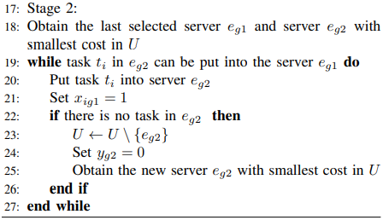
Notes:
在第二階段， 我們首先得到 在U集合裡有最後選擇的伺服器 eg1然後最小成本 eg2
如果伺服器eg1的可用資源可以滿足 在伺服器eg2裡的任務ti的資源需求
我們就重新把任務ti放回伺服器eg1 然後更新任務排成的變數 (第19-27)
當在伺服器eg2裡的任務都全數被移除 伺服器eg2就會從U裡移除 並更新 伺服器eg2 的狀態
然後再集合U裡選取有最小成本的新伺服器 (第22-25)

Slide 52
ALGORITHM DESIGN
We conduct the time complexity analysis for the TTSCO algorithm.
Recall the ﬁrst stage in our TTSCO algorithm, there are two main phases: sorting the servers and scheduling tasks to servers.
In the ﬁrst phase, the process of sorting servers will take at least O(mlog(m)) time.
In the second phase, there are n tasks that need to be scheduled.
Notes:
我們接著分析TTSCO的時間複雜度
回想第一階段的TTSCO演算法 有兩著主要的階段 分別是 伺服器的排序 以及 分配任務給伺服器
在第一階段 排序伺服器會花至少 mlogm的時間
在第二階段 有n個任務要被分配

Slide 53
ALGORITHM DESIGN
Considering the worst case that the selected server can meet the source requirements of all unscheduled tasks, algorithm will cost n time to compute dot product and choose the biggest task.
In this case, the second phase will cost at least n² time. Therefore, the worst time complexity of the ﬁrst stage is mlog(m)+n². For the second stage, it will task n−1 time in the worst case.
So the worst time complexity of our TTSCO algorithm is mlog(m)+n².
Notes:
考慮到最壞的情況 就是被選擇的伺服器可以滿足所有沒被分配的任務的資源需求
演算法會花N 次來計算內積 以及選擇最大的任務
在這種狀況 第二個階段會花至少n2時間
因此第一階段最糟的時間複雜度會是 mlogm+n2
對於第二個階段 最糟的情況會有n-1次
所以TTSCO罪遭的時間複雜度 匯市mlogm+n2

Slide 54
PERFORMANCE EVALUATION
In this section, we conduct the performance evaluation of TTSCO algorithm for solving the cost optimization problem.
By the simulation results, we show the effectiveness and improvement of our task scheduling strategy, compared with a baseline strategy: random scheduling strategy (RANDOM).
The random strategy randomly schedules each task to an available server for processing, where the selected server can satisfy the QoS requirements of task requests.
Notes:
在本節 我們對解決最佳化問題的TTSCO演算法進行效評估
透過模擬的結果 我們展示了我們任務排成策略跟隨積排程策略相比的有效性及進步
隨機排程策略將每個任務分配到一個可用伺服器去處理
選擇的伺服器可以滿足任務所需的QOS

Slide 55
PERFORMANCE EVALUATION
In the experiments, we consider that the edge computing system is composed of two types of servers. The edge computing system has sufﬁcient service capacity to process all the task requests. For each task request, its delay requirements is as d_{i}/α, where α is randomly distributed in [9,11].
Notes:
在實驗中 我們考慮邊緣計算系統有 兩種型態的伺服器
邊緣計算系統有足夠的服務能力來處理所有任務需求
對於各個任務需求，他的延遲需求是 di/a
di ti 傳輸的資料量
a是在9-11中隨機分布

Slide 56
PERFORMANCE EVALUATION
Without loss of generality, the service capacity parameters of different servers are all different, which include the storage capacity, the number of VMs, the computing rate and communication bandwidth.
And the cost of each server is set to be positively related to its service capacity.
Notes:
不失一 般姓 不同伺服器的服務能力參數都不同
包含了儲存容量 虛擬機的數量 計算速率 及溝通頻寬
且每個伺服器的成本 都被設為跟他服務能力 正相關

Slide 57
PERFORMANCE EVALUATION
Comparison Experiment
We ﬁrst check the performance of results obtained by our TTSCO algorithm. We compare the results of TTSCO algorithm with the optimal solutions.
We use LINGO software to obtain the optimal solutions. We plot the results of our algorithm and optimal solutions in Fig. 2.
Comparison result shows that the TTSCO algorithm solutions are close to the optimal solution.
Notes:
比較實驗
我們首先檢查由我們TTSCO演算法獲得結果的效能
我們把TTSCO的結果跟最佳解進行比較
我們用軟體LINGO 來獲得 最佳解

Slide 58
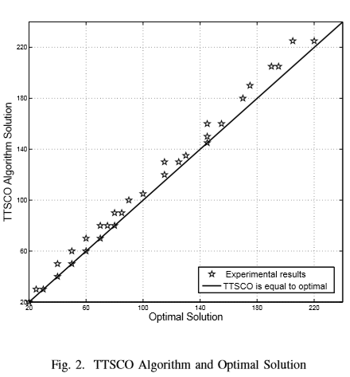
PERFORMANCE EVALUATION
Notes:
我們在圖2 劃出我們演算法的結果以及最佳解
比較的結果顯示 TTSCO演算法得出的解法很接近最佳解

Slide 59
PERFORMANCE EVALUATION
Then we denote c₁ as the solution obtained by our TTSCO algorithm, and c₂ as the optimal solution obtained by LINGO software. Let the approximate ratio, c₁/c₂, denote as the indicator of the performance of our algorithm.
We plot the cumulatively distribution function (CDF) of the approximation ratio in Fig. 3.
Notes:
接著我們 將c1表示為TTSCO得到的解法 C2表為LINGO得到的最佳解
近似比C1/C2表示我們演算法表現的指標

Slide 60
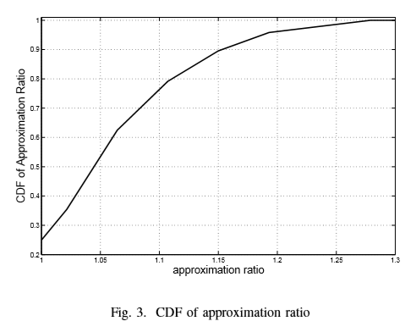
PERFORMANCE EVALUATION
Notes:
我們把近似比
的累積分布函數畫在圖3
從圖3可看出 近似比介於1-1.3 且95%的近似比小於1.2

Slide 61
PERFORMANCE EVALUATION
The simulation result can validate the accuracy of our TTSCO algorithm. With the increase of the number of input tasks, we ﬁnd that a long time (maybe more than one hour) will be spent to get the optimal solutions by LINGO software.
Notes:
模擬的結果可以驗證我們演算法的正確性
隨著我們Input任務數量的增加 我們發現用LINGO軟體 需要花費很長的時間(或許超過一小時)來求出最佳解

Slide 62
PERFORMANCE EVALUATION
However, the approximate solutions of our TTSCO algorithm can be obtained in a few seconds by MATLAB.
In addition, since the cost optimization problem is NP-hard, we can not obtain the optimal solutions in the polynomial time. However, an approximate solution can be obtained by our TTSCO algorithm in the polynomial time.
Therefore, the TTSCO algorithm proposed in this paper is both accurate and efﬁcient.
Notes:
然而 我們演算法的近似解可以藉由MATLAB來在幾秒內獲得
因為成本最佳化問題是NP HARD 我們不能在多項是時間內獲得最佳解
然而我們演算法可以在多項是時間 獲得一個最佳解
因此本篇提出的TTSCO 既準確又有效率

Slide 63
PERFORMANCE EVALUATION
B. Parameters Analysis
In this subsection, we analyse the effect of parameters on our TTSCO algorithm compared with the RANDOM algorithm.
These parameters include the number of input tasks, transmission data size and delay requirement.
Notes:
參數分析
在這小節 我們把TTSCO 及RANDOM演算法做 參數影響的比較
這些參數包含input任務的數量 要傳輸資料輛的大小 及延遲需求

Slide 64
PERFORMANCE EVALUATION
The Effect of Number of Tasks:
In this simulation, we evaluate the performance of our TTSCO algorithm with different number of input tasks.
The transmission data size of input tasks is set to 50MB. We change the number of input tasks from 30 to 150 with an increment of 30. The performance of TTSCO algorithm is compared with the RANDOM algorithm. We plot the cost of the edge computing system obtained by both algorithm in Fig. 4.
Notes:
任務數量的影響
在這個模擬 我們評估我們演算法在不同數量INPUT任務 的效能
傳輸資料量的大小 設為50MB
我們把INPUT任務數量從30開始 每次增加30 直到150
我們的表現是跟RANDOM演算法做比較
我們把兩個演算法 所花的邊緣計算系統成本 畫在圖4

Slide 65
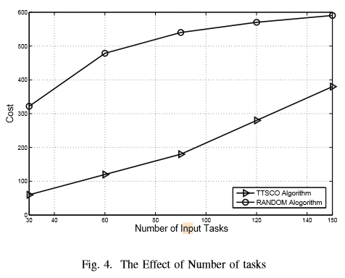
PERFORMANCE EVALUATION
Notes:
圖4 顯示當INPUT任務數量增加時 邊緣計算系統的成本也會增加
這是因為需要更多伺服器來處理任務 所以到置成本的增加
從圖4可看出 我們TTSCO演算法跟RANDOM演算法相比 可以平均降低50%的成本
那是因為我們TTSCO演算法增加個個被使用伺服器的資源利用率
在這種狀況 伺服器在ON狀態的數量會減少

Slide 66
PERFORMANCE EVALUATION
2) The Effect of Transmission Data Size:
In this simulation, we study the impact of different transmission data size of input tasks on the performance of our TTSCO algorithm and RANDOM algorithm.
We set the number of input tasks to 150. And the transmission data size of input tasks increases from 25MB to 50MB with an increment of 5MB. We plot the cost of the edge computing system obtained by both algorithms in Fig. 5.
Notes:
傳輸數據量大小的影響
在這個模擬 我們研究不同INPUT 任務的數據傳輸量 對我們即RANDOM演算法 的影響
我們將INPUT任務量設為150
然後傳輸數據量從25MB開始 每次增加5MB 直到50MB
我們把兩個演算法 所消耗的邊緣計算系統成本畫在圖5

Slide 67
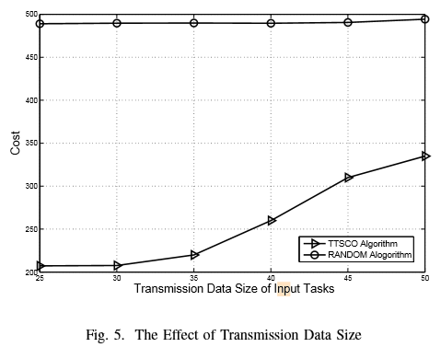
PERFORMANCE EVALUATION
Notes:
圖5 顯示 在我們演算法下 傳輸數據大小增加 時 邊緣計算系統的成本也會增加 然而 當傳輸數據大小低於30MB 時 邊緣計算系統的成本不會因為傳輸數據大小增加而增加 理由是因為 虛擬機的數量是 任務排成的主要限制 然而 各個伺服器上的頻寬資源使用率 跟儲存資源 相對低 當任務傳輸數據增加時 各個伺服器的資源使用率會增加但總成本不會改變 ( 在25-30MB) 當傳輸數據量不斷增加時 使用的伺服器的資源會不足以處理這些任務 然後更多的伺服器會被使用 讚這種情況 傳輸數據大小增加 時 邊緣計算系統的成本也會增加 從圖5 可看出 RANDOM演算法的成本大致相同 原因是因為RANDOM演算法隨機選取伺服器來處理任務 這樣會導致很多正在運行的伺服器資源利用率太低
當傳輸數據增加時 各個伺服器的資源使用率會增加 但總成本維持不變 圖5可看出 我們TTSCO演算法平均可以比RANDOM演算法減少50%的成本

Slide 68
PERFORMANCE EVALUATION
3) The Effect of Delay Requirement of Tasks:
In this simulation, we evaluate the performance of our TTSCO algorithm with the different delay requirement of input tasks.
We deﬁne a task set including 7 tasks where the transmission data size of tasks is varied from 20MB to 50MB with an increment of 5MB. We use 15 task sets as the input tasks.
Notes:
任務延遲要求的影響
在這個模擬 我們評估我們演算法在不同INPUT延遲需求下的效能
我們定義一個任務集合裡有7個任務
他們的傳輸數據大小從20MB每次增加5MB 直到50MB
我們用15個任務集合做為INPUT任務

Slide 69
PERFORMANCE EVALUATION
The delay requirement of each task is set to δ/ρ, where δ is the original delay and ρ is the reduction rate. We change ρ from 1 to 2 with an increment of 0.2, and plot the cost of the edge computing system obtained by both algorithms in Fig. 6.
Notes:
每個任務的延遲要求訂為 sigma/p
Sigma是原始的延遲 p是減少的速率
我們把P從1更改成2 每次增加0.2
我們把兩個演算法 所獲得的邊緣計算系統成本畫成圖6

Slide 70
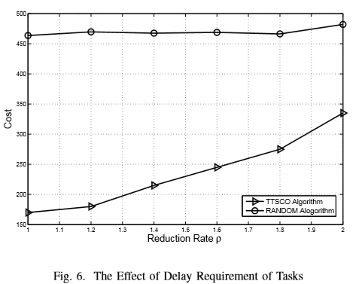
PERFORMANCE EVALUATION
Notes:
類似的結果可以從圖6得出
隨著減少速率P的增加 TTSCO演算法的成本也會增加 但基本上RANDOM策略的成本沒有變化
這是因為較小的延遲 表示需要較大的傳輸需求頻寬
這會導致更多的伺服器需要被用來處理任務
圖6顯示 我們TTSCO 跟RANDOM演算法相比 可以減少平均45%的成本

Slide 71
CONCLUSION
We explore the cost optimization for task scheduling problem in the edge computing system. We propose the optimization problem to minimize the cost of the edge computing system while satisfying all input tasks’ QoS requirements.
An effective algorithm, called TTSCO algorithm, is proposed to solve the cost optimization problem.
Notes:
在這篇paper 我們在邊緣計算系統探索任務排程問題的成本最佳化
我們提出最佳問題來最小化邊緣計算系統的成本 同時滿足所有任務的QOS需求
一個有效的演算法 叫TTSCO 被提出來解決成本最佳化的問題

Slide 72
CONCLUSION
By comparing with optimal solutions obtained by LINGO software, we verify the accuracy of our TTSCO algorithm.
Performance evaluation results show the improvement of our algorithm in reducing the cost of edge computing system compared with the RANDOM algorithm.
In the future research, we will consider dynamic resource management and tasking scheduling among multiple edge clouds.
Notes:
藉由與LINGO軟體所得到的最佳解相比 五們驗證了我們演算法的正確性
效能評估顯示 跟RANDOM演算法相比 我們演算法在減少邊緣計算系統成本 有改善
在未來的研究 我們會考慮在多個邊緣雲做動態的資源分配以及工作排成

Slide 73
REFERENCES
[1] M Hassanalieragh et al., ”Health Monitoring and Management Using Internet-of-Things (IoT) Sensing with Cloud-Based Processing: Opportunities and Challenges.” IEEE International Conference on Services Computing, 2015:285-292.
[2] S Tata, R Jain, H Ludwig, S Gopisetty, ”Living in the Cloud or on the Edge: Opportunities and Challenges of IOT Application Architecture.” IEEE International Conference on Services Computing, 2017:220-224.
[3] W. Shi et al., Edge Computing: Vision and Challenges, IEEE Internet of Things J., vol. 3, no. 5, 2016, pp. 637-646.
[4] S Li, J Huang, ”GSPN-Based Reliability-Aware Performance Evaluation of IoT Services.” IEEE International Conference on Services Computing, 2017:483-486.
[5] Y.-J. Ku et al., 5G radio access network design with the fog paradigm: Conﬂuence of communications and computing, IEEE Commun. Mag., vol. 55, no. 4, pp. 46-52, Apr. 2017.
[6] F. Bonomi, ”Fog Computing and Its Role in the Internet of Things”, Proc. First Edition of the MCC Workshop on Mobile Cloud Computing, Aug. 2018.
[7] M. Satyanarayanan, P. Bahl, R. Caceres, N. Davies, ”The case for vm-based cloudlets in mobile computing”, IEEE Pervasive Computing, vol. 8, no. 4, pp. 14-23, Oct 2009.
[8] T. Verbelen and P. Simoens and F. De Turck and B. Dhoedt, ”Cloudlets: Bringing the Cloud to the Mobile User,” in Proc. of ACM Workshop on Mobile Cloud Computing and Services, 2012, pp. 29-36.
[9] K. Habak, M. Ammar, K. A. Harras, E. Zegura, ”Femto clouds: Leveraging mobile devices to provide cloud service at the edge”, Cloud Computing (CLOUD) 2015 IEEE 8th International Conference, pp. 9-16, 2015.
[10] M. T. Beck, M. Werner, S. Feld, and T. Schimper, ”Mobile edge computing: A taxonomy, ” in Proc. of the Sixth International Conference on Advances in Future Internet, AFIN, 2014.

Slide 74
REFERENCES
[11] Kim, Yeongjin, J. Kwak, and C. Song. Dual-side Optimization for Cost-Delay Tradeoff in Mobile Edge Computing. IEEE Transactions on Vehicular Technology pp. 99 :1-1, 2017.
[12] Y. Mao, J. Zhang, and K. B. Letaief, Dynamic computation ofﬂoading for mobile-edge computing with energy harvesting devices, IEEE Journal on Selected Areas in Communications, vol. 34, no. 12, pp. 3590-3605, 2016.
[13] X. Lyu, W. Ni, H. Tian, R. P. Liu, X. Wang, G. B. Giannakis, and A. Paulraj, Optimal schedule of mobile edge computing for Internet of Things using partial information, IEEE J. Sel. Areas Commun., accepted, 2017.
[14] Y. Mao, J. Zhang, S. H. Song, and K. B. Letaief, Stochastic joint radio and computational resource management for multi-user mobileedge computing systems, 2017, http://arxiv.org/abs/1702.00892.
[15] M. Jia, J. Cao, and W. Liang. Optimal cloudlet placement and user to cloudlet allocation in wireless metropolitan area networks. IEEE Transactions on Cloud Computing, in press, 2015.
[16] D. Zeng, L. Gu, S. Guo, Z. Cheng, and S. Yu, Joint optimization of task scheduling and image placement in fog computing supported softwaredeﬁned embedded system, IEEE Transactions on Computers, vol. 65, no. 12, pp. 3702-3712, 2016.
[17] L. Gu, D. Zeng, S. Guo, A. Barnawi, and Y. Xiang, Cost efﬁcient resource management in fog computing supported medical cyberphysical system, IEEE Transactions on Emerging Topics in Computing, vol. 5, no. 1, pp. 108-119, 2017.
[18] L. Tong, Y. Li, and W. Gao, A hierarchical edge cloud architecture for mobile computing, in IEEE INFOCOM16, San Francisco, CA, USA, July 2016, pp. 1-9.
[19] R. Urgaonkar, S. Wang, T. Hea, M. Zafer, K. Chan, and K. K. Leung, Dynamic service migration and workload scheduling in edgeclouds, Performance Evaluation, vol. 91, pp. 205-228, 2015.

Slide 75
REFERENCES
[20] Song Y, Yau S S, Yu R, et al. ”An Approach to QoS-based Task Distribution in Edge Computing Networks for IoT Applications.” IEEE International Conference on Edge Computing IEEE, 2017:32-39.
[21] Tim Verbelen, Pieter Simoens, Filip De Turck, and Bart Dhoedt. 2012. Cloudlets: bringing the cloud to the mobile user. In Proceedings of the third ACM workshop on Mobile cloud computing and services (MCS ’12). ACM, New York, NY, USA, 29-36.
[22] K. Kumar, J. Liu, Y. Lu, and B. K. Bhargava, A survey of computation ofﬂoading for mobile systems, Mobile Networks and Applications, vol. 18, no. 1, pp. 129-140, 2013.
[23] Hadji, Makhlouf, and D. Zeghlache. ”Minimum Cost Maximum Flow Algorithm for Dynamic Resource Allocation in Clouds.” IEEE, International Conference on Cloud Computing IEEE, 2012:876-882.
[24] F. Cao, M.M. Zhu, C.Q. Wu, ”Energy-efﬁcient resource management for scientiﬁc workﬂows in clouds” in Services (SERVICES) 2014 IEEE World Congress on, IEEE, 2014.
[25] R. Panigrahy, K. Talwar, L. Uyeda, and U. Wieder, Heuristics for vector bin packing. Microsoft Research, Tech. Rep., 2010.
[26] Kang, J, and Park, S, Algorithms for the variable sized bin packing problem, European Journal Operational Research, vol. 147, no. 2, pp. 365-372, 2003.
[27] M. Gabay, S. Zaourar, ”Variable Size Vector Bin Packing Heuristics-ApplicationtotheMachineReassignmentProblem”, INRIA Tech. Rep., 2013.

