Slide 1
An SDN/NFV Based Framework for Management and Deployment of Service Based 5G Core Network
Lu Ma , Xiangming Wen , Luhan Wang , Zhaoming Lu , Raymond Knopp
China Communications
Notes:
基於SDN / NFV的基於服務的5G核心網管理和部署的框架

Slide 2
Abstract
The traffic explosion and the rising of diverse requirements lead to many challenges for traditional mobile network architecture on flexibility, scalability, and deployability.
The monolithic network elements (e.g., MME, PGW, etc.) are split into smaller network functions to provide customized services.
In this paper, we propose a novel management architecture for 5G service based core network based on NFV and SDN.
Notes:
流量激增和各種需求的上升給傳統移動網絡體系結構帶來了許多靈活性，可擴展性和可部署性方面的挑戰。
單片網絡元件（例如，MME，PGW等）被分成較小的網絡功能以提供客製服務。
我們提出了一種基於NFV和SDN的基於5G服務的核心網管理架構。

Slide 3
Abstract
Combined with SDN, NFV and edge computing, the proposed framework can provide distributed and on-demand deployment of network functions, service guaranteed network slicing, flexible orchestration of network functions and optimal workload allocation.
Notes:
結合SDN，NFV和邊緣計算，提出的框架可以提供分佈式和按需求的網絡功能部署，服務保證的網絡切片，網絡功能的靈活編排和最佳的工作負載分配。

Slide 4
I. INTRODUCTION
First, the explosion of mobile traffic and development of new radio access technologies make the bottleneck of the mobile network shifted from radio interface towards the backhaul and core networks [4].
Second, although the connections between human to machine, machine to machine require very low data rates and are not sensitive to latency, the number of connections is extremely huge.
Third, the requirements of low latency and extremely high reliability which are essential for some vertical industries (e.g. industrial automation, autonomous driving, etc.) bring challenges of reducing latency for mobile network.
Notes:
首先，移動業務的爆炸式增長和新無線電接入技術的發展使移動網絡的 * 瓶頸從無線電接口轉向回程和核心網絡[4]。
其次，儘管人與機器之間，機器與機器之間的連接需要非常低的數據速率並且對延遲不敏感，但是連接的數量卻非常龐大。
第三，對於某些垂直行業（例如工業自動化，自動駕駛等）必不可少的低等待時間和極高可靠性的要求帶來了減少移動網絡等待時間的挑戰。

Slide 5
I. INTRODUCTION
Software defined network (SDN) [9] and network function virtualization (NFV) [10] are considered attractive solutions to decouple the control and data planes, and decouple network functions from dedicated hardware in the mobile network [11]-[14].
Researchers in [15]-[18] proposed some SDN based approaches for mobile network which divide entities of conventional EPC into control planes and data planes to promote the efficiency of transmission.
An NFV based virtual network of EPC functions running on universal servers was proposed in [17], which decoupled the network functions from the dedicated hardware.
Notes:
軟件定義網絡（SDN）[9]和網絡功能虛擬化（NFV）[10]被認為是吸引人的解決方案，可將控制平面和數據平面分離，並將網絡功能與移動網絡中的專用硬件分離[11]-[14]。
[15]-[18]中的研究人員提出了一些基於SDN的移動網絡方法，將傳統EPC實體分為控制平面和數據平面以提高傳輸效率。
在[17]中提出了一種基於NFV的EPC功能虛擬網絡，該虛擬網絡在通用服務器上運行，該網絡將網絡功能與專用硬件分離。

Slide 6
I. INTRODUCTION
Also, many works brought both SDN and NFV into the design of mobile network architecture [18]-[20].
The SDN based works have improved the data forwarding efficiency in mobile core network, and these works based on NFV aim at promoting the efficiency of deployment and management of EPC network.
The service based architecture (SBA) is proposed for 5G core network [21].
Notes:
同樣，許多作品將SDN和NFV都帶入了移動網絡架構的設計[18]-[20]。
基於SDN的工作提高了移動核心網絡中的數據轉發效率，而這些基於NFV的工作旨在提高EPC網絡的部署和管理效率。
提出了基於服務的架構（SBA）用於5G核心網[21]。

Slide 7
I. INTRODUCTION
5G SBA different from the existing EPC based architectures, the conventional network elements in mobile core network are split and modularized into smaller and more lightweight network functions which expose APIs for communication.
In this paper, we investigate the management and deployment framework for 5G service based core network with consideration of service guaranteed network slicing, service chain orchestration, and workload allocation.
Notes:
5G SBA與現有的基於EPC的架構不同，移動核心網絡中的常規網絡元素被拆分和模塊化為更小，更輕便的網絡功能，這些功能公開了用於通信的API。
在本文中，我們研究了基於5G服務的核心網絡的管理和部署框架，其中考慮了服務保證的網絡切片，服務鏈編排和工作負載分配。
Investigate : 調查

Slide 8
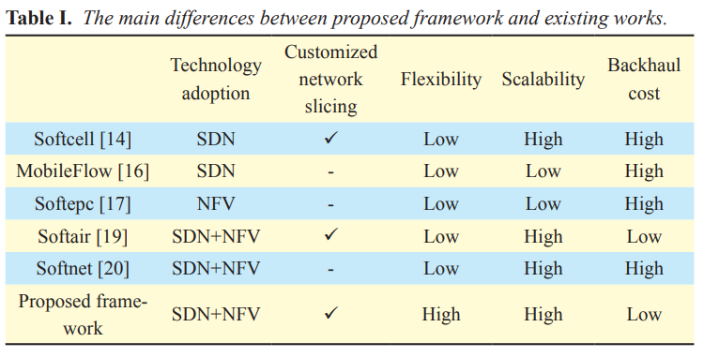
I. INTRODUCTION
The main differences between the existing works and the proposed framework are shown as Table 1.
Notes:
表1列出了現有工作與擬議框架之間的主要區別。
客製化的network slicing、靈活性、可擴展性、回傳成本

Slide 9
I. INTRODUCTION
The main contributions of this paper are summarized as follows.
In the proposed framework, the service management layer is responsible for the service management and orchestration, while the core and flow SDN controllers in the infrastructure management layer perform network function deployment, workload allocation, traffic scheduling, etc.
And the end-to-end network slicing architecture is presented, where some network functions related to scenarios of eMBB and URLLC can be deployed on the edge servers.
Notes:
本文的主要貢獻概述(summarized)如下。
1. 在提出的框架中，服務管理層負責服務管理和業務流程，而基礎架構管理層中的core和flow SDN controllers則負責網絡功能的部署，工作負載分配，流量調度等。
2. 提出了端到端的網絡切片架構，可以在邊緣服務器上部署一些與eMBB和URLLC場景相關的網絡功能。

Slide 10
I. INTRODUCTION
We formulate the workload allocation as a total cost minimization problem with consideration of the bandwidth cost of backhaul network, the energy consumption of mobile cloud core and mobile edge core, revenue loss associated with backhaul delay. And an optimal workload allocation algorithm is proposed.
Notes:
3.考慮到回程網絡的頻寬成本，cloud core and edge core的能耗以及與回程延遲相關的損失，我們將工作負載分配公式化為總成本最小化問題。 提出了一種最優的工作量分配算法。

Slide 11
II. THE MANAGEMENT ARCHITECTURE FOR 5G SERVICE BASED CORE NETWORK
2.1 Service based architecture for 5G core network
The 5G mobile network will be a service oriented network to enable more flexibility for the creation of new services and new applications.
Actually, the conventional mobile core network is an integrate system, it consists of network elements (e.g. MME, SGW, PGW, etc.) which includes different function modules tightly coupled with dedicated hardware.
The control plane and data plane are also coupled with hardware.
Notes:
二。 基於5G服務的核心網絡的管理架構
2.1 5G核心網的基於服務的架構
5G移動網絡將是面向服務的網絡，以為創建新服務和新應用程序提供更大的靈活性。
實際上，常規的移動核心網絡是一個集成系統，它由網絡單元（例如，MME，SGW，PGW等）組成，該網絡單元包括與專用硬體緊密耦合的不同功能模塊。
控制平面和數據平面也與硬件耦合。

Slide 12
2.1 Service based architecture for 5G core network
This architecture cannot accommodates the diverse demands of users in 5G era because of the lacks in flexibility, scalability, and deployability.
The 5G SBA is further designed according to microservice architecture pattern, the monolithic network elements are split into smaller network functions (NFs).
Each NF may be responsible for a single task and can be deployed independently.
Each NF exposes API that’s consumed by other NFs or clients.
Notes:
由於缺乏靈活性，可擴展性和可部署性，該架構無法適應(accommodates)5G時代用戶的多樣化(diverse)需求。
根據微服務架構模式進一步設計了5G SBA，將單片網絡元素拆分為較小的網絡功能（NF）。
每個NF可能負責一項任務，並且可以獨立部署。
每個NF公開其他NF或客戶端使用的API。

Slide 13
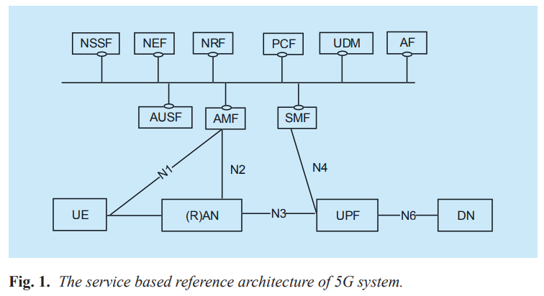
2.1 Service based architecture for 5G core network
Notes:
基於服務的5G參考架構

Slide 14
2.2 The proposed management architecture for service based 5G core network
For example, the autonomous driving and the smart grid controlling require radio latency of less than 1ms, and end-to-end latency of less than a few ms which cannot be guaranteed in current mobile network.
To solve the above challenges, we propose an NFV and SDN based architecture for management and deployment of 5G core network, as shown in figure 2.
Notes:
2.2提出的基於服務的5G核心網的管理架構
(低延遲) 例如，自動駕駛和智能電網控制需要不到1毫秒的無線電等待時間，以及不到幾毫秒的端到端等待時間，這在當前的移動網絡中是無法保證的。
為了解決上述挑戰，我們提出了一種基於NFV和SDN的架構來管理和部署5G核心網絡，如圖2所示。

Slide 15
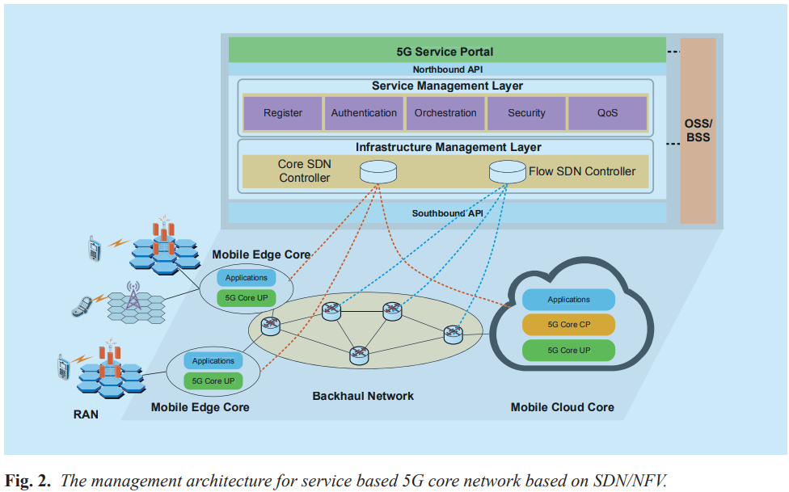
2.2 The proposed management architecture for service based 5G core network
Notes:
基於SDN / NFV的服務5G核心網絡管理架構

Slide 16
2.2 The proposed management architecture for service based 5G core network
The 5G Service Portal is the entrance of NFs to provide different services for users.
The Service Management Layer is responsible for orchestrating and configuring of NF modules based on the policy made by the Operation Support System (OSS) and Business Support System (BSS).
The 5G Infrastructure Management Layer manages the infrastructure of 5G core, including flow scheduling, NF deployment, network slicing, etc.
Notes:
5G服務門戶是NF的入口，可以為用戶提供不同的服務。
服務管理層負責根據運營支持系統（OSS）和業務支持系統（BSS）制定的策略來編排和配置NF模塊。
5G基礎架構管理層管理5G核心的基礎架構，包括流量調度，NF部署，網絡切片等。

Slide 17
2.2 The proposed management architecture for service based 5G core network
There are two kinds of SDN controllers in this layer: the Core SDN Controller in charge of NF management and coordination (e.g. service migration and deployment), the Flow SDN Controller in charge of efficient traffic dispatch in the backhaul network.
Controlled by SDN controller, the 5G core user plane (UP) and some applications can be deployed on the edge servers as mobile edge core (MEC), while the control plane (CP) are deployed in the cloud date center as mobile cloud core (MCC).
As a result, the requests related to mobile broadband and mission-critical applications could be served at edge of network to reduce the traffic anchoring to core network and eliminate backhaul delay.
Notes:
該層中有兩種SDN控制器：Core SDN Controller 負責NF管理和協調（例如服務遷移和部署），Flow SDN Controller負責回程網絡中高效流量分配。
在SDN控制器的控制下，5G核心用戶平面（UP）和某些應用程序可以作為移動邊緣核心（MEC）部署在邊緣服務器上，而控制平面（CP）作為移動雲核心（CP）部署在雲數據中心（MCC）。
結果，(需要低延遲的任務) 與移動頻寬和關鍵任務(mission-critical)應用有關的請求可以在網絡邊緣得到滿足，以減少將流量錨定到核心網絡並消除回程延遲。

Slide 18
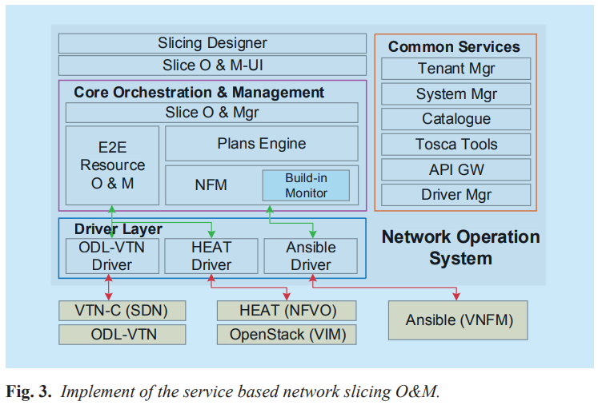
2.2 The proposed management architecture for service based 5G core network
Based on the proposed framework, we have accomplished the design and implementation of service based network slicing Orchestration and Management (O&M) architecture for 5G SBA, as shown in figure 3.
Notes:
在此框架的基礎上，我們完成了針對5G SBA的基於服務的網絡切片編排和管理（O＆M）架構的設計和實現，如圖3所示。

Slide 19
2.2 The proposed management architecture for service based 5G core network
OpenStack is utilized to realize the virtualization platform where the computing, storage resources of the NFVI are virtualized by means of a virtualized infrastructure manager (VIM).
The NFV orchestration (NFVO) is implemented by HEAT module in OpenStack which can conduct deployment and lifecycle management of services based on HEAT templates.
Ansible acts as the Virtualized Network Function Management (VNFM) which is an automation tool to configure, deploy, and orchestrate advanced tasks such as continuous deployment or zero downtime rolling updates.
Notes:
OpenStack用於實現虛擬化平台，其中NFVI的 [計算、存儲資源] 通過虛擬化基礎架構管理器（VIM）進行虛擬化。
NFV編排 (NFVO) 由OpenStack中的HEAT module實現，該模塊可以基於HEAT模板進行服務的部署和生命週期管理。
Ansible充當虛擬網絡功能管理（VNFM），這是一種用於配置，部署和編排高級任務（例如連續部署或零停機滾動更新）的自動化工具。

Slide 20
2.2 The proposed management architecture for service based 5G core network
As for the management and orchestration of IP transport network resources, we make use of OpenDaylight (ODL) open source project.
With ODL as the SDN controller, we can conduct the network resource management and structure multiple Virtual Tenant Network (VTN).
The Network Operation System (NOS) mainly consists of common services, core orchestration and management function, drivers as well as the slice designer and specific UIs.
The functions and implement of these components are as follow :
Notes:
至於IP傳輸網絡資源的管理和編排，我們利用OpenDaylight（ODL）開源項目。
使用ODL作為SDN控制器，我們可以進行網絡資源管理並構建多個虛擬租戶網絡（VTN）。
網絡操作系統（NOS）主要由公共服務，核心編排和管理功能，驅動程序以及分片設計器和特定的UI組成。
這些組件的功能和實現如下：

Slide 21
2.2 The proposed management architecture for service based 5G core network
The Common Services : provide the fundamental function for management of network slicing (e.g., tenant information management, service register and discovery, driver management, etc.).
The core orchestration and management : is responsible for slice monitoring, configuration and slice-level orchestration and management.
The Driver layer : provides different kinds of drivers as adaptors between the NOS and SDN/NFV components.
The Slicing Designer : provides on-demand customization of network slice for users through generating meta data design files or scripts for TOSCA model.
Notes:
公用服務：提供用於網絡切片管理的基本功能（例如，租戶信息管理，服務註冊和發現，驅動程序管理等）。
核心業務流程和管理：負責切片監控，配置以及切片級別的業務流程和管理。
驅動程式層：提供不同類型的驅動程序作為NOS和SDN / NFV組件之間的適配器。
切片設計器：通過為TOSCA模型生成元數據設計文件或腳本，為用戶提供按需定制的網絡切片。

Slide 22
2.2 The proposed management architecture for service based 5G core network
1) The Common Services :
Tenant Manager : provides tenant information of management and authorization, authentication control.
System Manager : provides system component management of slicing management system including register, update, and monitoring.
Catalogue : provides catalogue management of the data related to the slice orchestration and management. The NGINX is utilized to implement this service
Notes:
公用服務
承租人管理器：提供承租人信息的管理和授權，身份驗證控制。
系統管理器：提供切片管理系統的系統組件管理，包括註冊，更新和監視。
目錄：提供與切片編排和管理相關的數據的目錄管理。 NGINX用於實施此服務

Slide 23
2.2 The proposed management architecture for service based 5G core network
1) The Common Services :
TOSCA Tools : provide common tools to interpret and construct TOSCA models. We make use of Apache ARIA TOSCA to implement the orchestrator of TOSCA model.
API GW (API Gateway) : is a significant component to support service oriented framework. It provides API management, register, publishing and coordination of network services. The open source WSO2 API Manager is utilized to implement the design, creation, publishing and management of APIs in each service.
Notes:
TOSCA：工具提供了用於解釋和構造TOSCA模型。 我們利用Apache ARIA TOSCA來實現TOSCA模型的協調器。
API GW（API網關）：是支持面向服務的框架的重要組件。 它提供API管理，網絡服務的註冊，發布和協調。 開源WSO2 API管理器用於在每個服務中實現API的設計，創建，發布和管理。

Slide 24
2.2 The proposed management architecture for service based 5G core network
1) The Common Services :
Driver Manager : provides the management of drivers.
Notes:
驅動程序管理器：提供驅動程序管理。

Slide 25
2.2 The proposed management architecture for service based 5G core network
2) The core orchestration and management :
Slice O&M : provides the orchestration and management of end-to-end network slices including lifecycle and context management, monitoring, configuration. The Flask microframework is utilized to implement the slice O&M framework.
Plans Engine : is responsible for workflow model design of network slice. The open source project Activiti is used to implement the workflow management and design engine.
Notes:
2. 核心編排和管理：
Slice O＆M：提供端到端網絡切片的編排和管理，包括生命週期和上下文管理，監視，配置。 Flask microframework用於實現切片運維框架。
計劃引擎 (Plans Engine )：負責網絡切片的工作流模型設計。 開源項目Activiti用於實現工作流管理和設計引擎。

Slide 26
2.2 The proposed management architecture for service based 5G core network
2) The core orchestration and management :
E2E Resource O&M : provides end-to end infrastructure resource management of network slice, including the register, activation, management of computing and storage resources in data center (DC) and IP transport network resources.
Notes:
End to end資源運維：提供網絡切片的端到端基礎設施資源管理，包括數據中心（DC）和IP傳輸網絡資源的註冊，啟動，計算和存儲資源管理。

Slide 27
2.2 The proposed management architecture for service based 5G core network
2) The core orchestration and management :
NFM module : maintains and manages the interface information and parameters of network function. It can perform configuration, lifecycle management, monitoring of each network function. A build-in monitor component is implemented for collection and management of network function state information. The Build-in monitor is implemented by the open source Nagios which is monitoring system of running status information in the NOS.
Notes:
NFM模塊：維護和管理網絡功能的接口信息和參數。 它可以執行配置，生命週期管理，監視每個網絡功能。 實現了一個內置的監視程序組件，用於收集和管理網絡功能狀態信息。 內置監視器由開源Nagios實現，Nagios是NOS ( Network Operation System )中運行狀態信息的監視系統。

Slide 28
2.2 The proposed management architecture for service based 5G core network
The main novelties of the proposed management framework could be summarized as follows:
In the proposed framework, all the services are managed and deployed on NFV based platform. It provides more flexible orchestration of NFs to get better system performance, satisfying diverse requirements of users.
Notes:
提議的管理框架的主要新穎之處可以總結如下：
在提出的框架中，所有服務都在基於NFV的平台上進行管理和部署。 它提供了更靈活的NF編排以獲得更好的系統性能，滿足了用戶的各種需求。

Slide 29
2.2 The proposed management architecture for service based 5G core network
2. Two different SDN controllers are used in the infrastructure management layer. The Core SDN controller is responsible for deployment and management of NFs, and the Flow SDN controller handles efficient traffic dispatch of backhaul network.
In the proposed framework, not all services will be implemented in the MEC.
Notes:
2.在基礎結構管理層中使用了兩個不同的SDN控制器。 Core SDN控制器負責NF的部署和管理，而Flow SDN控制器則負責回程網絡的高效流量分配。
在建議的框架中，並非所有服務都將在MEC中實現。

Slide 30
2.2 The proposed management architecture for service based 5G core network
On one hand, the flow SDN controller makes the flow transmission more efficient, on the other hand, some core network functions are distributed to the edge of the access networks, and a lot of ultra-broadband traffic are anchored the MEC, backhaul traffic will significantly decrease, thereby bringing down backhaul investment costs as well.
Notes:
//// 例如，IMS服務將繼續在MCC中實現，而超實時(ultra-real time )服務和影片緩存服務將由MEC處理。
一方面，flow SDN控制器使流的傳輸效率更高，另一方面，一些核心網絡功能被分佈到接入網絡的邊緣，並且許多超頻寬流量被錨定在MEC上，回程流量將 顯著降低，從而也降低了回程投資成本。

Slide 31
2.2 The proposed management architecture for service based 5G core network
3. In the proposed framework, 5G core network functions are deployed in a distributed way.
As a complement to the MCC, the 5G MEC can process partial workloads locally on edge servers without transmitting them to the remote cloud data centers.
As a consequence, the 5G core network can achieve lower end-to-end delay for URLLC traffic which need ultra-low latency of a few ms.
Notes:
3.在建議的框架中，以分佈式方式部署5G核心網絡功能。
作為MCC的補充，5G MEC可以在邊緣服務器上本地處理部分工作負載，而無需將其傳輸到遠程雲數據中心。
結果，5G核心網絡可以為URLLC流量實現更低的端到端延遲，而這需要幾毫秒的超低延遲。

Slide 32
2.2 The proposed management architecture for service based 5G core network
4. In the proposed framework, the optimal strategy of minimizing the total cost of distributed 5G core network can be made in Core SDN controller by optimally deciding the number of active servers in cloud data centers, workload allocation between MEC and MCC.
Notes:
4. 在建議的框架中，可以通過最佳確定雲數據中心中活動服務器的數量，MEC和MCC之間的工作負載分配，在Core SDN控制器中製定使分佈式5G核心網絡的總成本最小化的最佳策略。

Slide 33
III. APPLICATIONS AND USE CASES
In this section, we present three network management applications to demonstrate the advantages of the proposed framework based on SDN/NFV
Notes:
三， 應用和使用案例
在本節中，我們將介紹三個網絡管理應用程序，以演示基於SDN / NFV的建議框架的優勢。

Slide 34
3.1 Service guaranteed network slicing
Hence, the operators have to serve a variety of devices with different characteristics and needs.
For example, AR and VR have strict requirements on data rate and latency, while the mobile broadband service need high capacity and video cache.
The network slices are virtual and end-to-end networks which are each logically isolated including device, access, transmission and core network and dedicated for diversified requirements and characteristics of vertical industries.
Notes:
3.1服務保證網絡切片
因此，運營商必須為具有不同特性和需求的各種設備提供服務。
例如，AR和VR對數據速率和延遲有嚴格的要求，而移動寬帶服務需要高容量和影片緩存。
網絡切片是虛擬的和端到端的網絡，每個邏輯上都是隔離的，包括設備，訪問，傳輸和核心網絡，並且專門用於垂直行業的各種需求和特徵。

Slide 35
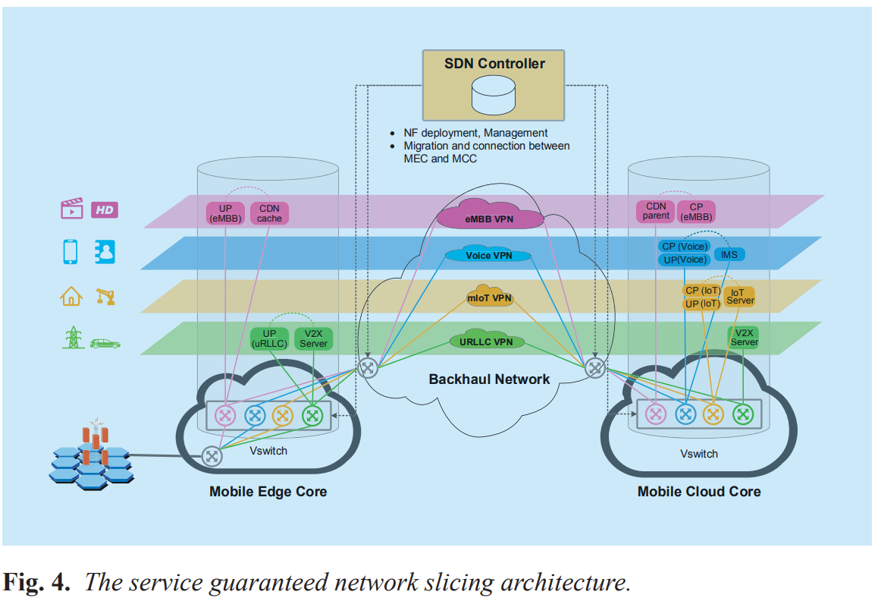
3.1 Service guaranteed network slicing
Notes:
VPN (virtual private network) 介紹在後面

Slide 36
3.1 Service guaranteed network slicing
First, the NFs are installed onto VMs deployed on the virtualized commercial servers.
Then, the virtualized network functions (VNFs) can be deployed in MEC or MCC depending on the types of services.
SDN controller performs provisioning of routers in the backhaul network to create SDN tunnels (i.e. Virtual Private Networks, VPNs) for different slices and manage VNFs in the clouds.
Notes:
首先，將NF安裝到部署在虛擬化商用(commercial)服務器上的VM。
然後，可以根據服務類型在MEC或MCC中部署虛擬網絡功能（VNF）。
SDN控制器在回程網絡中執行路由器的配置，以為不同的切片創建SDN隧道（即虛擬專用網，VPN）並管理雲中的VNF。

Slide 37
3.1 Service guaranteed network slicing
For instance, the user plane functions, the cache, the V2X server can be placed in the mobile edge to accommodate the requirements of eMBB and URLLC slices, while the functions of mIoT and traditional voice will implemented in the mobile core cloud.
For each network slice, isolation and dedicated resources such as resources within virtualized servers, network bandwidth and QoS are guaranteed.
Notes:
例如，用戶平面功能，緩存，V2X (Vehicle to Everything 車聯網相關的) 服務器可以放置在移動邊緣以適應eMBB和URLLC片的需求，而mIoT和傳統語音的功能將在移動核心雲中實現。
對於每個網絡切片，都可以保證隔離和專用資源，例如虛擬服務器中的資源，網路頻寬和QoS。

Slide 38
3.2 Flexible orchestration of network functions
In 5G era, not only the traffic types are diverse, but also the resource requirements of each scenario are dynamically changing over time and diverse among different users.
Hence, the mobile operators should have a collection of services which can be run on particular data flows.
The number of services and the order in which they are applied depend on the traffic and users.
Notes:
3.2網絡功能的靈活編排
在5G時代，不僅流量類型多種多樣，而且每種方案的資源需求都隨著時間動態變化，並且在不同用戶之間也多種多樣。
因此，移動運營商應具有可以在特定數據流上運行的服務的集合。
服務的數量和應用順序取決於流量和用戶。

Slide 39
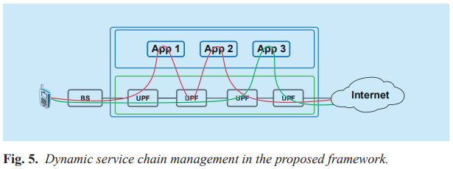
3.2 Flexible orchestration of network functions
As shown in figure 5, a user activates two types of flows which are routed to different services.
Notes:
* 服務鏈(red line and green line)的編排是動態的，並根據流量類型來決定路線

Slide 40
3.2 Flexible orchestration of network functions
The SDN controller will make a tradeoff between the revenue and expense of the migration based on the current network status (e.g. latency, bandwidth, QoS, cost, etc.) and then determine whether migrate the service or not.
The Migration Determining Factor ( MDF ) of service node x is a function of the latency, the available load, bandwidth, service price and credit, etc.
If y is defined as the previous service provider (i.e. the start point of migration), the MDF can be expressed as :
Notes:
SDN控制器將根據當前網絡狀態（例如，延遲，頻寬，QoS，成本等）在遷移的收入和費用之間進行權衡，然後確定是否遷移服務。
服務節點x的MDF是[ 延遲，可用負載，帶寬，服務價格和信用等 ] 的函數。
如果將y定義為先前的服務提供者（即遷移的起點），則MDF可以表示為：
Migration : 移民

Slide 41

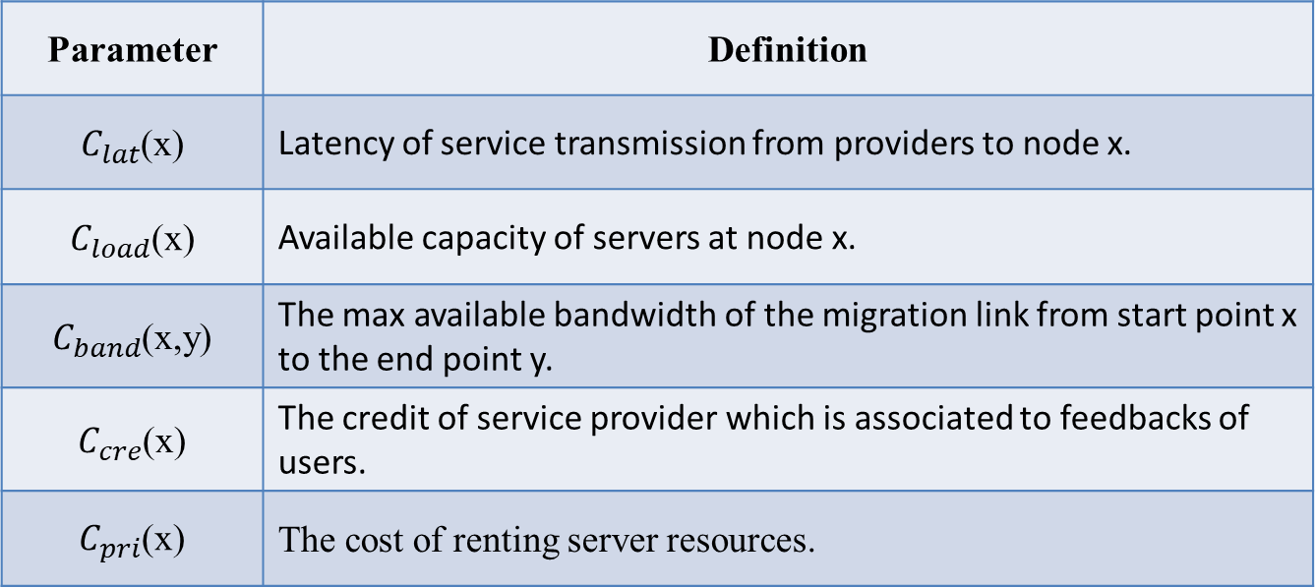
3.2 Flexible orchestration of network functions
Parameter | Definition
$C_{lat}$(x) | Latency of service transmission from providers to node x.
$C_{load}$(x) | Available capacity of servers at node x.
$C_{band}$(x,y) | The max available bandwidth of the migration link from start point x to the end point y.
$C_{cre}$(x) | The credit of service provider which is associated to feedbacks of users.
$C_{pri}$(x) | The cost of renting server resources.
Notes:
從提供商到節點x的服務傳輸延遲。
節點x上服務器的可用容量。
從起點x到終點y的遷移鏈接的最大可用頻寬。
與用戶的反饋相關聯的服務提供商的信譽。
租用服務器資源的成本。

Slide 42
3.2 Flexible orchestration of network functions
Consequently, we can get a matrix Q which consist of the determining factors of all service nodes.
Through setting the weight coefficients for parameters and normalizing the matrix, we can get the relative cost of migration to each node. Then, the node has minimum cost will be selected as the service provider.
Notes:
因此，我們可以獲得由所有服務節點的確定因素組成的矩陣Q。 (遷移到不同節點所形成的矩陣)
通過設置參數的權重係數並對矩陣進行歸一化，我們可以獲得遷移到每個節點的相對成本。 然後，將選擇具有最低成本的節點作為服務提供者。

Slide 43
3.3 Optimal workload allocation in 5G core network
Since the high operational cost of cloud and the collaboration requirements between MCC and MEC of some services, it is important to manage the operational cost in a distributed 5G core network.
In the proposed framework, the strategy of minimizing the total cost of distributed 5G core network can be made in Core SDN controller by optimally deciding the number of active servers in cloud data centers, workload allocation between MEC and MCC.
Notes:
3.3 5G核心網中的最佳工作負載分配
由於雲的高昂運營成本以及MCC與某些服務的MEC之間的協作要求，因此管理分佈式5G核心網絡中的運營成本非常重要。
在提出的框架中，可以通過最佳確定雲數據中心中活動服務器的數量，MEC和MCC之間的工作負載分配，在Core SDN控制器中製定將分佈式5G核心網絡的總成本降至最低的策略。

Slide 44
3.3 Optimal workload allocation in 5G core network
To investigate the problem, we assume that the 5G core network consists of N MECs and M cloud data centers in MCC to serve J types of requests.
Edge servers are co-located with their corresponding base stations and collaborate with MCC to process the tasks from users.
The problem modelling and formulation are given as flows.
Notes:
為了調查該問題，我們假設5G核心網絡由MCC中的N個MEC和M個cloud data centers組成，以服務於J類請求。
邊緣服務器與它們相應的基站位於同一位置，並與MCC協作以處理用戶的任務。
問題建模和表述以流程形式給出。 ( 介紹公式的意思 )

Slide 45

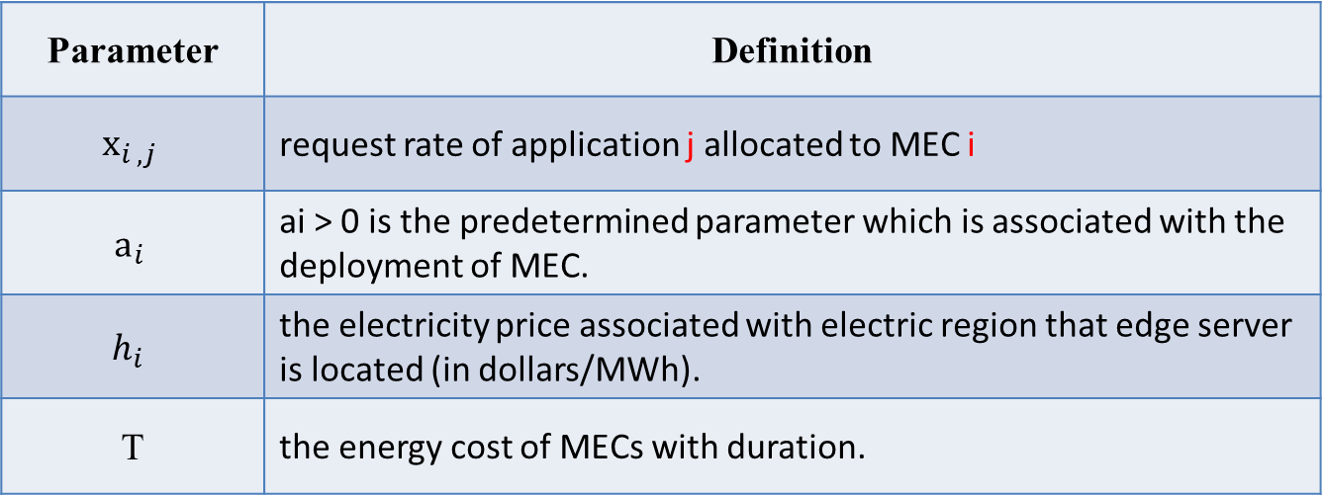
3.3 Optimal workload allocation in 5G core network
Energy cost of MEC :
We assume that there is a linear relationship between energy consumption and workload.
Parameter | Definition
$${\text{x}}_{i , j}$$ | request rate of application j allocated to MEC i
$${\text{a}}_{i}$$ | ai > 0 is the predetermined parameter which is associated with the deployment of MEC.
$$h_{i}$$ | the electricity price associated with electric region that edge server is located (in dollars/MWh).
T | the energy cost of MECs with duration.
Notes:
1. MEC的能源成本：
我們假設能耗與工作量之間存在線性關係。
${\text{x}}_{i , j}$ : 分配給MEC i的應用j的請求速率 ( 加入排隊的意思 )
${\text{a}}_{i}$ : ${\text{a}}_{i}$> 0是與MEC的部署相關聯的預定參數。
$h_{i}$ : 與邊緣服務器所在的電力區域相關的電價（美元/ MWh）。
T : MEC的能源成本和持續時間。

Slide 46
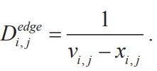

3.3 Optimal workload allocation in 5G core network
Processing delay of MEC : M/M/1 model is adopted to evaluate the processing delay of application j at MEC i [24].
M/M/1 model ( M/M/1排隊模型 )
加入隊列的速率 λ 在各狀態中均相同。
完成服務離開隊列的速率 μ 亦在各狀態中相同。
有人加入隊列。如果模型在狀態 k (模型中有k個人)，它會以速率 λ 進入狀態k + 1
有人離開隊列。如果模型在狀態 k，它會以速率 μ 進入狀態 k − 1
模型的隱定條件為λ < μ
Parameter | Definition
V_{i,j} | the service rate of application j at the MEC i (in requests/second).
Notes:
2. MEC的處理延遲：採用M / M / 1模型評估MEC i上應用j的處理延遲[24]。
MEC i上應用程序j的服務速率（以請求/秒為單位）。( 離開排隊的意思 )

Slide 47
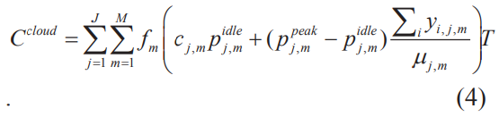
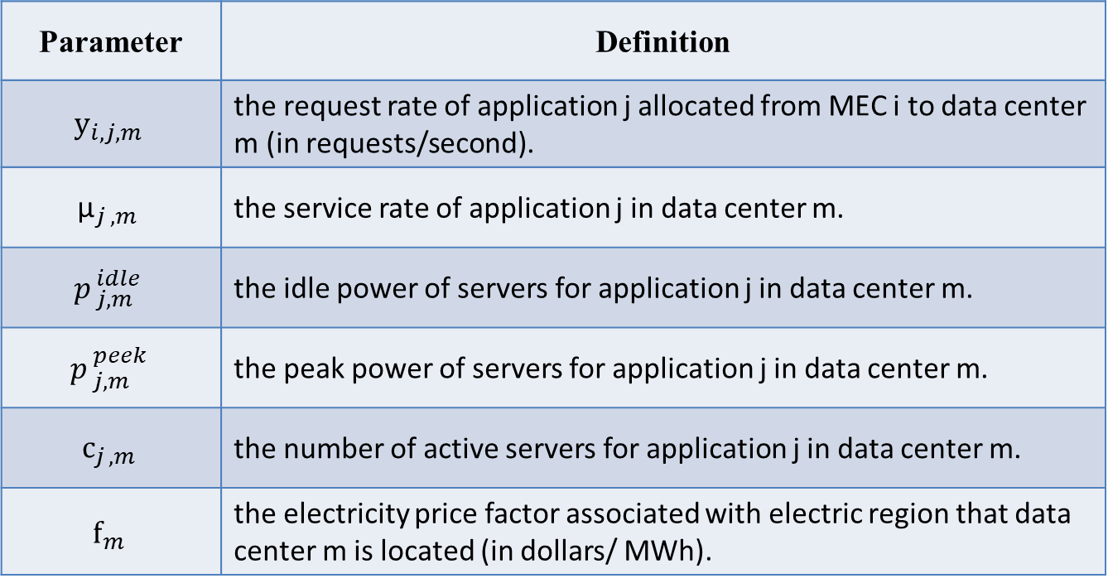
3.3 Optimal workload allocation in 5G core network
Energy cost of MCC :
Parameter | Definition
$${\text{y}}_{i,j,m}$$ | the request rate of application j allocated from MEC i to data center m (in requests/second).
$${\text{µ}}_{j , m}$$ | the service rate of application j in data center m.
$$p_{ j,m}^{ idle}$$ | the idle power of servers for application j in data center m.
$$p_{ j,m}^{ peek}$$ | the peak power of servers for application j in data center m.
$${\text{c}}_{j , m}$$ | the number of active servers for application j in data center m.
$${\text{f}}_{m}$$ | the electricity price factor associated with electric region that data center m is located (in dollars/ MWh).
Notes:
3. MCC的能源成本：
${\text{y}}_{i,j,m}$ : 從MEC i分配給數據中心m的應用j的請求速率（以請求/秒為單位）。
${\text{µ}}_{j , m}$ : 數據中心m中應用j的服務速率。
$p_{ j,m}^{ idle}\text{:}$ 數據中心m中應用程序j的服務器的空閒功率。
$p_{ j,m}^{ peek}\text{:}$數據中心m中應用j的服務器的峰值功率。
$c_{j , m}\text{:}$ 數據中心m中應用程序j的活動服務器數。
${\text{f}}_{m}$ : 與數據中心m所在的電力區域相關的電力價格因數（美元/ MWh）。

Slide 48

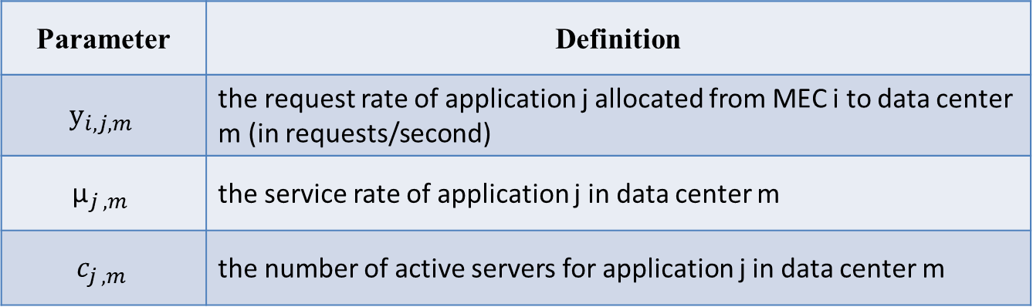
3.3 Optimal workload allocation in 5G core network
Processing delay of MCC :
Parameter | Definition
$${\text{y}}_{i,j,m}$$ | the request rate of application j allocated from MEC i to data center m (in requests/second)
$${\text{µ}}_{j , m}$$ | the service rate of application j in data center m
$$c_{j , m}$$ | the number of active servers for application j in data center m
Notes:
4. MCC的處理延遲：
${\text{y}}_{i,j,m}$ : 從MEC i分配給數據中心m的應用j的請求速率（以請求/秒為單位）。
${\text{µ}}_{j , m}$ : 數據中心m中應用j的服務速率。
$c_{j , m}\text{:}$ 數據中心m中應用程序j的活動服務器數。

Slide 49

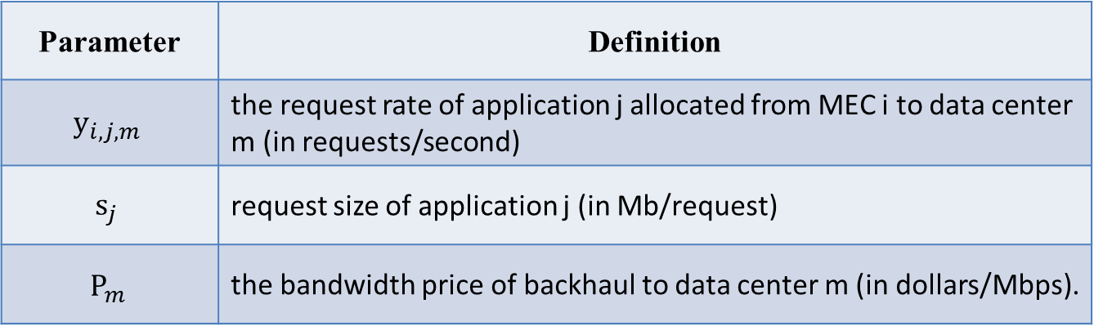
3.3 Optimal workload allocation in 5G core network
Bandwidth cost of backhaul network :
Parameter | Definition
$${\text{y}}_{i,j,m}$$ | the request rate of application j allocated from MEC i to data center m (in requests/second)
$${\text{s}}_{j}$$ | request size of application j (in Mb/request)
$${\text{P}}_{m}$$ | the bandwidth price of backhaul to data center m (in dollars/Mbps).
Notes:
5. 回傳網絡的帶寬成本 :
${\text{y}}_{i,j,m}$ : 從MEC i分配給數據中心m的應用j的請求速率（以請求/秒為單位）。
${\text{s}}_{j}$ : 應用程序j的請求大小（以Mb /請求為單位）
${\text{P}}_{m}$ : 回程到數據中心m的帶寬價格（美元/ Mbps）。

Slide 50

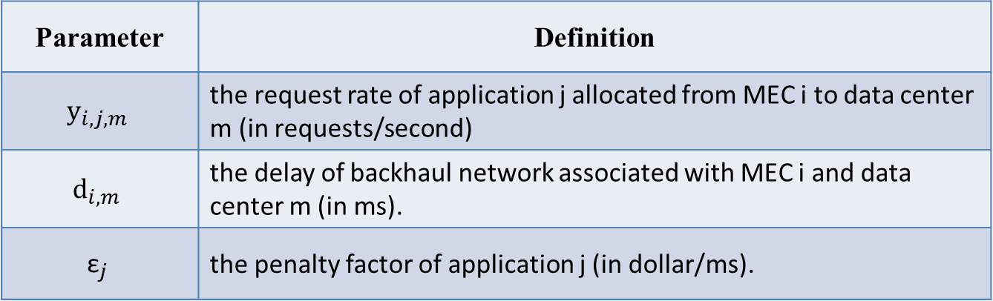
3.3 Optimal workload allocation in 5G core network
Revenue loss related to backhaul delay :
Because the backhaul delay usually leads to revenue loss, we deem it as a kind of cost.
Parameter | Definition
$${\text{y}}_{i,j,m}$$ | the request rate of application j allocated from MEC i to data center m (in requests/second)
$${\text{d}}_{i,m}$$ | the delay of backhaul network associated with MEC i and data center m (in ms).
$${\text{ε}}_{j}$$ | the penalty factor of application j (in dollar/ms).
Notes:
6.與回程延遲有關的收入損失：
由於回程延遲通常會導致收入損失，因此我們將其視為一種成本。
${\text{y}}_{i,j,m}$ : 從MEC i分配給數據中心m的應用j的請求速率（以請求/秒為單位）。
${\text{d}}_{i,m}$ : 與MEC i和數據中心m相關的回程網絡的延遲（以ms為單位）。
${\text{ε}}_{j}$ : 應用j的懲罰因子（以美元/毫秒為單位）。

Slide 51
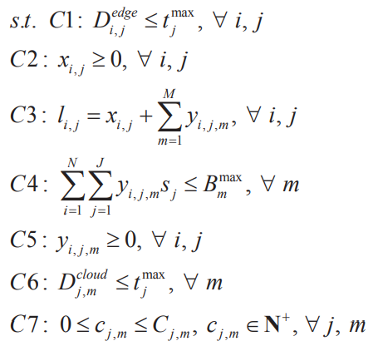
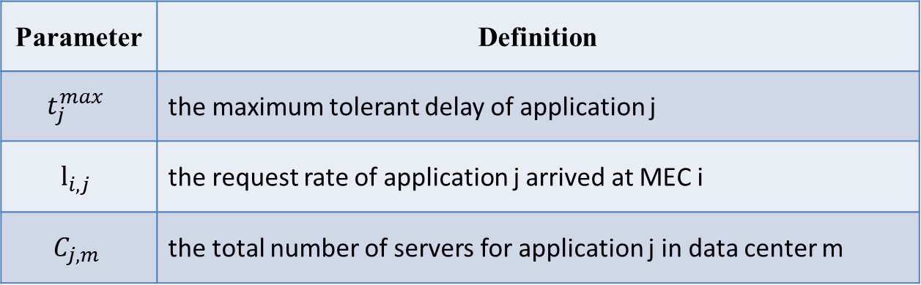
3.3 Optimal workload allocation in 5G core network
Consequently, the optimal workload allocation can be formulated as total system cost minimization problem :
(9)
Parameter | Definition
$$t_{j}^{max}$$ | the maximum tolerant delay of application j
$${\text{l}}_{i,j}$$ | the request rate of application j arrived at MEC i
$$C_{j,m}$$ | the total number of servers for application j in data center m
Notes:
因此，最佳工作量分配可公式化為總系統成本最小化問題：
C1 : $D_{ i,j}^{ edge}$ => Processing delay of MEC : 小於容忍值
C2 : $x_{i,j}$ => the request rate of application j allocated to MEC i : 過去排隊的request速率
C3 : $l_{i,j}$ => 總共到 MEC 的requests , $x_{i,j}$ => MEC 自己處理的requests , ${\text{y}}_{i,j,m}$ => 送給MCC處理的requests
C4 : B => 要小於最大頻寬
C5 : ${\text{y}}_{i,j,m}$ => the request rate of application j allocated from MEC i to data center m (in requests/second) : 送給MCC的request rate
C6 : $D_{ i,j}^{ cloud}$ => Processing delay of MCC : 小於容忍值
C7 : c => the number of active servers for application j in data center m => 有在動的server比total number of servers少

Slide 52
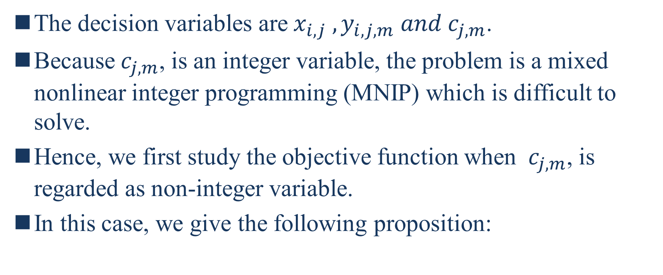
3.3 Optimal workload allocation in 5G core network
The decision variables are${ x}_{i,j} , y_{i,j,m} and{ c}_{j,m}$.
Because${ c}_{j,m}$, is an integer variable, the problem is a mixed nonlinear integer programming (MNIP) which is difficult to solve.
Hence, we first study the objective function when ${ c}_{j,m}$, is regarded as non-integer variable.
In this case, we give the following proposition:
Notes:
決策變量為${ x}_{i,j} , y_{i,j,m} and{ c}_{j,m}$
因為${ c}_{j,m}$是一個整數變量，所以問題是難以解決的混合非線性整數規劃（MNIP）。
因此，我們首先研究將${ c}_{j,m}$視為非整數變量時的目標函數。
在這種情況下，我們提出以下命題：
MNIP : https://wiki.mbalib.com/zh-tw/%E6%95%B4%E6%95%B0%E8%A7%84%E5%88%92 => 因為${ c}_{j,m}為整數$，代表一部分的參數被限制為整數，所以是一個”混合”的非線性整數規劃

Slide 53
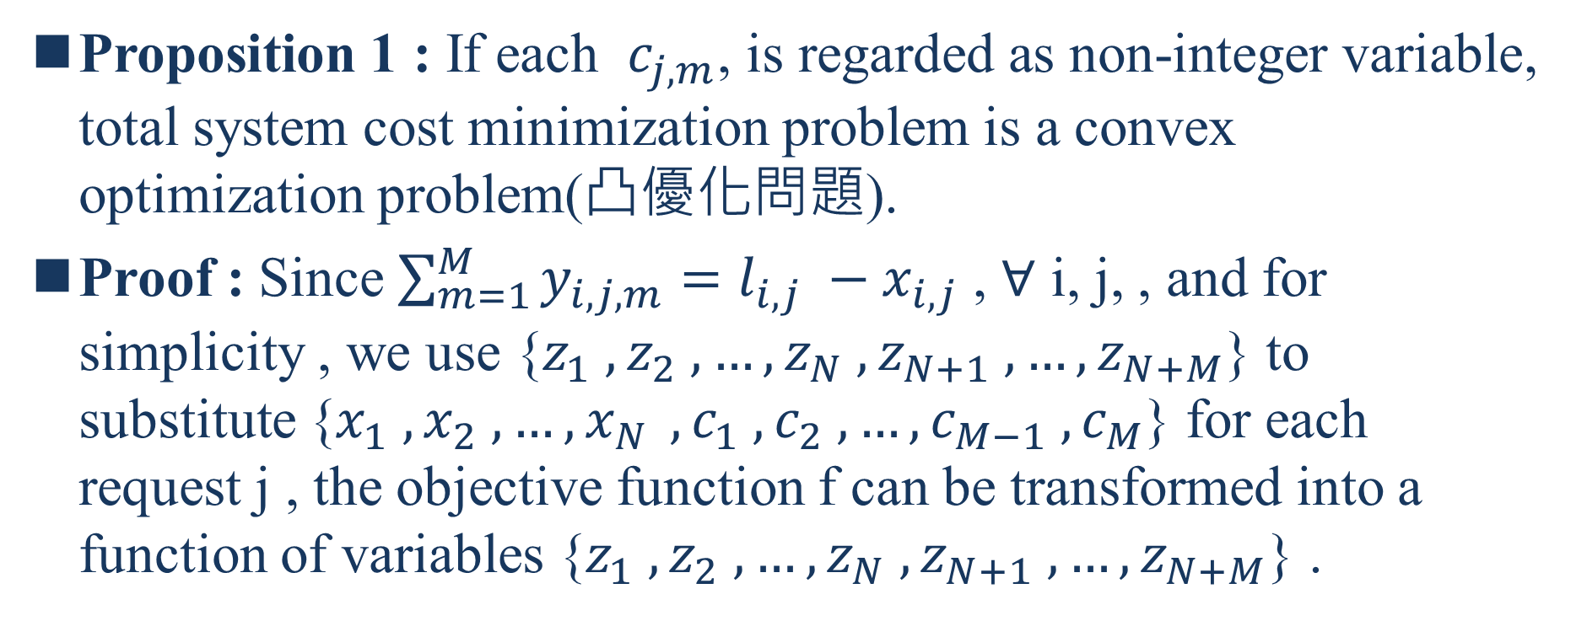
3.3 Optimal workload allocation in 5G core network
Proposition 1 : If each ${ c}_{j,m}$, is regarded as non-integer variable, total system cost minimization problem is a convex optimization problem(凸優化問題).
Proof : Since $\sum_{m=1}^{M}{y_{i,j,m}}=l_{i,j} −x_{i,j}$ , ∀ i, j, , and for simplicity , we use {$z_{1} ,z_{2} , …,z_{N} ,z_{N+1} , …,z_{N+M}$} to substitute {$x_{1} ,x_{2} , …{,x}_{N} ,c_{1} ,c_{2} , …,c_{M−1} ,c_{M}$} for each request j , the objective function f can be transformed into a function of variables {$z_{1} ,z_{2} , …,z_{N} ,z_{N+1} , …,z_{N+M}$} .
Notes:
命題1：如果將每個${ c}_{j,m}$視為非整數變量，則總系統成本最小化問題就是凸優化問題

Slide 54
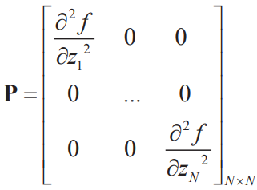
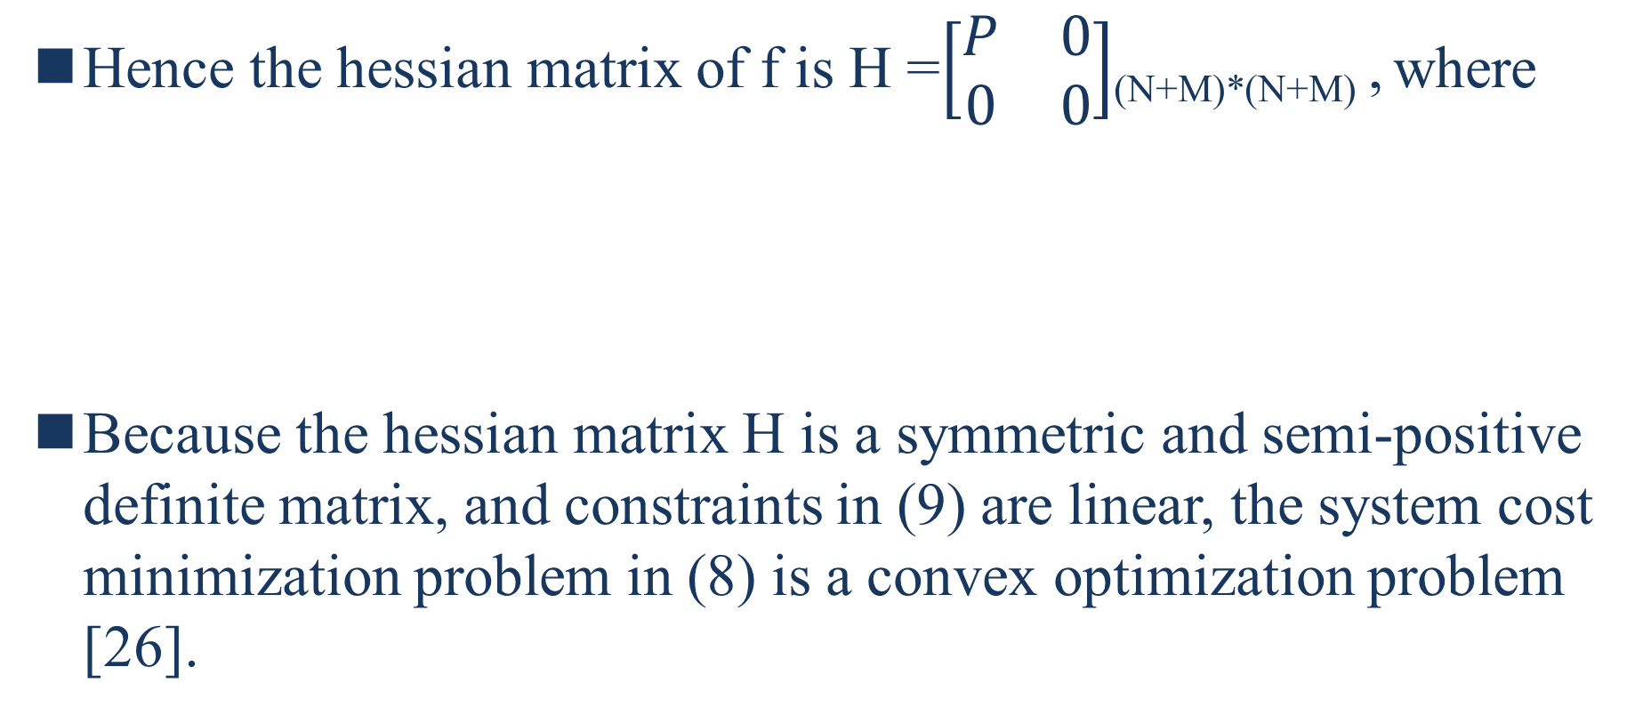
3.3 Optimal workload allocation in 5G core network
Hence the hessian matrix of f is H =$\left[\begin{matrix}P & 0 \\ 0 & 0\end{matrix}\right]$_{(N+M)*(N+M)} , where
Because the hessian matrix H is a symmetric and semi-positive definite matrix, and constraints in (9) are linear, the system cost minimization problem in (8) is a convex optimization problem [26].
Notes:
因為海森矩陣H是一個對稱的半正定矩陣，並且（9）中的約束是線性的，所以（8）中的系統成本最小化問題是凸優化問題[26]。

Slide 55
3.3 Optimal workload allocation in 5G core network
Therefore, the interior-point algorithm(內點法) can be used to solve the convex optimization problem, which has obvious advantages in convergence and computation speed.
Based on the above modelling and formulation, we develop a workload allocation algorithm to minimize the system cost, which can be implemented in the proposed framework.
The details of the workload allocation algorithm are described as Algorithm 1.
Notes:
因此，內點法可以解決凸優化問題，在收斂性和計算速度上具有明顯的優勢。
基於上述建模和公式化，我們開發了一種工作負載分配算法，以最大程度地降低系統成本，該算法可以在建議的框架中實現。
工作負載分配算法的詳細信息在算法1中進行了描述。
Interior Point Method 是一種用迭代的方式解最佳化問題的方法。
https://www.zhihu.com/column/p/30955829

Slide 56
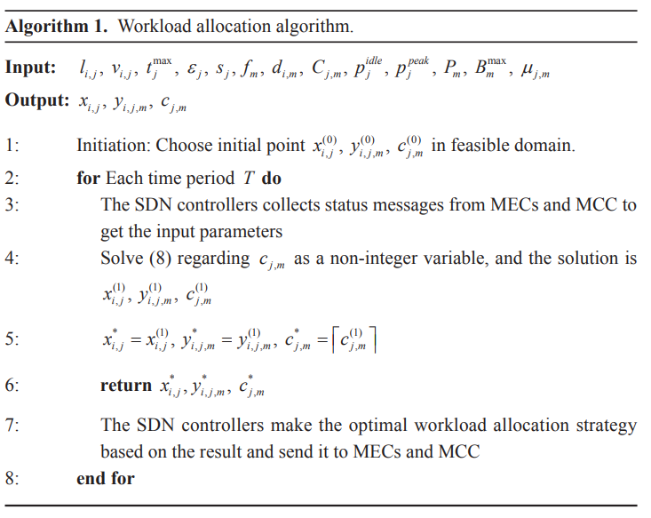
3.3 Optimal workload allocation in 5G core network
Notes:
因為$c_{j,m}是整數$ => 是一個MNIP問題，但很難解為NPC問題 => 把$c_{j,m}$視為非整數 => 問題將變成一個convex optimization problem ( 凸優化問題 ) => 比較好解

Slide 57
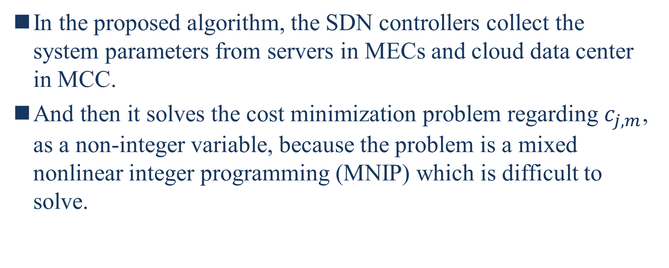
3.3 Optimal workload allocation in 5G core network
In the proposed algorithm, the SDN controllers collect the system parameters from servers in MECs and cloud data center in MCC.
And then it solves the cost minimization problem regarding$c_{j,m}$, as a non-integer variable, because the problem is a mixed nonlinear integer programming (MNIP) which is difficult to solve.
Notes:
在提出的算法中，SDN controllers從MEC中的server和MCC中的雲數據中心收集系統參數。
然後，它解決了將$c_{j,m}$作為非整數變量的成本最小化問題，因為該問題是難以解決的混合非線性整數規劃（MNIP）。

Slide 58
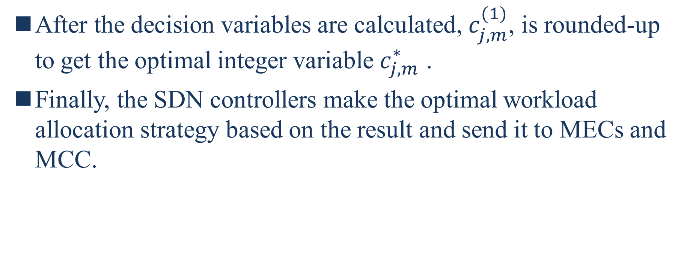
3.3 Optimal workload allocation in 5G core network
After the decision variables are calculated, $c_{j,m}^{(1)}$, is rounded-up to get the optimal integer variable $c_{j,m}^{∗}$ .
Finally, the SDN controllers make the optimal workload allocation strategy based on the result and send it to MECs and MCC.
Notes:
計算完決策變量後，對$c_{j,m}^{(1)}$進行四捨五入以獲得最佳整數變量$c_{j,m}^{∗}$。
最後，SDN控制器根據結果制定最佳的工作負載分配策略，並將其發送給MEC和MCC。

Slide 59
IV. EVALUATION AND ANALYSIS
In this section, we evaluate the optimal workload allocation and provide simulation results to show the advantages of proposed framework, compared with a baseline algorithm.
The baseline means minimizing the consumption of core network without collaborating with edge network when processing the workload from users.
Notes:
在本節中，我們評估最佳工作負載分配，並提供仿真結果，以顯示與基線算法相比，所提出框架的優勢。
基準線意味著在處理用戶的工作負載時，最大程度地減少核心網絡的消耗，而無需與邊緣網絡協作。

Slide 60
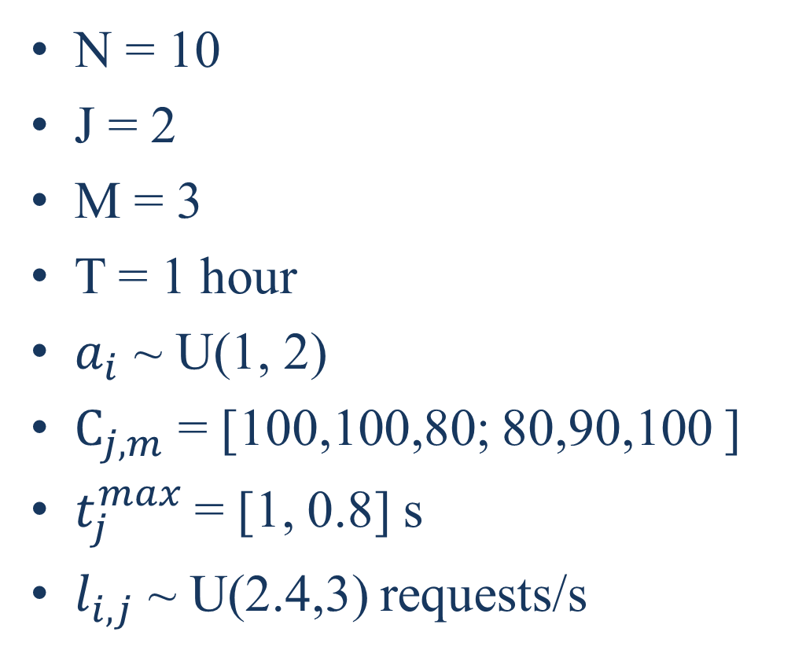
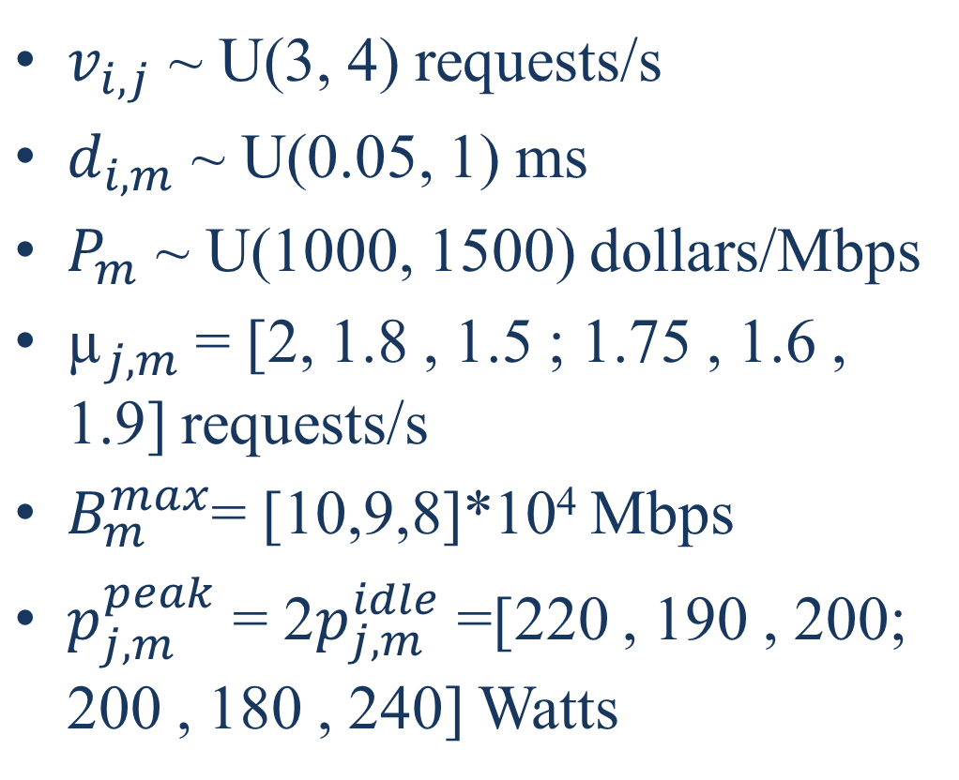
IV. EVALUATION AND ANALYSIS
N = 10
J = 2
M = 3
T = 1 hour
$a_{i}$ ~ U(1, 2)
$C_{j, m}$ = [100,100,80; 80,90,100 ]
$t_{j}^{max}$= [1, 0.8] s
$l_{i,j}$ ~ U(2.4,3) requests/s
$v_{i,j}$ ~ U(3, 4) requests/s
$d_{i,m}$ ~ U(0.05, 1) ms
$P_{m}$ ~ U(1000, 1500) dollars/Mbps
${\text{µ}}_{j,m}$= [2, 1.8 , 1.5 ; 1.75 , 1.6 , 1.9] requests/s
$B_{m}^{max}$= [10,9,8]*10⁴ Mbps
$p_{j,m}^{peak}$ = 2$p_{j,m}^{idle}$ =[220 , 190 , 200; 200 , 180 , 240] Watts

Slide 61

IV. EVALUATION AND ANALYSIS
${\text{ε}}_{j}$ = [2,3]*10⁻⁴ dollars/ms/request
$s_{1}$ = 2 Mb
$s_{2}$ = 1 Mb
$f_{m}$ = [80 , 70 , 90] dollars/ MWh.

Slide 62
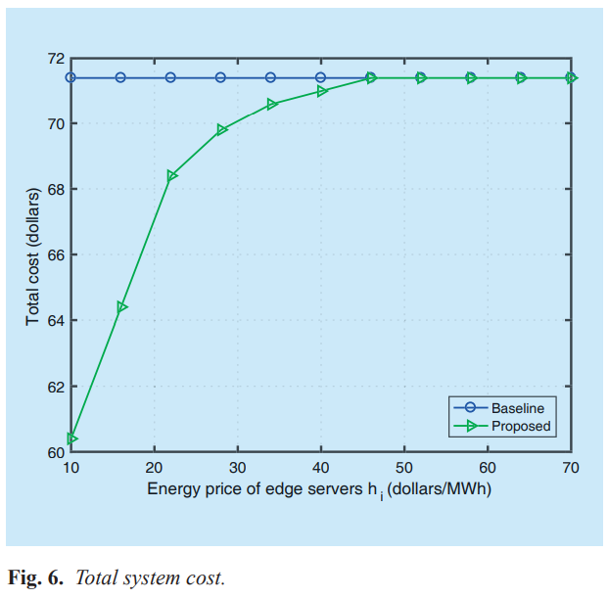

IV. EVALUATION AND ANALYSIS
Fig. 6 shows the total system cost when the energy price $h_{i}$ of edge servers increase from 10 to 70.
Notes:
$h_{i}$ : 與邊緣服務器所在的電力區域相關的電價（美元/ MWh）。
圖6顯示了當邊緣服務器的能源價格$h_{i}$從10增加到70時的總系統成本。

Slide 63
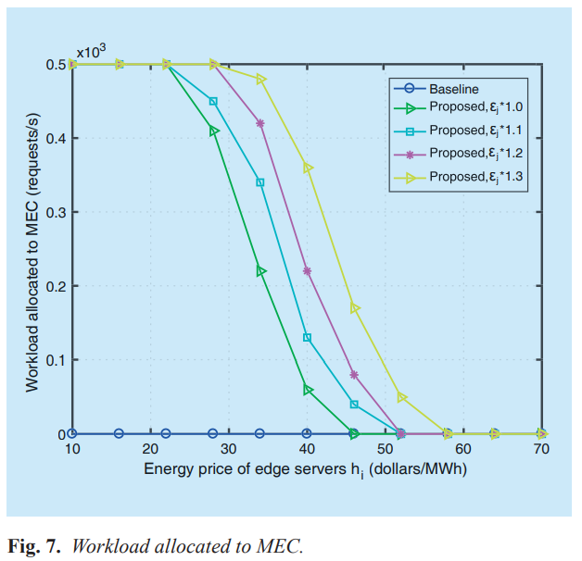


IV. EVALUATION AND ANALYSIS
Fig. 7 illustrates the workload allocated to MECs as the increase of $h_{i}$ , and the impacts of backhaul delay.
It can be seen from the figure, with the same value of $h_{i}$ , more workload is allocated to MECs when the backhaul network has higher revue loss associated with delay
Notes:
${\text{ε}}_{j}$ : 應用j的懲罰因子（以美元/毫秒為單位）
圖7說明了隨著$h_{i}$的增加而分配給MEC的工作負載，以及回程延遲的影響。
從圖中可以看出，當$h_{i}$的值相同時，當回程網絡具有較高的與延遲相關的修訂損失時，將更多的工作負載分配給MEC

Slide 64
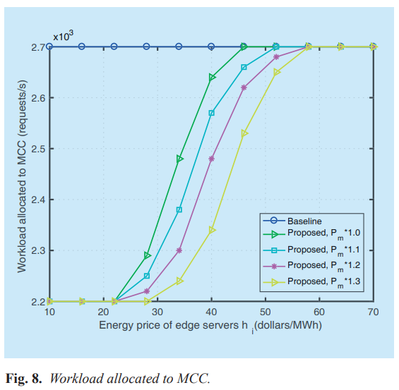
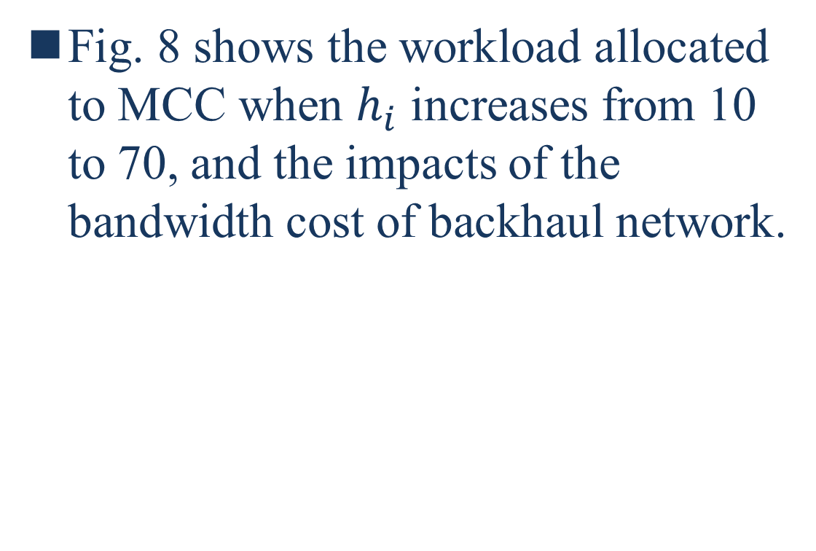
IV. EVALUATION AND ANALYSIS
Fig. 8 shows the workload allocated to MCC when $h_{i}$ increases from 10 to 70, and the impacts of the bandwidth cost of backhaul network.
Notes:
${\text{P}}_{m}$ : 回程到數據中心m的帶寬價格（美元/ Mbps）。
圖8顯示了當$h_{i}$從10增加到70時分配給MCC的工作量，以及回程網絡的帶寬成本的影響。

Slide 65
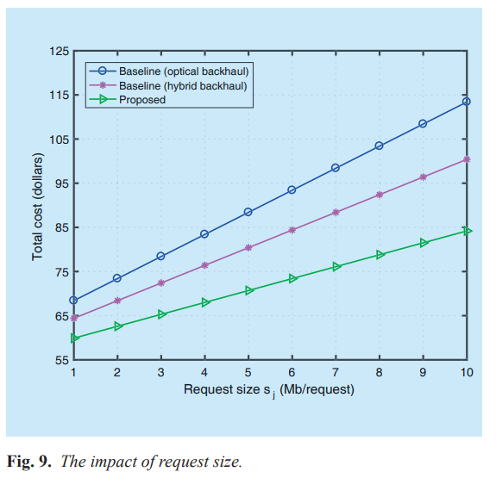
IV. EVALUATION AND ANALYSIS
Fig. 9 shows the system cost when the request size increases from 1 to 10 Mb/request.
Notes:
圖9顯示了當請求大小從1 Mb /請求增加到10 Mb時的系統成本。
Optical 光學的
Hybrid 混和的

Slide 66
IV. EVALUATION AND ANALYSIS
As can be seen from figure 8, the system cost of proposed framework is lower than the baselines, even when it has hybrid backhaul which is cheaper than optical backhaul.
This is because larger request size brings more backhaul cost, and the MECs can reduce backhaul cost due to the distributed architecture.
Notes:
從圖8 (圖9才對)可以看出，所提出框架的系統成本低於基線，即使它具有比光學回程便宜的混合回程。
這是因為較大的請求大小會帶來更多的回程成本，並且由於分佈式體系結構，MEC可以降低迴程成本。
( 隨著request size擴大，差距也更明顯是因為MEC可以降低delay )

Slide 67
V. CONCLUSION
Then, we propose a novel management architecture for 5G core network SBA and give three use cases.
Also, an optimal workload allocation algorithm is developed.
Combined with SDN, NFV and edge computing, the proposed framework can provide distributed and on-demand deployment of network functions, service guaranteed network slicing, flexible orchestration of network functions and optimal workload allocation.
Notes:
然後，我們為5G核心網絡SBA提出了一種新穎的管理架構，並給出了三個用例。
此外，開發了一種最佳的工作量分配算法。
結合SDN，NFV和邊緣計算，該框架可提供網絡功能的分佈式和按需部署，服務保證的網絡切片，網絡功能的靈活編排以及最佳的工作負載分配。

