Slide 1
A Service-Oriented Deployment Policy of
End-to-End Network Slicing Based on Complex Network Theory
WANQING GUAN, XIANGMING WEN, LUHAN WANG, ZHAOMING LU,
YIDI SHEN
IEEE Access, 6, 19691-19701.
Journal Article
Year: 2018
Notes:
這篇主要在講說 基於複雜的網路理論
去部屬三種不同服務類型的E2E網路切片
三種典型類型 (Embb , mmtc ,urllc )
部屬 代表說 將VNF部屬上去, 再來串連這些VNF以滿足服務要求
網路理論考慮, 網路節點的特性 , 如degree 中間度,

Slide 2
Authors

Slide 3
Authors

Slide 4
Authors

Slide 5
Outline
Abstract
Introduction
Related work
Mathematical model of network slicing
Deployment policy of ns based on cn
Simulation results and analysis
Conclusion
Reference

Slide 6
Abstract
For fifth-generation wireless communication systems, network slicing has emerged as a key concept to meet the diverse requirements of various use cases.
By slicing an infrastructure network into multiple dedicated logical networks, wireless networks can support a wide range of services.
However, how to fast deploy the end-to-end slices is the main issue in a multi-domain wireless network infrastructure.
Notes:
對於第五代無線通信系統，網絡切片已成為滿足各種use case 和各種要求的關鍵概念。
通過將基礎設施網路劃分為多個專用邏輯網路，無線網路可以支持廣泛的服務。
但是，如何快速部署端到端切片在multi-domain無線網路基礎設施中是主要問題。

Slide 7
Abstract
In this paper, a mathematical model is used to construct network slice requests and map them to the infrastructure network.
The mapping process consists of two steps: the placement of virtual network functions and the selection of link paths chaining them.
To efficiently utilize the limited physical resources, we pay attention to the service-oriented deployment by offering different deployment policies for three typical slices: eMBB slices, mMTC slices, and uRLLC slices.
Notes:
在本文中，使用數學模型來構造切片request 並將切片映射到基礎設施網路。
映射過程包括兩個步驟：VNF的放置和 選擇link將這些VNF 連接起來
為了有效地利用有限的物理資源，我們通過為三個典型的切片（eMBB片，mMTC片和uRLLC片）
提供不同的部署策略 來面向這些服務

Slide 8
Abstract
Furthermore, we adopt complex network theory to obtain the topological information of slices and infrastructure network.
we define a node importance metric to rank the nodes in node mapping.
The results have shown that our algorithm performed better in terms of resource efficiency and acceptance ratio.
the average execute time of our algorithm is in a linear growth with the increase of infrastructure network size.
Notes:
此外，我們採用複雜的網路理論來獲取切片和基礎設施網路的拓撲資訊。
作者定義了節點重要性 在 節點映射的時候對節點進行排名
結果表明，他們的演算法在資源效率和接受率方面表現更好。
並且, 隨著基礎設施網路規模的增加，他們演算法的平均執行時間呈線性增長。

Slide 9
Introduction

Slide 10
Introduction
With the explosive growth of mobile data traffic, the massive terminal connection and the rise of various kinds of new applications, future wireless network needs to be agile, programmable and open.
Moreover,fifth-generation(5G) network are nowadays expected to satisfy different requirements of numerous new services and support vertical markets such as automotive, energy, food and agriculture(農業), healthcare, etc [1].
[1] 5G Empowering Vertical Industries, 5GPPP and ERTICO,
2016. [Online]. Available: https://5g-ppp.eu/wp-content/
uploads/2016/02/BROCHURE_5PPP_BAT2_PL.pdf
Notes:
隨著移動數據流量的爆炸性增長，
龐大的終端連接以及各種新應用的興起，
未來的無線網絡需要彈性，且可編程和開放。
此外，如今，第五代（5G）網絡有望去滿足眾多新服務的不同要求，
並支持垂直市場，例如汽車行業，能源，食品和農業，醫療保健等[1]。

Slide 11
Introduction
A wide range of verticals with diverse requirements spur(促進) 5G networks to be flexible, scalable, manageable, customized, and allow multi-tenancy and multi-service support [2].
In order to realize the above vision,network slicing (NS) has been proposed as a concept for slicing a common underlying physical network into multiple end-to-end (E2E) logical networks which are mutually isolated, managed independently and created on demand [3].
[2] View on 5G Architecture, 5GPPP, 2016. [Online]. Available: https://5gppp.eu/wpcontent/uploads/2014/02/5G-PPP-5G-Architecture-WP-July-
2016.Pdf
[3] Description of Network Slicing Concept, NGMN-Alliance, 2016, vol. 1.
[Online]. Available: https://www.ngmn.org/leadmin/user_upload/
160113_Network_Slicing_v1_0.pdf
Notes:
具有不同要求的各種垂直行業促使5G網路具有彈性，
可擴展性，可管理性，客製化特性，並允許多租戶和多服務支持[2]。
為了實現上述願景，提出了網絡切片（NS）作為一種概念，
將共同的基礎物理網路切成 許多 相互隔離，獨立管理並且 按需創建的 端到端（E2E）邏輯網絡[ 3]。

Slide 12
Introduction
In NS based 5G system, resources of multi-domain infrastructure network can be efficiently allocated to multiple network slices according to the requirements of use cases [4].
The International Telecommunication Union (ITU) [5] has identified three broad use case families: enhanced mobile broadband (eMBB), massive machine-type communications (mMTC), and ultra-reliable and low-latency communication (uRLLC).
[4]H. Zhang, N. Liu, X. Chu, K. Long, A.-H. Aghvami, and V. C. M. Leung,
``Network slicing based 5g and future mobile networks: Mobility, resource
management, and challenges,'' IEEE Commun. Mag., vol. 55, no. 8,
pp. 138145, Aug. 2017.
[5]``Imt visionframework and overall objectives of the future development
of IMT for 2020 and beyond,'' Tech. Rep., 2015. [Online].
Available: https://www.itu.int/dms_pubrec/itu-r/rec/m/R-REC-M.2083-0-
201509-I!!PDF-E.pdf
Notes:
在基於NS的5G系統中，可以根據use case 的需求將多個domain 的基礎設施
資源有效地分配給多個網絡切片[4]。
國際電信聯盟（ITU）[5]定義(認定)了三個廣泛的範例：
增強型移動寬帶（eMBB），大規模機器類型通信（mMTC）
和超可靠和低延遲通信（uRLLC）。

Slide 13
Introduction
Notes:
如圖1所示，NS目的 在邏輯上分離物理基礎架構內的虛擬網絡功能（VNF），
以構建專用的和特殊的邏輯網絡。

Slide 14
Introduction
Although the concept of NS is still nascent(新生的), the potential technologies for achieving it, software-defined networking (SDN) and network functions virtualization (NFV), have many mature researches with concrete solutions and readily available platforms.
SDN architecture is an appropriate technology for the configuration and control of the forwarding planes of the underlying resources, while NFV can manage the life cycle of network slices and orchestrate VNFs efficiently.
Notes:
儘管網路切片的概念仍處於新生(萌芽)的階段，但要實現它的潛在技術，
包括軟件定義的網路（SDN）和網路功能虛擬化（NFV），
已經有了許多關於SDN,NFV的成熟研究 有具體解決方法和易於使用的平台。
SDN架構是用於配置和控制基礎資源forwading plane 一項 適當技術，
而NFV可以管理網絡切片的生命週期並有效地編排VNF。

Slide 15
Introduction
Actually, Ordonez-Lucena et al. [6] have presented a deployment example of NS by integrating SDN and NFV. [7] first propose an E2E 5G system framework and illustrate the techniques in the radio access network and the core network.
However, as far as we know, few researches have provided efficient and practical(實際的) deployment policies for E2E slices in wireless networks, and the technology development on NS is mostly focused on slicing the core network.
[6] J. Ordonez-Lucena, P. Ameigeiras, D. Lopez, J. J. Ramos-Munoz, J. Lorca, and J. Folgueira, ``Network slicing for 5G with SDN/NFV: Concepts, architectures, and challenges,'' IEEE Commun. Mag., vol. 55, no. 5, pp. 8087, May 2017.
[7] Q. Li, G. Wu, A. Papathanassiou, and U. Mukherjee. (2016). ``An end-toend network slicing framework for 5G wireless communication systems.'‘ [Online]. Available: https://arxiv.org/abs/1608.00572
Notes:
實際上，Ordonez-Lucena等人。 [6]通過 整合 SDN和NFV提出了NS的部署範例。
[7]首先提出了一個E2E 5G系統框架，並說明了 RAN和core network中的技術。
然而，據作者所知，很少有研究為無線網絡中的E2E 切片提供有效和實用的部署策略，
並且NS上的技術開發主要集中在核心網路切片上。

Slide 16
Introduction
Reference [8] defines that network slices are chains of VNFs and logical/physical resources meeting the service requirements.
Therefore, the realization of NS in essence(本質;要素) is the deployment and orchestration of VNFs, and there are plentiful(豐富的) related researches on VNF placement.
[8]M. R. Sama, X. An, Q. Wei, and S. Beker, ``Reshaping the Mobile core network via function decomposition and network slicing for the 5G era,‘’ in Proc. IEEE Wireless Commun. Netw. Conf. Workshops (WCNCW), Apr. 2016, pp. 9096.
Notes:
參考文獻[8]定義網絡切片 就是 VNF和邏輯或物理的串聯 以滿足服務的需求
因此，NS的實現本質上就是VNF的部署和編排，
並且有關VNF放置的研究也很多。

Slide 17
Introduction
References [9], [10] propose the algorithms of VNFs placement, which only for a single type of VNF chain request without considering diverse service requirements.
Besides, the mapping from slices to the infrastructure networks is a typical virtual network embedding (VNE) problem [11].
[9] F. Bari, S. R. Chowdhury, R. Ahmed, R. Boutaba and O. C. M. B. Duarte, "Orchestrating virtualized network functions", IEEE Trans. Netw. Service Manag., vol. 13, no. 4, pp. 725-739, Dec. 2016.
[10] R. Riggio, A. Bradai, D. Harutyunyan, T. Rasheed and T. Ahmed, "Scheduling wireless virtual networks functions", IEEE Trans. Netw. Service Manag., vol. 13, no. 2, pp. 240-252, Jun. 2016.
[11] S. Herker, A. Khan and X. An, "Survey on survivable virtual network embedding problem and solutions", Proc. Int. Conf. Netw. Services, pp. 1-6, 2013.
Notes:
參考文獻[9]，[10]提出了VNF放置算法，
該算法僅針對單一類型的VNF鏈請求，而未考慮多種服務需求。
此外，從切片到基礎設施網路的映射是一個典型的
虛擬網絡嵌入（VNE）問題[11]。

Slide 18
Introduction
As these two problems have been studied maturely in recent years, deployment of VNFs brings several advantages in terms of the resource utilization and cost saving.
Currently, little works in existing literature have been done on the deployment of E2E network slices although it is necessary for the realization of NS.
Notes:
隨著近年來對這兩個問題的研究日益成熟，
部署VNF帶來了資源利用和成本節省方面的諸多優勢。
目前，儘管實現NS是必需的，但是在現有文獻中關於E2E網絡切片的部署的工作很少。

Slide 19
Introduction
On one hand, E2E slices need to be instantiated rapidly and should support cross-domain deployment.
On the other hand, the resources of infrastructure network need to be allocated dynamically in order to support a diverse set of use cases.
Owing that different use case families have different demands on the multi-domain resources, NS deployment should be service-oriented.
The above-mentioned two respects raise extreme challenges for NS deployment in wireless communication systems.
Notes:
一方面，端到端切片需要快速實例化，並應支持跨域部署。
另一方面，基礎設施網路的資源需要動態分配，以支持各種用例。
由於不同的use case 對不同domain 的 資源有不同的要求，因此NS部署應面向服務。
上述兩個方面對無線通訊系統中的NS部署提出了極大的挑戰。

Slide 20
Introduction
In order to address these challenges, we propose a service-oriented deployment policy of E2E network slicing based on complex network (CN) theory.
CN theory aims at analyzing topological characteristics and predict dynamical behaviors of networked system [12].
Empirical studies have demonstrated that many real-life communication networks exhibit small-world and scale-free topological properties [13], [14].
[12] S. Boccaletti, V. Latora, Y. Moreno, M. Chavez and D.-U. Hwang, "Complex networks: Structure and dynamics", Phys. Rep., vol. 424, no. 4, pp. 175-308, 2006.
[13] B. Zhang, R. Liu, D. Massey and L. Zhang, "Collecting the internet AS-level topology", ACM SIGCOMM Comput. Commun. Rev., vol. 35, no. 1, pp. 53-61, 2005.
[14]J. Wu, C. K. Tse and F. C. M. Lau, "Optimizing performance of communication networks: An application of network science", IEEE Trans. Circuits Syst. II Exp. Briefs, vol. 62, no. 1, pp. 95-99, Jan. 2015.
Notes:
為了應對這些挑戰，我們提出了一種基於復雜網絡（CN）
理論的面向服務的端到端網絡切片部署策略。
CN理論目地在分析拓撲特徵並預測網絡系統的動態行為[12]。
實證研究表明，
許多現實生活中的通訊網路 是 small- world scale-free的特性
(
現實生活中這麼多是scale-free network
表現出小世界和無尺度的拓撲特性[13]，[14]。
)

Slide 21
Introduction
Moreover, [15] demonstrates that wireless networks are scale-free with a proper algorithm.
Using CN theory analyze the impact of topology on E2E NS deployment is reasonable and reliable.
[15]Y. B. Kim, B. Hong and W. Choi, "Scale-free wireless networks with limited degree information", IEEE Wireless Commun. Lett., vol. 1, no. 5, pp. 428-431, Oct. 2012.
Notes:
此外，[15]證明了使用適當的演算法，無線網絡是無尺度(或稱無標度)的。
用CN理論分析拓撲結構對端到端NS部署的影響是合理且可靠的。

Slide 22
Introduction
The contributions of this work can be concluded as following:
  1. A mathematical model is created to describe E2E NS deployment. The mathematical model consists of infrastructure network model, network slice request (NSR) model and slice deployment model.
  2. three service-oriented deployment algorithms and three optimization objectives are used for eMBB slice, mMTC slice and uRLLC slice accordingly.
  3. In order to improve the utilization of underlying resource and increase revenues of service providers, the topological properties of infrastructure are analyzed based on CN theory.
  4. Extensive simulations are carried out to evaluate the performance of our service-oriented deployment policy. The results show that our deployent policy performs better in terms of resource efficiency and acceptance ratio, and requires less time to execute.
Notes:
1.建立描述端到端NS部署的數學模型。該數學模型由基礎設施網路模型，
網絡分片請求（NSR）模型和分片部署模型組成。
這些模型是通過三個域進行的：
訪問網絡，傳輸網絡和核心網絡。
2.為了滿足不同的服務要求，分別為三個用例係列提供了三個專用的部署策略。
通過分析三種用例的不同特徵，針對eMBB切片，mMTC切片和uRLLC切片分別使用了三種面向服務的部署算法和三個優化目標。
3.為了提高基礎資源的利用率，增加服務提供商的收入，
基於CN理論對基礎設施的拓撲特性進行了分析。
(在部署NS時，拓撲屬性網絡與節點的本地資源結合在一起。)
4.進行了廣泛的模擬，以評估我們面向服務的部署策略的性能。
結果表明，我們的部署策略在資源效率和接受率方面表現更好，並且執行時間更少。

Slide 23
Related work
  CN theory
  E2E network slicing
  VNF Placement
  Virtual Network Embedding

Slide 24
Related work
we briefly introduce the structural characteristics in CN theory which are useful enablers for the purpose of obtaining the topological information.
We also give a short summary of works in E2E network slicing for 5G networks.
we review some existing works on VNF placement and VNE problem, showing their contribution to deployment of NS.
Notes:
作者簡要介紹了CN理論中的結構特徵，這些結構特徵對於獲取拓撲資訊有用。
作者還簡要概述了用於5G網絡的E2E網絡切片的研究。
作者回顧了一些有關VNF放置和VNE問題的現有文獻，顯示了它們對NS部署的貢獻。

Slide 25
CN theory
According to the analysis of many real-world networks, several topological properties have been proposed to capture structural characteristics of various networks in the past decades.
1. Degree
Notes:
根據對許多現實世界網絡的分析，在過去的幾十年中，已提出了幾種拓撲屬性來捕獲各種網路的結構特徵。
例如，
Degree
度(degree)就是指該節點的edges數量，也就是該節點與其他節點直接連接的總數
(節點的度數衡量連接到它的邊的數量，這反映了影響的程度。節點度可以表示為)

Slide 26
CN theory
Notes:
中間性
(中間性中心度量化在鏈接其他對節點的路徑之間找到多少個節點。
中間性中心度定義為穿過該節點的任何一對節點之間的最短路徑的比例，)
中間性(betweenness centrality)
是在衡量一個節點在網路中的仲介效果，
倘若該節點以外的節點，彼此之間的最短路徑大多經過該節點，
表示betweenness centrality越大，
它就像是一個重要的交通樞紐，透過它你總能在最短路徑抵達欲尋訪的節點。
可以用以下方式表示：
在該等式中，σst是從節點s到節點t的最短路徑的總數，
而σst（i）是通過節點i的那些路徑的數量。

Slide 27
E2E Network Slicing
Many researches focus on radio resource virtualization [16], [17], management and orchestration of network functions [18], [19], mapping of service and service description [16].
Although NS has been implemented in fixed network, E2E NS of the mobile network still lags behind. There is still lacking efficient deployment and management of E2E slices.
[16]N. Nikaein et al., "Network store: Exploring slicing in future 5G networks", Proc. 10th Int. Workshop Mobility Evol. Internet Archit., pp. 8-13, 2015.
[17] X. Costa-Pèrez, J. Swetina, T. Guo, R. Mahindra and S. Rangarajan, "Radio access network virtualization for future mobile carrier networks", IEEE Commun. Mag., vol. 51, no. 7, pp. 27-35, Jul. 2013.
[18] P. Rost et al., "Mobile network architecture evolution toward 5G", IEEE Commun. Mag., vol. 54, no. 5, pp. 84-91, May 2016.
[19] K. Samdanis, X. C. Perez and V. Sciancalepore, "From network sharing to multi-tenancy: The 5G network slice broker", IEEE Commun. Mag., vol. 54, no. 7, pp. 32-39, Jul. 2016.
Notes:
許多研究集中在無線電資源虛擬化 如[16]，[17]，
[18]，[19] 在網路功能的管理和編排，
服務映射和服務描述[16]。
儘管NS已在固網中實現，
但在移動網路的端到端NS仍然落後。
仍然缺乏有效的端到端切片部署和管理。

Slide 28
E2E Network Slicing
Zhou et al. [20] illustrate NS as a service (NSaaS) and introduce the business model of NSaaS. Reference [21] introduces PERMIT slice orchestration system which is first to consider E2E slicing.
[20] X. Zhou, R. Li, T. Chen and H. Zhang, "Network slicing as a service: Enabling enterprises’ own software-defined cellular networks", IEEE Commun. Mag., vol. 54, no. 7, pp. 146-153, Jul. 2016.
[21] T. Taleb, B. Mada, M. Corici, A. Nakao and H. Flinck, "PERMIT: Network slicing for personalized 5G mobile telecommunications", IEEE Commun. Mag., vol. 55, no. 5, pp. 88-93, May 2017.
Notes:
[20]這篇舉例說明了NS即服務（NSaaS），
並介紹了NSaaS的業務模型。
[21]這篇介紹了PERMIT切片編排系統，
這是第一個考慮端到端切片的系統。

Slide 29
VNF Placement
In order to dynamically allocate virtualization resources to VNFs, there are also many algorithms for the deployment of the service function chain (SFC).
These algorithms [27], [28] provide solutions to optimize VNF placement problem.
Similar with the dynamic VNF placement algorithm, Ghaznavi et al. [30] introduce Elastic Virtual Network Function Placement (EVNFP) problem and present a model for minimizing operational costs in providing VNF services.
[27] J. Liu, Y. Li, Y. Zhang, L. Su and D. Jin, "Improve service chaining performance with optimized middlebox placement", IEEE Trans. Services Comput., vol. 10, no. 4, pp. 560-573, Jul./Aug. 2017.
[28] L. Wang, Z. Lu, X. Wen, R. Knopp and R. Gupta, "Joint optimization of service function chaining and resource allocation in network function virtualization", IEEE Access, vol. 4, pp. 8084-8094, 2016.
[30] M. Ghaznavi, A. Khan, N. Shahriar, K. Alsubhi, R. Ahmed and R. Boutaba, "Elastic virtual network function placement", Proc. IEEE 4th Int. Conf. Cloud Netw. (CloudNet), pp. 255-260, Oct. 2015.
Notes:
為了將虛擬化資源動態分配給VNF，
有許多用於部署（SFC）的演算法。
這些演算法如[27]，[28]提供了優化VNF放置問題的解決方法。
與動態VNF放置算法類似，
[30]這篇 介紹了彈性虛擬網路功能放置（EVNFP）問題，
並提出了一種模型 用於在提供VNF服務時最小化運營成本的模型。

Slide 30
VNF Placement
Targeting to achieve optimal resource utilization of infrastructure resources
these works do not consider the characteristics of infrastructure network, and ignore the investigation of the placement algorithm matching the resource demands of providers.
Notes:
為了實現基礎設施資源的最佳資源利用，
這些文獻沒有考慮基礎設施網路的特徵，
而忽略了對 提供商的資源需求相匹配的放置演算法的調查/研究。

Slide 31
Virtual Network Embedding
Fischer et al. [31] provide a comprehensive survey on VNE algorithms.
Dealing with the virtual resources allocation both in nodes and links, VNE can be divided in two sub-problems:
  Virtual Node Mapping (VNoM)
  Virtual Link Mapping (VLiM)
[31] . A. Fischer, J. F. Botero, M. T. Beck, H. de Meer and X. Hesselbach, "Virtual network embedding: A survey", IEEE Commun. Surveys Tuts., vol. 15, no. 4, pp. 1888-1906, 4th Quart. 2013.
Notes:
[31]對VNE演算法進行了全面的調查。
在處理節點和link中的虛擬資源分配時，
VNE可以分為兩個子問題：

Slide 32
III. Mathematical model of network slicing
Mathematical Model of Network Slicing
  A. Infrastructure Network Model
  B. Network slice request model
  C. Slice Deployment Model

Slide 33
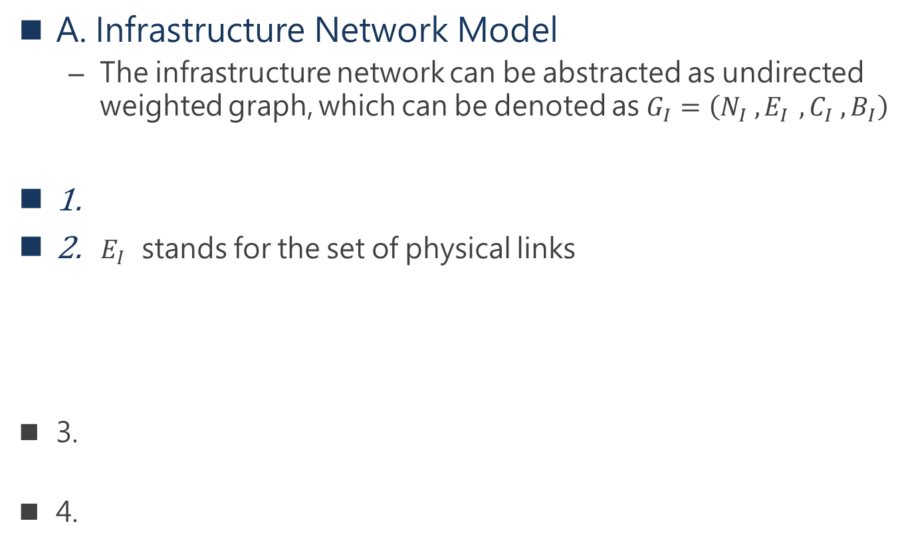
Mathematical Model of Network Slicing
A. Infrastructure Network Model
  The infrastructure network can be abstracted as undirected weighted graph, which can be denoted as $G_{I}=\left(N_{I} , E_{I }, C_{I} , B_{I}\right)$
1.
2. ${ E}_{I }$ stands for the set of physical links
3.
4.
Notes:
基礎設施網路可以抽象為無向加權圖，可以表示為
Ni 代表一組物理節點 可以分成 base station / optical switch / core nodes
Ei 代表 一組 link , 包含 無線link 和 有線的 wired optical links
無線link 包含 基地台或其他 無線裝置(如 IoT等)
Describes the resources available on the node: CPU, memory,
The fields in the capacity block indicate the total amount of resources that a Node has.
Ci 代表 基地台和 core node 的 capacity , 資源總量(CPU , memory )等
Bi 代表 頻寬 ,也是分成無線/ 有線

Slide 34
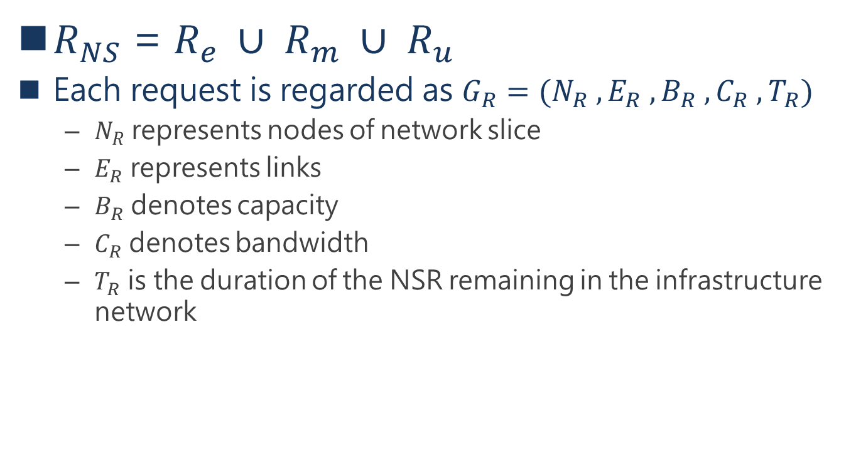
B. NETWORK SLICE REQUEST MODEL
$R_{NS}$ = $R_{e} ∪ R_{m} ∪ R_{u}$
Each request is regarded as $G_{R}=(N_{R} , E_{R} , B_{R} , C_{R} , T_{R})$
  $N_{R}$ represents nodes of network slice
  $E_{R}$ represents links
  $B_{R}$ denotes capacity
  $C_{R}$ denotes bandwidth
  $T_{R}$ is the duration of the NSR remaining in the infrastructure network
Notes:
Request model
這篇文中因為主要由三種服務組成
所有 由Embb , Mmtc , uRLLC 聯集組成
每個request可以表示成GR ,
N代表 request的節點數 (一樣有分 有線/ 無線 )
ER 代表links 數
BR代表 capacity
CR 代表頻寬
Tr 是request 保留在基礎設施中的持續時間
(這跟動態部屬有關係 , 跟靜態應該沒關係)

Slide 35
C. Slice Deployment Model
Slice deployment is a process in which nodes of slice requests are mapped onto substrate nodes and links are mapped onto substrate paths on the premise of meeting service demands of slices.
Notes:
切片部署是在滿足切片服務需求的前提下，
將切片請求的節點映射到底層節點上，
將鏈接映射到頂層路徑上的過程。

Slide 36
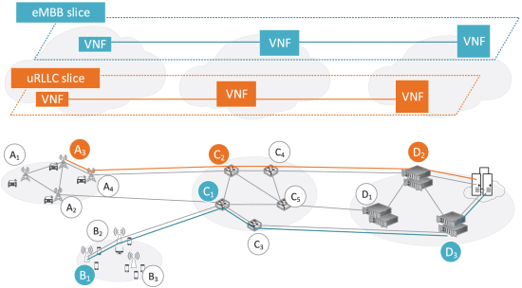
C. Slice Deployment Model
VNFs of eMBB slice are mapped in nodes$B_{1}, C_{1}, D_{3}$
$$B_{1}→B_{2}→C_{1}→C_{3}→D_{3}$$
Notes:
這是Embb切片的一個例子

Slide 37
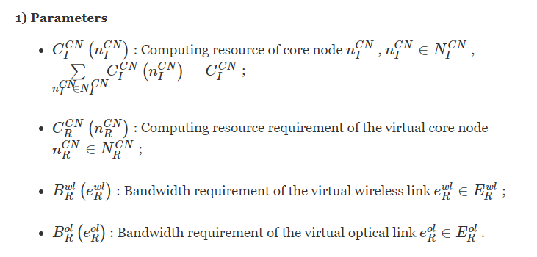
C. Slice Deployment Model

Slide 38
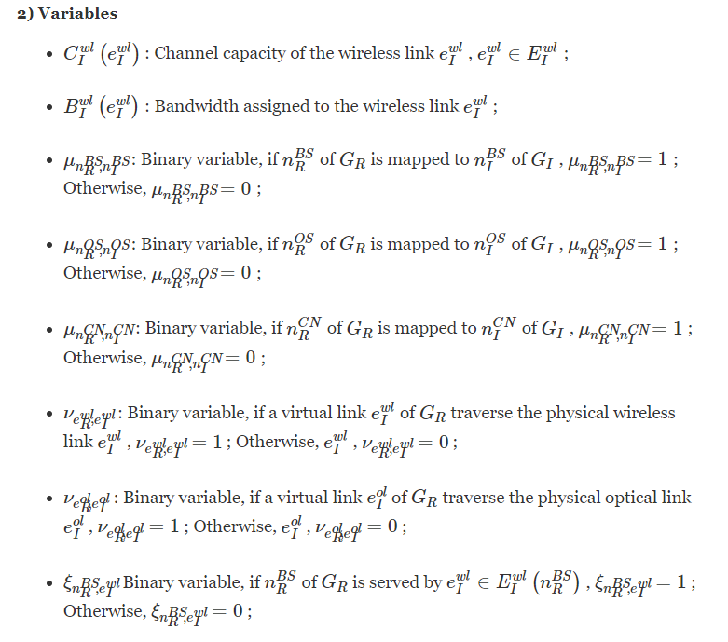
C. Slice Deployment Model

Slide 39
IV. DEPLOYMENT POLICY OF NS BASED ON CN

Slide 40
Deployment Policy of NS Based on CN
The main objective of deployment process is minimizing the deployment cost on the premise of meeting NS requirements.
In addition to the main objective, three types of slices have their peculiar(特有的) objectives because of different service demands.
Notes:
部署過程的主要目標是在滿足NS要求的前提下最大程度地降低部署成本。
除了主要目標外，由於服務需求的不同，三種類型的切片也有其特殊的目標。

Slide 41
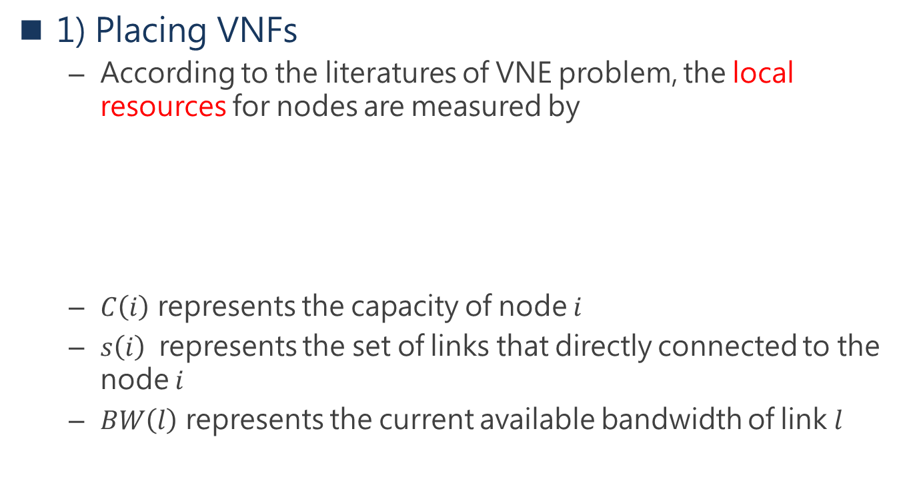
A. Mapping Algorithm
1) Placing VNFs
  According to the literatures of VNE problem, the local resources for nodes are measured by
  $C\left(i\right)$ represents the capacity of node $i$
  $s\left(i\right)$represents the set of links that directly connected to the node $i$
  $BW\left(l\right)$ represents the current available bandwidth of link $l$
Notes:
擺放VNF意味著在滿足服務要求的情況下，
選擇 虛擬節點滿足這些request
選擇底層網路的物理節點作為 NSR虛擬節點的主機。
根據VNE問題的文獻，節點的本地資源可通過以下方式測量：

Slide 42
A. Mapping Algorithm
The main shortcoming of this measurement is ignoring the topological characteristics of nodes.
Hence, we combine the degree and betweenness centrality of nodes to measure node importance in the step of placing VNFs.
First, the degree and betweenness centrality of nodes are normalized.
Notes:
這種測量的主要缺點是忽略了節點的拓撲特徵。
因此，在放置VNF的步驟中，
他們結合了節點的degree和中間性來衡量節點的重要性

Slide 43
A. Mapping Algorithm
Node degree
betweenness centrality
Notes:
Degree 正規化
中間性也正規化

Slide 44
A. Mapping Algorithm
$C_{2}^{N−1}$ $=\frac{\left(N−1\right)\left(N−2\right)}{2}$
Notes:
任選兩個node 作為 s,t , 不選擇 扣掉i

Slide 45

A. Mapping Algorithm
Therefore, combining the local resource and weighting of each node, the node importance of $i$can be given by

Slide 46
A. Mapping Algorithm
According to the node importance, we use graphical breadth-first search (BFS) algorithm to sort nodes, and map the virtual nodes to physical nodes based on BFS.
Notes:
根據節點的重要性，作者使用圖形廣度優先搜索（BFS）算法對節點進行排序，
並基於BFS將虛擬節點映射到物理節點。

Slide 47
A. Mapping Algorithm

Slide 48
Node mapping alogrithm

Slide 49
A. Mapping Algorithm
2) Chaining VNFs
  The procedure of creating paths that interconnect the VNFs placed nodes would be achieved on the basis of k-shortest paths (KSP) algorithm.
  KSP algorithm is used to select suitable physical paths in the premise of satisfying the bandwidth resource requirements.
  After removing the link paths that do not satisfy the requirements, Floyd algorithm is used to calculate the shortest path.
Notes:
創建互連VNF放置的節點的路徑的過程將基於k最短路徑（KSP）
算法來實現。
在滿足帶寬資源需求的前提下，使用KSP算法選擇合適的物理路徑。
刪除不滿足要求的鏈接路徑後，將使用弗洛伊德算法來計算最短路徑。
Floyd-Warshall 演算法。
我們現在要找的是任意兩個點之間的最短路徑，也稱作「多源最短路徑」

Slide 50
Link mapping algorithm
Notes:
在滿足帶寬資源需求的前提下，使用KSP算法選擇合適的物理路徑。
刪除不滿足要求的鏈接路徑後，將使用弗洛伊德演算法來計算最短路徑。
我們現在要找的是任意兩個點之間的最短路徑，也稱作「多源最短路徑」。
Floyd算法是一個經典的動態規划算法。
從任意節點i到任意節點j的最短路徑不外乎2種可能，1是直接從i到j，2是從i經過若干個節點k到j。
所以，我們假設Dis(i,j)為節點u到節點v的最短路徑的距離，對於每一個節點k，
我們檢查Dis(i,k) + Dis(k,j) < Dis(i,j)是否成立，如果成立，證明從i到k再到j的路徑比i直接到j的路徑短，我們便設置Dis(i,j) = Dis(i,k) + Dis(k,j)，

Slide 51
the ultimate goal is to take advantage of infrastructure resources efficiently. Hence, the main objective can be expressed by
Notes:
資源使用量 和 頻寬使用量 達到最小 並能完成服務

Slide 52
(1) EMBB SLICE
1) EMBB SLICE
  The eMBB usage scenario covers a range of cases, including wide-area coverage and hotspot.
  For the hotspot case, i.e. for an area with high user density, very high traffic capacity is needed, while the requirement for mobility is low and user data rate is higher.
  the deployment objective of eMBB slices should be maximizing the remaining resources of physical nodes
Notes:
eMBB的使用情況涵蓋了多種情況，包括廣域覆蓋和熱點。
對於熱點情況，即對於具有高用戶密度的區域，
需要非常高的業務容量，而對移動性的要求較低並且用戶數據速率較高。
這種切片不需要嚴格的延遲和足夠的資源。
eMBB slice的部署目標應該是最大化物理節點的剩餘資源

Slide 53
(2) MMTC SLICE
The mMTC usage scenario is characterized by a very large number of connected devices typically transmitting a relatively low volume of non-delay sensitive data.
This use case has plenty of connections, which results in the requirement of high computing resources and low congestion rate.
Therefore, the deployment objective should be minimizing the usage of bandwidth on physical links.
In other words, the remaining bandwidth on physical links should be maximized.
Notes:
mMTC使用情況的特點是，通常有大量連接的設備傳輸相對較少量的非延遲敏感數據。
這種use case 具有大量的連接，這導致對高計算資源和低擁塞率的需求。
因此，部署目標應該是最大程度地減少物理鏈路上帶寬的使用。
換句話說，物理鏈路上的剩餘帶寬應最大化。

Slide 54
(2) MMTC SLICE

Slide 55
(3) URLLC SLICE
The QoS guarantee of this use case is low latency, which causes that the deployment objective should be minimizing the delay of slices
We transfer delay time into the number of hops, so minimizing the delay means minimizing each physical path length.
Notes:
此用例的QoS保證是低延遲，這導致部署目標應該將切片的延遲最小化。
我們將延遲時間轉換為hops數，因此，
將延遲最小化意味著將每個物理路徑長度最小化。
無線link數 + optical link 數 最少

Slide 56
constraints
Notes:
12確保每個虛擬BS僅應被映射到物理BS
13確保每個物理BS僅應為每個NSR承擔虛擬BS
確保了所有無線channel佔用的頻寬 不應超過每個BS的總共可用的頻寬
15確保每個BS中的無線linl的channel 容量總和不應超過由控制平面分配的該BS的容量。
16 確保在該BS中承擔的所有虛擬BS的容量總和不應超過其分配的容量。
17確保為每個虛擬BS分配的容量不應小於其容量要求。
18確保僅將每個虛擬OS映射到物理OS
19確保每個物理OS只能為每個NSR承擔一個虛擬OS。
20確保每個虛擬CN僅應映射到物理CN
21確保每個物理CN只能為每個NSR承擔虛擬CN
22確保了每個物理CN的計算資源可以滿足映射到其中的所有虛擬CN的總需求。
23確保所選CN的計算資源不應小於虛擬CN的計算資源需求

Slide 57
constraints
Notes:
17確保為每個虛擬BS分配的容量不應小於其容量要求。
18確保僅將每個虛擬OS映射到物理OS
19確保每個物理OS只能為每個NSR承擔一個虛擬OS。

Slide 58
constraints
Notes:
20確保每個虛擬CN僅應映射到物理CN
21確保每個物理CN只能為每個NSR承擔虛擬CN
22確保了每個物理CN的計算資源可以滿足映射到其中的所有虛擬CN的總需求。
23確保所選CN的計算資源不應小於虛擬CN的計算資源需求

Slide 59
C. DEPLOYMENT STRATEGIES OF THREE TYPES OF SLICES
the deployment strategies we proposed are conducted under the assumption that the arrived NSR has been identified as one of those three types.
In our proposed deployment policy of NS, we give three different strategies to three types of slices.
the resource efficiency (RE) and acceptance ratio (AR) of NSRs are calculated.
Notes:
他們提出的部署策略是假設到達的NSR被確定為這三種類型之一的前提下進行的。
在他們提出的NS部署策略中，
對於三種類型的片提供了三種不同的部屬策略。
他們會計算 資源效益和 接受比率

Slide 60
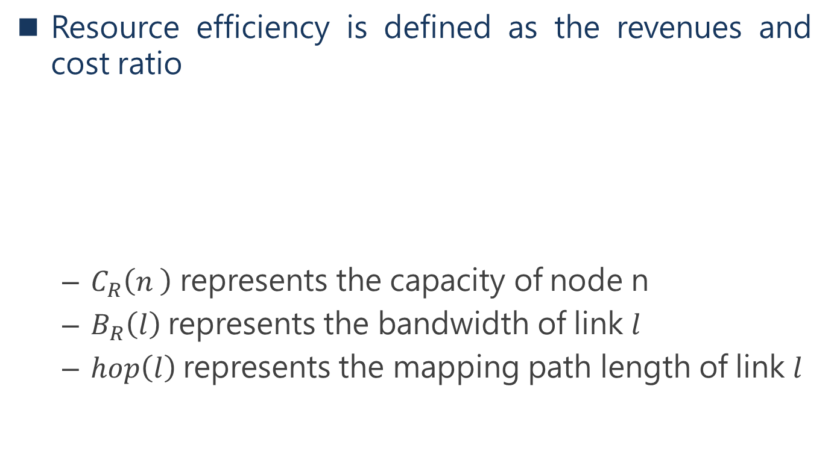
Resource efficiency is defined as the revenues and cost ratio
  $C_{R}\left(n \right)$ represents the capacity of node n
  $B_{R}\left(l\right)$represents the bandwidth of link $l$
  $hop\left(l\right)$represents the mapping path length of link $l$
Notes:
資源效率定義為收入和成本比率
Cr 代表 node n 的 capacity
Br 代表 link l的 頻寬
Hop(l) 代表 link l 的路徑長度

Slide 61
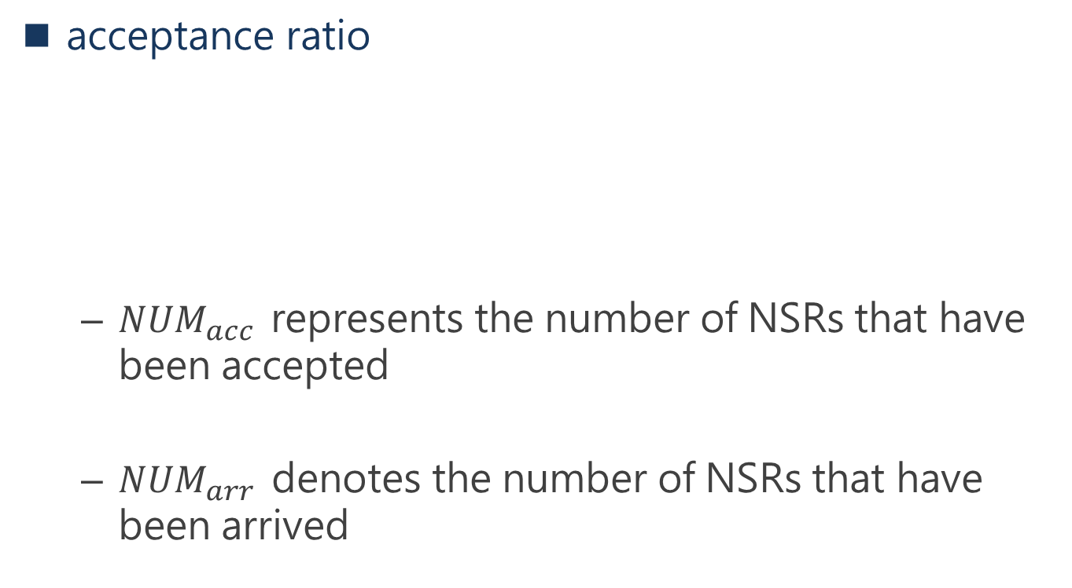
acceptance ratio
  ${NUM}_{acc }$ represents the number of NSRs that have been accepted
  ${NUM}_{arr }$ denotes the number of NSRs that have been arrived
Notes:
Acceptance ratio
NUMacc 代表 多少的request 被接受
NUMarr 代表有多少的request 抵達

Slide 62
we consider two conditions which are the static deployment and dynamic deployment.
The former means that slices are permanent once they are deployed successfully.
in the latter condition, NSRs have life time and the resource allocated to NSRs will be recycled at the end of life time.
Notes:
我們考慮兩個條件，即靜態部署和動態部署。
前者意味著片一旦成功部署便是永久性的。
在後一種情況下，NSR具有life time ，
分配給NSR的資源將在life time 結束時回收。

Slide 63
Notes:
輸入 Gi 目前資源總量 像是node數 link數 頻寬等等
和 輸入 哪個 slice 的request
前面在動態分布時提到
每個slice request有life time , 文章中描述說在第2步時
如果request的life time到了 他會回收部屬 request的資源
對於每類slice的mapping , 他會回傳 Mnode和 Mlink , 表示節點和鏈路都配置完成
如果回傳的是null , 表示這次的slice request 可能資源用量沒達到要求所以拒絕
他會計算 接受率

Slide 64
Notes:
首先 對虛擬BS進行分類和映射。
在映射虛擬BS之後，考慮計算資源需求，類似地映射虛擬CN。
當搜索每個BS-CN對之間的最短路徑時，
虛擬OS的映射完成。

Slide 65
Notes:
虛擬CN會首先進行映射。
接下來，將這些CN作為源端點，並找出候選BS作為目標端點。
然後，從CN和候選BS之間的候選路徑集中選擇最短路徑，以映射虛擬鏈路。
配置好 CN 和 BS之間的link 後 再把中間switch 的link配置好
最後才配置BS

Slide 66
Notes:
首先找出候選BS-CN對的集合
並蒐索這些候選對之間的所有可能的路由路徑作為候選路徑集。
根據NSR的虛擬link數，我們從候選路徑中選擇最短路徑以映射虛擬鏈接。
然後，我們將虛擬BS和CN映射到所選路徑的物理端點中

Slide 67
V. SIMULATION RESULTS AND ANALYSIS

Slide 68
The integral linear programming (ILP) model presented in previous section is implemented using YALMIP platform embedded in MATLAB which integrates the commercial programming solver CPLEX 12.7.
Algorithm 1-7 : MATLAB 2015b
Laptop : 2.4 CPU cores and 12GB memories
Notes:
前面公式中 介紹了的積分線性編程（ILP）模型
是使用嵌入在MATLAB中的YALMIP平台實現的，
該平台集成了商業編程求解器CPLEX 12.7。
使用MATLAB 2015b實現演算法1-7，
並在具有四個2.4GHz CPU內核和12GB內存的筆記本電腦上進行仿真。

Slide 69
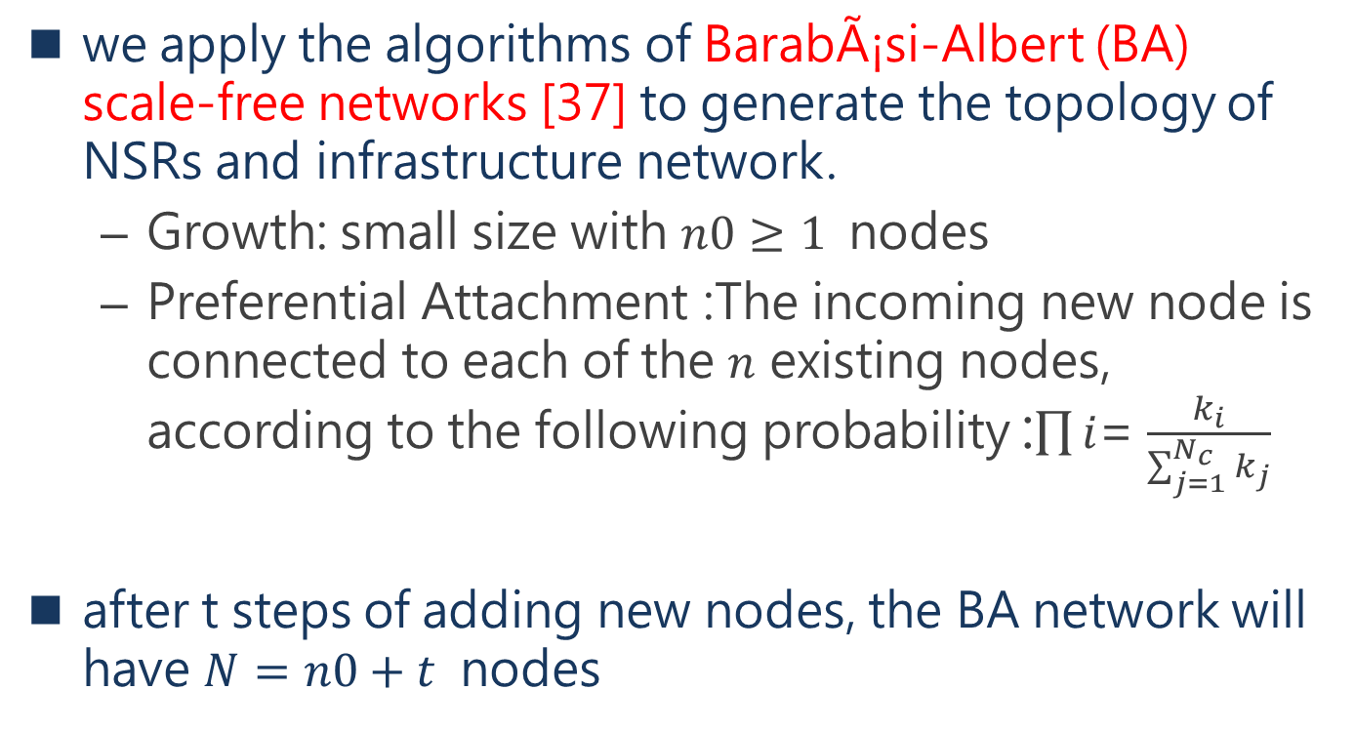
A. EXPERIMENTAL ENVIRONMENT SETTINGS
we apply the algorithms of BarabÃ¡si-Albert (BA) scale-free networks [37] to generate the topology of NSRs and infrastructure network.
  Growth: small size with $n0≥1$ nodes
  Preferential Attachment :The incoming new node is connected to each of the $n$ existing nodes, according to the following probability :$\prod{i}$= $\frac{k_{i}}{\sum_{j=1}^{N_{c}}{k_{j}}}$
after t steps of adding new nodes, the BA network will have $N=n0+t$ nodes
Notes:
從具有n0≥1個節點的小型連接網絡開始，
範例圖一開始選擇3個節點
增長模式：不少現實網路是不斷擴大不斷增長而來的，
例如網際網路中新網頁的誕生，人際網路中新朋友的加入
每次將一個新節點引入現有網絡，
並且此傳入的新節點連接到n個現有節點，其中1≤n≤no
優先連接：連接方式為優先考慮高度數的節點。對於某個原有節點 ki
將其在原網路中的度數記作ki ，那麼新節點與之相連的機率為
意思是當i這個節點的degree越大 , 新節點與他連結的機率越高
Nc表示當前現有節點的總數，ki是節點i的度數。

Slide 71

The specific parameter settings are shown in Table.1. We assume that the total number of physical nodes in infrastructure network can be $N=100,200,300$.
Notes:
具體的參數設置如表1所示。
他們假設基礎結構網絡中的物理節點總數可以為 100；200; 300
節點的容量是該節點可以處理的最大負載。
頻道容量的單位為位元每秒、奈特每秒等等
若以現在 網路單位為 Mbps
資料傳輸的單位為每秒多少 bit ，
亦即是 M bits/second, Mbps 的意思。
對於動態部署，區別在於切片的持續時間範圍從15個單位到45個單位
並且每個NSR的到達時間在1到50之間。

Slide 72
B. EXPERIMENTAL RESULTS AND ANALYSIS
As only a few deployment algorithm of E2E slices can be found in current literatures
Our deployment algorithm are compared with
  simulated annealing(退火) (SA) [38] based approach
  VNE algorithm LAVA(layered V-FiNE algorithm) [39]
  VNF placement algorithm GLL(greedy-leatst loaded) [40]
[38] E. Aarts and J. Korst, "Simulated annealing and boltzmann machines", 1988, [online] Available: https://www.osti.gov/biblio/5311236.
[39] C. Yu, W. Hou, Y. Guan, Y. Zong and P. Guo, "Virtual 5G network embedding in a heterogeneous and multi-domain network infrastructure", China Commun., vol. 13, no. 10, pp. 29-43, Oct. 2016.
[40] R. Mijumbi, J. Serrat, J.-L. Gorricho, N. Bouten, F. de Turck and S. Davy, "Design and evaluation of algorithms for mapping and scheduling of virtual network functions", Proc. 1st IEEE Conf. Netw. Softwarization (NetSoft), pp. 1-9, Apr. 2015.
Notes:
由於在當前文獻中只能找到一些端到端切片的部署算法
啟發式演算法當中有個相當有名的演算法是simulated annealing(1988)
從金屬加熱名詞而來
他是模擬金屬加熱，在退火的過程中，金屬能夠不斷的去找到自己能量最低的狀態，擴大晶粒，降低缺陷，
降溫的過程中還是有機會升溫再降溫， 藉由這樣的模擬過程找到最佳目標
這裡基於SA的方法 與[27]中基於SA的Middel Box放置算法相似。
LAVA是一種面向服務的底層資源部屬策略，
而GLL是一種貪婪演算法，該演算法基於將功能映射到具有最高可用容量的節點上。
此外，我們分析了三種不同部署策略(EMBB,mMTC,urllc)在NSR數量增加時的執行時間。
為了消除隨機性並提高準確性，模擬運行了50次並取平均值。

Slide 73
(1) RESOURCE EFFICIENCY
FIGURE 4.Resource efficiency of different types of slices.
(a) eMBB slices. (b) mMTC slices. (c) uRLLC slices.
Notes:
在靜態部署的情況下，每個NSR序列都包含一種類型的片。
他們在N = 300時計算結果，以保證有足夠的物理資源。
RE隨著NSR數量的增加而逐漸減小。
主要原因是NSR數量越多，平均mapping路徑長度越長，link資源被消耗的越多。
他們說的他們方法優於 SA 和 LAVA 這兩種啟發是演算法
他們說 可以得出結論，面向服務的資源切片方法可以提高資源使用效率。
uRLLC切片的RE最高 高於其他兩個
這是由於uRLLC切片序列中的link的平均映射路徑長度最低，(因為要求較短路徑)
所以 resource efficiency 分母的 數值較小 整體比率較大

Slide 74
(2) Acceptance Ratio
Notes:
AR與成功部署的片的數量成正比
隨著NSR數量的增加和每個NSR持續時間的增加，四種算法的AR值逐漸減小。
在28以前 他們的方法接受率優於 SA , 28以後低於 SA , 因為他們著重在資源效率(RE)
因為他們在部屬slice有更嚴格的限制
(b) 動態部屬 會在 slice 的life time結束時回收資源 , 所以有更多可用資源, 所以接受率普遍較高
當每個slice的持續時間增加 ,每個切片的life time 較久. 資源沒回收. 導致接受率都慢慢下降

Slide 75
(3) EXECUTION TIME
Figure 6 Execution time performance of different deployment algorithms.
(a) Algorithm A for eMBB slices. (b) Algorithm B for mMTC slices.
Notes:
他們提出的方法和 SA 方法 在 靜態部屬的情況下比較執行時間
request增加 時間都會增加 N = 資源總量
在作者提出的方法中, eMBB 會比 Mmtc 和 urllc低一些
因為演算法 B,C 會先找尋眾多 候選路徑, 再去計算最短路徑
所以他們說關鍵在於 基地台和core node 間找尋候選路徑配對的時間
另外 他們的方法是線性成長時間 , SA的方法是 指數成長時間, 他們在執行時間上比SA好

Slide 76
(3) EXECUTION TIME
Figure 6 Execution time performance of different deployment algorithms.
(c) Algorithm C for uRLLC slices
Notes:
他們提出的方法和 SA 方法 在 靜態部屬的情況下比較執行時間
request增加 時間都會增加 N = 資源總量
在作者提出的方法中, eMBB 會比 Mmtc 和 urllc低一些
因為演算法 B,C 會先找尋眾多 候選路徑, 再去計算最短路徑
所以他們說關鍵在於 基地台和core node 間找尋候選路徑配對的時間
另外 他們的方法是線性成長時間 , SA的方法是 指數成長時間, 他們在執行時間上比SA好

Slide 77
VI. CONCLUSION

Slide 78
CONCLUSION
The 5G network is envisioned to support a range of verticals and use cases, which causes that network slicing draws a lot of attention.
In this paper, we introduce the metric of node importance based on complex network theory.
And the network slice request implementation algorithm was proposed, which includes three different deployment algorithms for eMBB slices, mMTC slices and uRLLC slices respectively.
Notes:
預計5G網絡將支持一系列垂直領域和用例，這將導致網絡切片引起很多關注。
在本文中，作者介紹了基於復雜網絡理論的節點重要性指標。
提出了網路分片請求的演算法，該演算法包括三種分別針對eMBB分片，
mMTC分片和uRLLC分片的部署算法。

Slide 79
CONCLUSION
Results analysis of simulations have shown that our proposed algorithm achieve higher resource efficiency and acceptance ratio.
Analysis of execution time prove that E2E network slices can be deployed rapidly with our proposed service-oriented deployment policy.
Notes:
結果分析表明，本文提出的演算法具有更高的資源效率和接收率。
對執行時間的分析證明，借助我們提出的面向服務的部署策略，
可以快速部署E2E網絡切片。

Slide 80
心得
這篇作者提出三種典型服務的部屬策略,基於網路拓模的特性, 並將問題化為數學模型,在部屬VNF和link時提高資源效益,又能針對不同的slice去滿足各式要求。
提出的演算法有些部分沒有說明清楚, 為何這一步驟是做這樣的做
但是作者提出的objective function 可以作為參考依據。

Slide 81
REFERENCES
[1] 5G Empowering Vertical Industries, 5GPPP and ERTICO, 2016. [Online]. Available: https://5g-ppp.eu/wp content/uploads/2016/02/BROCHURE_5PPP_BAT2_PL.pdf
[2] View on 5G Architecture, 5GPPP, 2016. [Online]. Available: https://5gppp.eu/wp-content/uploads/2014/02/5G PPP-5G-Architecture-WP-July-2016.pdf
[3] Description of Network Slicing Concept, NGMN-Alliance, 2016, vol. 1.[Online]. Available: https://www.ngmn.org/_leadmin/user_upload/160113_Network_Slicing_v1_0.pdf
[4] H. Zhang, N. Liu, X. Chu, K. Long, A.-H. Aghvami, and V. C. M. Leung,``Network slicing based 5g and future mobile networks: Mobility, resource management, and challenges,'' IEEE Commun. Mag., vol. 55, no. 8,pp. 138_145, Aug. 2017.
[5] ``Imt vision_framework and overall objectives of the future development of IMT for 2020 and beyond,'' Tech. Rep., 2015. [Online].Available: https://www.itu.int/dms_pubrec/itu-r/rec/m/R-REC-M.2083-0-201509-I!!PDF E.pdf
[6] J. Ordonez-Lucena, P. Ameigeiras, D. Lopez, J. J. Ramos-Munoz, J. Lorca,and J. Folgueira, ``Network slicing for 5G with SDN/NFV: Concepts,architectures, and challenges,'' IEEE Commun. Mag., vol. 55, no. 5,pp. 80_87, May 2017.
[7] Q. Li, G. Wu, A. Papathanassiou, and U. Mukherjee. (2016). ``An end-toend network slicing framework for 5G wireless communication systems.''[Online]. Available: https://arxiv.org/abs/1608.00572
[8] M. R. Sama, X. An, Q. Wei, and S. Beker, ``Reshaping the Mobile core network via function decomposition and network slicing for the 5G era,''in Proc. IEEE Wireless Commun. Netw. Conf. Workshops (WCNCW),Apr. 2016, pp. 9096.

Slide 82
REFERENCES
[9] F. Bari, S. R. Chowdhury, R. Ahmed, R. Boutaba, and O. C. M. B. Duarte, ``Orchestrating virtualized network functions,'' IEEE Trans. Netw. Service Manag., vol. 13, no. 4, pp. 725_739, Dec. 2016.
[10] R. Riggio, A. Bradai, D. Harutyunyan, T. Rasheed, and T. Ahmed, ``Scheduling wireless virtual networks functions,'' IEEE Trans. Netw.Service Manag., vol. 13, no. 2, pp. 240_252, Jun. 2016.
[11] S. Herker, A. Khan, and X. An, ``Survey on survivable virtual network embedding problem and solutions,'' in Proc. Int. Conf. Netw. Services,2013, pp. 1_6.
[12] S. Boccaletti, V. Latora, Y. Moreno, M. Chavez, and D.-U. Hwang, ``Complex networks: Structure and dynamics,'' Phys. Rep., vol. 424, nos. 4_5, pp. 175_308, 2006.
[13] B. Zhang, R. Liu, D. Massey, and L. Zhang, ``Collecting the internet AS-level topology,'' ACM SIGCOMM Comput. Commun. Rev., vol. 35, no. 1, pp. 53_61, 2005.
[14] J.Wu, C. K. Tse, and F. C. M. Lau, ``Optimizing performance of communication networks: An application of network science,'' IEEE Trans. Circuits Syst. II, Exp. Briefs, vol. 62, no. 1, pp. 95_99, Jan. 2015.
[15] Y. B. Kim, B. Hong, and W. Choi, ``Scale-free wireless networks with limited degree information,'' IEEE Wireless Commun. Lett., vol. 1, no. 5,pp. 428_431, Oct. 2012.
[16] N. Nikaein et al., ``Network store: Exploring slicing in future 5G networks,'' in Proc. 10th Int. Workshop Mobility Evol. Internet Archit., 2015,pp. 8_13.

Slide 83
REFERENCES
[17] X. Costa-Pèrez, J. Swetina, T. Guo, R. Mahindra, and S. Rangarajan,``Radio access network virtualization for future mobile carrier networks,''IEEE Commun. Mag., vol. 51, no. 7, pp. 27_35, Jul. 2013.
[18] P. Rost et al., ``Mobile network architecture evolution toward 5G,'' IEEE Commun. Mag., vol. 54, no. 5, pp. 84_91, May 2016.
[19] K. Samdanis, X. C. Perez, and V. Sciancalepore, ``From network sharing to multi-tenancy: The 5G network slice broker,'' IEEE Commun. Mag., vol. 54, no. 7, pp. 32_39, Jul. 2016.
[20] X. Zhou, R. Li, T. Chen, and H. Zhang, ``Network slicing as a service: Enabling enterprises' own software-de_ned cellular networks,'' IEEE Commun. Mag., vol. 54, no. 7, pp. 146_153, Jul. 2016.
[21] T. Taleb, B. Mada, M. Corici, A. Nakao, and H. Flinck, ``PERMIT: Network slicing for personalized 5G mobile telecommunications,'' IEEE Commun. Mag., vol. 55, no. 5, pp. 88_93, May 2017.
[22] ``Network Functions Virtualisation (NFV); architectural framework,'' ETSI and GSNFV, Tech. Rep., 2013. [Online]. Available:
http://www.etsi.org/deliver/etsi_gs/NFV/001_099/002/01.01.01_60/gs_NFV002v010101p.pdf
[23] R. Mijumbi et al., ``Network function virtualization: State-of-the-art and research challenges,'' IEEE Commun. Surveys Tuts., vol. 18, no. 1, pp. 236_262, 1st Quart., 2016.
[24] LinuxFoundation. Opnfv. Accessed: Jun. 7, 2017. [Online]. Available: https://www.opnfv.org/

Slide 84
REFERENCES
[25] Telefonica. Openmano. Accessed: Jun. 7, 2017. [Online]. Available:https://github.com/nfvlabs/
[26] FraunhoferFOKUS. Openbaton. Accessed: Jun. 7, 2017. [Online]. Available:http://openbaton.github.io/
[27] J. Liu, Y. Li, Y. Zhang, L. Su, and D. Jin, ``Improve service chaining performance with optimized middlebox placement,'' IEEE Trans. Services Comput., vol. 10, no. 4, pp. 560_573, Jul./Aug. 2017.
[28] L. Wang, Z. Lu, X. Wen, R. Knopp, and R. Gupta, ``Joint optimization of service function chaining and resource allocation in network function virtualization,'' IEEE Access, vol. 4, pp. 8084_8094,2016.
[29] S. Clayman, E. Maini, A. Galis, A. Manzalini, and N. Mazzocca, ``The dynamic placement of virtual network functions,'' in Proc. IEEE Netw. Oper. Manage. Symp. (NOMS), May 2014, pp. 1_9.
[30] M. Ghaznavi, A. Khan, N. Shahriar, K. Alsubhi, R. Ahmed, and R. Boutaba, ``Elastic virtual network function placement,'' in Proc. IEEE 4th Int. Conf. Cloud Netw. (CloudNet), Oct. 2015, pp. 255_260.
[31] A. Fischer, J. F. Botero, M. T. Beck, H. de Meer, and X. Hesselbach,``Virtual network embedding: A survey,'' IEEE Commun. Surveys Tuts.,vol. 15, no. 4, pp. 1888_1906, 4th Quart., 2013.
[32] M. Yu, Y. Yi, J. Rexford, and M. Chiang, ``Rethinking virtual network embedding: Substrate support for path splitting and migration,'' ACM SIGCOMM Comput. Commun. Rev., vol. 38, no. 2, pp. 17_29, Apr. 2008.

Slide 85
REFERENCES
[33] N. M. M. K. Chowdhury, M. R. Rahman, and R. Boutaba, ``Virtual network embedding with coordinated node and link mapping,'' in Proc. IEEE INFOCOM, Apr. 2009, pp. 783_791.
[34] M. Chowdhury, M. R. Rahman, and R. Boutaba, ``ViNEYard: Virtual network embedding algorithms with coordinated node and link mapping,'' IEEE/ACM Trans. Netw., vol. 20, no. 1, pp. 206_219, Feb. 2012.
[35] M. Chowdhury, F. Samuel, and R. Boutaba, ``PolyViNE: Policy-based virtual network embedding across multiple domains,'' in Proc. 2nd ACM SIGCOMM Workshop Virtualized Infrastruct. Syst. Archit., 2010, pp. 49_56.
[36] W. Guan, X. Wen, L. Wang, and Z. Lu, ``Network slicing management of 5G ultra-dense networks based on complex network theory,'' in Proc. IEEE Globecom Workshops (GC Wkshps), Dec. 2017, pp. 1_6.
[37] A.-L. Barabási and R. Albert, ``Emergence of scaling in random networks,'' Science, vol. 286, no. 5439, pp. 509_512, 1999.
[38] E. Aarts and J. Korst, ``Simulated annealing and boltzmann machines,'' Tech. Rep., 1988. [Online]. Available: https://www.osti.gov/biblio/5311236
[39] C. Yu, W. Hou, Y. Guan, Y. Zong, and P. Guo, ``Virtual 5G network embedding in a heterogeneous and multi-domain network infrastructure,'' China Commun., vol. 13, no. 10, pp. 29_43, Oct. 2016.
[40] R. Mijumbi, J. Serrat, J.-L. Gorricho, N. Bouten, F. de Turck, and S. Davy, ``Design and evaluation of algorithms for mapping and scheduling of virtual network functions,'' in Proc. 1st IEEE Conf. Netw. Softwariza- tion (NetSoft), Apr. 2015, pp. 1_9.

