Slide 1
Realization of 5G Network Slicing Using Open Source Softwares
Sheng Chen
National Sun Yat-sen University, Taiwan
Chung-Nan Lee
National Sun Yat-sen University, Taiwan
Ming-Feng Lee
National Sun Yat-sen University, Taiwan
2020 Asia-Pacific Signal and Information Processing Association Annual Summit and Conference (APSIPA ASC)

Slide 2
Abstract
In this paper we realize the network slicing using OpenStack as a cloud platform, Tacker to manage the required virtual network functions for each service and OpenFlow switch for slice. We also apply OpenFlow Queue command to schedule the priority and proportion of each service. Finally, the actual implementation is carried out via OpenAirInterface and nextEPC. Experimental results show that the network slicing is feasible using open sources and the bandwidth can be assigned using queue. As a result, the QoS is guaranteed for each slice.

Slide 3
SECTION I.Introduction
The purpose of this study is to implement and verify the Proof of Concept (PoC) of 5G network slicing using existing open source softwares. We use OpenStack as a cloud platform, use Tacker to realize the Virtualized Network Functions (VNFs) required by each service, and then combine with OpenFlow switch, and use OpenFlow Queue command to ensure the priority and proportion of each service slice.

Slide 4
SECTION I.Introduction
The SDN controller OpenDaylight (ODL) is used to control the physical/virtual SDN switches, and the OpenFlow commands is used to implement 5G network slicing through the controller. In the proposed implementation, the framework of the mobile communication network is realized through OpenAirInterface (OAI) and nextEPC. Finally, some experiments are designed to verify that the proposed implementation in this paper can comply with the architecture and principles proposed by 3GPP.

Slide 5
SECTION I.Introduction
The main characteristics of this study are as follows. We propose an open source network architecture based on OAI, nextEPC, and OpenStack. On this architecture, we implement and verify the technical concept of 5G network slicing and adjust the OpenFlow Queue command at the service end to ensure the priority and usage ratio of each service

Slide 6
SECTION I.Introduction
. This effectively improve the utilization of network resources, and make the architecture more in line with low latency and higher transmission guarantee. The propoased open source network architecture makes it easy to modify or adjust the system through Software Defined Networking (SDN) and Network Function Virtualization (NFV), which makes the overall system architecture more versatile and convenient for management.

Slide 7
SECTION II.Related Work
Li et al. [2] They then proposed a network architecture, and explained the required technology from the control plane and the data plane, and what conditions need to be met at each plane. For example, the four conditions that need to be met at the data plane are as follows.
Traffic isolation: the network must be able to guarantee the quality of service (QoS) of each tenant. Any tenant in the network will not be affected by the amount of traffic of other tenants.

Slide 8
SECTION II.Related Work
Traffic separation: any tenant cannot hear or obtain other tenants’ traffic or find their usage trends in any way.
Traffic differentiation: even if different tenants enter the same network connection point, tenants’ packets can be forwarded in different ways.
Statistical multiplexing: the network can simultaneously handle network traffic of different tenants through different channels.

Slide 9
SECTION II.Related Work
Salvatore et al. [4] implemented network slicing in the open source network using the open source software OAI. They adopted the OAI C-RAN version, used FlexRAN as their controller to control the switches and achieve network slicing by issuing OpenFlow commands. Their verification method is to download packets through two user equipments (UE) at the same time. One UE increases the download traffic to test whether the other UE will be affected by it. The result of the experiment confirm that their architecture has met the concept of network slicing.

Slide 10
SECTION II.Related Work
Chien et al. [13] proposed a service-based approach to provide network slicing, aiming at allocating a slice to each service. Their architecture mainly integrates OpenStack with Tacker and other related open source softwares. This research also introduced a value R to define slice efficiency. By comparing the resources required by the computing service with the resources that can actually be given, R can be used to verify whether the method meets the needs of the three major application scenarios of 5G, including URLLC and mMTC and eMBB.

Slide 11
SECTION II.Related Work
The main research direction of our work is similar to the studies of [4] and [13]. Compared with [4] and [13], we design more experiments for verification according to the standard proposed by 3GPP, so as to ensure that the system can meet the network slicing criteria

Slide 12
SECTION II.Related Work
More specifically, the literature [4] does not provide appropriate experimental scenarios and experimental verification, nor does it express how to verify the independence between slices, and the overall architecture is relatively incomplete. In the literature [13], although a good architecture is proposed to implement network slicing, it also lacks verification of the independence between slices. This paper not only provides more complete simulation and practical tests, but also verifies the independence between slices and the security under UDP DDoS attacks.

Slide 13
SECTION III.Proposed Mechanism Realizing Network Slicing
A. System architecture
The architecture of the proposed implementation mechanism is shown in Fig. 1. In this architecture, the three types of service (eMBB, mMTC, URLLC) are planned for three different slices according to the 5G network specifications. The streaming server is mainly used to simulate the eMBB scenario that requires a large bandwidth to transmit images; the IoT server is mainly used to simulate the mMTC scenario of multiple IoT devices; finally, the V2X server is used to simulate URLLC scenario that transmits important signals. Then we use SDN controller and OpenStack to allocate resources reasonably to achieve the effective utility of resources

Slide 14
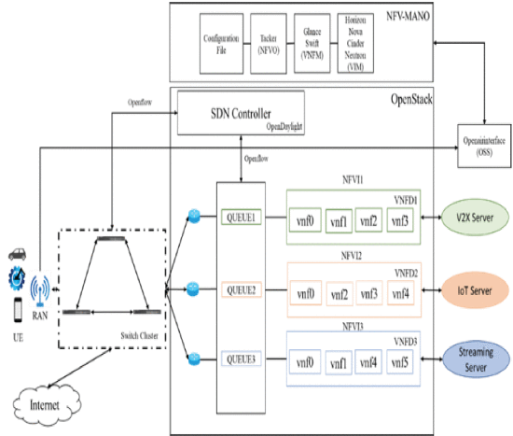
SECTION III.Proposed Mechanism Realizing Network Slicing

Slide 15
SECTION III.Proposed Mechanism Realizing Network Slicing
Fig. 2 gives an example of network topology that may be used in three types of service applications. Through Fig. 2, it can be seen that different services cannot communicate with each other, and service slices can be deployed more according to demand, not necessarily just the three slices shown in the figure. Through the SDN controller, we can correctly forward the packets of each service to the correct router to deploy the slice.

Slide 16
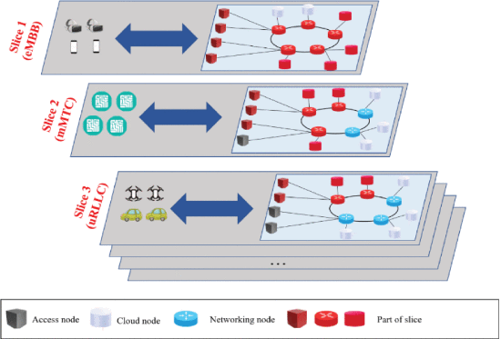
SECTION III.Proposed Mechanism Realizing Network Slicing

Slide 17
SECTION III.Proposed Mechanism Realizing Network Slicing
we also adopt Virtual eXtensible Local Area Network (VXLAN) in the proposed implementation mechanism. VXLAN is a new type of network virtualization technology. Compared with traditional Virtual LAN (VLAN), VXLAN can provide better scalability and flexibility. In 5G, services need to be provided to more users, so it is one of the reasonable methods to improve large cloud computing deployments through VXLAN. Based on the OpenStack architecture, we modify the configuration files of the controller node, network node, and compute node to implement VXLAN.

Slide 18
SECTION III.Proposed Mechanism Realizing Network Slicing
B. Control plane
In order to implement the network slicing architecture, the control plane and the data plane must be separated in practice. The proposed implementation mechanism realizes the control plane interface through the open source SDN controller ODL and OpenFlow protocol.

Slide 19
SECTION III.Proposed Mechanism Realizing Network Slicing
We implement resource management of network slice instances (NSIs) through ODL, and transfer signals through Application Programming Interface (API). In order to realize that each network slice is isolated from each other, the system logically separates each slice through NFV and SDN, and each slice obtains the network functions it needs.

Slide 20
SECTION III.Proposed Mechanism Realizing Network Slicing
C. Signal processing and slice management
Fig illustrates the signal processing in the proposed implementation mechanism. First, the UE sends its resource requirements to Remote Radio Head (RRH), then RRH passes the requirements to SDN Conroller and Slice Orchestrator (SC&SO), and finally SC&SO allocates the required resources to the UE, and establishes a service-based slice to the UE.

Slide 21
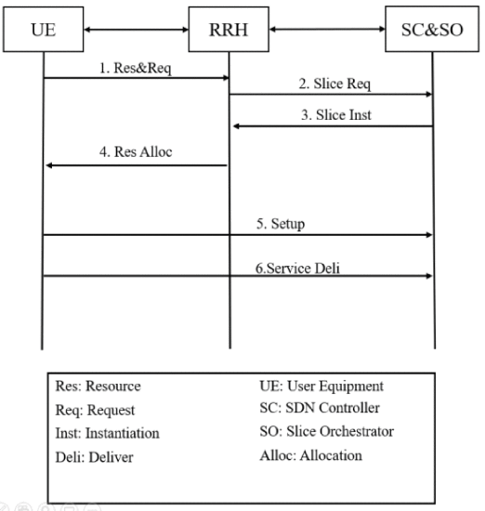

Slide 22
SECTION III.Proposed Mechanism Realizing Network Slicing
In different service scenarios of 5G, there are different process sequences. In the two scenarios of eMBB service and mMTC service, first of all, the service requirements will be passed to SC&SO through API. Then SC&SO will set the required resources for slicing according to the network resources and space resources owned by the system. In contrast, if it is a URLLC service, the required resources will be created directly through the SC, and will not go through the network functions created by the SO, thus the URLLC service will be delivered more quickly.

Slide 23
SECTION III.Proposed Mechanism Realizing Network Slicing
D. Implementation of VNF through Tacker and Queue
Tacker is an official project of OpenStack that builds a Generic VNF Manager (VNFM) and an NFV Orchestrator (NFVO) to deploy and operate network services and VNFs on OpenStack platform. In the proposed implementation mechanism, we first create a Tacker database, then connect with OpenStack, and create a Virtualized Infrastructure Manager (VIM) and VNF through a configuration file.

Slide 24
SECTION III.Proposed Mechanism Realizing Network Slicing
Then we write the configuration file of the Virtual Network Function Description (VNFD), and finally we can create the VNF required by the service through the VNFD configuration file. OpenFlow commands are used to create Queues to the corresponding ports, and Weighted Fair Queue (WFQ) is used to accurately ensure that services with higher priority are first guaranteed.

Slide 25
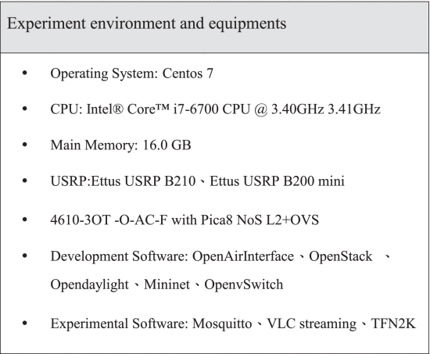
SECTION IV.Experimental Results

Slide 26
SECTION IV.Experimental Results
Experimental results
Experiment 1
The purpose of experiment 1 is to verify the error rate of bandwidth guaranteed by Queue. The test method is to set the upper and lower limits of the slice bandwidth guaranteed by the Queue to be the same, then generate traffic flow and measure the actual throughput through the iperf software. We measured once every 10 seconds and took the average of the other 10 times except the first measurement.

Slide 27
SECTION IV.Experimental Results
Fig. 6 shows the measurement before the Queue command has been issued. At the first second, because iperf is establishing a connection, the measured data is not accurate. Therefore, we do not take the measured result of the first second. After the measurement, the bandwidth is about 95-100 Mbits/sec before the OpenFlow Queue command is issued. Next, we issued Queue through ODL, and set the upper and lower slice throughput limits to 5 Mbits/sec and 50 Mbits/sec, as shown in Figure 7 and Figure 8, respectively.

Slide 28
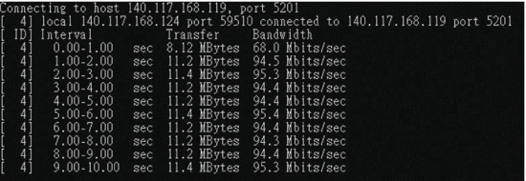

Slide 29
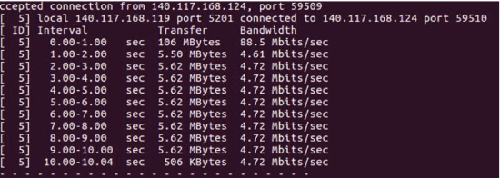

Slide 30
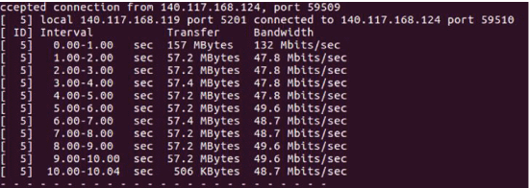

Slide 31
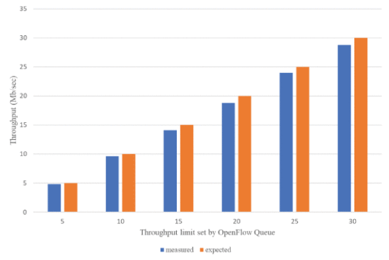
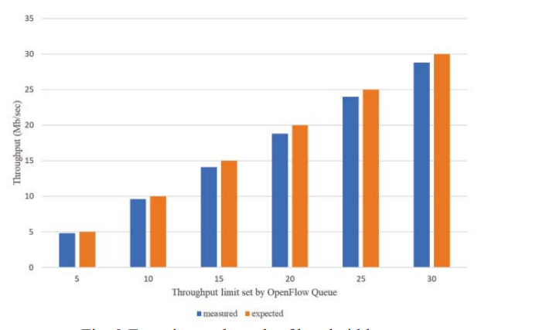

Slide 32
SECTION IV.Experimental Results
shows that the variation ratio between the actual bandwidth and the Queue setting bandwidth is about 4%-6%, and the variation ratio is not large. This experiment shows that it is effective to manage the network resources required by individual slices through the OpenFlow Queue command.

Slide 33
SECTION IV.Experimental Results
Experiment 2
The purpose of experiment 2 is to explore the end to end delay of the service slice. The architecture of experiment 2 is shown in Fig. 10. This experiment is divided into two kinds of tests. The first test is to check the variation of end to end latency from UE1 to the Google server (eMBB slice) and that from UE3 to the Google server (URLLC slice) under normal transmission conditions.

Slide 34
SECTION IV.Experimental Results
The second test is to observe the variation of end to end latency by increasing traffic load. To be more specifically, UE2 and UE4 used iperf to generate heavy traffic, we then used IP-Tools to observe the end to end latency from UE1 to the Google server and that from UE3 to the Google server. Note that in Fig. 10, the setting of URLLC slice (in red) is to install the core network in the physical machine instead of in the Virtual Machine (VM) of OpenStack and the transmission does not go through Open vSwitch (OVS), so it can reduce the latency slightly..

Slide 35
SECTION IV.Experimental Results
Fig. 11 shows the end to end latency variation under normal transmission conditions, and Fig. 12 shows the end to end latency variation under heavy traffic load. Since this experiment uses nextEPC and OAI eNB to implement, there is a transmission delay error in the experiment, so the latency of both eMBB and URLLC performs zigzag style curve under normal transmission condition in Figure 11. From Fig. 12, it can be found that both URLLC and eMBB slices have a significant increase in latency when the traffic load is greater than 0.6.

Slide 36
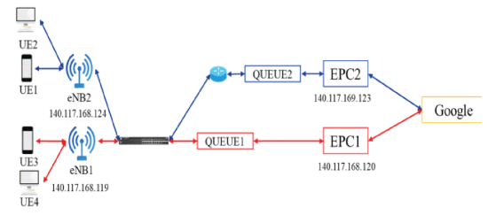

Slide 37
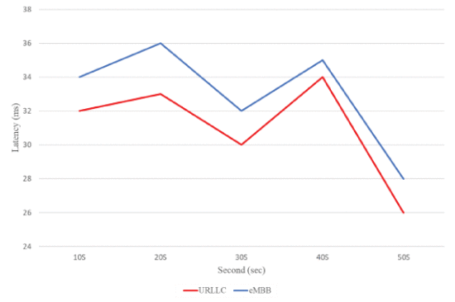

Slide 38
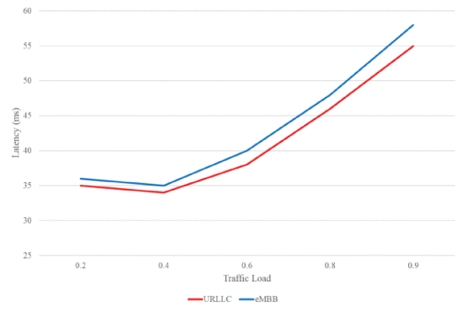

Slide 39
SECTION IV.Experimental Results
Experiment 3
The purpose of experiment 3 is to test whether the service of slices can be guaranteed through Queue. The experiment architecture is shown in Fig. 13.
First, we used Queue to set the upper and lower throughput limits of of eMBB and mMTC slices, and then injected heavy traffic flow to the mMTC slice to simulate network congestion, in order to verify whether the slice service can be guaranteed.

Slide 40
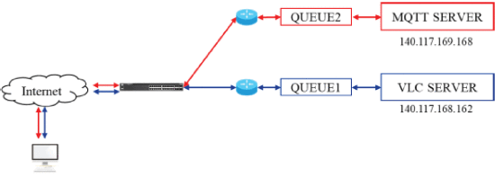
SECTION IV.Experimental Results
The traffic of eMBB and mMTC slices in this experiment are all simulated by iperf. The upper and lower limits of slices throughput are set as follows. The upper throughput limit of eMBB slice is 70 Mb/sec, the lower limit is 30Mb/sec. The upper throughput limit of mMTC is 50Mb/sec, and the lower limit is 30 Mb/sec.

Slide 41
SECTION IV.Experimental Results
Fig. shows the experimental result of traffic guarantee of slices. In this experiment, in order to facilitate the experiment process, we started the mMTC slice service and kept it stable through the Queue command, and then added the eMBB slice to verify whether the upper and lower throughput limits were guaranteed.

Slide 42
SECTION IV.Experimental Results
It can be seen that when the traffic load of mMTC slice is heavy, the throughput of the mMTC slice gradually drops to about the guaranteed lower limit, and then does not continue to decrease. Thus it can be confirmed that the slice throughput can be guaranteed by Queue. Note that because the setting bandwidth and the actual measured bandwidth have a variation rate of about 4%-6% (as shown in experiment 1), the actual minimum throughput of mMTC slice in Fig. 14 is slightly lower than the lower limit of 30Mb/sec set by Queue.

Slide 43
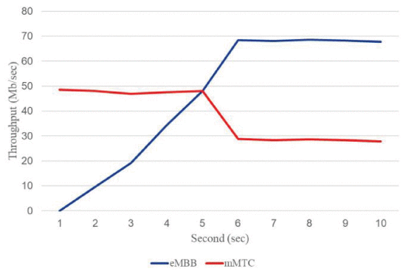

Slide 44
SECTION IV.Experimental Results
Experiment 4
The scenario of experiment 4 is that there are three slices in the system, two of which are in normal service, and the third slice suffers from UDP DDoS. The experiment checks whether the throughput of these two normally operating slices were also affected by DDoS. The architecture of experiment 5 is shown in Fig.

Slide 45
SECTION IV.Experimental Results
First of all, we set the upper and lower limits of the throughput of three slices. The upper throughput limit of mMTC slice is 30Mb/s, and the lower limit is 10Mb/s. The upper throughput limit of eMBB slice is 60Mb/s, and the lower limit is 30Mb/s. The upper throughput limit of NS slice is 5Mb/s, and the lower limit is 1Mb/s. We then set the priority of the three slices to be NS > eMBB > mMTC. Note that the NS slice is created to test and compare other slices and its internal VNF does not contain EPC core.

Slide 46
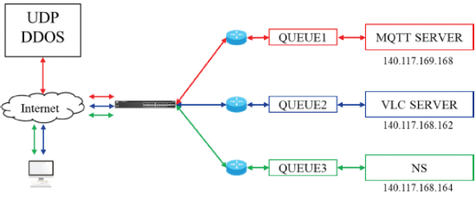
SECTION IV.Experimental Results

Slide 47
SECTION IV.Experimental Results
In this experiment, three slices mMTC, eMBB and NS were activated first and the traffic of these three slices is generated using iperf. Then we used open source software tfn2K to inject UDP DDoS traffic flow into the mMTC slice from the third second. Fig. 17 shows the result of experiment 5. From Fig. 17, it can be seen that when the UDP DDoS attack is launched, the mMTC slice cannot be connected intermittently after the fourth second, but it has no effect on the other two slices. eMBB and NS slices can still provide normal services.

Slide 48
SECTION IV.Experimental Results
Due to the scale problem, it is not easy to see the throughput variation from Fig. 17, so we present the throughput variation of mMTC slice separately in Fig. 18. As can be seen from Fig. 18, UDP DDoS makes the connection of the mMTC slice extremely unstable after the fourth second. This intermittent connection causes the throughput of the mMTC slice to oscillate between approximately 1 Mbps and 0 Mbps. At this time mMTC slice is difficult to serve normally.

Slide 49
SECTION IV.Experimental Results
Noted that the guarantee of Queue in this experiment can only be achieved based on the fact that the switch can properly handle traffic packets. If the switch shared by the three slices cannot work because of a larger-scale DDoS, then the guarantee of all slices will not be able to achieve.

Slide 50
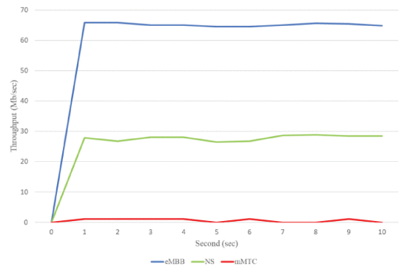
SECTION IV.Experimental Results

Slide 51
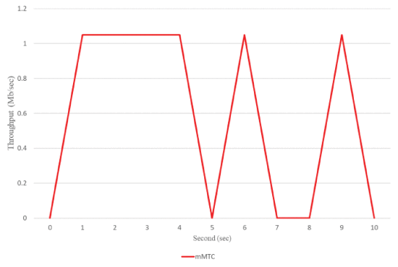
SECTION IV.Experimental Results

Slide 52
SECTION V.Conclusions
This research integrates various open source softwares, SDN controller and cloud platform to achieve network slicing. The proposed implementation mechanism guarantees the priority of use of each service, and uses VXLAN to cut the network segment, so as to protect the independence of each service. In terms of service deployment, Tacker can also be used to quickly set up the required VNFs to efficiently create different services.

Slide 53
SECTION V.Conclusions
Therefore, it is very convenient to set up different slices for difference service needs in the proposed implementation mechanism. In the future research, we hope to ensure the service resources on the user side and achieve better network utilization and also add appropriate scheduling scheme to adaptively improve resource utilization.

Slide 54
References
1.Study on scenarios and requirements for next generation access technologies, May 2017.
2.X. Li, R. Casellas, G. Landi, A. de la Oliva, X. Costa- Perez, A. García-Saavedra, et al., "5G-crosshaul network slicing enabling multitenancy in mobile transport networks", IEEE Communications Magazine, vol. 55, no. 8, pp. 128-137, 2017.
3.M. Yuki, T. Atsushi, K. Taichi, S. Norio and S. Katsuhiro, "An architecture and implementation of automatic network slicing for microservices", 2018 IEEE/IFIP Network Operations and Management Symposium (NOMS 2018), pp. 1-4, Apr 2018.
4.C. Salvatore, F. Ilhem, A. Nadjib and L. Rami, "DEMO: SDN-based network slicing in C-RAN", 2018 15th IEEE Annual Consumer Communications & Networking Conference (CCNC 2018), pp. 1-2, Jan 2018.
5.J. Kwak, J. Moon, H. W. Lee and L. B. Le, "Dynamic network slicing and resource allocation for heterogeneous wireless services", 2017 IEEE 28th Annual International Symposium on Personal Indoor and Mobile Radio Communications (PIMRC 2017), pp. 1-5, Oct 2017.

Slide 55
References
6.S. Vassilaras, L. Gkatzikis, N. Liakopoulos, I. N. Stiakogiannakis, M. Qi, L. Shi, et al., "The algorithmic aspects of network slicing", IEEE Communications Magazine, vol. 55, no. 8, pp. 112-119, 2017.
7.J. Ordonez-Lucena, O. Adamuz-Hinojosa, P. Ameigeiras, P. Munoz, Juan J. Ramos-Munoz, J. F. Chavarria, et al., "The creation phase in network slicing: from a service order to an operative network slice", 2018 European Conference on Networks and Communications (EuCNC 2018), pp. 1-6, Jul 2018.
8.C. Song, M. Zhang, Y. Zhan, D. Wang and L. Guan, "Hierarchical edge cloud enabling network slicing for 5G optical fronthaul", IEEE/OSA Journal of Optical Communications and Networking, vol. 11, no. 4, pp. B60-B70, 2019.
9.W. Guan, X. Wen, L. Wang, Z. Lu and Y. Shen, "Serviceoriented deployment policy of end-to-end network slicing based on complex network theory", IEEE Access, vol. 6, pp. 19691-19701, 2018.
10.A. Farrel, "Recent developments in Service Function Chaining (SFC) and network slicing in backhaul and metro networks in support of 5G", 2018 20th International Conference on Transparent Optical Networks (ICTON 2018), pp. 1-4, Jul 2018.

Slide 56
References
11.A. A. Barakabitze, A. Ahmad, R. Mijumbi and A. Hines, "5G network slicing using SDN and NFV: A survey of taxonomy architectures and future challenges", Computer Communications, vol. 167, pp. 1-40.
12.M. Afaq, J. Iqbal, T. Ahmed, I. U. Islam, M. Khan and M. S. Khan, "Towards 5G network slicing for vehicular adhoc networks: An end-to-end approach", Computer Communications, vol. 149, pp. 252-258, 2020.
13.H. T. Chien, Y.R. Lin, C. L. Lai and C. T. Wang, "Endto- end slicing as a service with computing and communication resource allocation for multi-tenant 5G systems", IEEE Wireless Communications, vol. 26, no. 15, pp. 104-112, 2019.

