Slide 1
A New Certificateless Signcryption Scheme Without Bilinear Pairing
Li Cui, Bai Yun, Shi Lin, Bai Wenhua
2018 13th International Conference on Computer Science & Education (ICCSE)

Slide 2
OUTLINE
Abstract
Introduction
Safety Analysis of Zhao's Scheme
The New Signcryption Scheme
Analysis of New Construction Scheme
Conclusion

Slide 3
Abstract
The certificateless signcryption schemes have been explored in depth by many scholars because of minor calculation, do not require complicated certificate management and inexistence of key escrow problem.
In recent years, many scholars promoted a large number of certificateless signcryption schemes, in which some schemes are insecure under the attack of replace several public keys.
On this background, a new certificateless signcryption scheme was proposed, and the computation and security of our scheme was analyzed. The results show that our scheme is not only more secure than former schemes, but also has a lower calculation.
Notes:
無證書簽密方案由於計算量小、不需要複雜的證書管理、不存在金鑰託管問題等優點，已被許多學者深入研究。
近年來，許多學者提出了大量的無證書簽密方案，其中一些方案在替換多個公開金鑰的攻擊下是不安全的。
在此背景下，提出了一種新的無證書簽密方案，並對該方案的計算和安全性進行了分析。結果表明，我們的方案不僅比以前的方案更安全，而且計算量也更低。
我們針對各種安全攻擊對我們提出的方案的安全強度進行了分析，以提供比以前報告的方案更好的性能。大量的實驗模擬表明，可以驗證我們提出的方案的計算複雜性。

Slide 4
Introduction
In the traditional public key cryptosystem, user's public key is bound to the identity of the user through a certificate issued by a credible Certification Authority (CA)[1], but this wastes a lot of storage space and computing time on the certificate management, which has greatly limited the application of PKI (Public Key Infrastructure) technology in real-time and bandwidth-constrained environments[2].
Notes:
在傳統的公開金鑰密碼體制中，使用者的公開金鑰通過可信憑證授權（CA）頒發的證書綁定到用戶的身份上[1]，這在證書管理上浪費了大量的存儲空間和計算時間，這大大限制了PKI（Public Key Infrastructure）技術在即時和頻寬受限環境中的應用[2]。

Slide 5
In order to simplify certificate management, Shamir proposed an identity-based public key cryptosystem in 1984[3].
In this system, user's identity information (such as ID number, student number, and mailbox) is the user's public key. This naturally achieves the binding of the user's public key and its identity, but because the user's private key is generated by the PKG (Private Key Generator), the PKG knows the private key of every user, so the identity-based cryptosystem brought new problems with key escrow.
Notes:
為了簡化證書管理，Shamir在1984年提出了一種基於身份的公開金鑰密碼體制[3]。
在本系統中，使用者的身份資訊（如身份證號、學號、郵箱）是用戶的公開金鑰。這自然實現了用戶公開金鑰與身份的綁定，但由於用戶的私密金鑰是由PKG（private key Generator）生成的，PKG知道每個使用者的私密金鑰，因此基於身份的密碼體制給金鑰託管帶來了新的問題。

Slide 6
In view of the complex certificate management in PKI and the unavoidable key escrow in identity-based cryptosystem, Al-Riyami and Paterson proposed the concept of Certificateless Public Key Cryptography (CL-PKC) in 2003[4].
In certificateless public key cryptosystem, a PKG is also required to generate user's partial private key. However, this partial private key does not need to be kept confidential, nor does it require a secure channel to transmit to the target user. The user selects a secret value that only he himself knows, and at the same time combines the partial private key to generate his complete private key.
Notes:
針對PKI中複雜的證書管理和基於身份密碼體制中不可避免的金鑰託管問題，Al-Riyami和Paterson在2003年提出了無證書公開金鑰密碼（CL-PKC）的概念[4]。
在無證書公開金鑰密碼體制中，還需要PKG來生成使用者的部分私密金鑰。然而，該部分私密金鑰不需要保密，也不需要安全通道來傳輸給目標使用者。用戶選擇一個只有他自己知道的秘密值，同時結合部分私密金鑰生成他的完整私密金鑰。

Slide 7
Since the certificateless cryptosystem not only avoids the problem of certificate management in the traditional public key cryptosystem, but also solves the problem of private key leakage in the identity-based cryptosystem. It builds a good balance between the traditional public key cryptosystem and the identity-based cryptosystem, which has caused widespread concern of relevant scholars.
Notes:
由於無證書密碼體制既避免了傳統公開金鑰密碼體制中的證書管理問題，又解決了基於身份密碼體制中的私密金鑰洩漏問題。它在傳統的公開金鑰密碼體制和基於身份的密碼體制之間建立了良好的平衡，引起了相關學者的廣泛關注。

Slide 8
Digital signature and encryption are two important functions of cryptography.
Signature and encryption functions were used separately before. As applications continue to expand, more and more applications are required to provide both authentication and confidentiality.
The traditional practice to achieve this goal is to “first sign and then encrypt”, the amount of computation and communication of this approach is the sum of the signature and encryption, and thus is less efficient.
Notes:
數位簽章和加密是密碼學的兩個重要功能。
以前簽名和加密功能是分開使用的。隨著應用程式的不斷擴展，越來越多的應用程式需要同時提供身份驗證和機密性。
實現這一目標的傳統做法是先簽名後加密，這種方法的計算量和通信量是簽名和加密的總和，因而效率較低。

Slide 9
On this background, Zheng proposed a new cryptographic primitive “Signcryption” in 1997 to accomplish both goals simultaneously[5]. Since certificateless public key cryptography was proposed, the certificateless signcryption scheme has been extensively studied by scholars.
Notes:
在此背景下，鄭於1997年提出了一種新的密碼原語“簽密”，以同時實現這兩個目標[5]。自無證書公開金鑰密碼體制被提出以來，無證書簽密方案得到了學者們的廣泛研究。

Slide 10
In the protocol design process, security and efficiency have always been the core concerns of people.
From the theoretical analysis[6] and the experimental results[7] [8], it is found that the bilinear pairing computation is about 20 times higher than point multiplication of the elliptic curve under the same safety intensity. Therefore, the certificateless signcryption scheme without bilinear pairing is more efficient and has greater research value.
Since Barreto[9] proposed the first certificateless signcryption scheme without bilinear pairing in 2008, many researchers have done a lot of efforts on the security and efficiency of the certificateless signcryption scheme without bilinear pairing.
Notes:
在協議設計過程中，安全性和效率一直是人們關注的核心問題。
從理論分析[6]和實驗結果[7][8]可以看出，在相同的安全強度下，雙線性配對計算比橢圓曲線的點乘計算高出20倍左右。因此，無雙線性配對的無證書簽密方案具有更高的效率和更大的研究價值。
自從Barreto[9]於2008年提出了第一個無雙線性對的無證書簽密方案以來，許多研究者對無雙線性對的無證書簽密方案的安全性和效率進行了大量的研究。

Slide 11
The certificateless signcryption scheme without bilinear pairing proposed by Zhu[14] was later proved to be insecure. Zhao[15] and Zhou[16] pointed out that Zhu's scheme could be forged and given a specific method of forgery.
Based on previous schemes, Wang[11], Zhao[15], and Zhou[16] designed a new certificateless signcryption scheme respectively and gave the scheme's security prove.
Through in-depth analysis of these improved solutions, this paper finds that their solutions can resist the attack of the attacker replacing a single public key, but cannot resist the attack of replacing multiple public keys at the same time.
Notes:
朱[14]提出的無證書無雙線性對簽密方案後來被證明是不安全的。趙[15]和周[16]指出，朱的方案可以偽造，並給出了具體的偽造方法。
在已有方案的基礎上，王[11]，趙[15]和周[16]分別設計了一個新的無證書簽密方案，並給出了該方案的安全性證明。

Slide 12
In addition, the plans of Zhou [16] and Wang[17] did not meet the forward security.
This article conducts an in-depth study of the schemes of Wang[11] and Zhao[15]. By increasing the restrictions of the association between public keys, a new certificateless signcryption scheme without bilinear pairing is designed. The new scheme has unforgeability, confidentiality, public verifiability, and forward security. The computational cost is lower and the efficiency is higher. It is suitable for resource-constrained network environment.
Notes:
通過對這些改進方案的深入分析，本文發現它們的解決方案能夠抵抗攻擊者替換單個公開金鑰的攻擊，但不能抵抗同時替換多個公開金鑰的攻擊。此外，周[16]和王[17]的方案不符合前向安全性。
(前向安全性:指的是長期使用的主金鑰泄漏不會導致過去的對談金鑰泄漏。前向保密能夠保護過去進行的通訊不受密碼或金鑰在未來暴露的威脅。如果系統具有前向保密性，就可以保證在私鑰泄露時歷史通訊的安全，即使系統遭到主動攻擊也是如此。 )
本文對王[11]和周[15]的方案進行了深入研究。通過增加公開金鑰之間關聯的限制，設計了一種新的無雙線性配對的無證書簽密方案。新方案具有不可偽造性、保密性、可公開驗證性和前向安全性。計算量小，效率高。它適用于資源受限的網路環境。

Slide 13
Safety Analysis of Zhao's Scheme
This section constructs concrete attack algorithms to prove that the schemes of Wang and Zhao cannot meet their claimed unforgeability and confidentiality.
Since Wang and Zhao's plan have the same security risks, this section uses Zhao's plan[15] as an example to give specific attack steps.
Zhao's plan is detailed in [15].
Notes:
本節構造具體的攻擊算法，以證明Wang和Zhao的方案不能滿足其聲稱的不可偽造性和機密性。
由於王和趙的計劃具有相同的安全風險，因此本節以趙的計劃[15]為例給出具體的攻擊步驟。
趙的計劃在[15]中有詳細說明。

Slide 14
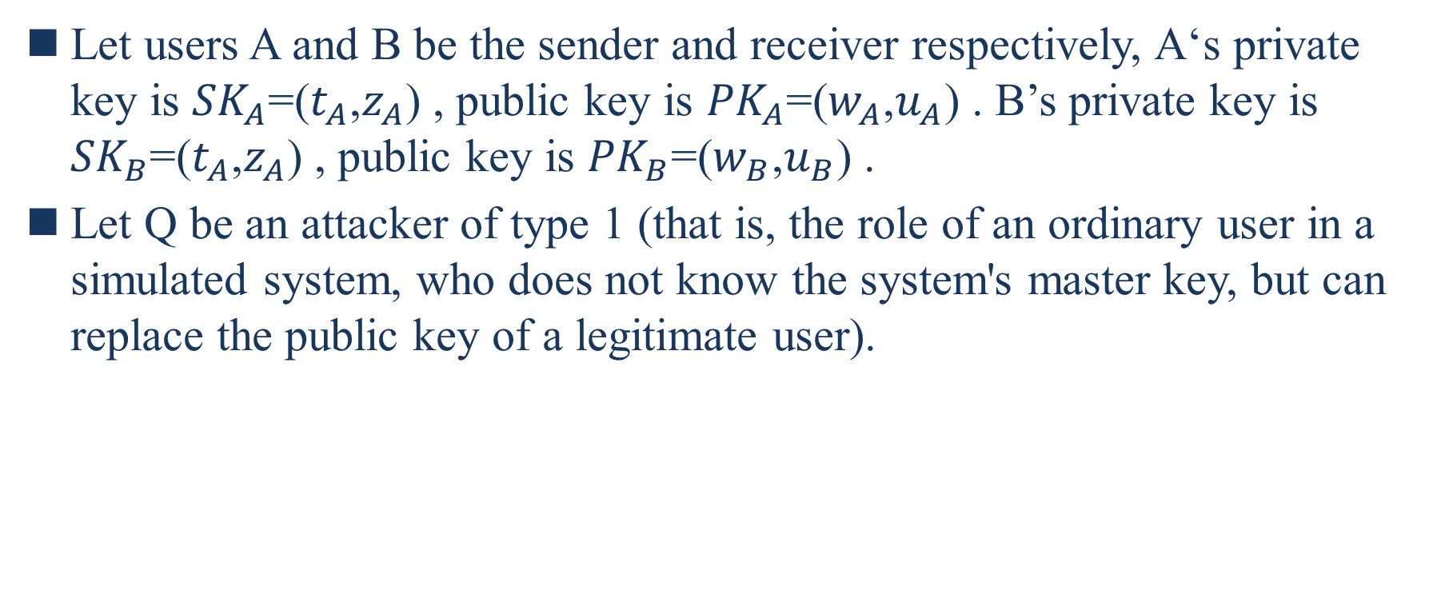
Let users A and B be the sender and receiver respectively, A‘s private key is ${SK}_{A}$=($t_{A}$,$z_{A}$) , public key is ${PK}_{A}$=($w_{A}$,$u_{A}$) . B’s private key is ${SK}_{B}$=($t_{A}$,$z_{A}$) , public key is ${PK}_{B}$=($w_{B}$,$u_{B}$) .
Let Q be an attacker of type 1 (that is, the role of an ordinary user in a simulated system, who does not know the system's master key, but can replace the public key of a legitimate user).
Notes:
假設用戶A和B分別為發送者和接收者，A的私鑰為${SK}_{A}$=($t_{A}$,$z_{A}$)，公鑰為${PK}_{A}$=($w_{A}$,$u_{A}$)。B的私鑰為${SK}_{B}$=($t_{A}$,$z_{A}$)，公鑰為${PK}_{B}$=($w_{B}$,$u_{B}$) 。
假設Q為類型1的攻擊者（即模擬系統中普通用戶的角色，該用戶不知道系統的主密鑰，但可以替換合法用戶的公鑰）。

Slide 15
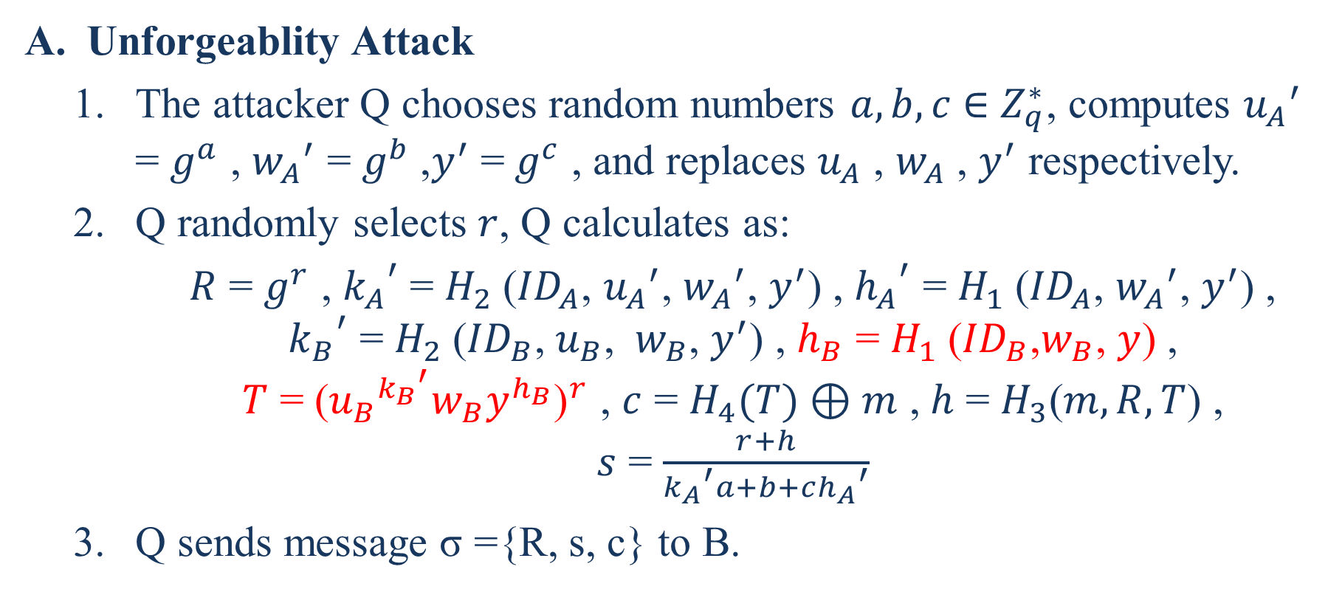
Unforgeablity Attack
  The attacker Q chooses random numbers $a,b,c$ ∈ $Z_{q}^{∗}$, computes ${u_{A}}^{′}$ = $g^{a}$ , ${w_{A}}^{′}$ = $g^{b}$,$y^{′}$ =${ g}^{c}$ , and replaces $u_{A}$ , $w_{A}$ , $y^{′}$ respectively.
  Q randomly selects $r$, Q calculates as:
  $R$ = $g^{r}$ , ${k_{A}}^{′}$= $H_{2}$(${ID}_{A}$, ${u_{A}}^{′}$, ${w_{A}}^{′}$, $y^{′}$) , ${h_{A}}^{′}$ = $H_{1}$(${ID}_{A}$, ${w_{A}}^{′}$, $y^{′}$) ,
  ${k_{B}}^{′}$ = $H_{2}$(${ID}_{B}$,$u_{B}$, $w_{B}$, $y^{′}$) , $h_{B}$ = $H_{1}$(${ID}_{B}$,$w_{B}$, $y$) ,
  $T$ = ${\text{(}{u_{B}}^{{k_{B}}^{′}}w_{B}y^{h_{B}}\text{)}}^{r}$ , $c$ = $H_{4}(T)⊕m$ , $h$ = $H_{3}$($m,R,T$) ,
  $s$ = $\frac{r+h}{{k_{A}}^{′}a+b+c{h_{A}}^{′}}$
  Q sends message σ ={R, s, c} to B.

Slide 16
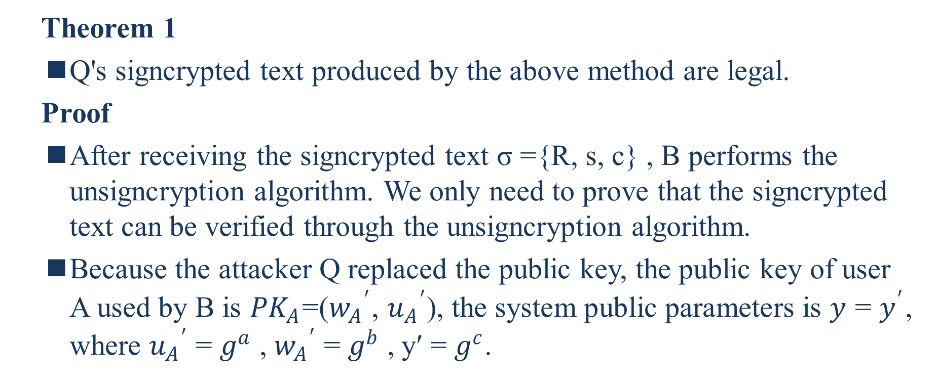
  Theorem 1
  Q's signcrypted text produced by the above method are legal.
  Proof
  After receiving the signcrypted text σ ={R, s, c} , B performs the unsigncryption algorithm. We only need to prove that the signcrypted text can be verified through the unsigncryption algorithm.
  Because the attacker Q replaced the public key, the public key of user A used by B is ${PK}_{A}$=(${w_{A}}^{′}$, ${u_{A}}^{′}$), the system public parameters is $y$ = $y^{′}$, where ${u_{A}}^{′}$ = $g^{a}$ , ${w_{A}}^{′}$ = $g^{b}$ , y′ = $g^{c}$.
Notes:
通過上述方法生成的Q的密文是合法的。
B收到簽密文本σ= {R，s，c}後，執行解簽密算法。我們只需要證明可以通過非簽密算法驗證簽密文本。
由於攻擊者Q替換了公鑰，因此B使用的用戶A的公鑰為${PK}_{A}$=(${w_{A}}^{′}$, ${u_{A}}^{′}$)，系統公有參數為$y$ = $y^{′}$，其中${u_{A}}^{′}$ = $g^{a}$ , ${w_{A}}^{′}$ = $g^{b}$ , y′ = $g^{c}$。

Slide 17

  B’s verification process is as follows:
    B computes as:
    ${k_{B}}^{′}$ = $H_{2}$(${ID}_{A}$,${u_{A}}^{′}$,${w_{A}}^{′}$, $y^{′}$)
    $T^{′}$ = $R^{{k_{B}}^{′}z_{B}+t_{B}}$ = ${\text{(}{u_{B}}^{{k_{B}}^{′}}w_{B}y^{h_{B}}\text{)}}^{r}$= T
    $m$ = $H_{4} \left(T\right)⊕c$

Slide 18
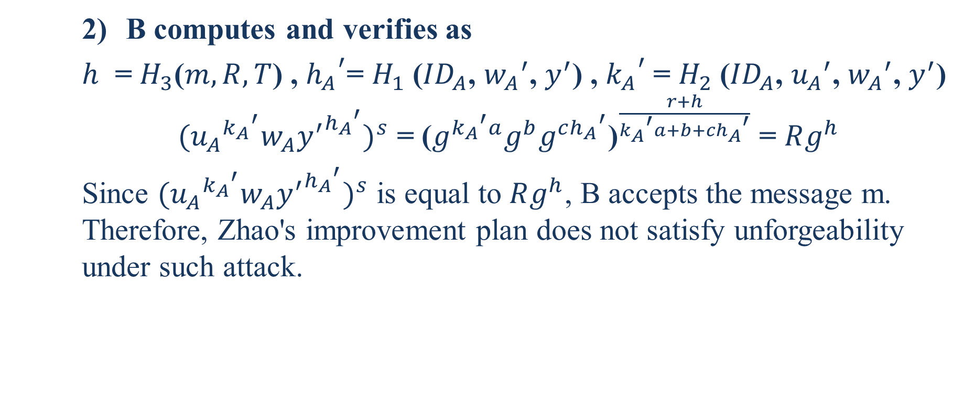
    B computes and verifies as
    $h$ = $H_{3}$($m,R,T$) , ${h_{A}}^{′}$= $H_{1}$(${ID}_{A}$, ${w_{A}}^{′}$, $y^{′}$) , ${k_{A}}^{′}$= $H_{2}$(${ID}_{A}$, ${u_{A}}^{′}$, ${w_{A}}^{′}$, $y^{′}$)
    ${({u_{A}}^{{k_{A}}^{′}}w_{A}{y^{′}}^{{h_{A}}^{′}})}^{s}$ = ${\text{(}g^{{k_{A}}^{′}a}g^{b}g^{c{h_{A}}^{′}}\text{)}}^{\frac{r+h}{{k_{A}}^{′}a+b+c{h_{A}}^{′}}}$ = $Rg^{h}$
    Since ${({u_{A}}^{{k_{A}}^{′}}w_{A}{y^{′}}^{{h_{A}}^{′}})}^{s}$ is equal to $Rg^{h}$, B accepts the message m. Therefore, Zhao's improvement plan does not satisfy unforgeability under such attack.
Notes:
由於${({u_{A}}^{{k_{A}}^{′}}w_{A}{y^{′}}^{{h_{A}}^{′}})}^{s}$等於$Rg^{h}$，因此B接受消息m。因此，趙的改進計劃不能滿足這種攻擊下的不可偽造性。

Slide 19
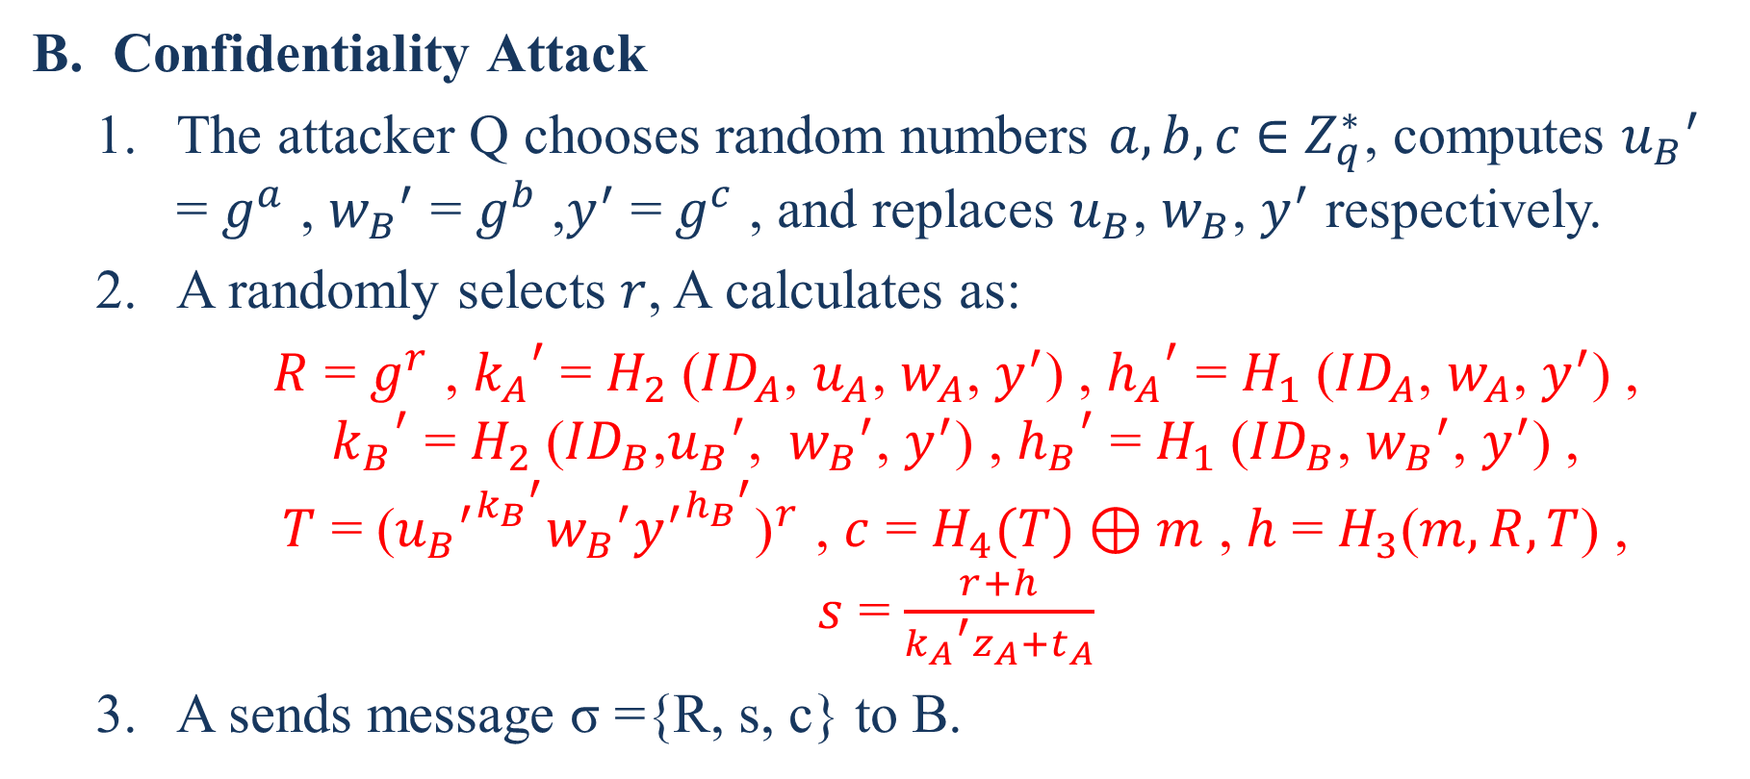
更改後
Confidentiality Attack
  The attacker Q chooses random numbers $a,b,c$ ∈ $Z_{q}^{∗}$, computes ${u_{B}}^{′}$ = $g^{a}$ , ${w_{B}}^{′}$ = $g^{b}$,$y^{′}$ =${ g}^{c}$ , and replaces $u_{B}$, $w_{B}$, $y^{′}$ respectively.
  A randomly selects $r$, A calculates as:
  $R$ = $g^{r}$ , ${k_{A}}^{′}$= $H_{2}$(${ID}_{A}$, $u_{A}$, $w_{A}$, $y^{′}$) , ${h_{A}}^{′}$ = $H_{1}$(${ID}_{A}$, $w_{A}$, $y^{′}$) ,
  ${k_{B}}^{′}$ = $H_{2}$(${ID}_{B}$,${u_{B}}^{′}$, ${w_{B}}^{′}$, $y^{′}$) , ${h_{B}}^{′}$ = $H_{1}$(${ID}_{B}$, ${w_{B}}^{′}$, $y^{′}$) ,
  $T$ = ${\text{(}{{u_{B}}^{′}}^{{k_{B}}^{′}}{w_{B}}^{′}{y^{′}}^{{h_{B}}^{′}}\text{)}}^{r}$ , $c$ = $H_{4}(T)⊕m$ , $h$ = $H_{3}$($m,R,T$) ,
  $s$ = $\frac{r+h}{{k_{A}}^{′}z_{A}+t_{A}}$
  A sends message σ ={R, s, c} to B.

Slide 20
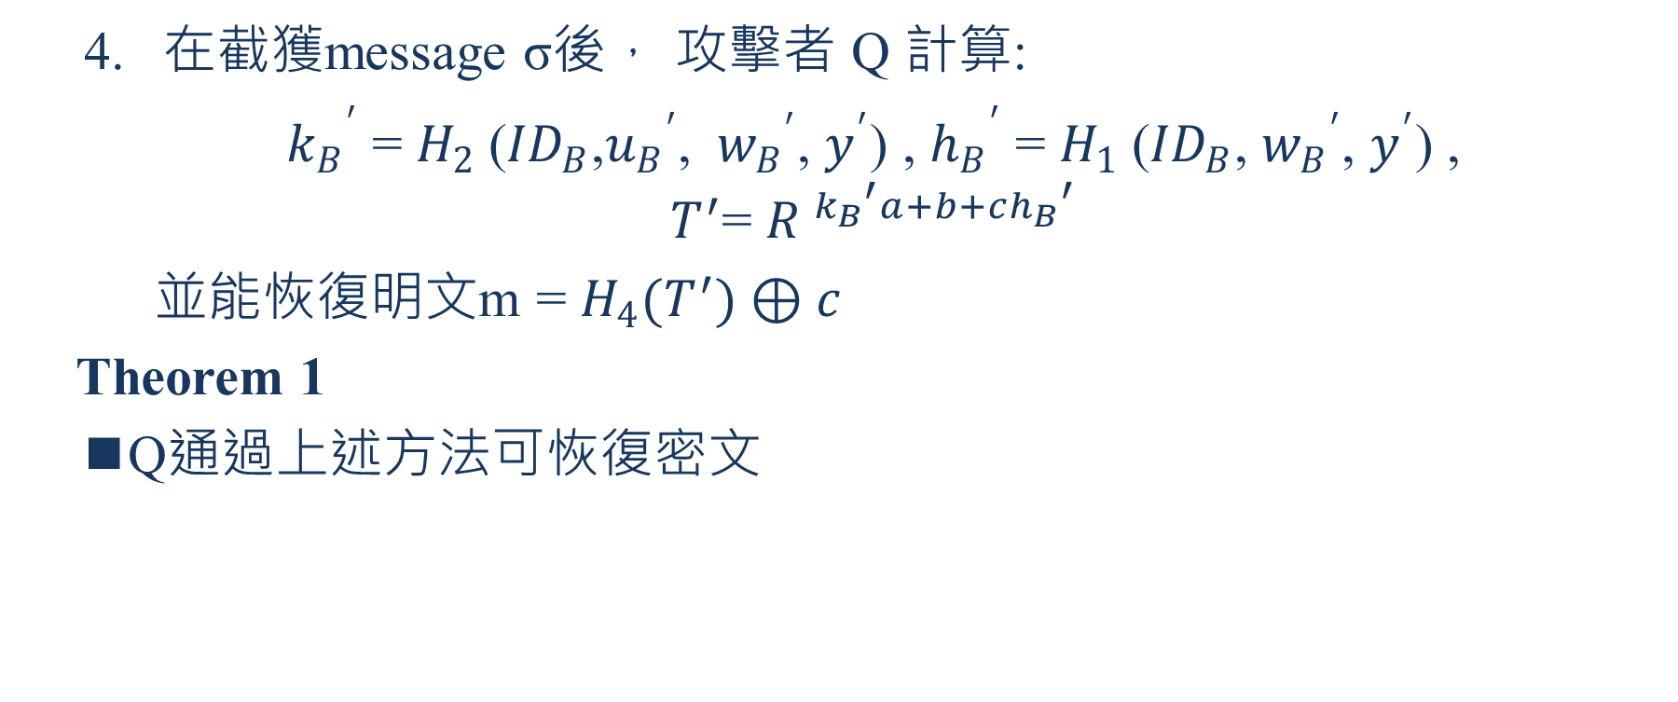
  在截獲message σ後， 攻擊者 Q 計算:
  ${k_{B}}^{′}$ = $H_{2}$(${ID}_{B}$,${u_{B}}^{′}$, ${w_{B}}^{′}$, $y^{′}$) , ${h_{B}}^{′}$ = $H_{1}$(${ID}_{B}$, ${w_{B}}^{′}$, $y^{′}$) ,
  $T^{′}$= ${R }^{{k_{B}}^{′}a+b+c{h_{B}}^{′}}$
  並能恢復明文m = $H_{4}(T^{′})⊕c$
  Theorem 1
  Q通過上述方法可恢復密文

Slide 21
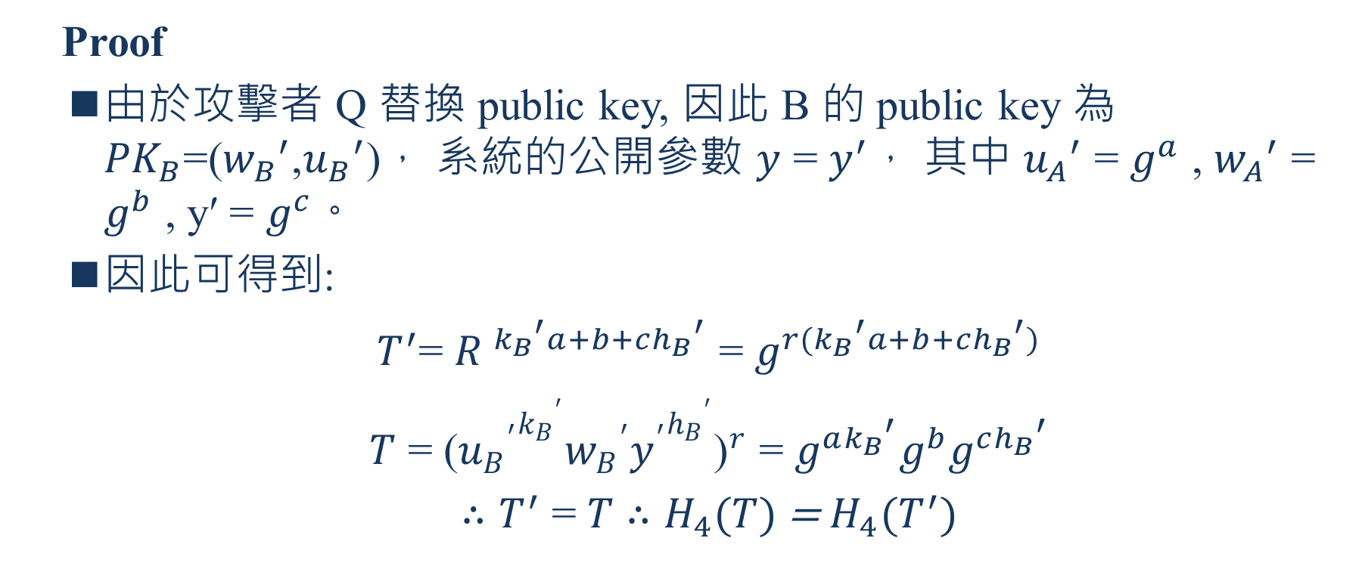
  Proof
  由於攻擊者 Q 替換 public key, 因此 B 的 public key 為 ${PK}_{B}$=(${w_{B}}^{′}$,${u_{B}}^{′}$)， 系統的公開參數 $y$ = $y^{′}，$ 其中 ${u_{A}}^{′}$ = $g^{a}$ , ${w_{A}}^{′}$ = $g^{b}$ , y′ = $g^{c}。$
  因此可得到:
  $T^{′}$= ${R }^{{k_{B}}^{′}a+b+c{h_{B}}^{′}}$ = $g^{r({k_{B}}^{′}a+b+c{h_{B}}^{′})}$
  $T$ = ${\text{(}{{u_{B}}^{′}}^{{k_{B}}^{′}}{w_{B}}^{′}{y^{′}}^{{h_{B}}^{′}}\text{)}}^{r}$ = $g^{a{k_{B}}^{′}}g^{b}g^{c{h_{B}}^{′}}$
  $∴T^{′}$ = $T$ $∴H_{4}(T)$ = $H_{4}(T^{′})$

Slide 22
  所以攻擊者 Q可以從截獲的message σ恢復明文m，因此趙等人的機制不能滿足這種攻擊下的保密性。

Slide 23
The New Signcryption Scheme
For the schemes in [10] [12] [14], by controlling uA/uB, the attacker uses a simple linear relationship to eliminate the influence of tA/tB on the signcrypted text and to achieves the purpose of forgery.
On this basis, the schemes in [11] [13] [15] improve their plans. Although replace single public key attack is avoided, after analyzing in the previous section, simply destroying this linear relationship can resist the attacker replacing the single public key Attacks, but if an attacker replaces multiple public keys at the same time, replacing multiple public keys with irrelevant numbers, the improved solution is also insecure.
Notes:
對於[10][12][14]中的方案，攻擊者通過控制uA/uB，利用簡單的線性關係消除tA/tB對簽密文本的影響，達到偽造的目的。
在此基礎上，[11][13][15]中的方案改進了它們的計畫。雖然避免了替換單個公開金鑰的攻擊，但經過上一節的分析，只要破壞這種線性關係，就可以抵抗攻擊者替換單個公開金鑰的攻擊，但是如果攻擊者同時替換多個公開金鑰，用不相關的數字替換多個公開金鑰，改進後的解決方案也是不安全的。

Slide 24
Therefore, in order to improve the defects of the existing schemes, this section designs a new certificateless signcryption scheme without bilinear pairing, and analyzes the correctness of the scheme.
Notes:
因此，為了改進現有方案的缺陷，本部分設計了一種新的無雙線性配對的無證書簽密方案，並對方案的正確性進行了分析。

Slide 25
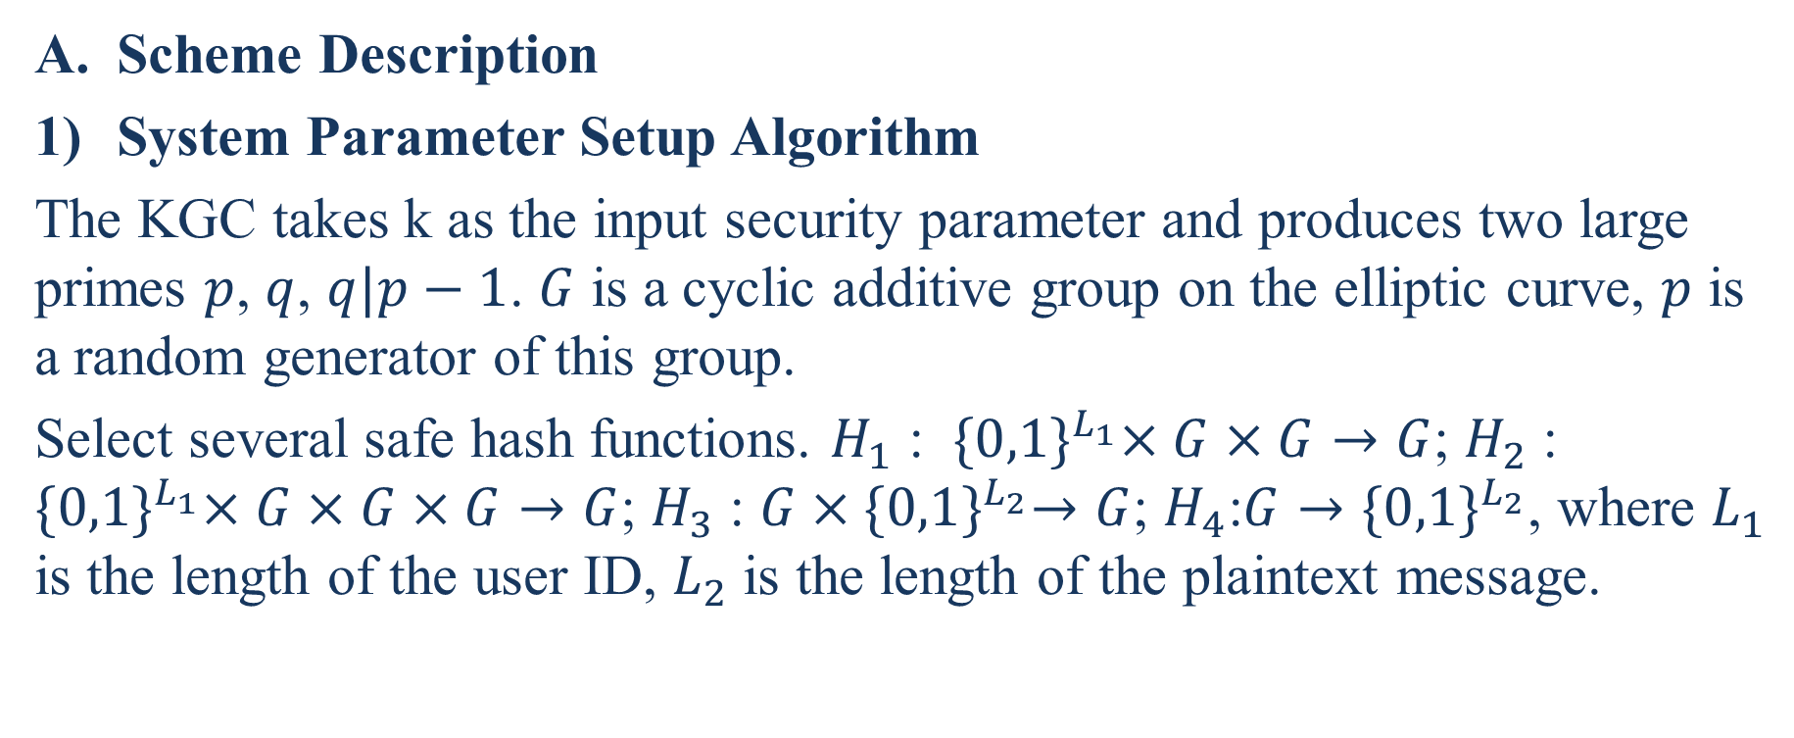
Scheme Description
System Parameter Setup Algorithm
The KGC takes k as the input security parameter and produces two large primes $p$, $q$, $q|p−1$. $G$ is a cyclic additive group on the elliptic curve, $p$ is a random generator of this group.
Select several safe hash functions. $H_{1}$ : ${\{0,1\}}^{L_{1}}×G×G→G$; $H_{2}$ : ${\{0,1\}}^{L_{1}}×G×G×G→G$; $H_{3}$ : $G{×\{0,1\}}^{L_{2}}→G$; $H_{4}$:$G→{\{0,1\}}^{L_{2}}$, where $L_{1}$ is the length of the user ID, $L_{2}$ is the length of the plaintext message.
Notes:
方案說明
KGC將k作為輸入安全性參數，並產生兩個大質數$p$, $q$, $q|p−1$。 $G$是橢圓曲線上的循環加法群，$p$是該組的隨機生成器。
選擇幾個安全的哈希函數。 $H$ : ${\{0,1\}}^{L_{1}}×G×G→G$； $H_{2}$ : ${\{0,1\}}^{L_{1}}×G×G×G→G$； $H_{3}$ : $G{×\{0,1\}}^{L_{2}}→G$; $H_{4}$:$G→{\{0,1\}}^{L_{2}}$，其中$L_{1}$是用戶ID的長度，$L_{2}$是純文本消息的長度。

Slide 26

The KGC randomly selects $x$∈ $Z_{q}^{∗}$ as the master key, calculates $y = xp$, secrets the master key $x$ and exposes system parameters $(p,q,y,H_{1},H_{2},H_{3},H_{4})$
Notes:
KGC隨機選擇$x$∈ $Z_{q}^{∗}$作為主密鑰，計算$y = xp$，秘密主密鑰$x$並公開系統參數$(p,q,y,H_{1},H_{2},H_{3},H_{4})$

Slide 27
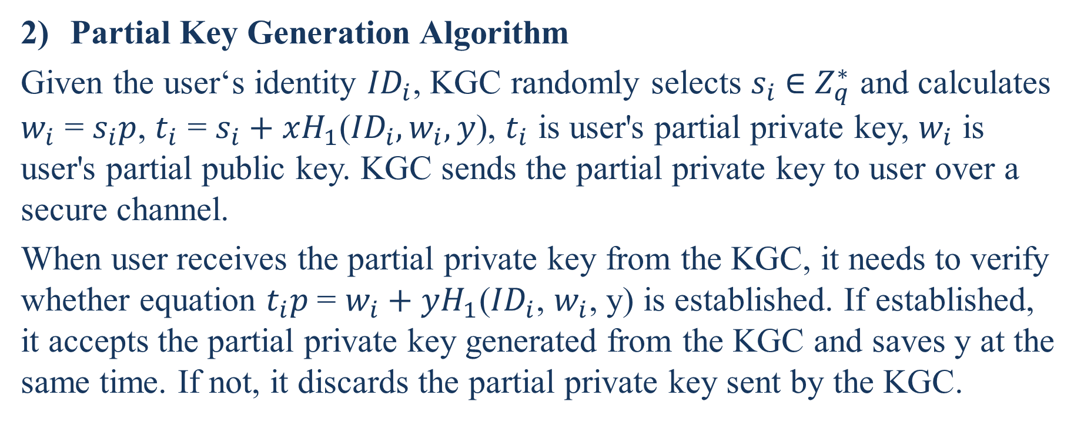
Partial Key Generation Algorithm
Given the user‘s identity ${ID}_{i}$, KGC randomly selects $s_{i}$ ∈ $Z_{q}^{∗}$ and calculates $w_{i}$ = $s_{i}p$, $t_{i}$ = $s_{i}+xH_{1}$(${ID}_{i},w_{i},y$), $t_{i}$ is user's partial private key, $w_{i}$ is user's partial public key. KGC sends the partial private key to user over a secure channel.
When user receives the partial private key from the KGC, it needs to verify whether equation $t_{i}p$= $w_{i}+yH_{1}$(${ID}_{i}$, $w_{i}$, y) is established. If established, it accepts the partial private key generated from the KGC and saves y at the same time. If not, it discards the partial private key sent by the KGC.
Notes:
給定用戶身份${ID}_{i}$，KGC隨機選擇$s_{i}$ ∈ $Z_{q}^{∗}$，計算$w_{i}$ = $s_{i}p$,，$t_{i}$ = $s_{i}+xH_{1}$(${ID}_{i},w_{i},y$)，$t_{i}$為使用者部分私密金鑰，$w_{i}$為使用者部分公開金鑰。KGC通過秘密頻道將部分私密金鑰發送給使用者。
當用戶從KGC接收到部分私密金鑰時，需要驗證是否建立了等式$t_{i}p$= $w_{i}+yH_{1}$(${ID}_{i}$, $w_{i}$, y) 。如果成立，它接受從KGC生成的部分私密金鑰，同時保存y。否則，它將丟棄由KGC發送的部分私密金鑰。

Slide 28
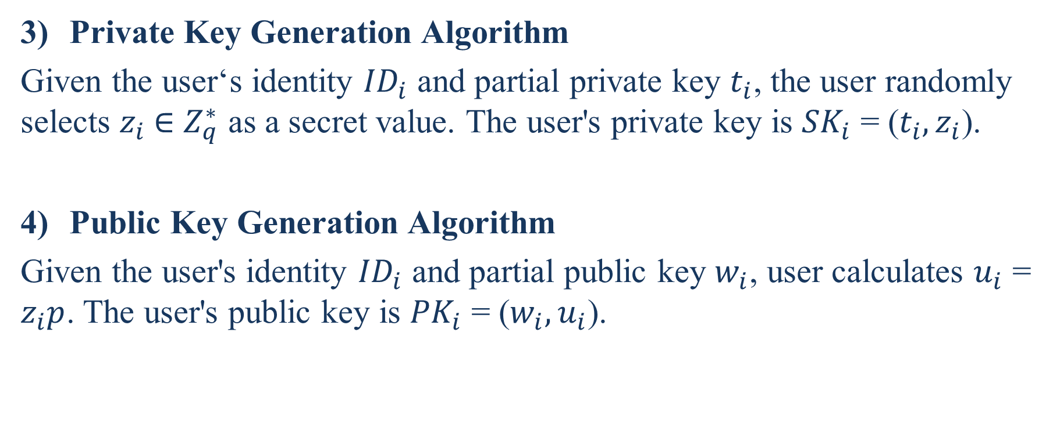
Private Key Generation Algorithm
Given the user‘s identity ${ID}_{i}$ and partial private key $t_{i}$, the user randomly selects $z_{i}$ ∈ $Z_{q}^{∗}$ as a secret value. The user's private key is ${SK}_{i}$ = ($t_{i},z_{i}$).
Public Key Generation Algorithm
Given the user's identity ${ID}_{i}$ and partial public key $w_{i}$, user calculates $u_{i}$ = $z_{i}p$. The user's public key is ${PK}_{i}$ = ($w_{i},u_{i}$).
Notes:
給定用戶的身份${ID}_{i}$和部分私密金鑰$t_{i}$，用戶隨機選擇$z_{i}$ ∈ $Z_{q}^{∗}$作為秘密值。用戶的私密金鑰是${SK}_{i}$ = ($t_{i},z_{i}$)。
給定用戶的身份${ID}_{i}$和部分公開金鑰$w_{i}$，用戶計算$u_{i}$ = $z_{i}p$。用戶的公開金鑰是${PK}_{i}$ = ($w_{i},u_{i}$) 。
。

Slide 29
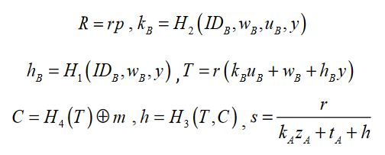
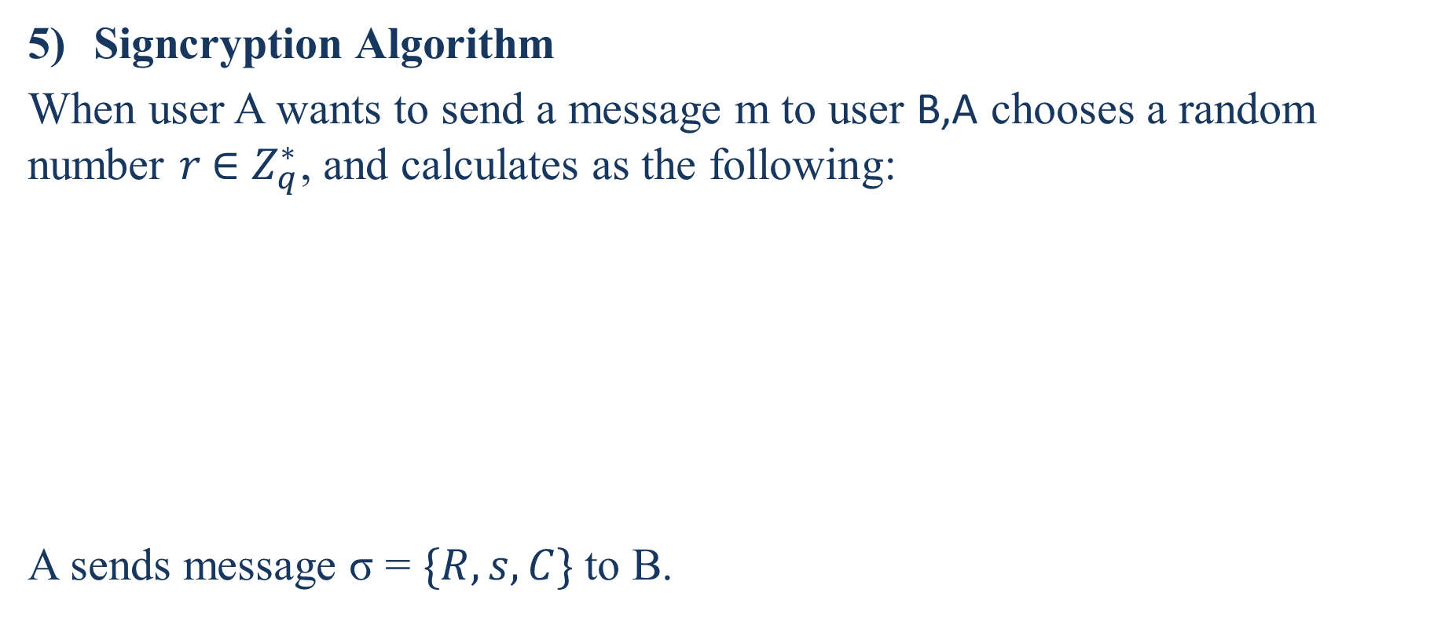
Signcryption Algorithm
When user A wants to send a message m to user B,A chooses a random number $r \text{∈} Z_{q}^{∗}$, and calculates as the following:
A sends message σ = $\{R, s, C\}$to B.

Slide 30
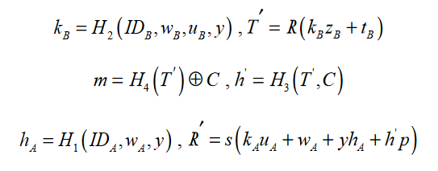
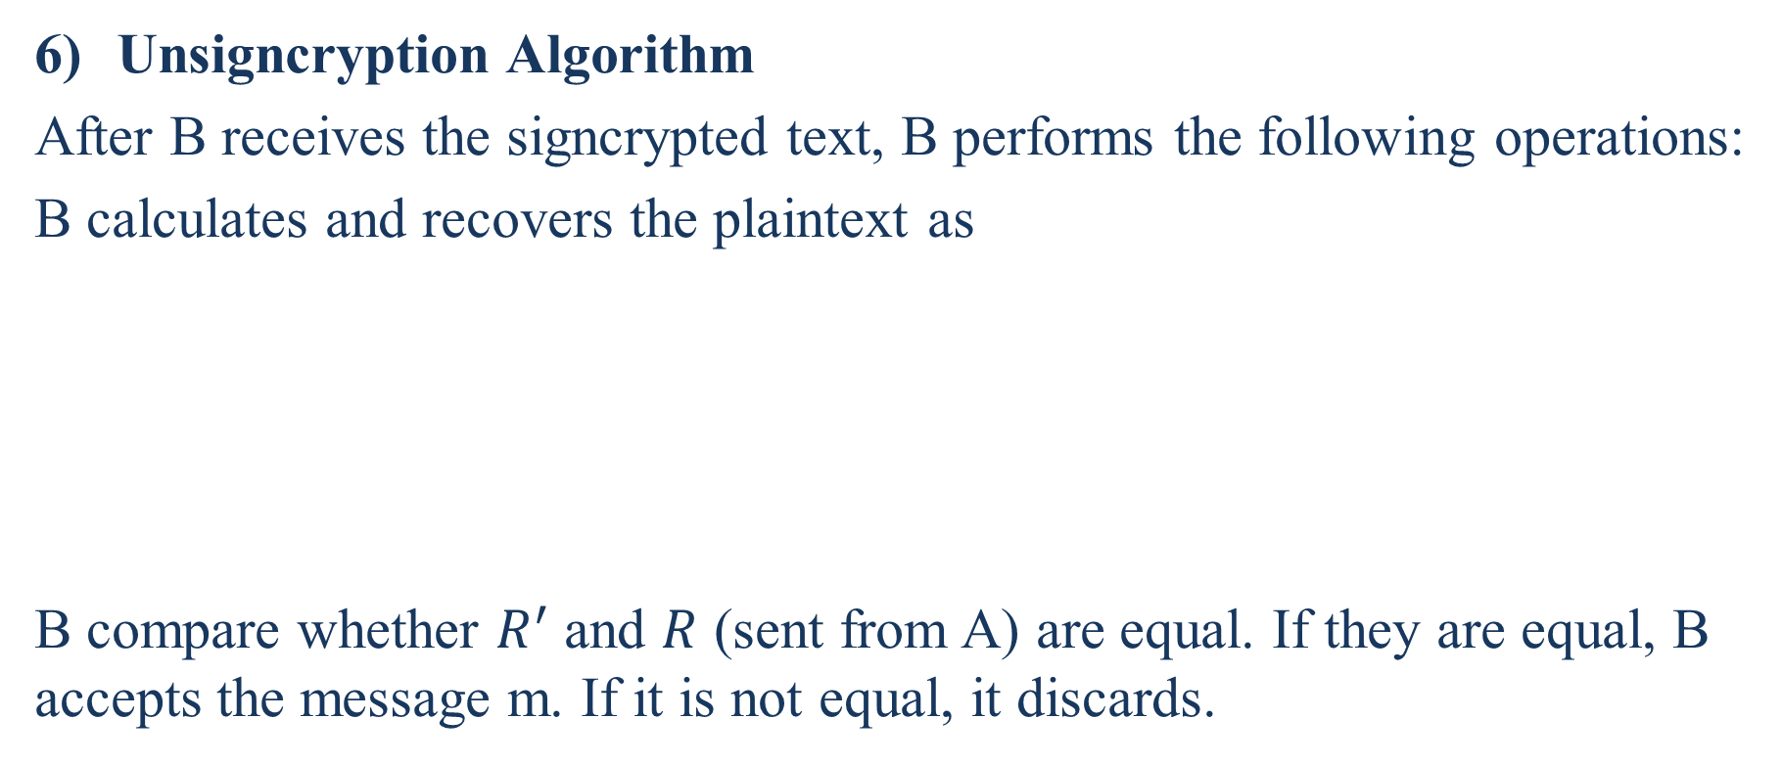
Unsigncryption Algorithm
After B receives the signcrypted text, B performs the following operations:
B calculates and recovers the plaintext as
B compare whether $R^{′}$ and $R$ (sent from A) are equal. If they are equal, B accepts the message m. If it is not equal, it discards.

Slide 31
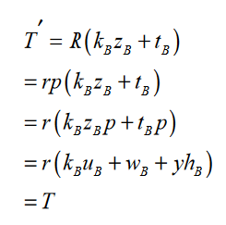
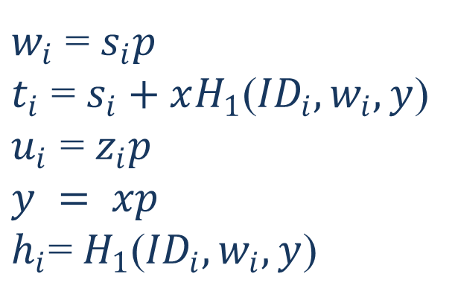
Correctness Analysis of the New Scheme
According to the unsigncryption algorithm:
$w_{i}$ = $s_{i}p$
$t_{i}$ = $s_{i}+xH_{1}$(${ID}_{i},w_{i},y$)
$u_{i}$ = $z_{i}p$
$$y = xp$$
$h_{i}$=$H_{1}$(${ID}_{i},w_{i},y$)
Notes:
$w_{i}$ = $s_{i}p$,
$t_{i}$ = $s_{i}+xH_{1}$(${ID}_{i},w_{i},y$)
$u_{i}$ = $z_{i}p$
$$y = xp$$
$h_{i}$=$H_{1}$(${ID}_{i},w_{i},y$)

Slide 32
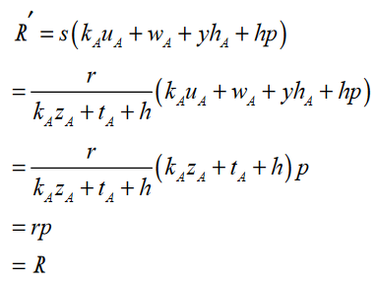

According to (9), B can recover the plaintext. Since $T^{′}$=$T$, then B calculates $h^{′}$ = $H_{3}$($T^{′},c$) = $h$
As $R^{′}$ is equal to $R$, B accepts the message m.
Notes:
當$R^{′}$等於$R$時，B接受消息m。
結果證明瞭該方案的正確性。

Slide 33
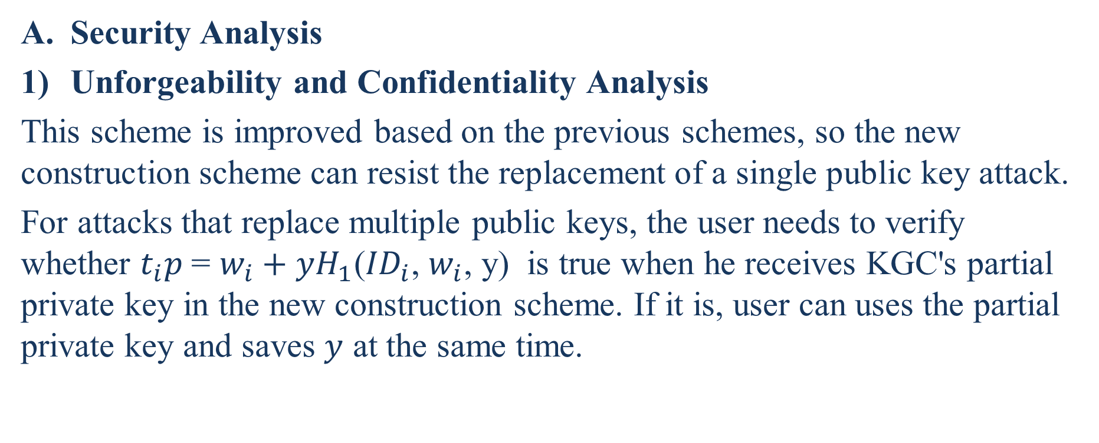
Analysis of New Construction Scheme
Security Analysis
Unforgeability and Confidentiality Analysis
This scheme is improved based on the previous schemes, so the new construction scheme can resist the replacement of a single public key attack.
For attacks that replace multiple public keys, the user needs to verify whether $t_{i}p$= $w_{i}+yH_{1}$(${ID}_{i}$, $w_{i}$, y) is true when he receives KGC's partial private key in the new construction scheme. If it is, user can uses the partial private key and saves $y$ at the same time.
Notes:
安全性分析。
不可偽造性和保密性分析
該方案在原有方案的基礎上進行了改進，使得新的構造方案能夠抵抗單個公開金鑰攻擊的替換。
對於替換多個公開金鑰的攻擊，用戶在新的構造方案中接收到KGC的部分私密金鑰時，需要驗證$t_{i}p$= $w_{i}+yH_{1}$(${ID}_{i}$, $w_{i}$, y)是否為真。如果是，使用者可以使用部分私密金鑰，同時保存y。

Slide 34
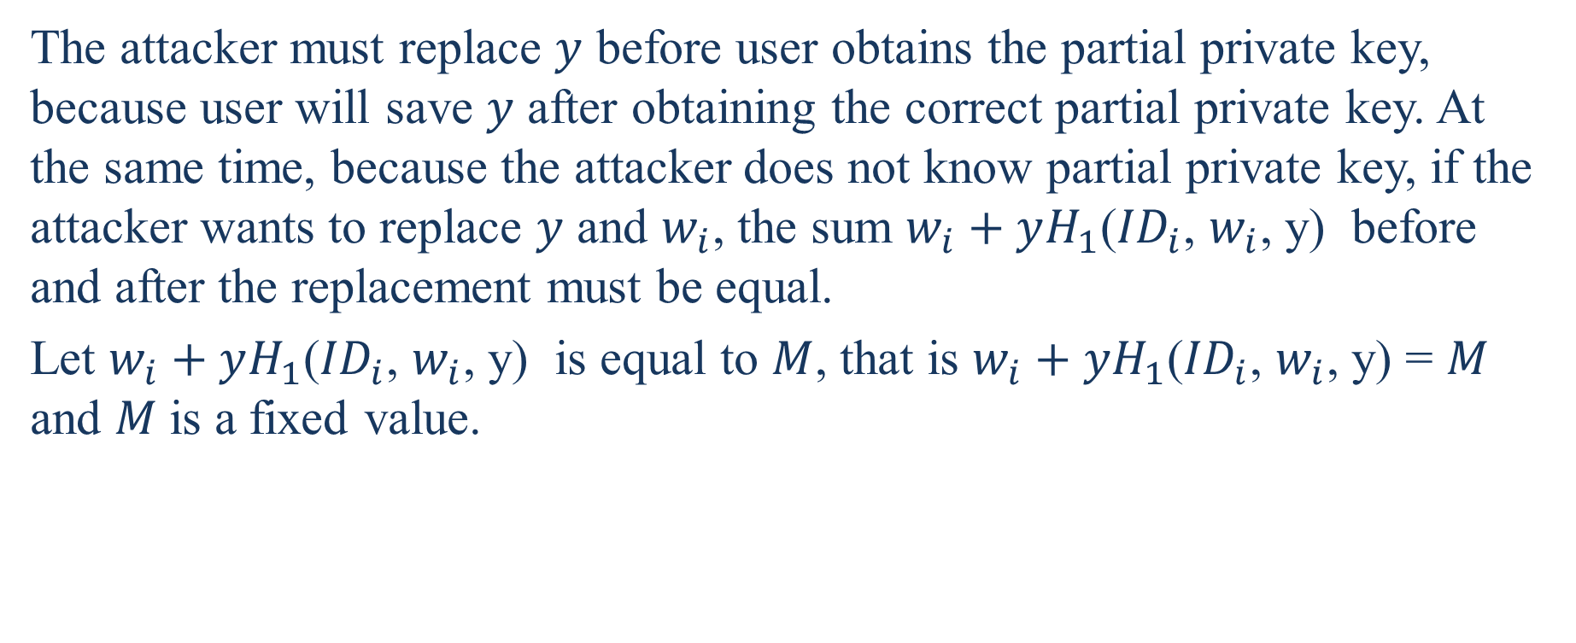
The attacker must replace $y$ before user obtains the partial private key, because user will save $y$ after obtaining the correct partial private key. At the same time, because the attacker does not know partial private key, if the attacker wants to replace $y$ and $w_{i}$, the sum $w_{i}+yH_{1}$(${ID}_{i}$, $w_{i}$, y) before and after the replacement must be equal.
Let $w_{i}+yH_{1}$(${ID}_{i}$, $w_{i}$, y) is equal to $M$, that is $w_{i}+yH_{1}$(${ID}_{i}$, $w_{i}$, y) = $M$ and $M$is a fixed value.
Notes:
攻擊者必須在使用者獲得部分私密金鑰之前替換y，因為使用者將在獲得正確的部分私密金鑰之後保存y。同時，由於攻擊者不知道部分私密金鑰，如果要替換$y$和$w_{i}$，則替換前後的$w_{i}+yH_{1}$(${ID}_{i}$, $w_{i}$, y)之和必須相等。
設$w_{i}+yH_{1}$(${ID}_{i}$, $w_{i}$, y)等於M，即$w_{i}+yH_{1}$(${ID}_{i}$, $w_{i}$, y) = $M$ ，$M$為固定值。

Slide 35
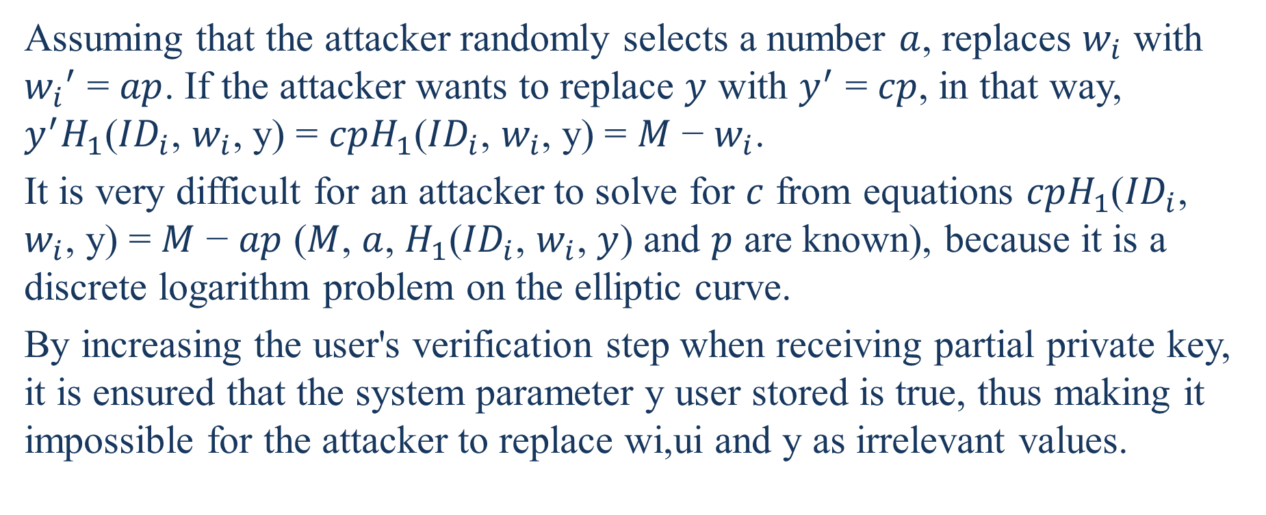
Assuming that the attacker randomly selects a number $a$, replaces $w_{i}$ with ${w_{i}}^{′}$ = $ap$. If the attacker wants to replace $y$ with $y^{′}$ = $cp$, in that way, $y^{′}H_{1}$(${ID}_{i}$, $w_{i}$, y) = $cpH_{1}\text{(}{ID}_{i}\text{, }w_{i}\text{,} \text{y}\text{)}$ = $M$ − $w_{i}$.
It is very difficult for an attacker to solve for $c$ from equations $cpH_{1}\text{(}{ID}_{i}\text{, }w_{i}\text{,} \text{y}\text{)}$ = $M$ − $ap$ ($M$, $a$, $H_{1}$(${ID}_{i}$, $w_{i}$, $y$) and $p$ are known), because it is a discrete logarithm problem on the elliptic curve.
By increasing the user's verification step when receiving partial private key, it is ensured that the system parameter y user stored is true, thus making it impossible for the attacker to replace wi,ui and y as irrelevant values.
Notes:
假設攻擊者隨機選擇一個數字$a$，則用${w_{i}}^{′}$ = $ap$替換$w_{i}$。如果攻擊者想用$y^{′}$ = $cp$替換$y$，那麼$y^{′}H_{1}$(${ID}_{i}$, $w_{i}$, y) = $cpH_{1}\text{(}{ID}_{i}\text{, }w_{i}\text{,} \text{y}\text{)}$ = $M$ − $w_{i}$。
攻擊者很難從方程$cpH_{1}\text{(}{ID}_{i}\text{, }w_{i}\text{,} \text{y}\text{)}$ = $M$ − $ap$（已知$M$, $a$, $H_{1}$(${ID}_{i}$, $w_{i}$, $y$) 和 $p$ ）求解c，因為這是橢圓曲線上的離散對數問題。
通過增加使用者在接收部分私密金鑰時的驗證步驟，確保使用者存儲的系統參數y為真，從而使攻擊者無法將$w_{i}$、$u_{i}$和$y$替換為無關值。

Slide 36
Therefore, the proposed scheme can resist attacks that replace multiple public keys. That is, the improved signcryption scheme in this paper can provide unforgeability and confidentiality.
Notes:
因此，該方案能夠抵抗替換多個公開金鑰的攻擊。也就是說，本文提出的改進簽密方案能夠提供不可偽造性和保密性。

Slide 37
Forward Security Analysis
In the new scheme, even if the sender's partial private key and secret value are both accidentally leaked, the person who has obtained the private key cannot calculates the random number r selected for each signcryption, cannot calculates T, and thus the plaintext cannot be recovered.
Notes:
前向安全分析
(前向安全性:指的是長期使用的主金鑰泄漏不會導致過去的對談金鑰泄漏。前向保密能夠保護過去進行的通訊不受密碼或金鑰在未來暴露的威脅。如果系統具有前向保密性，就可以保證在私鑰泄露時歷史通訊的安全，即使系統遭到主動攻擊也是如此。 )
在新方案中，即使發送方的部分私密金鑰和秘密值都被意外洩露，獲得私密金鑰的人也無法計算為每次簽密選擇的亂數r，也無法計算T，因此無法恢復明文。

Slide 38
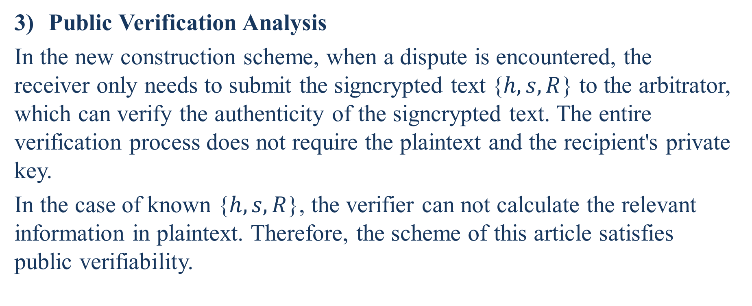
Public Verification Analysis
In the new construction scheme, when a dispute is encountered, the receiver only needs to submit the signcrypted text {$h,s,R$} to the arbitrator, which can verify the authenticity of the signcrypted text. The entire verification process does not require the plaintext and the recipient's private key.
In the case of known {$h,s,R$}, the verifier can not calculate the relevant information in plaintext. Therefore, the scheme of this article satisfies public verifiability.
Notes:
公開可驗證性分析
在新的構造方案中，當遇到爭議時，接收者只需將簽密文本{$h,s,R$}提交給仲裁員即可驗證簽密文本的真實性。整個驗證過程不需要明文和收件人的私密金鑰。
在已知{$h,s,R$}的情況下，驗證者不能計算明文中的相關資訊。因此，本文的方案滿足公開可驗證性。

Slide 39
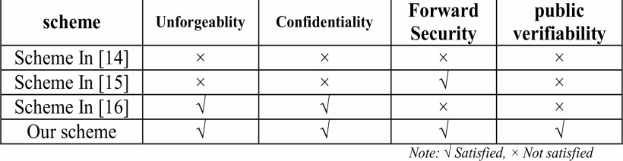
Compare each scheme with the scheme of this article as follows, the results are shown in Table 1.
Notes:
將每種方案與本文的方案進行比較，結果如表1所示。

Slide 40
From the above table, we can see that in the case of attackers replacing multiple public keys, the improved scheme can still provide unforgeability and confidentiality.
At the same time, the scheme has forward security and is publicly verifiable.
In summary, the improved scheme proposed in this article is safer than the previous scheme.
Notes:
從上表可以看出，在攻擊者替換多個公開金鑰的情況下，改進方案仍然可以提供不可偽造性和保密性。
同時，該方案具有前向安全性和可公開驗證性。
綜上所述，本文提出的改進方案比原方案更安全。

Slide 41
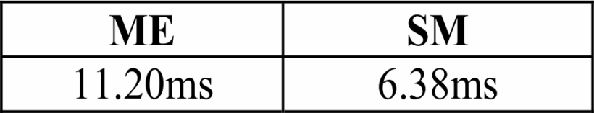
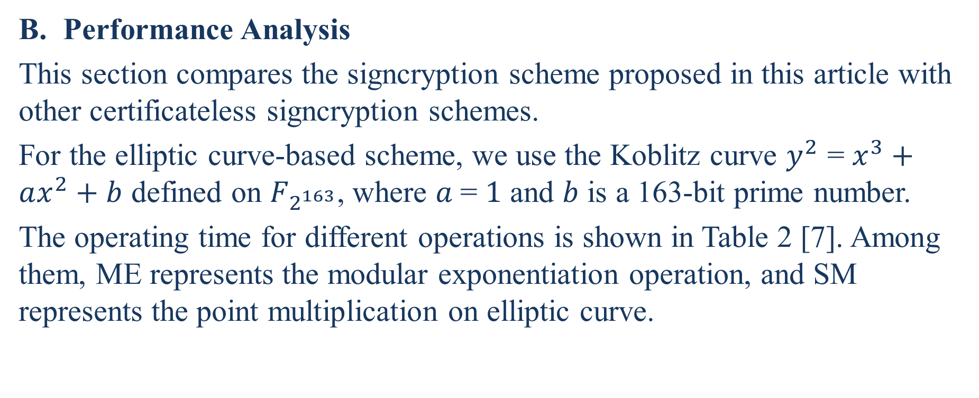
Performance Analysis
This section compares the signcryption scheme proposed in this article with other certificateless signcryption schemes.
For the elliptic curve-based scheme, we use the Koblitz curve $y^{2}$ = $x^{3}+ax^{2}+b$ defined on $F_{2^{163}}$, where $a$= $1$ and $b$ is a 163-bit prime number.
The operating time for different operations is shown in Table 2 [7]. Among them, ME represents the modular exponentiation operation, and SM represents the point multiplication on elliptic curve.
Notes:
本節將本文提出的簽密方案與其他無證書簽密方案進行比較。
對於基於橢圓曲線的方案，我們使用F2163上定義的Koblitz曲線$y^{2}$ = $x^{3}+ax^{2}+b$ ，其中a=1，b是一個163位質數。
不同操作的操作時間如表2[7]所示。其中，ME表示模指數運算，SM表示橢圓曲線上的點乘運算。
(模冪運算是指求整數b的e次方($b^{e}$)被正整數m所除得到的餘數c的過程，可用數學符號表示為c = b^{e} mod m。由 c 的定義可得0 ≤ c < m。 )

Slide 42
Here we compare the performance of the new scheme in this paper with the previous three schemes.
Compared with the running time of the modular exponentiation operation and the elliptic curve point multiplication operation, the impact of the hash function and the exclusive OR operation on the overall performance is negligible. Here only the operation of the elliptic curve point multiplication operation and the modular exponentiation operation are counted, as shown in Table 3.
Notes:
在這裡我們比較了新方案與前三種方案的性能。
與模冪運算和橢圓曲線點乘運算的執行時間相比，hash函數和異或運算對整體性能的影響可以忽略不計。這裡只統計橢圓曲線的點乘運算和模冪運算，如表3所示。

Slide 43
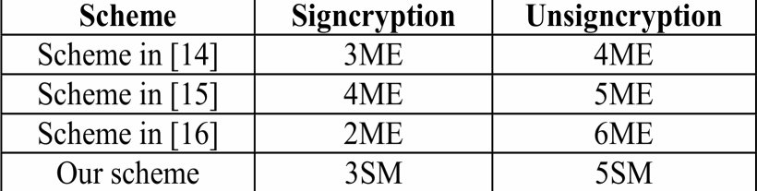
33.6ms 44.8ms
44.8ms 56.0ms
22.4ms 67.2ms
19.14ms 31.9ms

Slide 44
Conlusion
This paper analyzes and summarizes the existing certificateless signcryption schemes without bilinear pairing. It finds that the existing scheme is insecure and cannot provide unforgeability and confidentiality when the attacker replaces multiple public keys at the same time, and gives the attack process.
On this basis, this paper designs a new certificateless signcryption scheme without bilinear pairing. The new scheme resists the attacker's replacement of multiple public keys by increasing the correlation between public keys.
Notes:
分析和總結了現有的無雙線性配對的無證書簽密方案。發現現有方案是不安全的，當攻擊者同時替換多個公開金鑰時，不能提供不可偽造性和保密性，並給出了攻擊過程。
在此基礎上，設計了一種新的無雙線性對的無證書簽密方案。新方案通過增加公開金鑰之間的相關性來抵抗攻擊者對多個公開金鑰的替換。

Slide 45
After analysis, our scheme can not only meet the requirements of unforgeability, confidentiality, forward security, and public verification, but also reduce the amount of computation compared with previous scheme. By comparison, the scheme of this paper has higher security and operating efficiency.
From Table 3, it can be seen that the improved scheme in this paper also has an improvement in performance, which has advantages over those of Zhu, Zhao and Zhou. Therefore, the improved certificateless signcryption scheme has lower computational complexity and higher efficiency.
Notes:
經過分析，我們的方案不僅能滿足不可偽造性、保密性、前向安全性和公開驗證的要求，而且比以前的方案減少了計算量。通過比較，本文的方案具有更高的安全性和運行效率。
從表3可以看出，本文提出的改進方案在性能上也有一定的提高，這比朱、趙、周的方案有一定的優勢。因此，改進的無證書簽密方案具有較低的計算複雜度和較高的效率。

Slide 46
References
CHI I Hsu and YU Ching Tung, The benefits of PKI application and competitive advantage [J]. WSEAS Transactions on communications, 2008, 7(9): 758-767.
C. Ellison and B. Schneier, Ten risk of PKI: What you are not being told about public key infrastructure [J]. Computer Security Journal, 2000, 16(1): 1-7.
ADI Shamir, Identity–based cryptosystems and signature schemes [C]. Advances in Cryptology –Crypto’84, Berlin: Springer-Verlag, 1984: 47-53.

Slide 47
SS. AL-Riyami and KG. Paterson, Certificateless public key cryptography [C]. Advances in Cryptology-Asiacrypt’03, Berlin: Springer-Verlag, 2003: 452-473.
YL. Zheng. Digital signcryption or how to achieve cost (signature & encryption « cost (signature) + cost (encryption) [C]. Advances in Cryptology-Crypto’97, Berlin: Springer-Verlag, 1997: 165—179.
L. Chen, Z. Cheng and NP. Smart, Identity-based key agreement protocols from pairings[J]. Interational Journal of Information Security, 2007, 6(2): 213-241.

Slide 48
X.Cao and W. Kou, A pairing-free identity-based authenticated key agreement scheme with minimal message exchanges[J].Information Sciences, 2010, 180(6): 2895-2903.
D. He, J. Chen and J. Hu, An ID-based proxy signature schemes without bilinear pairings[J]. Annals of Telecommunications, 2011, 66(11-12): 657-662.
P. Barreto, A. Deusajute, E. Cruz and et al, Toward efficient certificateless signcryption from (and without)bilinear pairing[EB/OL]. http://sbseg2008.inf.ufrgs.br/proceedings/data/pdf/st03_03_artigo.pdf.

Slide 49
XF. Jing, Provably secure certificateless signcryption scheme without pairing[C]. 2011 International Conference on Electronic and Mechanical Engineering and Information Technology. China: IEEE, 2011: 4753-4756.
DG. Wang, XF. Ding and K. Huang, Security analysis and improvement of strongly secure certificateless key agreement protocol[J]. Computer Science, 2013, 40(11A): 203-223.
WH. Liu and C. Xu, Certificateless signcryption scheme without bilinear pairing[J]. Journal of software, 2011, 22(8):1918-1926.

Slide 50
DB. He, Security analysis of a certificateless signcryption scheme[J]. Journal of software, 2013, 24(3): 618-622.
H. Zhu, H. Li and YM. Wang, Certificateless signcryption scheme without pairing[J]. Journal of Computer Research and Development, 2010, 47(9): 1587-1594.
ZG. Zhao, Security analysis and improvement of a certificateless signcryption scheme[J]. Journal of Communication, 2015, 36(3): 2015060_1-2015060_6.

Slide 51
YW. Zhou, B. Yang and WZ. Zhang, Security analysis and improvement of certificateless signcryption scheme without bilinear pairing[J], CHINESE JOURNAL OF COMPUTER, 2016, 39(6), 1257-1266.
X. Wang, ZH. Qi and H. Huang, A certificateless signcryption scheme without bilinear pairing[J]. COMPUTER TECHNOLOGY AND DEVELOPMENT, 2017, 27(7): 106-110.

