Slide 1
Optimization-Based Resource Management Strategies for 5G C-RAN Slicing Capabilities
2021/01/28
陳靖
joesph60261@gmail.com
conference paper : 2018 Tenth International Conference on Ubiquitous and Future Networks (ICUFN)

Slide 2
Outline
Abstract
Introduction
LITERATURE REVIEW
MATHEMATICAL FORMULATION
SOLUTION APPROACH
COMPUTATIONAL EXPERIMENTS
CONCLUSIONS

Slide 3
ABSTRACT

Slide 4
Abstract
In an emerging paradigm in 5G networks, the computations of various types of mobile applications are offloaded to cloud environments. Edge and core clouds provide computing, storage, and networking resources to serve as a generic computing platform.
Network slicing techniques offer an effective way to boost various types of services, such as delay-sensitive or computationally intensive application, that are deployed on-demand in a shared resource infrastructure.
This study proposes a resource management mechanism to optimize the quality of experience (QoE) of users in terms of the delay gap tolerance.

Slide 5
Abstract
The Min-Fit algorithm is a heuristic-based solution that flexibly chooses a server that has the maximum remaining CPU resources for satisfying user requirements.
A mathematical model is formulated for 5G slicing capabilities to optimize the delay gap using a resource management approach to achieve QoE.
Some computational experiments are demonstrated as performance evaluations for verifying the suitability of our proposed approach in terms of slicing capabilities.
The results show that our approach outperforms other algorithms, which have larger delay gaps.

Slide 6
Introduction

Slide 7
Introduction
Various technologies are being changed to provide a common connected platform for various 5G applications. One major change is the decomposition of typical base stations intoremote radio heads (RRHs) and baseband units (BBUs) that are installed in the fronthaul and backhaul of the cloud radio access network (C-RAN), respectively.
The traditional centralized architecture of the core network has evolved into a cloud-basedarchitecture, which separates parts of the control plane from the user plane and thereby reduces control signaling and data transmission delays.
Virtualized network functions can be created by using software-defined networking (SDN) and network function virtualization (NFV) techniques to assign servers to core and edge clouds appropriately.

Slide 8
Introduction
Corresponding virtual machines (VMs) are distributed in the core and edge clouds to execute virtualized network functions. SDN is a promising technology that helps to simplify network design and management. NFV creates a logical network of VMs over several physical servers. The network service chaining model ornetwork slicing has now emerged as a novel 5G network architecture [1].
[1] R. Chaudhary, N. Kumar, and S. Zeadally, "Network Service Chaining in Fog and Cloud Computing for the 5G Environment: Data Management and Security Challenges," IEEE Communications Magazine, vol. 55, no. 11, pp. 114-122, November 2017.

Slide 9
Overview of Network Slicing Techniques
Network slicing techniques can boost various types of on-demand services in a shared resource infrastructure bounded by edge and core cloud environments [2].
Centralized computing relies on software-based programming rather than hardware-based configuration to control all virtualized network functionalities. Each network slice enables software reconfiguration for upgrading network topologies for achieving resource management efficiency and performance improvement [3].
[2] V. Sciancalepore, K. Samdanis, X. Costa-Perez, D. Bega, M. Gramaglia, and A. Banchs, "Mobile traffic forecasting for maximizing 5G network slicing resource utilization," in the IEEE International Conference on Computer Communications (INFOCOM 2017), Atlanta, GA, USA, pp. 1–9, May 2017.
[3] G. S. Aujla, R. Chaudhary, N. Kumar, J. J. P. C. Rodrigues, and A. Vinel, "Data Offloading in 5G-Enabled Software-Defined Vehicular Networks: A Stackelberg-Game-Based Approach," IEEE Communications Magazine, vol. 55, no. 8, pp. 100–108, August 2017.

Slide 10
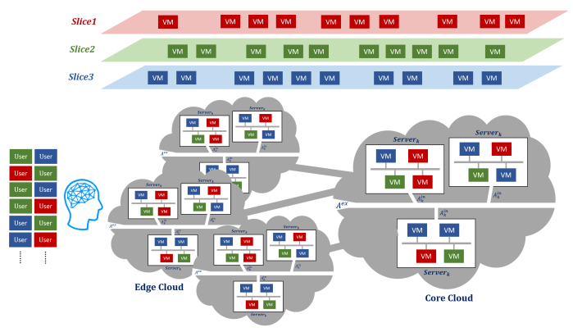
Fig.1 Network slicing
Notes:
Network slicing示意圖

Slide 11
Overview of Network Slicing Techniques
C-RAN servers are located separately in the edge and core clouds to form a centralized pool of virtualized functionalities. For user plane functions, functions in the packet data network gateway (P-GW) and serving gateway (S-GW) are shifted to the edge cloud to provide low-latency services to reduce the burdenon the backhaul. For control plane functions, BBUs perform dataforwarding between RRHs and the C-RAN; these are mainly located in the edge cloud.

Slide 12
Overview of Network Slicing Techniques
Mobility management, virtualized resource management, and interference management functions are performed in the core cloud.
Mobile edge computing platforms are also deployed in the edge cloud along with data forwarding and content storage servers that can collaborativelystore, compute, and transmit large amounts of data efficiently in real-time [4].
[4] H. Zhang, N. Liu, X. Chu, K. Long, A. H. Aghvami, and V. C. M. Leung, "Network Slicing Based 5G and Future Mobile Networks: Mobility,Resource Management, and Challenges," IEEE Communications Magazine, vol. 55, no. 8, pp. 138–145, August 2017.

Slide 13
Motivation
This study proposes a resource allocation scheme that is tailored for various quality of experience (QoE) requirements in network slicing.
uRLLC slices are used for video streaming and online gaming, in which communication services are more sensitive to delay and have delay tolerance. The QoE is defined by performance metrics such as the difference in delay tolerance and delay in the slice [4]. This study addresses resource or task assignment as the research objectivefunction to maximize the minimal QoE for each request appropriately in the slice.
[4] H. Zhang, N. Liu, X. Chu, K. Long, A. H. Aghvami, and V. C. M. Leung, "Network Slicing Based 5G and Future Mobile Networks: Mobility,Resource Management, and Challenges," IEEE Communications Magazine, vol. 55, no. 8, pp. 138–145, August 2017.

Slide 14
Paper Organization
Section 2 : a literature review of current ideas and mechanismsin emerging 5G technologies
Section 3 : the problem definitions of resource management and the formulation of a mathematical programming problem.
Section 4 : Several proposed solution processes contained in heuristics are developed to find an optimal solution.
Section 5 : various computational experiments and discusses and validates the results
Section 6 : conclusions and future work
Notes:
第二章:有關auto-scaling的文獻回顧
第三章:實驗設置
第四章:實驗結果
第五章:文獻回顧
第六章:結論

Slide 15
LITERATURE REVIEW

Slide 16
LITERATURE REVIEW
An end-to-end network slice is a specific collection of network modules and functions that can be compared with other network slices [5].
Anetwork slice is a tailored and connected set or chain of network functions formed through logical linking in a virtual network. Each slice satisfies the specific requirements of a service, such as those for bandwidth, delay, delay tolerance, and the business model [6].
[5] M. Jiang, M. Condoluci, and T. Mahmoodi, “Network Slicing Management & Prioritization in 5G Mobile Systems,” in the Euro. Wireless 2016, Oulu, Finland, pp. 1–6, May 2016.
[6] S. Sharma, R. Miller, and A. Francini, "A Cloud-Native Approach to 5G Network Slicing," IEEE Communications Magazine, vol. 55, no. 8, pp. 120-127, August 2017.
Notes:
Auto-scaling的概念早就被提出了,可以追溯到IBM的MAPE-K 架構,支援自動化運算,該運算系統可以根據管理者給定的high-level目標達到自我管理。
[8]這篇作者提出幾項自動化的關鍵指標:監控,分析,規劃,執行,知識/經驗
並提出一個可參考的模型作為自主自動運算系統的自動控制迴路

Slide 17
LITERATURE REVIEW
Many virtualized units (e.g., VMs) are required by the computation and communication requests that are allocated in a resource pool to perform service slicing in diverse QoE requirements [7].
A user-centric service slicing strategy for various delay and transmission bit-rate requirements was proposed and a genetic algorithm was devised to optimize virtualized radio resource management based on resource pooling in [8].
[7] M. Peng, C. Wang, V. Lau, and H. V. Poor, "Fronthaul-constrained Cloud Radio Access Networks: Insights and Challenges," IEEE Wireless Communications, vol. 22, no. 2, pp. 152-160, April 2015.
[8] X. Xu, H. Zhang, X. Dai, Y. Hou, X. Tao, and P. Zhang, "SDN Based Next Generation Mobile Network with Service Slicing and Trials," in China Communications, vol. 11, no. 2, pp. 65-77, February 2014.

Slide 18
LITERATURE REVIEW
In [9], a network slicing mechanism was introduced for network edge nodes to offer low-latency servicesto users, in which the centralized core network entities and related applications are shifted to the network edge to reduce delay and burden in the backhaul.
In [10], an auction-based revenue optimization method was proposed for resource management in each slice to satisfy user requirements and increase network revenue.
[9] J. Heinonen, P. Korja, T. Partti, H. Flinck and P. Pöyhönen, "Mobility Management Enhancements for 5G Low Latency Services," in the 2016 IEEE International Conference on Communications Workshops (ICC 2016), Kuala Lumpur, Malaysia, pp. 68-73, May 2016,.
[10] H. Zhang, C. Jiang, N.C. Beaulieu, X. Chu, X. Wang, and T.Q.S. Quek, “Resource Allocation for Cognitive Small Cell Networks: A Cooperative Bargaining Game Theoretic Approach,” IEEE Transactions on Wireless Communications, vol. 14, no. 6, pp. 3481–3493, June 2015.

Slide 19
LITERATURE REVIEW
The auction mechanism comprised a price competition model and an auction mechanism for network slicing [5].
Furthermore, in [11], admission and allocation algorithms were developed for maximizing system revenue by solving a problem modeled as a semi-Markov decision process.
Thus far, few studies have investigated the analytics of QoE models. Thus, the aim of present study is to propose a proof-of-concept system that demonstrates a cloud-based network slicing approach in a 5G network.
[5] M. Jiang, M. Condoluci, and T. Mahmoodi, “Network Slicing Management & Prioritization in 5G Mobile Systems,” in the Euro. Wireless 2016, Oulu, Finland, pp. 1–6, May 2016.
[11] D. Bega, M. Gramaglia, A. Banchs, V. Sciancalepore, K. Samdanis, and X. Costa-Perez, "Optimising 5G Infrastructure Markets: The Business of Network Slicing," in the IEEE Conference on Computer Communications (INFOCOM 2017), pp. 1-9, Atlanta, GA, USA, May 2017.

Slide 20
MATHEMATICAL FORMULATION

Slide 21
Problem Description
A resource management problem with limited resources is formulated from the perspective of network service providers. We choose QoE for the performance measurement and use it as the objective function; we also consider users’ strong focus on latency. Based on the network slicing concept, VMs in our model are requested by different users and require resources toserve the users.
The model supports network resource allocationto network slices. When facing a batch of requests, we assume that a resource management strategy is executed simultaneously to determine which server a slice should be assigned to.

Slide 22
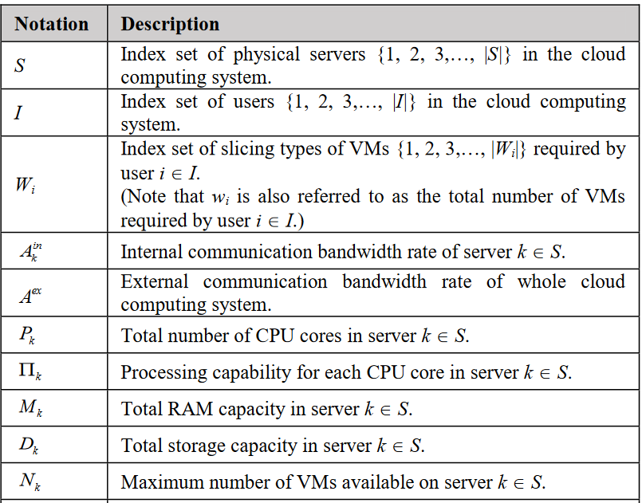
SUMMARY OF GIVEN PARAMETERS

Slide 23
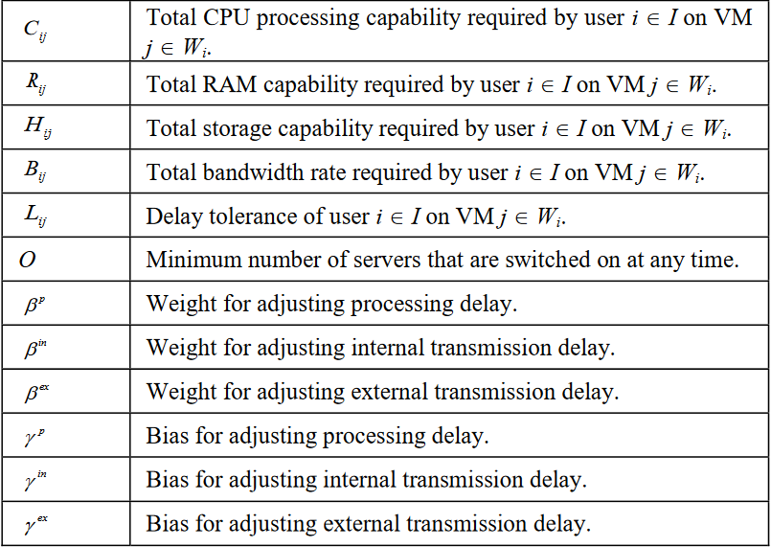
SUMMARY OF GIVEN PARAMETERS

Slide 24
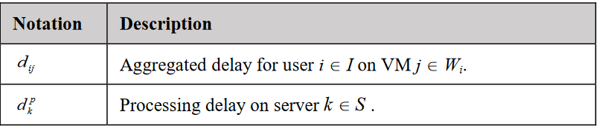
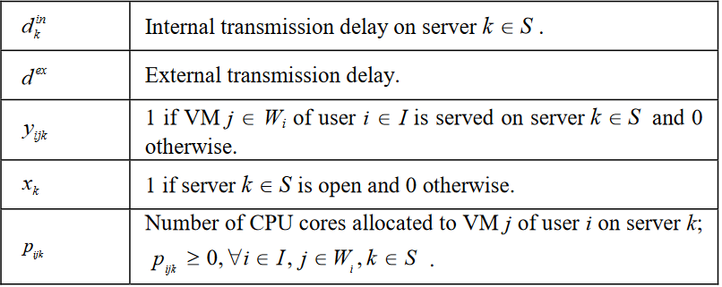
SUMMARY OF DECISION VARIABLES

Slide 25
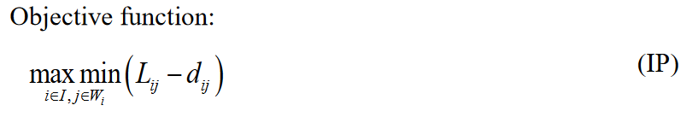
System Architecture and Problem Formulation
The delay gap is defined as the difference between the delay tolerance and the actual time delay to achieve QoE.
The objective function aims to maximize the minimum delay gap among all VMs requested by users.

Slide 26
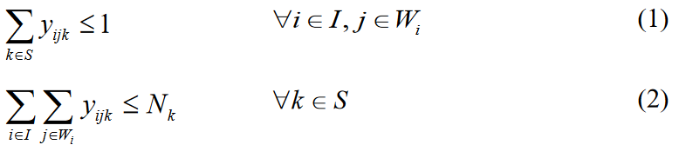
Subject to
Assignment-Related Constraints:

Slide 27
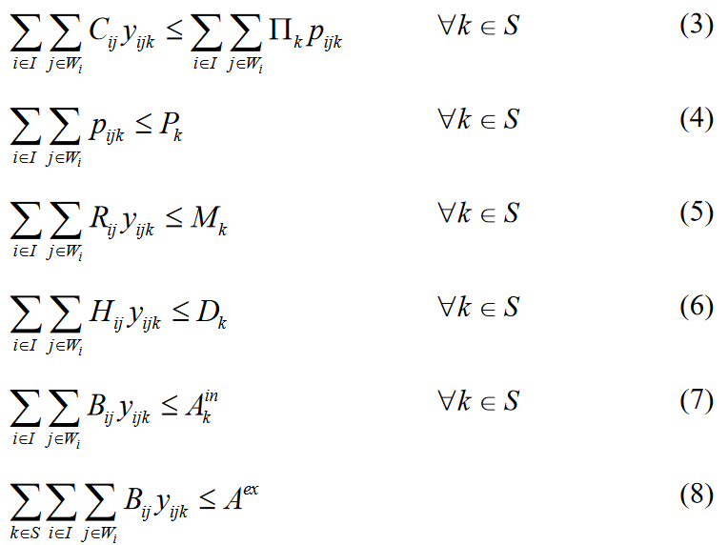

Subject to
Resource Constraints:

Slide 28
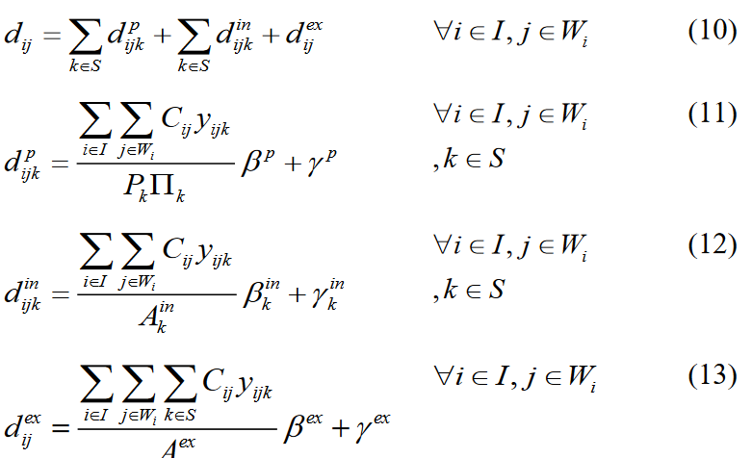
Subject to
Delay Constraints:

Slide 29
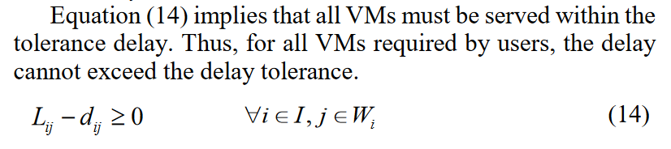
Subject to
Delay-Related Constraints:

Slide 30
SOLUTION APPROACH
CH4

Slide 31
SOLUTION APPROACH
The Min-Fit algorithm is a heuristic-based allocationmechanism. For optimizing a delay gap, it searches for the server that has the lowest CPU processing capability usage rate every time a VM is requested.
However, even the least-occupied server may be too busy to serve the VM. In this case, a new server is switched on if a powered-off server is available. Because this approach always chooses the server that has the minimum computing resources used, we call it the Min-Fit algorithm.

Slide 32
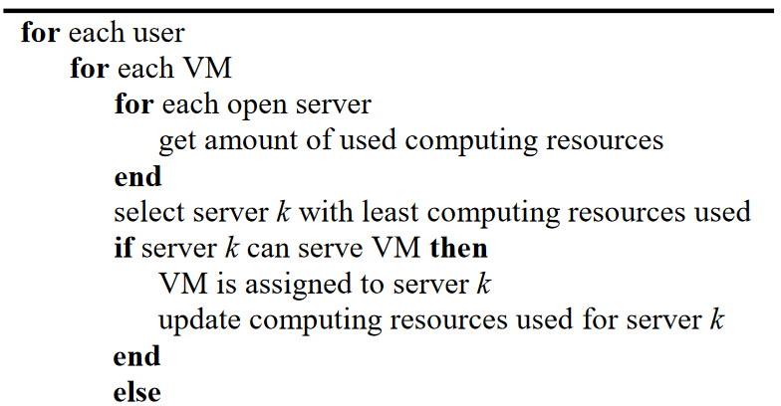
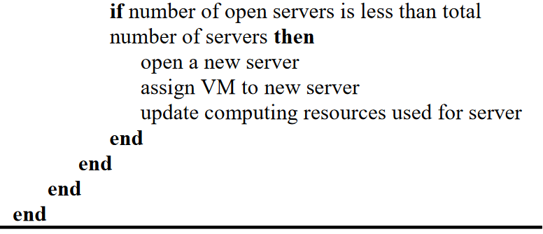
Min-Fit Algorithm

Slide 33
COMPUTATIONAL EXPERIMENTS
CH5

Slide 34
COMPUTATIONAL EXPERIMENTS
This section provides a performance comparison of our algorithm with three other common methods.
First-Fit always scans from the beginning of the server list and assigns a VM to the first available server.
Next-Fit scans the server list and assigns a VM to the first server that has sufficient capacity.
Round-Robin chooses a server according to the forward-and-backward order of the server list.
As in our proposed Min-Fit algorithm, these three methods turn on a server if required as long as one is available.

Slide 35
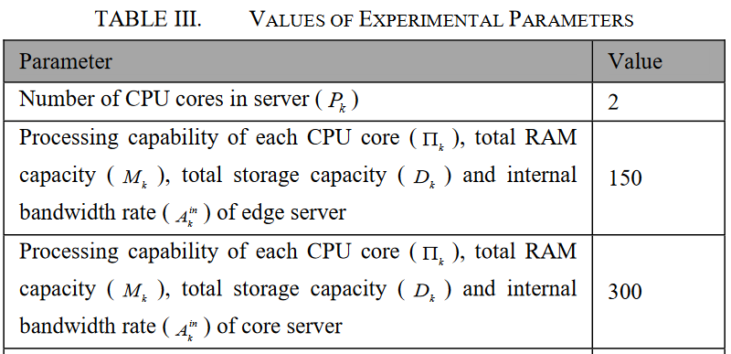
Environments
Six types of VMs are generated randomly, and each type of VM requires a different amount of resources.

Slide 36
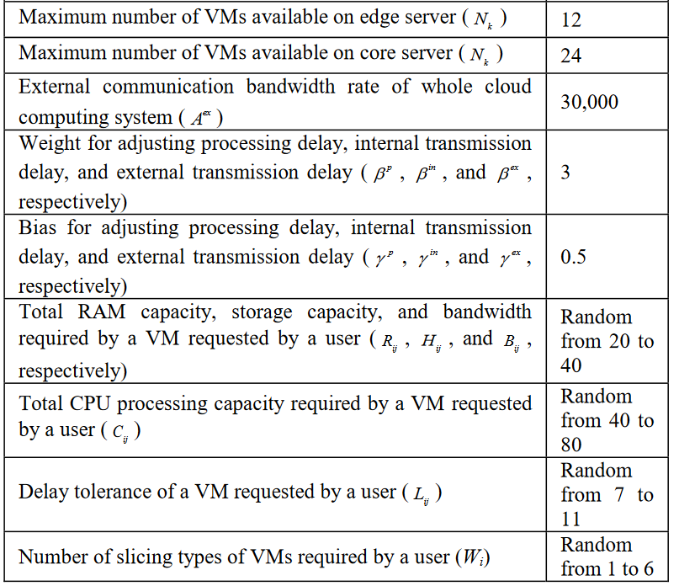
Environments

Slide 37
Performance Evaluation
Three experimental cases combined with algorithms and our approach are proposed to evaluate the performance.
the results are compared in terms of four parameters: minimum delay gap, average delay gap, maximum delay, and average delay.

Slide 38
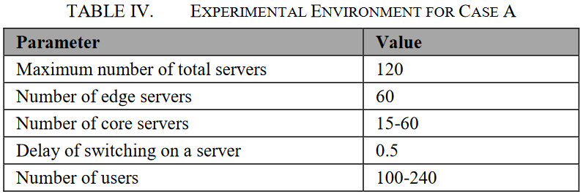
Case A: Increasing the Number of Users
the total number of requested VMs increases.

Slide 39
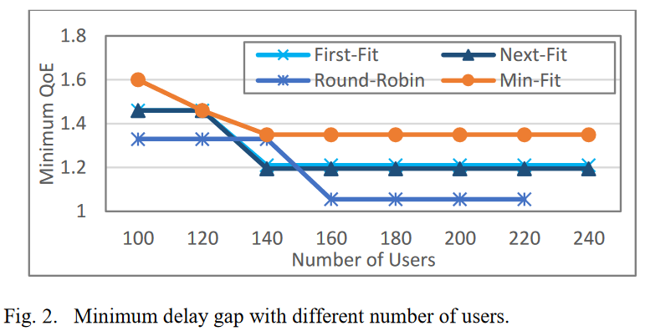
Fig 2

Slide 40
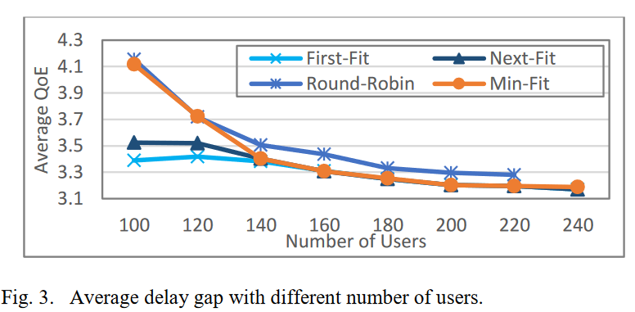
Fig 3

Slide 41
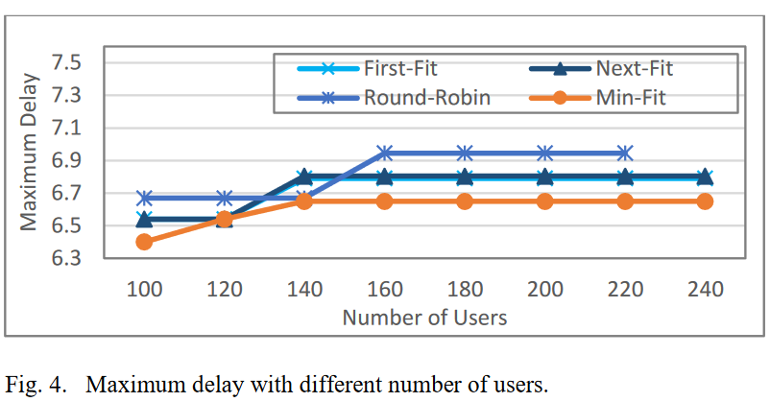
Fig 4
Notes:
在資源有限的情況下,目前的solution還是會失敗,因為該solution比起其他方法需要更多的Server(本實驗中,平均要4台VM)

Slide 42
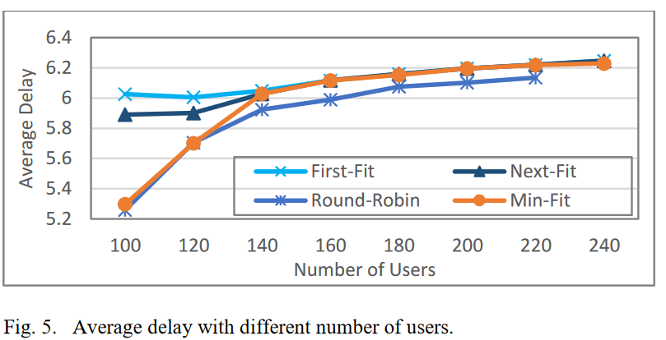
Fig 5

Slide 43
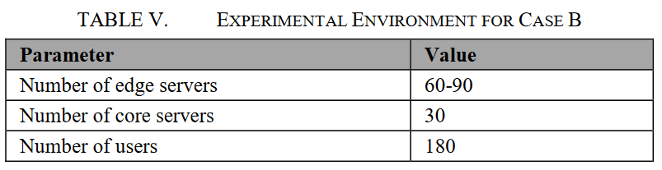
Case B: Increasing the Number of Edge Servers
the number of edge servers increases
Fix the number of core servers
All algorithms are unable to provide solutions when less than 70 edge servers are available.

Slide 44
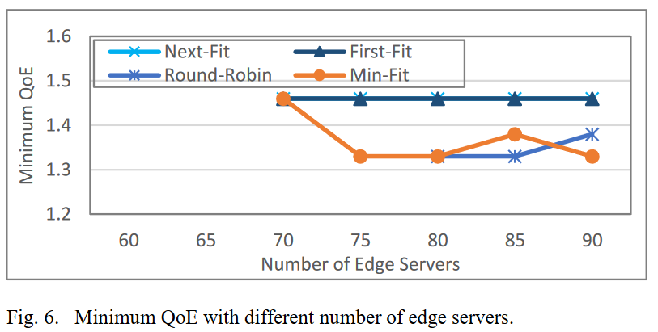
Fig 6

Slide 45
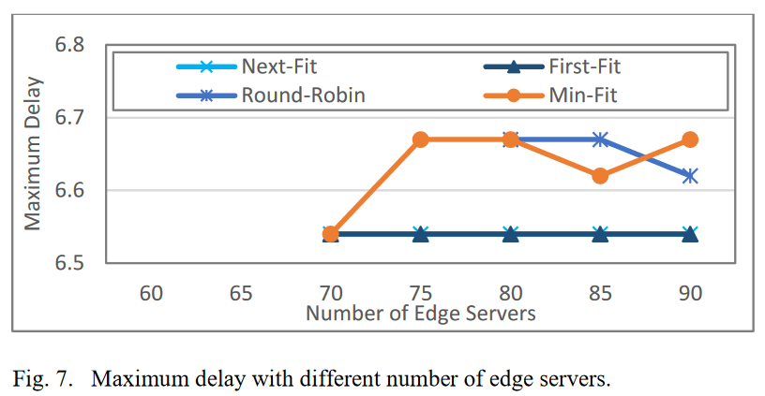
Fig 7

Slide 46
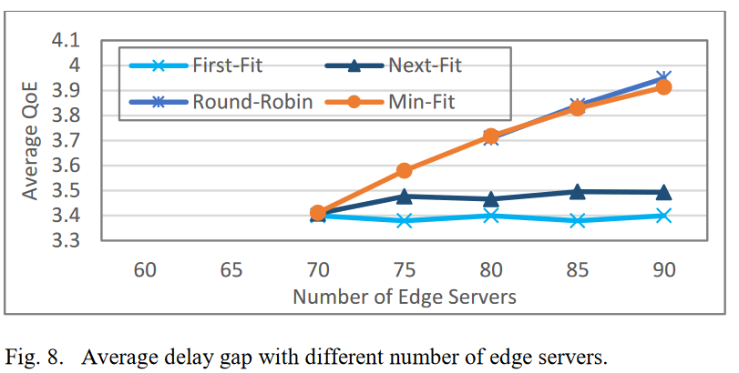
Fig 8

Slide 47
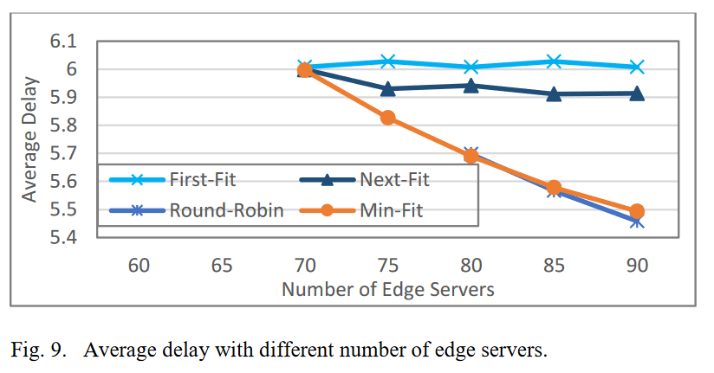
Fig 9

Slide 48
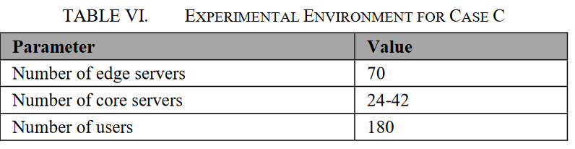
Case C: Increasing the Number of Core Servers
the number of core servers increases
Fix the number of edge servers
All methods are unable to provide feasible solutions when less than30 core servers are available.

Slide 49
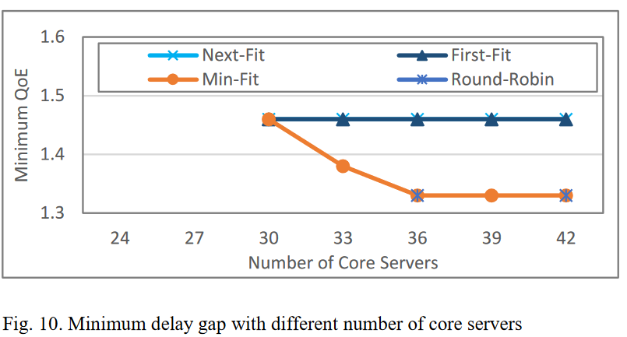
Fig 10

Slide 50
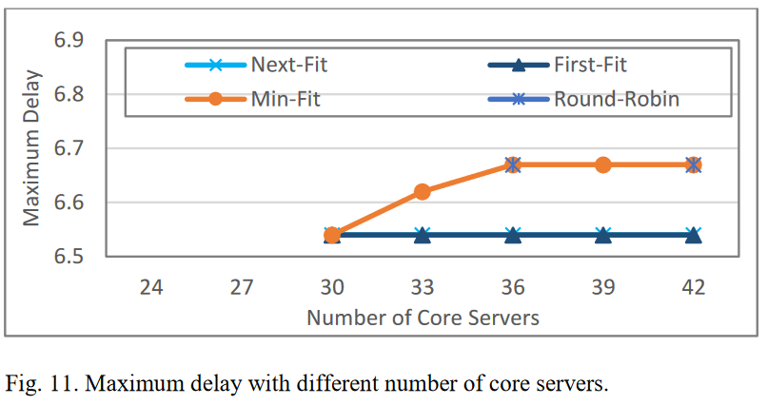
Fig 11

Slide 51
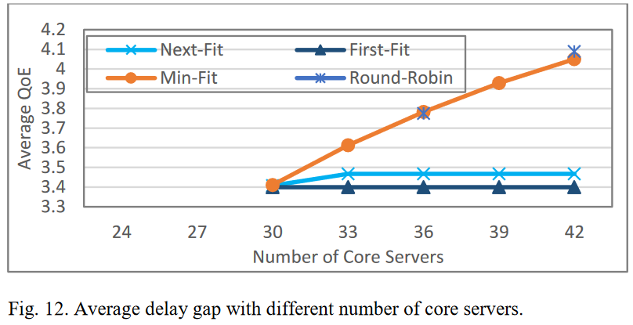
Fig 12

Slide 52
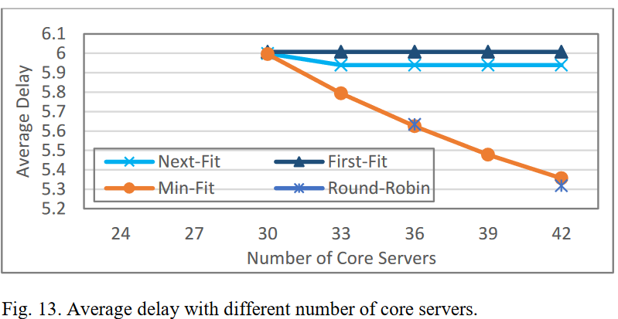
Fig 13

Slide 53
CONCLUSIONS
CH6

Slide 54
Conclusions
The slicing concept was used to increase the flexibility of network infrastructure to realize the requirements of 5G networks and to satisfy diverse user demands. In this study, we formulate a system model with a slicing scheme and use the delay gap as the objective function.
We present a simple and promising resource management approach and prove its effectiveness through three different experimental cases. More complicated conditions such as arriving users and their requirements will be considered in future works. Algorithms will be designed to solve problems, and their performance will be compared with those of existing methods.

Slide 55
My opinions
1.本篇用ILP作為解資源分配的工具,日後作為理論分析可以用ILP進行理論分析。

Slide 56
Reference

Slide 57
References
1] R. Chaudhary, N. Kumar, and S. Zeadally, "Network Service Chaining in Fog and Cloud Computing for the 5G Environment: Data Management and Security Challenges," IEEE Communications Magazine, vol. 55, no. 11, pp. 114-122, November 2017.
[2] V. Sciancalepore, K. Samdanis, X. Costa-Perez, D. Bega, M. Gramaglia, and A. Banchs, "Mobile traffic forecasting for maximizing 5G network slicing resource utilization," in the IEEE International Conference on Computer Communications (INFOCOM 2017), Atlanta, GA, USA, pp. 1–9, May 2017.
[3] G. S. Aujla, R. Chaudhary, N. Kumar, J. J. P. C. Rodrigues, and A. Vinel, "Data Offloading in 5G-Enabled Software-Defined Vehicular Networks: A Stackelberg-Game-Based Approach," IEEE Communications Magazine, vol. 55, no. 8, pp. 100–108, August 2017.
[4] H. Zhang, N. Liu, X. Chu, K. Long, A. H. Aghvami, and V. C. M. Leung, "Network Slicing Based 5G and Future Mobile Networks: Mobility,Resource Management, and Challenges," IEEE Communications Magazine, vol. 55, no. 8, pp. 138–145, August 2017.
[5] M. Jiang, M. Condoluci, and T. Mahmoodi, “Network Slicing Management & Prioritization in 5G Mobile Systems,” in the Euro. Wireless 2016, Oulu, Finland, pp. 1–6, May 2016.
[6] S. Sharma, R. Miller, and A. Francini, "A Cloud-Native Approach to 5G Network Slicing," IEEE Communications Magazine, vol. 55, no. 8, pp. 120-127, August 2017.
[7] M. Peng, C. Wang, V. Lau, and H. V. Poor, "Fronthaul-constrained Cloud Radio Access Networks: Insights and Challenges," IEEE Wireless Communications, vol. 22, no. 2, pp. 152-160, April 2015.

Slide 58
References
[8] X. Xu, H. Zhang, X. Dai, Y. Hou, X. Tao, and P. Zhang, "SDN Based Next Generation Mobile Network with Service Slicing and Trials," in China Communications, vol. 11, no. 2, pp. 65-77, February 2014.
[9] J. Heinonen, P. Korja, T. Partti, H. Flinck and P. Pöyhönen, "Mobility Management Enhancements for 5G Low Latency Services," in the 2016 IEEE International Conference on Communications Workshops (ICC 2016), Kuala Lumpur, Malaysia, pp. 68-73, May 2016,.
[10] H. Zhang, C. Jiang, N.C. Beaulieu, X. Chu, X. Wang, and T.Q.S. Quek, “Resource Allocation for Cognitive Small Cell Networks: A Cooperative Bargaining Game Theoretic Approach,” IEEE Transactions on Wireless Communications, vol. 14, no. 6, pp. 3481–3493, June 2015.
[11] D. Bega, M. Gramaglia, A. Banchs, V. Sciancalepore, K. Samdanis, and X. Costa-Perez, "Optimising 5G Infrastructure Markets: The Business of Network Slicing," in the IEEE Conference on Computer Communications (INFOCOM 2017), pp. 1-9, Atlanta, GA, USA, May 2017.

