Slide 1
Microservice Architecture: API Gateway Considerations
Sanjay Gadge, Principal Architect Vijaya Kotwani, Senior Engineer
GlobalLogic
Notes:
微服務架構：API網關注意事項
Sanjay Gadge，首席建築師Vijaya Kotwani，高級工程師

Slide 2
OUTLINE
Introduction
The What and Why of API Gateways
Security
Service Registry and Service Discovery
Orchestration
Transformation
Monitoring
Load Balancing and Scaling
High Availability and Failover
Governance
Conclusion and References
Notes:
介紹
API網關的內容和原因
安全
服務註冊和服務發現
編排
轉型
監控方式
負載平衡和擴展
高可用性和故障轉移
管治
結論與參考

Slide 3
Introduction
In today’s extremely competitive business environment, customers are more demanding than ever and will abandon a business that is too slow to respond.
Microservice architecture has the potential to address this business challenge; it is all about achieving speed and safety at scale and it provides the flexibility to pick and choose technology for implementing a solution
Microservice architecture consists of a suite of independently deployable, small, modular, and compassable (composable) services.
Notes:
在當今競爭激烈的商業環境中，客戶的要求比以往任何時候都要高，如果企業的反應太慢，他們就會放棄
微服務架構有潛力解決這一業務挑戰，它就是要在規模上實現速度和安全，並且它提供了選擇技術實施解決方案的靈活性
微服務架構由一套可獨立部署的、小型的、模塊化的、可組合的服務組成

Slide 4
Introduction
Each service runs a unique process and communicates through a well-defined, lightweight mechanism to serve a business goal.
It aligns with the business to deal with changes in agile fashion, matches business changes with agile response, and delivers solutions in a decentralized manner.
In addition to modular services, the API gateway and other elements are integral parts of microservice architecture (see figure below).
Notes:
每個服務都運行一個獨特的流程，並通過一個定義明確的輕量級機制進行通信，以服務於業務目標
它與業務保持一致，以敏捷的方式應對變化，將業務變化與敏捷響應相匹配，並以分散的方式提供解決方案。
API網關等要素也是微服務架構不可或缺的一部分（見下圖）。
Aligns : 對齊
Agile : 敏捷

Slide 5
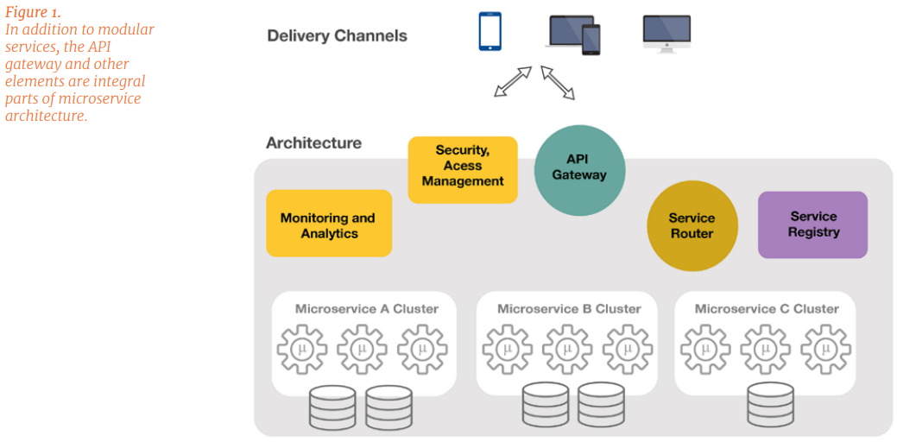
Introduction
Notes:
除了模塊化服務外，API網關等元素也是微服務架構不可或缺的一部份。

Slide 6
The What and Why of API Gateways
Basically, the API Gateway is a reverse proxy to microservices and acts as a single-entry point into the system.
It is similar to a Facade pattern from object-oriented design and similar to the notion of an “Anti-Corruption Layer” in Domain Driven Design.
It makes the processes of API design, implementation, and management considerably simpler and more consistent. The gateway helps to address some of the key concerns, including:
Notes:
基本上，API網關是微服務的反向代理，並充當進入系統的單入口。
它類似於來物件導向的設計，並且類似於域驅動設計中的“反腐敗層”的概念。
它使API設計，實施和管理的過程變得更加簡單和一致。網關有助於解決一些關鍵問題，包括
(各個微服務都會有自己的API API gateway就是整合多個microservices後傳送給user)

Slide 7
The What and Why of API Gateways
How to deal with features such as security, throttling, caching and monitoring at one place
How to avoid chatty communication between clients and microservices
How to satisfy the needs of heterogeneous clients
How to route requests to backend microservices
How to discover working microservice instances
How to discover when a microservice instance is not running
Notes:
如何在一處處理安全性，節流，緩存和監視等功能
2. 如何避免客戶端和微服務之間的交流
3. 如何滿足異構客戶的需求
4. 如何將請求路由到後端微服務
5. 如何發現有效的微服務實例
6. 如何發現微服務實例何時未運行

Slide 8
The What and Why of API Gateways
With a single-entry point into the system, it becomes easy (and manageable) to enforce runtime governance such as common security requirements, common design decisions (e.g. every consumer of the service should have X-Correlation-ID header), and real-time policies such as monitoring, auditing and measuring API usage, and throttling.
There may be an instance when different consumers of the service require particular data and/or have it in a special format.
Notes:
有了一個進入系統的單一入口點，執行運行時治理就變得很容易(和可管理)，如共同的安全要求、共同的設計決策(例如服務的每個消費者都應該有X-Correlation- ID頭)，以及實時策略，如監控、審計和測量API使用情況，以及節流。
可能會有當服務的不同消費者需要特定的數據和/或以特殊的格式這樣的情況。

Slide 9
The What and Why of API Gateways
The API Gateway is the best place to address these transformation requirements, which can be accomplished by providing application-specific APIs for the same business feature at the gateway level.
The gateway also helps by recording data for analysis and auditing purposes, load balancing, caching, and static response handling. The diagram below shows how the gateway typically fits into the overall microservice architecture.
Notes:
API網關是解決這些轉換需求的最佳場所，可以通過在gateway level為同一業務功能提供特定應用的API來實現
網關還可以通過記錄數據用於分析和審計、負載均衡、緩存和靜態響應處理來提供幫助。下圖顯示了網關通常是如何融入整個微服務架構中的。

Slide 10
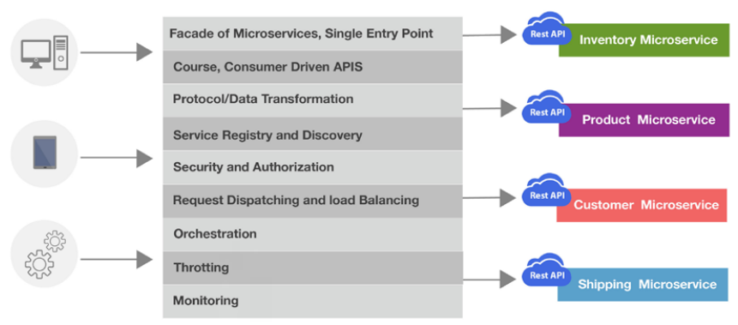
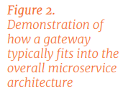
The What and Why of API Gateways
Notes:
演示api gateway通常是如何融入整體微服務架構的 (中間應該是功能)

Slide 11
Security
1. Authentication and Authorization
Federated identity is the preferred solution for implementing authentication and authorization in microservice architecture.
There are three major protocols for federated identity: OpenID, SAML, and OAuth.
Notes:
1.認證與授權
同盟身份認證是在微服務架構中實現認證和授權的首選解決方案
(同盟身分認證 : 將驗證委派給外部身分識別提供者)
同盟身份認證有三種主要協議。 OpenID、SAML和OAuth

Slide 12

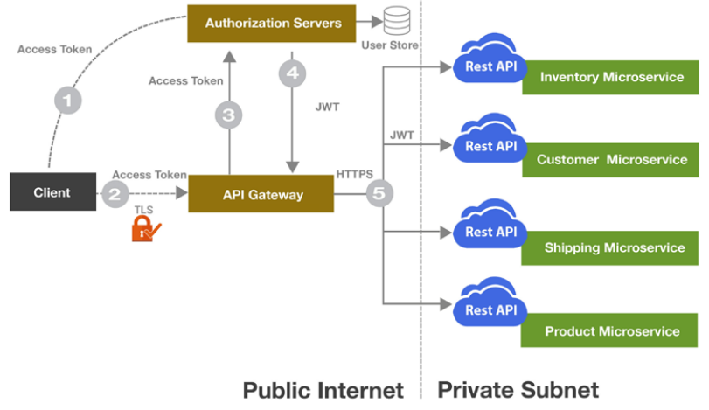
Security
On behalf of the end user, the application client first grabs an access token from the authentication server by presenting credentials.
This access token is then passed along with the API request in Authorization HTTP header
The API Gateway then validates the access token with the authorization server.
5. The JWT token, which contains the claims for the user, is then passed to backend microservices. Backend microservices then use the information inside the JWT token for authorization purpose.
The same JWT token is passed along when one microservice communicates with another microservice.
Notes:
JWT : Json Web token
1. 應用程序客戶端代表最終用戶，首先通過提供憑據從身份驗證服務器獲取訪問令牌。
2. 然後，此訪問令牌與API請求一起在Authorization HTTP標頭中傳遞
3. 然後，API網關使用授權服務器驗證訪問令牌。
4.5，包含用戶聲明的JWT令牌隨後被傳遞到後端微服務。 後端微服務隨後將JWT令牌內的信息用於授權目的。

Slide 13
Security
The flow above has the potential to be a ”confused deputy problem,” as every microservice is relying on the API Gateway for authentication.
Ideally, every microservice should authenticate the token as received from its caller (gateway or microservice).
Notes:
上面的流程有可能是一個 “混亂的副手問題”，因為每個微服務都在依賴API網關進行認證。 (其他MS有使用著的access token 可能可以冒充使用者對其他的MS進行操作)
理想情況下，每個微服務都應該對從其調用者（網關或微服務）收到的令牌進行認證。

Slide 14
Security
2. Threat Protection from DDoS
Most of the API Gateway provides (either integral or addon packages) features that can handle DDoS attacks, by regulating and controlling the traffic as it proceeds to backend microservices. Consider configuring the following traffic regulating parameters for the API Gateway :
Notes:
來自DDoS的威脅防護
大多數API網關都提供了（整體或附加包）功能，可以處理DDoS攻擊，通過調節和控制流量進入後端微服務的過程。考慮為API網關配置以下流量調節參數。

Slide 15
Security
Limiting the rate of requests. You might decide that an API may be accessed only once a day, by an authenticated user from a specific mobile application.
Limiting the number of connections
Closing slow connections
Black list / White list IP addresses
Limiting the connections to backend microservices
Notes:
1. 限制請求的速度。您可能會決定，一個API每天只能被來自特定移動應用的認證用戶訪問一次。
2. 限制連接數。一個客戶機可以為一個API打開的最大連接數
3. 關閉慢速連接。時間跨度，過了這個時間段，一個連接就會被關閉，因為客戶機寫數據的頻率太低，這可能代表了一種盡可能長時間保持連接開放的嘗試。
4.白名單和黑名單
5.限制與後端微服務的連接。

Slide 16
Security
6. Blocking requests :
  that seem to target a specific API
  that have a User-Agent header, set to a value that does not correspond to normal client traffic
  that have a referrer header, set to a value that can be associated with an attack
  that have other headers with values that can be associated with an attack
Notes:
阻止請求。
似乎是針對一個特定的API。
有用戶代理頭的請求，設置為與正常客戶端流量不對應的值。
有一個referrer(推薦人)頭的請求，設置為一個與攻擊相關的值。
有其他頭信息，其值可能與攻擊相關聯。

Slide 17
Security
3. Secure Communication
It is always desirable to have SSL/TLS compliant endpoints at the API Gateway, as well as at the microservices layer, to safeguard against man-in-middle attacks, and bi-directional encryption of message data to protect against tampering.
Notes:
3. 安全通信
在API網關以及微服務層，最好能有符合SSL/TLS標準的端點，以防止中間人攻擊，並對消息數據進行雙向加密，以防止被篡改。
Compliant : 符合

Slide 18
Security
4. Deployment Considerations
To strengthen security further, you should host all microservices on private subnet and whitelist the gateway IP at the microservices layer. If it is not possible to have microservices on private subnet, then you should validate each token with the authorization server per service call, however, this will impact performance.
Notes:
4.部署注意事項
為了進一步加強安全性，應該將所有微服務託管在私有子網，並在微服務層設置網關IP的白名單。如果無法將微服務託管在私有子網上，那麼你應該在每次服務調用時向授權服務器驗證每個令牌，但是，這將影響性能。
Validate : 驗證

Slide 19
Service Registry and Service Discovery
Ease in scaling is one of the key advantage of microservice architecture. You will keep adding or removing microservice instances to adapt to incoming traffic.
Service instances have dynamically assigned network locations.
Notes:
輕鬆擴展是微服務架構的關鍵優勢之一。 您將繼續添加或刪除微服務實例以適應傳入流量。
服務實例具有動態分配的網絡位置。

Slide 20
Service Registry and Service Discovery
1. Service Registry
The service registry helps to keep track of these instances.
Every service instance registers itself on start-up and de-registers on shutdown.
The API Gateway uses this information during service discovery.
Notes:
服務註冊表有助於跟踪這些實例。
每個服務實例在啟動時都會註冊自己，在關機時會註銷。
API網關在service discovery期間使用此信息。

Slide 21
Service Registry and Service Discovery
There are two models for checking the status of a service: pull model and push model.
Moreover, it is the service’s responsibility to update the registry about its availability/ unavailability to serve the request.
Notes:
有兩種用於檢查服務狀態的模型：拉模型和推模型。
此外，服務負責更新註冊表，以了解其是否可以為請求提供服務。

Slide 22
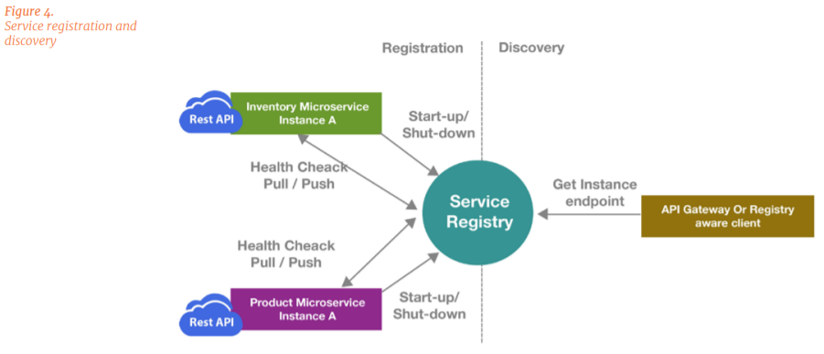
Service Registry and Service Discovery

Slide 23
Service Registry and Service Discovery
As a critical component, the service registry needs to be highly available.
You should plan for a cluster of registries that uses replication to maintain consistency.
Never try to cache the network locations obtained from the registry at the registry user (API Gateway or registry aware client).
That information eventually becomes out-of-date, causing clients to become unable to discover service instances.
Notes:
作為重要組件，服務註冊表需要高度可用。
您應該計劃一個使用複制來保持一致性的註冊表集群。 (service registry表)
切勿嘗試在註冊表用戶（API網關或支持註冊表的客戶端）上緩存從註冊表獲得的網絡位置。
該信息最終變得過時，導致客戶端無法發現服務實例。

Slide 24
Service Registry and Service Discovery
2. Service Discovery
The number and location of service instances is dynamic.
There are two main service discovery patterns: client-side discovery and serverside discovery, as shown in the figure below.
Notes:
服務實例的數量和位置是動態的。
有兩種主要的服務發現模式：客戶端發現和服務器端發現，如下圖所示。

Slide 25
Service Registry and Service Discovery
Server-side discovery is preferred for various reasons:
It removes the discovery burden from the client so it can focus on business functions.
If you have multiple clients, then you need to code and maintain the discovery code for each client.
It reduces number of calls over the internet.
Notes:
Service-side discovery 優點:
•它減輕了客戶端的發現負擔，因此可以專注於業務功能。
•如果您有多個客戶端，則需要為每個客戶端編寫代碼並維護髮現代碼。
•減少了通過互聯網的通話數量。

Slide 26
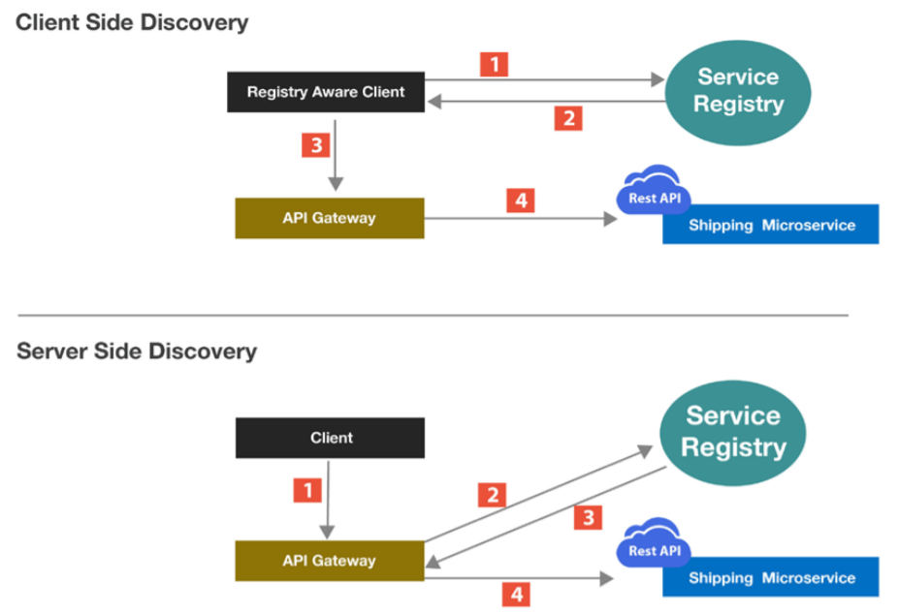
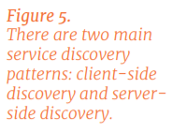
Service Registry and Service Discovery
Notes:
client-side discovery 優點:
避開單一節點(API gateway or Load Balancer)造成的效能瓶頸
容易自定義化，使用者高彈性
缺點 :
更新時難以同步更新

Slide 27
Orchestration
It is often necessary to orchestrate across multiple fine grained microservices to accomplish a business use case.
As shown in the figure below, there are two options for implementing the orchestration: using the API Gateway as the orchestration layer or coding orchestration in a separate microservice.
Notes:
編排
通常有必要跨多個的微服務進行協調以完成應用。
如下圖所示，有兩種實現業務流程的選項：使用API網關作為業務流程層或在單獨的微服務中編排業務流程

Slide 28
Orchestration
You should avoid orchestration at the gateway layer.
It violates the single responsibility principle and, in the case of scaling the API, you will have to scale the gateway along with orchestrated microservices.
Some of the API Gateways have little to no capability for orchestration.
Notes:
您應該避免在網關層進行編排。
它違反了單一責任原則，並且在scaleing API的情況下，您將不得不與協調的微服務一起擴展網關。
一些API網關幾乎沒有協調功能。

Slide 29
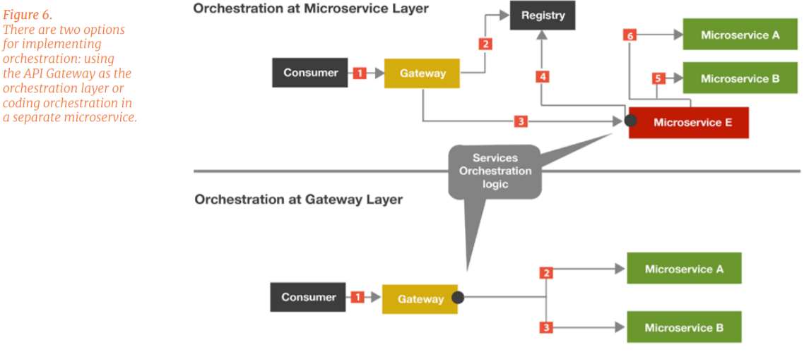
Orchestration
Notes:
通常有必要跨多個的微服務進行協調以完成應用。
如下圖所示，有兩種實現業務流程的選項：使用API網關作為業務流程層或在單獨的微服務中編碼業務流程

Slide 30
Transformation
Often microservices have to deal with different clients on the front end. They have different needs, from both protocol (SOAP, REST, JSON,and XML) and data perspective.
when you are moving from monolith to microservices, backend services may understand different protocols (SOAP, REST, AMQP etc.).
The API Gateway provides a place for data transformation, where messages can be translated between backend, API, and app formats and protocols.
The gateway provides a central data transformation point through which all traffic is translated for:
Notes:
微服務通常必須在前端與不同的客戶打交道。 從協議（SOAP，REST，JSON和XML）和數據角度來看，它們具有不同的需求。
當您從單體式服務轉移到微服務時，後端服務可能會理解不同的協議（SOAP，REST，AMQP等）
API網關提供了一個數據轉換的地方，可以在其中轉換消息，後端、API以及應用程序格式和協議。
通過該轉換點，所有流量都可以轉換為：
Monolithic architecture : 是一個「一站式」的應用程式—一個請求到回應的過程中，經過的各式各樣**元件（component）**都放在同一個地方（用同一個語言、在同一個地方部署）。

Slide 31
Transformation
• Requested payload transformations
• Header transformations
• Protocol transformations
Notes:
•請求的有效負載轉換
•標頭轉換
•協議轉換
Client ←-----→ API Gateway ←----→ Microservices
XML JSON

Slide 32
Monitoring
1. Health Monitoring
• System status and health (CPU, Memory, Thread usage)
• Network connectivity
• Security alerts
• Backups and recovery
• Maintenance of logs
Notes:
•系統狀態和運行狀況（CPU，內存，線程使用情況）
•網絡連接
•安全警報
•備份和恢復
•日誌維護

Slide 33
Monitoring
2. Traffic and Data Monitoring
You should consider monitoring the following basic metrics:
• Number of requests per API
• Request categorization by criteria (for example, remotehost)
• Performance statistics
• Successful and exception messages
• Blocked messages breaching gateway policies
Notes:
您應該考慮監視以下基本指標：
•每個API的請求數
•按條件請求分類（例如，遠端主機）
•效果統計
•成功和異常消息
•被阻止的郵件違反網關策略

Slide 34
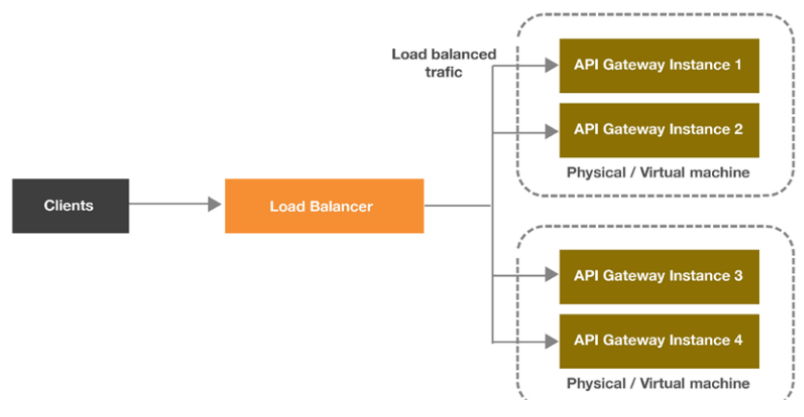

Load Balancing and Scaling
An API Gateway being load balanced runs the same configuration to virtualize the same APIs, and executes the same policies. If multiple API Gateway groups are deployed, load balancing should be across groups.
Notes:
負載均衡的API網關運行相同的配置以虛擬化相同的API，並執行相同的策略。如果部署了多個API網關組，則負載均衡應跨組進行。

Slide 35
Load Balancing and Scaling
Loads are balanced on a number of characteristics including the response time or system load.
The distributed state poses a certain restriction in terms of active/active and active/passive clustering.
This means that for a resilient highavailability system, you should employ a minimum of at least two active API gateways at any given time, extra in passive mode.
The API Gateway also ensures zero downtime by implementing configuration deployment in a rolling fashion.
Notes:
負載在許多特性上保持平衡，包括響應時間或系統負載。
分佈式狀態在主動/主動和主動/被動群集方面構成了一定的限制
這意味著對於有彈性的高可用性系統，您應該在任何給定時間至少使用至少兩個主動API網關，而在被動模式下則要額外。

Slide 36
Load Balancing and Scaling
This means, while each API Gateway instance in the cluster or group takes a few seconds to update its configuration, it stops serving new requests, but all existing in-flight requests are honored.
Meanwhile, the rest of the cluster or group can still receive new requests.
The load balancer ensures that requests are pushed to the nodes that are still receiving requests.
Notes:
這意味著，儘管集群或組中的每個API Gateway實例都需要花費幾秒鐘來更新其配置，但它會停止為新請求提供服務，但是所有現有的進行中請求都會得到滿足。
同時，集群或組的其餘部分仍可以接收新請求。
負載平衡器確保將請求推送到仍在接收請求的節點。
In-flight requests : 正在執行的requests
Honored : 榮幸(滿足?)

Slide 37
High Availability and Failover
Being a critical component and ONLY entry point in microservice architecture, you should deploy the API gateway in High Availability (HA) mode.
API Gateway instances are usually deployed behind standard load balancers, which periodically query the state of the API Gateway.
If a problem occurs, the load balancer redirects traffic to the hot stand-by instance.
Notes:
(高可用性和故障轉移準則)
作為微服務架構中的關鍵組件和唯一入口點，您應該以高可用性（HA）模式部署API網關。
API網關實例通常部署在標準負載均衡器之後，該負載均衡器會定期查詢API網關的狀態。
如果發生問題，負載平衡器會將流量重定向到熱備用實例。
Failover : 故障轉移

Slide 38
High Availability and Failover
High Availability can be maintained using either of these options: Active/Active, Active/Standby, or Active/Active Systems. These are described as follows:
• Active/Standby: System is turned off
• Active/Passive: System is operational but not containing state
• Active/Active: System is fully operational and with current system state
Notes:
可以使用以下兩個選項之一維護高可用性：主動/主動，主動/備用 或主動/主動系統。這些描述如下：
•主動/備用：系統已關閉
•主動/被動：系統正在運行但不包含狀態
•主動/主動：系統可以完全運行並且處於當前系統狀態

Slide 39
High Availability and Failover
HA and Failover Guidelines
• To achieve maximum availability, API Gateway should be used in Active/ Active for each production API Gateway
• Proper traffic analysis, to limit traffic to backend services, to protect against message flooding. This is particularly important with legacy systems that have been recently service-enabled. Legacy systems may not have been designed for the traffic patterns to which they are now subjected.
• Monitor the network infrastructure carefully, to identify any issues early on.
Notes:
高可用性和故障轉移準則
•為了實現最大可用性，應該在產品的API gateway中使用Active / Active
•適當的流量分析，以將限制流量到後端服務，以防止消息氾濫。對於最近已啟用服務的舊系統，這尤其重要。舊版系統可能尚未針對其現在所遵循的交通模式進行設計。
•仔細監視網絡基礎結構，儘早發現任何問題。

Slide 40
Governance
As the number of APIs keep on increasing, it is essential to establish policies and monitoring. The policies can broadly be categorized as design-time governance and runtime governance.
Notes:
(管制)
隨著API數量的不斷增加，建立策略和監控是很重要的。 這些策略可以大致分為設計時管理和運行時管理。
Establish : 建立
Broadly : 大致、廣義的

Slide 41
Governance
runtime governance
Tracking the life cycle of APIs:
• Handling routing, blocking, and processing
• Understanding the API utilization and raising the alerts/ alarms in case usage crosses the threshold
• Traffic throttling, smoothing, and load balancing
• Rate limiting per-API usage
• API versioning
• Schema versioning for input/ output request parameters
Notes:
跟踪API的生命週期：
•處理路由，阻止和處理
•了解API使用率，並在使用率超出閾值時發出警報/警報
•流量限制，平滑和負載平衡
•每個API使用率的限制
•API版本控制
•輸入/輸出請求參數的架構版本控制
Threshold : 閾、門檻
throttling : 節流、掐

Slide 42
Governance
Design time governance
• Defining the standards for API definitions (example: Swagger)
• Keyword tags used to categorize APIs
• Conformance to REST API design guidelines Microservice Architecture: API Gateway Considerations
Notes:
設計時治理：
•定義API的標準（例如：Swagger）
•用於對API進行分類的關鍵字標籤
•符合REST API設計準則微服務架構：API網關注意事項
Guidelines :指導方針

Slide 43
Conclusion
The API Gateway is the essential component of microservices architecture. It helps to:
• Decouple consumers of the services from backend services
• Implement policies in one place
• Achieve reusability
• Monitor the entire technology platform performance
• Enable easy scaling of services
Notes:
結論
API網關是微服務架構的基本組件。 它有助於：
•使使用者與後端服務脫鉤
•一個地方就可以實施政策
•實現可重用性
•監控整個技術平台的性能
•輕鬆擴展服務

Slide 44
References
• Pattern: API Gateway / Backend for Front-End (Microservices.io)
• Building Microservices: Using an API Gateway (NGINX)
• Enabling Microservice Architecture with Middleware (WSO2 Blog)
• Welcome to IdentityServer4 (IdentityServer4)
• Oracle® Fusion Middleware Part 1. API Gateway administration (Oracle)

