Slide 1
Auto-scaling a Defence Application across the Cloud using Docker and Kubernetes
2020/09/25
陳靖
joesph60261@gmail.com
2018 IEEE/ACM International Conference on Utility and Cloud Computing Companion (UCC Companion)
Impact factor:none

Slide 2
Outline
Author
Abstract
Introduction
Related Work
ATHENA Platform
Requirements for Scaling ATHENA
Auto-scaling ATHENA on the Cloud
Results and Findings
Conclusions and Future Work

Slide 3
Author
S. Kho Lin, U. Altaf, G. Jayaputera, J. Li,D. Marques, D. Meggyesy, S. Sarwar, S. Sharma, W. Voorsluys, R.O. Sinnott
School of Computing and Information Systems
University of Melbourne
Melbourne, Victoria, Australia
victorsankho.lin@unimelb.edu.au
A. Novak, V. Nguyen, K. Pash
Defence Science and Technology Group
Melbourne, Victoria, Australia
Notes:
總共有11位作者,9位來自墨爾本大學,2位來自澳洲國防科技集團

Slide 4
ABSTRACT

Slide 5
Abstract
The Australian Defence Forces (ADF) including the army,navy and air force often share resources. This is the case for helicopter training where the resources are often people, e.g. instructors. Understanding the current and future needs of the helicopter pilot training continuum is challenging.
New students are continually entering the Defence services as trainees/cadets; passing or failing exams at specialist flying schools; progressing through or leaving the Defence services and potentially becoming trained pilots or instructors that can subsequently train future students.
Notes:
澳洲軍隊由海陸空三軍組成,彼此之間共享資源。以直升機訓練為例,教練就是資源。釐清直升機人員持續訓練的問題對澳洲軍隊來說是個挑戰。
一屆又一屆的新生成為學員後,在飛行專業學校的考試中通過或淘汰,進而加入或是退出軍隊,並有可能成為飛行員或是教練訓練之後的學生。

Slide 6
Abstract
This continuum has an associated optimisation challenge. The ATHENA platform has been developed as a strategic discrete event simulation, optimisation and analysis system for manpower planning with specific focus on addressing the needs and demands of this helicopter pilot training continuum for the ADF.
ATHENA has been developed as a simulation platform running on a Cloud infrastructure. This paper introduces ATHENA and describes the way in which the platform leverages container technologies to autoscale across the Cloud with focus on the Kubernetes orchestration technology.
Notes:
持續訓練是個有關連性的最佳化挑戰。ATHENA平台為此開發,作為策略性離散問題模擬,最佳化和分析人力派遣的系統,特別應付澳洲軍隊的直升機駕駛長期培訓的需求。
ATHENA是個執行在雲端設施上的模擬平台。本篇論文介紹ATHENA和描述ATHENA利用container技術在雲端上做到auto-scaling,並著重在K8S的整合協調技術

Slide 7
INTRODUCTION

Slide 8
Introduction
Cloud Computing [1] and more recently container-based approaches [2] have changed the way software packaging and deployment are now achieved.
Containerised Applications [3],Infrastructure-as-Code (IaC) and associated systems administration and DevOps [4] underpin modern deployment practices.
[1] M. Armbrust, A. Fox, R. Griffith, A. D. Joseph, R. Katz, A. Konwinski, G. Lee, D. Patterson, A. Rabkin, I. Stoica, and M. Zaharia, “A view of cloud computing,” Commun. ACM, vol. 53, no. 4, pp. 50–58, Apr. 2010.
[2] M. J. Scheepers, “Virtualization and containerization of application infrastructure: A comparison,” in 21st Twente Student Conference on IT, vol. 1, no. 1, 2014, pp. 1–7.
[3] D. Merkel, “Docker: Lightweight linux containers for consistent development and deployment,” Linux J., vol. 2014, no. 239, 2014.
[4] M. Httermann, DevOps for Developers, ser. Expert’s voice in Web development. Apress, 2012.
Notes:
雲端計算和container-based的技術已經改變了現在的軟體封裝與部屬方式。
container化的應用程式, Infrastructure-as-Code(在雲端計算領域中,把軟硬體設備化為程式碼的概念),相關的系統管理和敏捷式開發是現在的佈署方式的基礎

Slide 9
Introduction
Advances in virtualization technologies have changed the Operating System landscape and it is now commonly required to support complex software systems/stacks for many enterprises.
Several studies [5] [6] have shown that container-based virtualization has numerous advantages over traditional Cloud/hypervisor-based virtualization including reducing the performance overheads that arise when creating new instances.
[5] Z. Kozhirbayev and R. O. Sinnott, “A performance comparison of container-based technologies for the cloud,” Future Generation Comp. Syst., vol. 68, pp. 175–182, 2017.
[6] J. Che, C. Shi, Y. Yu, and W. Lin, “A synthetical performance evaluation of openvz, xen and kvm,” in 2010 IEEE Asia-Pacific Services Computing Conference, Dec 2010, pp. 587–594.
Notes:
虛擬化技術的優勢改變了作業系統的格局,現在許多企業普遍使用虛擬化技術來運行複雜的軟體系統。
幾個研究[5] [6]指出container-based的虛擬化相比傳統的雲端/hypervisor為底的虛擬化技術有著多項優點,像是減輕建立新instances時所帶來的性能負擔

Slide 10
Introduction
One of the core advantages of Cloud-based solutions is to scale up and down with demand. For many applications it is essential to support auto-scaling [7], i.e. dynamically scaling to up/down to meet on-demand computing.
Ideally this whole process should be fully automated and not require any manual intervention.
There are a range of technologies and approaches that have been taken to support auto-scaling using container-based technologies.
[7] R. O. Sinnott and W. Voorsluys, “A scalable cloud-based system for data-intensive spatial analysis,” Int. J. Softw. Tools Technol. Transf., vol. 18, no. 6, pp. 587–605, Nov. 2016.
Notes:
雲端方案其中一個主要優點是可依需求擴展或縮減(scale up and down)。大多數的應用程式都需要支援auto-scaling,也就是說可動態的根據所需的計算資源去scaling up/down
理想情況中,整個過程應該完全自動不需要手動介入。
已經有一些用container化技術達到auto-scaling的技術和方法

Slide 11
Introduction
This project investigates auto-scaling solutions that have been implemented for a software stack supporting the helicopter training continuum of the Australian Defence Forces (ADF).
Specifically we consider containerised application scaling of a strategic discrete event simulation, optimisation and analysis system for manpower
planning (ATHENA) with specific focus on addressing the needs and demands of the helicopter pilot training continuum. We present ATHENA and demonstrate the use of Docker and Kubernetes to
build a cloud-native application with orchestration on the Cloud.
Notes:
本篇論文研究了auto-scaling應用在軟體上,協助解決澳洲軍隊的直升機持續訓練問題。
作者特別考慮一個用於人力規劃的策略離散事件的模擬,優化和分析系統(也就是ATHENA)的container化程式scaling,並聚焦在解決直升機飛行員持續培訓的需求與要求。
作者接下來介紹ATHENA和展示透過docker和K8S建立一個cloud-native的程式,且可以在雲端上進行orchestration 也就是整合協調

Slide 12
Introduction
Section 2 : related work focused on auto-scaling
Section 3 : an overview of the ATHENA platform and its core functionality
Section 4 : the ATHENA deployment, containerisation and scaling using Docker
Section 5 : the auto-scaling solution
that is supported
Section 6 :the results of the solution
Section 7 : concludes remarks and identifies areas for
future work
Notes:
第二章:有關auto-scaling的文獻回顧
第三章:實驗設置
第四章:實驗結果
第五章:文獻回顧
第六章:結論

Slide 13
RELATED WORK

Slide 14
The concept of auto-scaling
IBM’s MAPE-K :Autonomic Computing [8]
can manage themselves given high-level objectives from administrators
key autonomic elements
Monitor
Analyse
Plan
Execute
Knowledge
Provide the reference model for autonomic control loops used for self-managed autonomic computing systems
[8] J. O. Kephart and D. M. Chess, “The vision of autonomic computing,” Computer, vol. 36, no. 1, pp. 41–50, Jan 2003.
Notes:
Auto-scaling的概念早就被提出了,可以追溯到IBM的MAPE-K 架構,支援自動化運算,該運算系統可以根據管理者給定的high-level目標達到自我管理。
[8]這篇作者提出幾項自動化的關鍵指標:監控,分析,規劃,執行,知識/經驗
並提出一個可參考的模型作為自主自動運算系統的自動控制迴路

Slide 15
Survey of auto-scaling
In [9] further challenges were identified for auto-scaling in each of the MAPE-K phases. They created a taxonomy for auto-scaling web applications in clouds.
[9] presented a survey of auto-scaling surveys covering scaling indicators and different types of metrics such as resource estimation with rule and threshold based approaches, multi-tier application scaling and container-based auto-scaling.
Although not specific to auto-scaling, [10] provides a survey and taxonomy on resource optimisation for executing Bag-of-Task applications on Public Clouds.
[11] discusses dynamic provision with Aneka to burst out to Public Clouds from on-premise Private Clouds (Hybrid Cloud) to off-load deadline-driven data intensive applications required for big data processing tasks.
[9] C. Qu, R. N. Calheiros, and R. Buyya, “Auto-scaling web applications in clouds: A taxonomy and survey,” CoRR, vol.abs/1609.09224, 2016.
[10] L. Thai, B. Varghese, and A. Barker, “A survey and taxonomy of resource optimisation for executing bag-of-task applications on public clouds,” CoRR, vol. abs/1711.08973, 2017.
[11] A. N. Toosi, R. O. Sinnott, and R. Buyya, “Resource provisioning for data-intensive applications with deadline constraints on hybrid clouds using aneka,” Future Generation Comp. Syst., vol. 79, pp. 765–775, 2018.
Notes:
在[9]這篇論文中,更進一步確定在MAPE-K個階段的auto-scaling的挑戰,作者在雲端上為auto-scaling的網頁程式建立一套分類方法
Taxonomy : 分類法；分類學
[9]提出一個auto-scaling的survey,包含scaling指標和不同類型的數據,像是基於rule或是threshold的資源估計,多層的應用程式和container-based的auto-scaling
[10]這篇論文不是針對auto-scaling,該篇提出一個survey和分類法,關於公有雲執行Bag-of-Task(可以平行化且沒有相依的jobs)的資源最佳化。
[11]這篇討論利用Aneka去動態快速地從公有雲供應到營運中的私有雲,卸載大數據處理任務所需的deadline-driven數據密集型應用。

Slide 16
Auto-scaling technology
Auto-scaling techniques are also discussed in [12] where they focus on auto-scaling algorithm designs.
According to [12], the Kubernetes Horizontal Pod Auto-scaling (HPA) offers a reactive-approach where HPA is implemented as a threshold-based reactive controller that automatically adjusts the required resources based on application demand, e.g. through a control loop.
Other approaches discussed include threshold-based rules which scale up/down based on observed CPU load or average response times
[12] T. Lorido-Botran, J. Miguel-Alonso, and J. A. Lozano, “A review of auto-scaling techniques for elastic applications in cloud environments,” J. Grid Comput., vol. 12, no. 4, pp. 559–592, 2014.
Notes:
Auto-scaling技術也在[12]這篇論文討論,該篇著重在auto-scaling演算法的設計
根據[12],K8s Horizontal Pod Auto-scaling(縮寫HPA)提供一個互動的方法,當HPA作為一個thershold-based的互動式controller,根據程式需求去動態地調整所需的資源,像是透過control loop去控制
其他方法討論了包含thershold-based 的規則,觀測cpu的平均時間內負載去scale up/down

Slide 17
Queueing theory
Queuing theory is another approach that has been widely explored.
It is based on a model of virtual machines, containers and/or application tiers as the basis for forming queues of requests.
When the queues are filled, the system needs to scale-out. When the queues are empty, the system can scale-down.
This approach has also been considered for large-scale stream processing on the Cloud and automatic scaling on demand using technologies such as STORM and Heron [13].
[13] T. M. Truong, A. Harwood, and R. O. Sinnott, “Predicting the stability of large-scale distributed stream processing systems on the cloud,” in Proceedings of the 7th International Conference on Cloud Computing and Services Science - Volume 1: CLOSER,, INSTICC. SciTePress, 2017, pp. 603–610.
Notes:
排隊理論是另外一個常常被探討的方法
基於一種用VM,container或是程式組成一個模型,作為request queue的基礎
當queue塞滿了,該系統需要scale out;當queue為空時,該系統需要scale down
這種方法被用於雲端上的大規模的串流處理以及像是STROM和Heron,根據需求自動擴增縮減的技術

Slide 18
Time-series analysis
Time-series analysis is a further proactive auto-scaling approach that uses the past history of time-series data, e.g. CPU use, to predict future values.
Reinforcement learning is a machine learning based approach that supports automatic decision-making with no prior knowledge of the system model.
[14] also reviews cloud auto-scaling approaches and presents a combination of fuzzy logic controller with reinforcement learning for auto-scaling Cloud/OpenStack-based infrastructure based on HTTP traffic load.
It proposes a model-driven approach that focuses on attempting to converge resource utilisation to an optimal policy
[14] H. Arabnejad, C. Pahl, P. Jamshidi, and G. Estrada, “A comparison of reinforcement learning techniques for fuzzy cloud autoscaling,” in Proceedings of the 17th IEEE/ACM International Symposium on Cluster, Cloud and Grid Computing, ser. CCGrid ’17. Piscataway, NJ, USA: IEEE Press, 2017, pp. 64–73
Notes:
時序的分析是一種更進一步的主動auto-scaling的方法,使用歷史資料像是cpu的使用率去預測未來的情況/數據
Reinforcement learining是一種機器學的方法,可以載沒有系統模型的先前資訊下去自動決策
[14]也評論了雲端的auto-scaling方法和發表一個採取reinforcement learning方法與模糊邏輯controller的結合,可根據HTTP的流量負載執行auto-scaling的openstacke-based 設施
[14]作者也提出一種model-driven的方法,重點在嘗試把資源的利用率收斂到最佳的策略上

Slide 19
Measuring the performance of container
There has been a variety of efforts that have measured the performance of container technologies [15].
These have mostly focused on either comparing the performance of running containerised applications against that achieved by running the standard versions of the same applications on virtual machines VMs, and/or physical servers, or assessing their isolation capabilities, i.e. how the performance of an application running on a container or on a VM is impacted by external load in the same computing node.
Quetier et al. [16] were among the first to highlight the performance advantages of using kernel-level virtualization of computing resources. They showed that this approach provides much better start-up time for applications, thus helping to achieve flexibility and scalability .
[15] J. Nickoloff. (2016, Nov) Evaluating container platforms at scale. Retrieved from Medium, June 2018. [Online]. Available: https://medium.com/on-docker/ evaluating-container-platforms-at-scale-5e7b44d93f2c
[16] B. Quetier, V. Neri, and F. Cappello, “Scalability comparison of four host virtualization tools,” Journal of Grid Computing, vol. 5, no. 1, pp. 83–98, Apr. 2007
Notes:
[15]提出一些測量container性能的技術
這些研究著重在比較container化程式,VM上執行的程式和實體機上執行程式 的性能,也評估他們的隔離的效果,也就是說一個程式執行在Container或vm上是否產生額外的性能負擔
[16]是最早強調使用kernel-level的虛擬化計算資源的性能優勢的論文,提出該方法提供更短的程式啟動時間,有助於提升靈活性和擴展性

Slide 20
Performance between different environments
Other works focused on assessing the performance penalties
incurred by container based technologies and virtual machines
when particular physical resources are under load. Morabito et
al. [17] showed that container-based solutions perform better than their VM-based counterparts .
Felter et al. [18] used the SysBench OLTP benchmark on a single instance of the MySQL database management system, considering virtualized environments based on containers and VMs. Their results showed that the use of containers gives rise to a very small degradation in performance, when compared to a system that uses no virtualization technology .
On the other hand, using vanilla Infrastructure-as-a-Service (IaaS) platforms and creating, configuring and deploying instances, this overhead can be as high as 40%.
[17] R. Morabito, J. Kjllman, and M. Komu, “Hypervisors vs. lightweight virtualization: A performance comparison,” in 2015 IEEE International Conference on Cloud Engineering, March 2015, pp. 386–393.
[18] W. Felter, A. Ferreira, R. Rajamony, and J. Rubio, “An updated performance comparison of virtual machines and linux containers,” in 2015 IEEE International Symposium on Performance Analysis of Systems and Software (ISPASS), 2015, pp. 171–172.
Notes:
其他研究像是評估在特定的實體資源的負載對於container-based技術或是VM的效能懲罰
[17]顯示container-based的解決方案比VM-based表現較佳
[18]在Mysql database管理系統上的一個instance上執行SysBench OLTP 跑分 (針對database的跑分),考量container和VM的虛擬化環境,結果顯示container有較小的效能減損,相比VM
另一方面,用Iaas平台建立,設置和部屬instances,有高達40%的overhead(額外負擔)

Slide 21
Isolation capability of container technology
Xavier et al. [19] compared the performance isolation capabilities of several container technologies, and compared them against the performance isolation provided by virtualization technologies.
They used benchmarking suites with stress tests related to CPU memory, disk and network. Their results showed that container
technologies experience minimal interference regarding the CPU.
On the other hand, other resources suffered more interference when container technology was used, as compared to the interference that occurs when a VM was used.
In a later work, Xavier et al. [20] performed a deeper evaluation of the performance interference that disk-intensive containerised applications suffer under different stress scenarios. Their results show that in some scenarios, the performance degradation could be as high as 38%
[19] M. G. Xavier, M. V. Neves, F. D. Rossi, T. C. Ferreto, T. Lange, and C. A. F. D. Rose, “Performance evaluation of container-based virtualization for high performance computing environments,” in 2013 21st Euromicro International Conference on Parallel, Distributed, and Network-Based Processing, 2013, pp. 233–240.
[20] M. G. Xavier, I. C. D. Oliveira, F. D. Rossi, R. D. D. Passos, K. J. Matteussi, and C. A. F. D. Rose, “A performance isolation analysis of disk-intensive workloads on container-based clouds,” in 2015 23rd Euromicro International Conference on Parallel, Distributed, and Network-Based Processing, March 2015, pp. 253–260.
Notes:
[19]比較不同container技術的隔離性能,也比較虛擬化技術之間的隔離性能
[19]作者使用一套跑分軟體,包含針對CPU 記憶體 硬碟和網路的跑分,結果顯示container技術的CPU效能減損最小
另一方面,使用container技術相比VM,其他資源受到的影響較大
[19]作者之後的研究[20],對硬碟較敏感的container程式在不同壓力測試下的性能影響進行更進一步的評估。結果顯示在某些情況下,效能減損高達38%

Slide 22
Overheads of orchestration
There has been minimal work in assessing the overheads induced by the use of tools to orchestrate the execution of multiple containers.
[15] assesses the start up time of containers for both Docker Swarm and Kubernetes in experiments with as many as 30,000 containers on a cluster of a thousand nodes.
The results showed that more than half of the Docker Swarm nodes could start a container in less than 0.5s when the cluster was no more than 90% full, whilst over half of the Kubernetes nodes could only start a container in over 2s when the cluster was 50% full.
They identified that if the cluster of Kubernetes nodes was over 90% full, the start-up time of containers could exceed 124s and ultimately require manual intervention.
[15] J. Nickoloff. (2016, Nov) Evaluating container platforms at scale. Retrieved from Medium, June 2018. [Online]. Available: https://medium.com/on-docker/ evaluating-container-platforms-at-scale-5e7b44d93f2c
Notes:
評估使用某些工具去整合協調多個container之間運行的負擔的相關研究不多
[15]評估一個cluster 含有1000多個nodes,上面有3萬多個containers, docker swarm和K8S的container啟動時間
結果顯示.在cluster已經有90趴的負載下,超過一半的Docker Swarm節點可以在0.5秒之內啟動container,而在cluster在50趴的使用率下,超過一半的K8s節點需要超過2秒的時間啟動container
作者發現,若K8s的cluster有90趴的負載下,啟動container會超過124秒,最後需要手動操控

Slide 23
ATHENA intro
In supporting auto-scaling, numerous factors need to be considered.
One key area of concern is the notion of state of the application to be scaled.
As a case study, we present the ATHENA application and how it was developed and ultimately refactored to support auto-scaling across the Cloud.
Notes:
為了支援auto-scaling,需要考慮眾多條件
其中一個關鍵是可擴展scaling程式的狀態這樣一個概念
作者展示ATHENA程式,介紹ATHENA如何開發,最終重組程式成可以在雲端上auto-scaling

Slide 24
ATHENA platform

Slide 25
ATHENA platform
ATHENA is a state-of-the-art, purpose-built system developed for the Australian Defence Science and Technology Group [21] [22].
ATHENA is a strategic simulation and analysis system focused on manpower planning . The aim of the system is to tackle workforce planning challenges of the ADF across their training continuum.
ATHENA provides a framework designed to address the needs of ADF to perform whatif scenario analysis based on computationally intensive simulations
[22] V. Nguyen, A. Novak, M. Shokr, and K. Pash, “Aircrew manpower supply modeling under change: An agent-based discrete event simulation approach,” in 2017 W
Notes:
ATHENA是由澳洲國防科技集團開發出的一款最先進的專用系統
該系統著重在人力規劃的策略模擬和分析系統,目的是為了解決澳洲軍隊在培訓過程中遇到的勞動力規劃問題
ATHENA提供一個框架,用於滿足澳洲軍隊基於計算密集型的模擬,執行what if 情況分析(也就是假設分析)的需求

Slide 26
ATHENA platform
Eg. what if we close a flight school, what if the number of instructors do not need the needs and demands of the ADF in
5 years time, what should the intake of new students be in the next few years?
To address these issues, ATHENA provides facilities for simulation, visualisation and analysis of personnel, e.g. instructors, flight crew and cadets/trainees, and resources, e.g. flying schools and the courses/examinations that pilots must pass to progress in their flying careers within the ADF
Notes:
假設我們關閉了一所飛行學校,如果五年後的軍隊的教練需求沒有這麼多,那未來幾年應該招收多少新生?
為了解決這些問題,ATHENA提供一套工具提供模擬,把問題視覺化和分析人力(像是教練,飛行員,學員)和資源(像是飛行學校和飛行生涯中所需要通過的考核)的問題

Slide 27
ATHENA platform
multi-user, multi-tier microservices web application
major components
User interface
Backend web service
Databases
Message broker
Simulation workers
Backend : Spring framework-based modular application, written in Java.
provides logic related to the strategic aircrew training continuum.
supports management interfaces, business logic, data persistence and distributed computation tasks.
Notes:
多使用者,多層microservices的網頁程式
主要元件:使用者介面,後端網頁服務,資料庫, Message broker, Simulation workers
後端:Spring 框架,以java語言撰寫
提供與空中人員的持續訓練的相關規劃
提供管理介面,運作邏輯,永久資料和分散式計算任務

Slide 28
ATHENA platform
data layer
PostgreSQL database: stores access control data
NoSQL MongoDB : document-oriented , storing all data related to the simulation model.
Computation of simulations are performed by a network of lightweight workers, also written in Java, which communicate with the backend via Java Message Service (JMS).
Apache ActiveMQ is used for reliable delivery of messages containing simulation requests, results and status updates.
The user interface is based on a AngularJS JavaScript Single-Page Application.
The UI communicates with the backend application server using both the HTTP REST API and WebSocket channels.
Notes:
資料層:含有兩個部分
PostgreSQL database儲存access control的資料
NoSQL MongoDB 文件導向,儲存所有資料與模擬模型有關的
模擬的計算方式是由網路連接而成的輕量化的worker來計算,也是以java撰寫,以java message service(JMS)與後端通訊
Apache ActiveMQ 作為可靠的傳遞訊息管道,包含模擬的要求,結果和狀態更新
使用者介面以AngularJS JavaScript 單一網頁程式組成
UI和後端程式的通訊已HTTP Rest API和網頁端口進行通訊

Slide 29
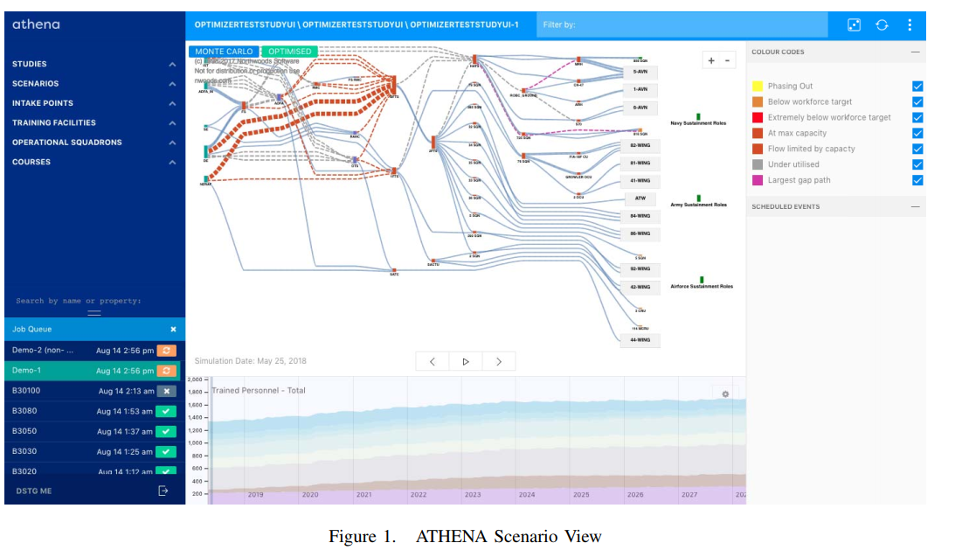
Fig 1
Notes:
圖1顯示ATHENA用於模擬10年份的澳洲軍隊的直升機飛行員的連續訓練情況
情景圖以Sankey diagram呈現
上層的部分顯示連續訓練過程的分層流動結構(方向由左而右)
學生和新生來自不同的地方,有的來自飛行學校畢業,或是上過幾種不同的課程,像是基本飛行訓練,在飛行學校的進階飛行訓練
這些地點分布在澳洲各地,學生可能通過或未通過課程,若學生未通過,有可能結束在澳洲軍隊的飛行生涯
可以看到,在培訓過程,有多條路徑/生涯,例如那些希望成為飛行員或是導航員的人
受過訓練的飛行員有可能會去服役或是成為教練
教練太多或太少都會影響培訓過程,例如未來學員或受訓人員的錄取都會受到影響,或者根據人員流動的情況,課程合格或不合格的學生會更多
需注意的是因為這是稀少的資源,所以這是一個難題,尤其是通常只有一百多人成為受訓的飛行員
場景時間軸(在底部) 顯示整個模擬時間範圍內的學員或教練的數量。蒙地卡羅模擬和最佳化招募演算法用於建立這些結果
模擬的狀態顯示再圖一的左下角,執行中的是橘色,完成的是綠色

Slide 30
ATHENA Scenario View
Figure 1 shows an example of ATHENA used for a 10 year simulation of the ADF helicopter pilot continuum.
The Scenario view (top) is given as a Sankey diagram.
The upper part shows a visualisation of the layered flow structure for the flow of the training continuum (left to right).
In this, students/cadets enter from the left from a variety of locations, e.g. University graduates in aeronautics, and undertake a variety of courses, e.g. basic flight training, advanced training at specialist schools. These are typically at locations around Australia. Students may pass or fail these courses and if they fail then they typically cease their career in the ADF.
Notes:
圖1顯示ATHENA用於模擬10年份的澳洲軍隊的直升機飛行員的連續訓練情況
情景圖以Sankey diagram呈現
上層的部分顯示連續訓練過程的分層流動結構(方向由左而右)
學生和新生來自不同的地方,有的來自飛行學校畢業,或是上過幾種不同的課程,像是基本飛行訓練,在飛行學校的進階飛行訓練
這些地點分布在澳洲各地,學生可能通過或未通過課程,若學生未通過,有可能結束在澳洲軍隊的飛行生涯

Slide 31
ATHENA Scenario View
As seen there are numerous pathways/careers in the training
continuum, e.g. for those that wish to become pilots or navigators .
Trained pilots may well go on active service duty or eventually become instructors.
Too few or too many instructors impacts on the continuum, e.g. intake of future cadets/trainees will be impacted or courses will pass or fail more students depending on the flow of personnel.
It is important to note that this is challenging since there are limited resources, e.g. typically only a hundred or so individuals that become fully trained pilots in the ADF.
The Scenario timeline (bottom) shows the statistics of trainees and/or instructors over the whole simulation time span. Monte Carlo simulations and recruitment optimisation algorithm are used to create these results
Notes:
可以看到,在培訓過程,有多條路徑/生涯,例如那些希望成為飛行員或是導航員的人
受過訓練的飛行員有可能會去服役或是成為教練
教練太多或太少都會影響培訓過程,例如未來學員或受訓人員的錄取都會受到影響,或者根據人員流動的情況,課程合格或不合格的學生會更多
需注意的是因為這是稀少的資源,所以這是一個難題,尤其是通常只有一百多人成為受訓的飛行員
場景時間軸(在底部) 顯示整個模擬時間範圍內的學員或教練的數量。蒙地卡羅模擬和最佳化招募演算法用於建立這些結果

Slide 32
ATHENA Remote Job Execution
The ATHENA simulations can be computationally intensive, especially if one of the optimisation algorithms is activated.
For this reason, a master-worker remote execution system has been designed that offers high-performance, scalable simulations as shown in Figure 2.
Monte Carlo simulations, composed of many repetitions of the same process, are inherently a good fit for this system due to their embarrassingly parallel nature .
In the master node, the job execution system is composed of a modular set of services .
Once a scenario is submitted for simulation, the Scenario Service deals with assembling a simulation model with the correct inputs and creates one sub-scenario for each Monte Carlo repetition.
Notes:
ATHENA的模擬程式可以設定成集中計算資源,特別是其中啟動某個最佳化演算法
因此,作者設計了一個主worker遠端運作系統,可提供高性能,可擴展的模擬環境,如圖2所示
蒙地卡羅模擬,由同個process迭代組成,具有恰好的平行性,非常適合ATHENA系統環境
在master node中,工作執行系統是由一組模組化的服務組成
一個scenario被提交至模擬工作, scenario 服務啟動,用正確的輸入組出一個模擬模型,並為每個蒙地卡羅迭代建立一個小scenario

Slide 33
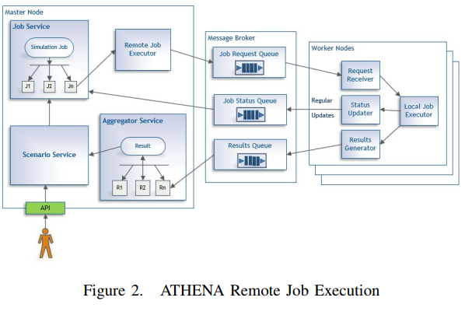
Fig 2

Slide 34
ATHENA Remote Job Execution
Effectively, the simulation is parallelised into N independent jobs, created by the Job Service, which is responsible for managing the job state, i.e. creating, updating and cancelling job executions.
The Remote Job Executor interfaces to the message broker via the JMS protocol. At this point, the Job Request Queue will contain multiple job definitions, ready to be consumed by
workers.
There can be many worker nodes, which consume messages from the Job Request Queue. These can interpret the job definition, read job inputs, and execute parts of the simulation model.
As jobs are dequeued, start and finish execution, the worker sends status updates via the Job Status Queue, which are in turn consumed by the master node to provide progress updates to the end-user.
Notes:
實際上,模擬被平行化為N個獨立的job,由job service建立,job service負責管理job的狀態:建立,更新,取消job的執行。
遠端Job執行介面與message broker之間介面是JMS(Java message service)。Job request queue包含多個job定義,準備由worker執行
多個worker 節點會執行來自job request queue的訊息。Worker nodes會解析job 定義,讀取job inputs,執行模擬模型的其中一部份
隨著queue的jobs執行完成,worker透過job status queue送出狀態更新,再由master node處理,把更新後的進度傳給end-user

Slide 35
ATHENA Remote Job Execution
Each individual simulation produces one result. These are sent
via the Results Queue and consumed by an Aggregator Service
that performs statistical aggregation, thus producing the mean and confidence intervals of all model statistics over all simulation runs.
The status of simulations is shown in bottom left of Figure 1 with
running (orange) and completed (green) boxes shown.
It is the ability to scale these simulations in near real time across the Cloud that form the basis for the cloud-native auto-scaling of ATHENA application that is the focus of this paper.
Notes:
每個獨立的模擬都會產生一種結果。這些結果透過Results Queue 傳送,由負責執行數據整合的Aggregator Service處理, Aggregator Service產生所有模擬的平均數據和信賴區間
模擬的狀態顯示再圖一的左下角,執行中的是橘色,完成的是綠色
基於以上幾點,作者擴展 scale這些模擬在雲端上,而本篇論文將主要探討ATHENA的cloud-native auto-scaling能力

Slide 36
REQUIREMENTS FOR SCALING ATHENA
CH4

Slide 37
Requirements for scaling ATHENA
For the initial use case of ATHENA, a monolithic, vertically scalable setup was suitable.
As more organisations within the ADF showed interest in using ATHENA, a robust horizontally scalable platform was needed.
Furthermore, certain advanced use cases were identified, which were meant to rigorously inspect and test the simulation and optimisation engine.
These experiments required running the simulations a large number of times (typically 1,000-10,000 times) with different values for all input parameters.
The results of these simulations were then analysed to explore
relationships between inputs and bottlenecks in the operational
pipelines. The existing architecture was not feasible for this work
load, and elastically scaling ATHENA became essential to running
these benchmarks within a reasonable time period.
Notes:
根據ATHENA的一開始使用情況, 整體,垂直 monolithic, vertically的擴展方式是最適合的
隨著澳洲軍隊中越來越多單位對ATHENA有興趣,需要一個強大的可horizon scaling平台
另外還有更進階的使用情況,是為了嚴格檢查和測試模擬和優化引擎
這些實驗需要跑大量的模擬(大約1000~10000次),每次都用不同的input數值
這些模擬的結果用來分析,探討平行運算時的input和瓶頸之間的關係。

Slide 38
Requirements for scaling ATHENA
ATHENA uses NeCTAR as an IaaS Cloud provider. The ATHENA deployment leverages two tenancies with total number of 300 vCPU cores ranging between 4 cores to 16 cores per instance.
Unlike typical IaaS uses of NeCTAR, ATHENA uses a container-based approach focused predominantly around the Docker technology for auto-scaling.
The ATHENA stack was originally deployed in a traditional IaaS
manner, e.g. using scripting technologies such as Ansible to create instances and configure/deploy the ATHENA software through Ansible Playbooks. Initially ATHENA was deployed onto a single large VM instance (16 cores and 64Gb RAM).
The advantage of this approach was the almost zero network latency between software component communications.
Notes:
ATHENA以NeCTAR(一個澳洲官方的雲端平台)作為IaaS雲端供應商, ATHENA總共有300個cpu核心,每個instances有4核到16核cpu的選擇
ATHENA使用container-based的方式,以docker作為技術基底來達成auto-scaling
ATHENA是以傳統Iaas方式部屬,透過撰寫腳本方式,透過Ansible Playbooks去建立instances和設置部屬ATHENA。而一開始配置運行ATHENA的instance非常肥大(16 cpus 64g ram)
這種佈署方式有個優點就是軟體套件之間的通訊幾乎沒有網路延遲

Slide 39
Requirements for scaling ATHENA
However this approach had vertical scaling limitations, e.g. it could only run on a single VM and larger scale simulations were not possible.
The first step to scale horizontally was to identify the State of the software stack and separate out stateful and stateless components.
The components were then built into Docker images and run as containers using a pool of worker nodes as shown in Figure 3.
With this arrangement, horizontal scaling was possible .
The solution allowed more database nodes to be supported for MongoDB sharding and replication to handle the terabytes of simulation data that can be generated.
Further worker nodes could also be added into the dedicated worker pool for higher throughput.
Notes:
然而這種部屬方式限制了vertical scaling(垂直擴增)的可能,也就是說只能跑一個肥大的VM,要(擴增模擬) scale simulations是不可能的。
Horizon scaling(水平擴增)的第一步是分出哪些軟體元件的狀態是stateful還是stateless的元件
元件做成docker image,由圖三所示,worker nodes作為container運行
如此一來,可以horizon scaling了
這個解決方案可允許更多database 節點,以MongoDB為底,把TB達的模擬資料切分和複製
之後worker節點可以加入特定的worker pool,以提升性能輸出

Slide 40
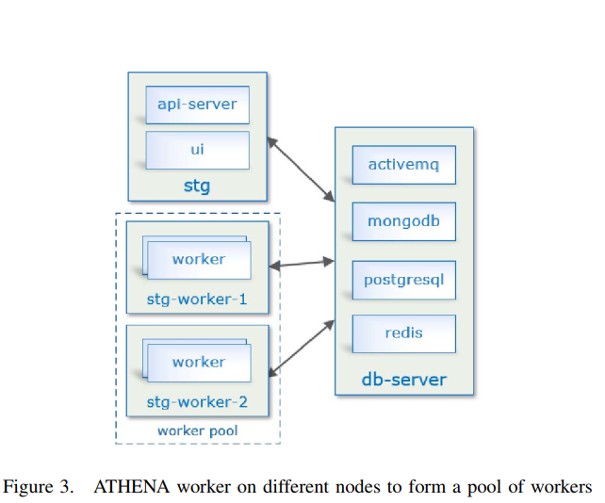
Fig 3

Slide 41
Requirements for scaling ATHENA
A dockerised version of ATHENA including orchestration capabilities to meet this dynamic scaling was thus need.
We utilise Kubernetes for this purpose, based on experiences comparing Docker Swarm and Kubernetes in other work.
Notes:
docker版的ATHENA包含整合協調能力,以達到作者要的動態scaling
作者以K8s技術達到以上目標,並在其他的研究中比較Docker Swarm 和 Kubernetes

Slide 42
AUTO-SCALING ATHENA ON THE CLOUD
CH5

Slide 43
AUTO-SCALING ATHENA ON THE CLOUD
As market leader, Docker was used as the core container-based solution and Kubernetes was used as the container orchestration.
Docker was thus an empirical choice based on the maturity of the software and built-in auto-scaling support through Kubernetes .
Kubernetes is a production grade container orchestration system designed for the deployment, scaling, management, and composition of application containers across clusters of hosts.
It provides a robust container management system that creates a virtual abstraction layer on top of Cloud platforms that is used for deploying and maintaining scalable distributed systems.
This abstraction enables developers to deploy their applications consistently across different Cloud providers.
Figure 4 shows this concept.
Notes:
docker常被作為主要的container-base的解決方案,K8s常被作為container的協調方案
擁有較多的docker使用經驗,搭配成熟的軟體程式,透過K8S實現auto-scaling
K8s為一個container的協調系統,可以部屬 擴展和組織那些跨實體的cluster的container
K8s提供一個強大的container管理系統,在雲端上建立一個虛擬抽象層,用於部屬和維護可擴展的分離式系統
該抽象層可以讓開發者部屬程式在不同雲端平台

Slide 44
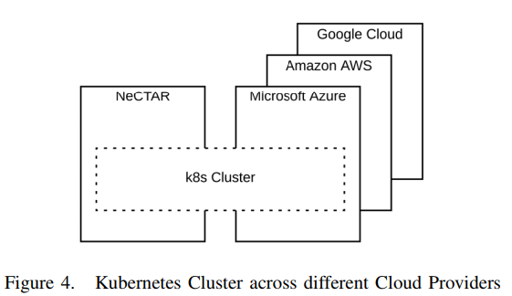
Fig 4

Slide 45
K8S simple intro
Kubernetes is the third incarnation of Google’s own container management systems [23].
Since the process of containerization encapsulates the application, Kubernetes introduces an Application-Oriented Infrastructure to abstract away details of hardware and
operating systems from application developers.
Kubernetes has a breadth of functionality that grows daily and it’s associated documentation is outdated quickly.
Every layer of Kubernetes provides several ways to setup and configuration clusters that can be used for a particular cloud deployment.
For ATHENA, we explored numerous options and eventually selected kubeadm to bootstrap the Kubernetes cluster for ATHENA deployment
[23] B. Burns, B. Grant, D. Oppenheimer, E. Brewer, and J. Wilkes, “Borg, omega, and kubernetes,” Queue, vol. 14, no. 1, pp. 10:70– 10:93, Jan. 2016.
Notes:
K8s是google的第三個container管理系統(另外兩個為Borg,omega)
由於container化的過程中封裝了應用程式,K8s引入程式導向的基礎架構,向程式開發者把硬體和作業系統抽象化
K8s的功能每天都在增加,相關文件很快就過時了
Kubernetes的每一層都提供了幾種設置和配置cluster的方法，可以用於特定的雲部署。
作者探索了幾種方案最後選擇以Kubeadm作為ATHENA的佈署方式以及引導整個K8s cluster

Slide 46
The Concept of Pod
In Kubernetes, the concept of a Pod is used to encapsulate containers.
A Kubernetes Pod object holds one or more containers and, introduces an IP-per-Pod network model.
This implies IP addressing is at the Pod scope. Therefore, containers within a Pod share their network namespaces including their IP address.
The Pod networking requirement states that nodes and containers can communicate each other without Network Address Translation (NAT) [24]. Therefore, the IP that a container sees itself as is the same IP as others see it.
The Kubernetes network model bars usage of intentional network segmentation policies such as NAT.
Kubernetes documentation offers several ways for overcoming this and overlay network using kube-flannel add-on was adopted as the ATHENA solution.
[24] K. Developers. (2018) Kubernetes documentation. V1.10, Access June 2018. [Online]. Available: https://kubernetes.io/docs/
Notes:
在Kubernetes中，Pod的概念是用來封裝container的。
一個Kubernetes Pod對象可以容納一個或多個container，並且引入了一個IP-per-Pod網絡模型。
這表示IP位址是在Pod範圍內的。因此，一個Pod內的container彼此共享其網絡命名空間，包括其IP地址。
Pod網絡需求規定，node和container可以在沒有NAT的情況下相互通信[24]。因此，一個container看到的自己的IP和其他人看到的IP是一樣的。
Kubernetes網絡模型禁止使用故意的網絡分割規則，如NAT.
Kubernetes說明文件提供了幾種克服這個問題的方法，ATHENA使用kube-flannel add-on方法的overlay network為解決方案。

Slide 47
The Concept of Pod
In Kubernetes, Pods are ephemeral. That is, a Kubernetes cluster can replicate Pods (destroy and re-create new ones) for dynamically scaling up or down, for self-healing and/or for self-managing purposes.
As a given Pod can be destroyed or recycled, the Pod IP address may subsequently change. This is challenging for application developers to keep track of.
The Kubernetes Service is a network abstraction layer used to maintain a consistent endpoint within a cluster.
The Kubernetes Service can be also seen as a front-end service proxy for other Kubernetes objects such as Pod, Deployment, ReplicaSet, etc.
Notes:
在Kubernetes中，Pods是暫時的。也就是說，一個Kubernetes cluster 可以復制Pods（銷毀和重新創建新的pods），以便動態地 擴大或縮小規模，達到自我修復和/或自我管理的目標。
由於一個給定的Pod可以被銷毀或回收，所以 Pod IP地址隨後可能會發生變化。這對於程式開發者來說這是個挑戰。
Kubernetes服務是一個網絡抽象層，用於維護cluster內一致的端點
Kubernetes服務也可以看作是其他Kubernetes物件的前端服務代理，如Pod、Deployment、ReplicaSet等。。

Slide 48
Kubernetes Horizontal Pod Autoscaler (HPA)
The Kubernetes Horizontal Pod Autoscaler (HPA) dynamically
adjusts the number of Pod replicas in a given deployment based
on the observed CPU utilisation.
The HPA is implemented as a
Kubernetes API resource with an associated controller.
The first version of HPA scaling of Pods was based on observed CPU utilization and memory usage.
In Kubernetes 1.6, the Custom Metrics API was introduced that enabled HPA to access arbitrary metrics through the REST API. In Kubernetes 1.7, the API server aggregation layer allowed third party applications to extend the Kubernetes API by registering themselves as API Add-ons.
Notes:
Kubernetes Horizo​​ntal Pod Autoscaler (HPA)根據觀測到的CPU使用率去動態調整Pod的數量
HPA是作為一個 Kubernetes API資源與關聯控制器。
第一個 版本的HPA縮放的pods是基於觀察到的CPU
使用率和ram使用率。
在 Kubernetes 1.6 中，新增Custom Metrics API ，使HPA能夠訪問任意的透過REST API觀測各項數值。
在 Kubernetes 1.7 中，API server aggregation層允許第三方程式透過將自己註冊為API Add-ons來擴展Kubernetes API。

Slide 49
Kubernetes Horizontal Pod Autoscaler (HPA)
Figure 5 depicts the full orchestration of Prometheus metrics
monitoring stack for ATHENA using HPA.
In the Core Metrics pipeline, the Metrics Server retrieves node and container metrics from the Kubelet cAdvisor. In the Monitoring pipeline, the Prometheus Operator collect metrics through its Service Monitor and stores them in Prometheus.
The Kubernetes Custom Metrics API along with the API Aggregation Layer make it possible for monitoring systems like Prometheus to expose application-specific metrics to the HPA controller.
For applications like the ATHENA API service, it is relatively straight forward to expose metrics on JVM stats, embedded Tomcat (HTTP Requests/Responses traffic load) and any application-specific metrics (e.g. workload and number of Jobs in queue) using Spring Boot Actuator and Micrometer.
Notes:
圖5描述了使用HPA對ATHENA的Prometheus(一個監控系統)監控stack的完整的整合協調。
在主要的Metrics pipeline中,監控server從Kubelet cAdvisor(一個監控套件)取得container和node的數據。
在Monitoring pipeline中, Prometheus Operator 透過Service Monitor 收集數據並從在Prometheus
Kubernetes 客制化 Metrics API以及API Aggregation Layer可以讓Prometheus傳送特定的程式資料給HPA controller

Slide 50
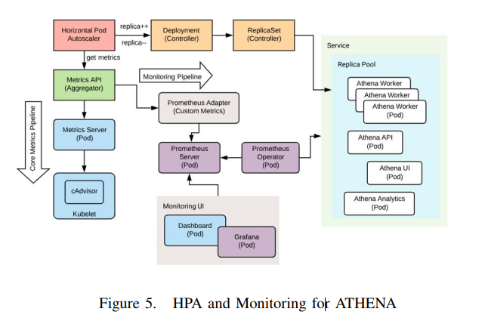
Fig 5

Slide 51
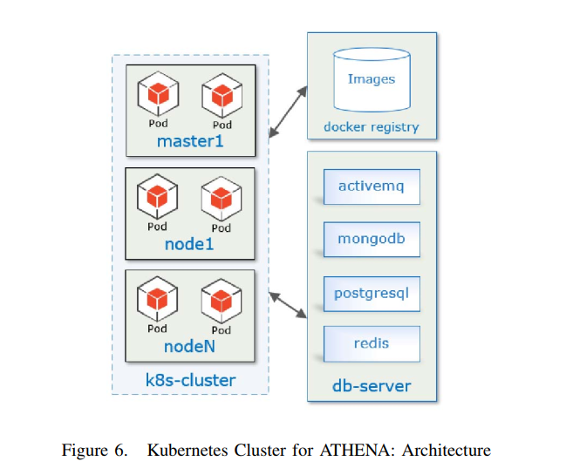
ATHENA Architecture
Notes:
圖6介紹在K8S cluster內部署ATHENA的架構圖
Docker registry是一個使用Nexus repository manager 管理的docker
Nexus repository manager : 一種管理docker images的套件

Slide 52
HPA auto-scaling algorithm
According to [24], the HPA implementation of the ATHENA auto-scaling algorithm works in the following manner:
A Control Loop is set for 30 seconds by default, however
this is configurable;
Periodically Pods are queried to collect information on their CPU utilization;
The arithmetic mean of the Pods’ CPU utilization with a given target is compared;
[24] K. Developers. (2018) Kubernetes documentation. V1.10, Access June 2018. [Online]. Available: https://kubernetes.io/docs/
Notes:
HPA所使用的auto-scaling演算法詳細流程如下
1.預設的控制迴圈為30秒,不過這設定可以修改
2.定期收集Pods的cpu使用率
3.計算pods的cpu平均(算數)使用率,和設定的條件比較

Slide 53
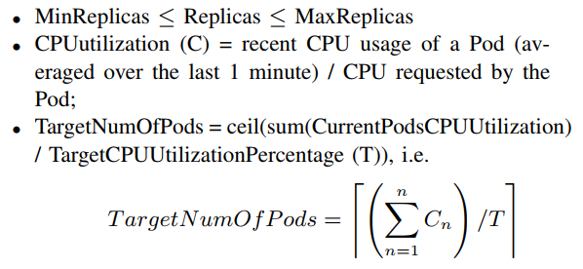
HPA auto-scaling algorithm
4) The number of Pod replicas required is checked to match the target based on:
Notes:
4.檢查需要的pod 數量是否與設定的條件符合
最少pod數量 小於等於 pod數量 大於等於 最大pod數量
Cpu使用率 = 最近的pod cpu使用數量 除以 pod所需的cpu
目標pod數量 = 現在的pod的cpu使用率總和 除以 目標的cpu使用率 最後無條件進位

Slide 54
HPA auto-scaling algorithm
5) Scale-up can only happen if there was no rescaling within the last 3 minutes to avoid temporary CPU fluctuations;
6) Scale-down will wait for 5 minutes from the last rescaling to avoid temporary CPU fluctuations, and
7) Any scaling will only be made if within 10% tolerance such
that:
avg(CurrentPodsConsumption) / TargetCPUUtilizationPercentage drops below 0.9 or increases above 1.1.
Notes:
5. 只有過去3分鐘內沒有重新scaling的情況下,才可以scaling,目的是為了避免cpu波動(cpu使用率大幅變化)
6.只有過去5分鐘內沒有重新scaling的情況下,才可以scale down,目的是為了避免cpu波動(cpu使用率大幅變化)
7.若只有10趴的誤差範圍內,可以scaling
10趴誤差: 現有所有pod的使用率取平均 除以 目標cpu使用率 結果介於0.9~1.1之間

Slide 55
RESULTS AND FINDINGS
CH6

Slide 56
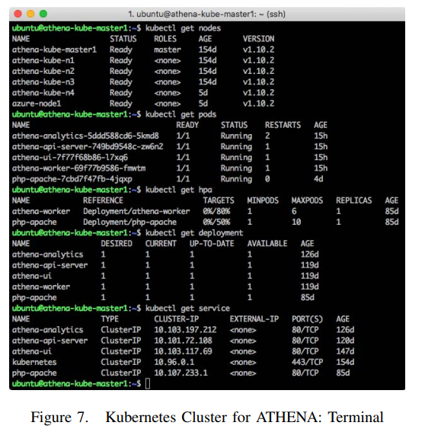
Fig 7
Notes:
圖7顯示K8s cluster執行ATHENA

Slide 57
Results and Findings
To experiment with the auto-scaling setup and benchmarking of
ATHENA, we configured the ATHENA Worker HPA to use 80%
target CPU utilisation with 1 CPU resource request for each Worker Pod instance. We set the HPA replication factor to a minimum of one Pod to a maximum of six Pods. It is noted that the Azure VM node was excluded in the ATHENA runtime benchmarking.
Figure 8 shows the ATHENA Worker runtime for a simulation
of 10, 20 and 30 years and different number of Monte Carlo
repetitions.
The integers next to lines show the maximum number
of Pods spawned by the HPA algorithm.
Notes:
為了實驗ATHENA的auto-scaling設置和跑分,作者把ATHENA worker 的HPA設置每個worker pod instance的一個cpu目標使用率為80趴,HPA的pod數量最少為1個,最多6個
需注意的是AzureVM節點不在ATHENA跑分測試中
圖8顯示ATHENA worker的執行時間,有不同時間(10 20 30年)和不同的蒙地卡羅迭代次數
圖中線條旁的數字為由HPA演算法所產生的最大pod數量

Slide 58
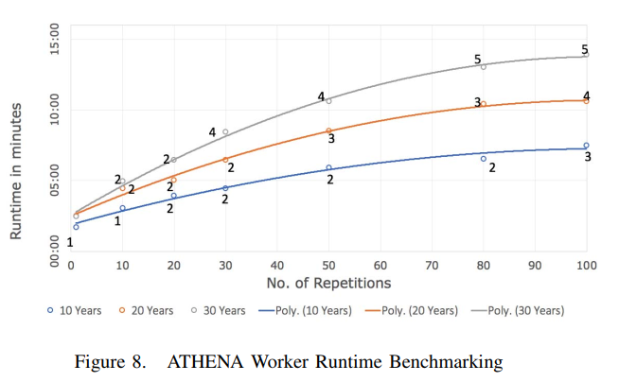
Fig 8

Slide 59
Results and Findings
The runtime chart clearly shows that as we increase the workload (i.e. the number of repetitions and the simulation span) HPA successfully spawns more compute resources (Pods).
However during the experimental runs, it was noted that the auto-scaler doesn`t react immediately to usage spikes.
By default, the metric synchronisation happens once
every 30 seconds and scaling up/down can only happen if there
was no rescaling within the last 3-5 minutes.
In this way, the HPA prevents rapid execution of conflicting decisions (oscillation)
Notes:
根據圖8的執行結果清楚顯示,增加運算負載(模擬的迭代次數),HPA成功產生更多的運算資源(pod)
然而在實驗進行時,注意到auto-scaler沒有馬上根據使用率變化去立即反應
預設情況下,觀測數值每30秒才會更新,而且過去3~5分鐘內沒有重新scaling,才會scaling up /down
就是因為如此,HPA避免與規則衝突的快速運作(震盪) (這邊要舉例一下)

Slide 60
Results and Findings
It was also found that auto-scaling based on observed CPU utilisation alone was not sufficient for ATHENA workers, due to
the dynamics of the different simulation runs, i.e. when selecting
simulation alone or simulation + optimisation algorithm. CPU
utilisation scaling works better with the optimisation algorithm
activated.
However, simulation alone with Monte Carlo jobs executes rapidly, and hence it missed the scaling observation period delay time and consequently, it missed the HPA replication trigger cycle. As a result, there was only one worker Pod instance used for the simulations.
This can be tuned accordingly to the target threshold and CPU utilisation feedback control loop, however, it is still an imperfect solution. Further refinements to the system are also possible, e.g. in addition to CPU utilisation, observing job queue metrics could be implemented for improved workload balancing.
Notes:
研究還發現，由於不同模擬的動態性，即只選擇模擬或模擬+最佳化演算法時，只有基於觀察到的CPU使用率的自動縮放對ATHENA workers來說是不夠的。 在最佳化算法啟用的情況下，CPU使用率scaling效果更好。
然而，單獨使用蒙特卡洛jobs進行模擬，執行速度很快，因此錯過了scaling觀察期延遲時間，進而錯過了HPA的觸發週期。因此，模擬中只使用了一個worker Pod instacne。
這可以根據目標threshold和CPU使用率反饋給控制迴路進行相應的調整，然而，這仍然是一個不完善的解決方案。系統的進一步完善也是可能的，例如除了CPU利用率，還可以實現觀察job queue metrics ，以改善工作負載平衡。

Slide 61
Results and Findings
Figure 9 shows a screenshot of the Grafana front-end monitoring system.
The auto-scaling dashboard was custom built with Grafana for observing the ATHENA Worker Pod replication created by the Kubernetes HPA controller .
The autoscaling dashboard is vertically split into two parts. On the right hand side, the HPA status is shown in boxes such as the number of Current Replicas and the number of Desired Replicas.
These are derived from the HPA algorithm and the minimum and maximum HPA replication factor that has been set.
The HPA Replica graph shows the discrete steps of the ATHENA Worker Pods scaling up/down during a simulation run based on demand.
Notes:
圖9顯示了Grafana前端監控系統的截圖。
auto-scaling儀表板是用Grafana定制的，用於觀察Kubernetes HPA controller創建的ATHENA Worker Pod 情況 。
auto-scaling儀表板在垂直方向上分為兩個部分。在右側，HPA狀態以方框的形式顯示，如當前pod 數量和期望pod 數量。
這些都是由HPA算法和已設置的最小和最大HPA的設定pod數量得出的。
HPA Replica 圖顯示了 ATHENA Worker Pods 在模擬運行期間根據需求scaling up/down的過程。
左側的 API CPU 圖顯示了 ATHENA API 服務器的 CPU 使用情況。 PODs CPU圖顯示了ATHENA Worker Pods的相關CPU使用情況.

Slide 62
Results and Findings
On the left hand side, the API CPU graph shows the CPU usage of the ATHENA API server. The PODs CPU graph shows the associated CPU usage of the ATHENA Worker Pods.
Since we set the minimal computation resource required for
simulation Workers to one Pod unit, there will be at least one
simulator engine running constantly, which we denote as the
primary Worker.
The primary Worker Pod`s CPU usage athena worker-69f77b9586-fmwtm is represent as the Yellow trend in
Figure 9.
Notes:
左側的 API CPU 圖顯示了 ATHENA API 服務器的 CPU 使用情況。 PODs CPU圖顯示了ATHENA Worker Pods的相關CPU使用情況.
由於我們將模擬workers所需的最小計算資源設置為一個Pod單元，因此至少會有一個模擬器引擎在不斷運行，我們將其表示為primary Worker。
在圖 9 中，主 Worker Pod`s 的 CPU 使用率以黃色趨勢表示,也就是worker-69f77b9586-fmwtm。

Slide 63
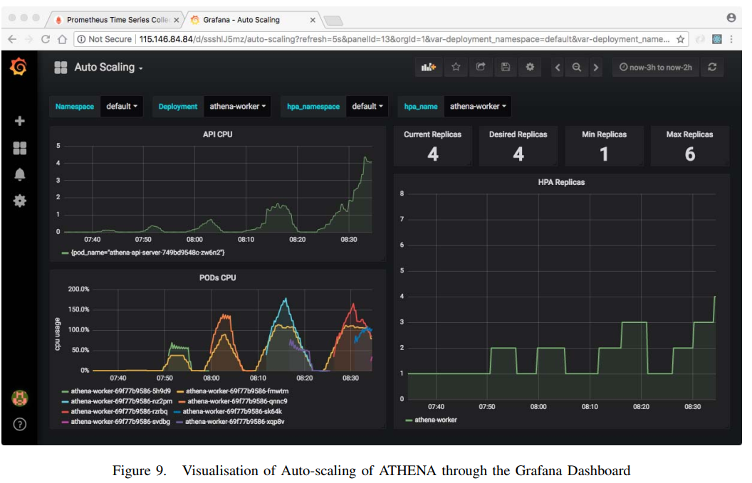
Fig 9
Notes:
圖9

Slide 64
CONCLUSIONS AND FUTURE WORK
CH7

Slide 65
Conclusions and future work
In this paper we presented an overview of the defence-oriented ATHENA system and how it was designed to exploit Docker-based scaling across the Cloud through separation and consolidation of stateless and stateful considerations.
To support auto-scaling we described the capabilities of Kubernetes and how it can be used for auto-scaling of pods.
Auto-scaling system cannot meet the user performance demands by simply relying on CPU utilisation and memory usage metrics alone.
Most web and mobile applications require auto-scaling based
on Requests Per Second to handle bursty traffic and stochastic
user load.
Notes:
這篇論文中作者介紹了ATHENA系統，以及ATHENA系統是如何透過拆解和整合stateless和stateful的情況,來達到基於Docker的scaling。
作者講述了K8s的auto-scaling能力,以及如何用pod進行auto-scaling
Auto-scaling尚無法滿足使用者的需求,只靠cpu和ram的使用率去判斷
大多數的網頁和行動裝置程式需要基於每秒需求量達到auto-scaling,以應付突發的流量和隨機的用戶負載

Slide 66
Conclusions and future work
With the new Custom Metrics API feature introduced in Kubernetes, we intend to extend the API and expose ATHENA’s
metrics to Prometheus, so that it can be consumed by the HPA
controller and auto-scaled better.
Auto-scaling can also be triggered by the ActiveMQ job queue length exceeding some empirical threshold. Threshold-based Reactive approach with Control Theory auto-scaling techniques can be explored.
The use of Kubernetes here is not unique, however the application domain and combining defence-based services with dynamic Cloud-based technologies is unique.
There are many challenges in prototyping on public clouds to meeting the robust, enterprise level services and infrastructure demands on private and often mission critical systems.
Notes:
透過Kubernetes中引入的新的自定義Metrics API功能，我們打算擴展該API，並將ATHENA的metric傳送給Prometheus，以便它可以被HPA controller處理並更好地auto-scaling
Auto-scaling也可以透過ActiveMQ job queue長度超過某個threshold來觸發。Threshold-based Reactive approach與控制理論的auto-scaling技術可以被探索。
K8s技術並非獨特，然而應用領域上並且把基於defence-based的服務與動態Cloud-based技術相結合是獨一無二的。
設計出一個基於公有雲,強大,企業級的服務和設備需求在私有雲上仍有許多挑戰

Slide 67
My opinions
1.除了硬體的使用率與瓶頸外,也可以考慮其他方面的因素(每秒的Request數量)作為scaling的條件之一
2.Docker和K8S近年來在各領域廣泛使用,未來可在docker和k8s上進一步的鑽研
3.auto-scaling的演算法還有很大的研究空間,可加入各種判斷條件或是採用技術(機器學習)。

Slide 68
Reference

Slide 69
References
[1] M. Armbrust, A. Fox, R. Griffith, A. D. Joseph, R. Katz, A. Konwinski, G. Lee, D. Patterson, A. Rabkin, I. Stoica, and M. Zaharia, “A view of cloud computing,” Commun. ACM, vol. 53, no. 4, pp. 50–58, Apr. 2010.
[2] M. J. Scheepers, “Virtualization and containerization of application infrastructure: A comparison,” in 21st Twente Student Conference on IT, vol. 1, no. 1, 2014, pp. 1–7.
[3] D. Merkel, “Docker: Lightweight linux containers for consistent development and deployment,” Linux J., vol. 2014, no. 239, 2014.
[4] M. Httermann, DevOps for Developers, ser. Expert’s voice in Web development. Apress, 2012.
[5] Z. Kozhirbayev and R. O. Sinnott, “A performance comparison of container-based technologies for the cloud,” Future Generation Comp. Syst., vol. 68, pp. 175–182, 2017.
[6] J. Che, C. Shi, Y. Yu, and W. Lin, “A synthetical performance evaluation of openvz, xen and kvm,” in 2010 IEEE Asia-Pacific Services Computing Conference, Dec 2010, pp. 587–594.
[7] R. O. Sinnott and W. Voorsluys, “A scalable cloud-based system for data-intensive spatial analysis,” Int. J. Softw. Tools Technol. Transf., vol. 18, no. 6, pp. 587–605, Nov. 2016
[8] J. O. Kephart and D. M. Chess, “The vision of autonomic computing,” Computer, vol. 36, no. 1, pp. 41–50, Jan 2003.
[9] C. Qu, R. N. Calheiros, and R. Buyya, “Auto-scaling web applications in clouds: A taxonomy and survey,” CoRR, vol. abs/1609.09224, 2016.

Slide 70
References
[10] L. Thai, B. Varghese, and A. Barker, “A survey and taxonomy of resource optimisation for executing bag-of-task applications on public clouds,” CoRR, vol. abs/1711.08973, 2017.
[11] A. N. Toosi, R. O. Sinnott, and R. Buyya, “Resource provisioning for data-intensive applications with deadline constraints on hybrid clouds using aneka,” Future Generation Comp. Syst., vol. 79, pp. 765–775, 2018.
[12] T. Lorido-Botran, J. Miguel-Alonso, and J. A. Lozano, “A review of auto-scaling techniques for elastic applications in cloud environments,” J. Grid Comput., vol. 12, no. 4, pp. 559–592, 2014.
[13] T. M. Truong, A. Harwood, and R. O. Sinnott, “Predicting the stability of large-scale distributed stream processing systems on the cloud,” in Proceedings of the 7th International Conference on Cloud Computing and Services Science - Volume 1: CLOSER,, INSTICC. SciTePress, 2017, pp. 603–610.
[14] H. Arabnejad, C. Pahl, P. Jamshidi, and G. Estrada, “A comparison of reinforcement learning techniques for fuzzy cloud autoscaling,” in Proceedings of the 17th IEEE/ACM International Symposium on Cluster, Cloud and Grid Computing, ser. CCGrid ’17. Piscataway, NJ, USA: IEEE Press, 2017, pp. 64–73.
[15] J. Nickoloff. (2016, Nov) Evaluating container platforms at scale. Retrieved from Medium, June 2018. [Online]. Available: https://medium.com/on-docker/ evaluating-container-platforms-at-scale-5e7b44d93f2c
[16] B. Quetier, V. Neri, and F. Cappello, “Scalability comparison of four host virtualization tools,” Journal of Grid Computing, vol. 5, no. 1, pp. 83–98, Apr. 2007.

Slide 71
References
[17] R. Morabito, J. Kjllman, and M. Komu, “Hypervisors vs. lightweight virtualization: A performance comparison,” in 2015 IEEE International Conference on Cloud Engineering, March 2015, pp. 386–393.
[18] W. Felter, A. Ferreira, R. Rajamony, and J. Rubio, “An updated performance comparison of virtual machines and linux containers,” in 2015 IEEE International Symposium on Performance Analysis of Systems and Software (ISPASS), 2015, pp. 171–172.
[19] M. G. Xavier, M. V. Neves, F. D. Rossi, T. C. Ferreto, T. Lange, and C. A. F. D. Rose, “Performance evaluation of container-based virtualization for high performance computing environments,” in 2013 21st Euromicro International Conference on Parallel, Distributed, and Network-Based Processing, 2013, pp. 233–240.
[20] M. G. Xavier, I. C. D. Oliveira, F. D. Rossi, R. D. D. Passos, K. J. Matteussi, and C. A. F. D. Rose, “A performance isolation analysis of disk-intensive workloads on container-based clouds,” in 2015 23rd Euromicro International Conference on Parallel, Distributed, and Network-Based Processing, March 2015, pp. 253–260.
[21] V. Nguyen, M. Shokr, A. Novak, and T. Caelli, “A reconfigurable agent-based discrete event simulator for helicopter aircrew training,” in Proceedings of the 2016 ISMOR Conference, 2016
[22] V. Nguyen, A. Novak, M. Shokr, and K. Pash, “Aircrew manpower supply modeling under change: An agent-based discrete event simulation approach,” in 2017 Winter Simulation Conference (WSC), Dec 2017, pp. 4070–4081.
[23] B. Burns, B. Grant, D. Oppenheimer, E. Brewer, and J. Wilkes, “Borg, omega, and kubernetes,” Queue, vol. 14, no. 1, pp. 10:70– 10:93, Jan. 2016.
[24] K. Developers. (2018) Kubernetes documentation. V1.10, Access June 2018. [Online]. Available: https://kubernetes.io/docs/

