Slide 1
(2014)Software-Defined Networking State of the Art and Research Challenges
Manar Jammal, Taranpreet Singh, Abdallah Shami, Rasool Asal, and Yiming Li
Department of Electrical and Computer Engineering, Western University, Canada
Submitted for review and possible publication in Elsevier’s Journal of Computer Networks
Impact factor: X

Slide 2
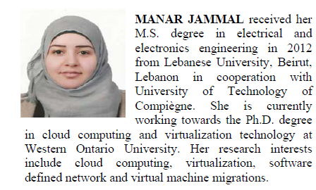
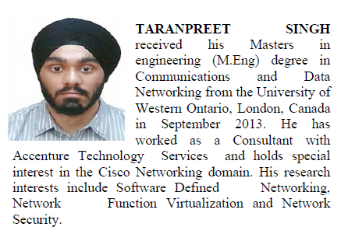
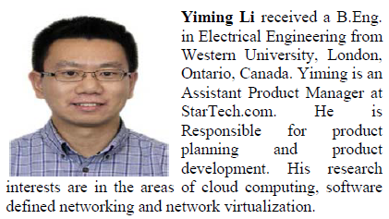

Slide 3
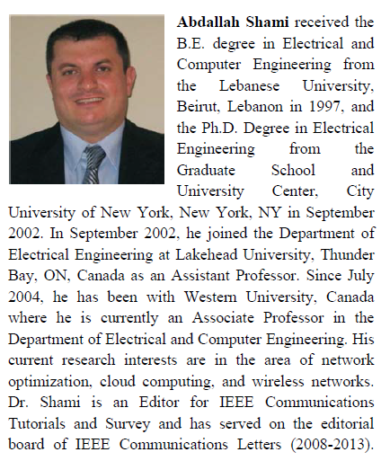
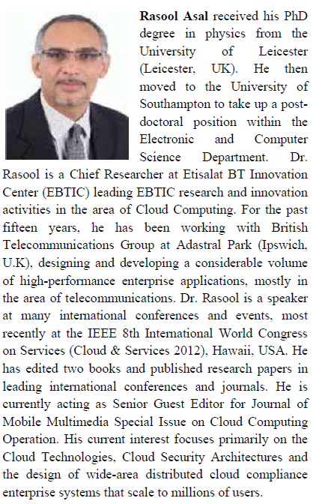

Slide 4
Outline
Abstract
Introduction
SDN/OpenFlow
NFV
SDN Challenges And Existing Solutions

Slide 5
Abstract
With the advent of cloud computing, many ecosystem and business paradigms are encountering potential changes and may be able to eliminate their IT infrastructure maintenance processes.
Real-time performance and high availability requirements have induced telecom networks to adopt the new concepts of the cloud model: software-defined networking (SDN) and network function virtualization (NFV).

Slide 6
In this paper, our aim is to describe the benefits of using SDN in a multitude of environments such as in data centers, data center networks, and Network as Service offerings.
We also present the various challenges facing SDN, from scalability to reliability and security concerns, and discuss existing solutions to these challenges.

Slide 7
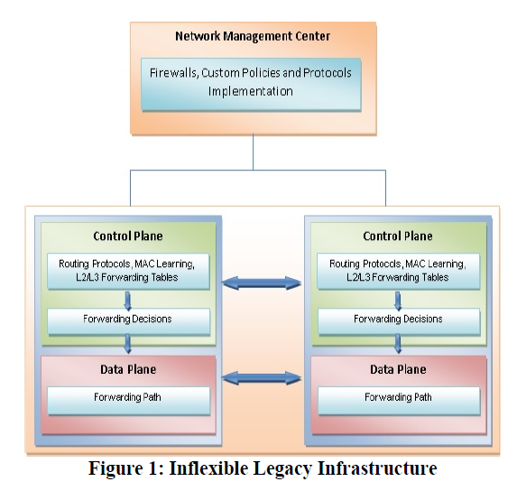
Introduction
The problems of legacy network
  the data paths and the decision-making processes for switching or routing are collocated on the same device.
  difficult to automate.
  increase management complexity.

Slide 8
Operators require a network that is efficient, flexible, agile, and scalable.
Software-defined networking (SDN) and virtualization are poised to be the solutions that overcome the challenges.
SDN operates on an aggregated and centralized control plane that might be a promising solution for network management and control problems.
  separate the forwarding/data plane from the control plane while providing programmability on the control plane.
  The centralized control of the entire network makes the network highly flexible [8, 9].

Slide 9
SDN Architecture
Control Plane
  an abstract view of the complete network infrastructure, enabling the administrator to apply custom policies/protocols across the network hardware.
  NOX controller is the most widely deployed controller.
  Northbound Protocols
East-West Protocols
Data Plane and Southbound Protocols
  The most popular southbound protocol is the OpenFlow protocol.

Slide 10
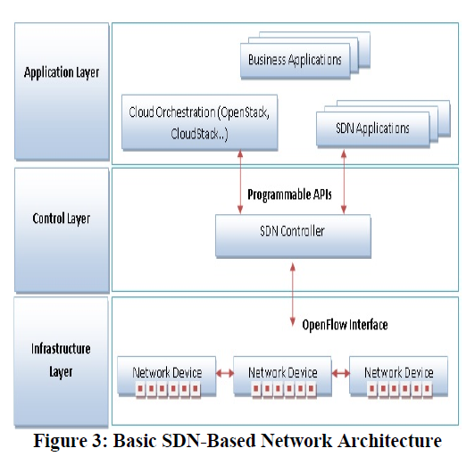
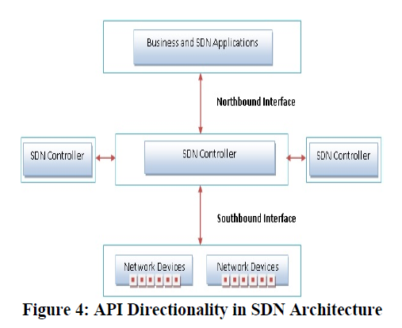

Slide 11
SDN Benefits
Programmability of the Network
  SDN simplifies network management and brings virtualization to the network.
  network administrators no longer need to implement custom policies and protocols on each device in the network separately.
The Rise of Virtualization
  SDN is a promising opportunity for managing hyper-scale data centers (DCs).
  Network virtualization, which can be seen as an SDN application, offers a prominent opportunity for hyper-scale data centers.

Slide 12
  Device Configuration and Troubleshooting
  device configuration and troubleshooting can be done from a single point on the network.
  SDN also provides the capability to encourage innovation in the networking field by offering a programmable platform for experiments on novel protocols and policies using production traffic.

Slide 13
Open Flow Definition
It is the first standard interface defined to facilitate interaction between the control and data planes of the SDN architecture.
OpenFlow provides software-based access to the flow tables that instruct switches and routers how to direct network traffic.
OpenFlow protocol provides a basic set of management tools which can be used to control features such as topology changes and packet filtering.

Slide 14
OpenFlow-compliant switches come in two main types: OpenFlow-only and OpenFlow-hybrid.
OpenFlow-only switches support only OpenFlow operations, i.e., all packets are processed by the OpenFlow pipeline.
OpenFlow-hybrid switches support both OpenFlow operations and normal Ethernet switching operations, i.e., traditional L2 and L3 switching and routing.

Slide 15
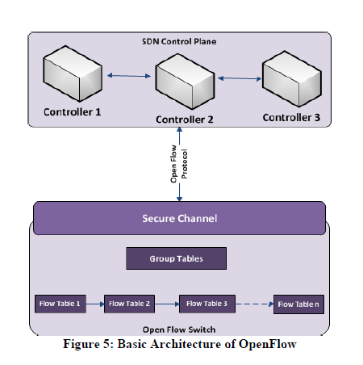
OpenFlow Architecture

Slide 16
Defining a Flow
  Network traffic can be partitioned into flows, where a flow could be a transmission control protocol (TCP) connection.
OpenFlow Switch
  An OpenFlow switch consists of one or more flow tables and a group table.
  It performs packet look-ups and forwarding.
OpenFlow Channel
  The interface that connects each OpenFlow switch to a controller.
  The OpenFlow protocol supports three message types, all of which are sent over a secure channel.

Slide 17
  These messages can be categorized as controller-to-switch, asynchronous, and symmetric.
  The OpenFlow channel is usually encrypted using transport layer security (TLS), but can also operate directly over TCP[11].
OpenFlow Controller
  The OpenFlow controller is responsible for determining how to handle packets without valid flow entries.
  It manages the switch flow table by adding and removing flow entries over the secure channel using the OpenFlow protocol.
  SDN controllers can be implemented in the following three structures [12]: Centralized structure、Distributed structure、Multi-layer structure.
Notes:
Asynchronous->switch傳給controller 像是packet-in flow removed
Symmetric ->不帶有請求意味的訊息 像是hello

Slide 18
Flow & Group Tables
Each entry in the flow table has three fields [11]:
  Header(VLAN ID, source and destination ports, IP address, and Ethernet source and destination)
  Action
  Statistics(counters)

Slide 19
Network Virtualization
The value of SDN in the enterprise lies specifically in its ability to provide network virtualization and automated configuration across the entire network fabric, enabling rapid deployment of new services and end systems in addition to minimizing operating cost[13][14].
Network virtualization decouples and isolates virtual networks from the underlying network hardware.

Slide 20
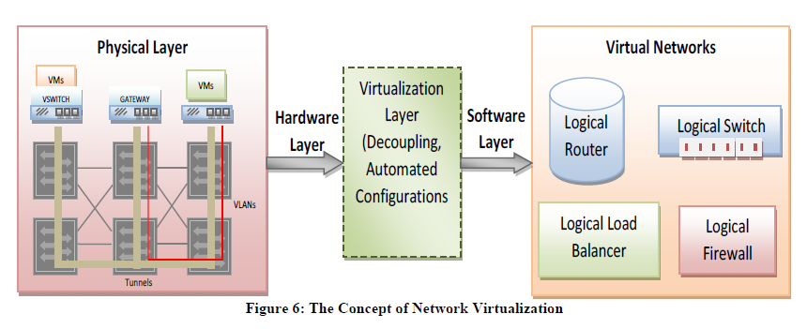

Slide 21
The isolated networks share the same physical infrastructure.
Once virtualized, the underlying physical network is used only for packet forwarding.
To achieve virtualization at the network level, a network virtualization platform (NVP) is needed to transform the physical network components into a generalized pool of network capacity.

Slide 22
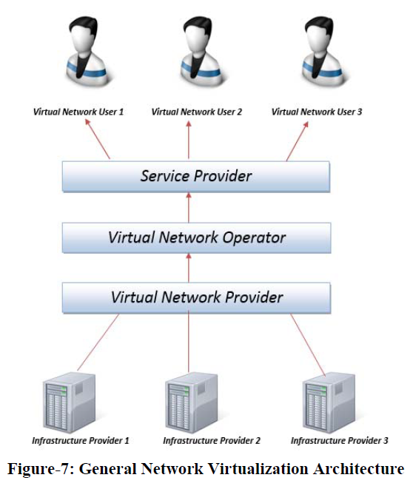
Network Virtualization Architecture
Notes:
InP: 負責維護底下實體網路設施
VNP: 跟底下要資源及組合virtual network
VNO: 評估/管理/決定授權 VNP給的virtual network

Slide 23
Infrastructure Provider (InP):
  maintaining the underlying physical equipment.
Virtual Network Provider (VNP)
  requesting virtual resources and assembling the virtual network for a virtual network operator (VNO).
Virtual Network Operator (VNO)
  assess the network requirements for the VNP to assemble the virtual resources.
  managing and granting access to virtual networks.

Slide 24
Service Provider
  use virtual network resources and services to tailor specialized services for end users.
Virtual Network User/End User

Slide 25
Benefits of Network Virtualization
Co-existence of Dissimilar Networks
  create multiple virtual networks on the same physical hardware.
Encouraging Network Innovation
  The isolation that can exist between two virtual networks can be used to create separate domains for production traffic and test traffic.
Provisioning of Independent and Diverse Networks
  NV deploys packet handling, quality of service (QoS) and security policies to configure network operations and behaviors. This configuration allows the categorization of different networks based on their services, users and applications.

Slide 26
Deployment of agile network capabilities
  NV allows the integration between legacy and advanced networks.
Resource Optimization
  The dynamic mapping of multiple virtual network nodes to the physical substrate ensures that the network hardware is utilized up to capacity.
Deployment of Distinct Network Services
  deploying such services in separate virtual networks.
Notes:
敏捷軟體開發主張適度的計畫、進化開發、提前交付與持續改進，並且鼓勵快速與靈活的面對開發與變更。這些原則支援許多軟體開發方法的定義和持續進化。

Slide 27
Network Function Virtualization
NFV reduces capital expenditures (CAPEX) and operating expenditures (OPEX) by minimizing the purchase of dedicated hardware appliances.
Virtualization of network functions enables fast scale-up or scale-down of various network services and provides agile delivery of these services using a software application running on commercial off-the-shelf(COTS) servers.

Slide 28
NFV and NV
NF can be viewed as a tunnel connecting any two domains in a network. Therefore, it eliminates the physical wiring for each domain connection and replaces it with a virtualized infrastructure.
NFV deploys services on it(tunnel). NFV virtualizes the functions from layer 4 (L4) till layer 7 (L7) such as load balancing and firewalls.

Slide 29
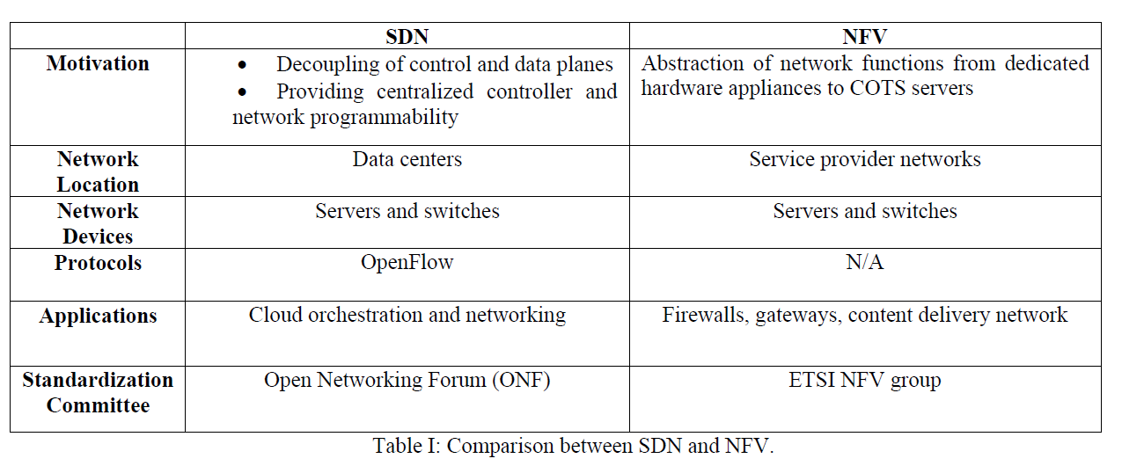
NFV and SDN
SDN and NFV are complementary technologies; they do not depend on each other.

Slide 30
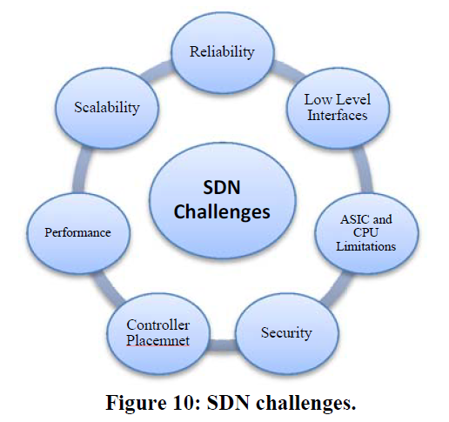
SDN Challenges And Existing Solutions

Slide 31
1. Reliability
In centralized controller architecture (SDN) and in the absence of a stand-by controller, only one central controller is in charge of the whole network.
  single point of failure.
In case of path/link failure, the SDN controller should have the ability to support multiple-path solutions or fast traffic rerouting into active links.
If the controller supports technologies such as Virtual Router Redundancy Protocol (VRRP) and Multi-Chassis Link Aggregation Group (MC-LAG), these might contribute to increasing network availability.
Notes:
VRRP: 虛擬路由器備援協定

Slide 32
In case of controller failure, it is important that the controller can enable clustering of two or more SDN controllers in an active stand-by mode;
  memory synchronization[46].
Solutions: [23]

Slide 33
2. Scalability
The complexity of defining standard APIs between both planes, scalability limitations may arise.
Voellmy et al. [50] concluded that “when the network scales up in the number of switches and the number of end hosts, the SDN controller can become a key bottleneck”.
In addition to controller overload, the flow-setup process may impose limitations on network scalability.
  A packet arrives at a switch and does not match any flow entry.
  The switch sends a request to the controller to get instructions on how to forward the packet.

Slide 34
  The controller sends a new flow entry with new forwarding rules back to the switch.
  The switch updates its entries in the flow table.
Flow-setup delays may pose a challenge to network scalability.
Solutions: [34][35][54-58][50]

Slide 35
3. Performance under Latency Constraints
Flow-setup time, and the number of flows per second that the controller can handle [46].
There are two ways to setup a flow: proactive and reactive.
  This mode(proactive) has negligible delay.
  Reactive flow-setup time is the sum of the processing time in the controller and the time for updating the switch as the flow changes.[59][60]
Solutions:
  I/O batching [60]
  Two basic parameter: input batching threshold(IBT) & pending raw-packet threshold(PRT)[65][66]
  [50]
Notes:
Batching -> 分批處理
IBT-> 用於要創建flow時，處理多少封包的threshold
PRT-> 用於在queue上，允許處理多少封包的封包數

Slide 36
4. Controlling the Data Path between the ASIC and the CPU
OpenFlow counters and the logic to support them add significant ASIC complexity and area and place more burdens on the CPU [63, 67, 68].
As is well known, switches have a CPU to manage the ASICs, but the bandwidth between the two is limited [67]. Therefore, storing the counters in the CPU and DRAM instead of in the ASIC would simplify the path from the counters to the controller and minimize the overhead on the controller to access these counters.
Solutions: [67]

Slide 37
5. Use of Low-Level Interfaces between the Controller and the Network Device
Although SDN simplifies network management by developing control applications with simple interfaces to determine high-level network policies, the underlying SDN framework needs to translate these policies into low-level switch configurations[69].
[71] proposes FML, a high-level programming language consisting of operators that allow or deny flows while coordinating the flows through firewalls and maintaining QoS.
Solutions: [70][71]

Slide 38
6. Controller Placement Problem
The controller placement problem influences every aspect of a decoupled control plane, from flow-setup latencies to network reliability, to fault tolerance, and finally to performance metrics.
Solutions: [74][75][73]

Slide 39
7. Security
SDN security risks emerge from the absence of integration with existing security technologies and the inability to poke around every packet.
Increasing SDN security requires from the controller the ability to support the authentication and authorization classes of the network’s administrators.
Additional security-aware solutions are the implementation of an intelligent access control list (ACL) in the controller to filter packets and complete isolation between the tenants sharing the infrastructure.

Slide 40
The controller should be able to alert the administrators in case of any sudden attack and to limit control communication during an attack [46].
Notes:
當有attack發生，controller應告知管理者

Slide 41
心得
Survey論文不適合報告。
從蠻多方面去思考會帶來的問題，可以提供要寫論文的人，找到自己寫解決的問題，及提供了一些論文的解決方法，可以針對自己想要處理的問題去研讀那些論文。

Slide 42
References
[1] Anderson, T., Peterson, L., Shenker, S., Turner, J., "Overcoming the Internet Impasse through Virtualization." Computer, vol. 38, no. 4: 34–41, 2005.
[2] HP, "Deliver HP Virtual Application Networks,“ http://h17007.www1.hp.com/docs/interopny/4AA4-3872ENW.pdf,2012.
[3] HP, "Realizing the Power of SDN with HP Virtual Application Networks,“ http://h17007.www1.hp.com/docs/interopny/4AA4-3871ENW.pdf, 2012.
[4] Brocade Communications Systems, “Network Transformation with Software-Defined Networking and Ethernet Fabrics,” California, USA,http://www.brocade.com/downloads/documents/positioningpapers/network-transformation-sdn-wp.pdf, 2012.
[5] Xia, W.F., Foh, C.H., Xie, H.Y., Niyato, D., Wen, Y.G., "A Survey on Software-Defined Networking," (In Submission) IEEE Journal of Communications Surveys and Tutorials, May 2013.
[6] Mendonça, M.,Nunes Astuto, B., Nguyen, X.N., Obraczka, K., Turletti,T., "A Survey of Software-Defined Networking: Past, Present, and Future of Programmable Networks," (In Submission) Networking and Telecommunication, HAL, INRIA, June 2013.
[7] Duan, Q., Yan, Y.H., Vasilakos, A.V., "A Survey on Service-Oriented Network Virtualization toward Convergence of Networking and Cloud Computing," IEEE Transactions on Network and Service Management,vol.9, no.4, pp.373–392, December 2012.
[8] Big Switch Networks, The Open SDN Architecture,http://www.bigswitch.com/sites/default/files/sdn_overview.pdf, 2012.
[9] Shin, M.K., Ki-Hyuk Nam, K.H., Kim, H.J., "Software-Defined Networking (SDN): A Reference Architecture and Open APIs,“ Proceedings, 2012 International Conference on ICT Convergence (ICTC), pp.360–361, 15–17 October 2012.
[10] IBM, Software-Defined Networking: A New Paradigm for Virtual,Dynamic, Flexible Networking, October 2012.
[11] OpenFlow Switch Consortium, OpenFlow Spec, v1.3.0 https://www.opennetworking.org/images/stories/downloads/sdnresources/onf-specifications/openflow/openflow-spec-v1.3.0.pdf, 2012.
[12] Ferro, G., "OpenFlow and Software-Defined Networking,"http://etherealmind.com/software-defined-networking-openflow-so-farand-so-future/, Nov. 2012

Slide 43
[13] NICIRA, "It’s Time to Virtualize the Network,“ http://www.netfos.com.tw/PDF/Nicira/It%20is%20Time%20To%20Virtualize%20the%20Network%20White%20Paper.pdf, 2012.
[14] Lippis, N. J., "Network Virtualization: The New Building Blocks of Network Design,“ https://www.cisco.com/en/US/solutions/collateral/ns340/ns517/ns431/ns725/net_implementation_white_paper0900aecd80707cb6.pdf, 2007.
[15] Wen; Heming, Tiwary; Prabhat Kumar, Le-Ngoc; Tho, “Network Virtualization: Overview,” Wireless Virtualization, Springer Briefs, pp.5-10, Google Books Web, 2013
[16] Carapinha, J., Feil, P., Weissmann, P., Thorsteinsson, S., Etemoglu, Ç. Ingþórsson, Ó., Çiftçi, S., Melo, M., "Network Virtualization: Opportunities and Challenges for Operators," Future Internet-FIS 2010: 138–147, 2012.
[17] Khan, A., Zugenmaier, A., Jurca, D., Kellerer, W., "Network Virtualization: a Hypervisor for the Internet?" IEEE Communications Magazine, vol.50, no.1, pp.136–143, January 2012.
[18] Leon-Garcia, A., Mason, L.G., “Virtual Network Resource Management for Next-Generation Networks,” IEEE Commun. Mag., vol. 41, no. 7, pp.102–109, July 2003.
[19] Network Virtualization Study Group, “Advanced Network Virtualization: Definition, Benefits, Applications, and Technical Challenges,” https://nvlab.nakao-lab.org/nv-study-group-whitepaper.v1.0.pdf, 2012.
[20] Oltsik, J., Laliberte, B., IBM and NEC Bring SDN/OpenFlow to Enterprise Data Center Networks, Enterprise Strategy Group Tech Brief, 2012.
[21] Murphy, A., Keeping Your Head Above the Cloud: Seven Data Center Challenges to Consider Before Going Virtual, F5 Networks, U.S.A., 2008.
[22] Vello Systems, “Optimizing Cloud Infrastructure with Software-Defined Networking,”http://www.margallacomm.com/downloads/VSI_11Q4_OPN_GA_WP_01_1012_Booklet.pdf, 2012.
[23] Macapuna, C.A.B., Rothenberg, C.E., Magalhaes, M.F., "In-Packet Bloom Filter-Based Data-Center Networking with Distributed OpenFlow Controllers, "IEEE 2010GLOBECOM Workshops, pp.584–588, 6–10 December 2010.
[24] Thanh, N.H.,Nam, P.N.,Truong, T.-H.,Hung, N.T.,Doanh, L.K., Pries, R., "Enabling Experiments for Energy-Efficient Data-Center Networks on an OpenFlow-Based Platform,"Proceedings,2012 Fourth International Conference on Communications and Electronics (ICCE),pp.239–244, 1–3 August 2012.

Slide 44
[25] Stanford University, “Mininet: Rapid Prototyping for Software-Defined Networks,”http://yuba.stanford.edu/foswiki/bin/view/OpenFlow/Mininet, 2012.
[26] Vu, T.H.,Nam, P.N.,Thanh, T.,Hung, L.T.,Van, L.A.,Linh, N.D.,Thien,T.D.,Thanh, N.H., "Power-Aware OpenFlow Switch Extension for Energy Saving in Data Centers, "Proceedings, 2012 International Conference on Advanced Technologies for Communications (ATC), ,pp.309–313, 10–12 October 2012.
[27] Baker, C., Anjum, A., Hill, R., Bessis, N., Kiani, S.L., "Improving Cloud Datacenter Scalability, Agility and Performance Using OpenFlow,"Proceedings,2012 Fourth International Conference on Intelligent Networking and Collaborative Systems (INCoS), pp.20–27, 19–21 September 2012.
[28] Fang, S.,Yu, Y., Foh, C.H., Aung, K.M.M., "A Loss-Free Multipathing Solution for Data Center Network Using Software-Defined Networking Approach," IEEE Transactions on Magnetics, vol.49, no.6, pp.2723–2730, June 2013.
[29] Yu, Y.,Aung, K.M.M., Tong, E.K.K., Foh, C.H., "Dynamic Load Balancing Multipathing for Converged Enhanced Ethernet," 2010 IEEE International Symposium on Modeling, Analysis, and Simulation of Computer and Telecommunication Systems (MASCOTS), pp.403–406,17–19 August 2010.
[30] Sun, L., Suzuki, K., Yasunobu, C., Hatano, Y., Shimonishi, H., "A Network Management Solution Based on OpenFlow Towards New Challenges of Multitenant Data Centers,"Proceedings,2012 Ninth Asia-Pacific Symposium on Information and Telecommunication Technologies (APSITT), pp.1–6, 5–9 November 2012.
[31] Kanagavelu, R., Mingjie, L.N., Khin, M.M., Lee, F.B.-S., Heryandi, H.,"OpenFlow-Based Control for Re-Routing with Differentiated Flows in Data Center Networks,"Proceedings,2012 18th IEEE International Conference on Networks (ICON), pp.228–233, 12–14 December 2012.
[32] Pries, R., Jarschel, M., Goll, S., "On the Usability of OpenFlow in Data Center Environments,"Proceedings,2012 IEEE International Conference on Communications (ICC), pp.5533–5537, 10–15 June 2012.
[33] Kannan, K., Banerjee, S., "Scissors: Dealing with Header Redundancies in Data centers through SDN, "Proceedings, 2012 Eighth International Conference and 2012 Workshop on Systems Virtualization Management (SVM), Network and Service Management (CNSM), pp.295–301, 22–26 October 2012.
[34] Boughzala, B., Ben Ali, R., Lemay, M., Lemieux, Y., Cherkaoui, O., "OpenFlow Supporting Inter-Domain Virtual Machine Migration,"Proceedings,2011 Eighth International Conference on Wireless and Optical Communications Networks (WOCN), pp.1–7, 24–26 May 2011.

Slide 45
[35] Mann, V., Vishnoi, A., Kannan, K., Kalyanaraman, S., "CrossRoads:Seamless VM Mobility across Data Centers through Software-Defined Networking,"2012 IEEE Network Operations and Management Symposium (NOMS), pp.88–96, 16–20 April 2012.
[36] Santhi; Ram Kumar, “A Service Based Approach for Future Internet Architectures,” PhD Thesis University of Agder, 2010, Web, Feb. 2011
[37] Costa, P., Migliavacca, M., Pietzuch, P., Wolf, A., "NaaS: Network-asa-Service in the Cloud," 2012 USENIX: Management of Internet, Cloud,and Enterprise Networks and Services (Hot-ICE'12), San Jose CA,,April 2012.
[38] Feng, T.,Bi, J.,Hu, H.Y.,Cao, H., "Networking as a Service: A Cloud-Based Network Architecture." Journal of Networks, vol.6, no.7,pp.1084–1090, July 2011.
[39] Gutierrez, M.A.F., Ventura, N., "Mobile Cloud Computing Based on Service-Oriented Architecture: Embracing Network as a Service for Third-Party Application Service Providers," Proceedings, ITU Kaleidoscope 2011: The Fully Networked Human—Innovations for Future Networks and Services (K-2011), pp.1–7, 12–14 December 2011.
[40] TERENA Network Architects Workshop, Network as a Service principle virtual CPE as a Service, http://www.terena.org/activities/netarch/ws1/slides/reijs-NaaS-221112-NAW.pdf, November 2012.
[41] Benson, T., Shaikh, A.A.A., Sahu, S., "CloudNaaS: A Cloud Networking Platform for Enterprise Applications," Proceedings, Second ACM Symposium on Cloud Computing (SOCC '11),New York, NY,2011.
[42] Costa, P., "Bridging the Gap between Applications and Networks in Data Centers," ACM SIGOPS Operating Systems Review,vol.47,no. 1, pp.3–8, January 2013.
[43] Raghavendra, R., Lobo, J.,Lee, K.-W., "Dynamic Graph Query Primitives for SDN-Based Cloud Network Management," Proceedings, First Workshop on Hot Topics in Software-Defined Networks(HotSDN'12), New York, NY, pp.97–102, 2012.
[44] Khan, F., Naas as Step towards SDN, http://www.telecomlighthouse.com/naas-as-step-towards-sdn/,March 2013.
[45] Sharkh, M.A.; Jammal, M.; Shami, A.; Ouda, A., "Resource allocation in a network-based cloud computing environment: design challenges,"Communications Magazine, IEEE , vol.51, no.11, pp.46,52, November 2013.
[46] Ashton, Metzler, and Associates, Ten Things to Look for in an SDN Controller, Technical Report, 2013.
[47] Ferro, G., OpenFlow and Software-Defined Networking,http://etherealmind.com/software-defined-networking-openflow-so-farand-so-future/, November 2012.

Slide 46
[48] Yazıcı, V.,Sunay, O., Ercan, A.O., “Controlling a Software-Defined Network via Distributed Controllers”, NEM Summit, Istanbul, Turkey,http://faculty.ozyegin.edu.tr/aliercan/files/2012/10/YaziciNEM12.pdf,October 2012.
[49] Yeganeh, S.H., Tootoonchian, A., Ganjali, Y., "On Scalability of Software-Defined Networking," IEEE Communications Magazine, vol.51, no.2, pp.136–141, February 2013.
[50] Voellmy, A.,Wang, J.C., "Scalable Software-Defined Network Controllers," Proceedings, ACM SIGCOMM 2012 Conference on Applications, Technologies, Architectures, and Protocols for Computer Communication, pp. 289–290, 2012.
[51] Tavakoli, A., Casado, M.,Koponen, T.,Shenker, S., "Applying NOX to the Data Center," Proceedings, Ninth ACM SIGCOMM Workshop on Topics in Networks (Hotnets-IX), October 2009.
[52] Enterasys Networks, “Software-Defined Networking (SDNs) in the Enterprise”,http://www.enterasys.com/company/literature/SDN_tsbrief.pdf, October 2012.
[53] Bae, H., “SDN Promises Revolutionary Benefits, but Watch Out for the Traffic Visibility Challenge,”http://www.networkworld.com/news/tech/2013/010413-sdn-trafficvisibility-265515.html,January 2013.
[54] Yu, M.L., Rexford, J.,Freedman, M.J.,Wang, J., "Scalable Flow-Based Networking with DIFANE," Proceedings, ACM SIGCOMM 2010 Conference (SIGCOMM '10), New York NY, pp. 351–362, 2010.
[55] Kim, H.J., Santos, J.R., Turner, Y., Schlansker, M., Tourrilhes, J., Feamster, N., "CORONET: Fault Tolerance for Software-Defined Networks,"Proceedings,2012 20th IEEE International Conference on Network Protocols (ICNP), pp.1–2, October 30–November 2, 2012.
[56] Curtis, A., Mogul, J.,et al., "DevoFlow: Scaling Flow Management for High-Performance Networks," Proceedings, ACM SIGCOMM 2011 Conference (SIGCOMM '11), New York NY,pp.254–265, 2011.
[57] Mogul, J.C., Tourrilhes, J.,et al., "DevoFlow: Cost-Effective Flow Management for High-Performance Enterprise Networks," Proceedings, Ninth ACM SIGCOMM Workshop on Hot Topics in Networks(Hotnets-IX),New York, NY, 2010.
[58] Voellmy, A., Hudak, P., “Nettle: Functional Reactive Programming of OpenFlow Networks,” Practical Aspects of Declarative Languages (PADL) Symposium, January 2011.
[59] Rexford, J., “Software-Defined Networking”, COS 461: Computer Networks Lecture, http://www.cs.princeton.edu/courses/archive/spring12/cos461/docs/lec24-sdn.pdf, 2012.
[60] Tootoonchian, A., Gorbunov, S.,et al., "On Controller Performance in Software-Defined Networks," Proceedings,2nd USENIX Conference on Hot Topics in Management of Internet, Cloud, and Enterprise Networks and Services, p. 10, 2012.

Slide 47
[61] Chu, J.,Malik, M.S.,Software-Defined Networks. http://www.cs.illinois.edu/~pbg/courses/cs538fa11/lectures/25-Jonathan-Salman.pdf,September 2012.
[62] Lantz, B., Heller, B., McKeown, N., "A Network in a Laptop: Rapid Prototyping for Software-Defined Networks," Proceedings, Ninth ACM SIGCOMM Workshop on Hot Topics in Networks, New York, NY,2010.
[63] Foster, N., Freedman, M.,et al., “Language Abstractions for Software-Defined Networks (LADA),” Philadelphia, PA, January 2012.
[64] Pluribus Networks, “Of Controllers and Why NICIRAHad to Do a Deal (Part III: SDN and OpenFlow Enabling Network Virtualization in the Cloud),” https://www.pluribusnetworks.com/blog/item/5-of-controllersand-why-nicira-had-to-do-a-deal-part-iii-sdn-and-openflow-enablingnetwork-virtualization-in-thecloudhttp://pluribusnetworks.com/blog/,August 2012.
[65] Cai, Z.,Cox, A.L.,Ng, T.S.E., Maestro: A System for Scalable OpenFlow Control, Rice University Technical Report TR10-08, December 2010.
[66] Cai, Z.,Cox, A.L.,Ng, T.S.E., Maestro: Balancing Fairness, Latency,and Throughput in the OpenFlow Control Plane, Rice University Technical Report TR11-07, December 2011.
[67] Mogul, J.C., Congdon, P., "Hey, You Darned Counters! Get Off my ASIC!" First Workshop on Hot Topics in Software-Defined Networks,pp. 25–30, 2012.
[68] Wolf, W., "A Decade of Hardware/Software Codesign," Computer, vol.36, no.4, pp.38–43, April 2003.
[69] Scott, R.C.,Wundsam, A., et al., What, Where, and When: Software Fault Localization for SDN, Technical Report No. UCB/EECS-2012-178, July 2012.
[70] Katta, N.P.,Rexford, J.,Walker, D., “Logic Programming for Software-Defined Networks,”http://www.cs.princeton.edu/~jrex/papers/xldi12.pdf,July 2012.
[71] Hinrichs, T.L.,Gude, N.S., Casado, M., Mitchell, J.C.,Shenker, S.,“Practical Declarative Network Management,” First ACM Workshop on Research in Enterprise Networking (WREN '09), pp.1–10, 2009.
[72] Foster, N.,Harrison, R., et al., "Frenetic: A Network Programming Language,” Proceedings, 16th ACM SIGPLAN International Conference on Functional Programming (ICFP '11), New York, NY, pp.279–291,2011.

Slide 48
[73] Heller, B., Sherwood, R., McKeown, N., "The Controller Placement Problem,” First Workshop on Hot Topics in Software-Defined Networks,pp. 7–12, 2012.
[74] Hu, Y.-N.,Wang,W.-D.,et al., “On the Placement of Controllers in Software-Defined Networks,” http://www.sciencedirect.com/science/article/pii/S100588851160438X,October 2012.
[75] Beheshti, N.,Zhang, Y., “Fast Failover for Control Traffic in Software-Defined Networks,” Next-Generation Networking and Internet Symposium(Globecom), Ericsson Research, 2012.
[76] Metzler, J., "Understanding Software-Defined Networks,“ InformationWeek Reports, pp.1–25,http://reports.informationweek.com/abstract/6/9044/Data-Center/research-understanding-software-defined-networks.html, October 2012.
[77] Marsan, C.D., “IAB Panel Debates Management Benefits, Security Challenges of Software-Defined Networking,” IETF Journal, October 2012.
[78] Abu Sharkh, M.; Ouda, A.; Shami, A., "A resource scheduling model for cloud computing data centers," Wireless Communications and Mobile Computing Conference (IWCMC), 2013 9th International , pp.213,218,1-5 July 2013.
[79] Kobayashi, M.,Seetharaman, S.,et al., "Maturing of OpenFlow and Software-Defined Networking through Deployments," Elsevier, pp.1–50, August 2012.
[80] Greenberg, A., Hjalmtysson,G., et al., "A Clean-Slate 4D Approach to Network Control and Management," ACM SIGCOMM Computer Communication Review,vol.35,no. 5, pp.41–54, October 2005.
[81] Casado, M., Freedman, M.J., Pettit, J.,Luo, J.Y., Gude, N., McKeown, N., Shenker, S., "Rethinking Enterprise Network Control," IEEE/ACM Transactions on Networking, vol.17, no.4, pp.1270–1283, August 2009.
[82] Gude, N.,Koponen, T.,et al., "NOX: Towards an Operating System for Networks," ACM SIGCOMM Computer Communication Review,vol.38,no. 3, pp.105–110, July 2008.
[83] Banikazemi, M., Olshefski, D., Shaikh, A., Tracey, J.,Wang, G.H.,"Meridian: an SDN Platform for Cloud Network Services," IEEE Communications Magazine, vol.51, no.2, pp.120–127, February 2013.
[84] Koponen, T.,Casado, M.,et al., "Onix: A Distributed Control Platform for Large-Scale Production Networks," Proceedings, Ninth USENIX Conference on Operating Systems Design and Implementation (OSDI'10),Berkeley, CA, 2010.

Slide 49
[85] Khurshid, A.,Zhou, W.X., Caesar, M.,Godfrey, P.B., "VeriFlow: Verifying Network-Wide Invariants in Real Time," First Workshop on Hot Topics in Software-Defined Networks (HotSDN '12),New York,NY,pp.49–54, 2012.
[86] Nascimento, M.R., Rothenberg, C.E.,et al., "Virtual Routers as a Service: The RouteFlow Approach Leveraging Software-Defined Networks," Proceedings, Sixth International Conference on Future Internet Technologies (CFI '11), New York, NY,pp.34–37, 2011.
[87] Kim, H.J., Feamster, N., "Improving Network Management with Software-Defined Networking," IEEE Communications Magazine, vol.51, no.2, pp.114–119, February 2013.
[88] Voellmy, A.,Kim, H.J., Feamster, N., "Procera: A Language for High-Level Reactive Network Control," First Workshop on Hot Topics in Software-Defined Networks (HotSDN '12), New York, NY, pp. 43–48,2012.
[89] Big Switch Networks, FloodLight OpenFlow Controller, http://www.projectfloodlight.org/floodlight/,2013.
[90] Mehra, R., Designing and Building a DataCenter Network: An Alternative Approach with OpenFlow, http://www.nec.com/en/global/prod/pflow/images_documents/Designing_and_Building_a_Datacenter_Network.pdf, January 2012.
[91] OpenFlow Components, http://archive.openflow.org/wp/openflowcomponents/,2011.
[92] Erickson, D., Beacon,https://openflow.stanford.edu/display/Beacon/Home, February 2013.
[93] Zarifis, K, Kontesidu, G., "OpenFlow Virtual Networking: A Flow-Based Network Virtualization Architecture," Telecommunication Systems Laboratory and School of Information and Communication Technology, Master of Science Thesis, Stockholm, Sweden, 2009.
[94] NICIRA, Network Virtualization Platform,https://www.vmware.com/products/nsx/, February 2013.
[95] Suresh, L.,Schulz-Zander, J.,et al., "Towards Programmable Enterprise WLANs with Odin," First Workshop on Hot Topics in Software-Defined Networks (HotSDN '12), New York, NY, pp.115–120, 2012.

