Slide 1
Cloudified IP Multimedia Subsystem (IMS) for
Network Function Virtualization (NFV)-based architectures
Giuseppe Carella, Marius Corici, Paolo Crosta
Paolo Comi, Thomas Michael Bohnert,
Andreea Ancuta Corici, Dragos Vingarzan
Thomas Magedanz
2014 IEEE Symposium on Computers and Communications (ISCC)
Impact factor: X
Notes:
基於NFV架構, 雲端化IMS
將IMS component 虛擬化, 並將IMS作為一種雲端服務提供

Slide 2
OUTLINE
ABSTRACT
INTRODUCTION
BACKGROUND AND RELATED WORK
IMS AS A SERVICE ARCHITECTURE
EVALUATION OF VIRTUALIZED-IMS ARCHITECTURE
CONCLUSIONS AND FUTURE WORK

Slide 3
ABSTRACT
The maturity reached by virtualisation technology enabled great innovation for efficient applications and services development and delivery, independent of the underlying hardware equipment, especially with the large deployment of off-the-shelf hardware based cloud infrastructures.
In order to take advantage of this technology, the existing network functions have to be developed and adapted to the new paradigm.
traditional telecom services are still implemented on dedicated hardware resulting in high deployment and maintenance costs compared to the other already cloudified services.
Notes:
虛擬化技術的成熟為高效的application , service部屬和
提供帶來巨大的創新 , 而這項技術 不用依賴於底層硬體設備
尤其是大規模部屬現成的雲端基礎設施
為了利用這項技術, 現有的network function必須部屬和適應新的模式
傳統電信服務仍然實作在特定的硬體上, 和其他雲端服務相比, 傳統
電信服務有更高的部屬和維護成本

Slide 4
ABSTRACT
This paper introduces a set of three software architectures for efficient virtualisation of IP Multimedia Subsystem (IMS) in different operator environments responding to the high level requirements of the ETSI NFV use case for virtualizing operator core network functions.
Notes:
這篇論文介紹了三種軟體架構, 用在不同營運商環境下
將 IMS 有效虛擬化
,這些架構 是依照 ETSI NFV 提出對營運商核心網路功能虛擬化的需求

Slide 5
INTRODUCTION
Cloud computing mechanisms have already gained broad attention attracting a steadily increasing number of service providers by enabling service realization with optimized resource consumption, and by enabling the outsourcing of infrastructure and service management costs.
To guarantee high availability and performance level that are typical for telecom services, both hardware and software components must be extremely reliable, well tested and proven in their capabilities.
Notes:
雲端計算藉由優化資源消耗和基礎設施和service管理成本的外包
已獲得廣泛的關注 並且吸引越來越多 的 service provider
為了保證電信服務 有 high availability 和 performance ,
硬體和軟體元件都必須非常可靠, 經過充分測試並證明其能力

Slide 6
INTRODUCTION
This type of systems are usually called Carrier Grade Systems, tested and engineered to meet or exceed "five-nines" high availability standards [1], and provide very fast fault recovery through redundancy.
To reach these results, carrier solutions were until now based on components developed on dedicated hardware and interconnected through vendor specific synchronization and load balancing mechanisms.
[1]Continuity Central, “Five nines: chasing the dream?”, Nov. 2005,
http://www.continuitycentral.com/feature0267.htm.
Notes:
這類系統通常被稱為電信等級的系統,並經過測試和設計能達到 或 超過 five-nines
的high-availability標準 .並提供快速的故障修復。
Five-nines: 99.999%
為了達到這些結果,營運商的解決方案直到現在都是在專用硬體上開發，
並通過供應商的同步和負載平衡機制進行溝通。

Slide 7
INTRODUCTION
Additionally,hardware resource utilization significantly varies with current user load during the day or during the week.
That holds true even more for special peak times in the year, such as during special sport and cultural events and during specific periods, like New Year's Eve.
the network shall guarantee service continuity even in case of very critical environmental situations such as fire, flood or earthquake.
To satisfy the availability requirement many network elements shall be duplicated and deployed in different geographical locations [2].
[2] P. Bellavista, K. Campowsky , G. Carella, L. Foschini, T. Magedanz, F. Schreiner, "QoS-aware elastic cloud brokering for IMS infrastructures",The Seventeenth IEEE Symposium on Computers and Communications (ISCC’12). July 1 - 4, 2012, Cappadocia, Turkey.
Notes:
此外, 硬體資源的利用率 在一天或一周內會隨著目前user load有顯著變化
一年中某些特殊高峰期(如 特定體育賽事或文化活動或是新年期間)更是如此
並且網路在緊急環境情況下應保證服務連續性(不中斷) ,例如火災,水災,地震等
為了滿足這些要求, 網路元件應該複製,並部屬在不同的地理位置

Slide 8
INTRODUCTION
The IP Multimedia Subsystem (IMS) [4] is the overlay-architecture for session control in all-IP Next Generation Networks (NGNs) aiming at openness and interoperability.
Common hardware architectures currently address mainly applications and are not yet suitable for complex service control platforms, such as IMS.
In order to level this limitation, a larger number of entities have to be deployed for the same number of subscribers, thus resulting in a higher management complexity by the automatic scaling procedures.
Notes:
IMS 是 All-IP 下一代網路中 session control的架構,
目的在達到開放性和互通性(互操性),
基於sip訊號 分離應用層的方法達到
一般的硬體架構主要面向應用服務,還不適合IMS等複雜的服務控制平台
為了消除這些限制, 必須為相同數量的用戶部屬更多的元件(實體) , 因此在automatic
scaling 過程 有更高的管理複雜度

Slide 9
INTRODUCTION
This results in a critical level of instability of the overall system that should be mitigated through a service orchestration function.
The deployment of IMS "as a Service" (IMSaaS) is expected to reduce the overall deployment and management costs through the acquisition of software components running on top of common hardware architecture and through elastic deployments.
Notes:
這導致整個系統的不穩定度達到臨界值, 應該通過service orchestration function
來減輕這種不穩定狀況
IMS as s service 藉由 軟體在通用硬體上運行 和 彈性部屬
希望達到減少整體的部屬和管理成本

Slide 10
INTRODUCTION
This paper presents the results obtained through the virtualisation of IMS on top of a cloud base infrastructure based on OpenStack [6], its management and orchestration as well as a set of evaluation measurements proving the feasibility of deploying IMS "as a Service" on top of Mobile Cloud Networking infrastructures.
Notes:
這篇論文介紹了 基於 openstack IMS的虛擬化結果,
IMS虛擬化 的管理和編排 以及 一系列 評估措施
結果 證明了 在mobile cloud networking 基礎設施上部屬
ims as as service 的可行性

Slide 11
RELATED WORK
IMS [4] is a signalling platform aiming at providing session control for multimedia services.
It includes functionality for End User authentication and authorization, call control and charging for multimedia sessions, as well as QoS decision and notifications at data path level through the integration with core network platforms such as the 3GPP Evolved Packet Core (EPC) [7].
[4] 3GPP. TS 23.228. IP Multimedia Subsystem (IMS) .
[7] 3GPP TS 23.401, “General Packet Radio Service (GPRS) enhancements for Evolved Universal Terrestrial Radio Access Network (E-UTRAN) access”, www.3gpp.org;
Notes:
IMS 是一個signaling platform 目的在提供多媒體服務的seesion control
它包含 EU的認證, 授權 ,打電話控制和多媒體seesion計費,
並透過匯集core network 平台(例如EPC), 並提供QoS決策和通知

Slide 12
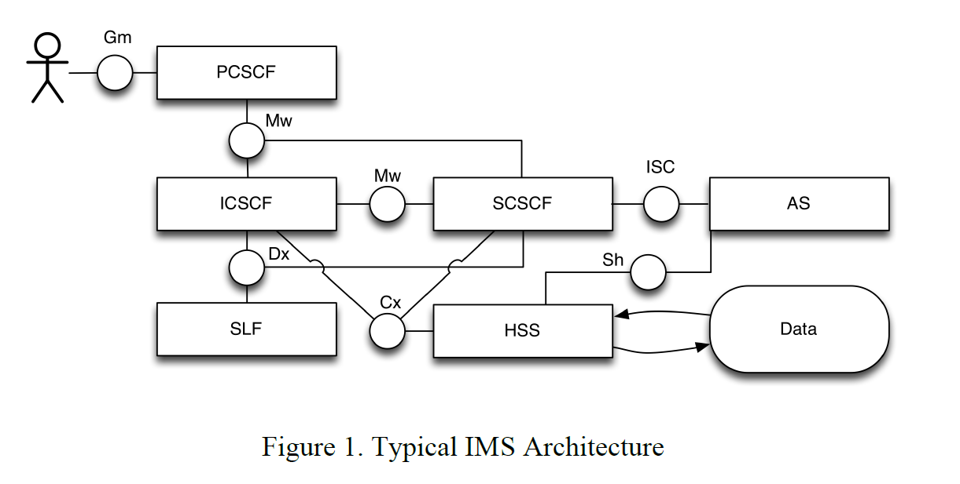
RELATED WORK
Notes:
P-cscf UE和ims網路的第一個聯繫點
UE 執行dns query以解析p-cscf完整的domain name
在多個P-CSCF的情况下，IMS將使用 循環機制來選擇P-CSCF
---
P-CSCF在本地保存資訊。這意味著P-CSCF是一個有狀態的組件，
因此ue的後續請求需要被傳遞到應該檢索狀態的組件。
---
S-cscf
Signaling plane 的中心節點
基本上執行一些session control服務
它還充當sip registrar , maintain用戶的ip address和 user的一些紀錄資訊
有一個diameter interface 用來和HSS 拿一些user 資訊,包含一組trigger和 initial filter criteria
並重新導向sip message 給 AS
I-CSCF
它的address list在DNS records裡
有 diameter interface 去詢問SLF(subscriber location function)
解析哪個HSS和該user相關
從HSS詢問user profile 資訊 , 並分配合適的S-CSCF給該user
HSS
一個中央儲存庫, 儲存end user 的profiles和 網路連接資訊等
包含一些 安全資訊, 認證, 授權, user profiles information , trigger points,
initial filter criteria 等
一個domain裡面可以有超過一個的HSS ,
但是一個user的所有相關資訊會儲存在一個HSS裡
SLF : S-CSCF和I-CSCF要詢問USER所在的HSS時要透過它
AS : 執行應用服務的SIP 實體
它在IMS基礎結構中起著至關重要的作用，
因為在大多數情況下，它是實現諸如消息傳遞，
在線狀態等服務邏輯的組件。
UE : 發起多媒體seesion 的裝置

Slide 13
RELATED WORK
Proxy Call Session Control Function (P-CSCF)
  is the first point of contact between the IMS terminal generically named IMS User Equipment (IMS UE) and the IMS network.
  The IMS UE does a DNS query for resolving the P-CSCF Fully Qualified Domain Name (FQDN).
  In case of multiple P-CSCF there will be a DNS round-robin mechanism that will be used by the IMS terminal for selecting the entry P-CSCF.
Notes:
P-cscf UE和ims網路的第一個聯繫點
UE 執行dns query以解析p-cscf完整的domain name
在多個P-CSCF的情况下，IMS將使用DNS迴圈機制來選擇P-CSCF

Slide 14
RELATED WORK
Serving Call Session Control Function (S-CSCF)
  is the central node of the signalling plane.
  is basically a SIP server and it performs also some session control.
  It acts also as SIP registrar maintaining a binding between the IP address of the user's IMS UE and the user's SIP address of record.
  has also a Diameter interface with the HSS for downloading the user profile containing a set of triggers and initial filter criteria for redirecting SIP messages to application servers.
Notes:
S-cscf
Signaling plane 的中心節點
基本上執行一些session control服務
它還充當sip registrar , maintain用戶的ip address和 user的一些紀錄資訊
有一個diameter interface 用來和HSS 拿一些user 資訊,包含一組trigger和 initial filter criteria
並重新導向sip message 給 AS

Slide 15
RELATED WORK
Interrogating Call Session Control Function (I-CSCF)
  Its address is listed in the DNS records of the domain.
  It has a Diameter interface to the Subscriber Location Function (SLF) for retrieving the HSS associated with the users.
  routes SIP requests to the appropriate S-CSCF based on the user profile information received from the HSS.
Notes:
I-CSCF
它的address list在DNS records裡
有 diameter interface 去詢問SLF(subscriber location function)
解析哪個HSS和該user相關
從HSS詢問user profile 資訊 , 並分配合適的S-CSCF給該user

Slide 16
RELATED WORK
Home Subscriber Server (HSS)
  represents the central repository for end user subscription profiles and network connectivity dynamic information.
  contains security information, authentication and authorization, user profile information, trigger points, initial filter criteria and S-CSCF association points.
  In one domain there could be more than one HSS. But all the data belonging to a user need to be stored in a single HSS.
Notes:
一個中央儲存庫, 儲存end user 的profiles和 網路連接資訊等
包含一些 安全資訊, 認證, 授權, user profiles information , trigger points,
initial filter criteria 等
一個domain裡面可以有超過一個的HSS ,但是一個user的所有相關資訊會儲存在一個HSS裡

Slide 17
RELATED WORK
Subscriber Location Function (SLF)
  is used by the other components for retrieving the HSS
Application Server (AS)
  is a SIP entity that hosts and executes services.
User Equipment (UE)
  is a device able to act as originating or terminating endpoint of multimedia sessions such as a SIP phone.
Notes:
SLF : S-CSCF和I-CSCF要詢問USER所在的HSS時要透過它
AS : 執行服務的SIP 實體
它在IMS基礎結構中起著至關重要的作用，
因為在大多數情況下，它是實現諸如消息傳遞，
在線狀態等服務邏輯的組件。
UE : 發起多媒體seesion 的裝置

Slide 18
RELATED WORK
Many virtualization techniques were introduced in the IT world and Telco's increased their interest of the potentialities of pure software implementations over virtualized platforms.
One of the most relevant initiatives is the open-source project called Clearwater [8].
Clearwater is an open source implementation of IMS embracing a cloudoriented design making it extremely well suited for deployment in a Network Functions Virtualization (NFV) [9] environment.
Virtualization and cloud-based architectures are actually appealing for Telcos.
Notes:
IT界引入了許多虛擬化技術，電信公司對虛擬化平臺上純軟體實作的潜力
越來越感興趣。
最相關的計畫 是名為Clearwater 的開源計畫
Clearwater 是一個實作IMS的open source, 採用了雲端導向設計,
使其非常適合在NFV環境中部屬
虛擬化和cloud-base 架構實際上對電信商很有吸引力
但是, 許多挑戰仍然存在

Slide 19
RELATED WORK
Authors of [10] proposed novel solutions for enhancing the intradomain scalability problem.
authors of [11] focus on a specific service, a cloud-based IMS presence service.
In [12] are focusing on Web Services having a similar approach but with a limited number of analyzed monitored data.
In [13] a "profile-based" solution is being described, which only takes into account the CPU utilization of a given Virtual Machine (VM).
Notes:
[10]的作者提出了在 intradomain 擴展性問題的新解決方案。
[11]的作者關注的是一個特定的服務，一個基於雲端的IMS呈現服務。
Mobicent sip servlet 開源的 平台 , 用程式(java)實作一些sip服務,
[11]將 mobicent sip servlet 可以在雲端上運作的方法
在[12]中，他們關注的是web服務,但只分析了有限數量的data
在web服務時,不能保證response time , 它設計能夠
在[13]中，描述了一個“基於profile”的解決方案，
它只考慮給定虛擬機器（VM）的CPU利用率。
在傳統要部屬應用程式在雲端平台, 需要開發人員手動配置
它提供 配置 profile檔 使它可以自動配置部屬application

Slide 20
IMS AS A SERVICE ARCHITECTURE
virtualization presumes the logical separation between functional entity and the underlying host. A function is realized as software on top of a container, that is, a Virtual Machine (VM), running on top of a generic host.
it is not only possible to deploy them on physical machines with common hardware, but also on VMs.
the most important requirement is to have network entities realized in software.
Once a network function is virtualized, meaning it has the possibility to be deployed on a VM, its lifecycle needs to be orchestrated.
Notes:
為了獲得一個高效的IMS-as-a-Service體系結構，考慮了以下步驟。
首先, 虛擬化假設 功能實體和底層設備是邏輯分離
一個function是在一個container(虛擬機)上的軟體, 它運作在一個通用的主機上
不僅可以將function部屬在 通用的實體機上, 也可以在VM上
最重要 要求是用軟體實現network entities
一旦網路功能虛擬化, 意味著它有可能被部屬到虛擬機上, 它的生命週期需要被編排

Slide 21
IMS AS A SERVICE ARCHITECTURE
Virtualization of network elements and their implementation as software components is only an aspect of the cloudification process.
Once the components are virtualized, they can reside on top of virtual machines, and all the cloud principles can be applied also to them.
An elastic infrastructure is able to automatically increase or reduce the number of resources potentially without limits.
Notes:
虛擬化網路元素和他們實作成軟體 只是雲端化過程的一方面
一旦元件被虛擬化, 他們可以存在於虛擬機上, 並且所以雲端規則也應用於這些components
一個彈性的基礎設施能夠自動或減少資源的數量而限制

Slide 22
IMS AS A SERVICE ARCHITECTURE
Virtualized-IMS (vIMS)
  an architecture option in which each 3GPP IMS functional entity is mapped 1:1 with the virtual network function units
Split-IMS
  an architecture option in which each 3GPP IMS component is split into multiple sub-components in order to be deployed on top of multiple hosts and containers
Merge-IMS
  an architecture option in which components are merged into less components enabling a low delay and functional reduced processing for external requests by a single same virtual network function unit.
Notes:
vIMS: 一個架構選項, 其中每個3GPP的IMS 功能實體是1對1 虛擬網路功能元件
Split-IMS :每個3GPP的ims元件分割成多個子元件, 以便部屬在多個hosts和container上
Merge-IMS : 合併為較少的元件 減少了延遲和單一相同的元件對外部request的處理
P-CSCF分發-UE査詢DNS以發現P-CSCF，並在其中發送後續消息。如果一個域有多個P CSCF實例，這意味著多個主機與該P-CSCF關聯，那麼DNS名稱服務器應該選擇其中一個。一旦選擇了P-CSCF，UE將其隨後的消息發送到該實體。在服務ue請求時，P-CSCF在本地保存資訊。
這意味著P-CSCF是一個有狀態的組件，囙此ue的後續請求需要被傳遞到應該檢索狀態的組件。
•I-CSCF分發-I-CSCF是一個無狀態組件，其主要任務是檢索應分配給傳入請求的S-CSCF。
當一個域中存在多個I-CSCF時，可以使用DNS NAPTR動態選擇其中一個。
•S-CSCF分佈——S-CSCF選擇由I-CSCF完成。特別是，I-CSCF充當負載平衡器，
具有將特定S-CSCF實例分配給EU的所有算灋和機制。它被稱為“S-CSCF選擇過程”，
I-CSCF向HSS發送Diameter請求，
I-CSCF的任務是選擇滿足特定EU所需能力的特定S-CSCF。
•HSS ——提供diameter interface。
囙此，在一個域中具有多個HSS需要SLF組件的存在。
•SLF分佈-作為I-CSCF，SLF是無狀態組件。擴展無狀態實體只需要DNS負載平衡機制。

Slide 23
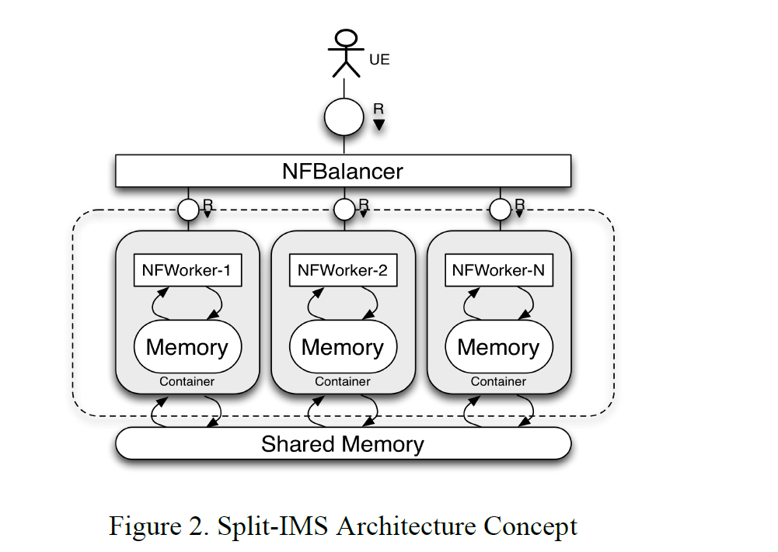
IMS AS A SERVICE ARCHITECTURE
Notes:
NFBalancer是傳入request的入口,
NFBalancer將request分發給下面這些 stateless的 Nfworker
用戶的state儲存在外面的shared memeory中
它說有以下優點 ,減少load balancer的複雜性
大量的stateless元件能夠達到水平穩定
狀態轉移到外部的shared memory使 執行功能時具有較高的彈性
這種配置可用於在單個資料中心中部署單個網絡實體。特別是，不需要在I-CSCF前面進行平衡，因為I-CSCF是無狀態的，並且其操作的持續時間非常短。囙此，從這個角度來看，
I-CSCF組件不會靜態地分配給訂閱服務器，只要需要，可以從池中選擇下一個空閒組件。從P-CSCF或S-CSCF中的選擇充當平衡器。對於CSCFs功能，需要一個特定的平衡器組件來分發請求。實際上，Mw介面是使用SIP協議實現的，囙此平衡器應該能够提供SIP介面，並將SIP請求分發給池中可用的工作者。
UE通過DNS査詢發現PCSCF平衡器。
然後，PCSCF平衡器將請求重定向到其中一個PCSCF工作行程。

Slide 24
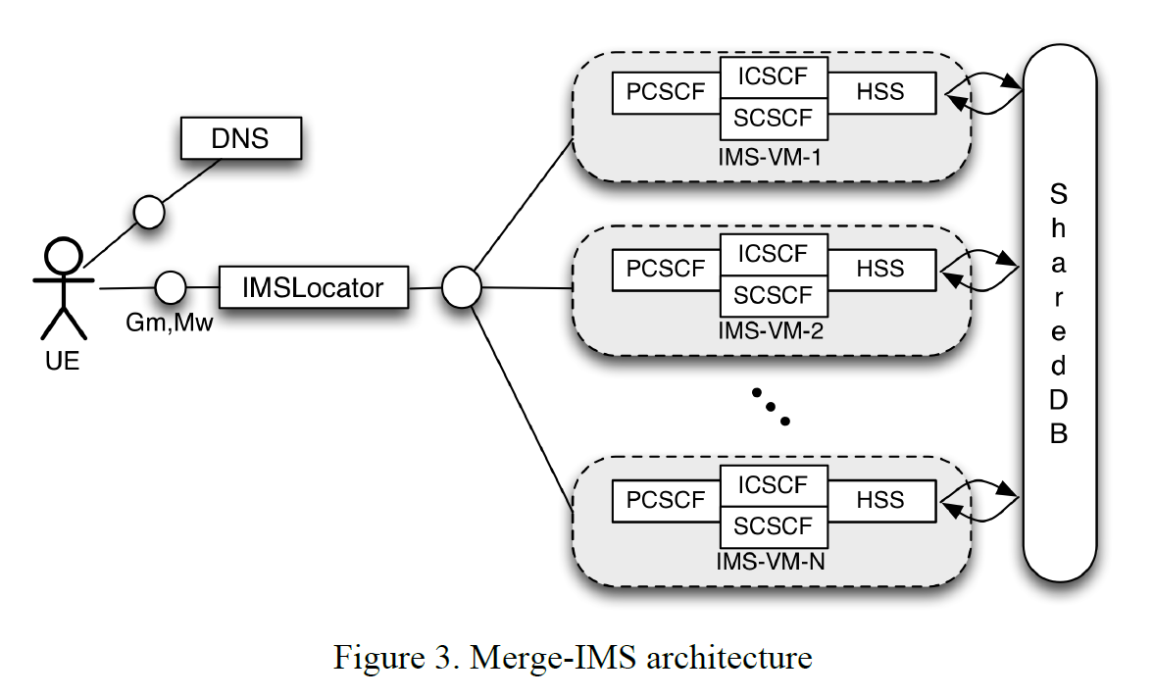
IMS AS A SERVICE ARCHITECTURE
Notes:
將每個用戶分配的某個 IMS-VM上可以減少這些compnents之間的訊息交換次數
IMS-locator: 在註冊階段將用戶分配給特定的ims-instances, 有3GPP的標準interfaces Gm,Mw
IMS-VM-pool: 是一個IMS-VM instances pool, 它由 services orchestrator管理, service
Orchestrator可以根據當下情況判斷需不需要new 一個VM instance
sharedDB : 儲存用戶的資訊
缺點是這種架構降低了彈性,特別是在執行階段和管理階段
IMSLocator充當一個簡單的代理，而不改變消息的內容，
通過添加自己的位址至 sip via

Slide 25
IMS AS A SERVICE ARCHITECTURE
For this reason it has been proposed also an architecture in the context of the Mobile Cloud Networking (MCN) project [14] for managing the lifecycle of those deployment models, reducing the complexity in the provisioning and runtime phases. The architecture proposed in Fig. 4.
[14] T. Bohnert and A. Edmonds (eds.), Overall Architecture Definition,
deliverable D2.2, MobileCloud Networking Project, Oct. 2013
Notes:
因此, 在MCN project中也提出了一項架構, 用於管理這些部屬 model的生命週期,
降低運行和供應階段的 複雜性

Slide 26
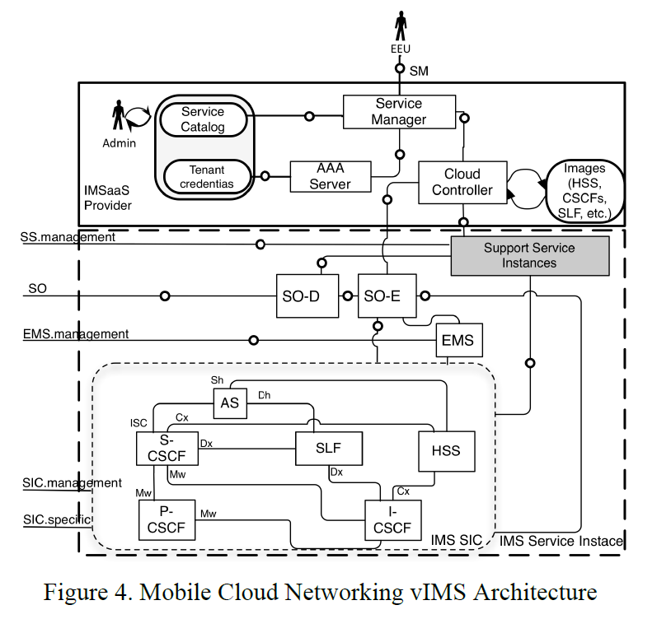
IMS AS A SERVICE ARCHITECTURE
Notes:
EEU:Enterprise end user
Service manager : 提供一個外部介面 給EEU, 以便
EEU可以創建想要的服務
Service catalog :服務目錄, 用來描述服務
Tenant credential : 租戶憑證
AAA server :Authentication、Authorization、Accounting:紀錄一些使用者網路使用情況
Cloud controller : 負責支持SO的需求,類似於openstack的heat ,主要負責編排各項服務
support service instance :負責監控service,並提供一些雲端方面的計費機制 ,
SO- D:負責 比對觸發條件(trigger-condtion-action)並做決策,
SO-E :通過與CC和EMS溝通來協調服務的部屬和運行時管理
EMS:元件管理系統,負責管理元件的資源等

Slide 27
EVALUATION
For evaluating the feasibility of the proposed architecture, we have used OpenStack [6] and the Fraunhofer FOKUS OpenSDNCore Orchestrator [16] for the instantiation of the different components, while as IMS infrastructure we have used the open-source Fraunhofer FOKUS OpenIMSCore [17].
In order to evaluate the performance of the virtualized-IMS we employed the IMSBench tool [17].
Notes:
為了評估所提出架構的可行性，我們使用OpenStack和Fraunhofer FOKUS OpenSDNCore Orchestrator來實作不同的元件，
而IMS infrastructure，我們使用了Fraunhofer FOKUS OpenIMSCore。
為了評估虛擬化IMS的效能，我們採用了IMSBench工具

Slide 28
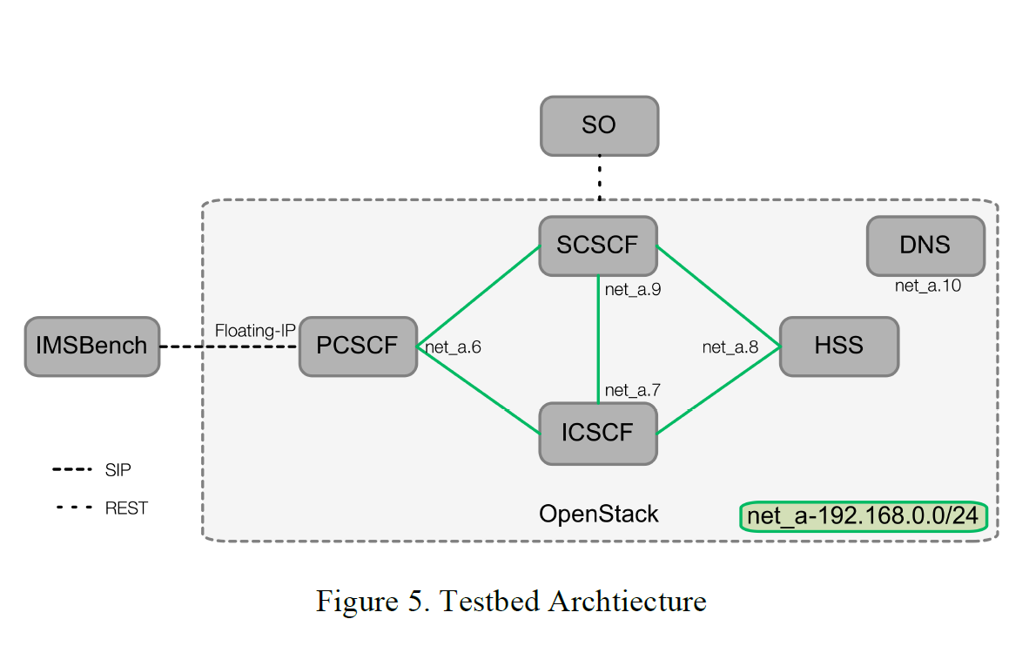
EVALUATION
Notes:
圖5。 顯示了testbed architecture。
特別是，vIMS的所有網絡功能都由OpenSDNCore Orchestrator部署和管理。
vIMS實體部署時帶有少量配置，1vCPU和2GB RAM。

Slide 29
EVALUATION
The test has been divided in three main phases:
  the first one regards the registration of a pool of subscribers,
  the second is just a stir phase for preparing the system
  the third one is performing the real benchmark of the SUT.
Notes:
測試分為三個主要階段：第一個階段是用戶註冊池，
第二個階段只是準備系統的階段，
第三個階段是執行SUT的真實benmark。
SUT(System Under Test) 是指測試目標，就是要被測試的對象。
特別是在第三步中，
將執行多種場景的混合：注册、
取消注册、呼叫設定、消息傳遞和狀態。

Slide 30
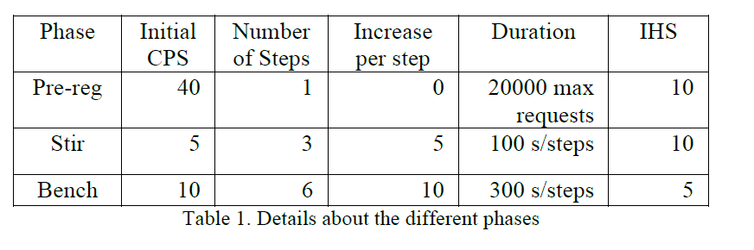
EVALUATION
Notes:
測試分為三個主要階段：第一個階段是用戶註冊池，
第二個階段只是準備系統的階段，
第三個階段是執行SUT的真實benmark。
特別是在第三步中，
將執行多種場景的混合：注册、
取消注册、呼叫設定、消息傳遞和狀態。

Slide 31
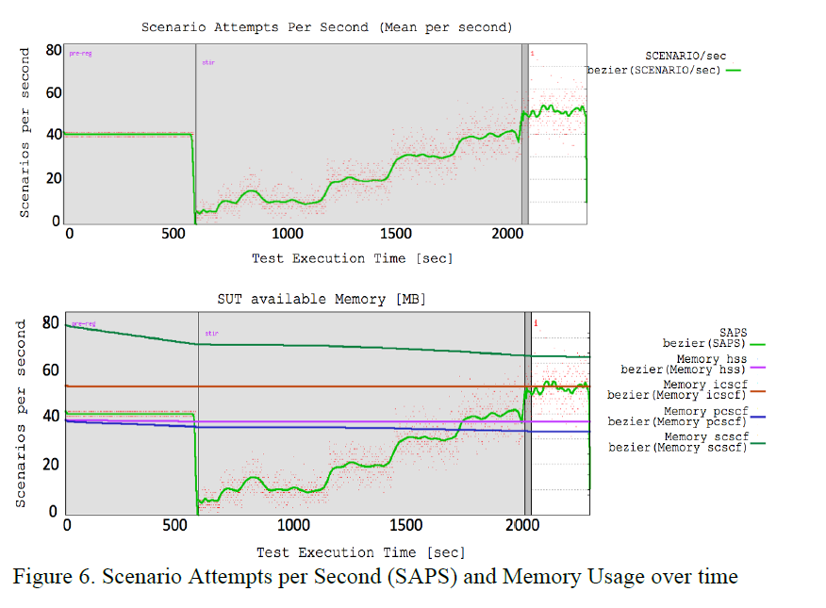
EVALUATION
Notes:
圖6示出了如上表所述的每秒鐘場景嘗試次數（SAPS）
和vIMS的不同元件部分隨時間的記憶體使用情况的圖。

Slide 32
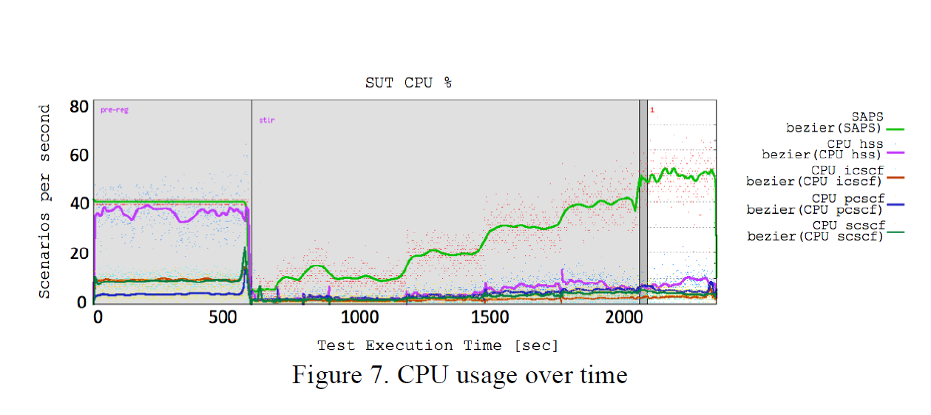
EVALUATION
Notes:
圖7表示出了不同組件隨時間的CPU使用情况：
在預註冊階段，超載最嚴重的組件是HSS。
這主要是由於在執行授權和身份驗證階段
需要進行大量計算。

Slide 33
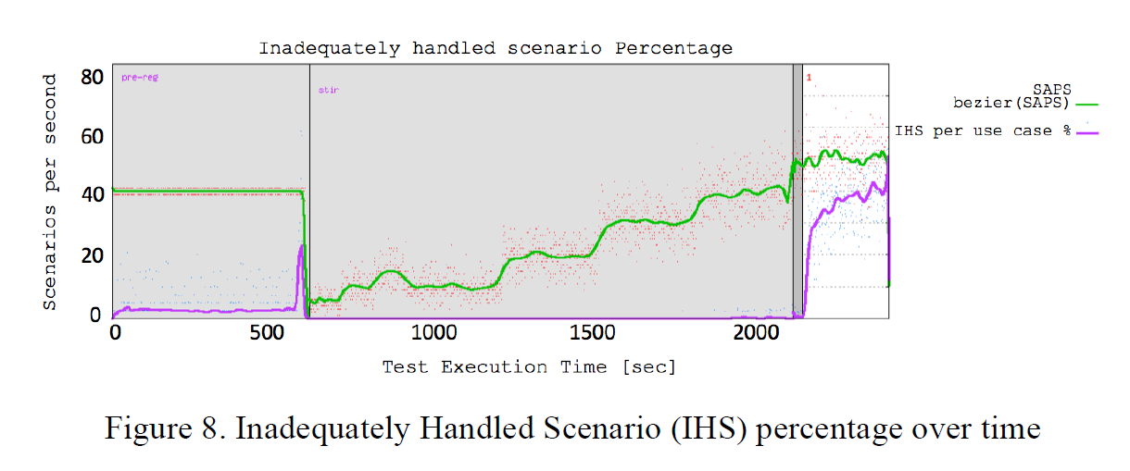
EVALUATION
Notes:
圖8顯示了未充分處理的場景（IHS）的百分比。
它清楚地描述了當SAPS達到每秒45個call per seconds，
這個值會增加
他說這項benmark指出
由於SCSCF組件的記憶體使用限制(2GB)，
在大約50 call per seconds時會開始fail
達到的CPS級別滿足了IMS在平均負載下對當前中型固定或移動運營商的完全支持。
然而，對於較大的運營商和高峰時段，必須進一步擴展vIMS。

Slide 34
EVALUATION
Considering that the flavour used for this experiment is a small one, this value can be easily increased scaling vertically each of the components.
Furthermore having a physical limit on scaling vertically, the best approach would be to use the Service Orchestrator for horizontally scaling the proposed vIMS
allowing also saving energy consumption and paying only for the used resources, as well as for offering geographically localized services with low delay for the subscribers.
Notes:
考慮到本實驗中使用的配置較小，
可以很容易地垂直增加每個元件配置。
此外，在垂直擴展方面存在物理限制，
最好的方法是使用服務編排來水平擴展vIMS
還可以節省能源消耗並僅為已使用的資源付費，
以及提供用戶 低延遲的 地區服務

Slide 35
CONCLUSIONS AND FUTURE WORK
A possible architecture for offering IMS-as-a-Service has been proposed.
It gives the possibility to deploy on-demand an instance of the IMS platform.
three different deployment models have been proposed for the implementation of a cloud-based IMS platform.
  Virtualized-IMS
  Split-IMS
  Merge-IMS
In all of those models the scalability problem of the IMS infrastructure has been addressed.
Notes:
提出了一種可能的架構 , IMS即服務
它提供了IMS 平台 on-demand 部屬instance的可能性
作者並且介紹了在cloud-base IMS 平台已經提出的 三種不同的部屬 models
這些model都解決了ims infrastructure的擴展性問題

Slide 36
CONCLUSIONS AND FUTURE WORK
Furthermore the vIMS platform has been integrated into the MCN platform,in order to interoperate with the SO for being offered as a service.
This integration allows the combination among IMSaaS and other MCN services like for instance EPCaaS.
A further step represents the development and the deployment of a merge-IMS infrastructure
Notes:
此外, vIMS平台已經 合併/結合 到 MCN平台中 , 作為一種服務和
service orchestrator 互相溝通
這種合併 允許IMSaaS 和其他MCN服務(像是EPCaaS) 之間進行組合
另外一個是開發和部屬merge-IMS infrastructure

Slide 37
CONCLUSIONS AND FUTURE WORK
As seen from the presented evaluation results, with a very limited number of entities a large number of subscribers can be served.
We expect that a merge-IMS maintain this property while being able to serve the subscribers in a low delay localized fashion.
Notes:
從前面的結果可以看出, 在有限的entities數量下, 可以服務大量的用戶
作者期望merge-IMS 能保持此特性, 同時以低延遲的方式服務用戶

Slide 38
REFERENCE
[1] Continuity Central, “Five nines: chasing the dream?”, Nov. 2005, http://www.continuitycentral.com/feature0267.htm .
[2] P. Bellavista, K. Campowsky , G. Carella, L. Foschini, T. Magedanz, F. Schreiner, “QoS-aware elastic cloud brokering for IMS infrastructures”, The Seventeenth IEEE Symposium on Computers and Communications (ISCC’12). July 1 - 4, 2012, Cappadocia, Turkey.
[3] K. Campowsky , G. Carella, T. Magedanz, F. Schreiner, “Optimization of Elastic Cloud Brokerage Mechanisms for Future Telecommunication Service Environments”, Praxis der Informationsverarbeitung und Kommunikation. Volume 0, Issue 0, ISSN (Online) 1865-8342, ISSN (Print) 0930-5157, DOI: 10.1515/pik-2012-0036, June 2012
[4] 3GPP. TS 23.228. IP Multimedia Subsystem (IMS) .
[5] J. Rosenberg et al., “SIP: Session Initiation Protocol,” IETF RFC 3261
[6] Open source software for building private and public clouds:http://www.openstack.org/
[7] 3GPP TS 23.401, “General Packet Radio Service (GPRS) enhancements for Evolved Universal Terrestrial Radio Access Network (E-UTRAN) access”, www.3gpp.org;
[8] Project Clearwater – IMS in the Cloud, http://www.projectclearwater.org/
[9] ETSI NFV Whitepaper Update, October 2013, http://portal.etsi.org/NFV/NFV_White_Paper2.pdf
[10] P. Bellavista, A. Corradi, L. Foschini, “Enhancing Intradomain Scalability of IMS-Based Services”, Parallel and Distributed Systems, IEEE Transactions on (Volume:24 , Issue: 12 )

Slide 39
REFERENCE
[11] T. Louvain-la-Neuve, “Migration of Mobicents Sip Servlets on a cloud platform.” Master Thesis, Universite catholique de Louvain, Louvain, School of Engineering, academic year 2010 – 2011, online: http://thibault.leruitte.name/tmp/cc04980d.pdf
[12] W. Iqbal, M. Dailey, and D. Carrera, “Sla-driven adaptive resource management for web applications on a heterogeneous compute cloud,”in Cloud Computing, ser. Lecture Notes in Computer Science, M. Jaatun, G. Zhao, and C. Rong, Eds. Springer Berlin / Heidelberg, 2009,vol. 5931, pp. 243–253.
[13] Y. Jie, Q. Jie, and L. Ying, “A profile-based approach to justin-time scalability for cloud applications,” sep. 2009, pp. 9–16
[14] T. Bohnert and A. Edmonds (eds.), Overall Architecture Definition, deliverable D2.2, MobileCloud Networking Project, Oct. 2013
[15] OpenStack Heat, http://wiki.openstack.org/wiki/Heat
[16] Fraunhofer FOKUS OpenSDNCore, http://www.opensdncore.org
[17] Fraunhofer FOKUS OpenIMSCore, www.openimscore.org
[18] IMS Bench SIPp, Open Source IMS benchmarking tool, http://www.sipp.sourceforge.net/ims_bench

